Slide 1
RD51 – “Precision timing Workshop”
Our experience in the use of
CsI in gaseous detectors
Fulvio Tessarotto
INFN – Trieste
On behalf of the COMPASS RICH team

Slide 2
OUTLINE
CsI photoconversion
RD26 MWPCs with CsI Photocathodes
COMPASS MWPCs with CsI
The winter accident and CsI memory
The long term CsI quantum efficiency variation
The Hybrid THGEM+MM PDs
CsI deposit on THGEMs
COMPASS upgraded PDs

Slide 3
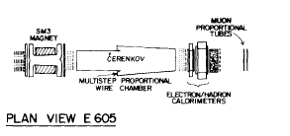
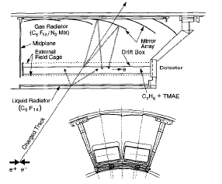
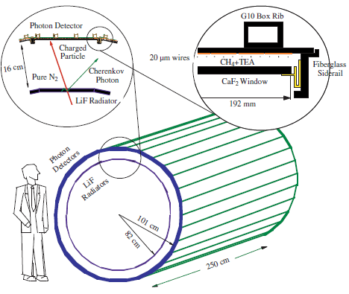
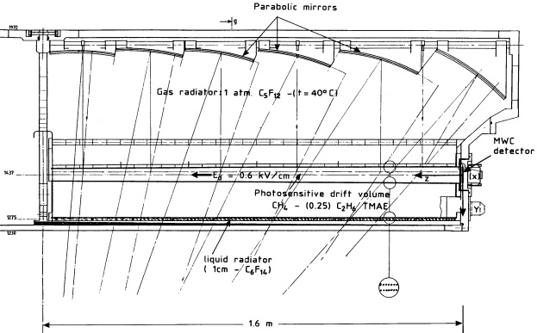
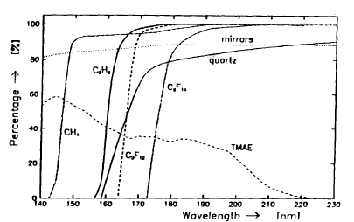
Before CsI, photoconverting vapours
in large RICHs with gaseous PD’s
E605
SLD - CRID
Cherenkov photon
Townsend
avalanche
photoelectron
E
CLEO III
anode wires cathode pads
TEA (Tri-Ethyl-Amine)
OMEGA
DELPHI
QE,
TMAE(Tetrakis-Dimethylamine-Ethylene)
NIMA 323 (1992) 351
CERN, 21/02/2017, RD51 Miniweek - Precision timing Workshop - CsI in gaseous detectors - Fulvio Tessarotto

Slide 4
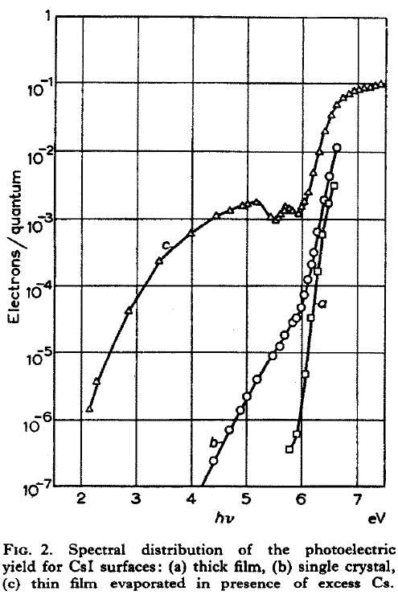
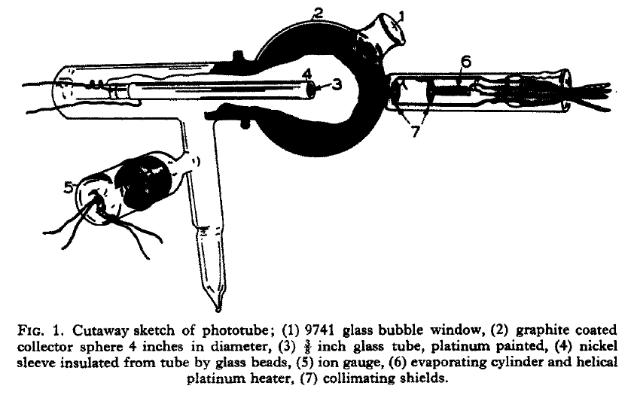
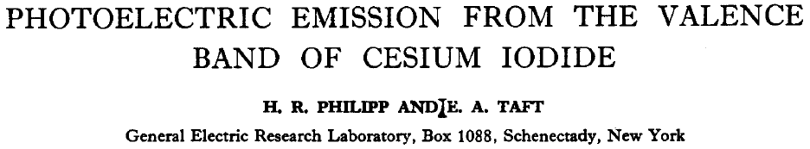
Thin CsI film provides UV photoconversion
vacuum operated photocathodes
were developed for space astronomy:
G.R.Carruthers,
Appl. Opt. 8 (1969) 633
Appl. Opt. 12 (1973) 2501
Appl. Opt. 14 (1975) 1667
The first position sensitive gas detectors with CsI photocathodes were developed at the end of the 80s:
G.Charpak et al., Proceedings of Symposium on Particle Identification at
High Luminosity Hadron Colliders, Fermilab, Batavia, IL, 1989, p. 295.
J.Séguinot et al., Nucl. Instr. and Meth. A 297 (1990), p. 133
1956:
CsI layer has large
QE for photons
with hν > 6 eV
(Philipp and Taft)

Slide 5
Thin film photo cathodes
α = 0.1 nm⁻¹
Semitransparent photocathode:
Light absorption
e- propagation
e- escape
γ
0
window
β = 0.05 nm⁻¹
x
(1)
(2)
PC
x_{max}
(3)
vacuum
e⁻
Reflective photocathode:
γ
e⁻
e⁻
substrate
PC
CERN, 21/02/2017, RD51 Miniweek - Precision timing Workshop - CsI in gaseous detectors - Fulvio Tessarotto

Slide 6
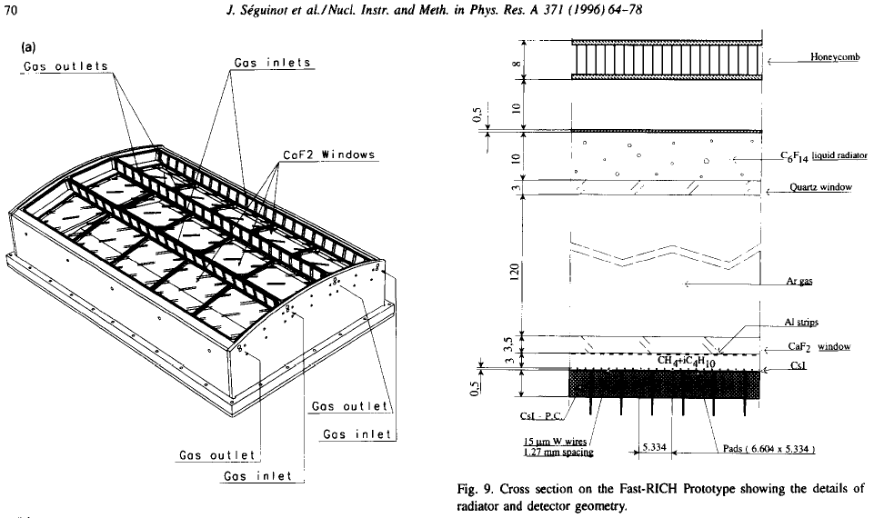
Reflective CsI photocathodes
CsI is highly reactive
with moisture:
it took many years to
develop appropriate
substrate preparation,
deposition method,
handling technology
for high QE gaseous PDs
Townsend
avalanche
J.Séguinot et al., Nucl. Instr. and Meth. A 371 (1996), p. 64.
Cherenkov
photon
This technique was pioneered by T. Ypsilantis and
J. Séguinot, who built an extraordinary prototype
and correctly concluded the technology was not
adequate for the extreme time performance they needed
thin layer (300 - 500 nm) of
CsI on a cathode pad plane

Slide 7
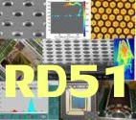
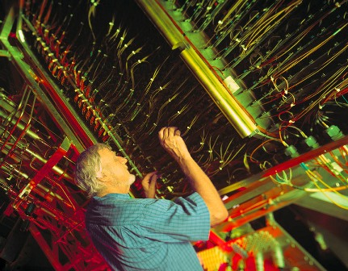
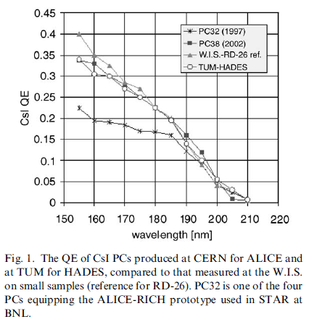
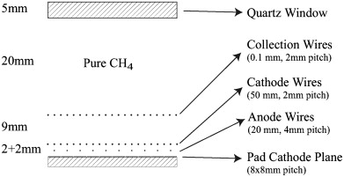
RD26: the technology of MWPCs + CsI
1992, F. Piuz et al. Development of large area advanced fast-RICH detector for particle identification at LHC operated with heavy ions
François Piuz
  TO ACHIEVE HIGH CsI QE:
  Substrate preparation:
  Cu clad PCB coated by Ni (7 µm) and Au(0.5 µm), surface cleaning in ultrasonic bath, outgassing at 60 ºC for 1 day
  Slow deposition of 300 nm CsI film:
  1 nm/s (by thermal evaporation or e⁻-gun) at a vacuum
  of ~ 10⁻⁷ mbar, monitoring of residual gas composition
  Thermal treatment:
  after deposition at 60 ºC for 8 h
  Careful Handling:
  measurement of PC response, encapsulation under dry Ar, mounting by glove-box.
The best fused silica cuts here
Schematic structure of the COMPASS Photon Detector:
A. Di Mauro, NIM A 525 (2004) 173.

Slide 8
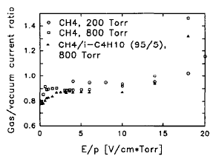
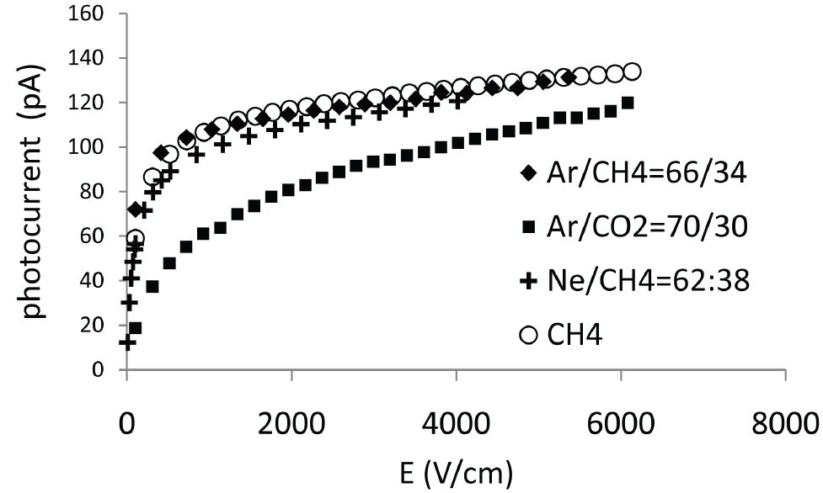
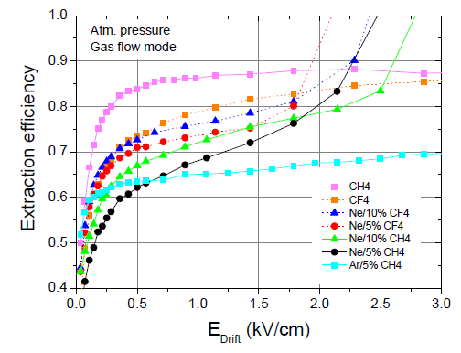
Photoelectron extraction from CsI in gas
Photoelectron extraction from a CsI film, the role of gas and E
VACUUM
Breskin et al.,
NIM A 367 (1995) 342
M. Alexeev et al., NIM A 623 (2010) 129
C. D. R. Azevedo et al., 2010 JINST 5 P01002

Slide 9
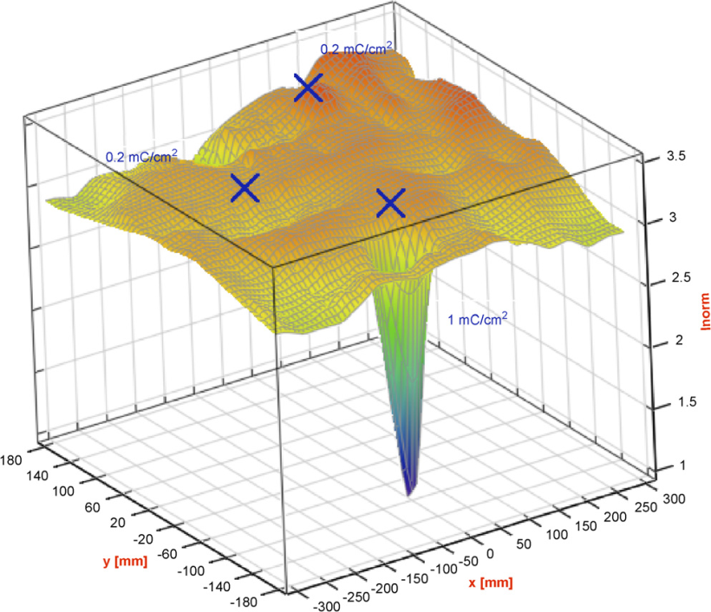
CsI robustness
  CsI is the most robust solid-state photoconverting material among the typical ones, thanks to a higher work function (PC stability under ion bombardment)
CsI exhibits a relative chemical robustness against oxygen and water, as compared to other photoconverters:
0.2 mC/cm²
1 mC/cm²
Accelerated ageing test,
H. Hoedlmoser et al., NIM A 574 (2007) 28.

Slide 10
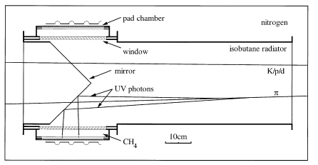
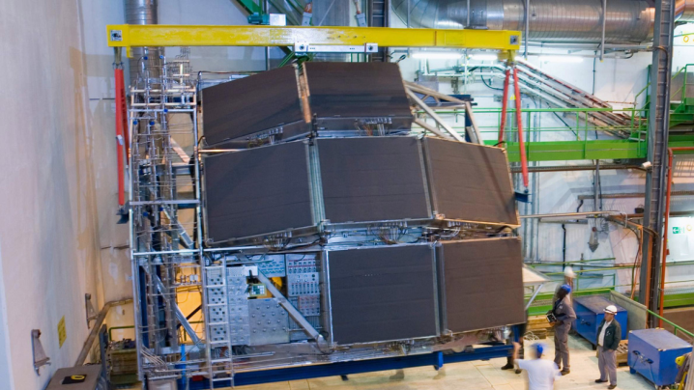
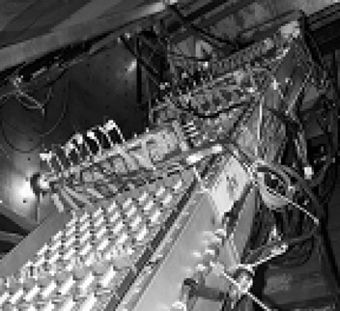
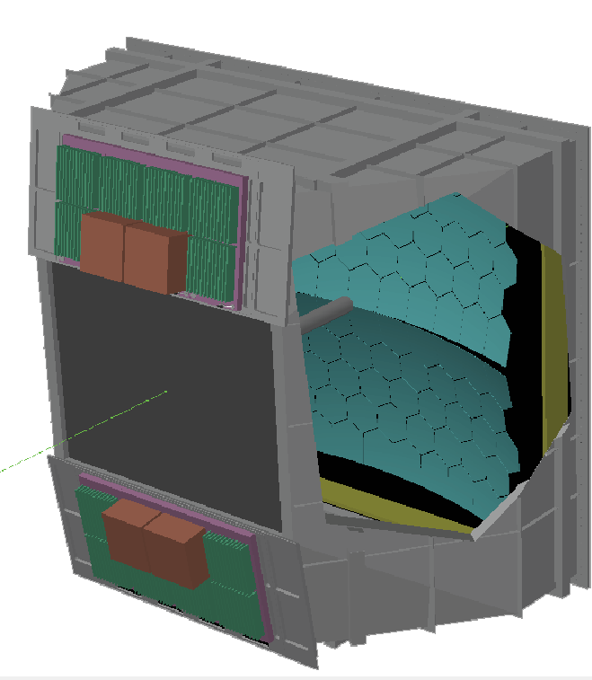
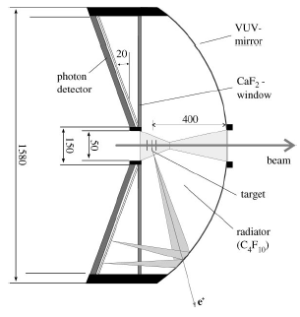
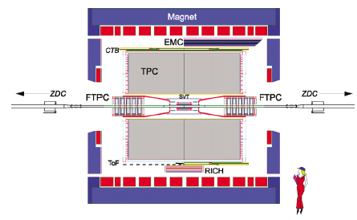
RICH with large area gaseous PD’s
2 nd generation: MWPC’s + CsI
MWPCs with solid state photocathode (the RD26 effort)
ALICE-HMPID
2009
CsI > 10 m²
TIC, NA44
JLAB-HALL A
HADES 1999
CsI > 1 m²
COMPASS RICH-1 2002 CsI > 5 m²
STAR

Slide 11

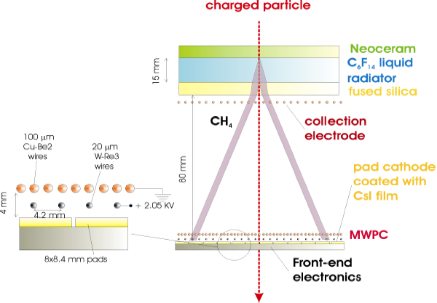
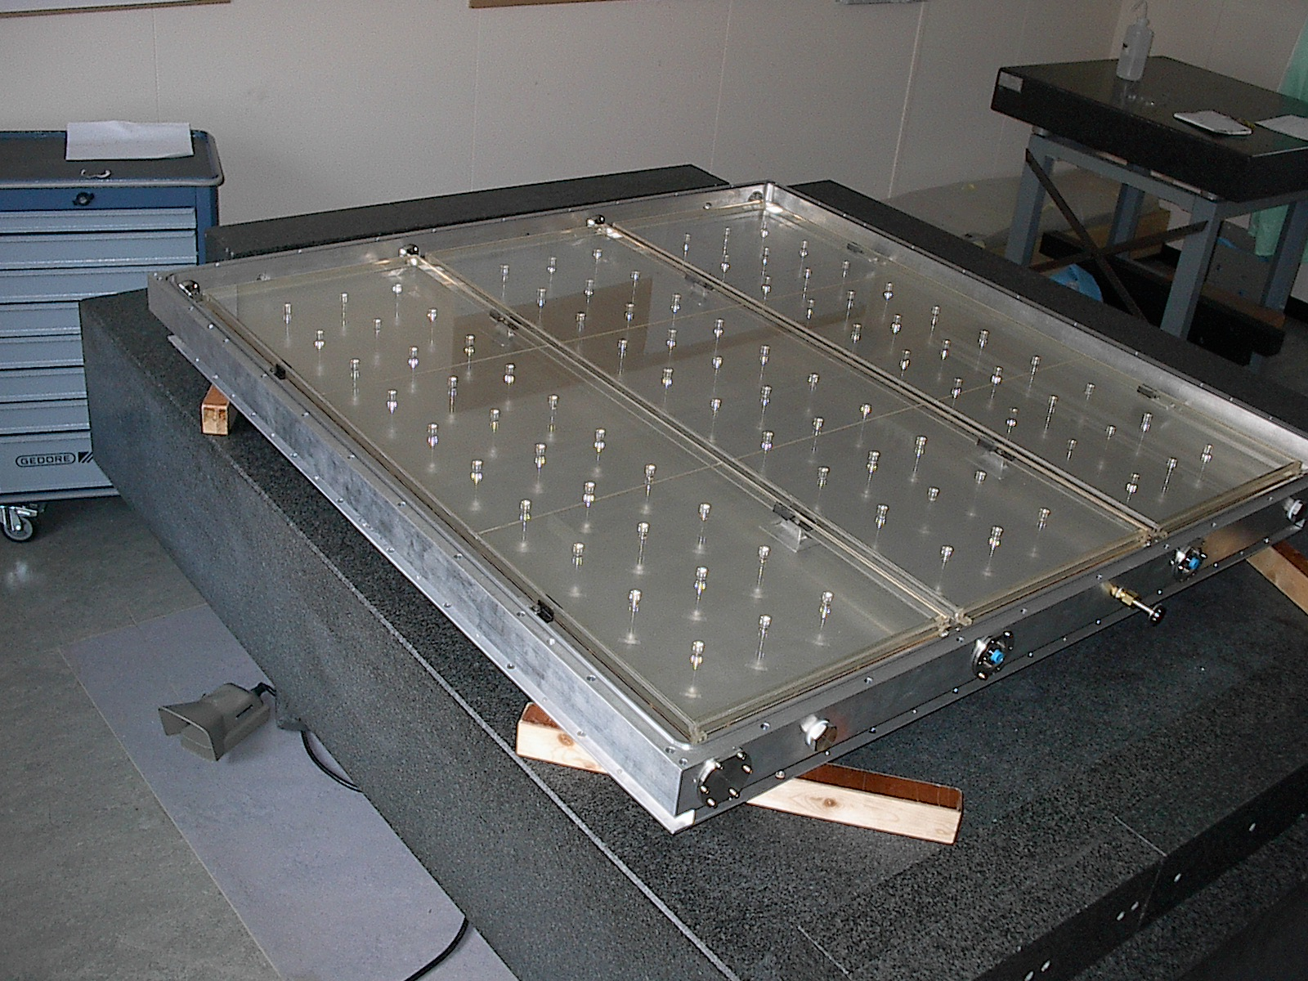
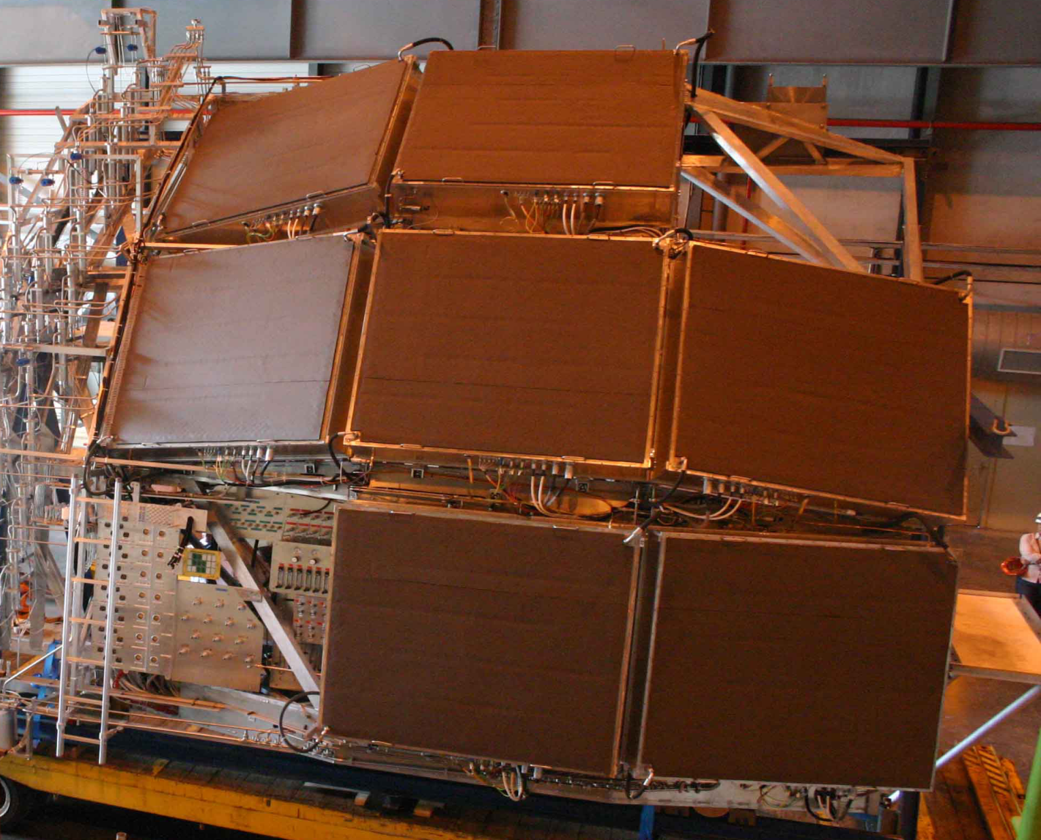
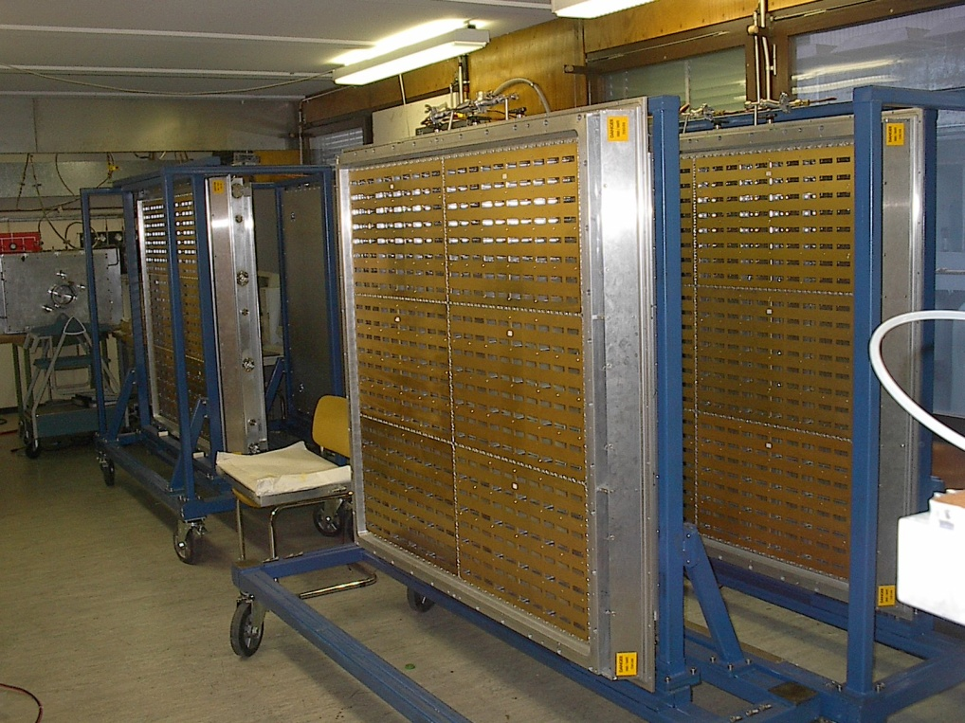
ALICE HMPID
RADIATOR: 15 mm liquid C₆F₁₄, n ~ 1.2989 @ 175nm, β_{th} = 0.77
PHOTON CONVERTER: Reflective layer of CsI (QE ~ 25% @ 175 nm)
PHOTOELECTRON DETECTOR: MWPC with CH₄ at atmospheric pressure (4 mm gap) HV = 2050 V.
- Analogue pad readout
7 modules, each ~1.5 x 1.5 m²

Slide 12
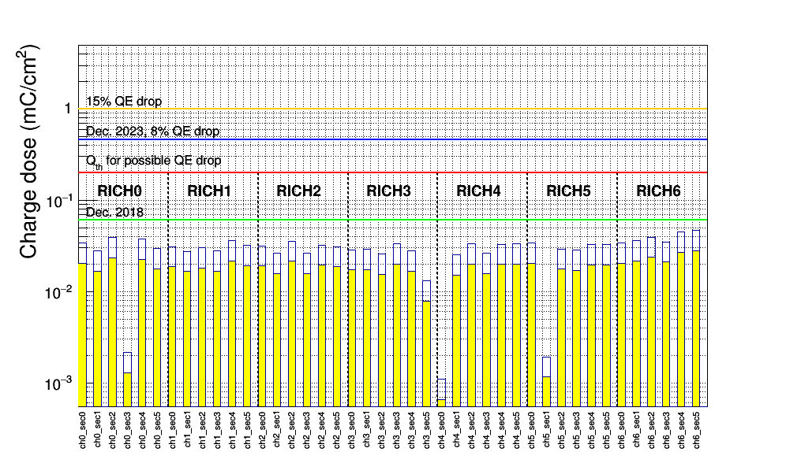
Charge dose on the ALICE CsI photocathodes
PC with Npe dropping
Charge dose threshold (Qth red line) for possible CsI QE loss: 0.2 mC/cm^{2;}
Still far during Run2;

Slide 13
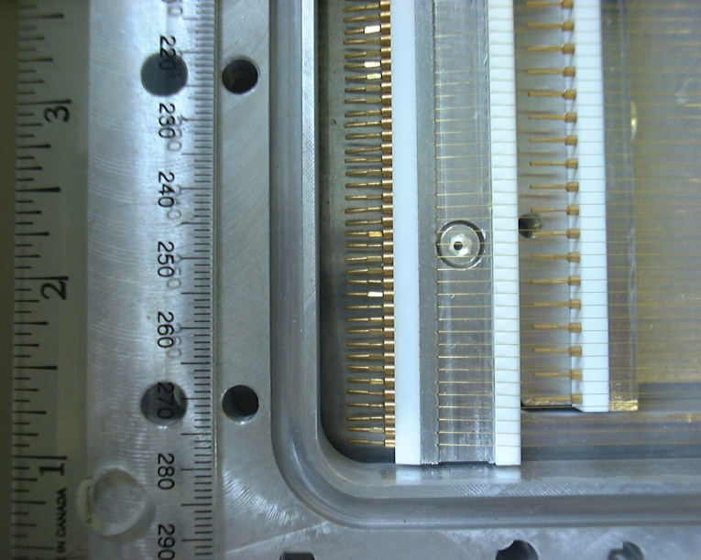
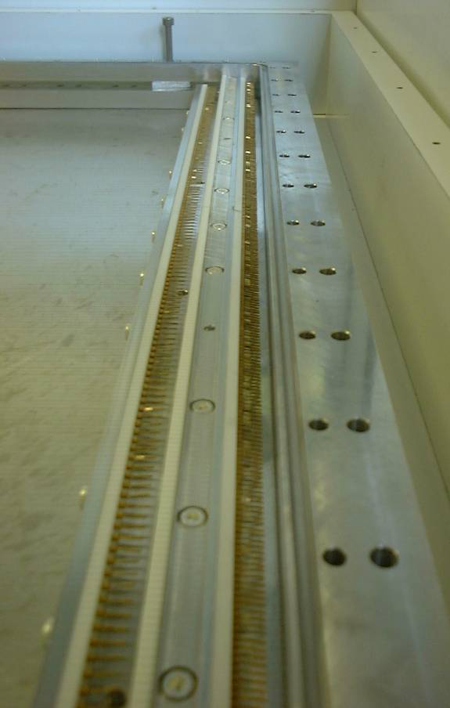
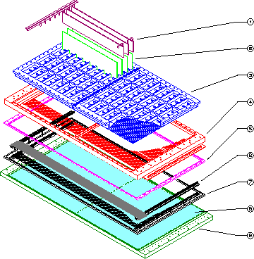
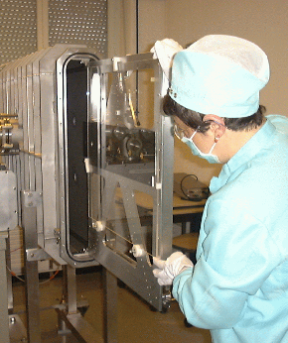
COMPASS RICH-1 MWPC’s with CsI

Slide 14
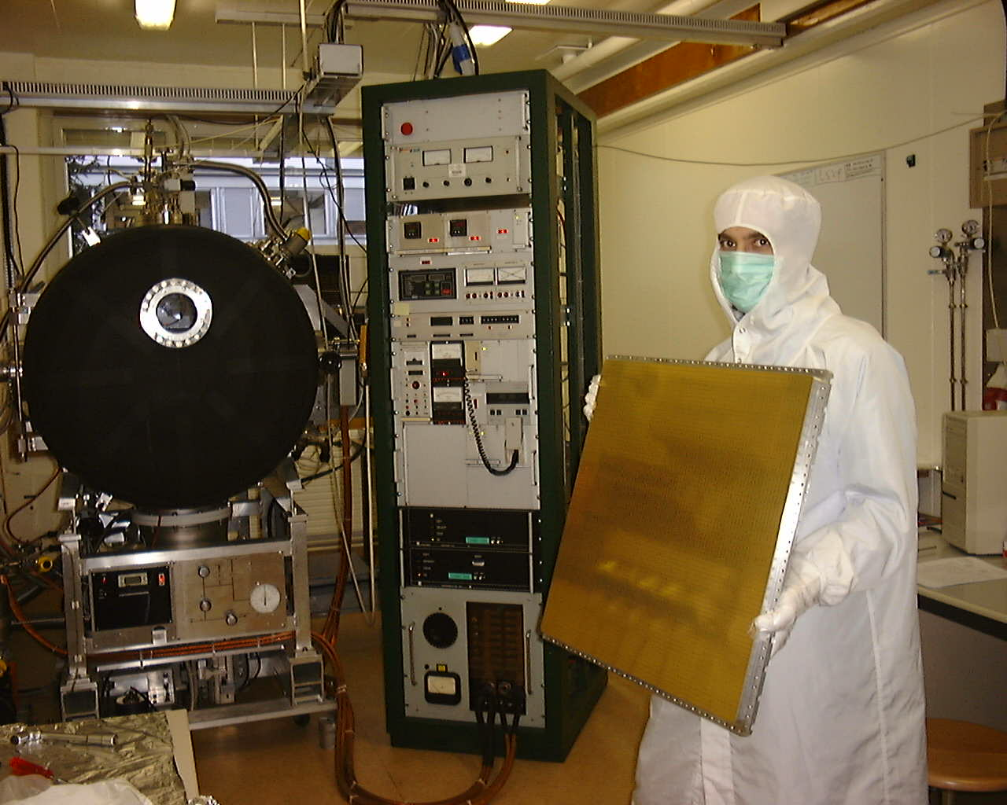
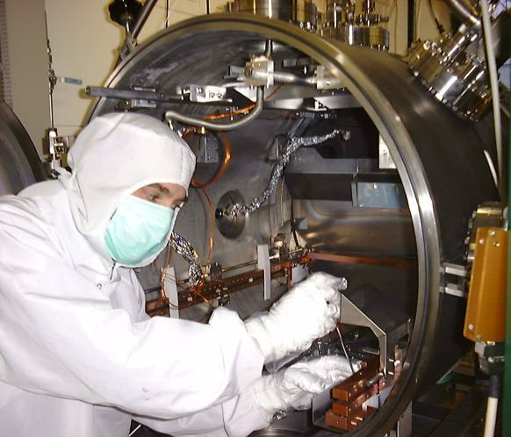
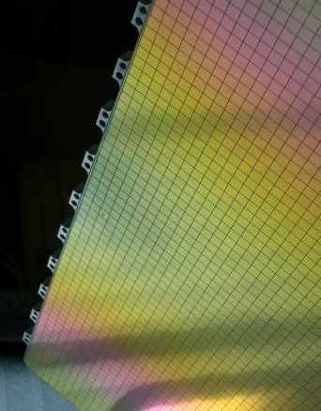
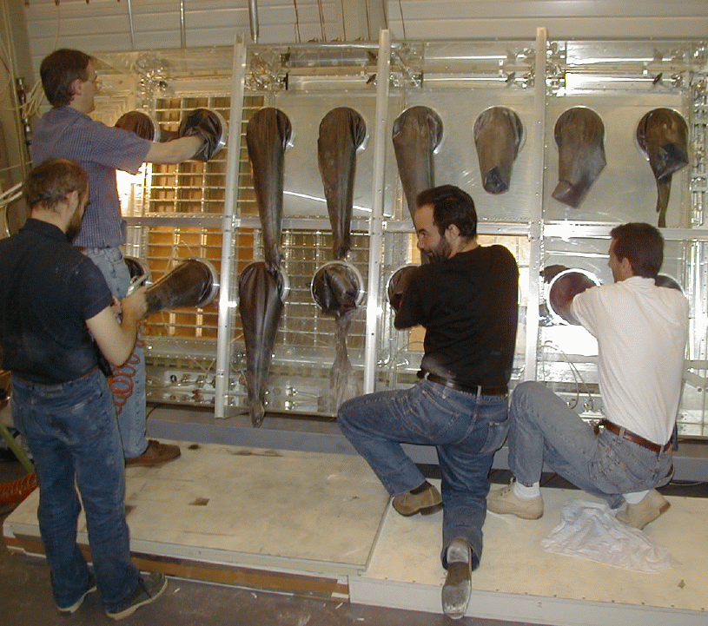
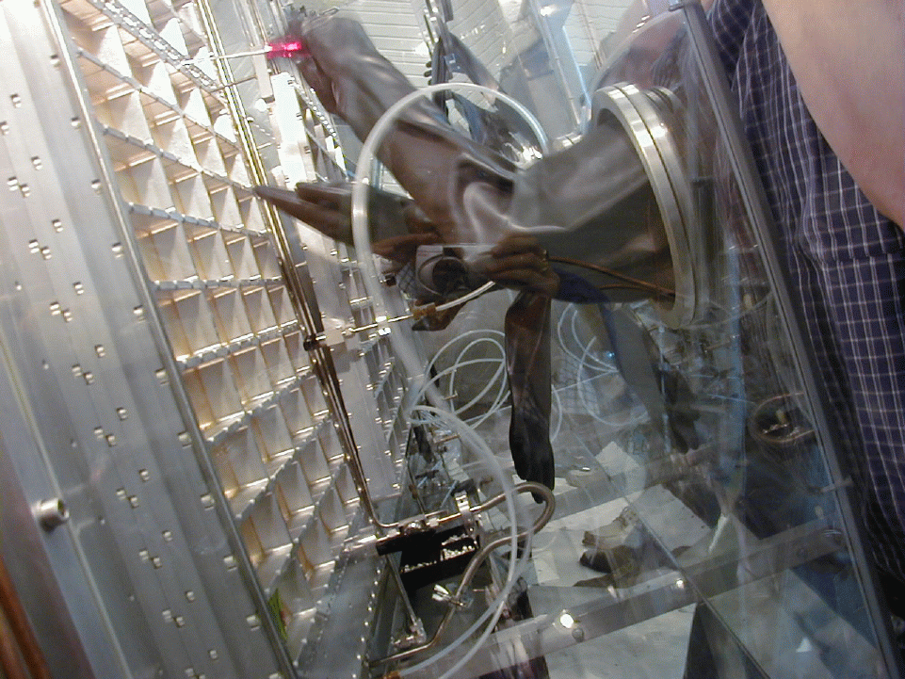
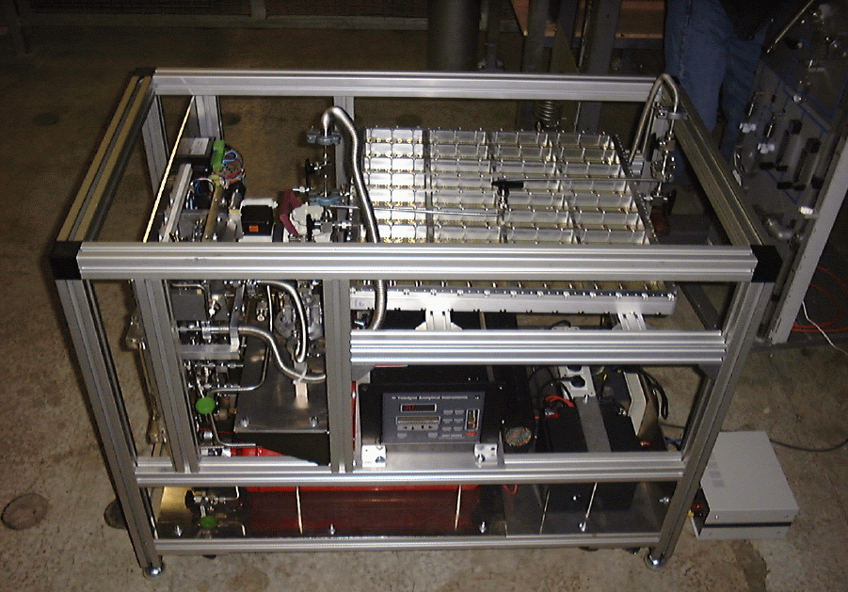
photocathodes

Slide 15
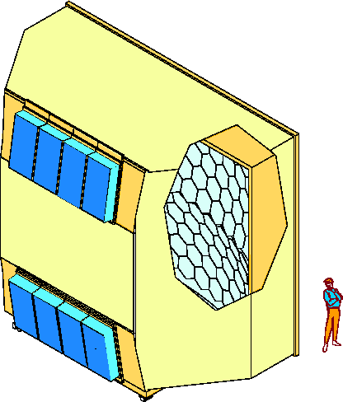
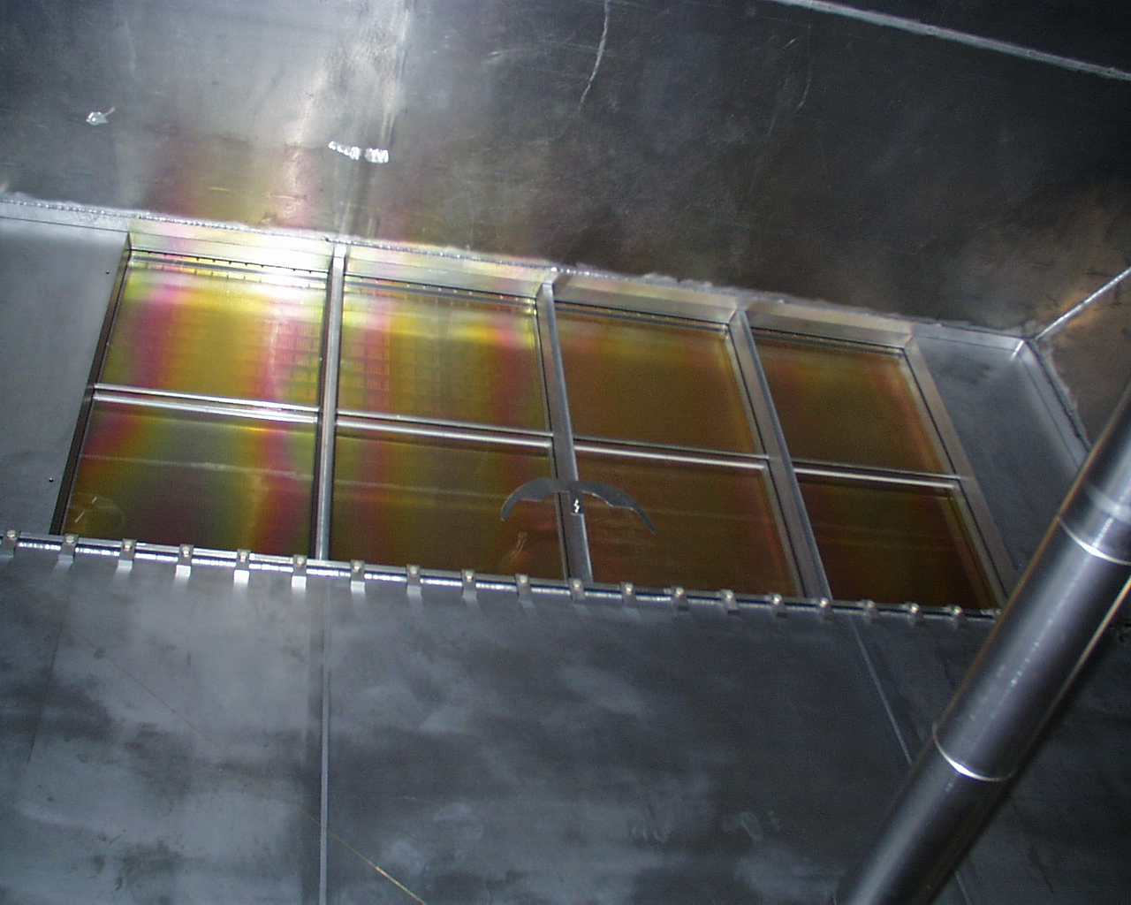
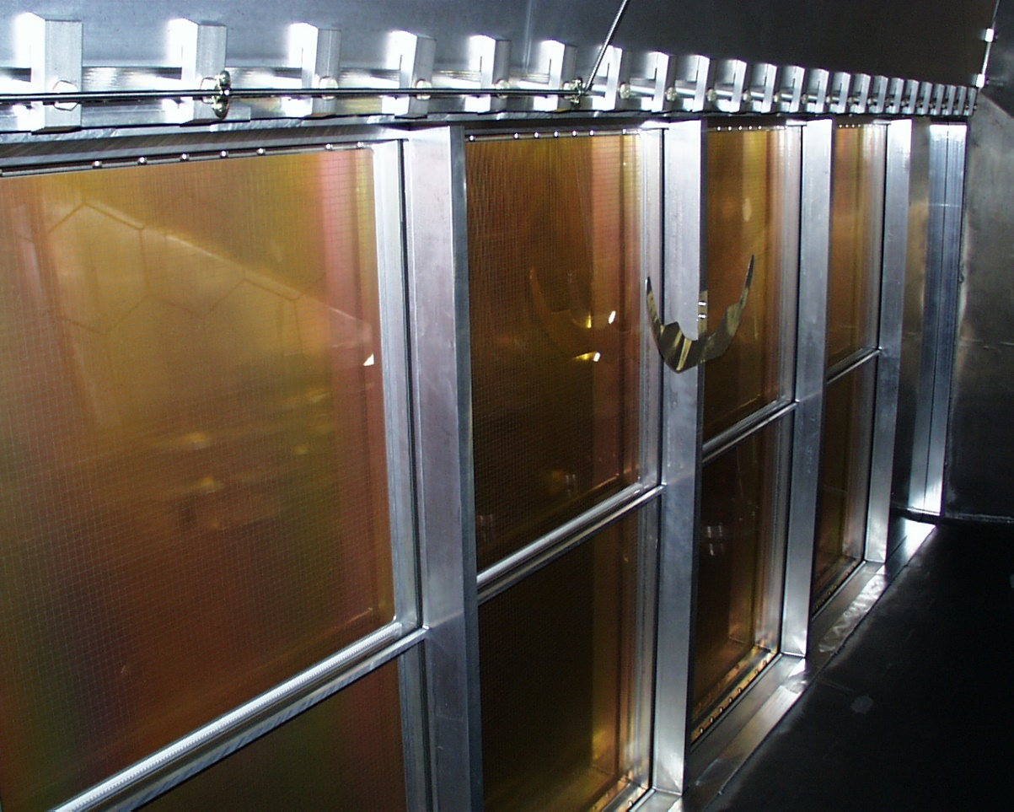
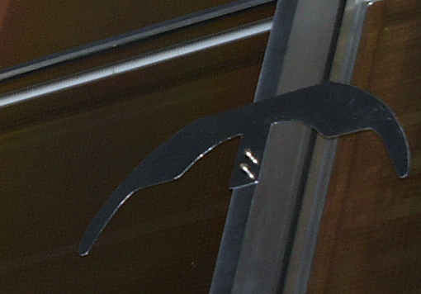
Pictures of RICH PDs in 2002
“lunette” photon interceptor was inserted to protect the PDs from high illumination

Slide 16
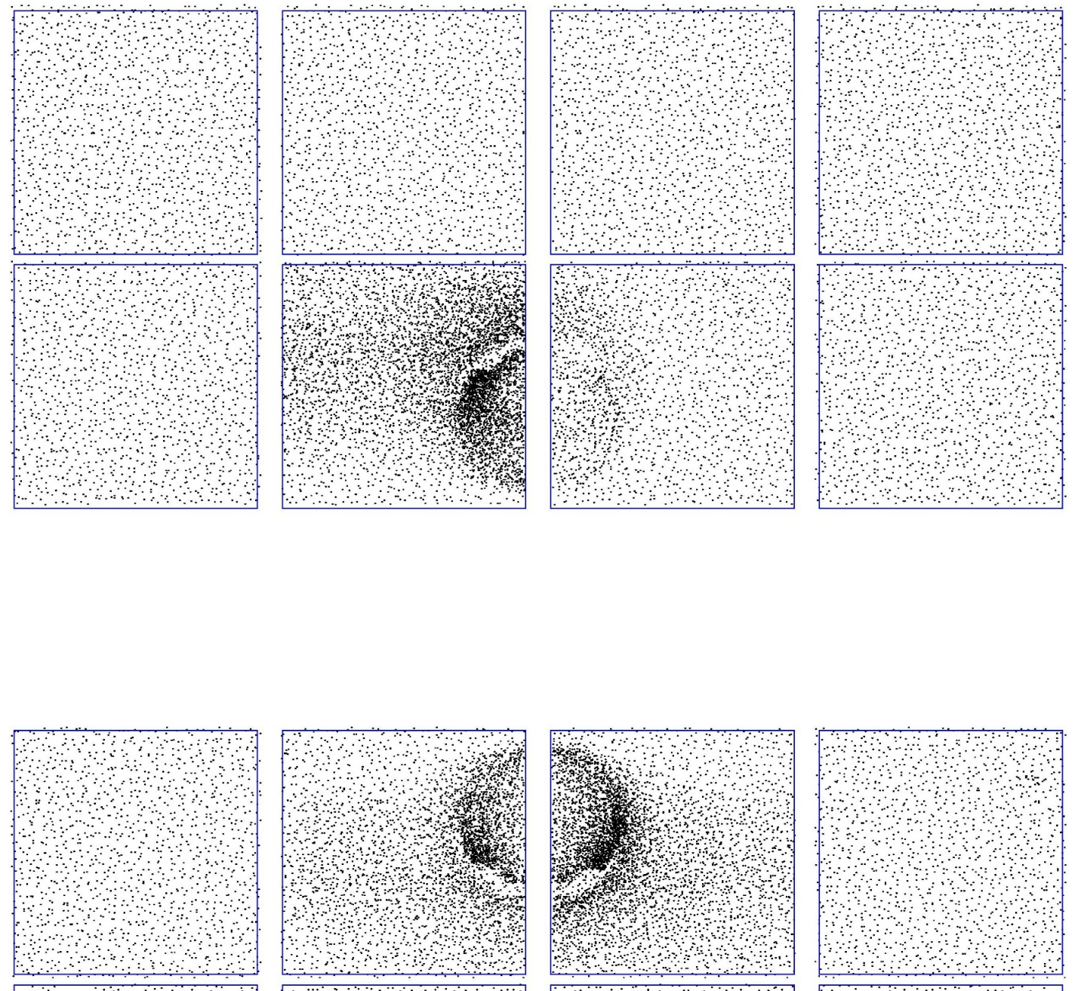
Beam halo ring from data
Beam time: 27/5 – 10/9 ~ 100 days
Duty factor: ~0.25 x ~100 days = ~2 x10⁶ s
PD 5 at 2000 V, anode current in spill: ~ 130 nA
Total charge generated in PD 5: ~ 0.26 C
Number of highly illuminated pads: ~ 50 - 100
Charge on single highly illuminated pad: ~ 1 - 3 mC

Slide 17
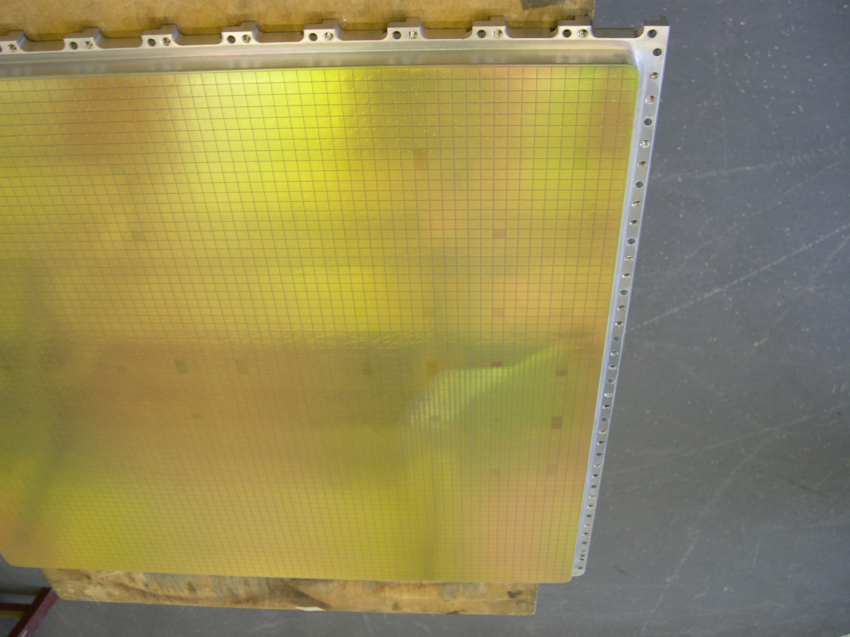
Accidental exposure to air of a
photocathode during winter shut-down

Slide 18
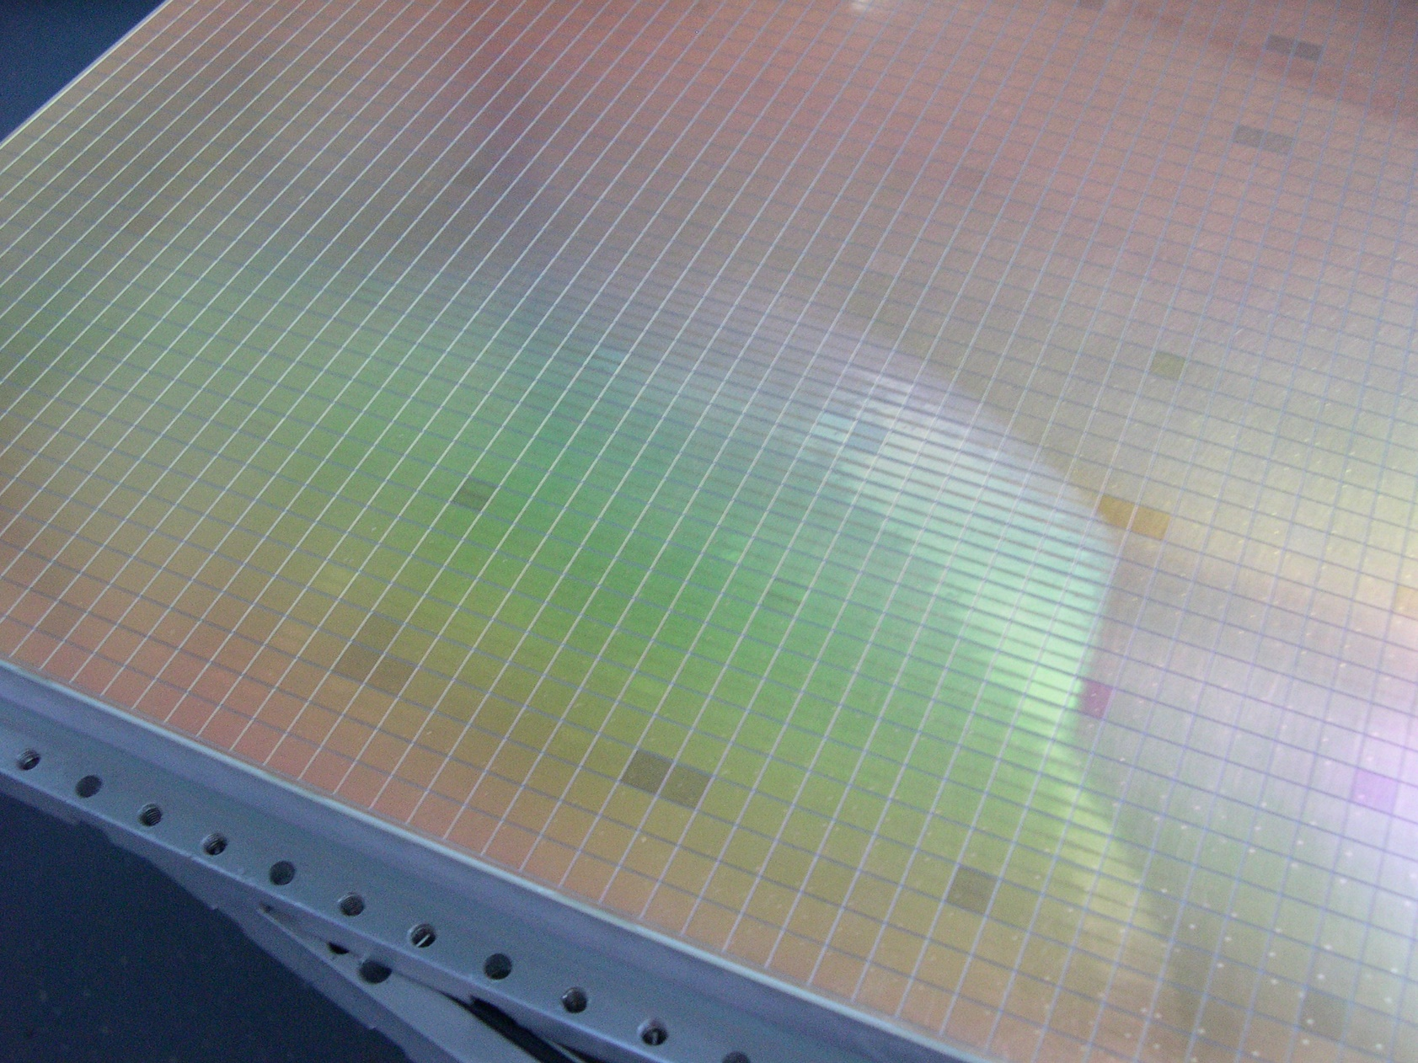
The whole halo region

Slide 19
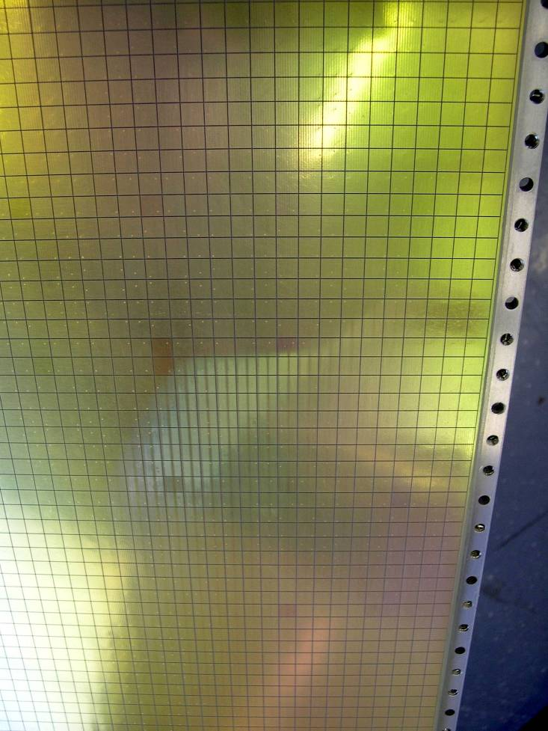
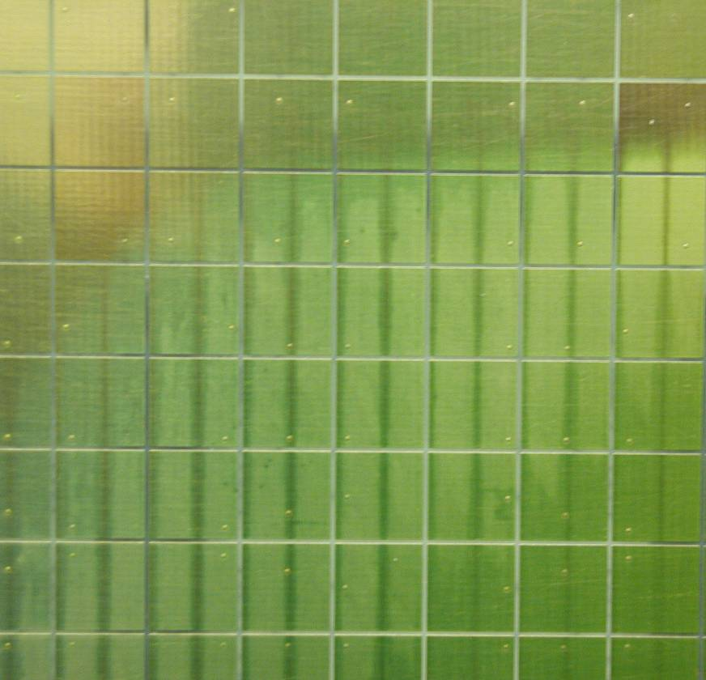
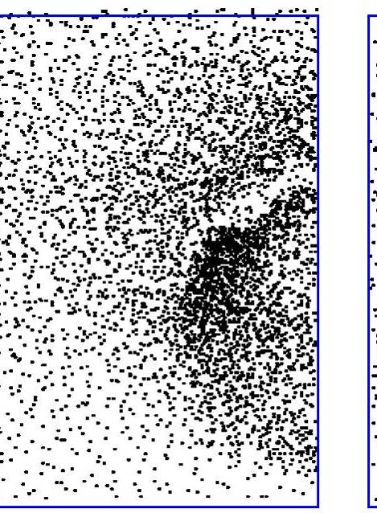
Few months after the end of the first run
wires
accumulated charge:~ 1 mC/pad
highest photon flux region

Slide 20
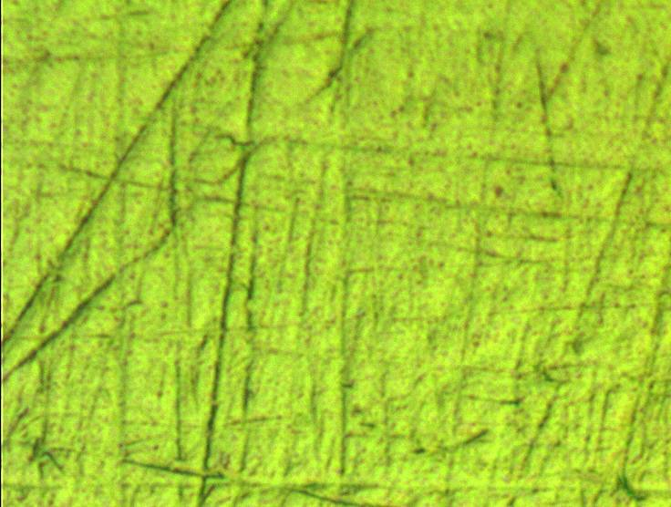
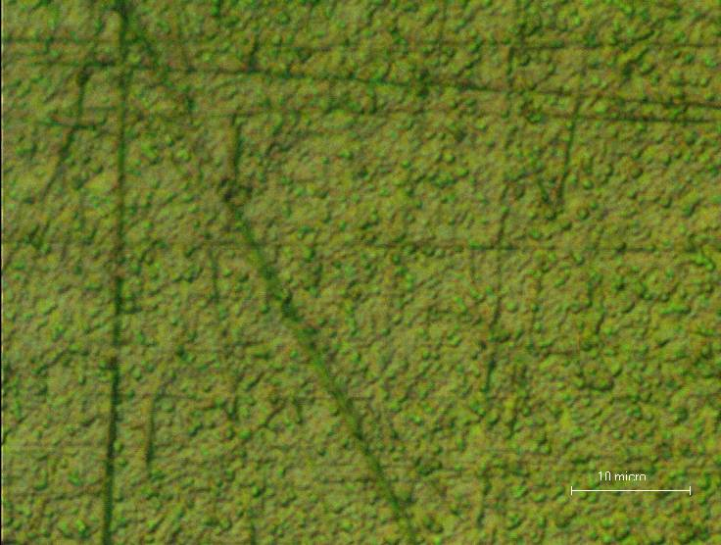
CsI surface at microscope (x 1000)
normal
“white strip”
10 μm

Slide 21
Study of long term CsI QE variations
M. Alexeev et al, 2014 JINST 9 P01006
    Principle:
    Extract the mean number of detected photons per particle from the data collected during six years of COMPASS data taking
6 consecutive years of COMPASS data taking
up to 15 days of data taking per sample
identical cuts applied to the reconstructed particle trajectories (track quality)
MAPMTs
RATES IN THE EXTERNAL DETECTORS during SPS spills:
Photoelectrons < 10 Hz / cm²
MIPs < 10 Hz / cm²
→ Integrated charge over 6 years < 10 μC/cm²

Slide 22




Data selection, correction and fit
only identified π’s
only rings fully contained in a single cathode
count N_{ph} (detected photons) of each ring
(background cannot be disentangled at this stage)
1 mrad wide θ_{Ch} bins → N = < N_{ph} >
Cherenkov photons : Poisson distribution
→ detected photons : Poisson distribution
at least 1 detected photon
→measured N is biased, corrected
measured: μ’
μ solving numerically the equation
FIT THE DISTRIBUTION:
corrected
Frank and Tamm distribution
Background (flat distribution assumed)

Slide 23


Fit quality, consistency and stability
NDF = 18
χ² theoretical
distributions
and fits (>25 mrad)
2006 data
→estimated systematic error: 0.7 x σ_{stat}
use N(θ_{Ch} = 55.2 mrad)
for extrapolation
Fit results stable versus:
fit range variations
different ring selection:
at least 2, 3 photons

Slide 24


results
Frank and Tamm
background
N(θ_{Ch} = 55.2 mrad)
vs year
(statistical errors)
MEAN OVER 11 CATHODES
(statistical & systematic errors)
Too few photons:
not used in the following

Slide 25

CsI photocathodes can preserve QE over years
<N> vs year is compatible
with no CsI QE variation
max CsI QE variation
rate : 2.3 % / year
[1 “COMPASS year” :
~6 months of data taking]
For the 3 most critical cathodes:
max CsI QE variation rate : 5.2 % / year
Estimated systematic error of the measurement: 2 % /year
Errors enlarged to get 50% probability for the linear fit
<N> corrected for
lower HV (-20V)
The CsI QE decrease is modest

Slide 26

MWPCs with CsI have good performance
photons / ring (β ≈ 1, complete ring in acceptance) : 14
σ_{θ-ph} (β ≈ 1) : 1.2 mrad
σ_{ring} (β ≈ 1) : 0.6 mrad
2σ π - K separation @ 43 GeV/c
PID efficiency ~ 95% for θ _{Ch} > 30 mrad
except for the very forward region
After a long fight for increasing electrical stability at high m.i.p. rates and systematic studies at the CERN GIF we came to the same conclusion as Ypsilantis and Seguinot:
J. Seguinot et al., NIM A 371 (1996), 64:
CsI-MWPC with 0.5 mm gap to minimize ion collection time, fast front-end electronics (20 ns int. time):
stable operation is not possible at 10⁵ gain because of photon feedback, space charge and sparks

Slide 27








THGEM + CsI R&D for RICHes
ALICE VHPID
THGEM &
HYBRID
V.Peskov et al., NIMA 695 (2012) 154
COMPASS, RICH-1 upgrade by Triple THGEM detectors
beam
Č photon

Slide 28
COMPASS RICH-1 UPGRADE IN 2016
3 m
Photon detectors system now:
              12 MWPC + CsI 600 x 600 mm²
              4 MAPMT 600 x 600 mm² (2006)
6 m
UV mirror
wall
MWPC + CsI
MAPMT
… in 2016
5 m
Photon Detectors
radiator:
C₄F₁₀
Hybrid Detector (2 THGEM + MM)
4 New 600 x 600 mm² MPGD based PDs
will be installed for a total sensitive surface of ̴ 1.1 m²
radiator gas: C₄F₁₀

Slide 29










The Hybrid detector concept and the building blocks
Two modules are put side by side to build a 600 mm x 600 mm detector
To simplify the construction requirements a modular architecture has been adopted where one “module” consists of:
    One 300 mm x 600 mm Bulk Micromegas detector
    Two layers of THGEMs (300 mm x 600 mm) in staggered configuration
Signal read out via capacitive coupling pad readout and APV25 F/E boards
THGEM 1
THGEM 2
Multi-Pad Anode 8mm X 8mm pad size

Slide 30

exploded view of the new COMPASS PD
CERN, 21/02/2017, RD51 Miniweek - Precision timing Workshop - CsI in gaseous detectors - Fulvio Tessarotto

Slide 31







The THGEMs design: specifics
12 sectors on both top and bottom, 0.7 mm separation
Thickness: 0.4 mm, hole diameter: 0.4 mm, pitch: 0.8 mm
24 fixation points to guarantee THGEMs flatness
THGEM pcb size = 620 mm x 320 mm,
active area = 581 mm x 287 mm
pillars in PEEK
border holes diam.: 0.5 mm

Slide 32











THGEM production @ ELTOS and the surface treatment in Trieste
A post production specific surface treating and cleaning procedure developed in Trieste is applied:
Surface Polishing.
High pressure water cleaning.
Ultrasonic Bath with Sonica PCB solution (PH11), distilled water rinsing and oven @ 160 ºC
  image transfer
  development
  etching
  stripping dry-film
  mounting
  multi-spindle drilling
  drilling

Slide 33





THGEM storage, transport and gold coating
  etching
  THGEM ready for CsI coating

Slide 34

The CERN CsI evaporation system
CERN, 21/02/2017, RD51 Miniweek - Precision timing Workshop - CsI in gaseous detectors - Fulvio Tessarotto

Slide 35




THGEM CsI coating
THGEM
THGEM box
piston
QE measurement
4 evaporators
Turbopump
evaporators

Slide 36


COMPASS THGEM CsI coating
19 CsI evaporations performed in 2015 - 2016
on 15 pieces: 13 THGEMs, 1 dummy THGEM,
and 1 reference piece (from ALICE coatings)
11 coated THGEMs available, 8 used + 3 spares
  etching
  THGEM number evaporation date at 60 degrees at 25 degrees
Thick GEM 319 |  |  | 1/18/2016 | 2.36 | 2.44
Thick GEM 307 |  |  | 1/25/2016 | 2.65 | 2.47
Thick GEM 407 |  |  | 2/2/2016 | 2.14 | 2.47
Thick GEM 418 |  |  | 2/8/2016 | 2.79 | 2.98
Thick GEM 410 |  |  | 2/15/2016 | 2.86 | 3.14
Thick GEM 429 |  |  | 2/22/2016 | 2.75 | 2.74
Thick GEM 334 |  |  | 2/29/2016 | 2.77 | 3.00
Thick GEM 421 re-coating |  |  | 3/10/2016 | 2.61 | 2.83
  Reference piece 7/4/2016 3.98 3.76
QE measurements indicate an average THGEM QE = 0.73 x Ref. piece QE, in agreement with expectations (THGEM optical transparency = 0.76)
We are grateful to Thomas Schnider and Miranda Van Stenis for their excellent
professsionality and dedication: working with them is both effective and a pleasure

Slide 37




glovebox for CsI THGEM mounting
CERN, 21/02/2017, RD51 Miniweek - Precision timing Workshop - CsI in gaseous detectors - Fulvio Tessarotto

Slide 38






the challenge of the integration in the existing environment
30 mm x 30 mm
External view
“Photon” view
CERN, 21/02/2017, RD51 Miniweek - Precision timing Workshop - CsI in gaseous detectors - Fulvio Tessarotto

Slide 39





larger glovebox for CsI mounting on RICH

Slide 40


A preliminary estimate of the number of photons
Comparing the number of detected photons in the present status:
Active surface of the detector (HV) 50%
from the same data, the number of “signal hits” on Hybrids is larger than on MWPCs

Slide 41
THANK YOU

