Slide 1
THGEM and MICROMEGAS HV issues:
The experience gained with the novel
COMPASS photon detectors
C. Azevedo, S. Dalla Torre, S. Dasgupta, M. Gregori, G. Hamar,
S. Levorato, G. Menon, F. Tessarotto

Slide 2
NOVEL DETECTOR HV ISSUES
quick reminder
THGEM and HV performance
  Reminder: during the 2016 run, 3 THGEM sectors (over 16) with lower gain
  Total surface: 1.5 m²
MM and HV performance
  Reminder: during the 2016 run, about 20 pads (over 19040) exhibiting shorts

Slide 3
Quick remninder

Slide 4
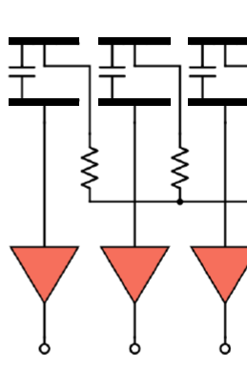

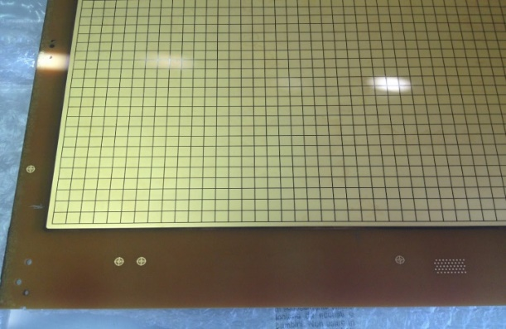
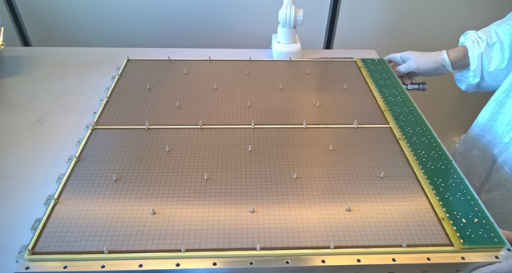
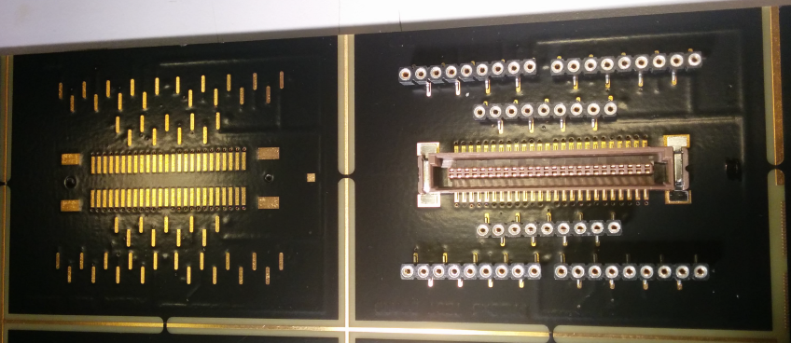
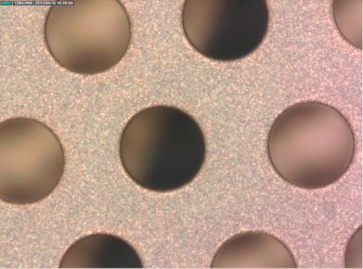
DETECTOR ARCHITECTURE
Single pad
HV is applied here through a resistor (mesh @ ground)
CsI coating t
Signal read-out from this pad
0.5 GΩ
0.07 mm
fiberglass
HV
PCB
60 x 60 cm² detectors
formed by 30 x 60 cm²
active elements
Resistor arrays
Connections for groups of 48 pads
Signals

Slide 5
THGEM and HV performance

Slide 6
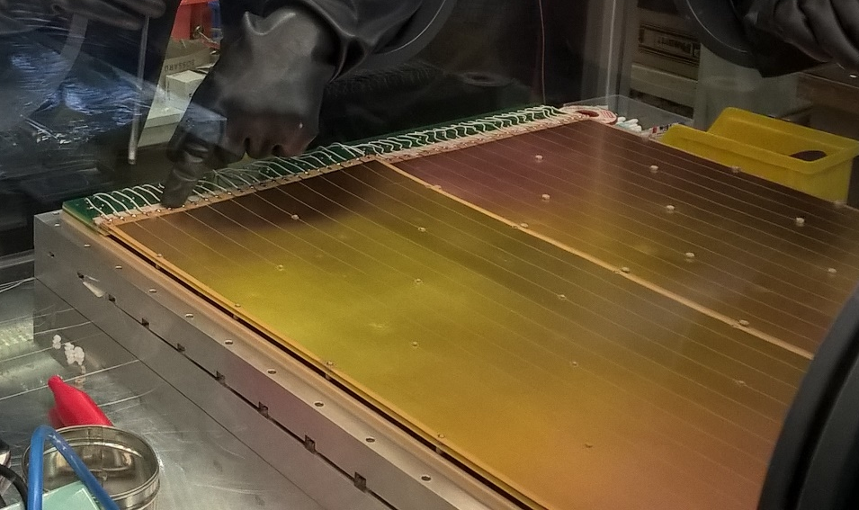
THGEM and HV performance
chamber
THGEM HV distribution
  1 chamber: 2 hybrids (detectors)
  1 hybrid: 2 sectors
  1 sector: 6 segments
  → 1 segment is 4% of a chamber
  HV is distributed sector by sector via
  independent HV channels for
  THGEM1_top_sector_ij
  THGEM1_bottom_sector_ij
  THGEM2_top_sector_ij
  THGEM2_bottom_sector_ij
  resulting in 16 THGEM-HV ch.s per detector, namely the segments are grouped 6 by 6
a relevant feature:
  when both THGEM1 and THGEM2 in a sector are on, the sparks always propagates to both
during standard operation it is not possible to disentangle the following
    Was the spark originated in THGEM1 or THGEM2 ?
    In which segment was the spark generated ?
Under laying principle of the fixing procedure
    Identify the feeble segments and isolate them providing separate HV ch.s
    GOAL: from 19% (= 3 sectors) to 3-5%(= 3-5 segments) low efficiency surface
hybrid
sector (1 HV ch.)
segment

Slide 7
THGEM and HV performance
First exercise to identify the feeble channels
  only the THGEM1 (2) sectors on at high HV, with THGEM2(1) at lower HV
  THGEM1’s (CsI coated) are performing better !
  Top chambers are electrically better (already observed during the run)
  By product: an approximate reference to go on testing in Ar-CO₂ (no methane) to be able to continue during the winter shut-down period
bottom chambers
top chambers

Slide 8
THGEM and HV performance
Studying segment by segment
2 dedicated voltage distribution boxes built
  6 segments per box, independent HV supply
Dedicated software control tool
ANALYSIS OF THE RESULTS
THE TEST LOGICS
Voltage
1 step every 10’
dot size ~ N (n. of sparks)
Voltage decreased when N > 4
TIME at the given HV
Number of sparks
Spark rate (1/min)
time

Slide 9
THGEM and HV performance
Parametrizing the test results via a single figure
Extract it from the spark rate vs voltage
  3 algorithm used
    When they give the same indication
    (LARGE MAJORITY OF CASES), use it
    When they are at variance, repeat the measurement
Results OK
REPEAT THE MEASUREMENT

Slide 10
THGEM and HV performance
Feeble sectors, study of the bottom chambers completed (top chambers on going)
THGEM 2
Repeated measurements
Bad segment that matches with what
observed during the 2016 run
THGEM 1
Sector 0,0
Sector 0,1
Sector 1,0
Sector 1,1
Sector 0,0
Sector 0,1
Sector 1,0
Sector 1,1
Chamber PD1
Chamber PD2

Slide 11
THGEM and HV performance
Summary of segments prepared for separate HV supply
in colour, the feeble segments as detected during the 2016 run

Slide 12
NEW: TOP CHMBERs COMPLETED
PD5
THGEM 1
THGEM 2

Slide 13
NEW: TOP CHMBERs COMPLETED
PD6
THGEM 1
THGEM 2

Slide 14
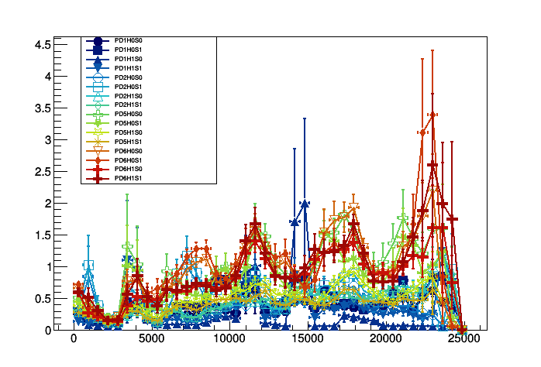
THGEM SPARK RATE DOES NOT DEPENED ON BEAM INTENSITY
The beam intensity is not an issue !
  Using slow control data
  Correlations between spark rate and other parameters being studied
Spark rate (h⁻¹)
BEAM INTENSITY from ppp on T6 (AVERAGE per h)

Slide 15
MICROMEGAS and HV performance

Slide 16
MICROMEGAS and HV
REMINDER

Slide 17
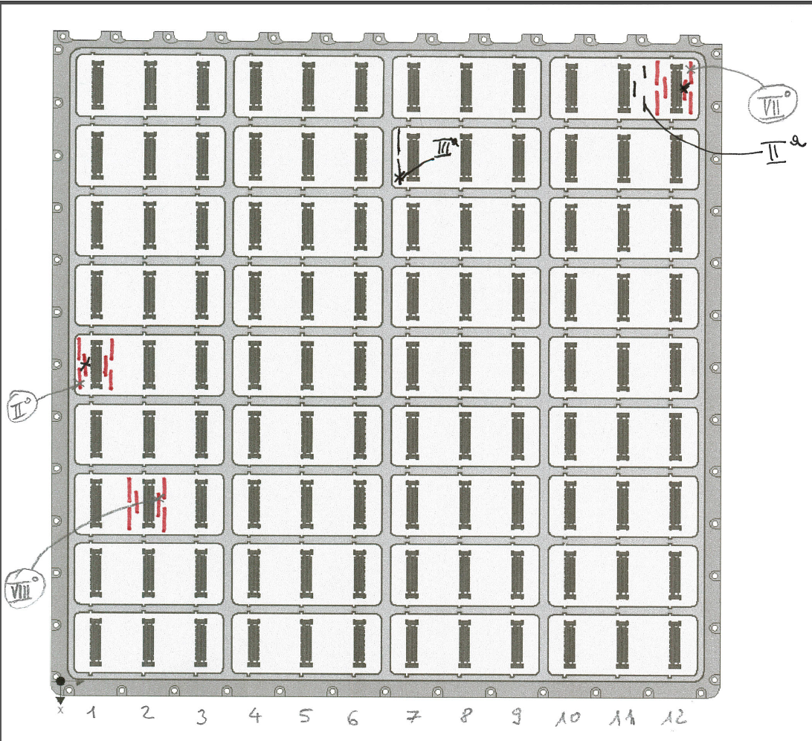
MICROMEGAS and HV
PD1, PD2, PD6 – detailed study of the pads with shorts
  To be performed for PD5
Pads with shorts identified, fixed by applying a reverse bias when possible, connection removed to the others
In PD1:
5 pads with shorts (over 4760)
  1 fixed
  4 isolated
+ 1 pad isolated due to connector
In PD2:
5 pads with shorts (over 4760)
  2 fixed
  3 isolated
In PD6:
7 pads with shorts (over 4760)
  1 fixed
  6 isolated
PD2
Pads off at 0.1 ‰ level

Slide 18
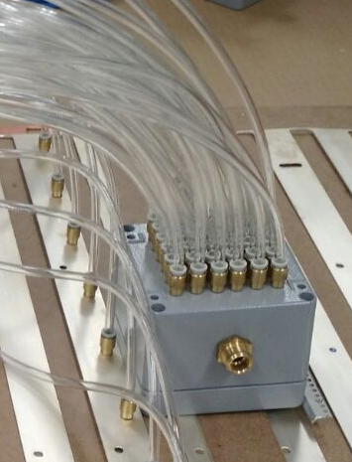
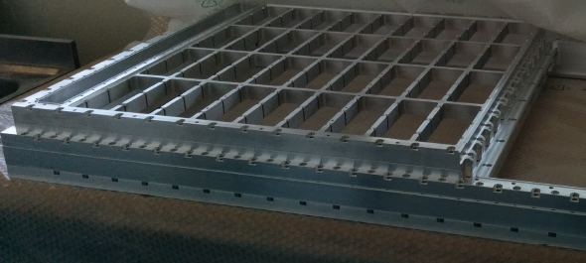
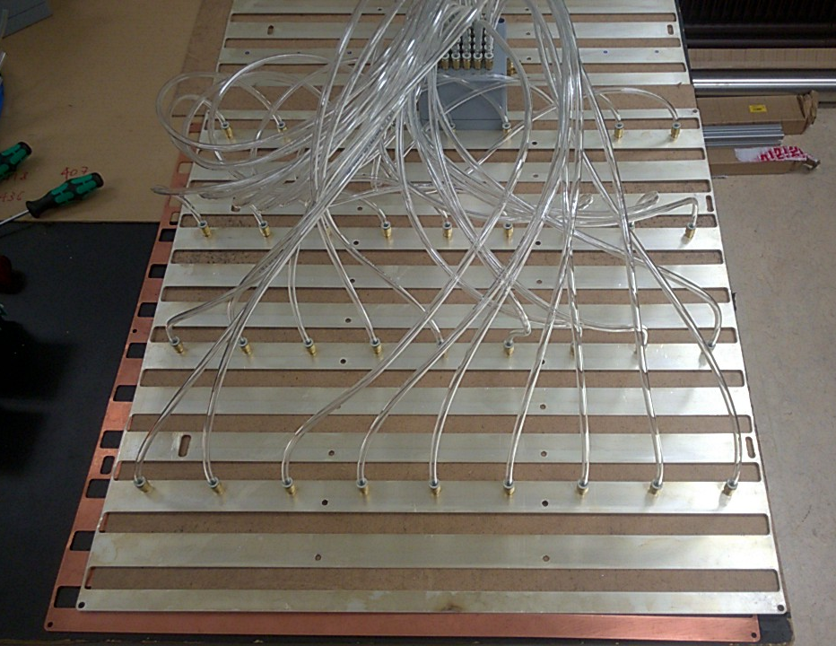
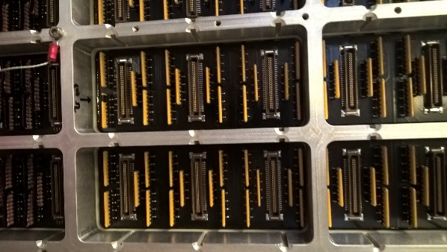
MICROMEGAS and HV
More leak current when humidity condensed onto the resistor arrays that supply the pads
N₂ flow to overcoming similar episodes (and reduce parasitic noise)

