Slide 1
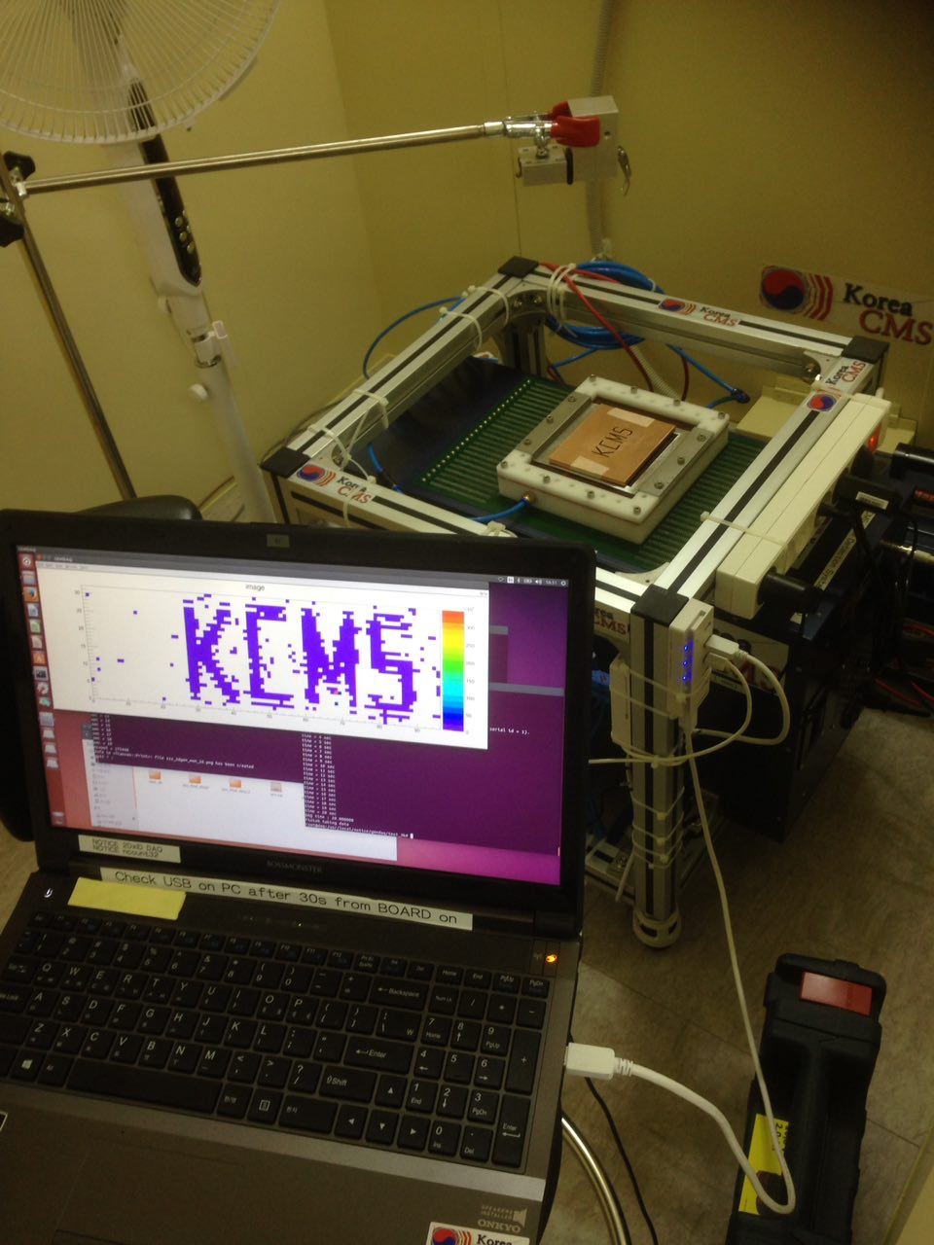
KCMS-MECARO
GEM Production
Status
RD51 meeting
Feb. 22, 2017
Inkyu Park
(U. of Seoul) for KCMS
&
Yeonsu Yu
for MECARO
Notes:
1

Slide 2


Contents
KCMS plan
MECARO GEM Production site & facilities
New machines being built
Double mask alignment test at OPTIRAY
(Large bipolar lithography specialist)
긍정
창의
열정
혁신

Slide 3
KCMS Plans

Slide 4
Revised Plan for KCMS GEM foil
LS2 Upgrade: GE1/1
  Double-sided method production: 2016 Oct → First half of 2017
    Large area litho machine (400kCHF), DRF film coater, Cu etching (160kCHF)
    Delay of 6 months due to finding the right specs for the litho machine and initial funding for purchase order
  2017-2018
    Hope to produce 200-250 GE1/1 foils → 250~300kCHF contribute in-kind
LS3 Upgrade: GE2/1 and ME0
  2019: GEM foil production for GE2/1 and ME0

Slide 5
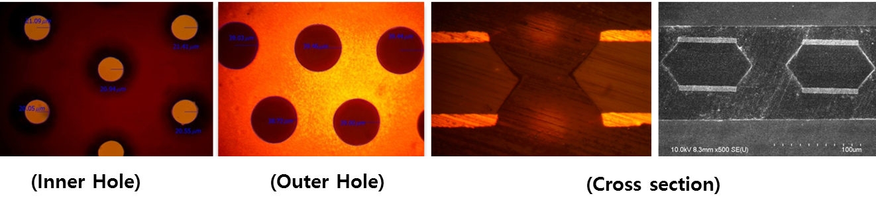
KCMS GEM Foil Production
KCMS Developed the double mask method
10cm x 10cm GEM foil test completed
  Testing at CERN (2014.02.17): High gain was achieved
IBS GEM foil (13.5m x 17.5cm) test completed
  IBS (2014.10): Gain ~ 10x higher than other GEM foils
50cm x 120cm GEM foil production by Single Mask Method
  not very successful so far due to non-uniformity of the raw FCCL material

Slide 6
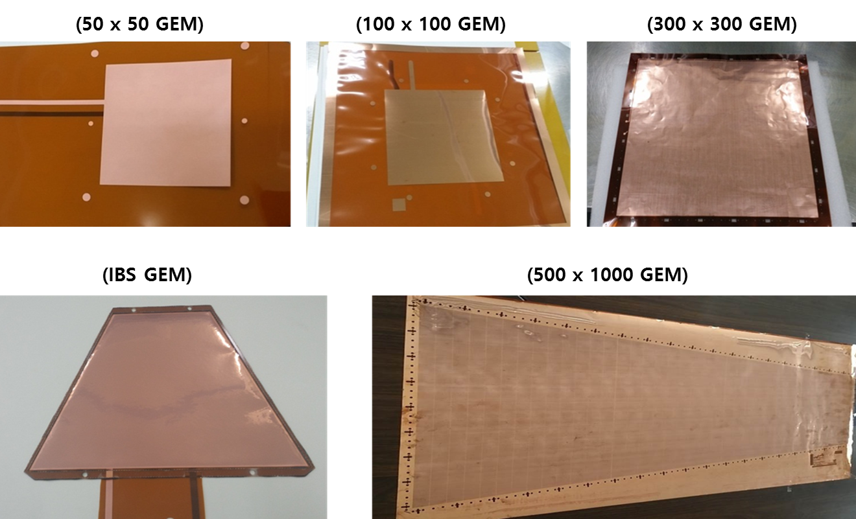
Some of the Products
Available in various sizes and designs produced within 1250mm X 710mm.
Capacity : Small & Mid size (2000 foils/year)

Slide 7
MECARO GEM Production site

Slide 8
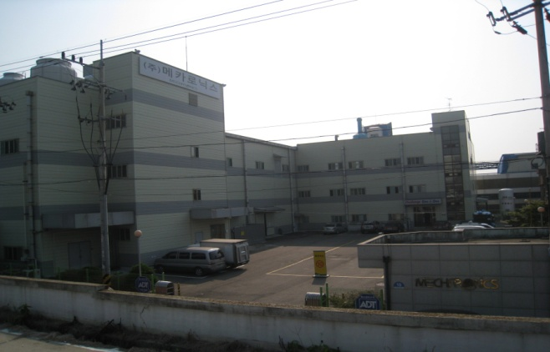
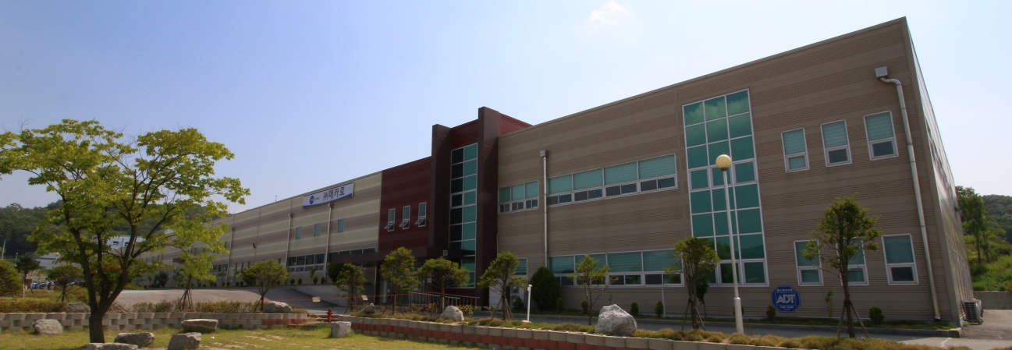
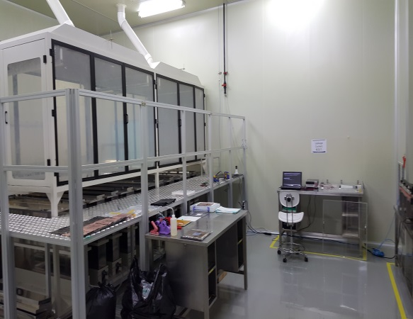
Mecaro
Semiconductor parts manufacturer in Korea.
  Products: Heater block, Chemical Precursor, GEM foil etc.
Head Quarter & Production Facility
Clean room : 1000 m²
R&D and Production Facility
Clean room : 1300 m²
R&D for GEM foil fabrication done here

Slide 9
Status of Production Facility
GEM foils up to 30x30 cm² have been produced successfully
  These are small scale production and we relied on equipments of other companies
For large scale production of large GEM foils, we need dedicated equipment
  DFR laminator
  Large bipolar lithography machine
  DFR film developer, Copper etching, drying
  Clean rooms for the equipments have been ready for some time
  Orders have been placed and expect delivery by April 2017
    Initial payment with help from MECARO

Slide 10
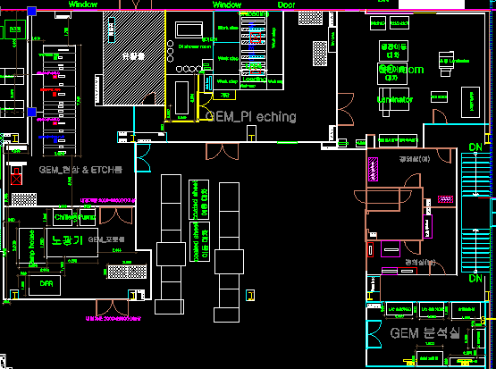
Production site layout
New rooms
Existing rooms
Laminate & Exposure / DFR Develop & Cu Etch / GEM Room / Analysis Room
Yellow Room
Yellow Room
Notes:
박인규 설명)
YELLOW ROOM에는 DFR 필름 현상과 Cu에칭등 사진 작업을 위해 특별히 노란등을 사용합니다.
그림에서 보시다시피, 젬생산시설은
노광룸 (좌측하단)
DRF필름 현상룸, Cu에칭룸 (좌측 상단)
PI에칭룸 (중앙상단)
검사실 (우측 하단)
으로 구성되어 있습니다.

Slide 11
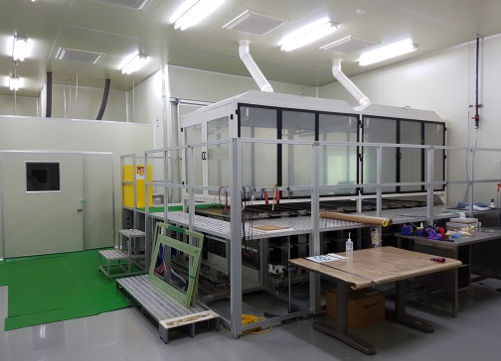
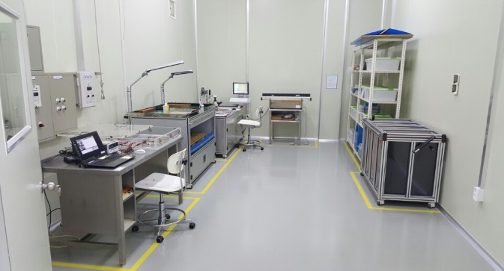
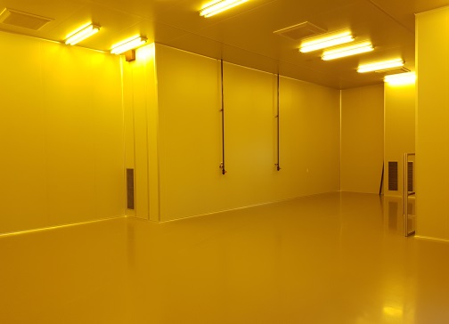
GEM Production Facilities: Clean room
Production room
Optical Inspection and Analysis room
A new space for new facilities
Total clean room space ~1200m^2
Whole clean room space < 10000 Class.
A new space is prepared to produce large GEM foils (GE11)
  A high precision bipolar lithography
  A DFR film developper & Cu etching machine
  Curing system

Slide 12
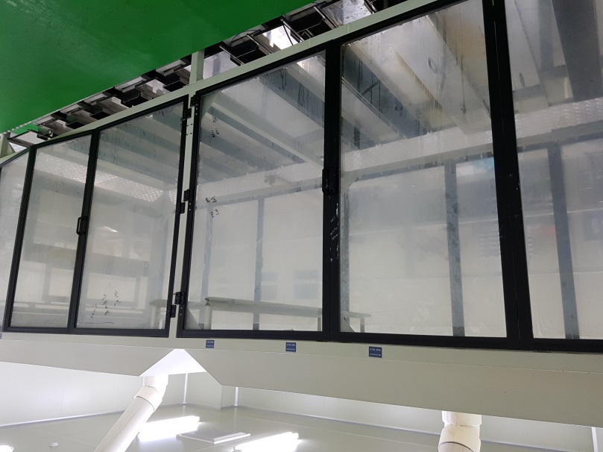
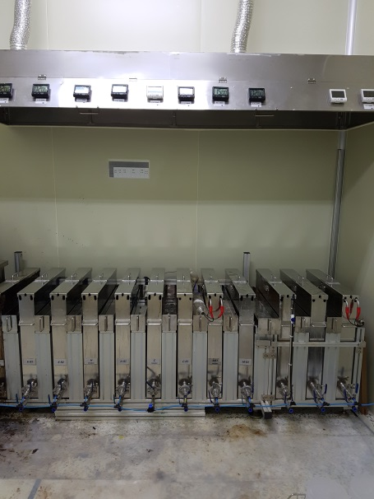
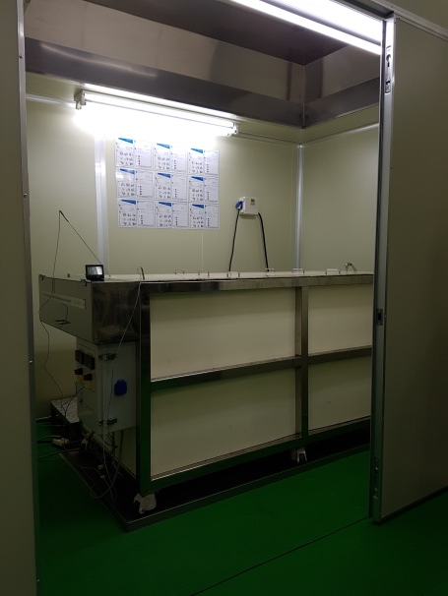
GEM Production Facilities: Production room
Small size etching bath
Mid size etching bath
Large size etching bath
Multiple etching baths are ready for various sizes of GEMs
  Small: 10cm x 10cm, 30cm x 30cm
  Middle: 50cm ~ 1m
  Large: > 1m

Slide 13
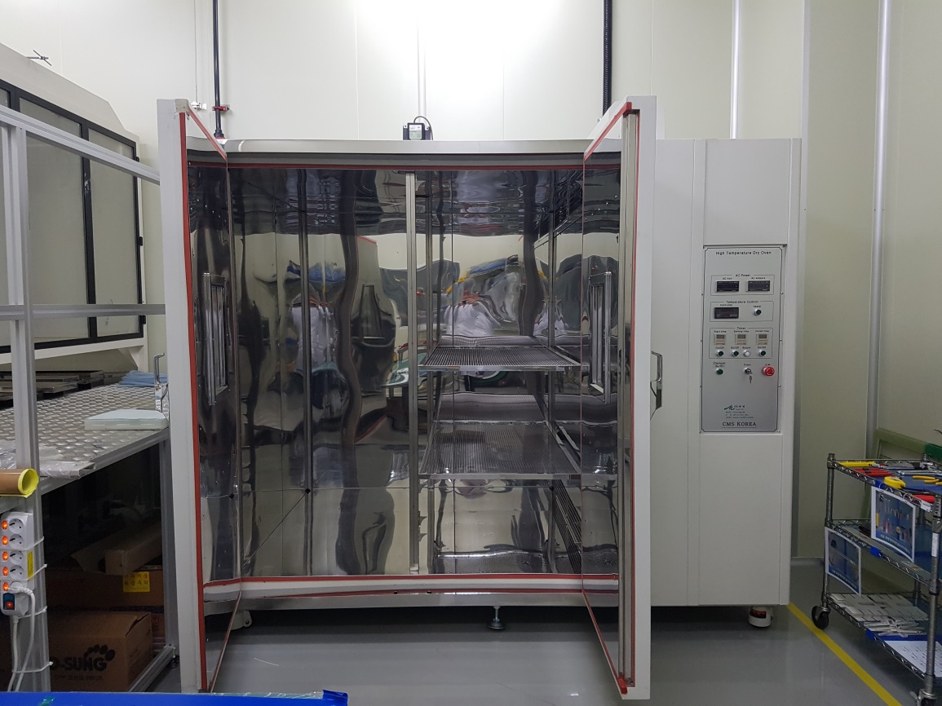
Large size dry oven & storage
Dimensions: W1600 X D1500 X H1800 : Holds tens of large size GEM foils
Notes:
박인규)
대형 GEM호일 건조기 및 보관함

Slide 14
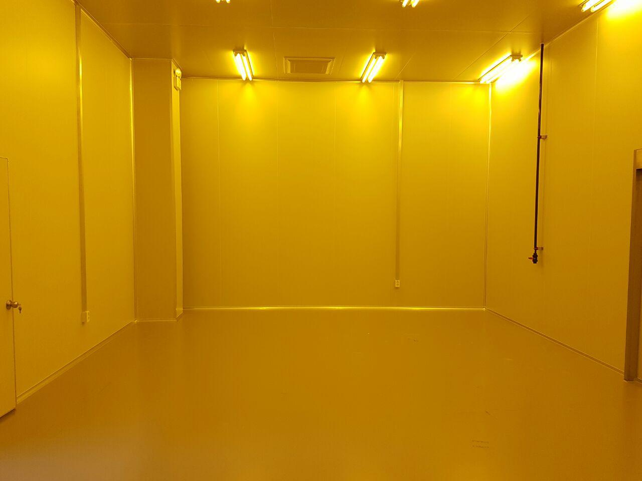
New large bipolar lithography room
Laminate & Exposure / DFR Develop & Cu Etch / GEM Room / Analysis Room
Exposure
Machine
Laminate
Machine
Notes:
박인규 설명)
여기에 리소그래피 장비가 들어 올것입니다. 2017년 4월 도입 확정

Slide 15
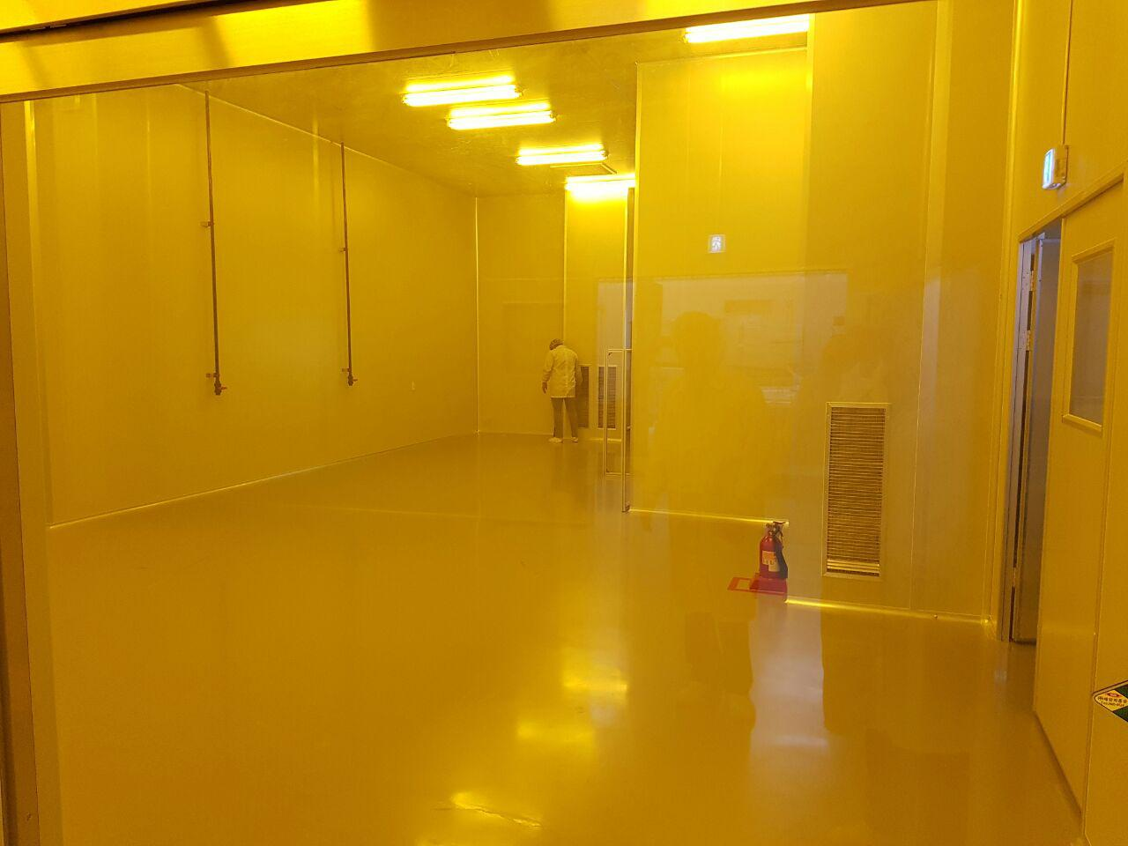
New DFR developer & Cu etching room
Laminate & Exposure / DFR Develop & Cu Etch / GEM Room / Analysis Room
DFR Develop Cu Etch Machine
Notes:
박인규 설명)
여기에 CFR필름 현상기와 Cu 에칭 (구리에 원형 구멍을 파내는 작어)기가 들어 옵니다. 2017년 3월 도입

Slide 16
MECARO
New machines being built

Slide 17
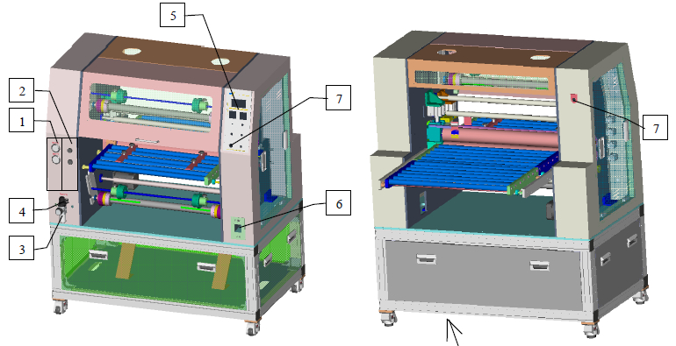
DFR Laminator
DFR Laminate
DFR 650 mm max width (FCCL width : 610 mm max width)
Double or Single side Laminate possible
Notes:
박인규 설명)
4월 도입을 예정으로 있는 양면 DFR필름 코팅기… 리쏘그래피를 하기전에 매스크패턴을 구리위에 입히기 위한 비닐 필름 (이 필름에 빛이다면 GEM 패턴이 생긴다)

Slide 18
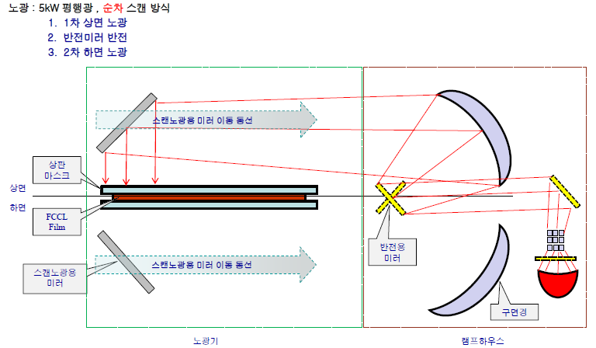
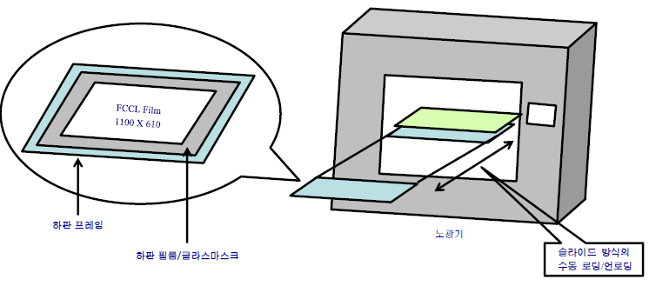
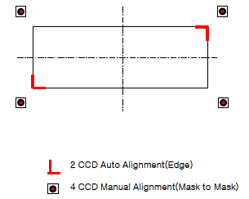
Large Bipolar lithography
Exposure Machine
Bipolar machine. Mask alignment precision < 3 microns. Parallel beam.
Effective Exposure Area : 54.3 inch x 32 inch (1379 mm x 813 mm)
Notes:
박인규 설명)
4월 도입을 예정으로 있는 양면 노광기… 광학계에 의하여 평면광을 조사한다. 가장 비싼 장비로 4.7억원 투자…
(이 투자는 오로지 GEM생산에만 쓰임. 현재 이 장비를 가지고 다른 제품을 만들거나 하는 계획도 없고, Market도 없음,. 훗날 업그레이드 기여로 인정받아야함)

Slide 19
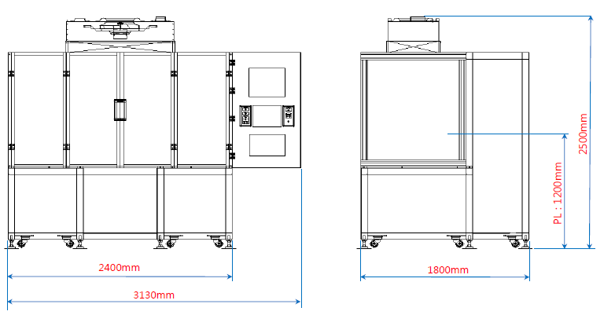
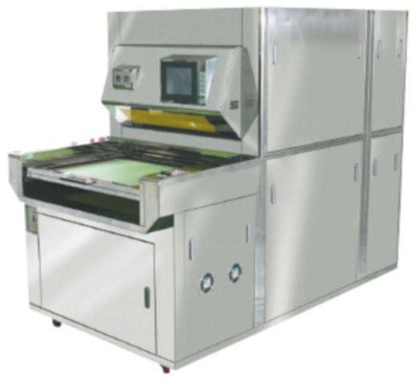
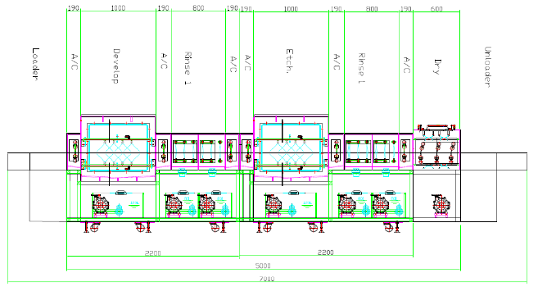
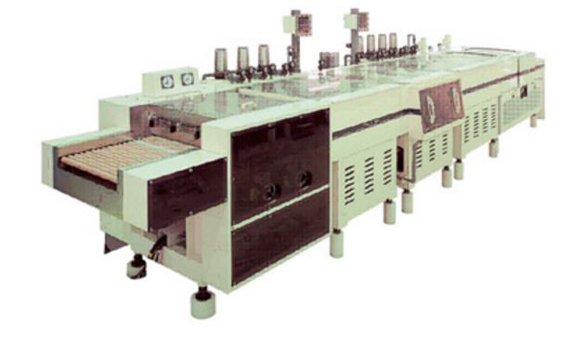
GEM Production Facilities: new machines
  A Large-size high precision bipolar lithography
  up to 1.3x0.8 m²
  double mask alignment precision ~ 2-3μ
  will be delivered 2017.5
  A DFR film developer & Cu etching machine : will be delivered 2017.3

Slide 20
MECARO
Double mask alignment test at OPTIRAY

Slide 21
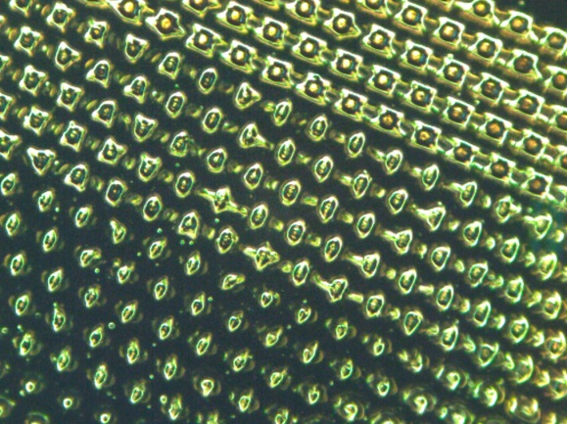
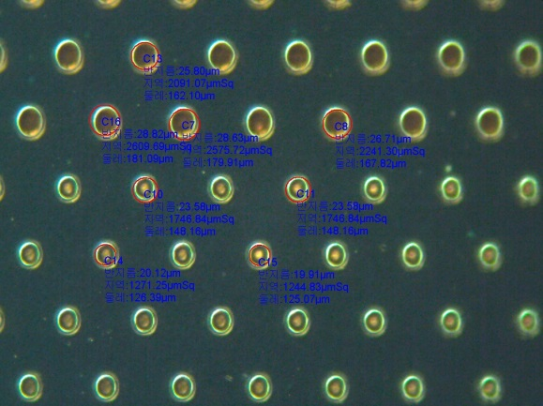
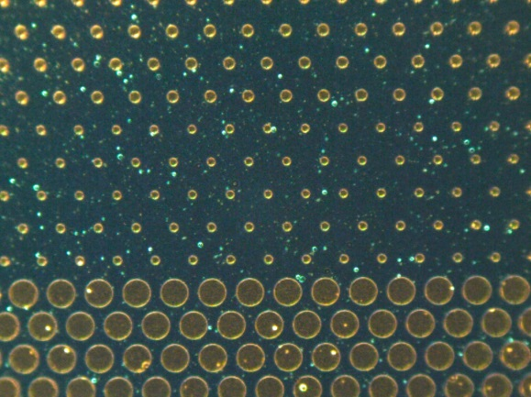
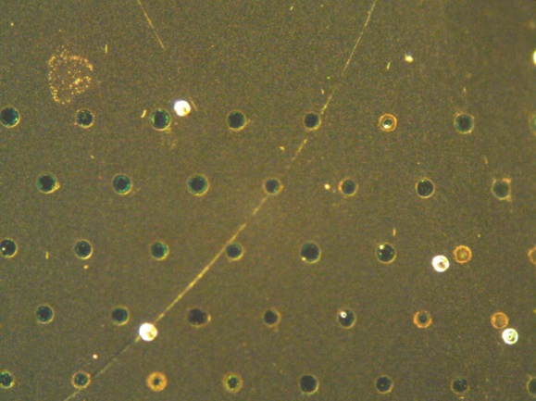
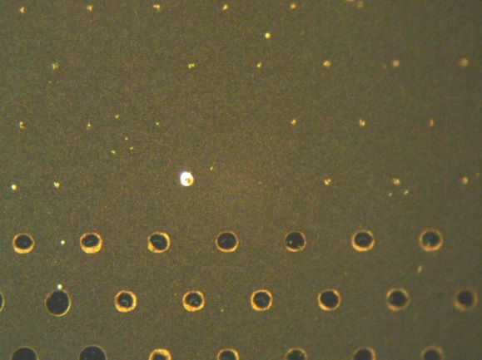
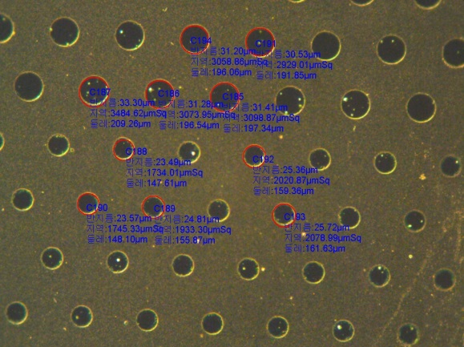
Normal light .vs. Parallel light
Comparison between PhilOptics .vs. Optiray using a various pattern mask
PHILOPTICS semiparallel LED light source (Soft Contact)
Maritime Univ. parallel source
PHILOPTICS semiparallel LED light source(Soft Contact)
OPTIRAY parallel source
Notes:
박인규ㅒ
왼쪽 4장… 분산광으로 찍은 후 Cu 에칭을 한 결과.. 분산광에 의해 원형이 제대로 나오지 않음, 다양한 크기의 구멍을 뚫어보면, 구멍 사이즈가 작아지면 어느 정도에서 아예 뚫리지 않음
오른쪽 2장 .. 평행광으로 찍은후 결과… 구멍이 이쁘게 원형으로 뚫린다. 심지어 작은 구멍일지라도 원형을 유지한다…
결론) 평행광을 써야한다,

Slide 22
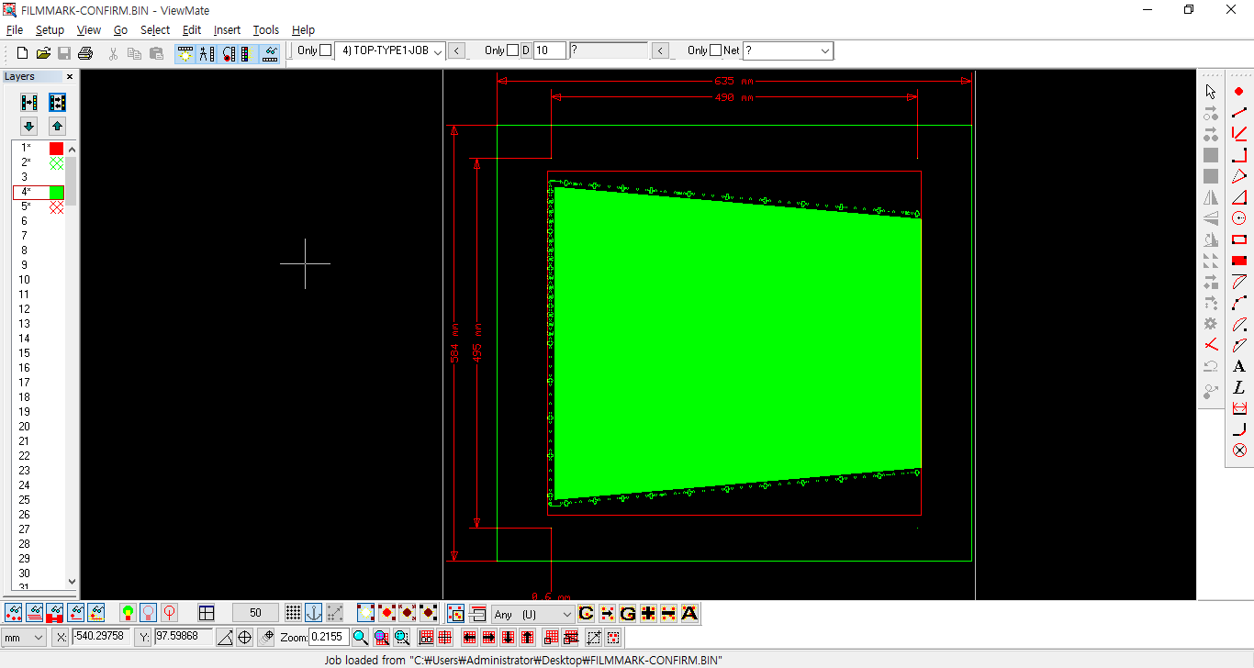
GE11 (half) double mask alignment
Exposure Test – Optiray (2016.9.26)
Film mask 584*635mm
Real image(495*430)
Next plan
1.Film mask alignment check(GE1/1 Real size)
2.Emulsion glass mask test (low cost)

Slide 23
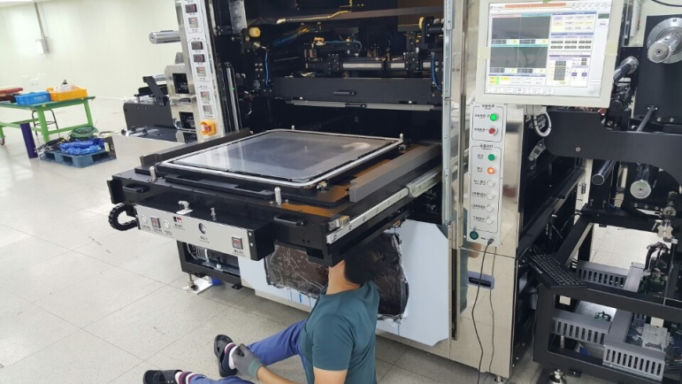
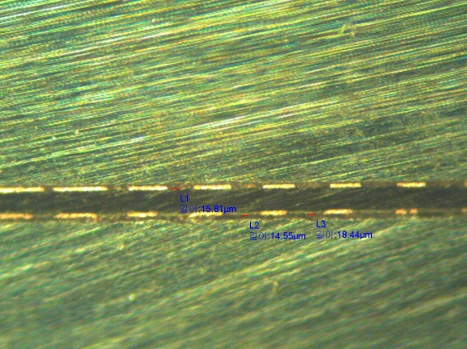
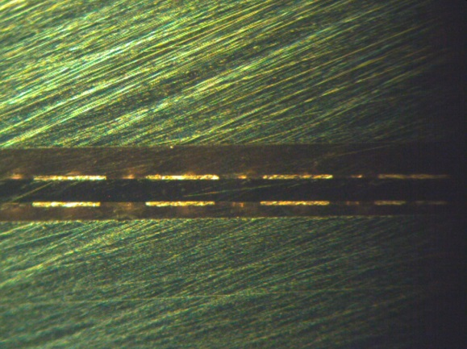
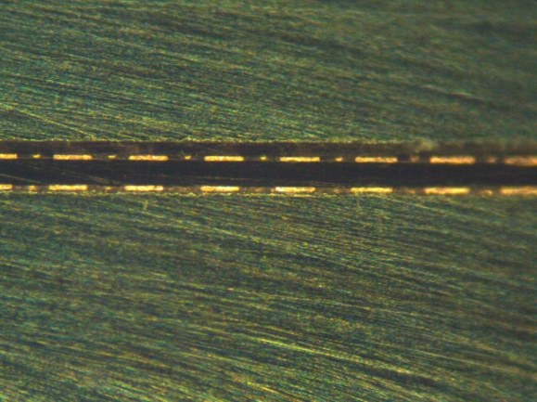
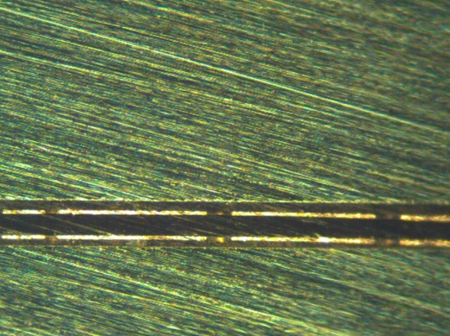
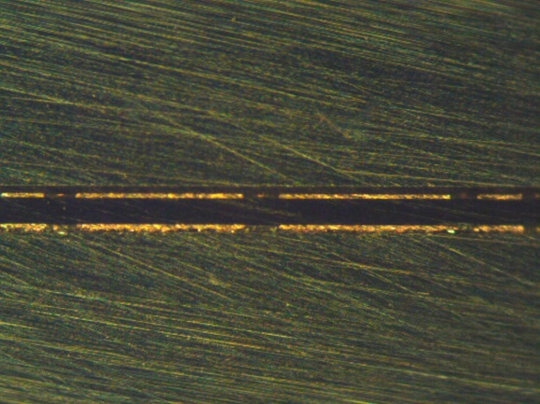
Alignment results
Alignment test using one half of GE 1/1 using a sample lithography at OPTIRAY → successful
Center
Corner 1
Corner 2
Corner 3
Corner 4
Emulsion mask / Exposure machine spec : ±10㎛
Good alignment already achieved. Machine we ordered has better resolution (< 3 um)
Notes:
박인규)
양면 마스크 얼라인 테스트 : GE11 디자인의 큰쪽 반만 짤라 노광시킴
그림에서 본 바와 같이, 양면 10마이크론 짜리 해상도를 가진 리소그래피로도 5군데 (정중안 + 4귀퉁이) 모두 얼라인이 잘 되고 있슴 ==> 우리가 주문하는 장비는 3마이크론 정밀도라, 위의 테스트 보다 더 얼라인이 잘 될 것임.

Slide 24
Timeline for GE11 production
2017 Feb. ~ Jun.: MECARO – OPTIRAY contract
  Large bipolar lithography (~$0.5M) purchase
  3 months minimum to be built & delivered
2017 Jun. ~ Aug.: GE11 test production
  2017.06: production line completed & commissioning
  2017.07: test production (GE11 large type)
    10 GE11 GEMs : to be shipped to CERN for QC
  2017.08: final decision for Korean foil.
2017 Sep. ~ Nov.: GE11 production
  100 GE11 GEM (Larger one)
2017 early
  another 100 GE11 (Smaller one?)

Slide 25
backup

Slide 26
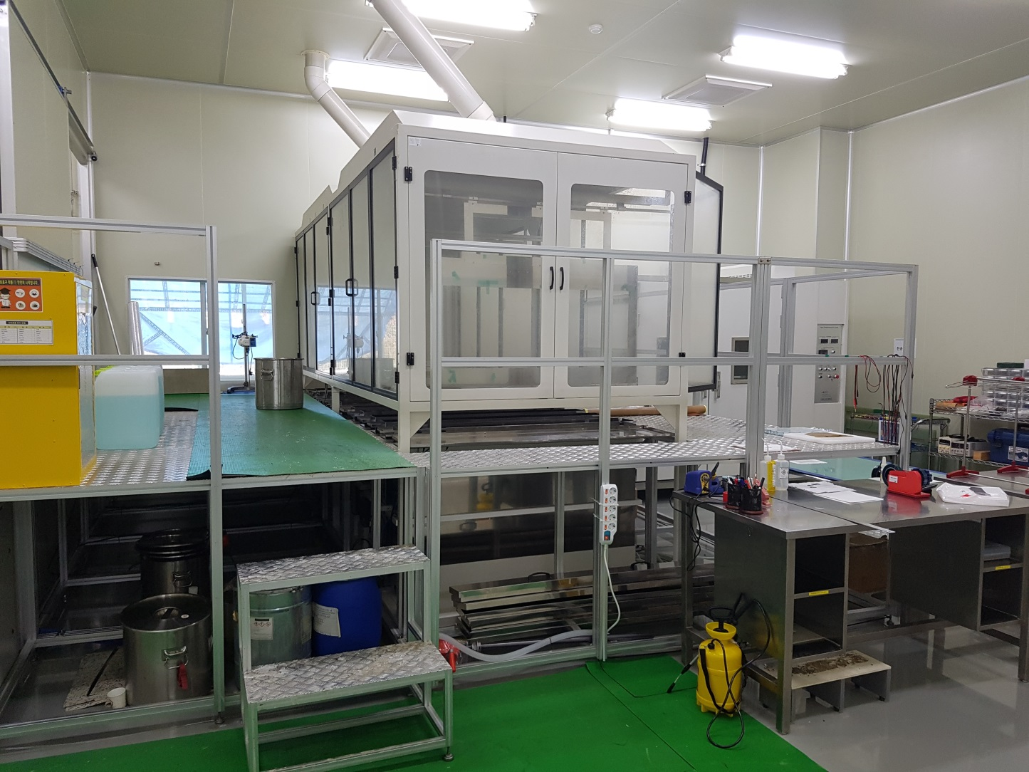
PI etching room & facilities
Laminate & Exposure / DFR Develop & Cu Etch / GEM Room / Analysis Room
Notes:
박인규 설명)
이미 구축 완료된 PI에칭 시설, 대형 GEM 대응가능

Slide 27
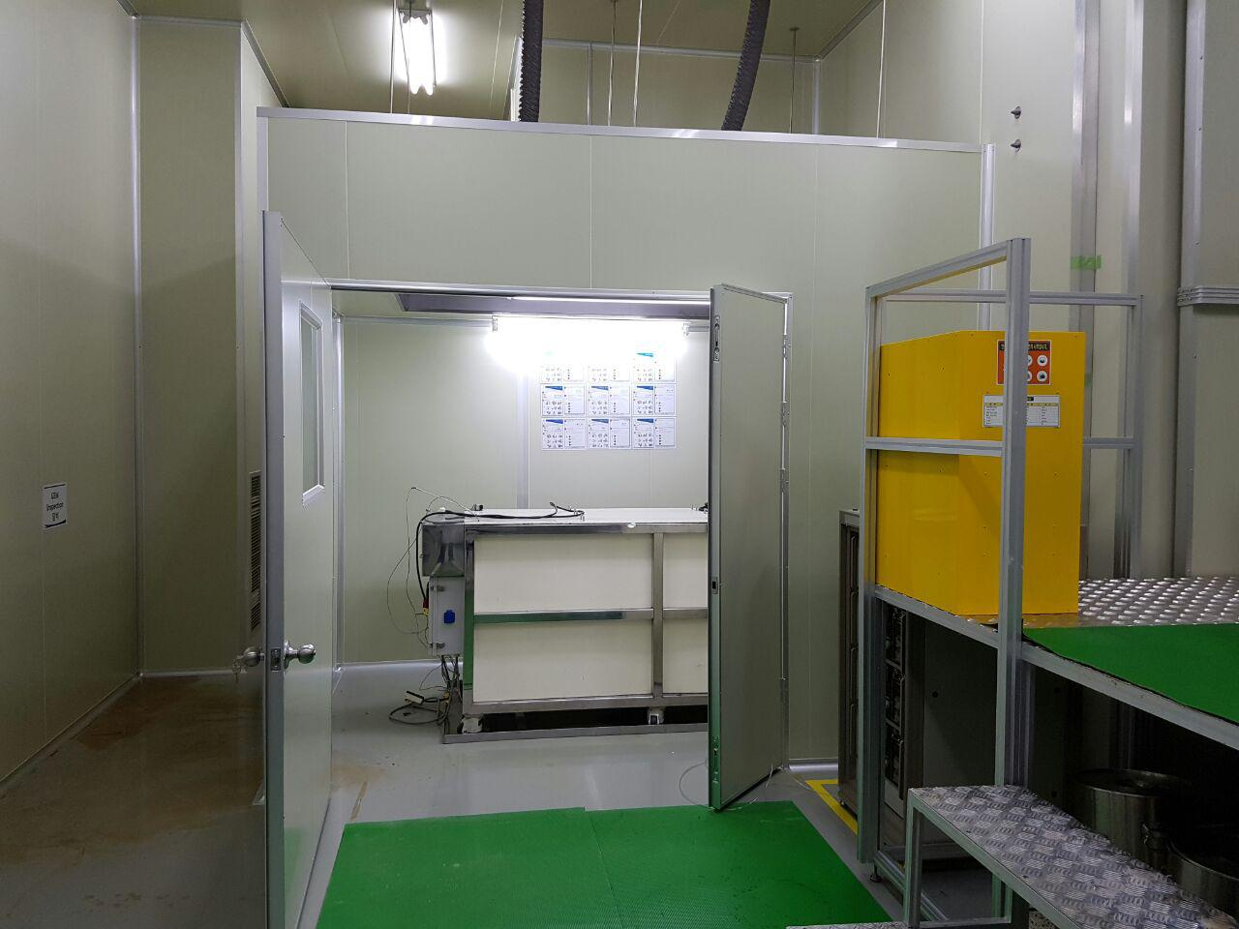
Semi-automatic PI etching machine
For large size GEM
Laminate & Exposure / DFR Develop & Cu Etch / GEM Room / Analysis Room
Notes:
박인규 설명)
이미 구축 완료된 반 자동화된 PI에칭 시설, GE11용으로 제작하였슴

Slide 28
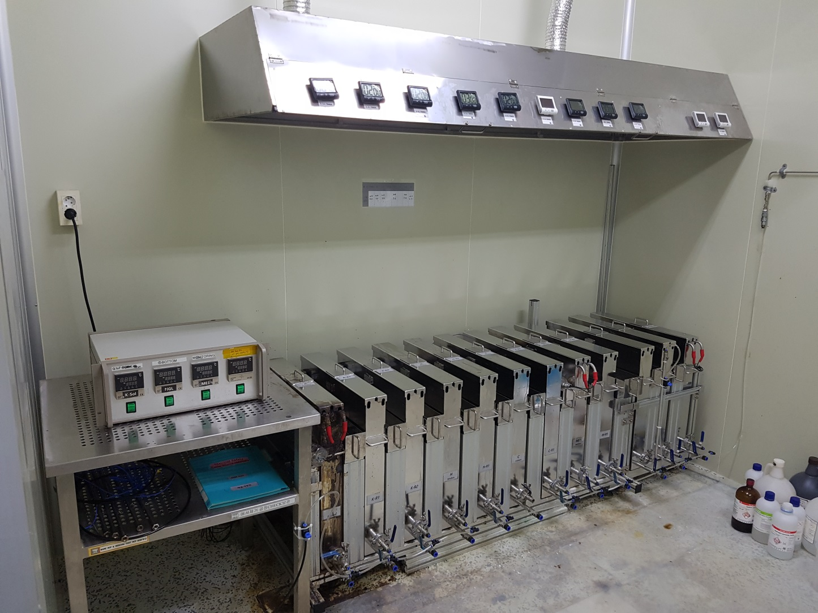
Semi-automatic PI etching machine
For small & mid size GEM
Laminate & Exposure / DFR Develop & Cu Etch / GEM Room / Analysis Room
Notes:
박인규 설명)
이미 구축 완료된 반 자동화된 PI에칭 시설, 소형, 중형사이즈 GEM호일용으로 제작되었음.

Slide 29
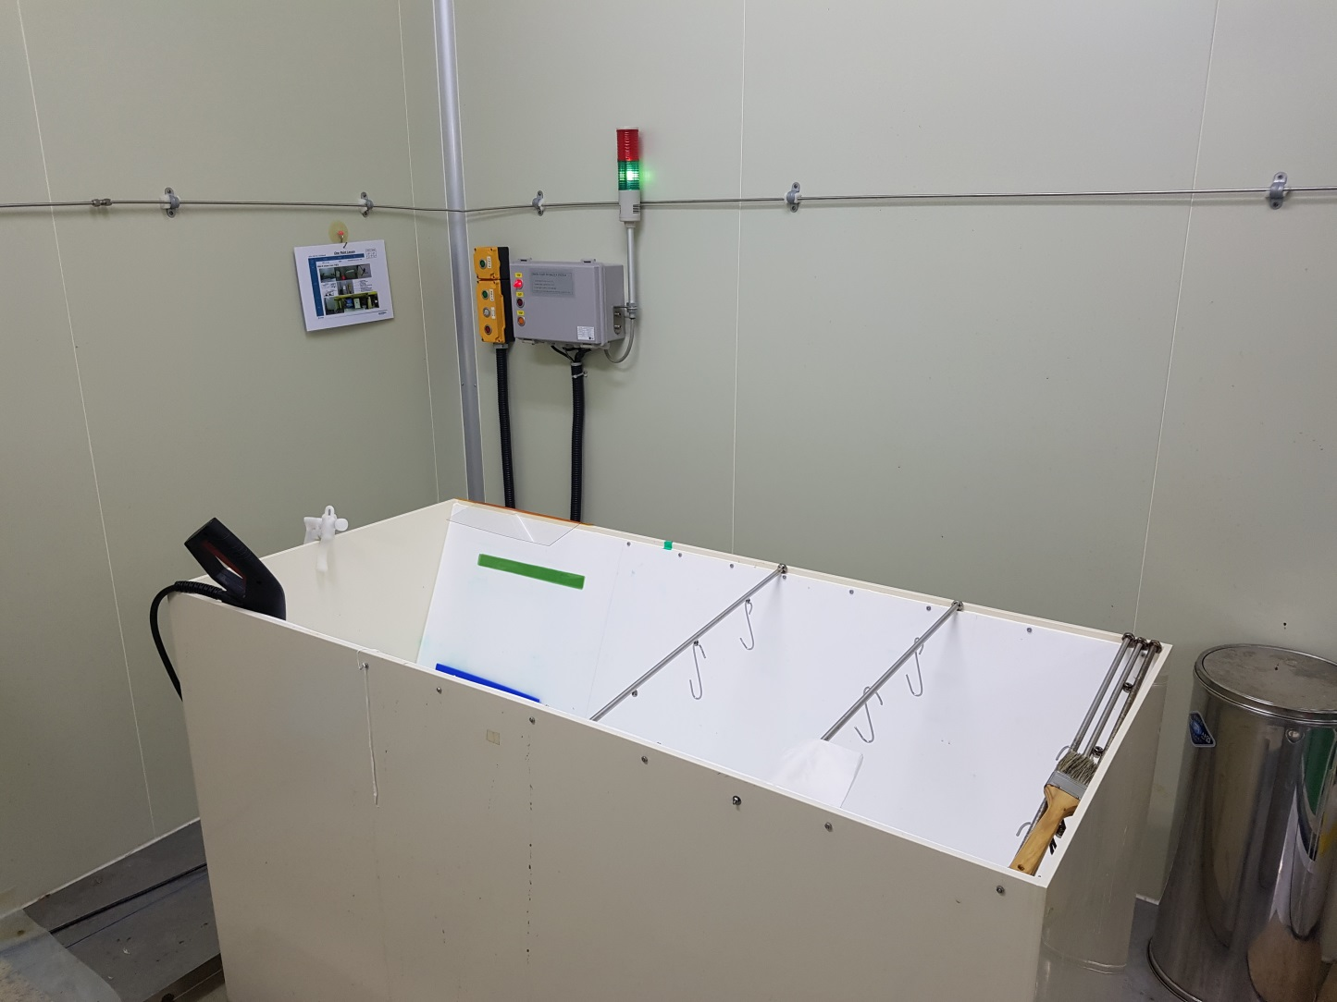
Cleaning and dryer
Laminate & Exposure / DFR Develop & Cu Etch / GEM Room / Analysis Room
Notes:
박인규 설명)
제작이 끝난 GEM호일을 건조시키는 건조대.

Slide 30
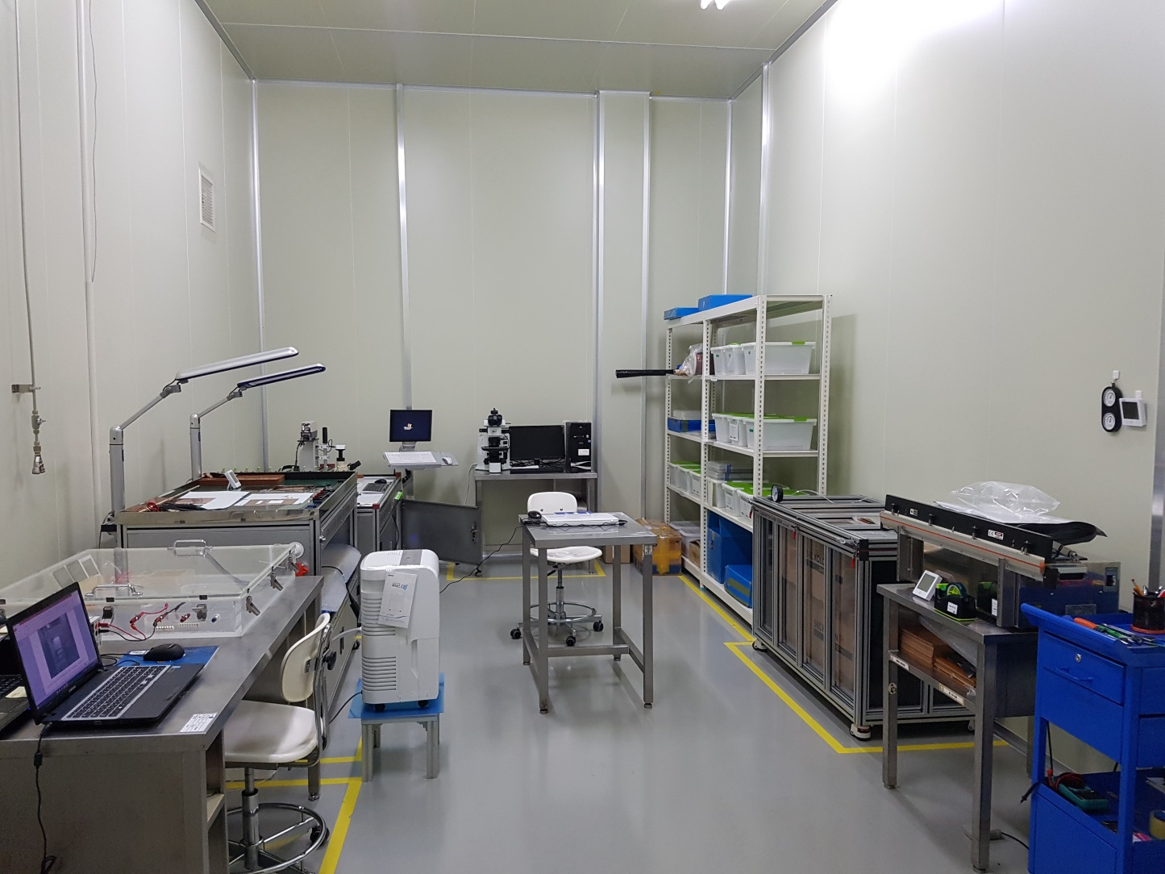
Inspection room
Laminate & Exposure / DFR Develop & Cu Etch / GEM Room / Analysis Room
Notes:
박인규 설명)
Leakage current를 측정하는 장비 (왼쪽 하단)
섹션별 Leakage 전류를 재는 장비 (왼쪽 중간)
Alignment 측정장비 (왼쪽 상단)
현미경 (중앙상단)
보관창고, 코팅기 (오른쪽)

Slide 31
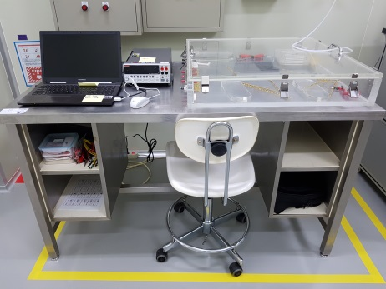
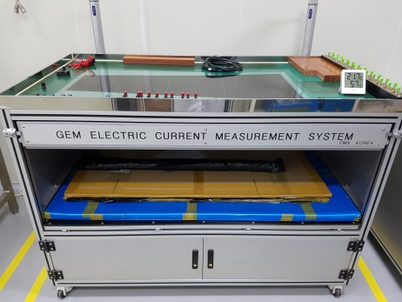
GEM Production Facilities: QC
Small size leakage current test
Large size leakage current test

Slide 32
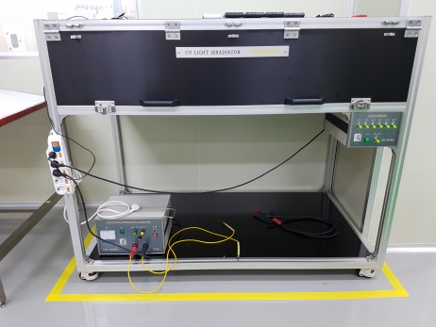
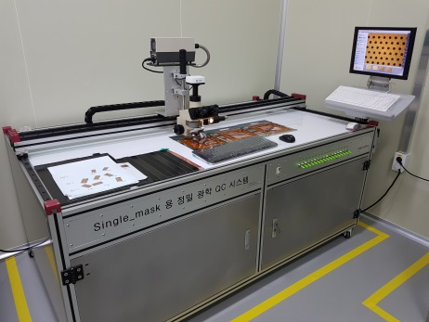
GEM Production Facilities: QC
UV light system
Optical inspection table
Page. 5

