Slide 1


Low-lying structure of neutron-rich A=73 Zn and Ga isobars
Spokepersons:
Cristina Petrone&Mihai Stanoiu
Horia Hulubei" National Institute of Physics and Nuclear Engineering, Bucharest, Romania
INTC meeting, 8th February 2017, CERN

Slide 2
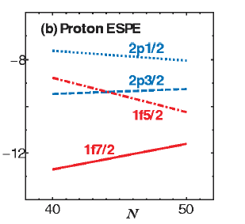
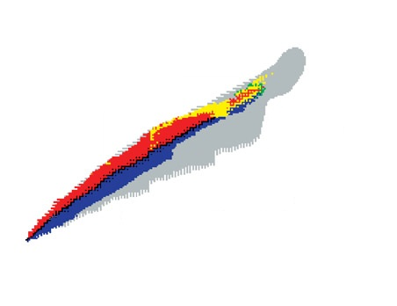
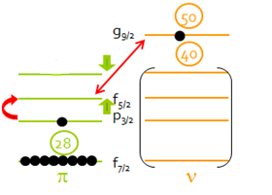
Nuclear structure of neutron-rich nuclei
Z=28 shell gap evolution
N=40 (⁶⁸Ni) and N=50 (⁷⁸Ni) magic numbers
Important role of the νg_{9/2} orbital
T. Otsuka et al., Phys. Rev. Lett. 95, 23502 (2005)
N=40
N=82
N=50
Tensor force
Z=50
Z=82
Z=28

Slide 3
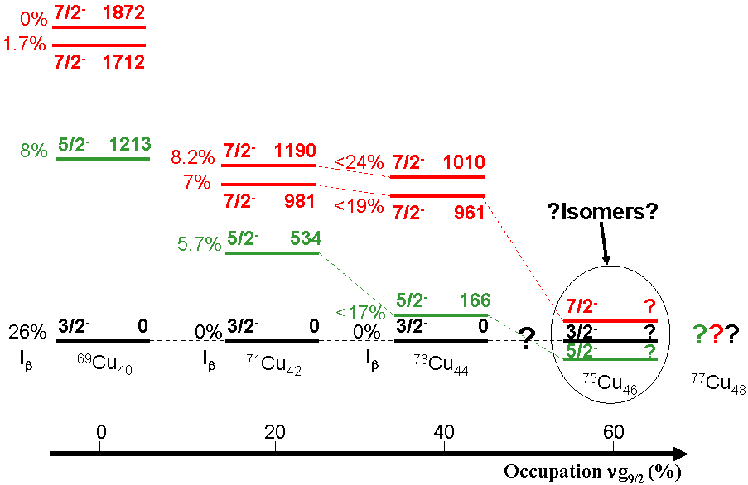
Cu versus Zn isotopic chain
N = 46 (⁷⁵Cu): π1f_{5/2} g.s. configuration
K.Flanagan et al , Phys. Rev.C80(2009)
I. Stefanescu et al, Phys. Rev.Lett 100,112502(2008)
1 π outside Z=28
gradual reduction of the 1/2─ and 5/2 ─ energy with N
1|2⁻
C. Petrone et al., Phys. Rev. C 94, 024319 (2016)
2 isomeric states
1096
1|2⁻
454
1|2⁻
135
1|2⁻
X. F. Yang et al., Phys. Rev. Lett. 116, 182502 (2016)
2 π outside Z=28 (more complex structure)
N>40 normal g.s configuration: 9/2⁺

Slide 4
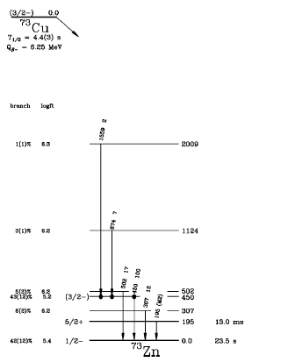
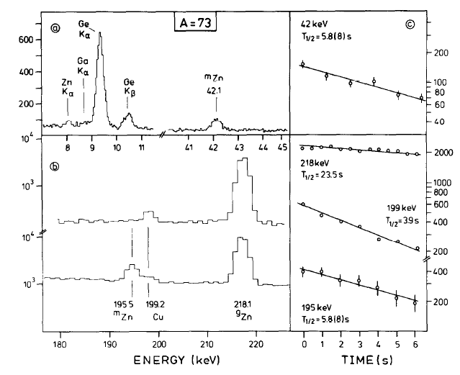
⁷³Zn: previous studies
E. Runte et al., Nucl. Phys. A 441, 237 (1985)
Multinucleon transfer (⁸²Se beam on W target)
M. Huhta et al., Phys. Rev. C 58, 6 (1998)
Fragmentation reaction (⁷⁶Ge on Be target)
T_{1/2} of 42 and 195.5 keV is 5.8(8)s
42 keV from ⁷³Ga
199keV is from β–decay of ⁷³Cu
195.5 keV with T_{1/2}=13.0(2) ms
42 and 199 keV transitions not observed

Slide 5
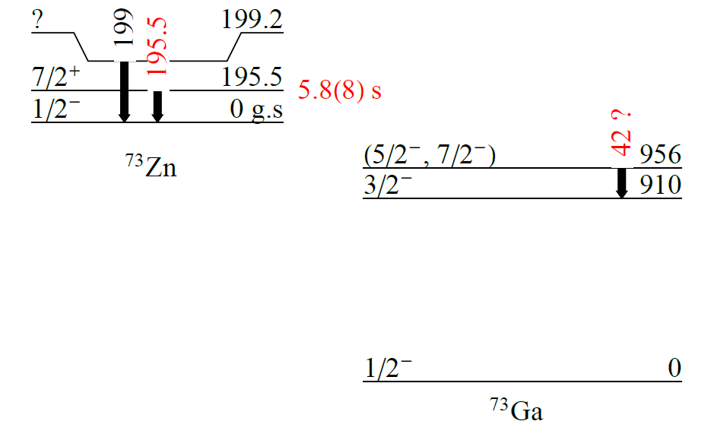
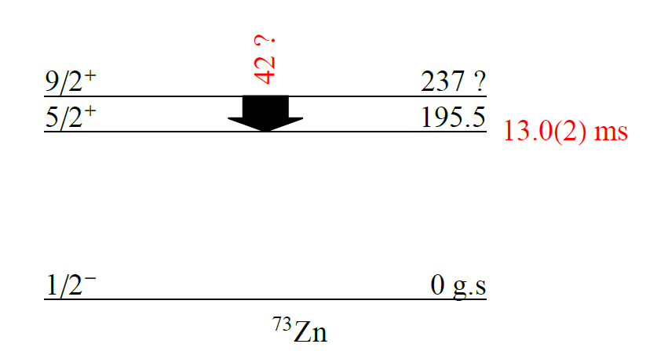
⁷³Zn&⁷³Ga possible scenarios
E. Runte et al., Nucl. Phys. A 441, 237 (1985)
E. Runte et al, Nucl. Phys. A 399, 163 (1983)
M. Huhta et al., Phys. Rev. C 58, 6 (1998)
Fragmentation reaction (⁷⁶Ge on Be target)
The 42 keV transition is from ⁷³Zn
Probably the 9/2⁺ level
199 keV level from ⁷³Zn or ⁷³Ga?

Slide 6
Low energy systematics for odd-A N=43 isotones
5/2─
5/2⁺
9.68(6)ns
5/2 ─
5/2⁺
E (MeV)
9/2⁺
17.36(5)s
78.7(1)ns
47.7(5)s
5/2⁺
9/2⁺
9/2⁺
6.4(5)us
7/2⁺
5/2 ─
9/2⁺
7/2⁺
7/2⁺
7/2⁺
50 (3)s
5/2 ─
1/2 ─
1/2 ─
1/2 ─
0.39 (5)us
1/2 ─
⁷⁵Ge
⁷⁷Se
⁷⁹Kr
⁸¹Sr
E3(7/2⁺ → 1/2⁻) transition observed for all N=43 isotones
Low energy positive parity states
Gradual reduction in energy of the 5/2⁻ state
What is the value of T_{1/2} of 5/2⁻ in ⁷³Zn?

Slide 7
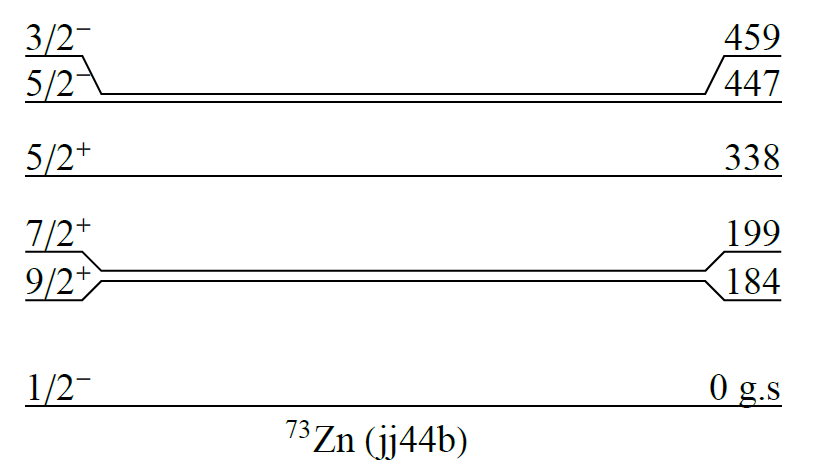
Shell model predictions
NuShell code
jj44b interaction, ⁵⁶Ni core, pf_{5/2}g_{9/2} valence space
B.A. Brown and A. Lisetskiy unpublished
T_{1/2}= 5.8 s => B(E3) = 4.6 10⁻² W.u
B_{theor} (E3, 7/2 ⁺ →1/2 ─ ) = 10⁻² W.u
Fast-timing measurement::
5/2⁻ at the energy of 477 keV
[πf_{5/2}¹υg_{9/2}³] configuration
Experimentally the 502 keV state?
B(E2, 5/2⁻→ 1/2⁻)= 4.9 W.u
T_{1/2}~0.8 ns

Slide 8
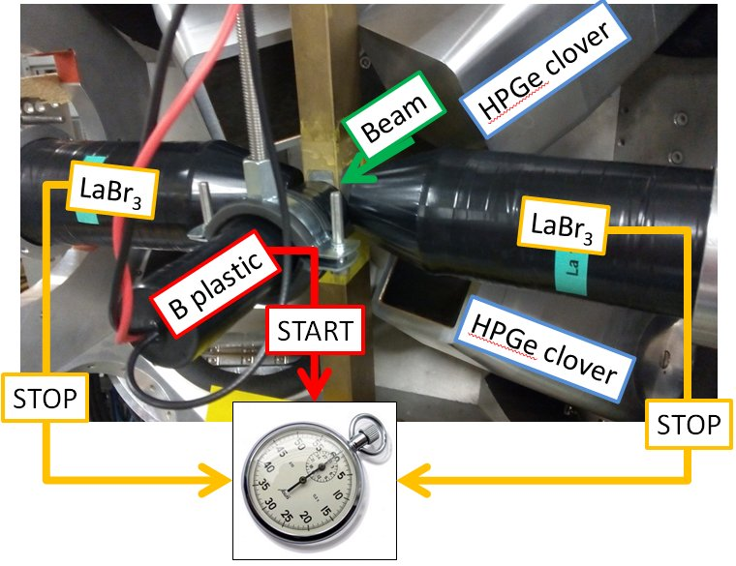
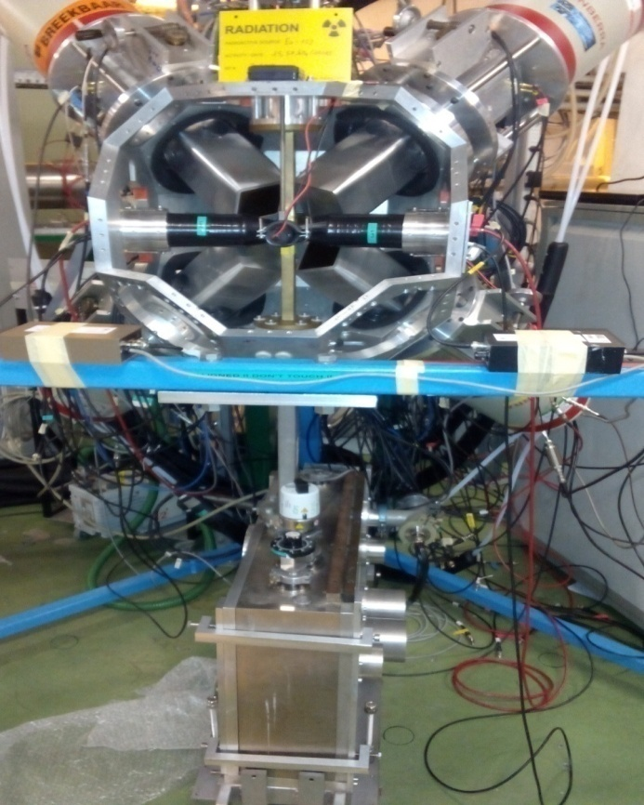
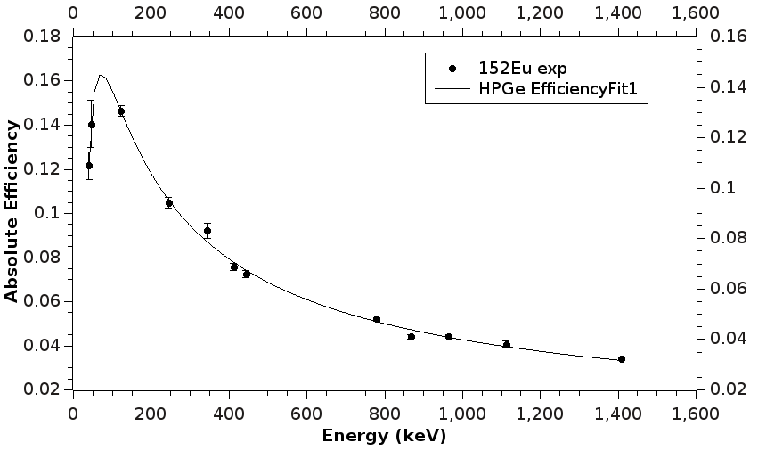
The ISOLDE Decay Station(IDS) set-up
4 HPGe clovers
1 LEPS
2 LaBr₃ scintillators. (Timing resolution ∼ 120 ps)
1 beta plastic scintillator (Eff~25%)
Tape to remove the unwanted radioactivity

Slide 9
Objectives
clarify the puzzling situation of the 199 and 42 keV transitions by studying separately the β decay of ⁷³Cu and ^{73,73m}Zn. What role plays the υ1g_{9/2} orbital in the evolution of the nuclear structure in neutron-rich Zinc isotopes?
determining the half-life of the 195.5 keV isomer of ⁷³Zn
measuring the half-life of the 5/2─ state with fast-timing technique. Important for determining the degree of collectivity of negative parity states in ⁷³Zn!
to extend the knowledge about the level scheme of ⁷³Zn and ⁷³Ga (take advantage of the unique features of IDS set-up and large production rates available at ISOLDE)

Slide 10
Expected count rates
Laser ion source (RILIS), HRS and quartz line are required to suppress the Rb and Ga contaminants
An additional LEPS detector
Lower implantation rates to avoid pile-up effects and dead time issues of DAQ
Isotope | T_{1/2}[s] | Ions implanted [ions/s] | Target | Expected count rate β-γ_{Ge}-γ_{Ge} [counts/shift] | Expected count rate β-γ_{Ge –}γ_{LaBr} [counts/shift] | Shifts
⁷³Cu | 3.9 | 5X10⁵ | UC_{x} | 1.3 x10² | 2.3 x10² | 4
^{73.73m}Zn | 23.5/5.8/ 0.018 | 5X10⁵ | UC_{x} | 2.1 x10² | - | 4
Summary of requested shifts: We request 8 shifts: 8 shifts for ⁷³Cu and ⁷³Zn and
2 shifts for in-beam calibrations for fast-timing detection system (¹³⁸Cs).

Slide 11
IDS collaboration
C. Petrone¹, M. Stanoiu¹, A. Algora², A. Andreyev³, G. Benzoni⁴, T.Berry⁵, C. Borcea¹, R. Borcea¹, S. Calinescu¹, C. Costache¹, J.M. Daugas⁶, P. Van Duppen⁷, L. M. Fraile⁸, L. Hakness-Brennan⁹, I.M. Harca¹⁰, M. Huyse⁷, A. Illana⁷, R. Lica^{1,11}, A. Negret¹, N. Marginean¹, R. Marginean¹, C. Mihai¹, R. Mihai¹, R. Page⁷, Zs. Podolyak⁵, M. Ramhane¹², F. Rotaru¹, G. Simpson¹², I. Stefan¹³ , C. Sotty¹, A. Turturica¹, N. Warr¹⁴, H. De Witte⁷
¹ "Horia Hulubei" National Institute of Physics and Nuclear Engineering, Bucharest, Romania
² Instituto de Fisica Corpuscular, Univ. Valencia, Correos 22085, E-46071 Valencia, Spain
³ University of York, Dept Phys, York, United Kingdom
⁴ Dipartimento di Fisica, University of Milano, Milano, Italy and INFN, Sezione di Milano, Milano Italy
⁵ University of Surrey, Surrey, United Kingdom
⁶ CEA,DAM, DIF, F-91297 Arpajon, France
⁷ KU Leuven, Instituut voor Kern- en Stralingsfysica, Celestijnenlaan 200D, B-3001 Leuven, Belgium
⁸ Grupo de Fisica Nuclear, Universidad Complutense, CEI Moncloa, Madrid, Spain
⁹ Department of Physics, Oliver Lodge Laboratory, University of Liverpool, Liverpool, United Kingdom
¹⁰ Flerov Laboratory of Nuclear Reactions, JINR, Dubna, Rusia
¹¹ CERN, Geneva, Switzerland
¹² LPSC, Université Grenoble-Alpes, CNRS/IN2P3, Institut Polytehnique de Grenoble, 38026 Grenoble Cedex, France.
¹³ IPNOrsay, UMR8608, IN2P3-CNRS, Universite Paris Sud 11,91406 Orsay, France
¹⁴Institut für Kernphysik, Universität zu Köln, Köln, Germany

Slide 12
Thank you!

Slide 13
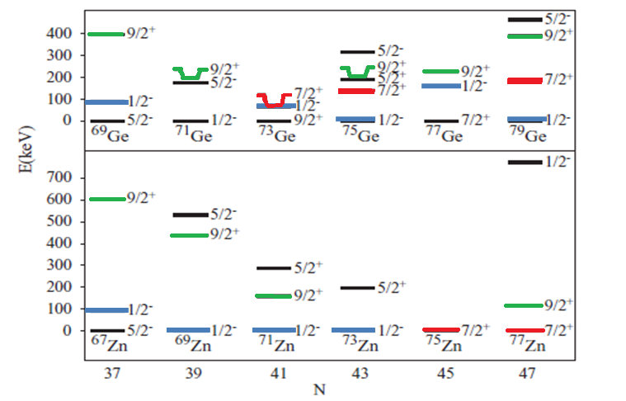
Low energy systematics for neutron-rich Zn and Ge isotopes

Slide 14
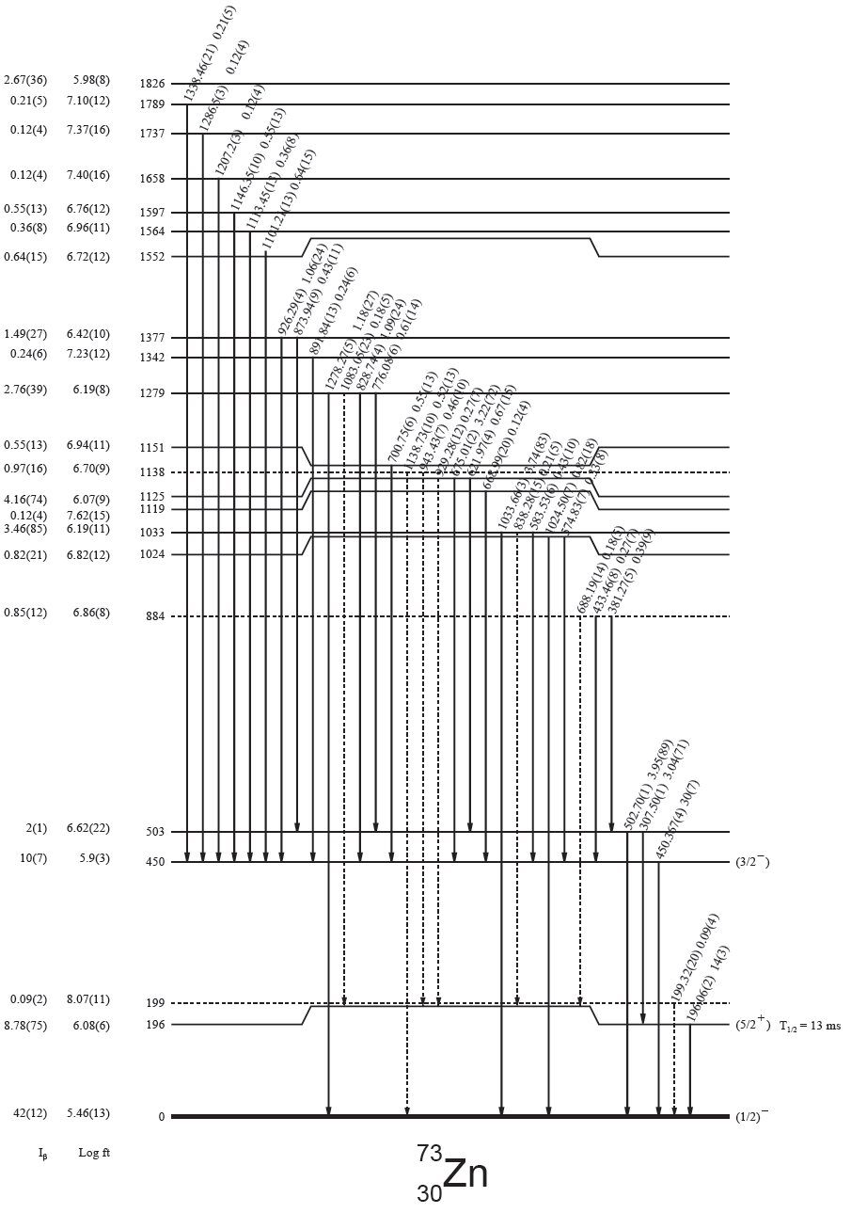
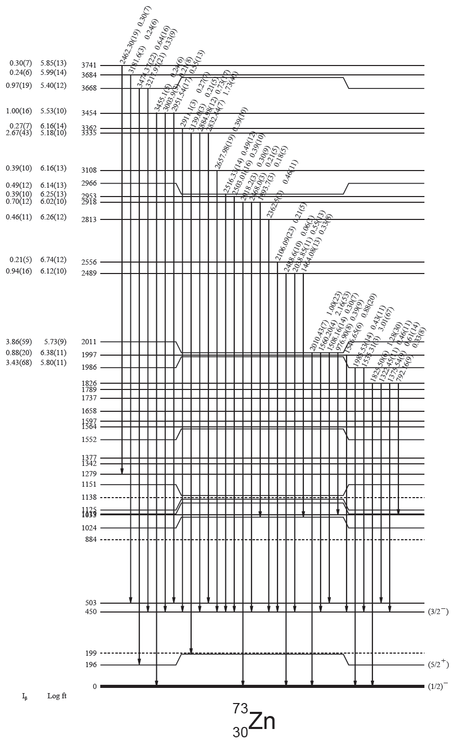
T. Faul, PhD Thesis, Louis Pasteur University, Strasbourg, 2007 (data from 1998)

Slide 15
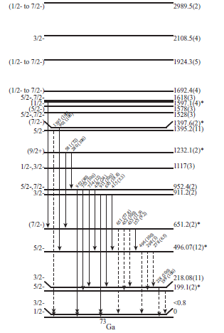
What is known about ⁷³Ga level scheme?
J. Diriken et al., Phys. Rev. C 82, 064309 (2010)
B. Cheal et al., Phys. Rev. Lett. 104, 252502 (2010)
I. Stefanescu et al., Phys. Rev. C 79, 064302 (2010)
G. Rotbard et al., Phys. Rev. C 21, 2293 (1980)

