Slide 1



Measurement of the ²³⁰Th(n,f) reaction cross-section at EAR-1 and EAR-2 of the CERN n_TOF facility
R. Vlastou¹, M. Diakaki^{1,2}, A. Tsinganis², M. Kokkoris¹, A. Stamatopoulos¹, J. Andrzejewski³, E. Berthoumieux⁴, N. Colonna⁵, E. Dupont⁴, J. Heyse⁶, N. Patronis⁷, P. Schillebeeckx⁶, L. Tassan-Got², E. Chiaveri²
and the n_TOF Collaboration
¹ National Technical University of Athens (NTUA), Greece
² European Organisation for Nuclear Research (CERN), Geneva, Switzerland
³ Uniwersytet Lódzki, Lodz, Poland
⁴ CEA Saclay, Irfu, Gif-sur-Yvette, France
⁵ Istituto Nazionale di Fisica Nucleare (INFN), Bari, Italy
⁶ European Commission JRC, Institute for Reference Materials and Measurements, Geel, Belgium
⁷ University of Ioannina, Greece

Slide 2
Outline
Motivation:
nuclear technology applications
fundamental research of the fission process
Status of data
Proposed experiment
Summary
Measurement of the ²³⁰Th(n,f) reaction cross-section at EAR-1 and EAR-2 of the CERN n_TOF facility
55th INTC Meeting, CERN, February 2017

Slide 3
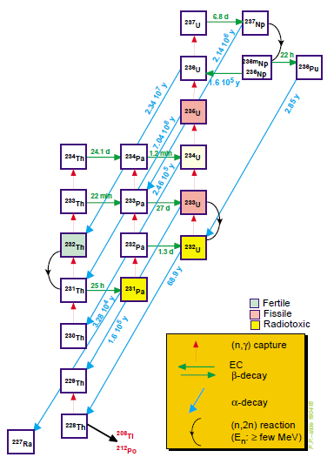
Motivation (I)
Nuclear technology applications:
Important for the proposed Th-U fuel cycle
(advantages: radioactive waste management,
non-proliferation).
All neutron induced reactions on Th isotopes
are needed with good accuracy
(For neutron energies: thermal to MeV)
Measurement of the ²³⁰Th(n,f) reaction cross-section at EAR-1 and EAR-2 of the CERN n_TOF facility
55th INTC Meeting, CERN, February 2017
Notes:
ROSA, ejhghsh
th230 mporei na yparxei mesa sto kaysmo apo thn arxh alla kai na paraxthei mesa ston antidrasthra me (n,xn) reactions gia fast reactors

Slide 4
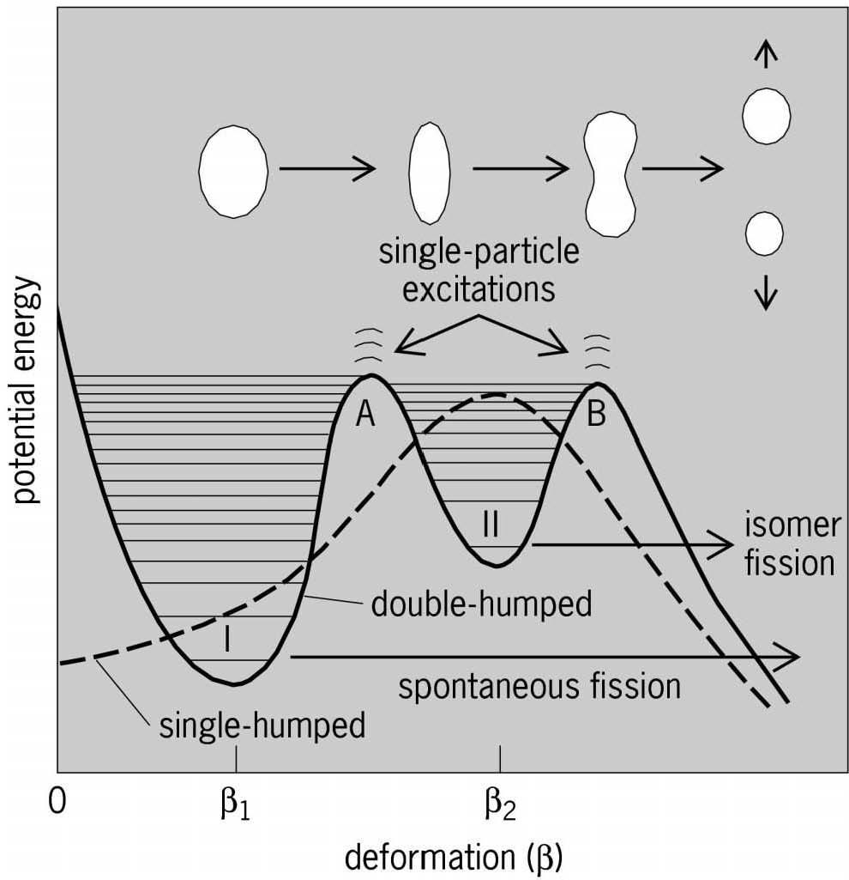
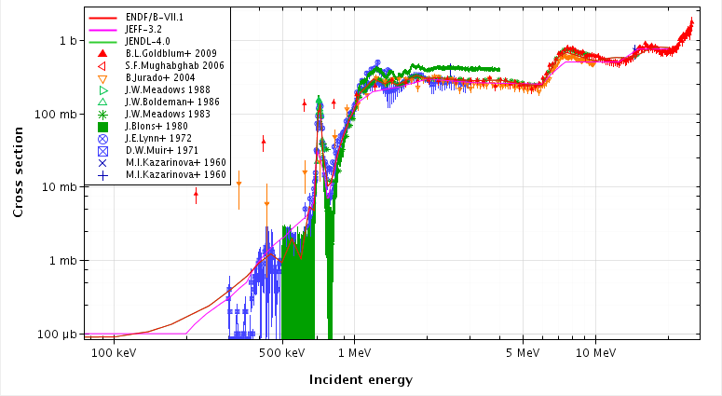
Motivation (II)
Study cross section close to fission barrier:
structural behavior
=> understanding of fission barrier structure
(barrier shape + states in wells)
fission
Th anomaly:
Subject of extensive theoretical
investigation:
Vibrational states
(bandheads of rotational bands) in:
Second well (James et al.).
Third well (Boldeman et al.).
Phenomenological barriers
from rearrangement of states
during fission - Hybrid model (Mirea et al).
²³⁰Th fission at
barrier energies
Need for high accuracy + energy resolution
data in order to test the models
Measurement of the ²³⁰Th(n,f) reaction cross-section at EAR-1 and EAR-2 of the CERN n_TOF facility
55th INTC Meeting, CERN, February 2017
Notes:
pronounced

Slide 5
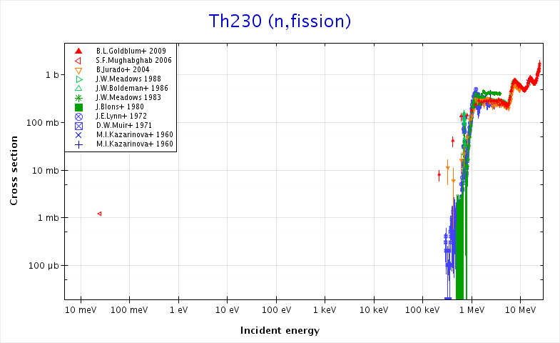
Status of data (I)
Very scarce + discrepant data (Very rare isotope, very low cross section)
No data below threshold (only one point at thermal)
Measurement of the ²³⁰Th(n,f) reaction cross-section at EAR-1 and EAR-2 of the CERN n_TOF facility
55th INTC Meeting, CERN, February 2017

Slide 6
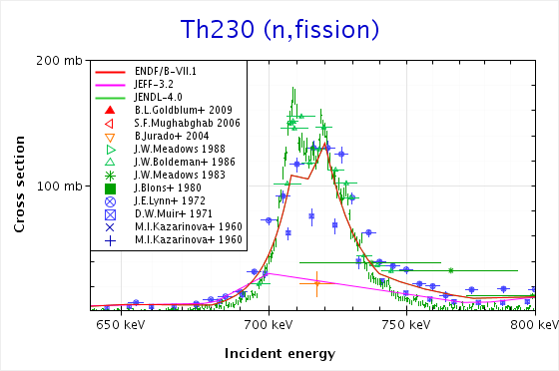
Status of data (II)
Few datasets at and above the fission threshold up to 25 MeV (surrogate/indirect measurements, many discrepancies)
Measurement of the ²³⁰Th(n,f) reaction cross-section at EAR-1 and EAR-2 of the CERN n_TOF facility
55th INTC Meeting, CERN, February 2017
Notes:
goldblum: surrogate reaction: (3He,3He') and (3He,α) reactions on targets of 232Th and 236U
meadows: direct: p-Li and d-d (0.7-9MeV) / d on t (1988)
blons: indirect 230Th(d,pf) measurement at Saclay
lynn: direct measurement 7Li(p,n)
muir: Underground nuclear explosion as pulsed neutron source. (Veeser.pdf)

Slide 7
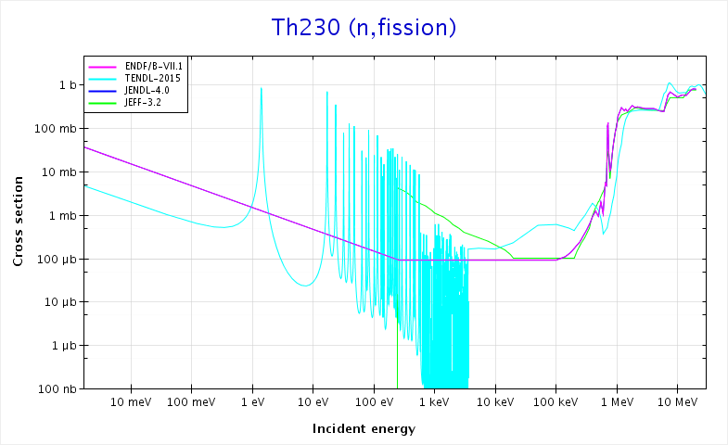
Status of evaluated data
Measurement of the ²³⁰Th(n,f) reaction cross-section at EAR-1 and EAR-2 of the CERN n_TOF facility
55th INTC Meeting, CERN, February 2017

Slide 8
Proposed measurement
Measurements are proposed to be performed at n_TOF:
EAR-1: high statistics data + excellent energy resolution mainly at and above the fission threshold.
EAR-2 reasonable statistics + good resolution in the resonance and sub-threshold region.
The overlapping data from both areas (mainly from the threshold region to higher energies): validation of the cross section results.
Reference reactions: ²³⁵U(n,f), ²³⁸U(n,f) and ¹⁰B(n,α).
Difficulties:
high alpha background (natural ²³⁰Th radioactivity).
minimization of activity / target =>minimum mass per target
low ²³⁰Th(n,f) cross section
maximization of instantaneous neutron fluence => big collimators
maximization of total mass => stack of many ²³⁰Th targets
Measurement of the ²³⁰Th(n,f) reaction cross-section at EAR-1 and EAR-2 of the CERN n_TOF facility
55th INTC Meeting, CERN, February 2017
Notes:
difficulty to be faced for both areas

Slide 9
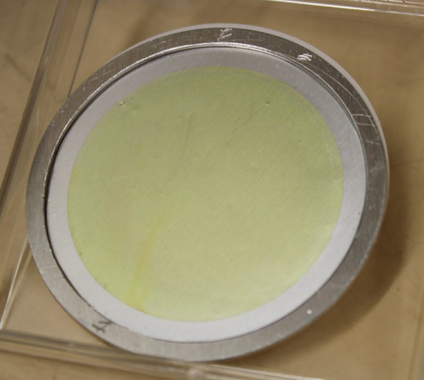
Experimental setup (I)
Targets: Joint Research Centre – Geel, Belgium
preliminary agreement with IRMM already exists, to be made official upon approval of this
proposal.
²³⁰Th targets:
material available.
Electrodeposition in the form of thorium dioxide (ThO₂) on 25 μm Al backing.
Low mass/activity per sample, large surface
Impurity: ²³²Th (8.46%): contribution very small and easily subtracted (one hyperpure target for cross check).
Reference targets: ²³⁵U, ²³⁸U, ¹⁰B
(same geometry + backing characteristics).
Courtesy: J. Heyse
Isotope | Purity [%] | Thickness [μg/cm²] | Diameter [cm] | Sample Mass [mg] | Sample Activity [MBq] | No. of samples | Total Mass [mg] | Total Activity [MBq]
²³⁰Th | 91.54 | 100 | 8.0 | 5.0 | 3.8 | 6 | 30.0 | 23
Measurement of the ²³⁰Th(n,f) reaction cross-section at EAR-1 and EAR-2 of the CERN n_TOF facility
55th INTC Meeting, CERN, February 2017
Notes:
total activity is easy to handle????
a-activity

Slide 10
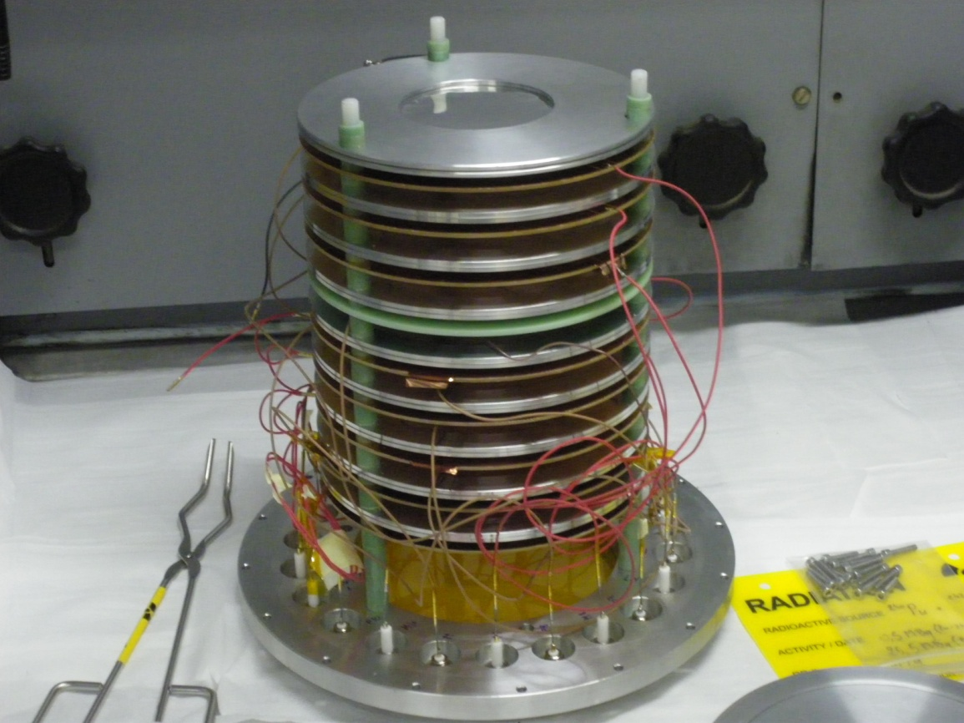
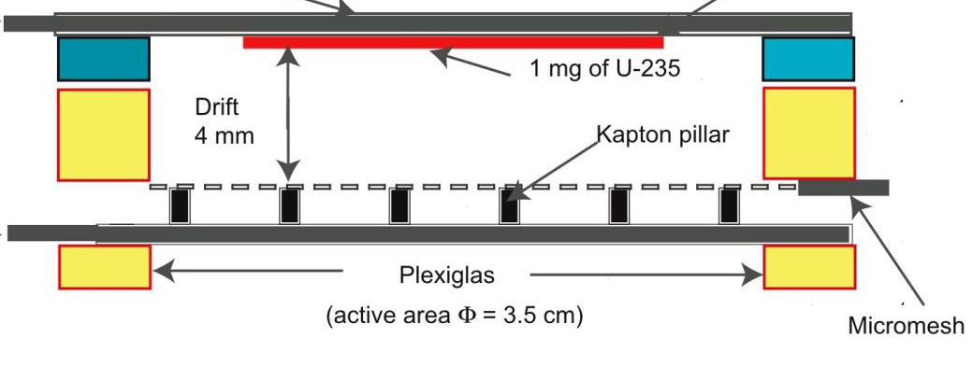
Experimental setup (II)
Detection system: Micromegas microbulk detectors
(already successfully used at n_TOF for fission (²³⁷Np,²⁴²Pu, ²⁴⁰Pu))
FF
existing chamber
up to 10 actinide
targets measured
simultaneously
target
FF
tare
“amplification region”
Electronics: existing preamplifiers, some modifications envisaged based on previous experience.
Acquisition: standard n_TOF Data Acquisition System based on flash-ADCs (12- or 14-bit). Analysis routines already developed.
Measurement of the ²³⁰Th(n,f) reaction cross-section at EAR-1 and EAR-2 of the CERN n_TOF facility
55th INTC Meeting, CERN, February 2017

Slide 11
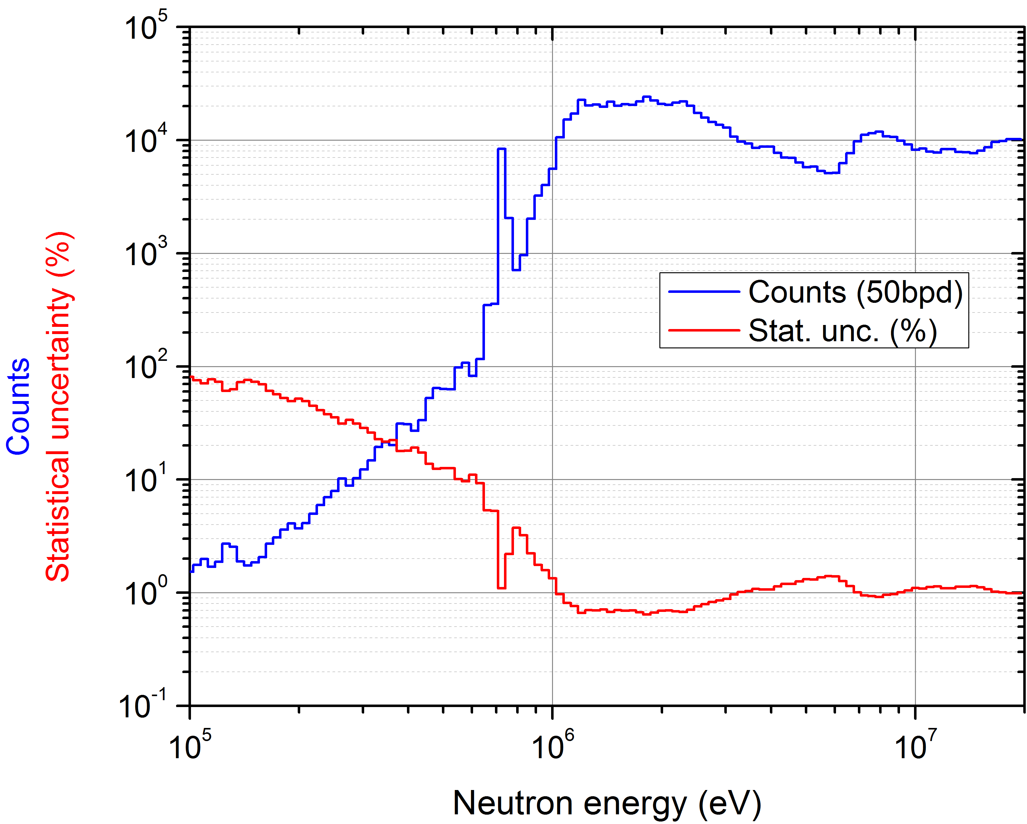
Expected count rates – beam request
EAR-1:
large (“fission”) collimator (8 cm diameter)
3x10¹⁸ protons on target
High statistics and resolution cross
section data > 600 keV
(investigation of resonant structure
at threshold + data up to high
energies)
Measurement of the ²³⁰Th(n,f) reaction cross-section at EAR-1 and EAR-2 of the CERN n_TOF facility
55th INTC Meeting, CERN, February 2017

Slide 12
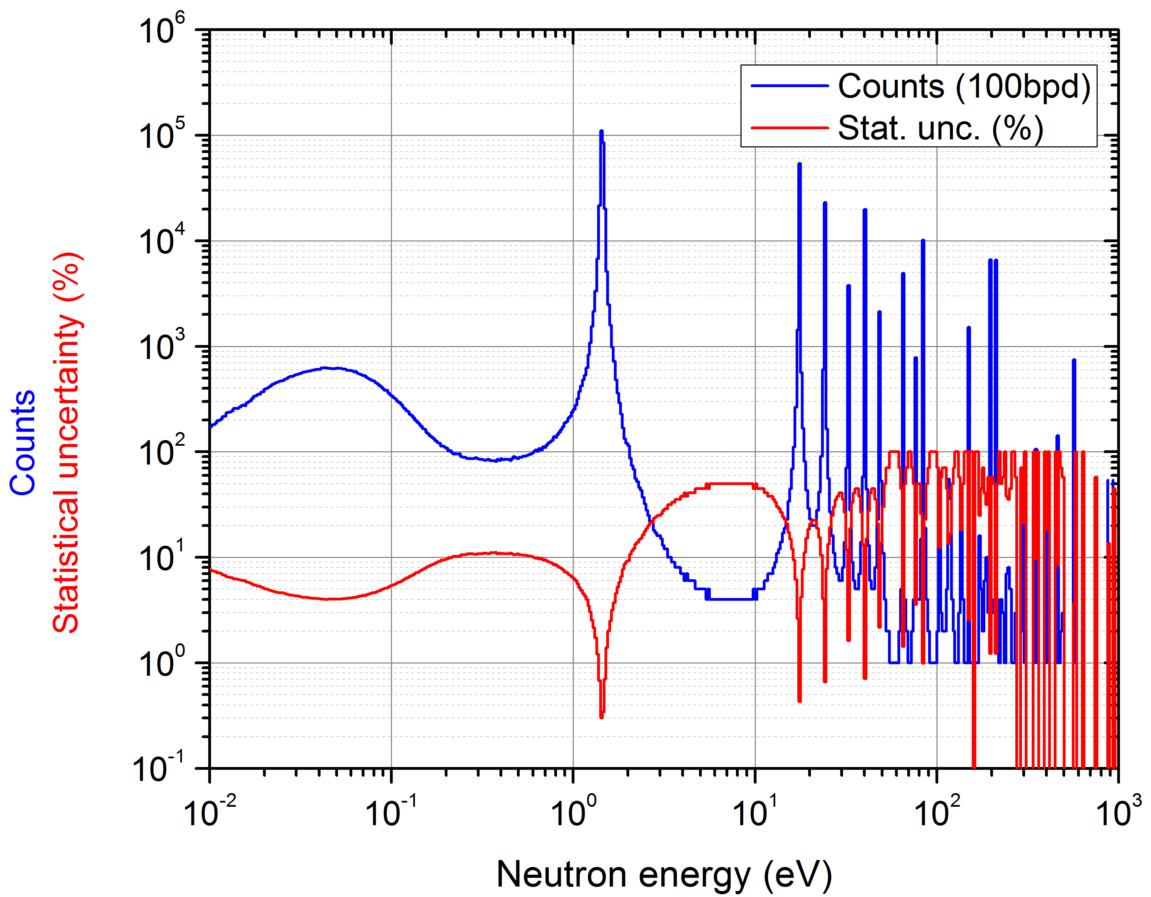
Expected count rates – beam request
EAR-2:
large (“fission”) collimator (6 cm diameter)
calculations based on TENDL-2015
3x10¹⁸ protons on target
Reasonable statistics and resolution
from thermal to subthreshold region
(no data exist so far!)
Measurement of the ²³⁰Th(n,f) reaction cross-section at EAR-1 and EAR-2 of the CERN n_TOF facility
55th INTC Meeting, CERN, February 2017

Slide 13
Summary
²³⁰Th(n,f) cross section measurement: Important for fundamental research on the fission process / nuclear reactor technology.
The availability of the very rare isotope ²³⁰Th at JRC-Geel, provides the opportunity to perform high-quality direct measurement at EAR-1 and EAR-2 exploiting their respective features: The first complete high-accuracy dataset from thermal to tens of MeV.
Measurement of the ²³⁰Th(n,f) reaction cross-section at EAR-1 and EAR-2 of the CERN n_TOF facility
55th INTC Meeting, CERN, February 2017

Slide 14
EXTRA SLIDES

Slide 15
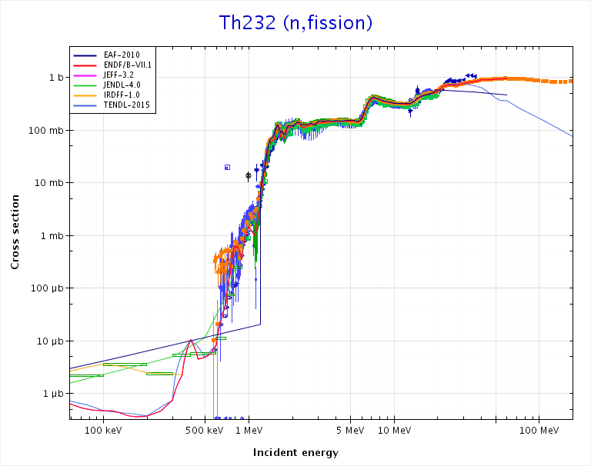
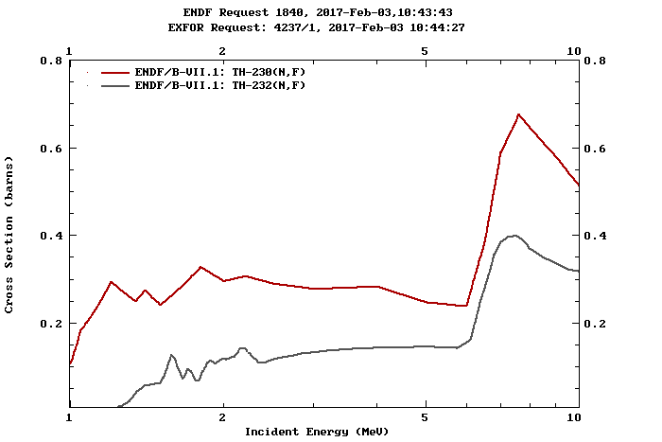
²³²Th(n,f) cross section

Slide 16
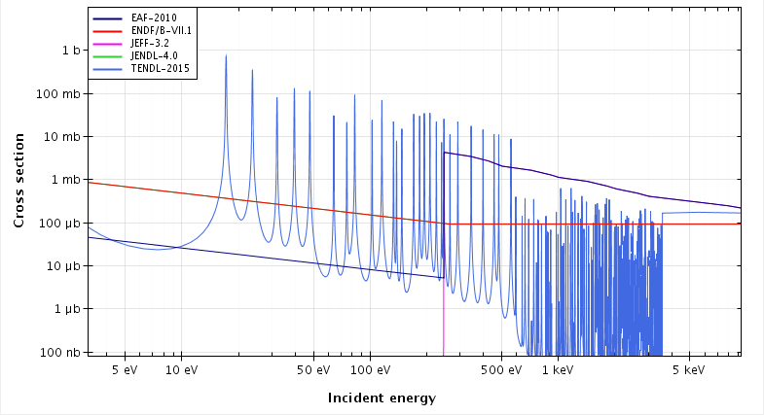
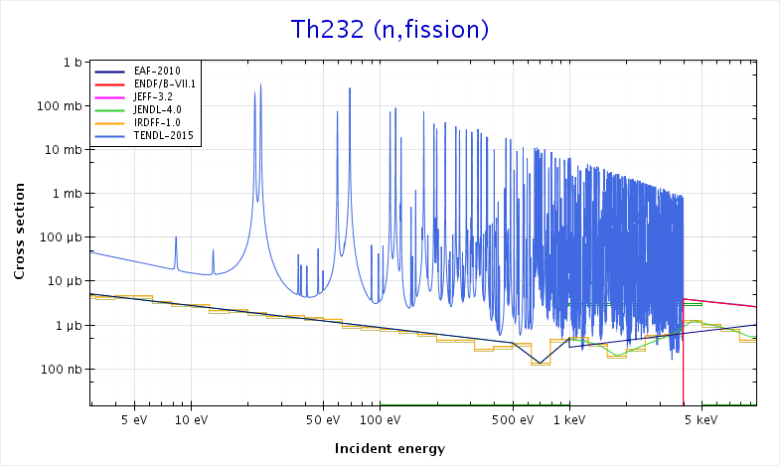
²³⁰⁻²³²Th(n,f) cross section at resonances
²³⁰Th(n,f)
T
²³²Th(n,f)

Slide 17
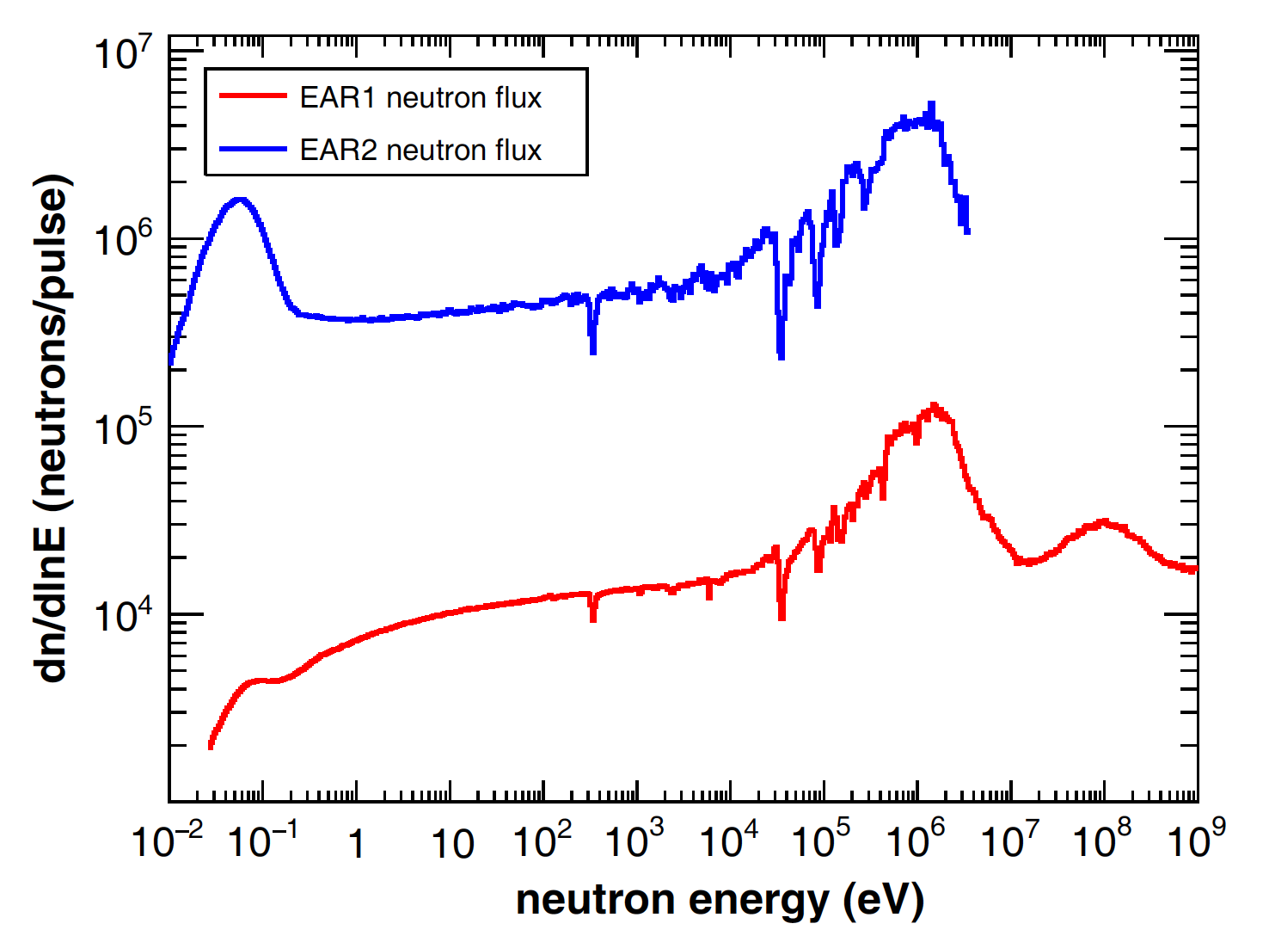
n_TOF neutron flux
small collimators
EAR1-185m,
FWHM = 18mm
EAR2-20m,
FWHM = 21mm

Slide 18
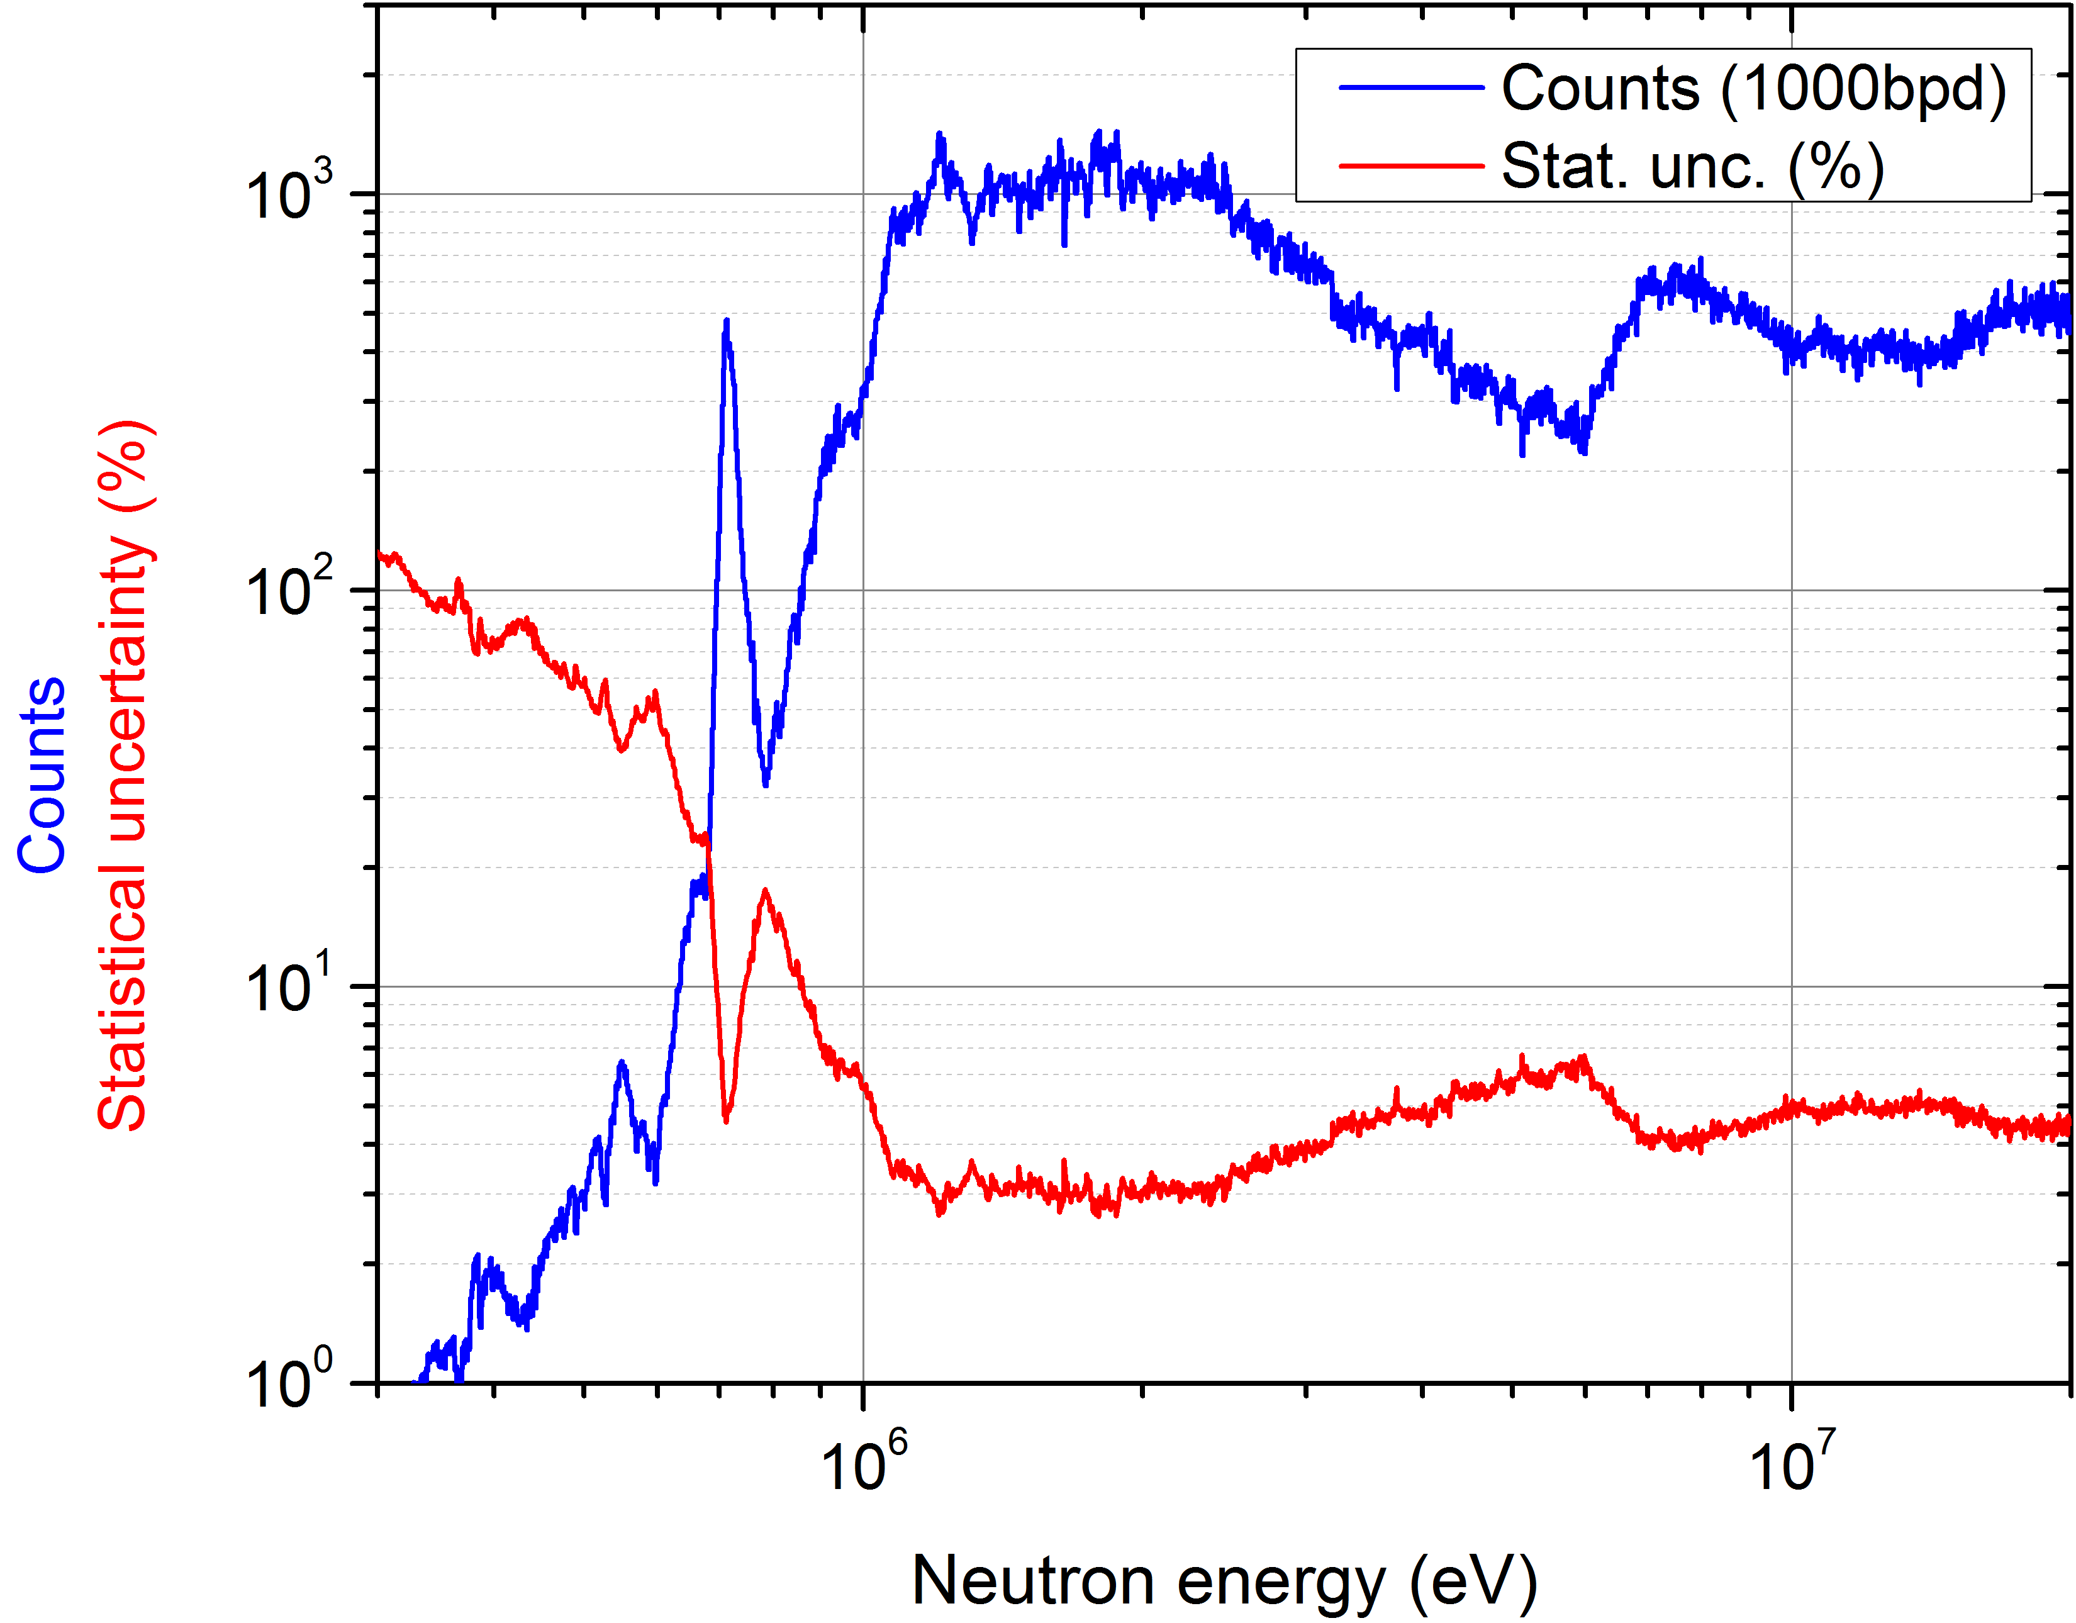
Expected count rates – beam request
EAR-1:
large (“fission”) collimator (8 cm diameter)
3x10¹⁸ protons on target

