Slide 1

Nuclear-chemical synthesis of iron compounds and their Mössbauer identification
Proposal to the ISOLDE and Neutron Time-of-Flight Committee
H. P. Gunnlaugsson, S. K. Dedushenko, L. Hemmingsen et al.,
Notes:
10:19

Slide 2
Outline
Introduction about ⁵⁷Mn (T_{½} = 1.5 min.) → ⁵⁷Fe
Chemistry with ⁵⁷Mn
Physics/chemistry that can be addressed here
Mössbauer collaboration at ISOLDE/CERN
Beam request

Slide 3
⁵⁷Mn (T_{½} = 1.5 min.) and ⁵⁷Fe eMS
Beam developed in 1996-1997: ~3·10⁸ s⁻¹
Used for eMS in many experiments: IS-359, IS-426, IS-443, IS-501, IS-576, IS-578, I-161, IS-611, IS-612 & IS-630
Ion-implantation
Drive
Sample
Charge state
Symmetry
Magnetism
Binding prop.
....
⁵⁷Mn (1.5 min)
Resonance
detector
β –
^{57M}Fe (100 ns)
14.4 keV
ΔE = 10⁻⁹ eV
⁵⁷Fe
⁵⁷Fe

Slide 4
Ion-implantation
Creates amorphous zones/regions
  Anneal (sometimes) at low temperatures
  Cases which cannot (easily) be studied with ion-implantation
Point defects
  Study of interactions of Fe/Mn atoms with point defects
V’s
I’s

Slide 5
Make materials with the probe
Surface physics
  Used successfully in ASPIC/VITO
  Implantation into catcher ⇒ transfer ⇒ MBE growth
  Measurements with Perturbed Angular Correlation (PAC) spectroscopy
  Dictated by the life-time of the radioactive probe
  Many fundamental papers on surface physics in the 1990’s
Biophysics
  Used successfully for different isotopes (^{111m}Cd, ¹⁹⁹Hg, ...) all with T_{½} > 30 minutes
  Implantation into ice ⇒ thawing ⇒ reactions
  Measurements with PAC

Slide 6

Chemistry and eMS with ⁵⁷Mn (1.5 min)
Implantation into thin foils on suitable (inert targets). 100 Å Mn or Zn on Cu or glass seem promising
Removal from vacuum (~5 sec)
  Addition to on-line eMS chamber available
Dissolution (Mn_{metal} → Mn_{aq}²⁺)
  ~1 M acid: instantaneous
  0.2 M acid: few seconds
Ion-implantation
On-line
measurement

Slide 7
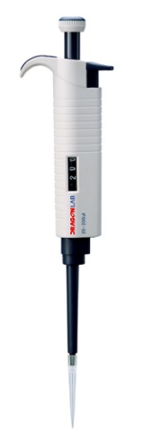


Chemistry with ⁵⁷Mn (cont)
Chemical reactions
  1-300 seconds
Transfer to a cold finger
Off-line measurements (77 K – 273 K)
Variables:
  Acid strength
  Reaction time/temperature
  Measurement temperature
  ...
Chemical reaction (1-300 s)

Slide 8
Risk involved
Radioactivity
  ~27 µSv/h at 30 cm distance
  ~50 µSv (total dose during ~5 day experiments)
  Transfer of (radiactive) acids in confined spaces
Protocols have to be made that ensure the safety at all levels of measurements
  Practice-practice-practice, ....
Risk assessment
  ~25 min wait time in case of spills (radioactive)
  Water to thin out chemical spills?
No long lived impurities (MR-TOF)
  No radioactive waste (only chemical)

Slide 9
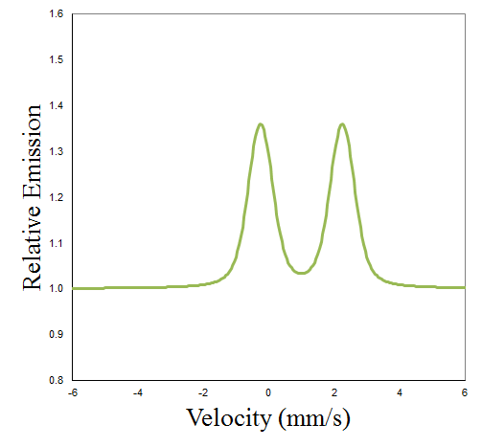
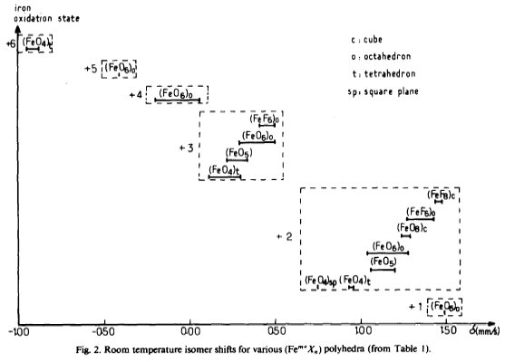
Physics & eMS
Mössbauer spectrum:
δ ∝ |ψ(0)|²
  ∝ charge/spin state of the atom
ΔE_{Q} ∝ V_{ΖΖ}
  ∼ coordination
Area ∝ f(T, θ_{D})
  ∼ binding properties
ΔE_{Q}
Area
δ

Slide 10
Nuclear chemical synthesis
FeO₂ does not exist (Fe as Fe⁴⁺)
However, MnO₂ exists
⇒
  Make ⁵⁷MnO₂
  Wait for ⁵⁷FeO₂

Slide 11
High charge states of Fe
“Natural” charge states:
  Fe: 2+, 3+, 4+, 5+, 6+
  Mn: 2+, 3+, 4+, 5+, 6+, 7+, 8+
Oxidation involving Mn⁷⁺
  2Mn²⁺ + 5NaBiO₃ + 14H⁺ = 2MnO₄⁻ + 5Na⁺ + 5Bi³⁺ + 7H₂O
Freezing and wait for the decay... (β⁻)
The 100 ns lifetime of ^{57*}Fe, should not change the local configuration i.e. Fe⁷⁺ should be measured
All supported by theoretical calculations

Slide 12
Future ...
Isotopic exchange
  ⁵⁷Mn²⁺ + ⁵⁵MnO₄⁻ = ⁵⁵Mn²⁺ + ⁵⁷MnO₄⁻
Precipitation of MnO₂
  + comparison to direct implantation into MO₂ substrates
Biological role: Mn²⁺ function as cofactors for a large variety of enzymes and are essential in detoxification of superoxide free radicals in organisms. This project may provide a new analytical method within this field of study

Slide 13
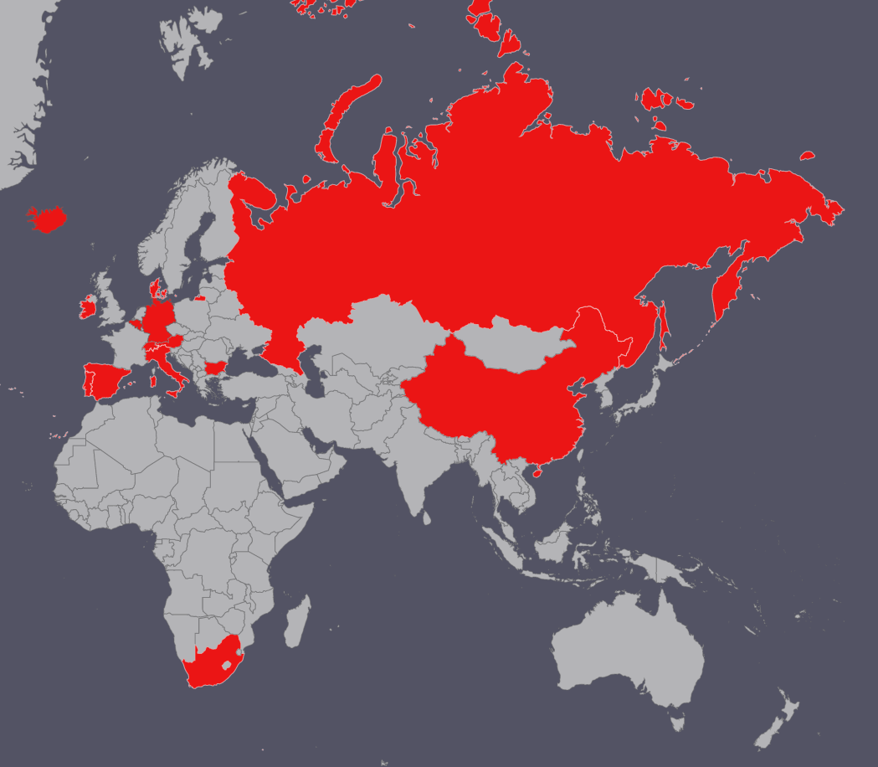
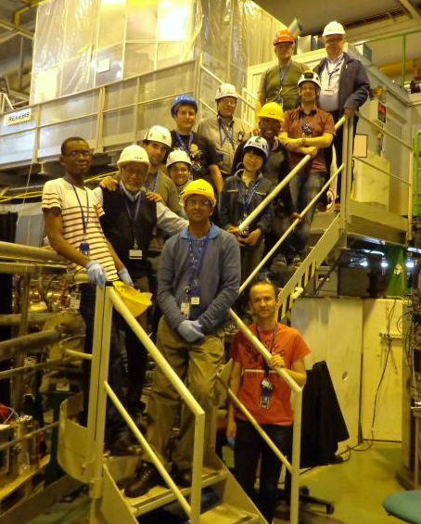
The eMS collaboration
The Mössbauer collaboration at ISOLDE/CERN, >30 active members
Involved in 6 experiments at CERN
Organize the WEMS conference series
Year | Rev. publications
2017 | (2)
2016 | 5
2015 | 2
2014 | 4
2013 | 2
2012 | 10
2016
Key people:
H. P. Gunnlaugsson, Copenhagen: eMS
S. K. Dedushenko, Moscow : Chemistry & MS
L. Hemmingsen, Copenhagen: Biophysics & PAC
S. P. A. Sauer, Copenhagen: Chemistry, simulations
J. Bendix, Copenhagen, Calculations

Slide 14
Beam request
For each reaction (See tables), one needs to:
  vary reaction time/temperature
  strength (acid)
  possibly repeat to get sufficient statistics
  Measurement temperature
  ....
Each measurement: ~10 min.
  +20% calibration
  +20% contingency
14 shifts requested for the next 3 operation years
Thanks for your attention

