Slide 1



Measurement of the ²⁴¹Am fission cross-section
A. Tsinganis¹, M.Diakaki², R. Vlastou², M. Kokkoris², N. Colonna³, J. Heyse⁴, L.Tassan-Got¹, N.Patronis⁵, A. Stamatopoulos² and the n_TOF Collaboration
1) European Organisation for Nuclear Research (CERN), Geneva, Switzerland
2) Department of Physics, National Technical University of Athens, Greece
3) Istituto Nazionale di Fisica Nucleare (INFN), Bari, Italy
4) European Commission JRC, Institute for Reference Materials and Measurements, Geel, Belgium
5) Department of Physics, University of Ioannina, Greece

Slide 2
Outline
Introduction
  Motivation and status of data
  Previous n_TOF measurement
Experimental setup
  Samples
  Detectors and electronics
Expected count rates and beam request
Summary

Slide 3
Introduction
Motivation – Status of data

Slide 4
Motivation
The isotope ²⁴¹Am is present in high-level nuclear waste
Important for different waste transmutation and recycling scenarios
²⁴¹Am(n,f) reaction included in the NEA High Priority Request List
The present experimental uncertainties do not meet the requirements set by sensitivity studies of advanced nuclear systems
 | Uncertainty
Range | Initial | Target
19.6 - 6.07 MeV | 12.7 | 5.7
6.07 - 2.23 MeV | 11.7 | 1.7
2.23 - 1.35 MeV | 9.8 | 1.4
1.35 - 0.498 MeV | 8.3 | 1.2
183 - 498 keV | 8.3 | 4.0
NEA Nuclear Data High Priority Request List, www.nea.fr/html/dbdata/hprl
OECD/NEA WPEC Subgroup 26 Final Report, www.nea.fr/html/science/wpec/volume26/volume26.pdf

Slide 5
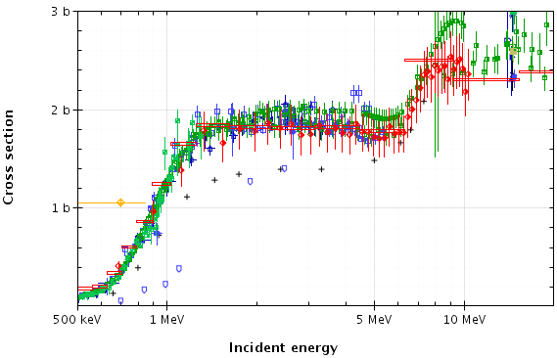
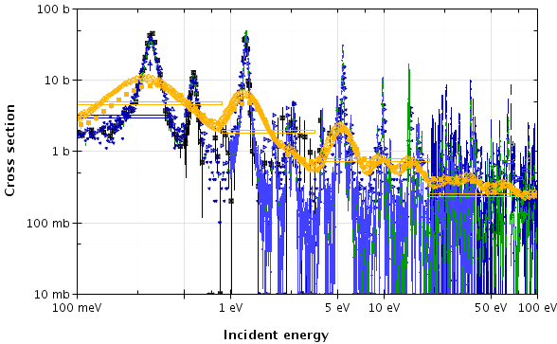
Present status of data
Measurements of ²⁴¹Am(n,f) are challenging for two main reasons:
  Relatively short half-life of 433y (127 MBq/mg, 100% α)
  Steep fission threshold with value decreasing rapidly below 1 MeV, reaching 100 mb already at 500 keV incident neutron energy
Significant discrepancies among existing data can be observed both above the fission threshold and at lower energies

Slide 6
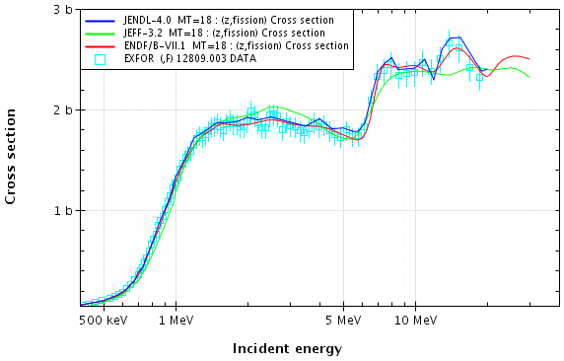
Present status of data
This situation is also reflected in the discrepancies among evaluated libraries, which mostly follow the data by Dabbs et al. (1983)

Slide 7
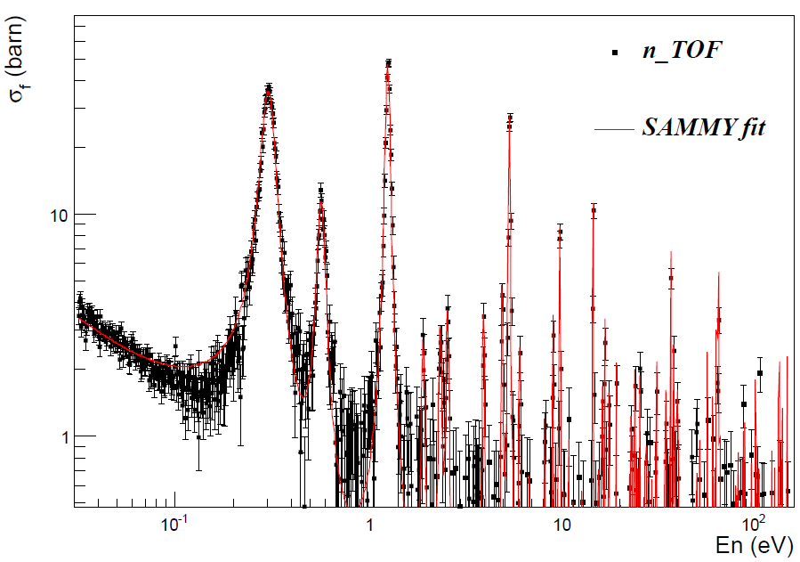
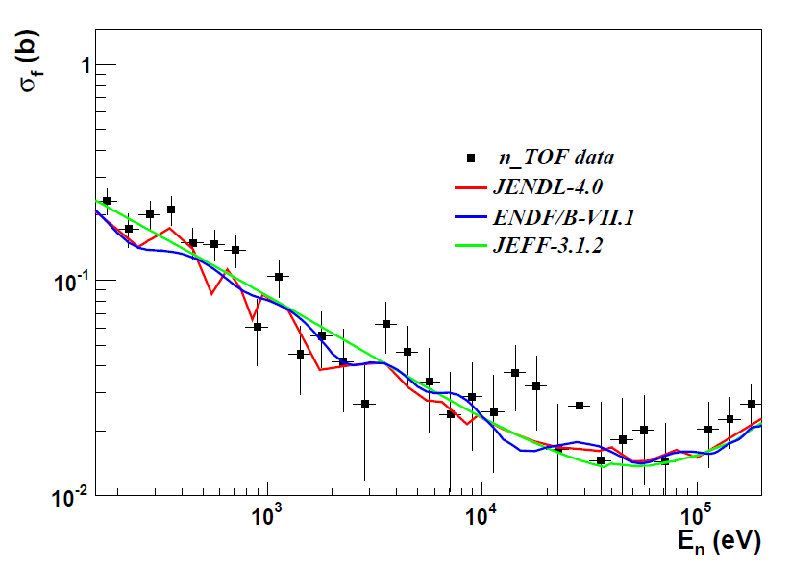
Previous n_TOF measurement
Performed in Phase-I (2001-2004) (EAR-1 with large collimator)
Total mass: 2.26mg (35MBq/sample, 8 samples)
High amplitude threshold applied to deal with the high α-activity
  Data normalized to 3rd resonance in Dabbs data
Results at low energies (e.g.):
M. Mastromarco et al.

Slide 8
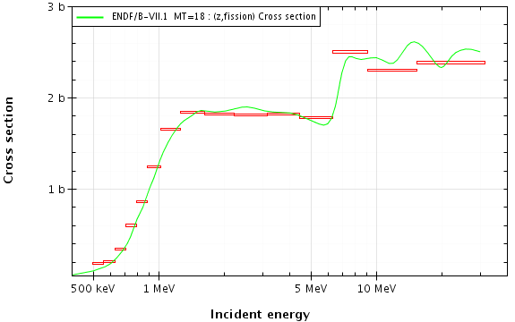
Previous n_TOF measurement
Low statistics at and above fission threshold
Variable bin width chosen to keep statistical uncertainty <2%
F. Belloni et al., Eur. Phys. J. A (2013) 49: 2, 10.1140/epja/i2013-13002-3

Slide 9
The new proposal
Perform the measurement in EAR-2
  Maximization of the flux with the large collimator
  Lower activity per sample
  Stronger background suppression
  → Higher statistics in wide energy range

Slide 10
Experimental setup
Samples – Detectors and electronics

Slide 11
Samples
To be prepared at JRC-IRMM
Proposed sample characteristics
  Low mass/activity per sample (~half of EAR-1)
  6cm diameter for large EAR-2 collimator
Total mass ~2.5 times lower than EAR-1 measurement
A further ~30% reduction of the activity could be achieved by reducing the diameter to 5cm, with small loss of flux, depending on the beam profile (to be checked)
  Exact information (e.g. ^{242m,243}Am) on impurities not yet available
Reference samples:
  ^{235,238}U, ¹⁰B
Sample characteristics
Area density (μg/cm²) | 5
Diameter (cm) | 6
Activity (MBq) | 17.9
Mass (mg) | 0.14
No. of samples | 6
Total mass (mg) | 0.85
Total activity (MBq) | 107.7

Slide 12
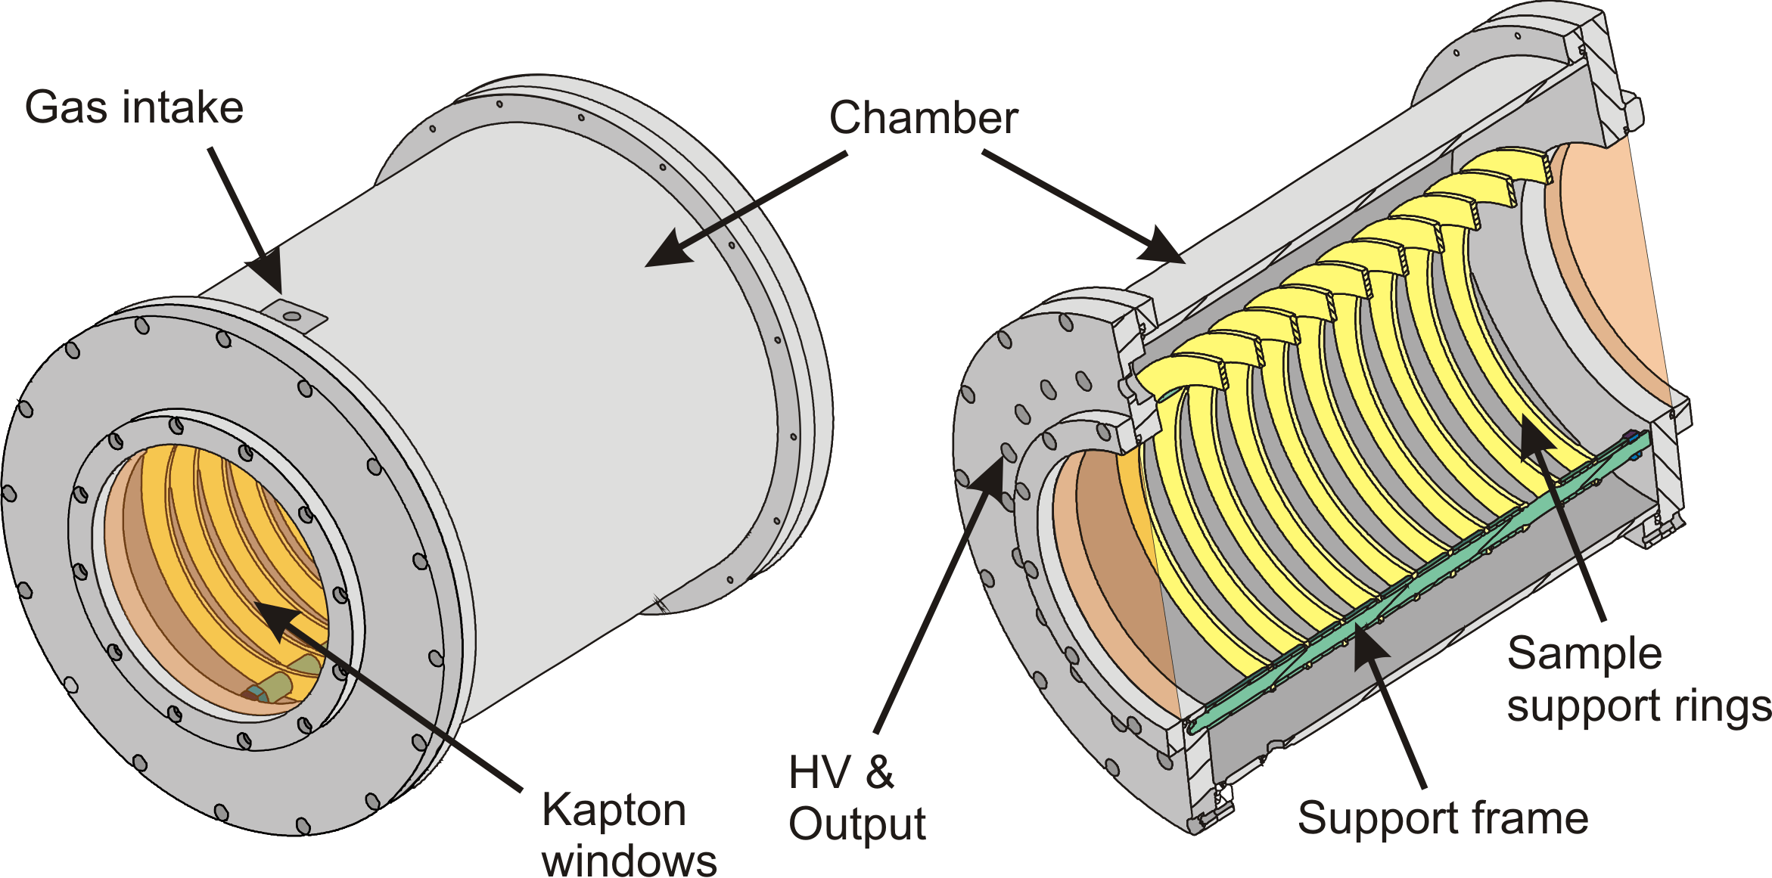
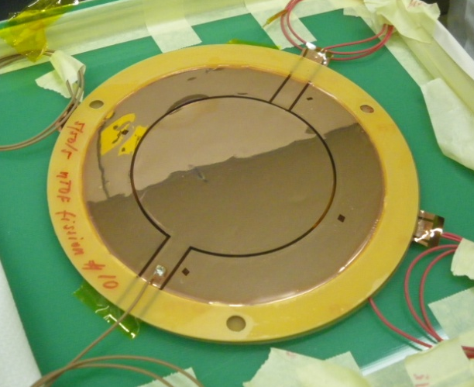
Experimental setup
Based on Micromegas microbulk detectors
Existing chamber houses up to 10 sample-detector modules
  Filled with circulating Ar:CF₄:isoC₄H₁₀ mixture (88:10:2) at 1 bar
Various improvements based on past experience
  Electronics
    Preamplifier modules with one channel each (no cross-talk)
    Compact, shielded modules (better response to γ-flash)
  Drift gap reduction (faster signal)

Slide 13
Beam request
Expected count rates and beam request

Slide 14
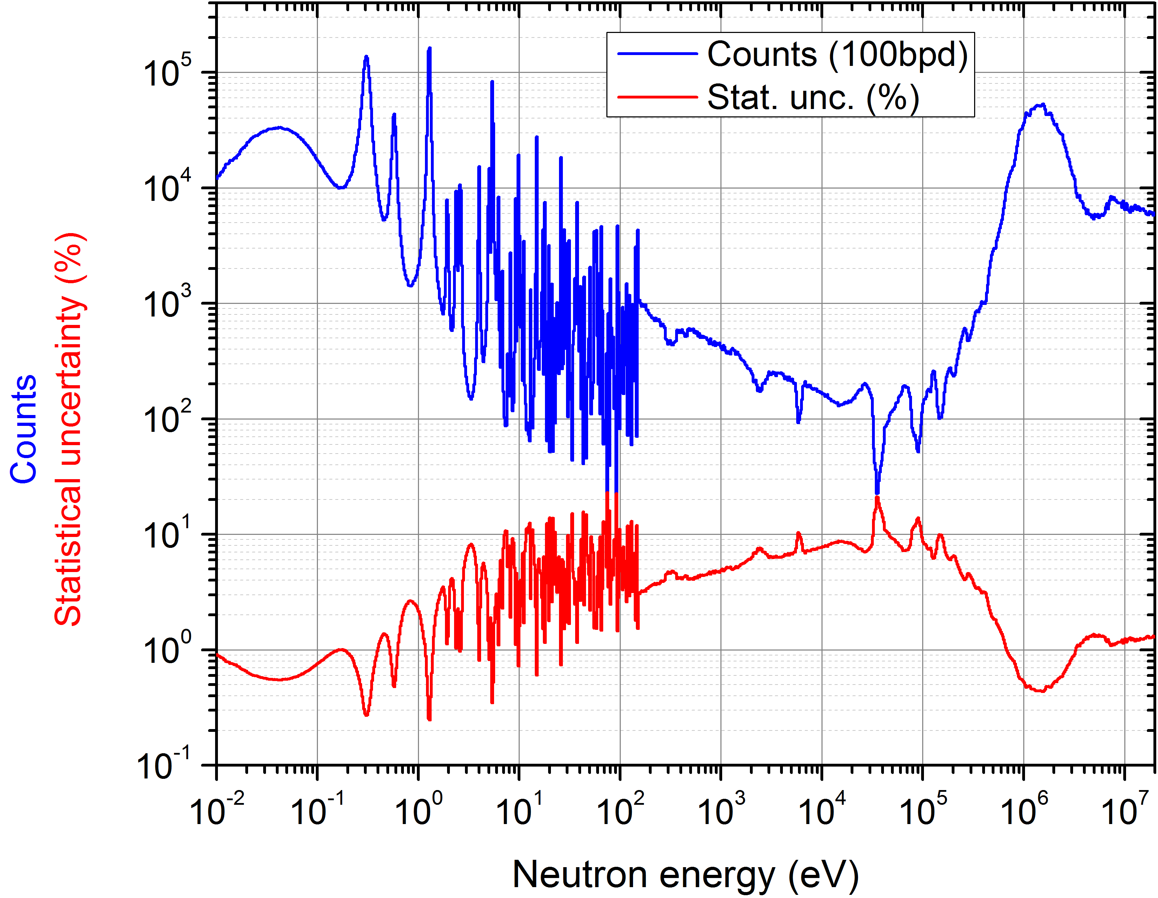
Beam request
We request 3x10¹⁸ p.o.t. in EAR-2 with the large collimator
Continuous data can be obtained almost in the entire energy range <100keV, with certain exceptions in the RRR

Slide 15
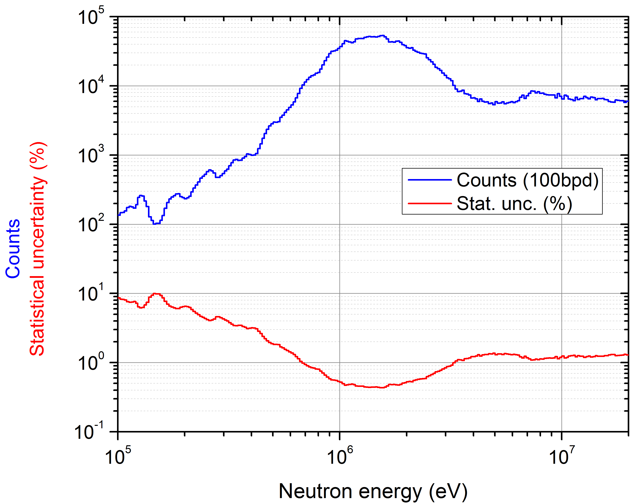
Beam request
We request 3x10¹⁸ p.o.t. in EAR-2 with the large collimator
Statistical uncertainty <2% above 500keV at 100 bpd, <10% above 100keV
  Very significant improvement in statistics compared to EAR-1

Slide 16
Summary
The fission cross-section of ²⁴¹Am remains in the NEA High Priority Request List; it is important for waste transmutation and recycling applications
Existing data do not meet the accuracy requirements for the design of future nuclear systems
A significant improvement upon the previous n_TOF data can be achieved by exploiting the features of EAR-2
Accurate data can be provided in a wide energy range
We request 3x10¹⁸ p.o.t. in EAR-2 with the large collimator

Slide 18
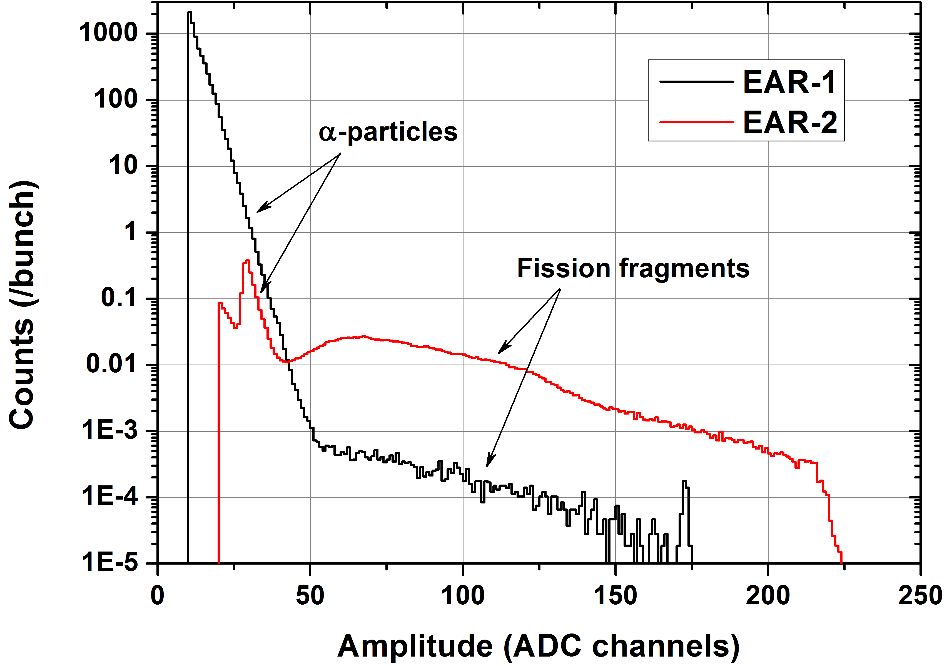
EAR-1 & EAR-2 comparison
Increased flux
Stronger background suppression
Example: same ²⁴⁰Pu sample (6.5MBq) in both areas

