Slide 1
Study of the kinetics of complex formation and in vivo stability of novel radiometal-chelate conjugates for applications in nuclear medicine
Monika Stachura on behalf of the P501 collaboration

Slide 2







IS501 Collaboration
Valery Radchenko, Monika Stachura, Caterina Ramogida, Paul Schaffer, Cornelia Hoehr
Lars Hemmingsen, Peter W. Thulstrup, Morten J. Bjerrum
Ulli Koester
Chris Orvig
Karl Johnston, Juliana Schell
Dmitry Filosofov, Elena Kurakina
Doru C. Lupascul

Slide 3
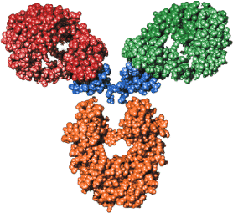
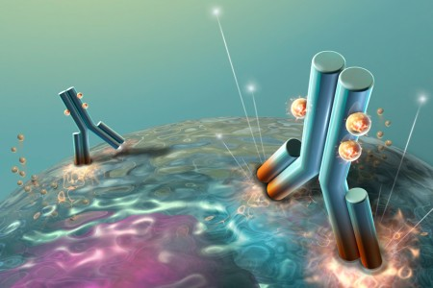

Radiopharmaceuticals
Chelator
Biomolecule
Radionuclide
Specific target

Slide 4
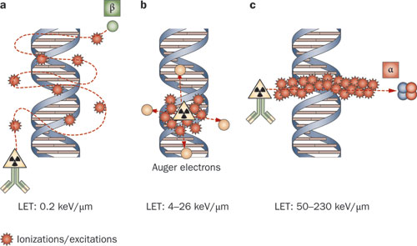
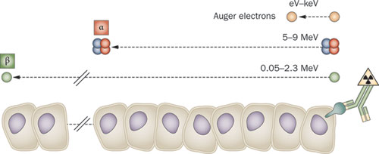
Targeted Radionuclide Therapy (TRT)
Candidates:
Targeted Alpha Therapy: ²¹²Pb (t_{1/2} 10.64 h)
Targeted Auger Therapy: ¹¹⁹Sb (t_{1/2} 38.5 h)
^{197g}Hg (t_{1/2} 64.14 h)
Challenges:
Design of appropriate chelation systems
Kinetics of complex formation (gram)
Radionuclide complex stability in vivo
Pouget J.-P. et al. (2011) Clinical radioimmunotherapy—the role of radiobiology
Nat. Rev. Clin. Oncol. doi:10.1038/nrclinonc.2011.160

Slide 5
PAC Spectroscopy
PAC spectroscopy:
Studies of radiometal-complex structure in vitro and in vivo
Kinetics of complex formation (mg of ligand)
Studies of complex stability in vitro and in vivo
Direct studies under biologically relevant conditions
PAC spectroscopy:
Targeted Alpha Therapy: ²¹²Pb (t_{1/2} 10.64 h) → PAC isotope ^{204m}Pb
Targeted Auger Therapy: ¹¹⁹Sb (t_{1/2} 38.5 h) → PAC isotope ^{118m}Sb
^{197g}Hg (t_{1/2} 64.14 h) → PAC isotope ^{199m}Hg

Slide 6
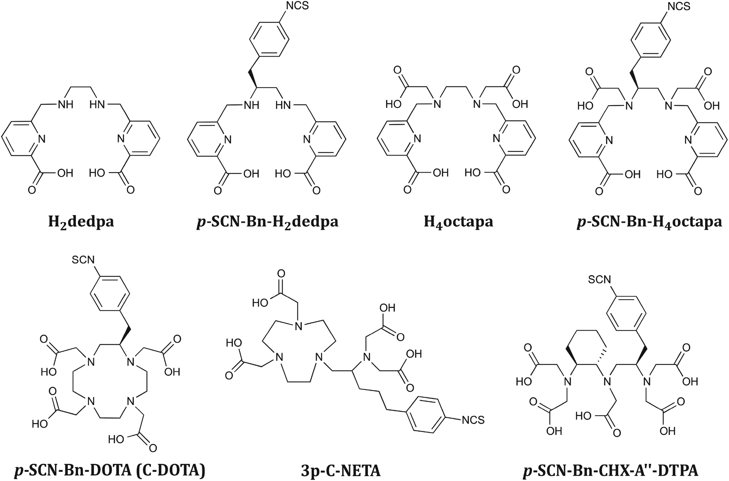
PAC Measurements
Step I:
Experiments with well-known (commercially available) complexes
Step II:
Experiments with novel complexes
Synthesised at UBC/TRIUMF
Hg

Slide 7
In vivo Generators
In vivo generators:
Generator: mother radionuclide decays to the daughter radionuclide (suitable for imaging or therapy)
Challenge: keeping stable complex during transition between parent and daughter
Unknown: will the daughter remain attached to the targeting complex?
Possible in vivo generators:
Imaging: ^{44m}Sc/^{44g}Sc,¹⁴⁰Nd/¹⁴⁰Pr, ¹³⁴Ce/¹³⁴La, ⁵²Fe/^{52m}Mn, ⁶²Zn/⁶²Cu
Therapy: ²¹²Pb/²¹²Bi, ¹⁶⁶Dy/¹⁶⁶Ho, ²²⁵Ac/²¹³Bi

Slide 8
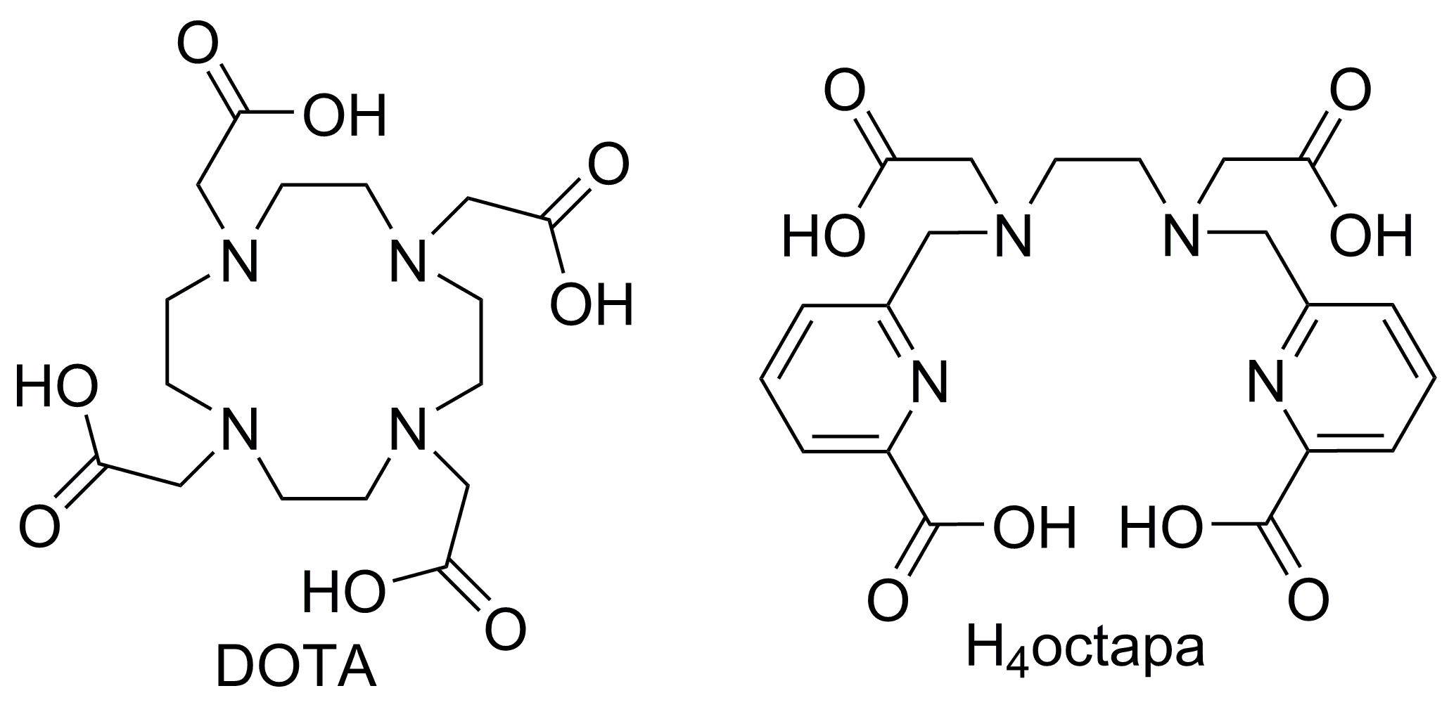
In vivo Generators
PAC isotopes: ^{139m}Nd/¹³⁹Pr, ¹⁴⁰La/¹⁴⁰Ce, ¹⁴⁷Gd/¹⁴⁷Eu, ¹⁴⁹Gd/¹⁴⁹Eu, ¹⁵¹Tb/¹⁵¹Gd, ¹⁷²Lu/¹⁷²Yb
Step I:
Experiments with well-known (commercially available) complexes
Step II:
Comparison of β⁻ decays (i.e. La>Ce) with EC decays (i.e. Lu>Yb) where the nuclear charge of the daughter nuclide increases or decreases, respectively.

Slide 9
PAC Experiments at ISOLDE
Step I: Collections
GLM / new biophysics chamber
Implantations into foils and ice
Step II: Chemistry
Sample preparation in the Chemistry lab (b.508)
Short-lived isotopes → measurements performed immediately
Long-lived isotopes → measurements performed later (or shipped elsewhere)
Step III: PAC measurements
PAC spectrometers in b. 508 (PAC lab)

Slide 10
Beam Request
Total: 15 shifts over 2 years, several runs

Slide 11
Beam Request
New biophysics chamber (designed by M. da Silva, in production, ready in 6 weeks)
Long-lived contamination: ¹³⁹Ce (139d)

Slide 12
IS501 Outputs 2012-2017
24 PhD theses
5 MSc theses
159 peer-reviewed publications
101 oral presentations at the international conferences

Slide 13



Thank you!
Merci!
Follow us at TRIUMFLab

