Slide 1

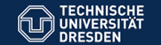
Addendum to the ISOLDE and Neutron Time-of-Flight Committee
Precision Mass Measurements with ISOLTRAP to Study the Evolution of
the N = 82 Shell Gap far from Stability
Spokespersons:
Susanne Kreim and Dinko Atanasov
Contact person:
Vladimir Manea
55th INTC Meeting, 8 - 9 February 2017, CERN, Geneva

Slide 2
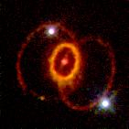
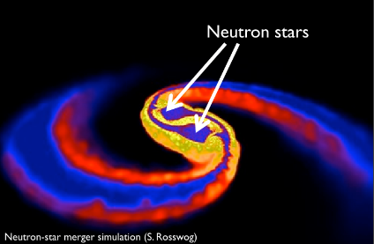
Outline
Physics case
Status of IS574
Results (2014 and 2016 runs)
Shift Request
SN1987A
T. Tsujimoto A&A 565 L5 2014 , Daniel Price (U/Exeter) and Stephan Rosswog (Int. U/Bremen)

Slide 3
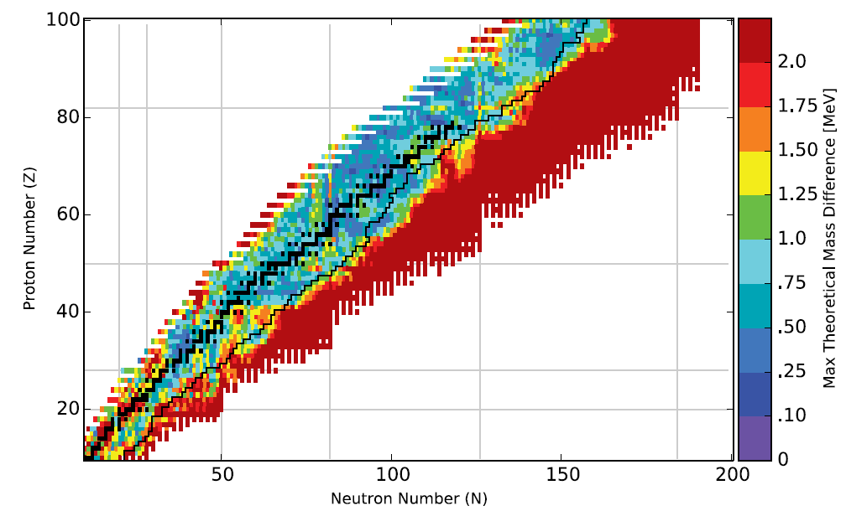
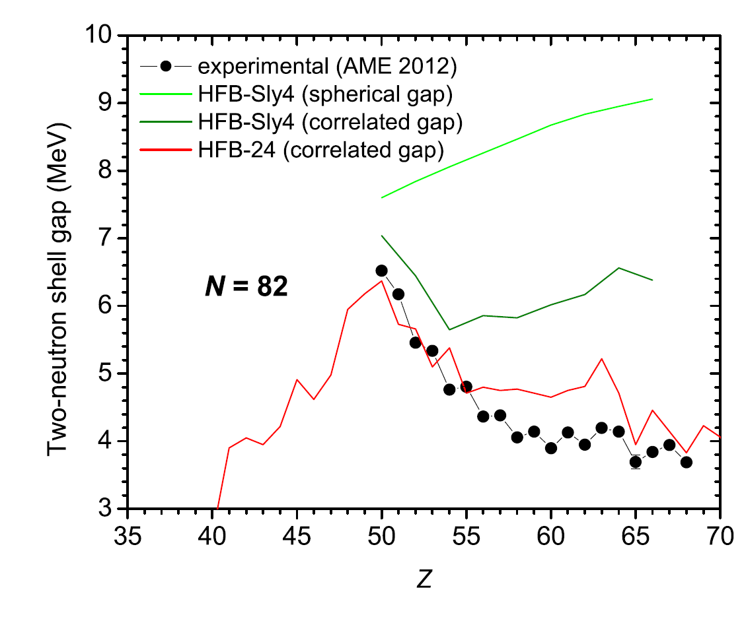
Nuclear mass models - uncertainties
Experimental data still missing for
important r-nuclei
Rely on theoretical extrapolations
Shell evolution far from stability puts constraints on nuclear interaction used
¹²⁹⁻¹³²Cd
ISOLTRAP
R. Surmann ECT Workshop (2014), M. Mumpower et al. Prog. Part Nucl Phys, 86:86–126, 2016, M. Wang et al., Chinese Phys. C 36, 1603 (2012); M. Bender et al., PRC 73, 034322 (2006); S. Goriely et al., PRC 88, 024308 (2013)

Slide 4
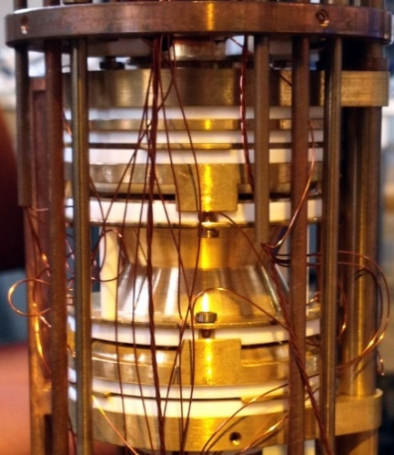
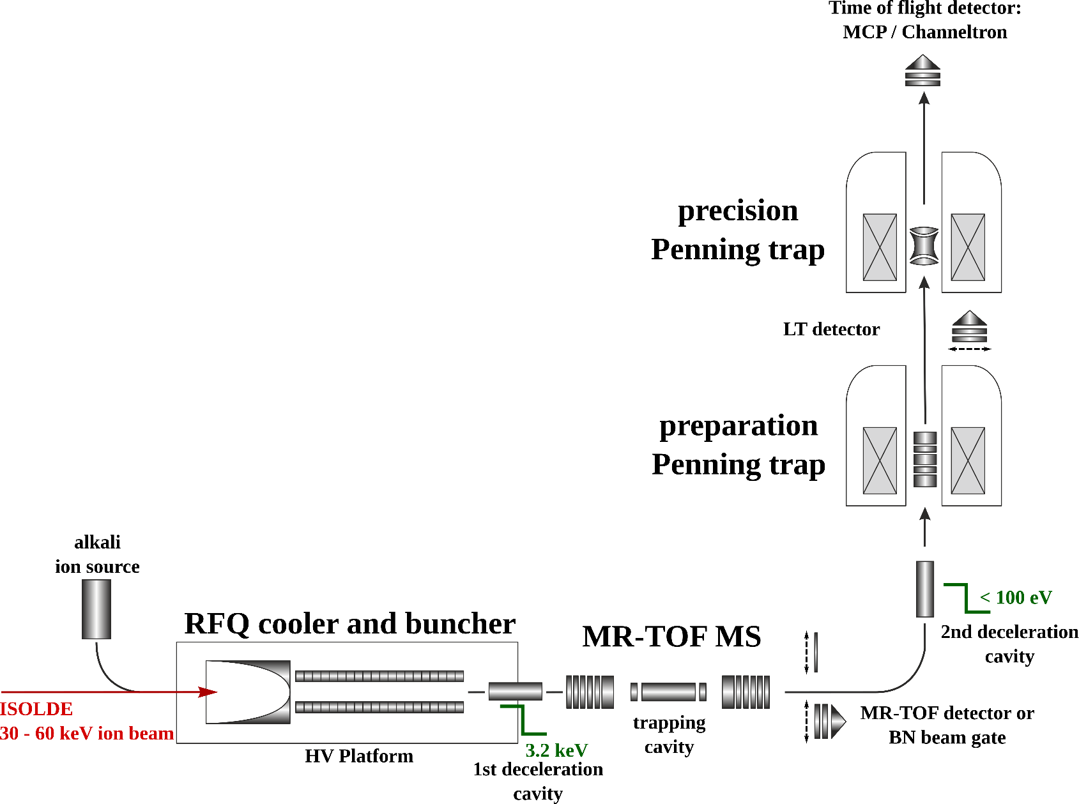
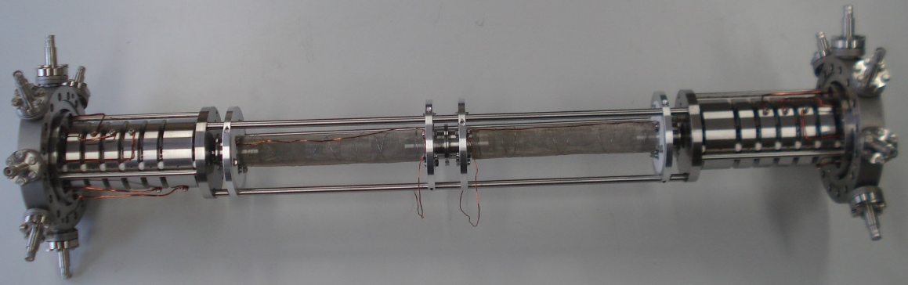
ISOLTRAP setup
1987
Penning Trap Mass Spectrometry
Multi-Reflection Time-Of-Flight Mass Spectrometry
2010
M. Mukherjee et al., Eur. Phys. J. A 35, 1 (2008); S. Kreim et al., Nucl. Instrum. Methods B 317, 492 (2013).

Slide 5
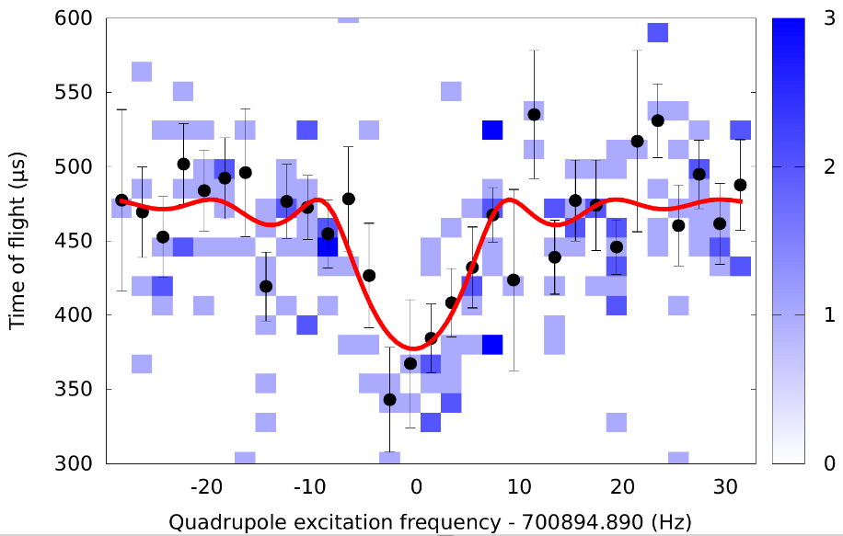
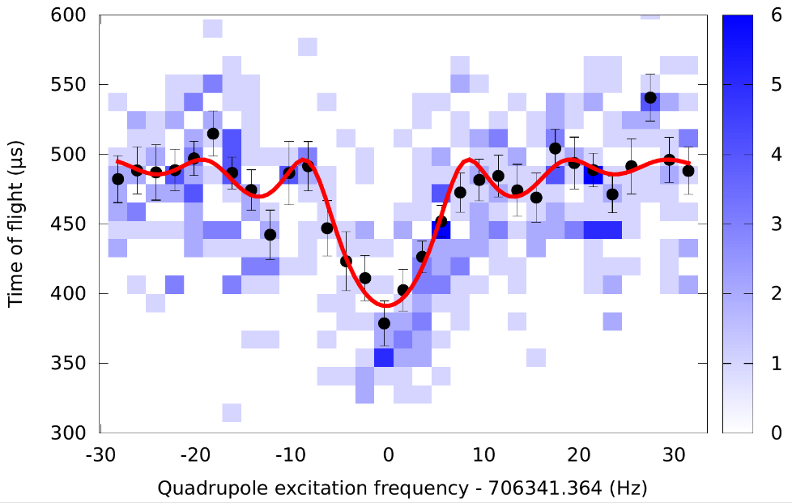

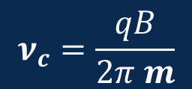
Penning trap measurements of ^{129,130}Cd⁺
¹³⁰Cd⁺
Quartz insert reduced contamination by
4 orders of magnitude for Cs and In
T_{ex}(¹²⁹Cd) = 20-160-20 ms
(4 resonances >1500 events)
T_{ex}(¹³⁰Cd) = 10-80-10 ms
(3 resonances with >550 even)
¹²⁹Cd⁺
Time-Of-Flight Ion-Cyclotron-Resonance
$$ν_{c}=\frac{qB}{2π m}$$
rf excitation
$$ν_{c}=v_{+}+v_{−}$$
M. König et al., Int. J. Mass Spectrom. 142, 95 (1995); S. George et al., Phys. Rev. Lett. 98, 162501 (2007);

Slide 6
MR-TOF measurements of ^{129,130,131}Cd⁺
¹²⁹Cd⁺
¹³⁰Cs⁺/¹³⁰Ba⁺
¹³⁰In⁺
¹³⁰Cd⁺
Laser blocked
Laser
blocked
Clear Identification of Cd nuclides
Low background
¹³¹Cd⁺ ≈ 88 ions/s from ISOLDE
Total of 11 spectra (1366 ions)
Abundance of contamination in spectra
Ratio of ¹³¹Cs⁺ / ¹³¹Cd⁺ = 3:1 (per bg = 160 ms)
R. N. Wolf et al., IJMS 313, 8 (2012); F.Wienholtz et al., Nature 489, 346 (2013)

Slide 7
IS574 Results
A | Ratio r or C_{ToF} | ME_{new} (keV) | ME_{AME} (keV) | Δ (AME - new) (keV)
129 | 0.970 105 338(136) | −63 148(74) | -63 510(200)# | -452
130 | 0.977 645 186(180) | −61 118(22) | -61 530(160) | -412
131 | 0.482 304 4(539) | −55 215(100) | -55 331(196)# | -116
S_{n}(N, Z) = B(N, Z) – B(N-1, Z)
Δ_{n} = S_{n}(N, Z) – S_{n}(N+1, Z)
D. Atanasov et al., PRL 115, 232501 (2015);

Slide 8
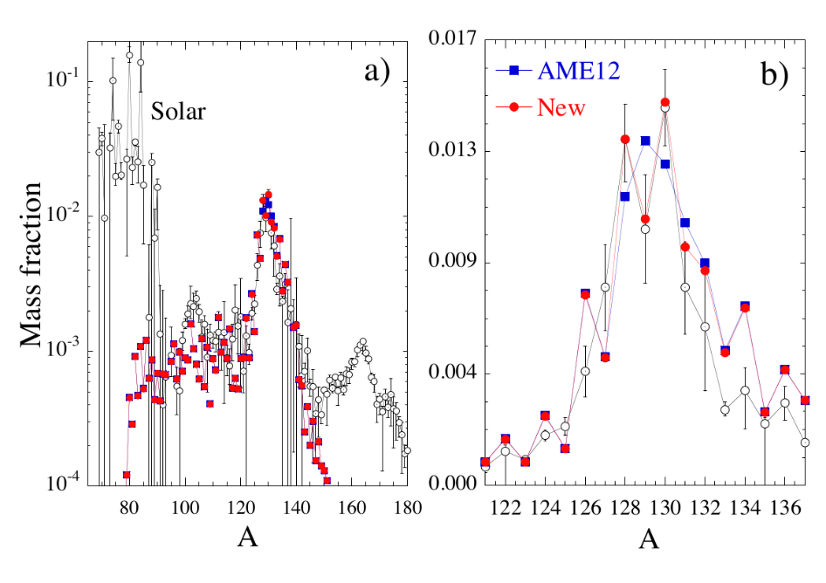
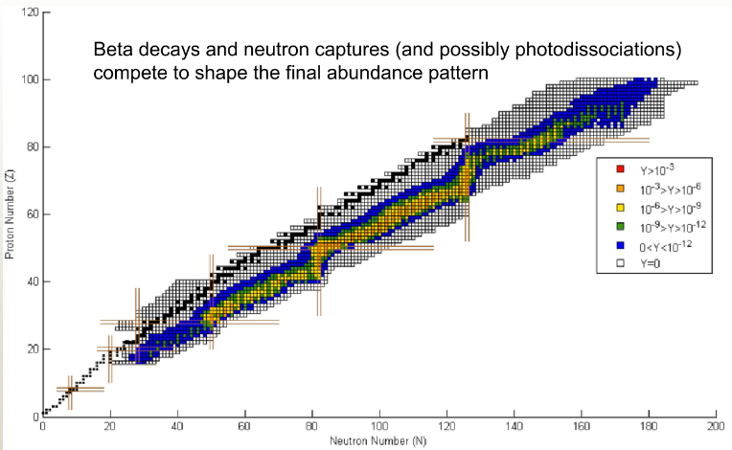
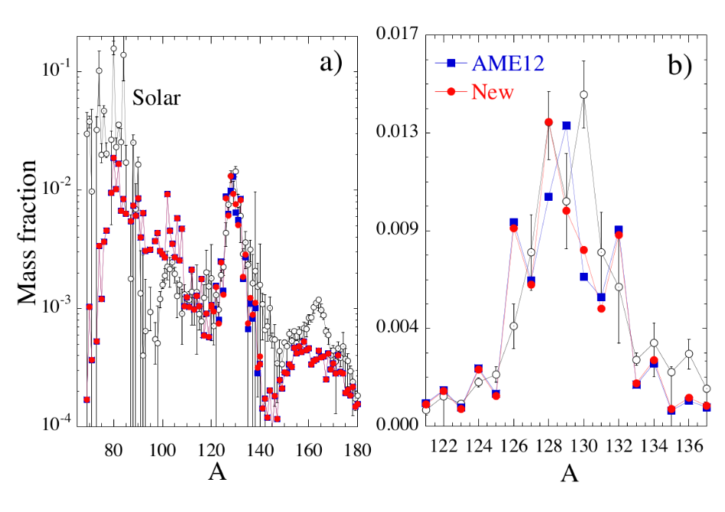
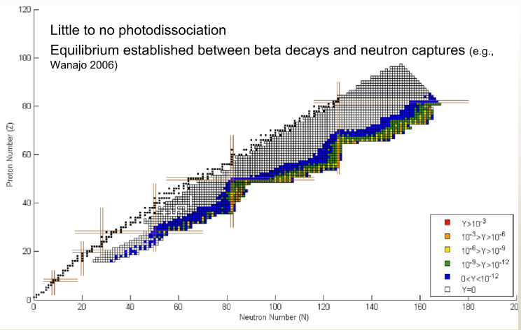
IS574 Results
ν-driven Core-collapse Supernovae –
Calculations Parameters: Entropy s_{kB} = 193, electron fraction Y_{e} = 0.48, Mass loss dM/dt = 6.10⁻⁷M_{sol} s⁻¹ and breeze solution f_{w} = 3
Neutron star Mergers –
MODEL M3A8m1a5 mean entropy s̅/k_{B}= 28, electron fraction Y_{e} = 0.24,total mass ejected M_{ej} = 2.5x10⁻² M_{sol}
Calculations performed by S.Goriely; R. Surman Workshop Hirschegg (2013),

Slide 9
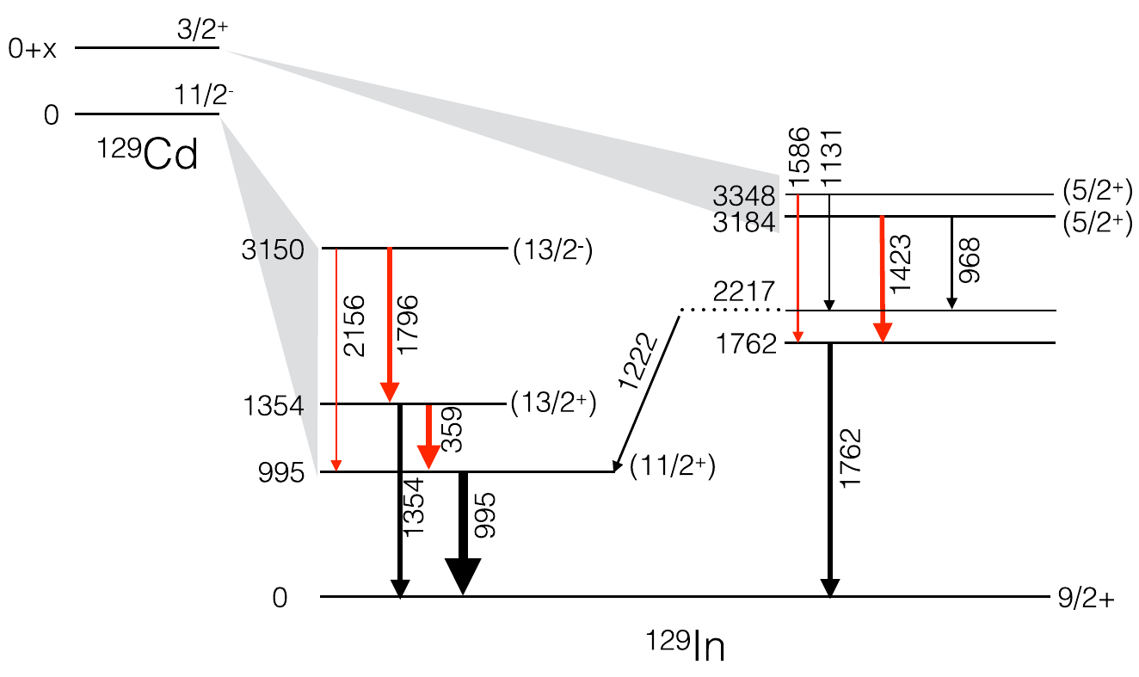
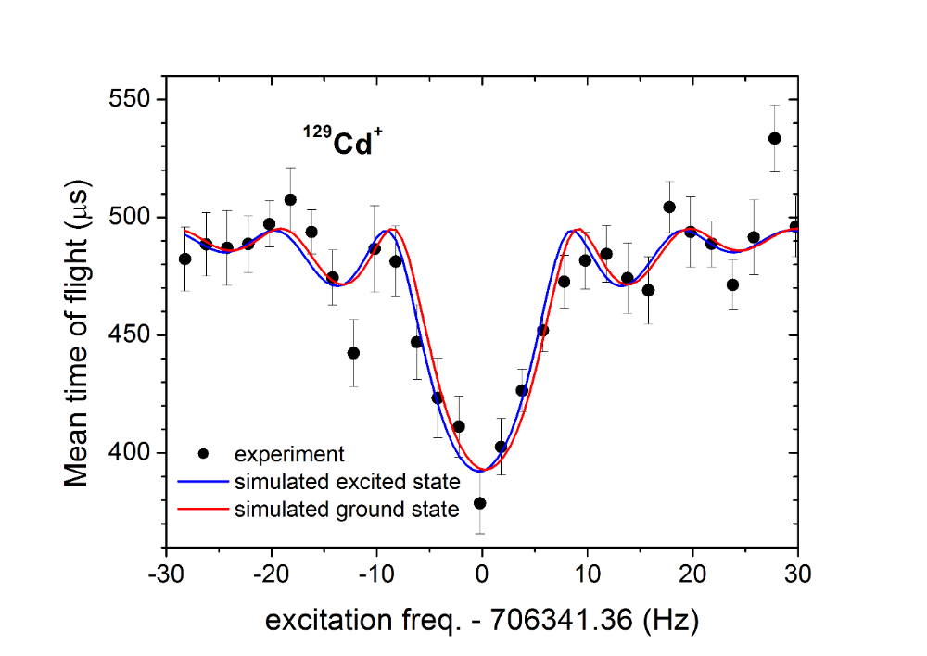
Isomeric state of ¹²⁹Cd
Estimated energy of the
isomer E = 180(100) keV
Simulated ToF-ICR for the
isomeric state with E = 100 keV
Two isomeric states with spins 3/2⁺ and 11/2⁻
D. Yordanov et al., PRL 110, 192501 (2013)
Available data from RIKEN experiment in 2015 yielded 151(15) ms,146(8) ms.
Confirmed by TITAN in 2016
J. Taprogge et al., PRC 91, 054324 (2015)
R. Dunlop et al., PRC 93, 062801(R) (2016)
Estimate for E_{ex}(^{129m}Cd) = 100 keV leads to phase differance of φ=12° at ISOLTRAP
M. König et al., Int. J. Mass Spectrom. 142, 95 (1995); S. Eliseev, Phys. Rev. Lett. 110, 082501;

Slide 10
Isomeric states in ^{123,127}Cd
 | ISOLTRAP (keV) | AME12 (keV)
E_{ex}(¹²³Cd) | 149(50) | 143(4)
E_{ex}(¹²⁷Cd) | 270(50) | 0#(100#)
M. König et al., Int. J. Mass Spectrom. 142, 95 (1995); S. Eliseev, Phys. Rev. Lett. 110, 082501; A. Kankainen et al. Phys. Rev. C 87, 024307 (2013)
10

Slide 11
Isomeric states in ^{123,127}Cd
⁸⁵Rb
 | ISOLTRAP (keV) | AME12 (keV)
E_{ex}(¹²³Cd) | 149(50) | 143(4)
E_{ex}(¹²⁷Cd) | 270(50) | 0#(100#)
M. König et al., Int. J. Mass Spectrom. 142, 95 (1995); S. Eliseev, Phys. Rev. Lett. 110, 082501; A. Kankainen et al. Phys. Rev. C 87, 024307 (2013)
10

Slide 12
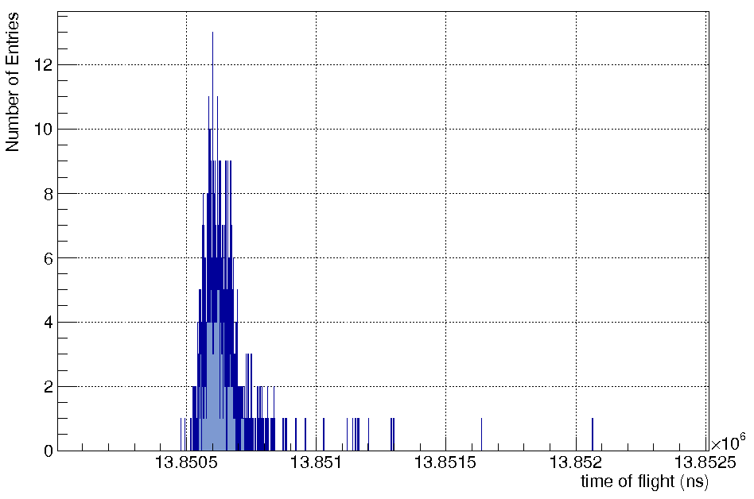
IS574 Shift request
8 shifts (6 physics + 2 optimizations)
Nuclide | Half-life, ms | Ion/µC | Technique | Shifts (8h) Remaining + Requested
^{127g,m}Cd | 330(20), 200# | 1.2*10⁵ | PTMS | 0 + 2
^{129g,m}Cd | 151(15), 146(8) | 3*10⁴ | PTMS | 0 + 4
¹³²Cd | 97(10) | 5*10⁰# | MR-TOF MS | 6 + 0
A = 132
Spectrum accumulated in 30 min
Expected TOF for ¹³²Cd⁺
M. König et al., Int. J. Mass Spectrom. 142, 95 (1995); S. Eliseev, Phys. Rev. Lett. 110, 082501;
11

Slide 13




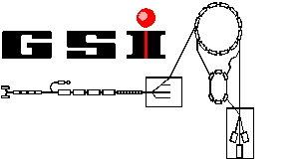





Acknowledgements
N. Althubiti, P. Ascher, G. Audi, D. Atanasov, D. Beck, K. Blaum, G. Bollen, M. Breitenfeldt, R. B. Cakirli, T. Cocolios, S. Eliseev, S. George,
F. Herfurth, A. Herlert, J. Karthein, J. Kluge, M. Kowalska, S. Kreim,
Yu. A. Litvinov, D. Lunney, V. Manea, E. Minaya-Ramirez, D. Neidherr,
R. Ringle, M. Rosenbusch, A. de Roubin, L. Schweikhard, M. Wang,
A. Welker, F. Wienholtz, R. N. Wolf, K. Zuber
Theoretical calculations: S. Goriely, H. –T. Janka, O. Just
Grants No.:
05P12HGCI1
05P12HGFNE
ISOLDE Target
and Technical Group
Mikhail Goncharov,
Achim Czasch
http://isoltrap.web.cern.ch

Slide 14
Publications/PhD Thesis by the ISOLTRAP Collaboration for the period 2012-2017
Title | First Author | Journal | Year
A study of octupolar excitation for mass-selective centering in Penning traps | M. Rosenbusch | Int. J. Mass Spectrom. 314, 6-12 | 2012
Q Value and Half-Lives for the Double-β-Decay Nuclide 110Pd | D. Fink | Phys. Rev. Lett. 108, 062502 | 2012
On-line separation of short-lived nuclei by a multi-reflection time-of-flight device | R.N. Wolf | Nucl. Instr. and Meth. A 686, 82-90 | 2012
Trap-assisted decay spectroscopy with ISOLTRAP | M. Kowalska | Nucl. Instr. and Meth. A 689, 102-107 | 2012
Buffer-gas-free mass-selective ion centering in Penning traps by simultaneous dipolar excitation of magnetron motion and quadrupolar excitation for interconversion between magnetron and cyclotron motion | M. Rosenbusch | Int. J. Mass Spectrom. 325-327, 51-57 | 2012
Surveying the N = 40 island of inversion with new manganese masses | S. Naimi | Phys. Rev. C 86, 014325 | 2012
Recoil-ion trapping for precision mass measurements | A. Herlert | Eur. Phys. J. A 48, 97 | 2012
Plumbing Neutron Stars to New Depths with the Binding Energy of the Exotic Nuclide 82Zn | R.N. Wolf | Phys. Rev. Lett. 110, 041101 | 2013
Masses of exotic calcium isotopes pin down nuclear forces | F. Wienholtz | Nature 498, 346 | 2013
ISOLTRAP's multi-reflection time-of-flight mass separator/spectrometer | R.N. Wolf | Int. J. Mass. Spectrom. 349-350, 123-133 | 2013
Mass spectrometry and decay spectroscopy of isomers across the Z=82 shell closure | J. Stanja | Phys. Rev. C 88, 054304 | 2013
Collective degrees of freedom of neutron-rich A≈100 nuclei and the first mass measurement of the short-lived nuclide 100Rb | V. Manea | Phys. Rev. C 88, 054322 | 2013
Recent exploits of the ISOLTRAP mass spectrometer | S. Kreim | Nucl. Instrum. Methods B 317, 492–500 | 2013
New developments of the in-source spectroscopy method at RILIS/ISOLDE | B.A. Marsh | Nucl. Instrum. Methods B 317, 550-556 | 2013
Ion bunch stacking in a Penning trap after purification in an electrostatic mirror trap | M. Rosenbusch | Appl. Phys. B 114, 147-155 | 2014
Competition between pairing correlations and mean-field effects in heavy, deformed nuclei | S. Kreim | Phys. Rev. C 90, 024301 | 2014
Evolution of nuclear ground-state properties of neutron-deficient isotopes around Z=82 from precision mass measurements | Ch. Böhm | Phys. Rev. C 90, 044307 | 2014
Experimental tests of an advanced proton-to-neutron converter at ISOLDE-CERN | A. Gottberg | Nucl. Instrum. Methods B 336, 143-148 | 2014
Probing the N=32 Shell Closure below the Magic Proton Number Z=20: Mass Measurements of the Exotic Isotopes 52,53K | M. Rosenbusch | Phys. Rev. Lett. 114, 202501 | 2015
Precision Mass Measurements of 129–131Cd and Their Impact on Stellar Nucleosynthesis via the Rapid Neutron Capture Process | D. Atanasov | Phys. Rev. Lett. 115, 232501 | 2015
Background-free beta-decay half-life measurements by in-trap decay and high-resolution MR-ToF mass analysis | R.N. Wolf | Nucl.Instrum. Meth. B 376, 275–280 | 2016
Precision mass measurements of cesium isotopes - new entries in the ISOLTRAP chronicles | D. Atanasov | J Phys. G Accepted | 2017
Total of 22 publications.
M. König et al., Int. J. Mass Spectrom. 142, 95 (1995); S. Eliseev, Phys. Rev. Lett. 110, 082501;

Slide 15
Publications/PhD Thesis by the ISOLTRAP Collaboration for the period 2012-2017
PhD Title | Author | Institute / University | Year
Mass Measurements of Exotic Ions in the Heavy Mass Region for Nuclear Structure Studies at ISOLTRAP | Ch. Borgmann | Ruprecht-Karls-Universität Heidelberg, Germany | 2012
Synergy of decay spectroscopy and mass spectrometry for the study of exotic nuclides | J. Stanja | Technische Universität Dresden, Germany | 2013
First on-line applications of a multi-reflection time-of-flight mass separator at ISOLTRAP and the mass measurement of 82Zn | R. Wolf | Ernst-Moritz-Arndt-Universität Greifswald, Germany | 2013
Penning-trap mass measurements of exotic rubidium and gold isotopes for a mean-field study of pairing and quadrupole correlations | V. Manea | Université Paris-Sud XI, CSNSM-IN2P3-CNRS Orsay, France | 2014
High-precision mass measurements of neutron-deficient Tl isotopes at ISOLTRAP and the development of an ultra-stable voltage source for the PENTATRAP experiment | Ch. Böhm | Ruprecht-Karls-Universität Heidelberg, Germany | 2015
Development of new ion-separation techniques and the first mass measurement of 52,53K | M. Rosenbusch | Ernst-Moritz-Arndt-Universität Greifswald, Germany | 2016
Precision mass measurements for studies of nucleosynthesis via the rapid neutron-capture process | D. Atanasov | Ruprecht-Karls-Universität, MPIK, Heidelberg, Germany | 2016
Mass measurements of neutron-rich strontium and rubidium isotopes in the A ≈ 100 region of deformation and development of an electrospray ionization ion source | A. de Roubin | University of Bordeaux | 2016
Total of 8 PhD theses completed.
M. König et al., Int. J. Mass Spectrom. 142, 95 (1995); S. Eliseev, Phys. Rev. Lett. 110, 082501;

