Slide 1
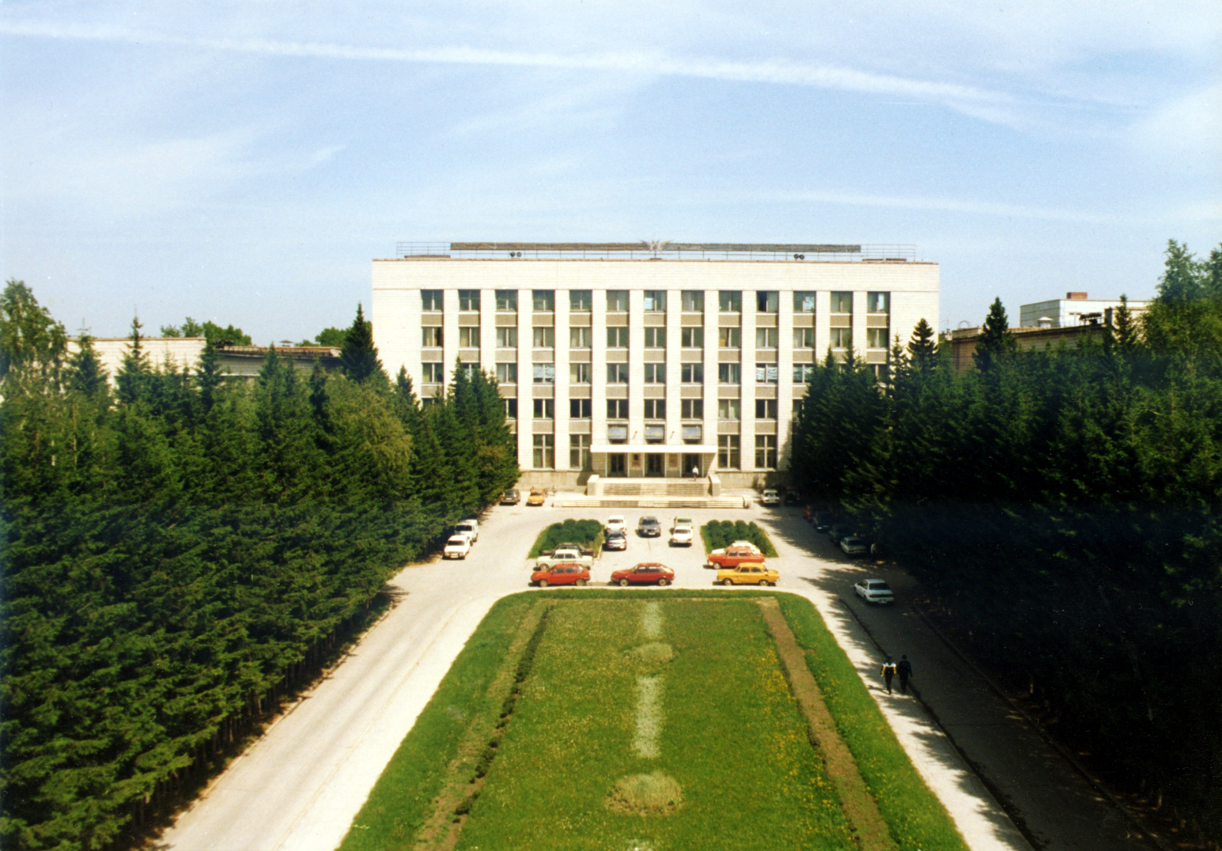
BINP RF group
at a glance
A. Tribendis, BINP 01/02/2017, CERN 1st collaboration meeting on SRF for FCC

Slide 2
Contents:
CCDTL for Linac4
SRF activities
RF for NovoFEL
RF electron sources
RF for e+e- BINP colliders
RF for NICA at JINR, Dubna

Slide 3
1. CCDTL for Linac4.

Slide 4




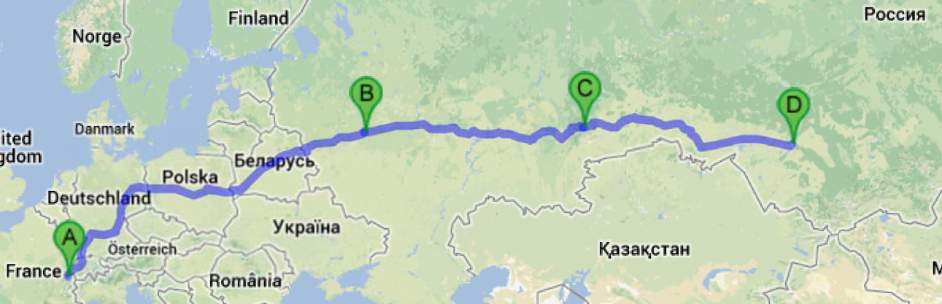
CCDTL for Linac4.
CERN – European Organization for Nuclear Research, Geneva, Switzerland
BINP – Budker Institute of Nuclear Physics of Siberian Branch of Russian Academy of Sciences, Novosibirsk
VNIITF – Russian Federal Nuclear Center – Russian Scientific Research Institute of Technical Physics, Snezhinsk
ISTC – International Science and technology Center, Moscow (now moved to Kazakhstan)
7 CCDTL modules logistics.
BINP, Novosibirsk
ISTC, Moscow
VNIITF, Snezhinsk
CERN, Geneva
6 296 km

Slide 5
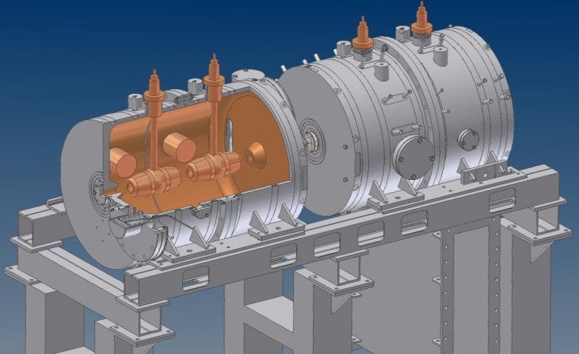
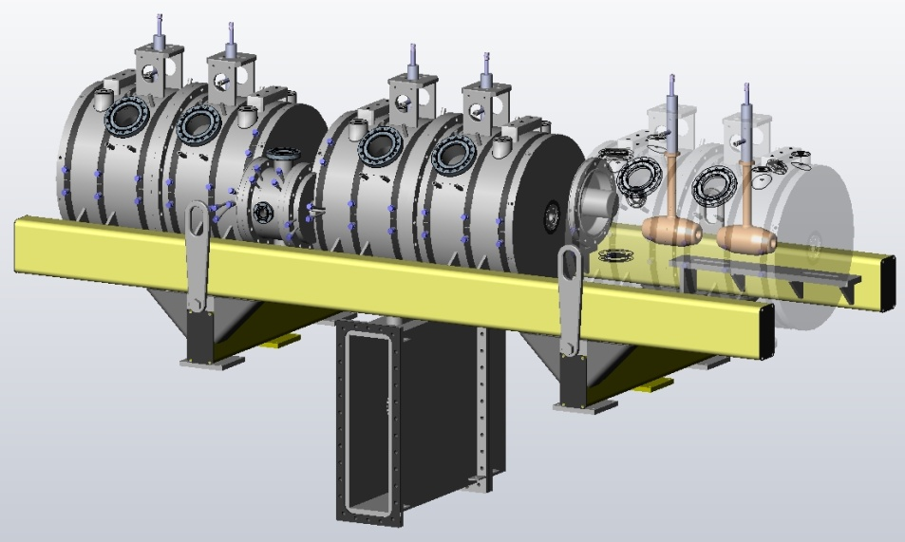
CCDTL for Linac4.
2004 | Start of an ISTC project for the construction of a CCDTL “pre-series” prototype in Russia
2005 2006 | Design and construction of the ISTC prototype at BINP / VNIITF
2007 | Successful high power tests of the ISTC prototype at CERN
ISTC prototype
2 full tanks + CC
2009 | Start of 2 ISTC project for the construction of the 7 CCDTL modules in Russia
2010 2013 | Design and construction of the 7 CCDTL modules at BINP / VNIITF
2013 | Successful high power tests of the first CCDTL module at CERN, delivery of the last module to CERN
CCDTL module
3 full tanks + 2 CCs
×7

Slide 6
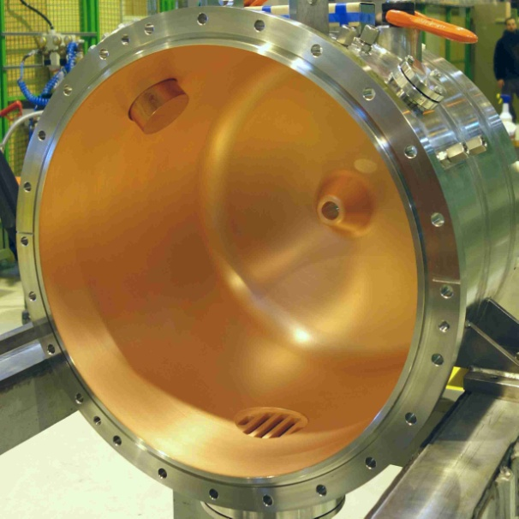
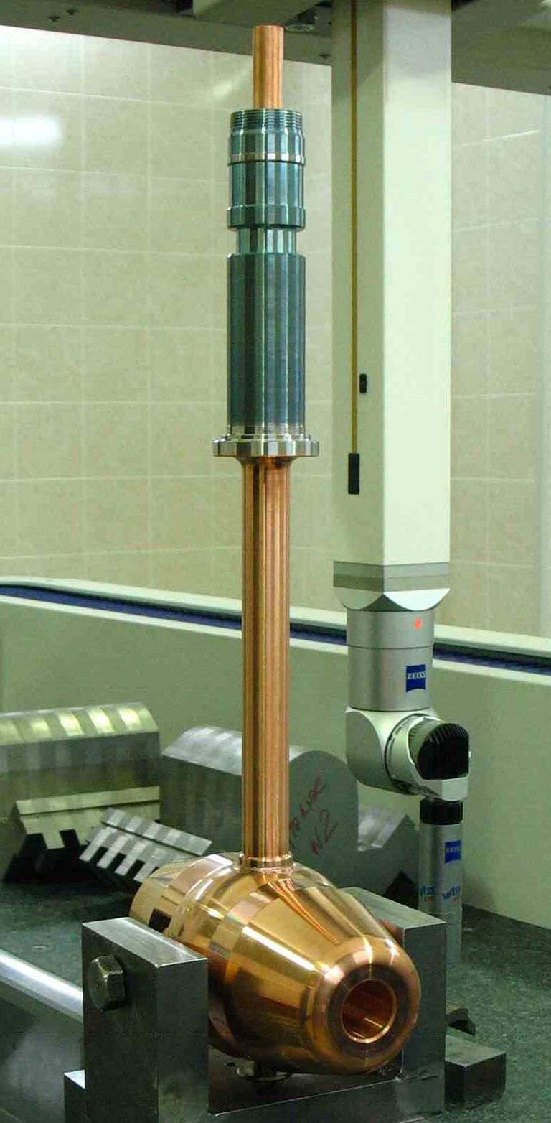
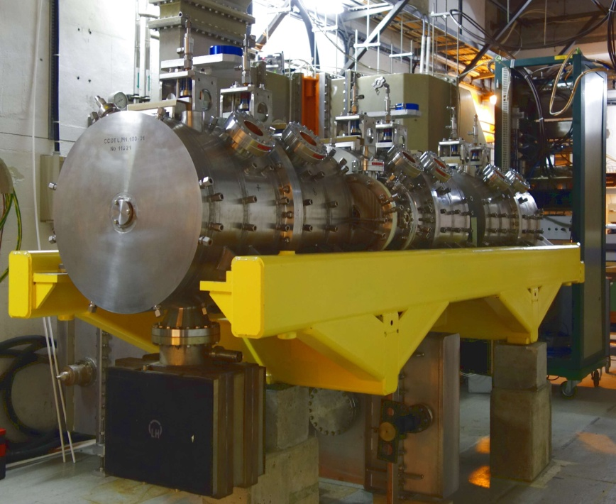
CCDTL for Linac4.
VNIITF
CERN
BINP

Slide 7
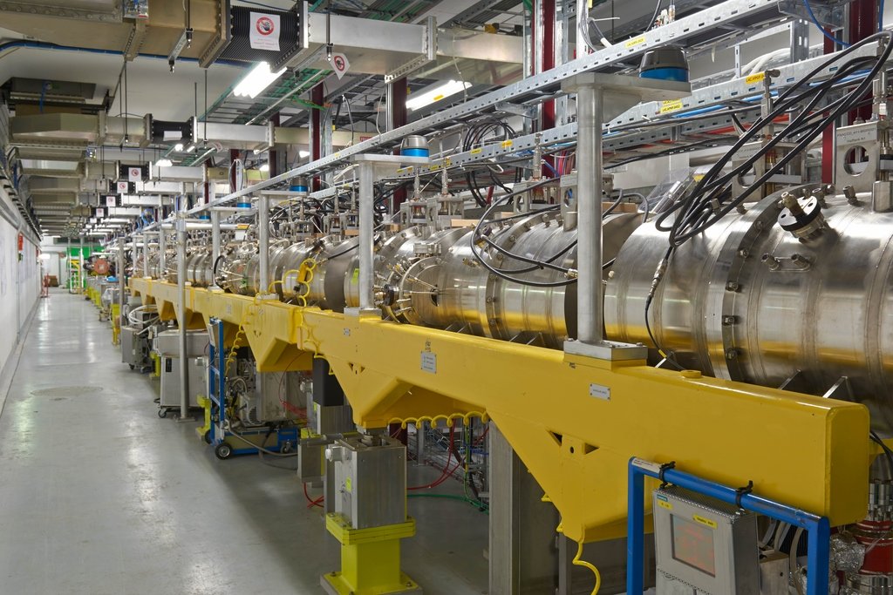

Slide 8
2. Past SRF activities.

Slide 9
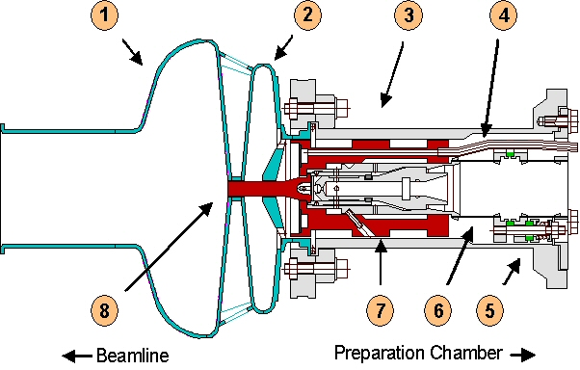
RF superconducting electron photoinjector
A promising option of low emittance, high average current electron source is a CW photo-injector based on a superconducting RF gun. An advanced concept of such injector was worked out in collaboration with Research Center Rossendorf (FZR), Germany. The main feature of the design is an original copper photo-cathode holder inside an SRF Nb cavity. The holder has no thermal contact with the cavity superconducting walls and produces no heat leakage to the LHe bath but is cooled by LN₂. A photolayer of Cs₂Te on a Mo substrate is deposited on top of a copper stem in a special preparation chamber and transported to the cathode holder by a manipulator. No vacuum break or cavity warm-up is necessary to change the photo-cathode.
1 – Nb Cavity
2 – Choke Filter
3 – Cooling Insert
4 – LN2 tube
5 – Ceramic Insulation
6 – Thermal Insulation
7 – 3-stage Coax Filter
8 – Cathode Stem
1998
Notes:
The Institute continuously promotes advanced technologies in high quality electron beams production. A promising option of low emittance, high average current electron source is a CW photo-injector based on a superconducting RF gun. An advanced concept of such an injector was worked out in collaboration with Research Center Rossendorf (FZR), Germany and some other institutions. The main feature of the design is an original copper photo-cathode holder inside an SRF Nb cavity. The holder has no thermal contact with the cavity superconducting walls and produces no heat leakage to the LHe bath but is cooled by LN2. A photolayer of Cs2Te on a Mo substrate is deposited on top of a copper stem in a special preparation chamber and transported to the cathode holder by a manipulator. No vacuum break or cavity warm-up is necessary to change the photo-cathode.
A sample prototype 1.3 GHz cavity was developed and produced at Budker Institute and tested at DESY TTF. Maximum achieved Eacc is 27 MV/m at Q value of 2·10^9 at 2K. A cathode preparation chamber was also produced at BINP.
A full scale experiment with UV laser driven photo-cathode was performed at FZR and proved the design feasibility.
An optimized injector suitable for FEL and linear collider applications based on a 3.5-cell TESLA cavity was developed as well.

Slide 10
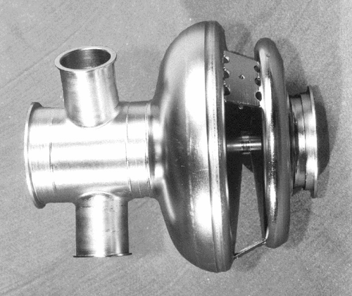
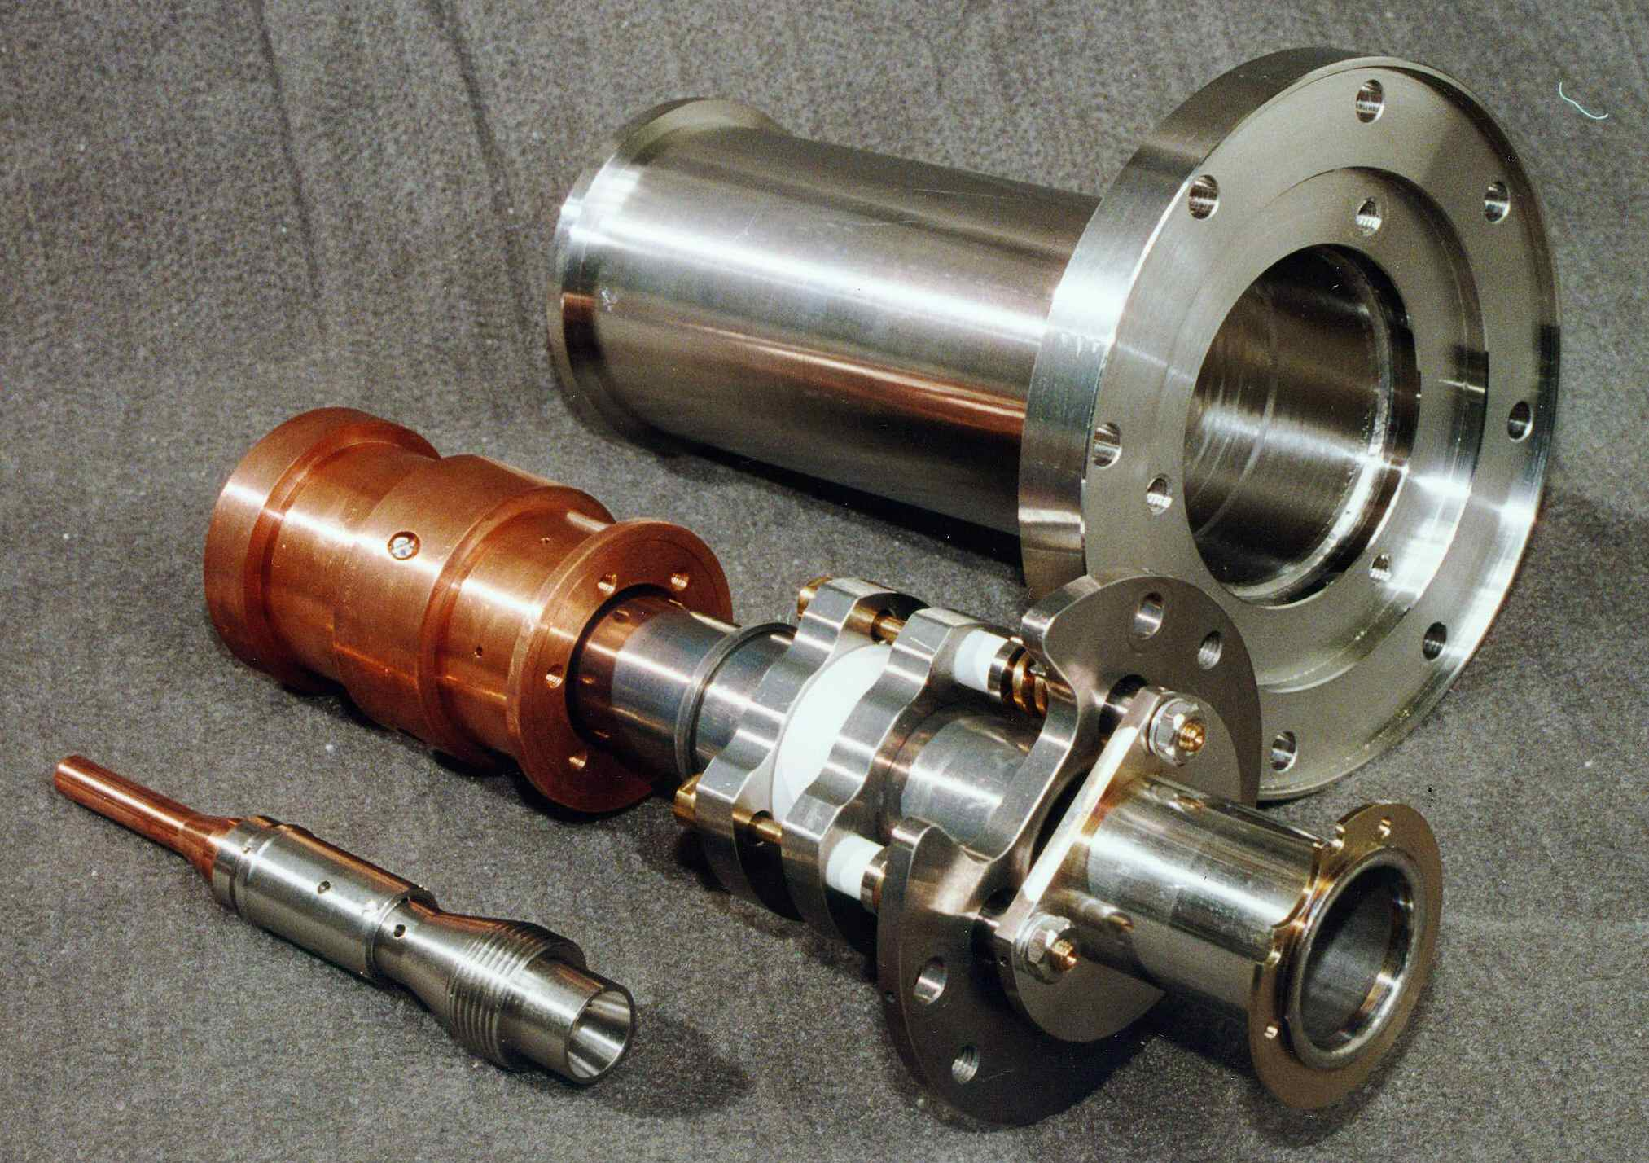
RF superconducting electron photoinjector
A prototype 1.3 GHz cavity was developed and produced at Budker Institute and tested at DESY TTF. Maximum achieved E_{acc} is 27 MV/m at Q value of 2·10⁹ at 2K. A cathode preparation chamber was also produced at BINP.
A full scale experiment with UV laser driven photo-cathode was performed at FZR and proved the design feasibility.
An optimized injector suitable for FEL and linear collider applications based on a 3.5-cell TESLA cavity was developed as well.
1998

Slide 11
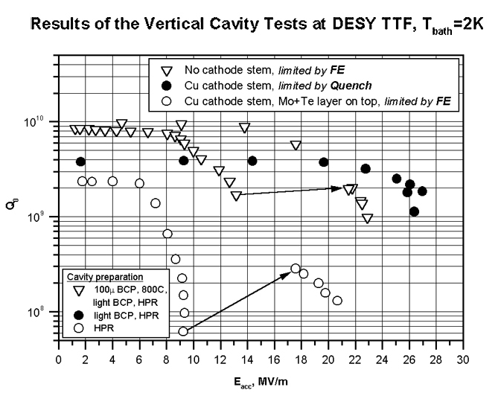
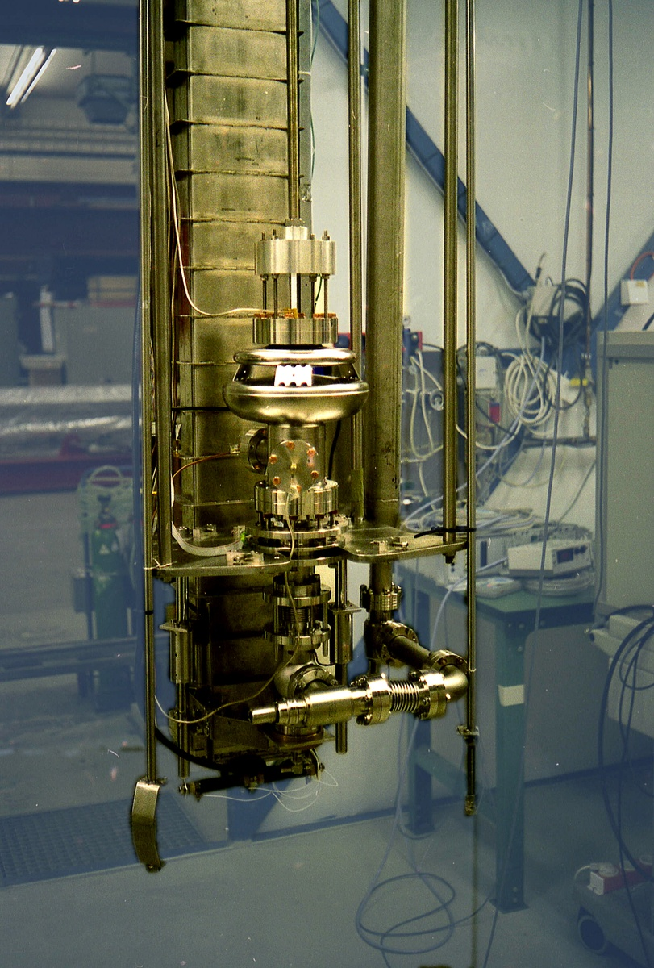
1998

Slide 12
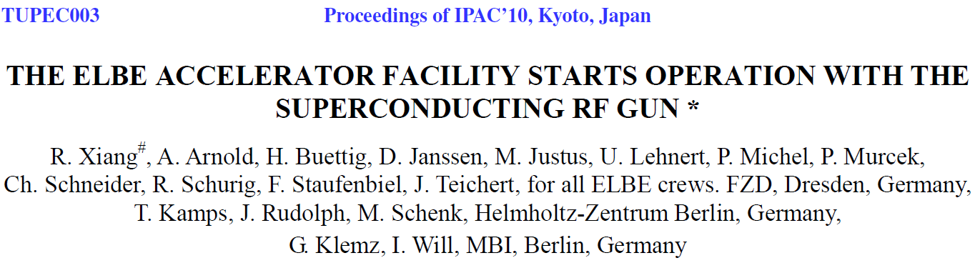
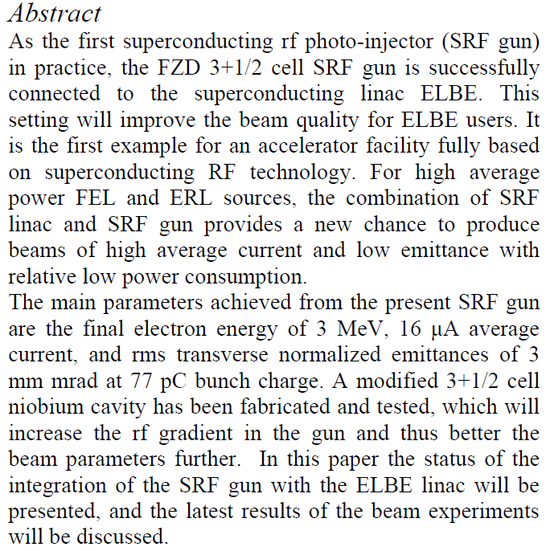
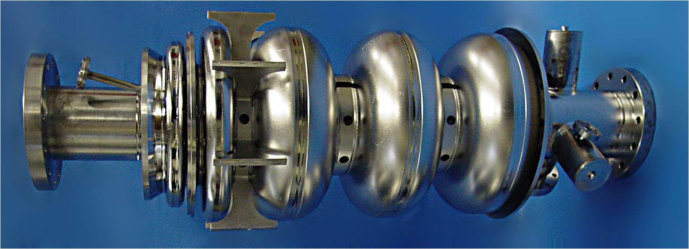
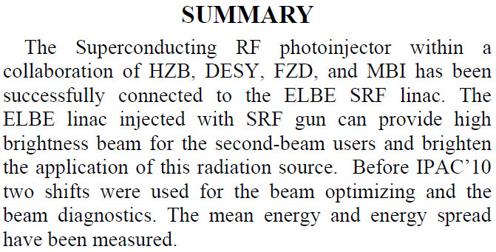

Slide 13
3. RF for NovoFEL.

Slide 14

Overview of the NovoFEL facility
E_{inj}
+/− ΔE₁
E_{inj}
Beam dump
Accelerating structure
Injector
Race-track microtron
FEL
(undulator, optical resonator, …)
N
E = E_{inj} + ΔE₁
≈ 0.99E
THz radiation
P_{THz} ~1% P_{beam}

Slide 15

Overview of the NovoFEL facility
The first stage of Novosibirsk high power free electron laser (NovoFEL) based on one-track energy recovery linac (ERL) working in spectral range (90÷240) μm was commissioned in 2003.
The second stage of NovoFEL based on two-tracks energy recovery linac, working in spectral range (37÷80) μm, was commissioned in 2009.
The third stage of NovoFEL based on four-tracks ERL was commissioned in July of 2015. Spectral range now is (8÷11) μm. First operation for users was done in 2016.

Slide 16

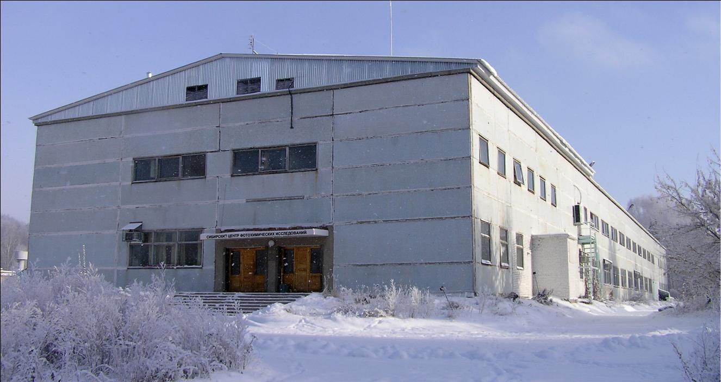
Budker INP, Novosibirsk, Russia
Siberian Center of Photochemical Research

Slide 17
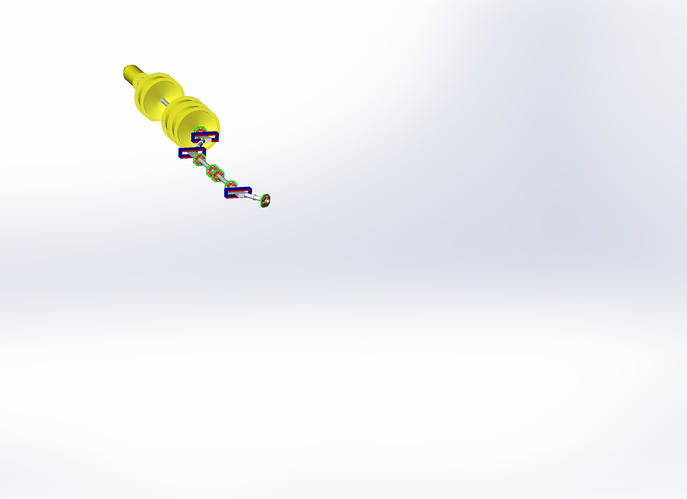
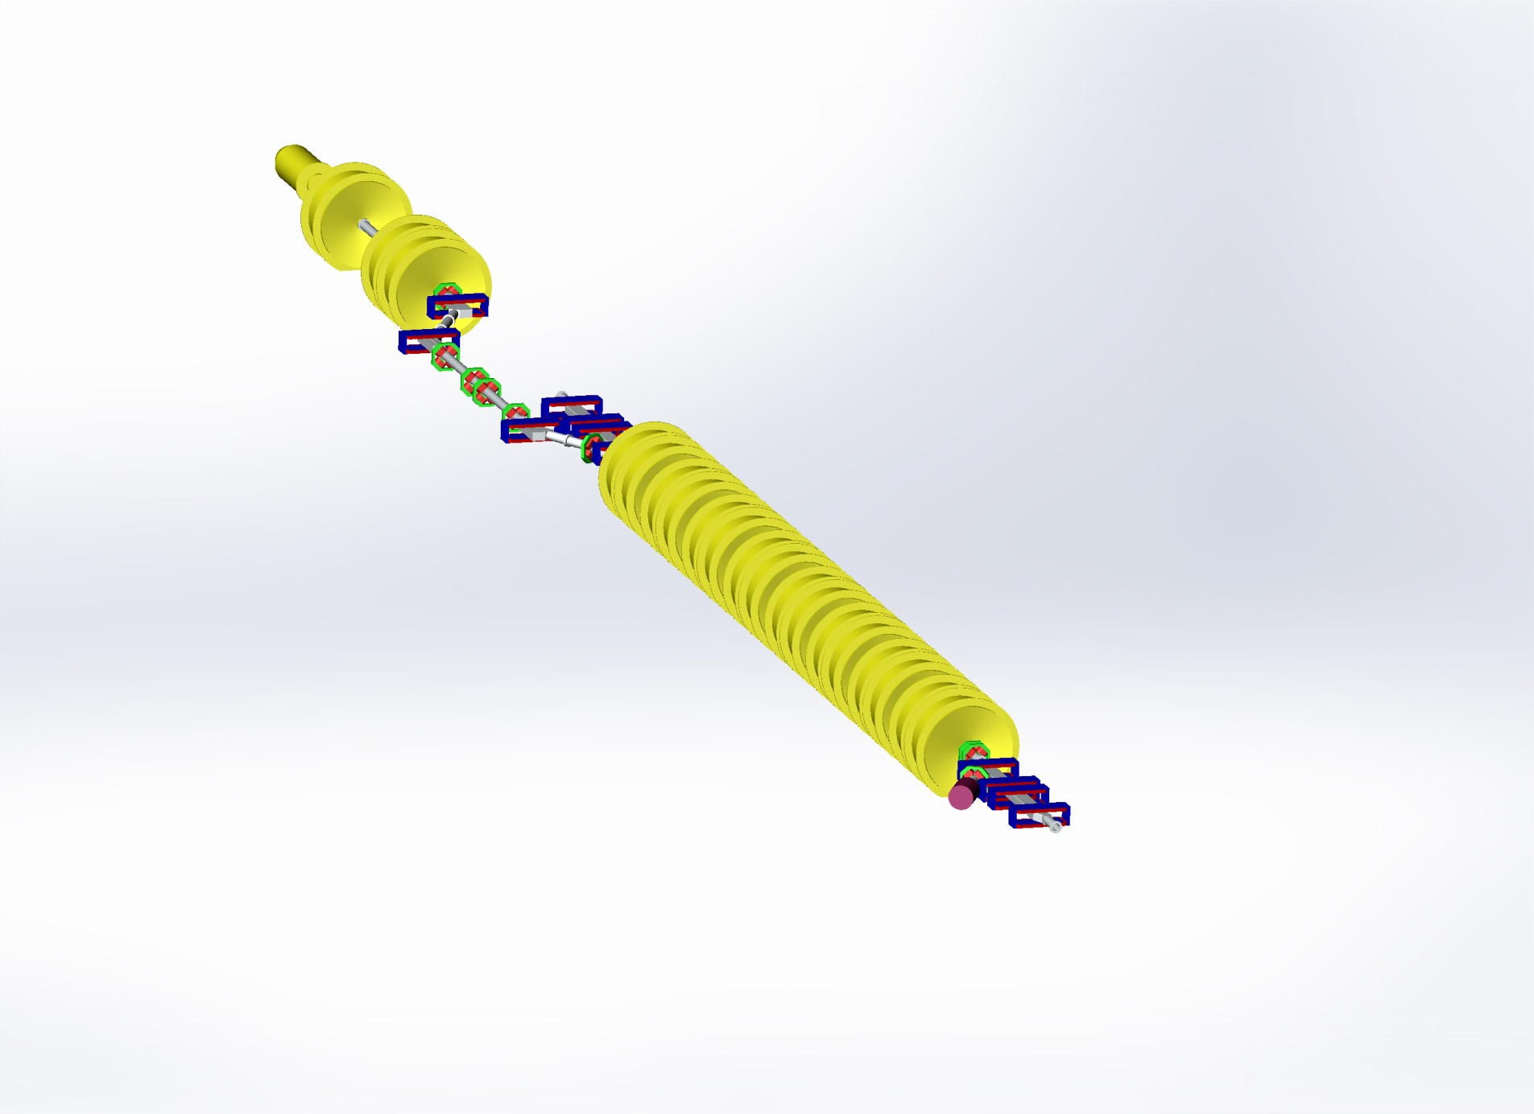
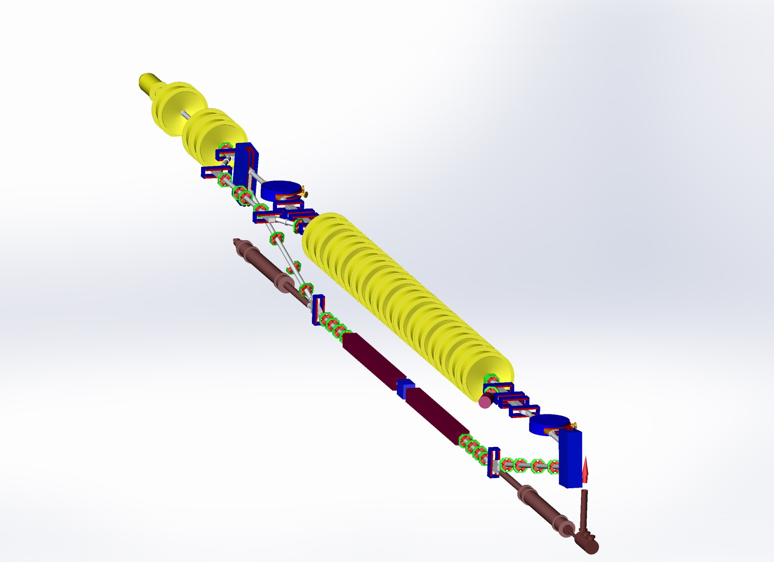
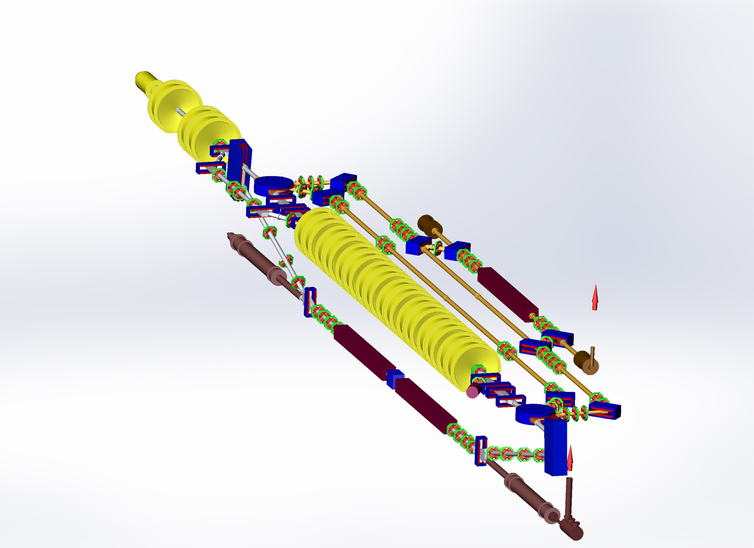
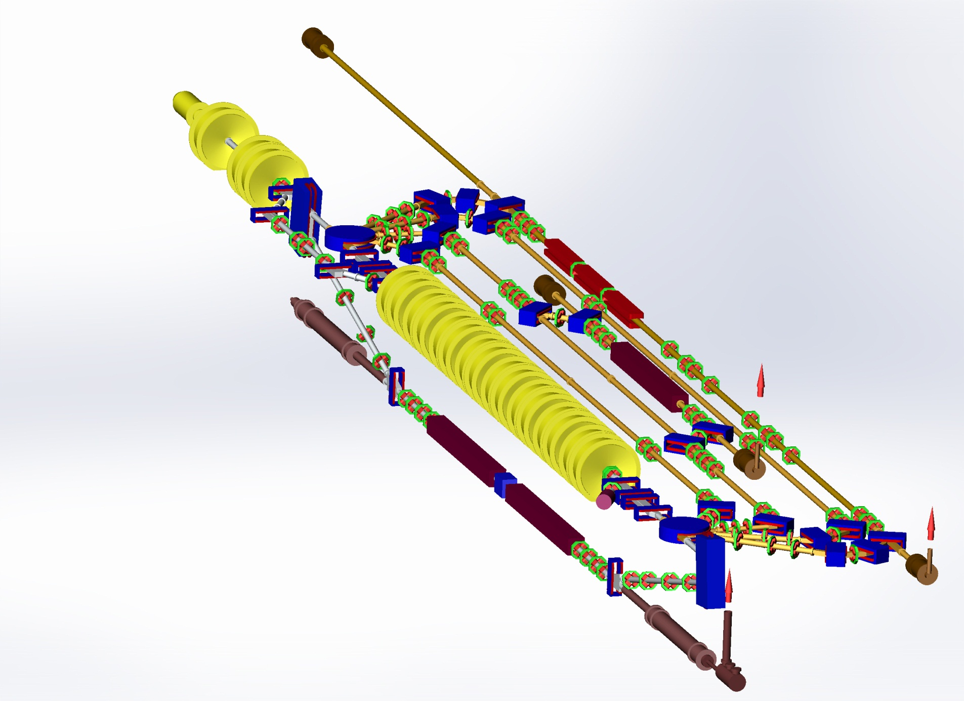
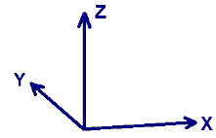
NovoFEL Accelerator Design
Gun
Gun
Gun
Gun
Gun
The third IR FEL
undulator sections
The second FEL
undulator
The second FEL
undulator
Injector
Injector
Injector
Injector
Injector
Main linac
Main linac
Main linac
Main linac
The first THz FEL
undulator sections
The first THz FEL
undulator sections
The first THz FEL
undulator sections
Dump
Dump
Dump
Dump

Slide 18
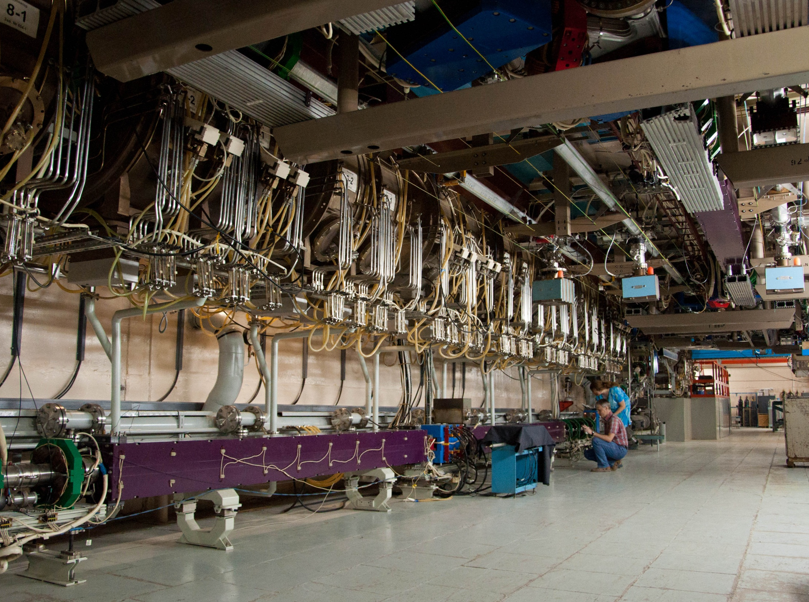
Horizontal tracks
1st stage FEL
undulator
2nd stage FEL
undulator
Main linac

Slide 19
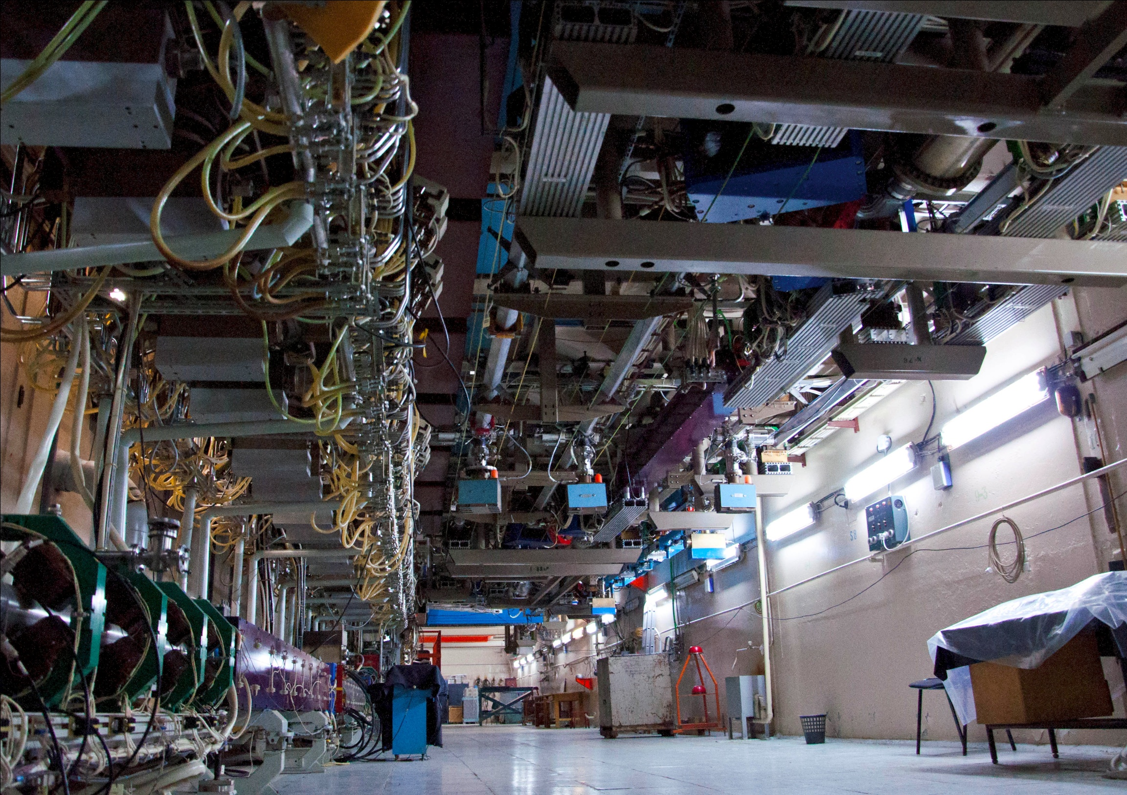
3rd stage FEL
undulator

Slide 20
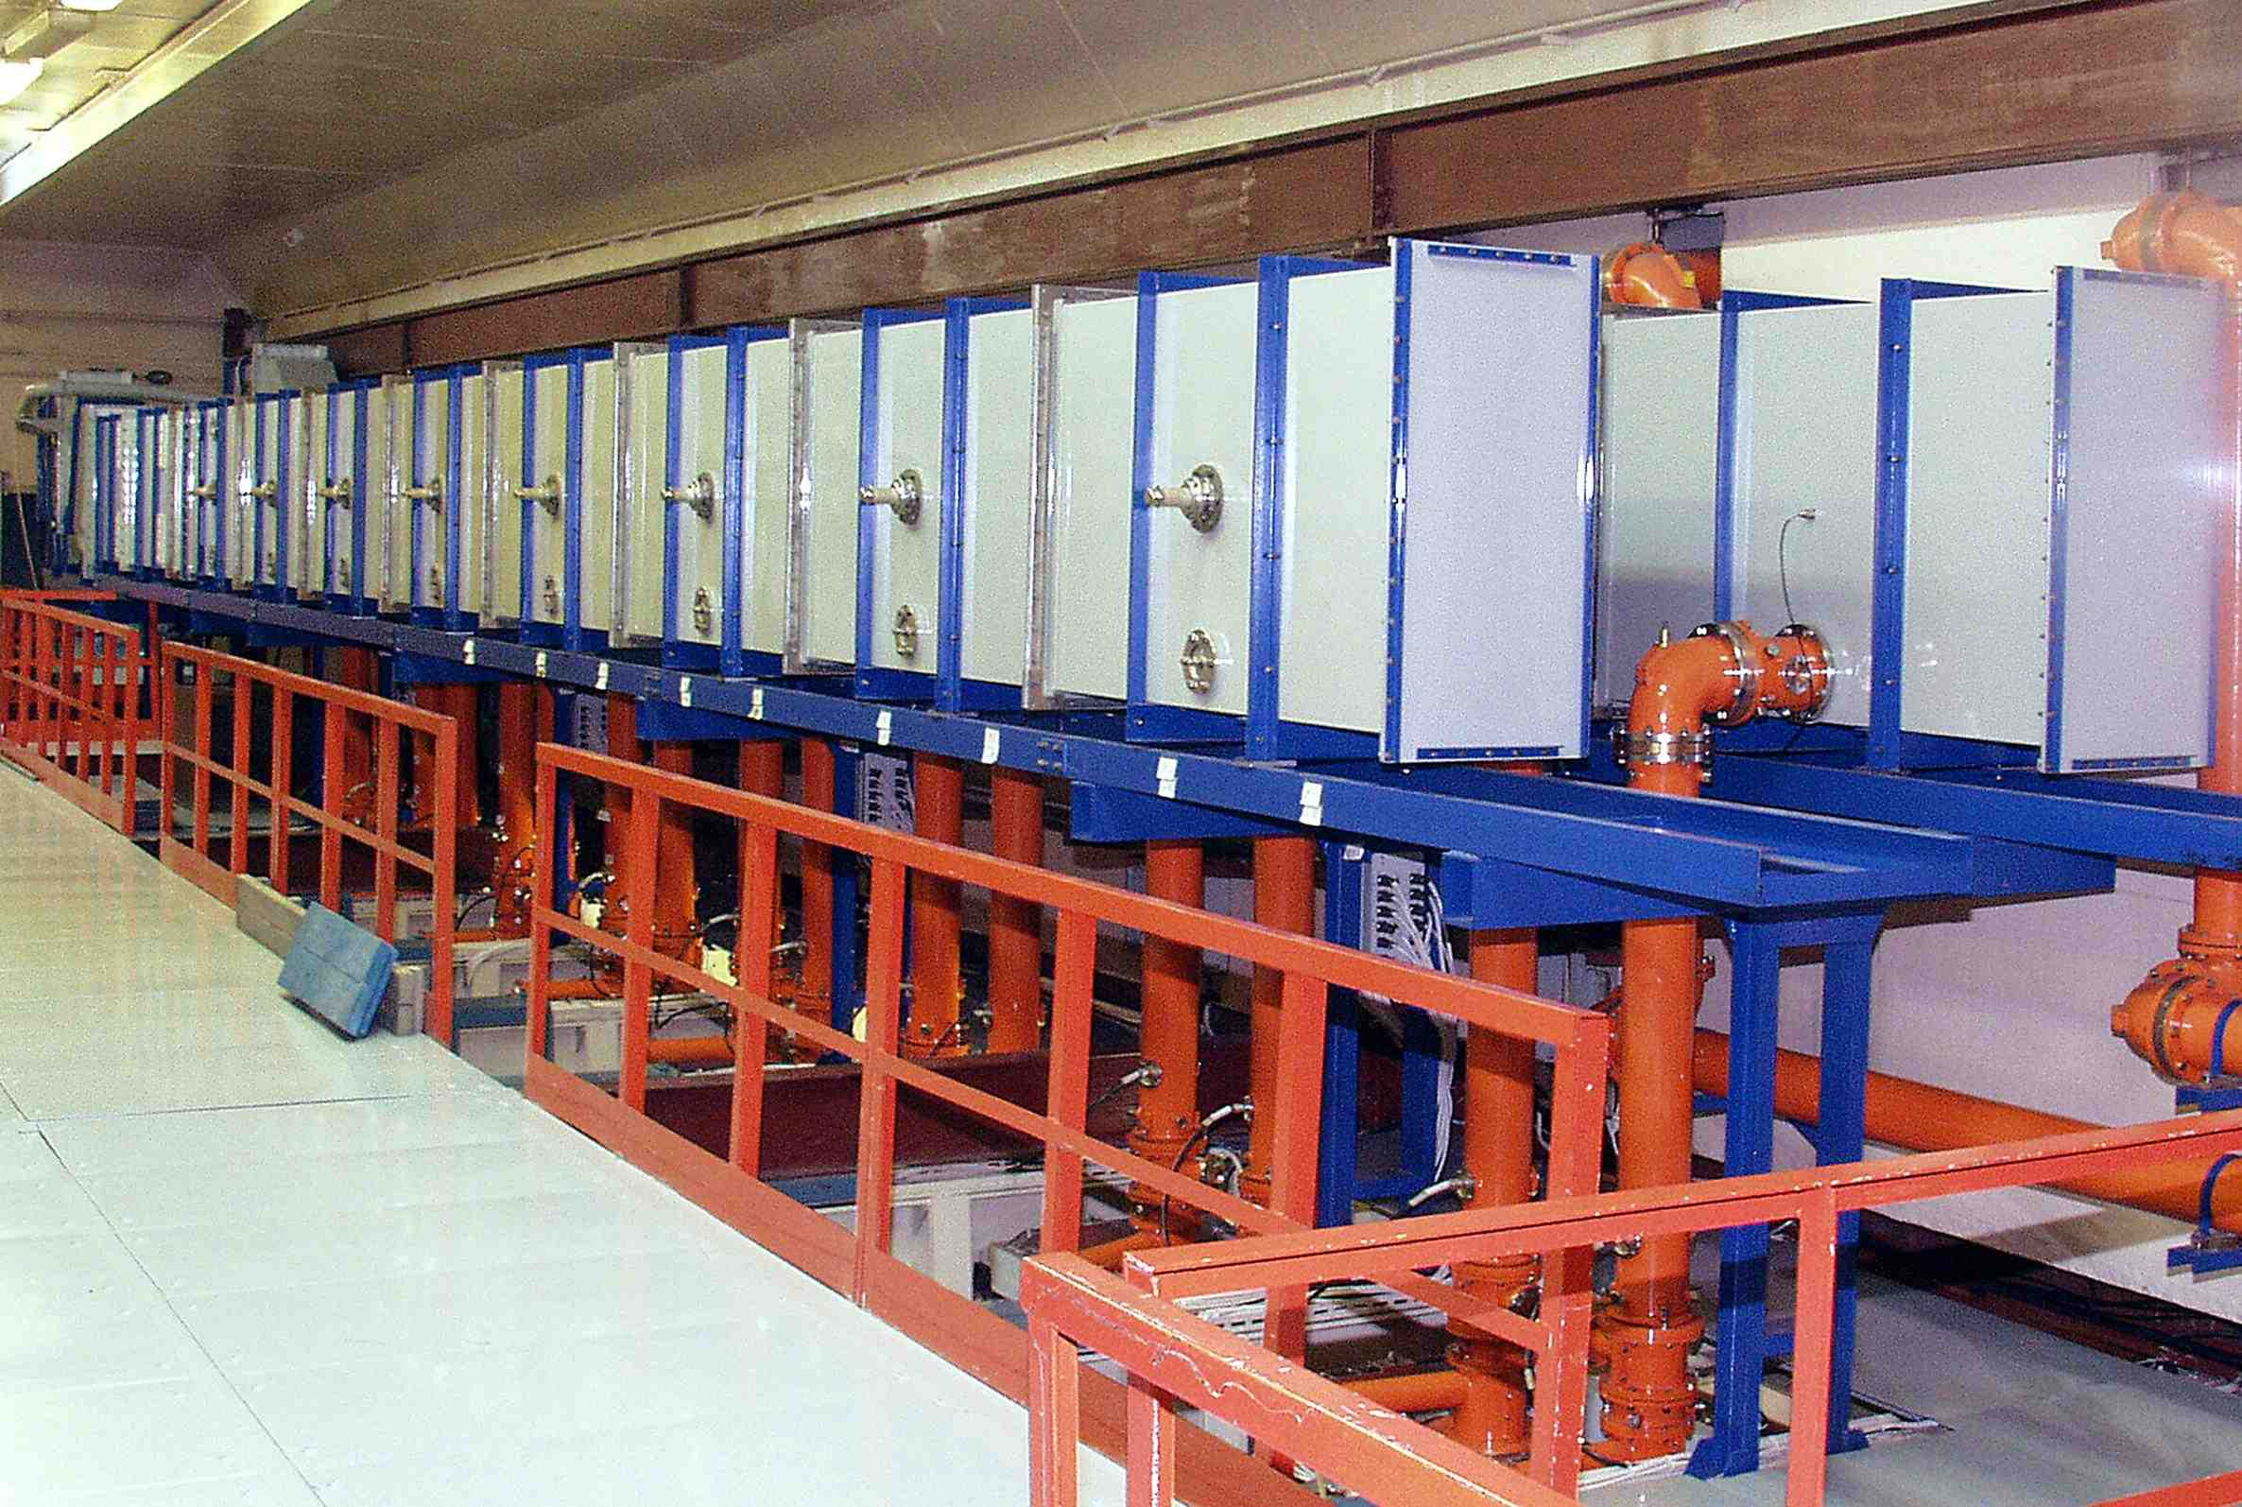
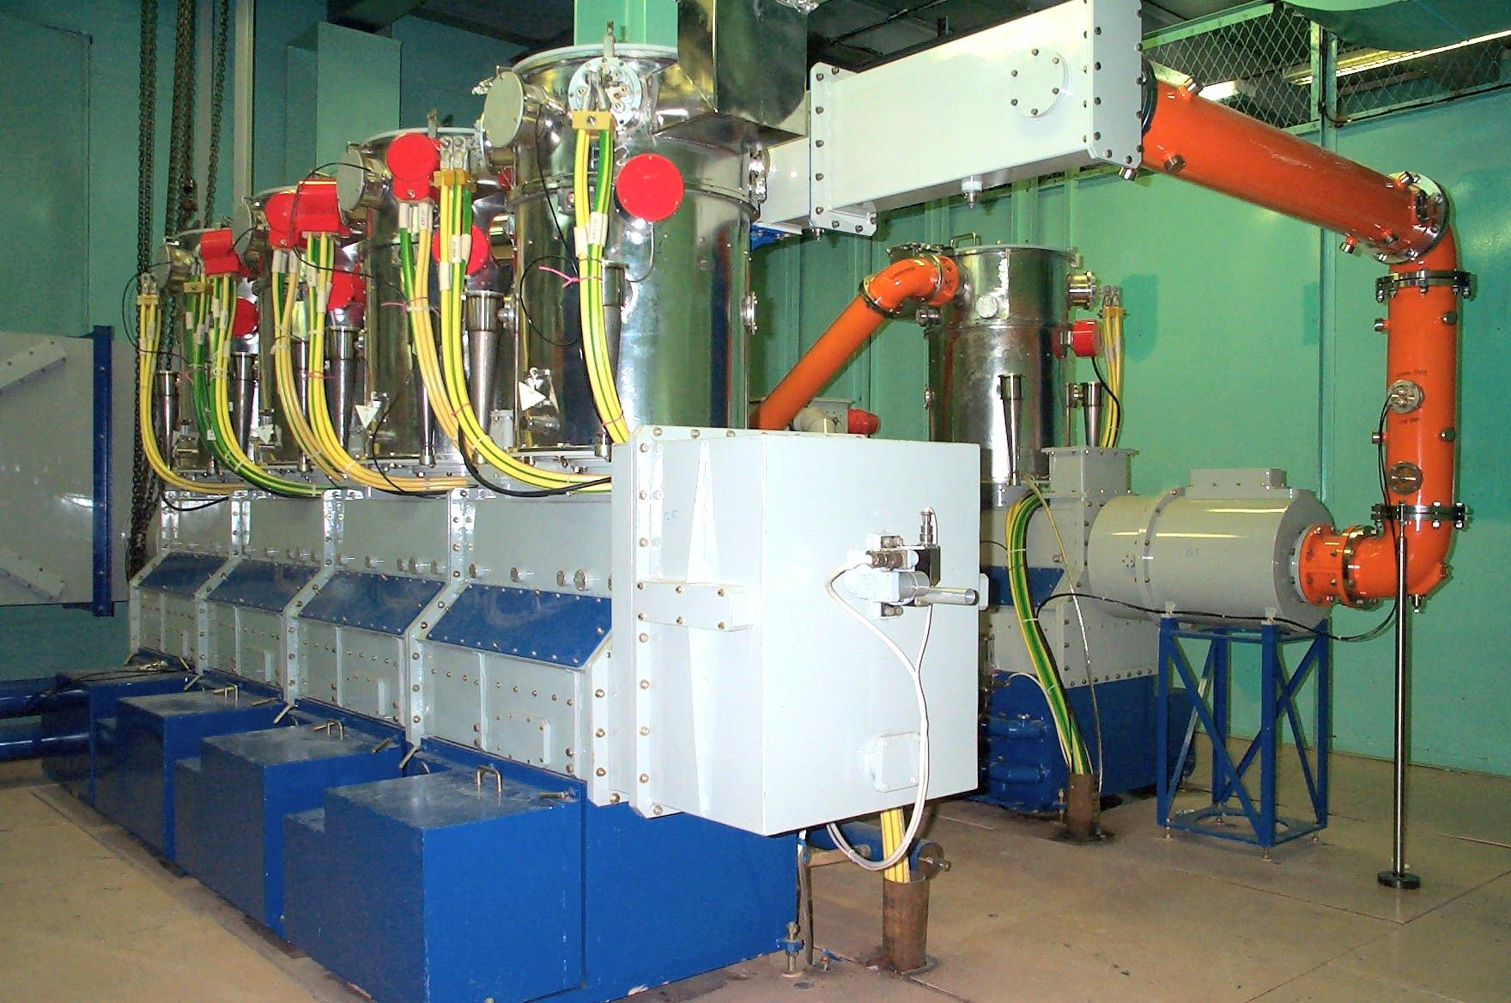
1/2 of the Microtron RF system
8 accelerating cavities
WG/coax power distribution system
180°
Λ / 2
958 x 415
Output stage 4xTH781
4 x 150 kW = 600 kW max
Coax lines to the cavities
RF amplifier

Slide 21
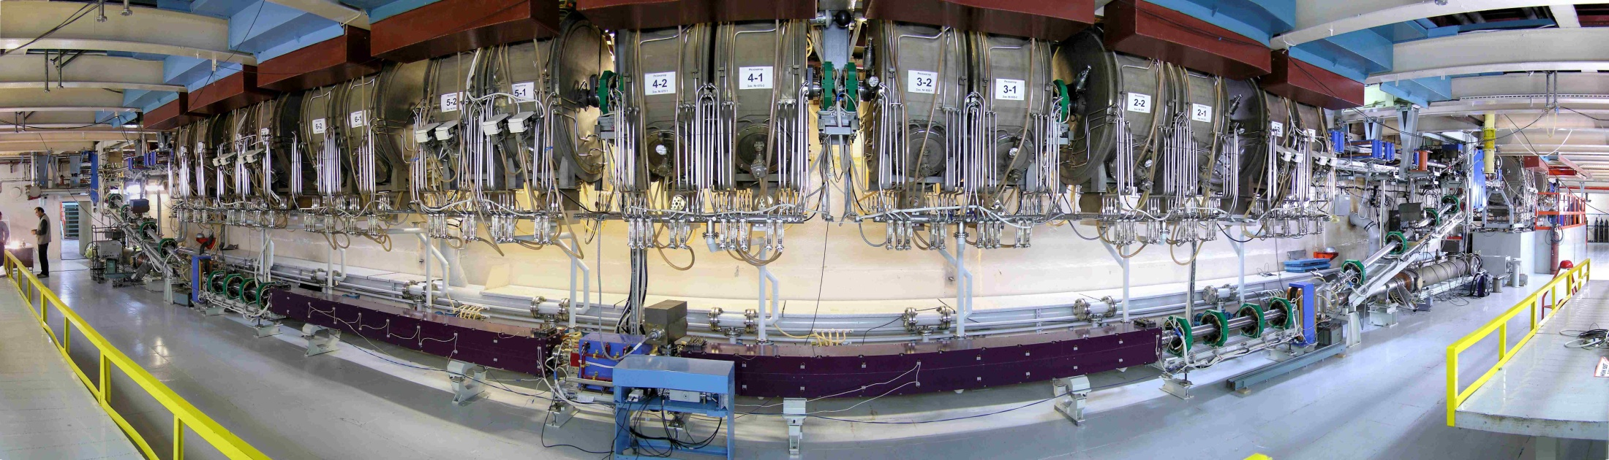
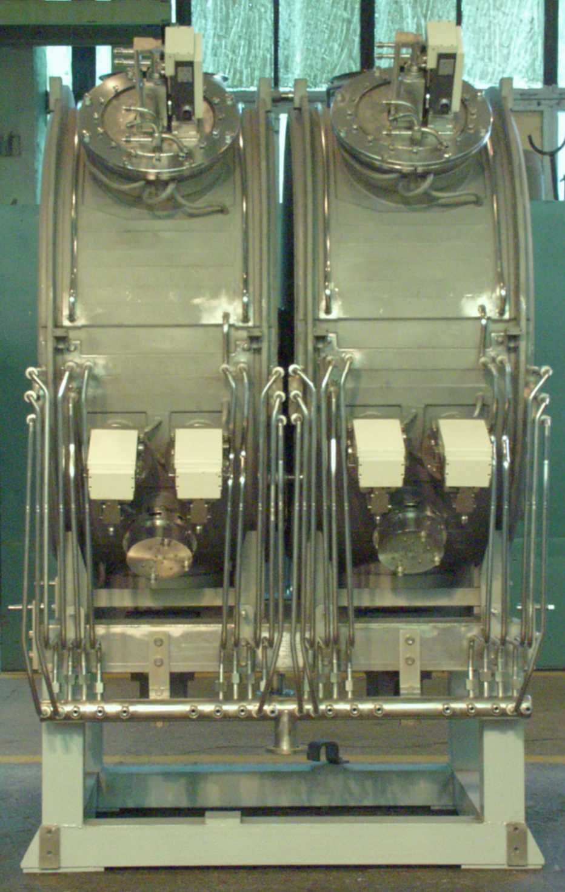
Bi-metal cavities of NovoFEL
SS
Cu
Operating frequency, MHz | 180.4
Tuning range, kHz | 320
Characteristic impedance, Ohm | 133.5
Quality factor | 40⋅10³
Shunt impedance, MOhm | 5.3
Operating gap voltage, kV | ≤ 950
Power dissipation, kW | 85
Transit time factor | 0.9

Slide 22
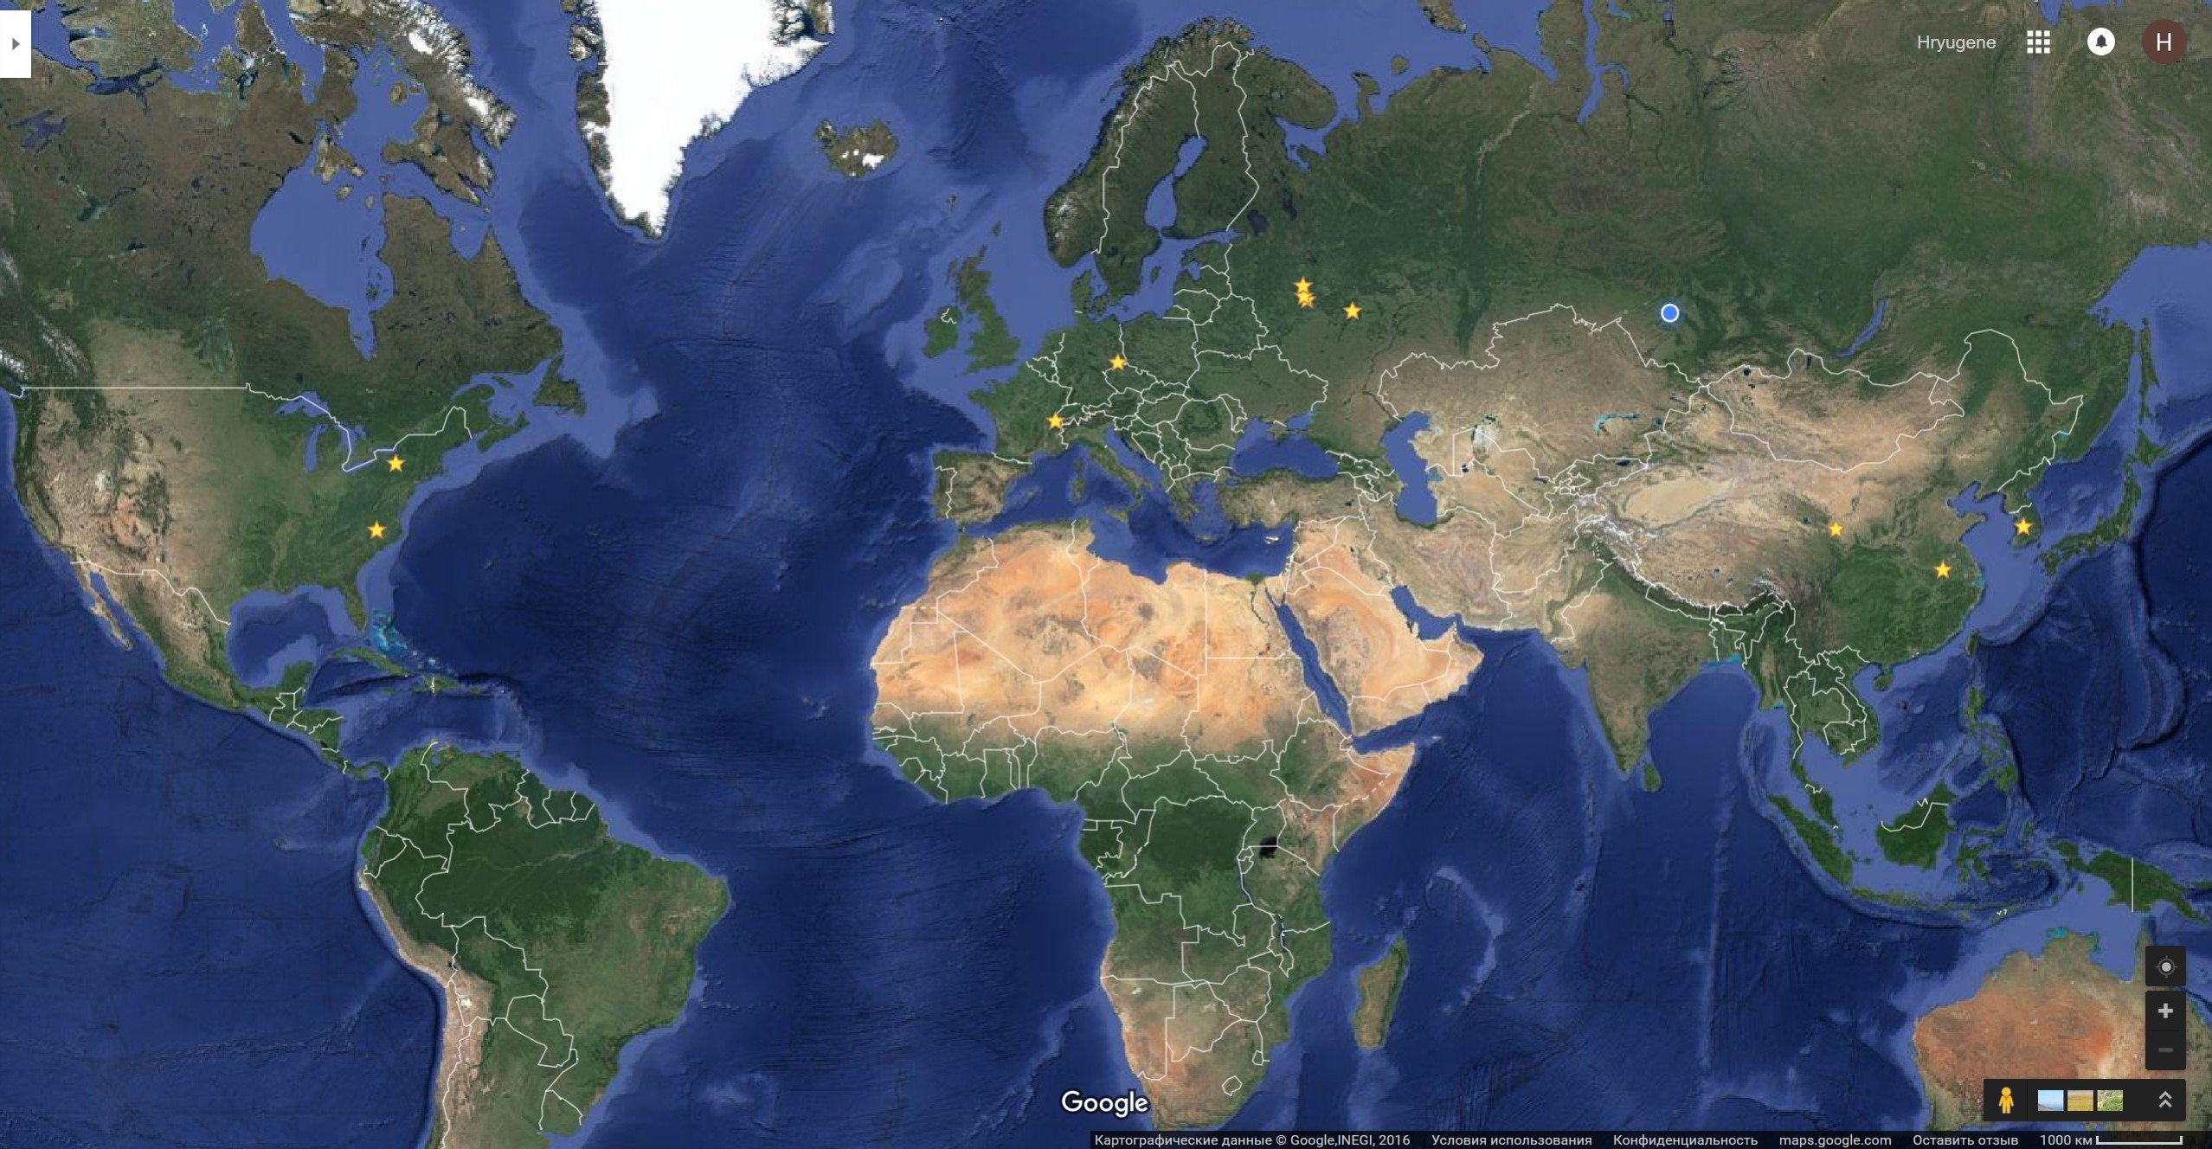
BINP NovoFEL-like cavities over the World
Phy. Devices Zelenograd
Kurchatov Inst.
Moscow
BINP Novosibirsk
2
3
KAERI
Daejeon,
S.Korea
20
5
DFELL
Durham NC,
USA
2

Slide 23
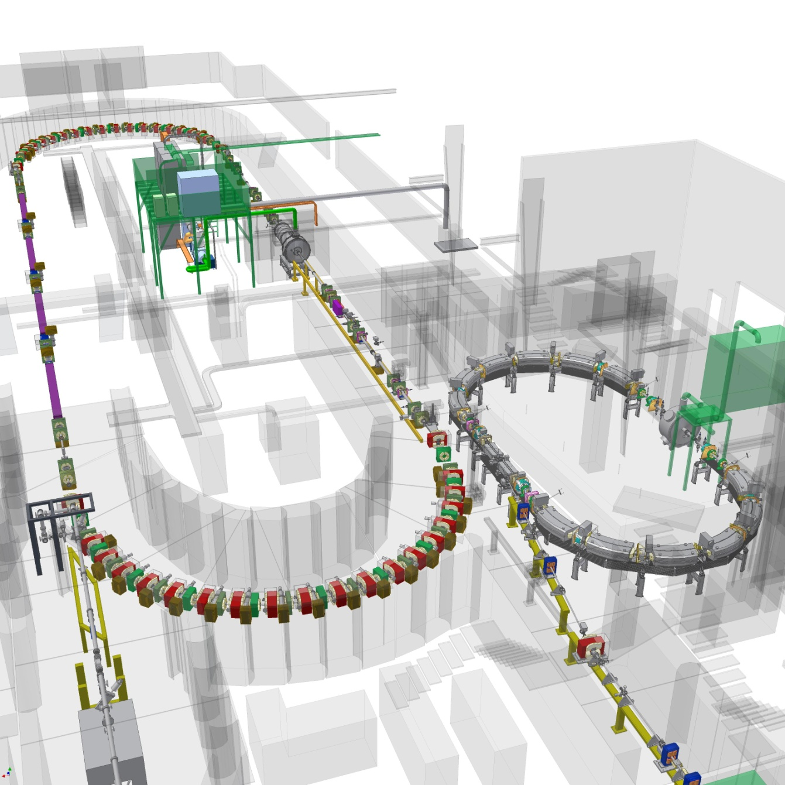
Duke Free Electron Laser Laboratory, Durham NC, USA
Duke-2 cavity
(2004)
Undulators
1.2 GeV
Storage Ring
1.2 GeV Booster
Duke-1 cavity
(1993)
Linac

Slide 24
Single mode cavity for the DFELL
Input Coupler
Fundamental Mode Tuner
Cutoff Waveguide
HOM Load
Gate Valve
Gate Valve
E_{z} (r = 0, z)
RF Pick-ups
Ion / Getter Pump
Cooling Water Manifold
Operating frequency, MHz | 178.5
Tuning range, kHz | 320
Characteristic impedance, Ohm | 150
Quality factor | 40⋅10³
Shunt impedance, MOhm | 6
Operating gap voltage, kV | ≤ 950
Power dissipation, kW | 85
Transit time factor | 0.77

Slide 25
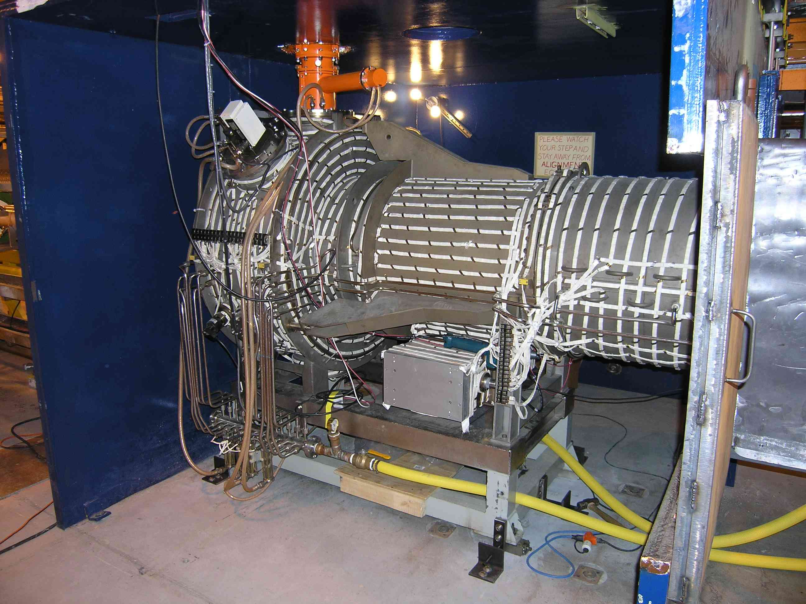
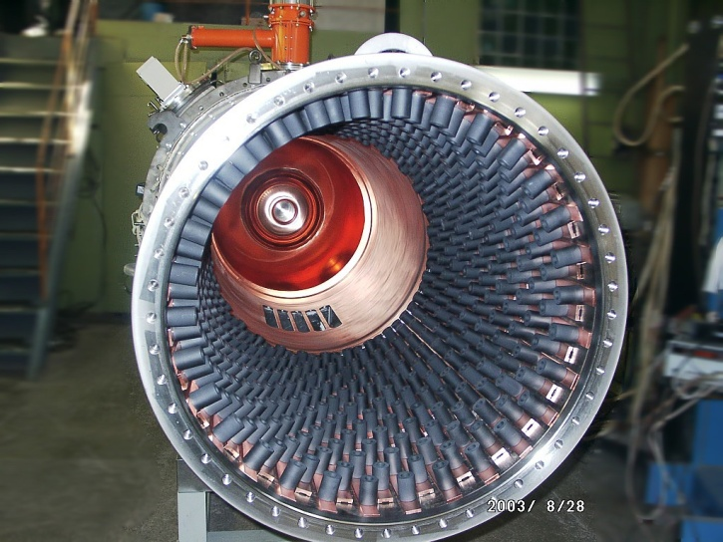
Single mode cavity for the DFELL
HOM damping measurement data:
- amplitude of many HOMs is below the measurement noise level

Slide 26
4. RF electron sources.

Slide 27
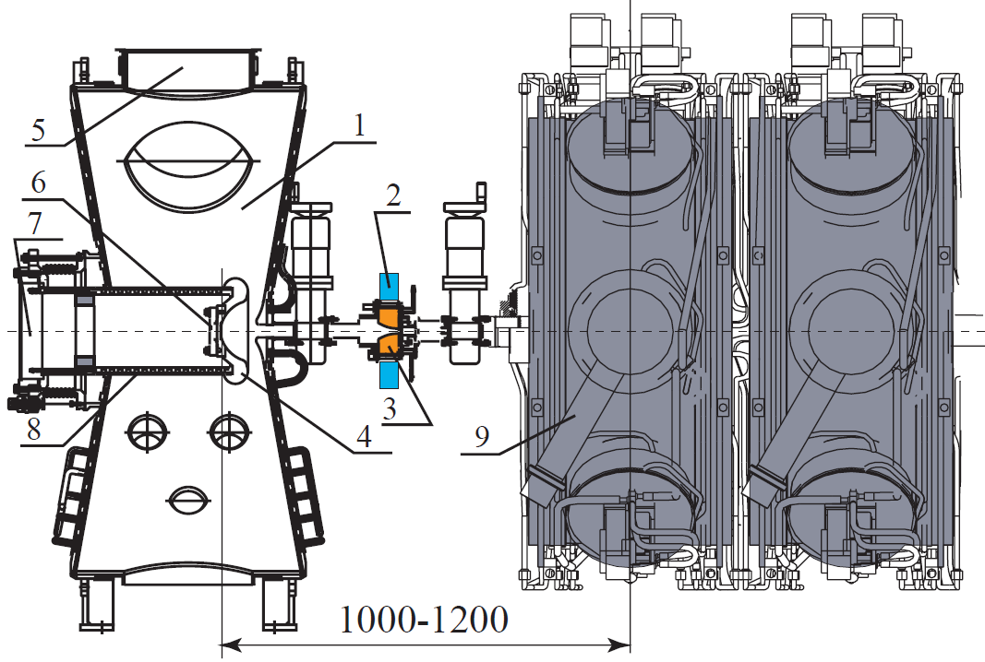
New RF electron source for NovoFEL.
1 – RF gun 90 MHz cavity
5 – input coupler port
6 – cathode-grid unit
9 – accelerating 180 MHz cavity

Slide 28
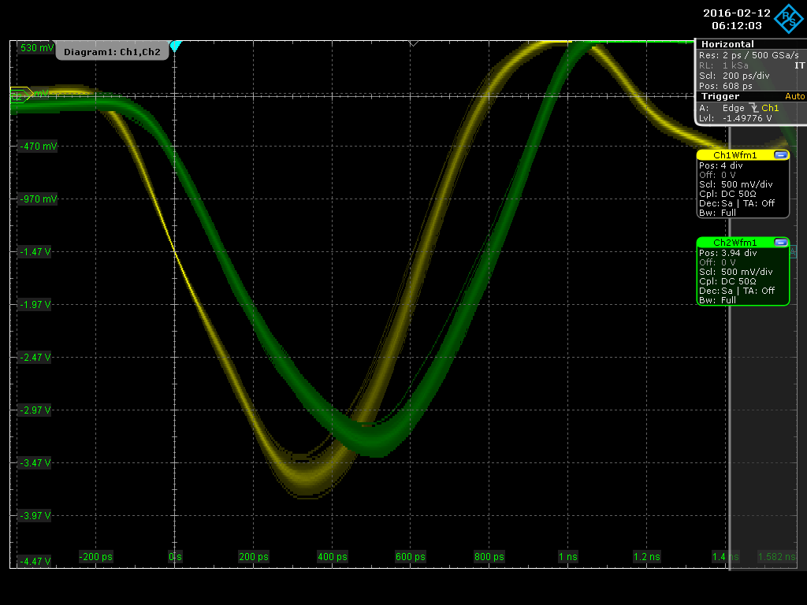
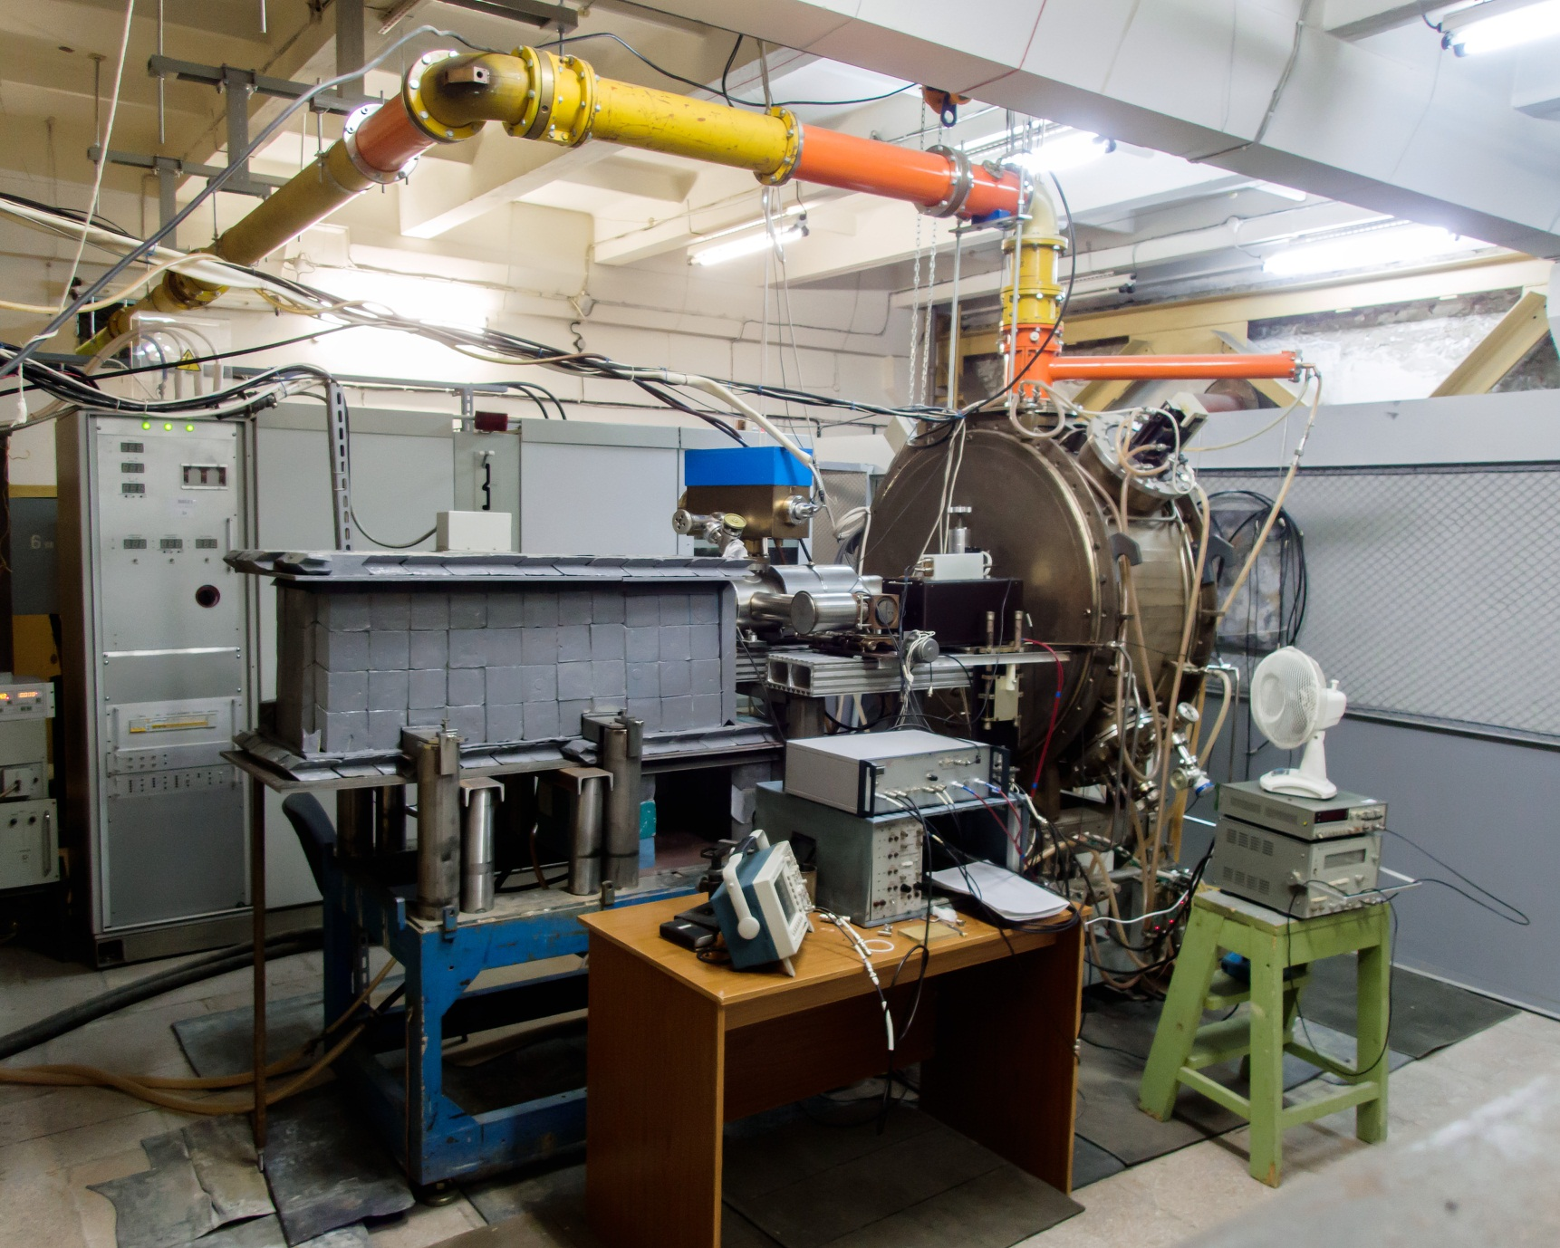
RF Gun Test Setup
575 пс
Measured beam parameters
Energy, KeV | 100 ÷ 320
Pulse duration(FWHM), ns | ≤ 0.6
Bunch charge, nQ | 0.3 ÷ 1.5
Repetition rate, MHz | 0.01 ÷ 90
Average current, mA | 102 max

Slide 29
5. RF for e+e- BINP colliders.

Slide 30
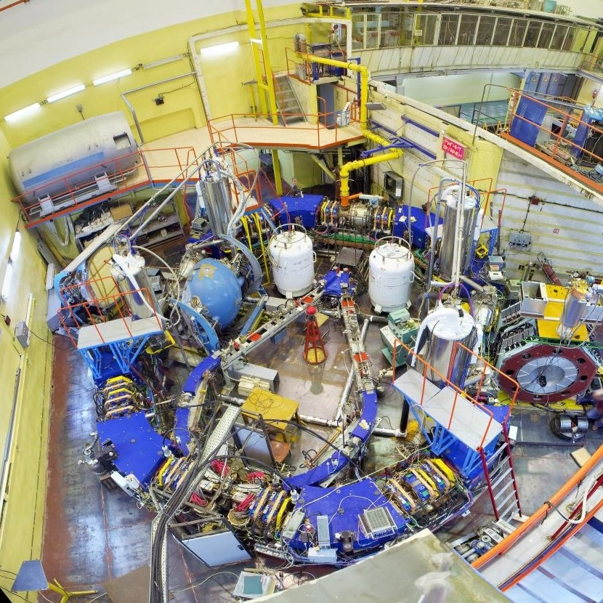
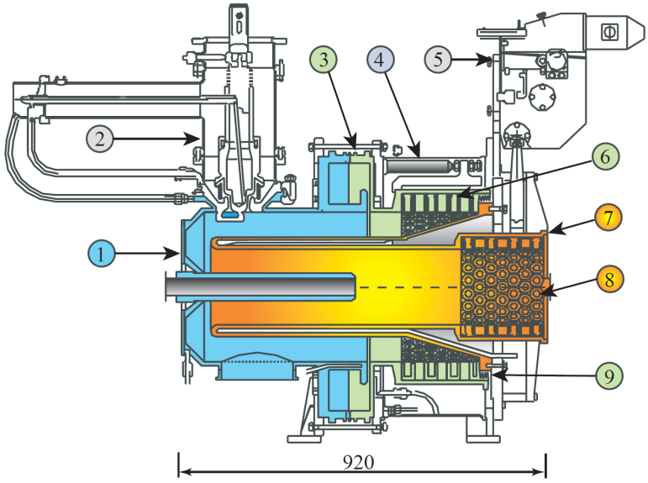
VEPP-2000
RF amplifier
172 MHz, 60 kW CW
Coax feeder
“Single-mode” RF cavity
172 MHz, 120 kV CW
Operating frequency, MHz | 172.09
Quality factor | 8 200
Transit time factor | 0.99
Characteristic impedance, Ohm | 28
Shunt impedance, kOhm | 230
HOM shunt impedances, Ohm | ≤ 300
Operating gap voltage, kV | 120
Cavity power losses, kW | 30
RF power transmitted to beam, kW | 24

Slide 31
6. RF for NICA at JINR, Dubna.

Slide 32
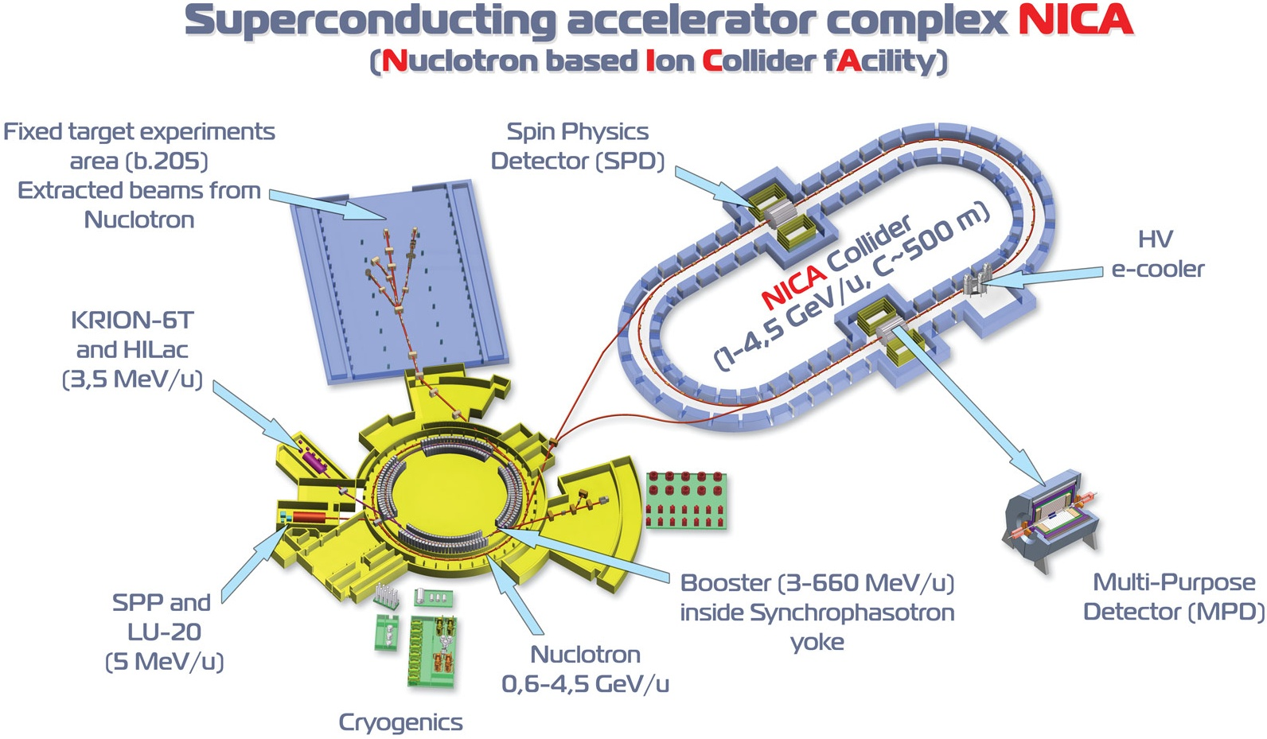
Joint Institute for Nuclear research, Dubna
BINP contribution to the RF:
2 RF stations for the Booster
2 + 8 + 16 RF stations for the Collider
…2023

Slide 33
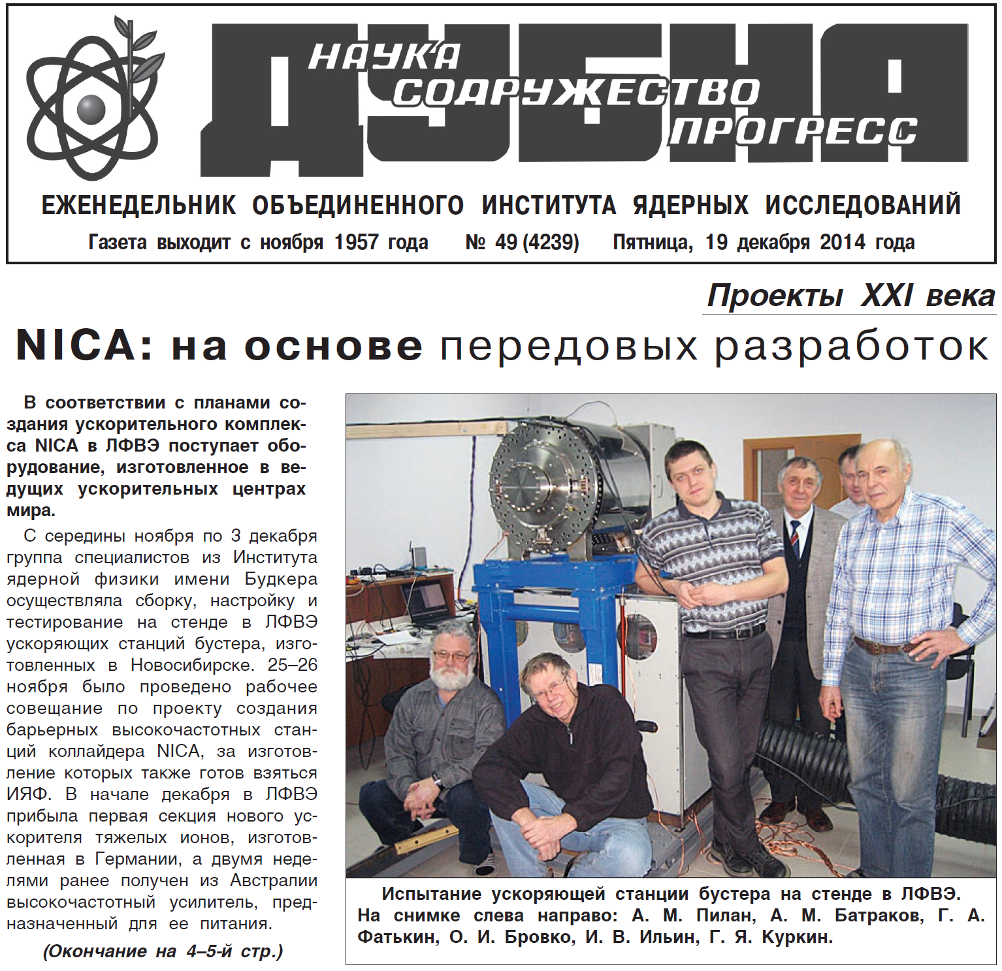
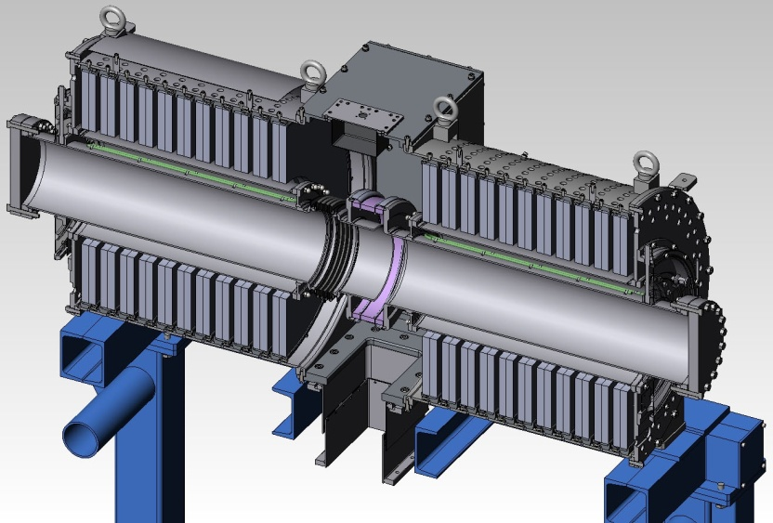
RF stations for the Booster.
6.2 MeV/u
from the Linac
¹⁹⁷Au³²⁺
Booster
RF stations
0.5÷5.5 MHz, 2×5 kV
to the Nuclotron
600 MeV/u
Caxial RF cavity
Amorphous metal
2 RF stations shipped to Dubna in 2014 and successfully tested at a test stand.
Acc.gap
Vac. chamber

Slide 34
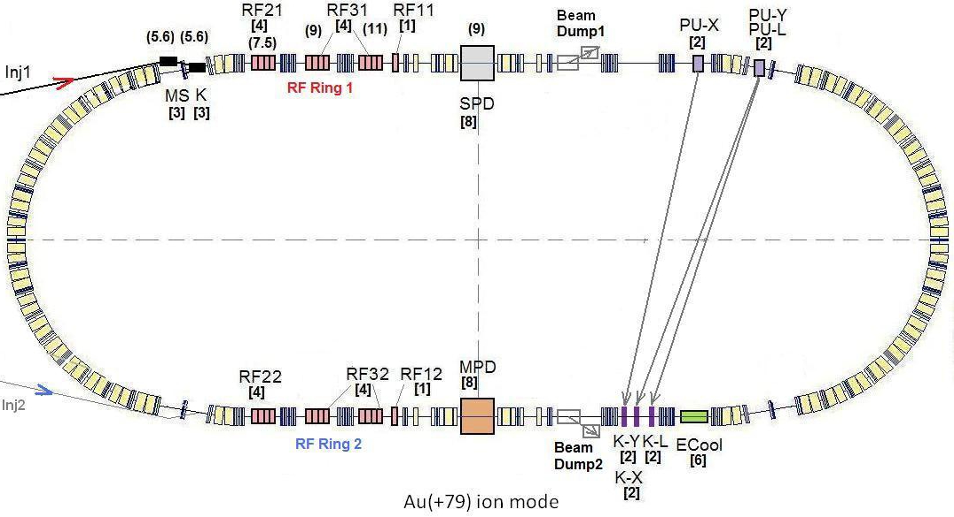
RF stations for the Collider.
RF1 – barrier bucket RF system (±5 kV 20÷80 ns pulses), 1/ring
RF2 – 22nd harmonic RF station (coaxial cavity 11÷13 MHz, 25 kV), 4/ring
RF3 – 66nd harmonic RF station (coaxial cavity 34÷39 MHz, 125 kV), 8/ring

Slide 35
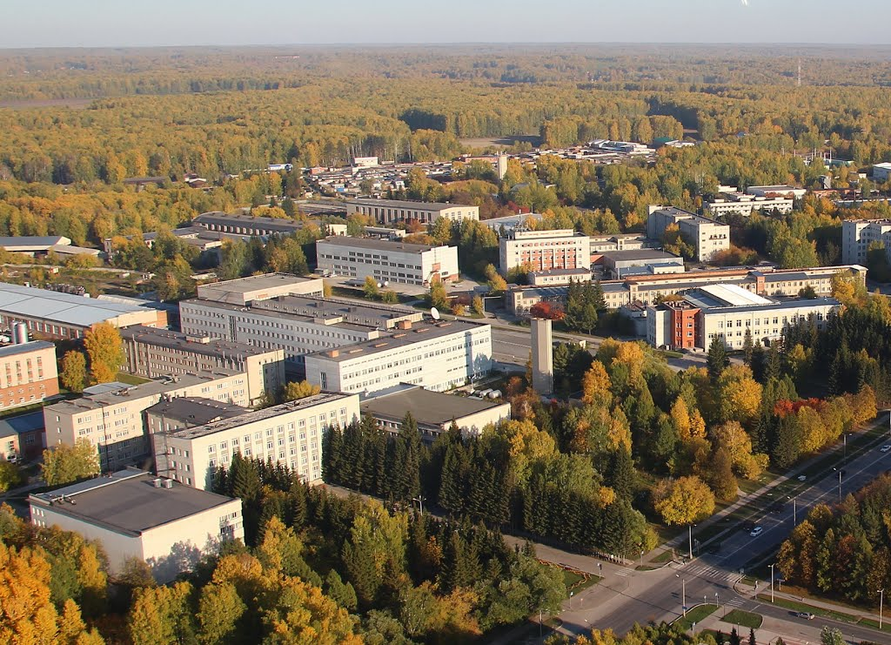
Thank you for your attention and welcome to BINP!
A. Tribendis, BINP 01/02/2017, CERN 1st collaboration meeting on SRF for FCC

