Slide 2
Cold vacuum system
FCC beam screen
  Beam screen functions and concept
  Beam screen prototype manufacturing
  Status
New deformable RF finger module
LHC cold/warm transition

Slide 3
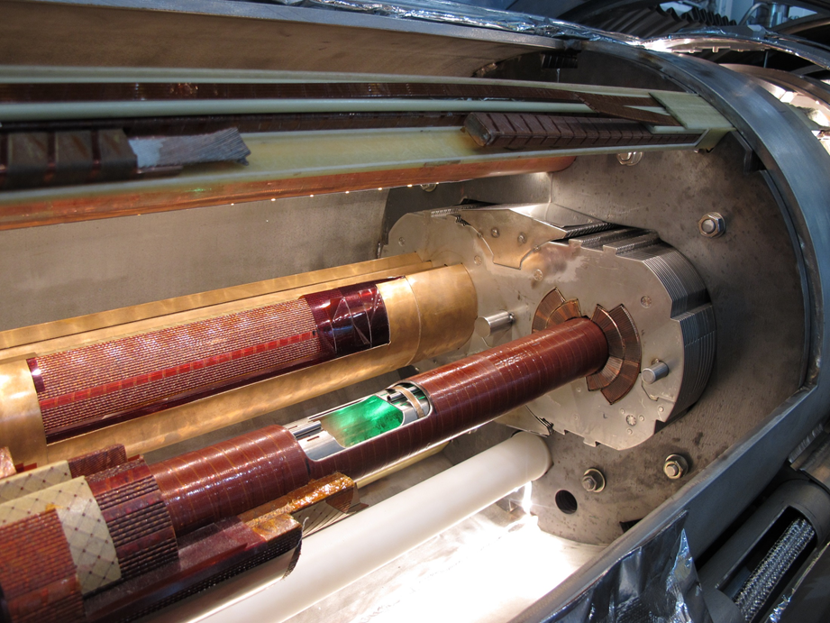
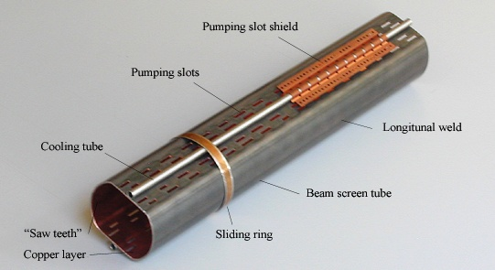
LHC beam screen and cold bore
Cold mass
Coils
Cold bore: separation UHV/ superfluid helium
Beam screen

Slide 4

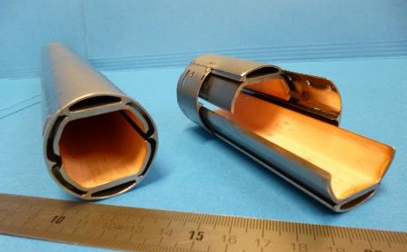
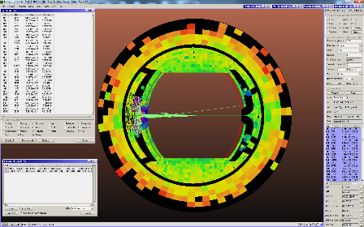
Synchrotron radiation/beam screen
Handling of high synchrotron radiation load of protons @ 50 TeV:
~30 W/m/beam (@16 T) (LHC <0.2W/m)
5 MW total in arcs
New beam screen with ante-chamber
absorption of synchrotron radiation at 50 K to reduce cryogenic power
avoids photo-electrons, helps vacuum
Photon distribution

Slide 5
Beam screen concept
Cooling channels
Magnet cold bore
Copper layer, 0.3 mm for impedance
Screen
Deflector
Copper strips for heat transfer
Ribs:
Mechanical strength
Photon stopper
Pumping holes

Slide 6
Design – Main dimensions
Cold bore diameter: 44/47 mm
Beam screen wall:
  1.25 mm P506 (high-Mn high-N st. steel)
  0.3 mm copper
Nominal aperture:
  H:~ 29.6 mm
  V:~26.4 mm
Slit height: ~ 3/5 mm
Cooling channel:
  Thickness 1 mm
  Internal 53.58 mm²
  Hydraulic diameter: 5.61 mm
Copper for heat transfer: 0.3 mm

Slide 7
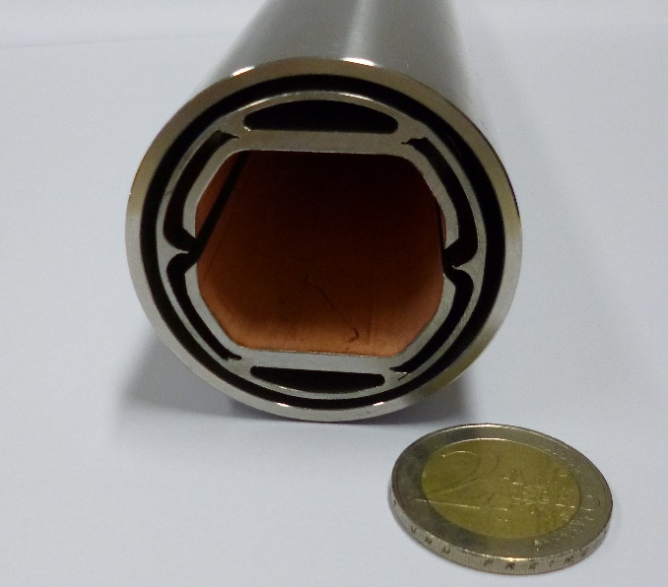
Prototypes
Series vs first prototypes
Sub-component manufacturing:
Series
1st prototype
Beam screen wall:
P506, 1.25 mm
copper colamination, 0.3 mm
Beam screen wall:
304L, 1. 5 mm
copper electrodeposition, 0.05 mm
Ribs:
304L
Laser cutting
Ribs:
P506
punching
Reflector:
304,
Machined + forming + finishing
Cooling channel:
P506 stainless steel
Extruded
Reflector:
P506 stainless steel
Extruded + finishing
Cooling channel:
316L,
3D printed + machined

Slide 8
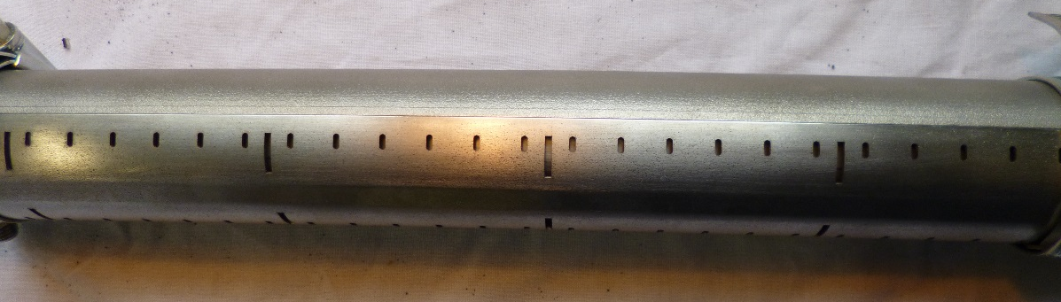
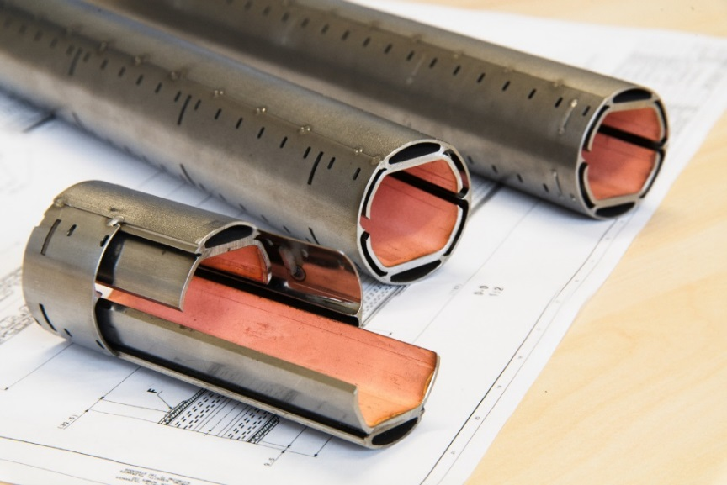
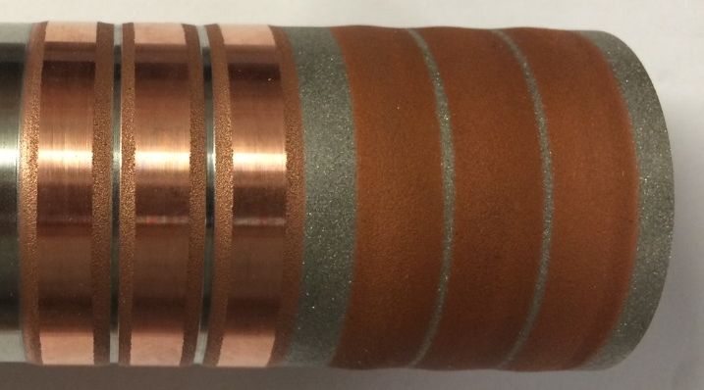
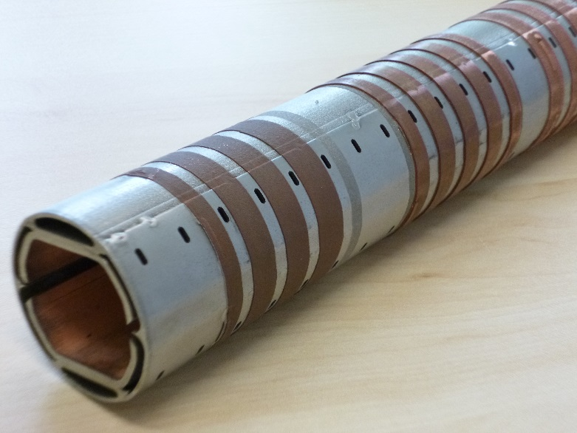
Short (30 cm) prototype manufacturing
Assembly and welding
30 cm long prototypes
Cold sprayed copper (0.3 mm)

Slide 9
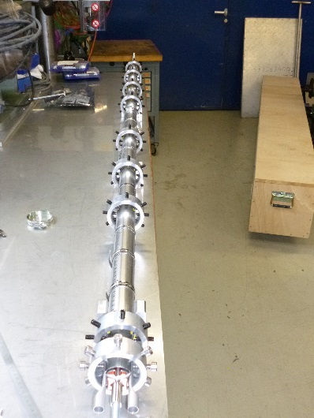
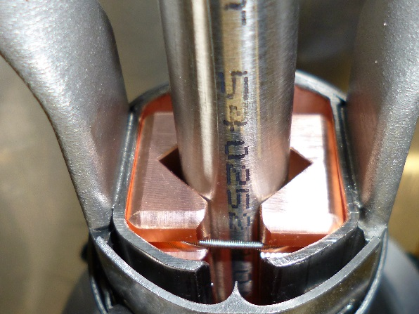
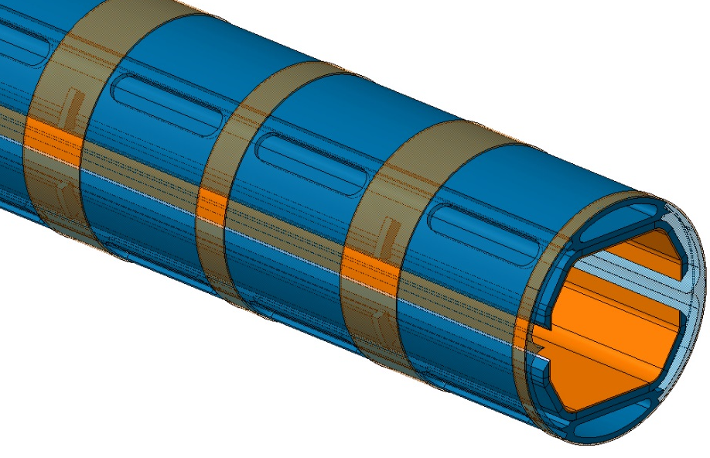
Status
First 2m long prototype being manufactured and to be tested at ANKA.
2 m long prototype
Next steps:
New prototypes with updated design
Beam screen interconnection
Updated design

Slide 10
HL-LHC cold vacuum system layout principle
Cold mass
Cryostat vacuum vessel
Cold bore
Bellows
Beam screen
IP
side
BPM
BPM
Connection beam screen/cold bore
Fixed point Cold mass/ vacuum vessel
Fixed point of the beam screen on the IP side
Bellows between beam screen and cold bore on the other side
Shielded bellows between the two magnets (PIM)

Slide 11
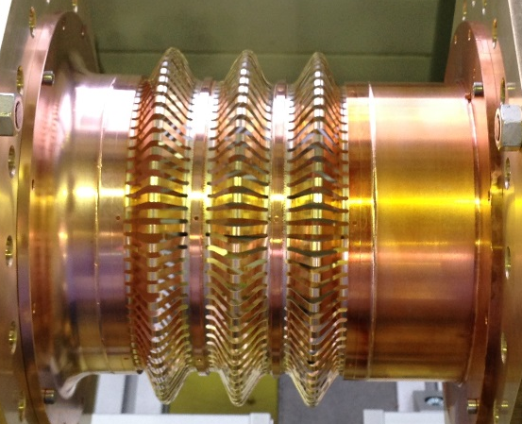
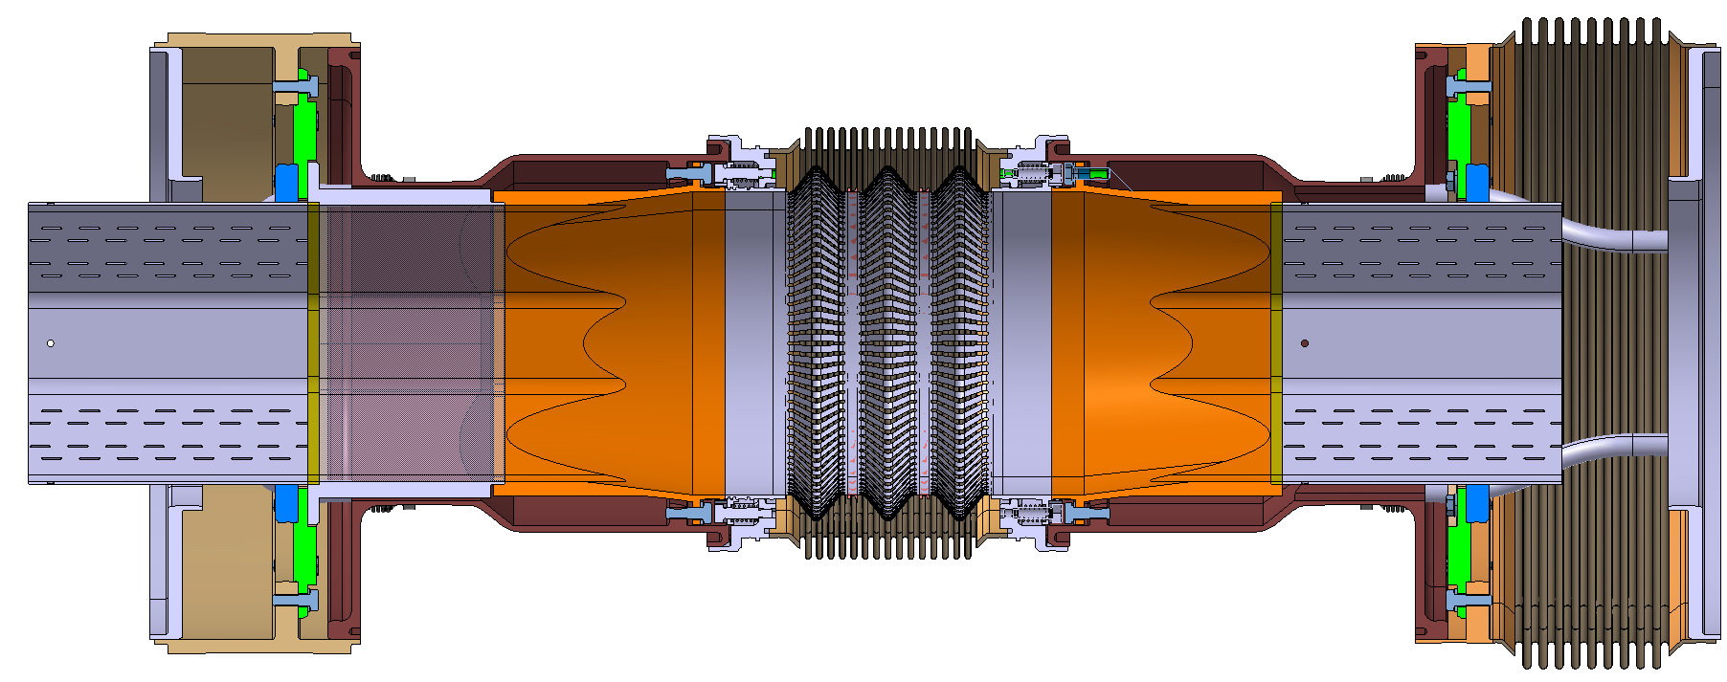
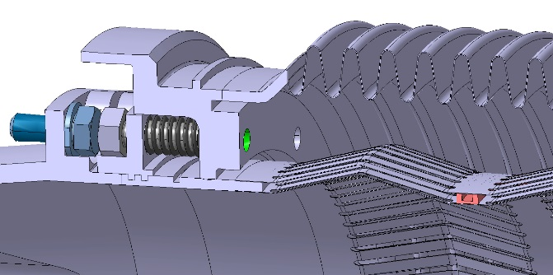
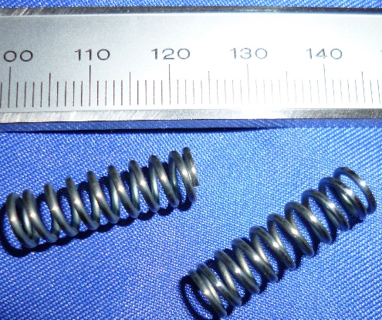
RF finger design in triplet area
Copper Beryllium deformable RF fingers:
Compact and robust design
C17410
0.1 mm thick, 3 mm width, gap: 1.4 mm
φ131
Copper insert
Beam vacuum interconnection (BPM not integrated)
Static RF fingers
Titanium spring (total prestress: ~370 N)

Slide 12
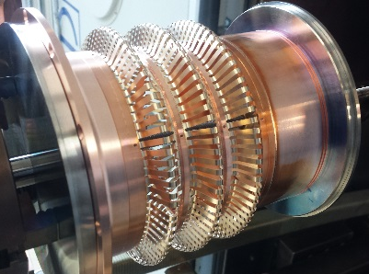
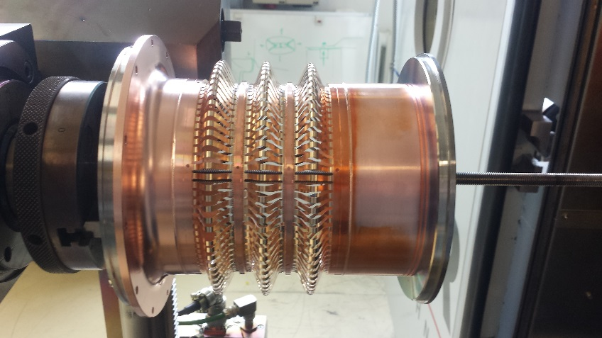
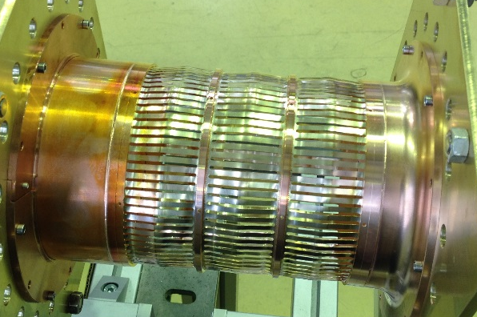
Status
First prototypes have been manufactured.
Mechanical and RF tests have been successfully carried out.
Prototype assembly
Plug-in modules with deformable RF fingers are now the baseline for the HL-LHC interconnections in the triplet areas.
Prototype for RF measurements
The design is being updated.
New prototypes will have to be produced and tested before the series production.

Slide 13
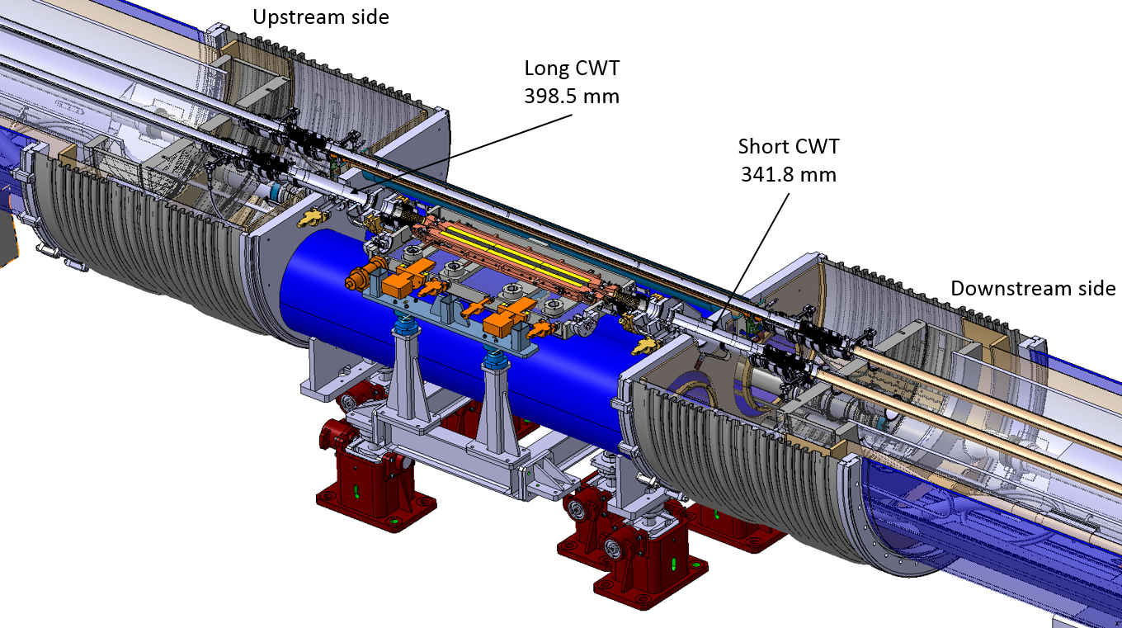
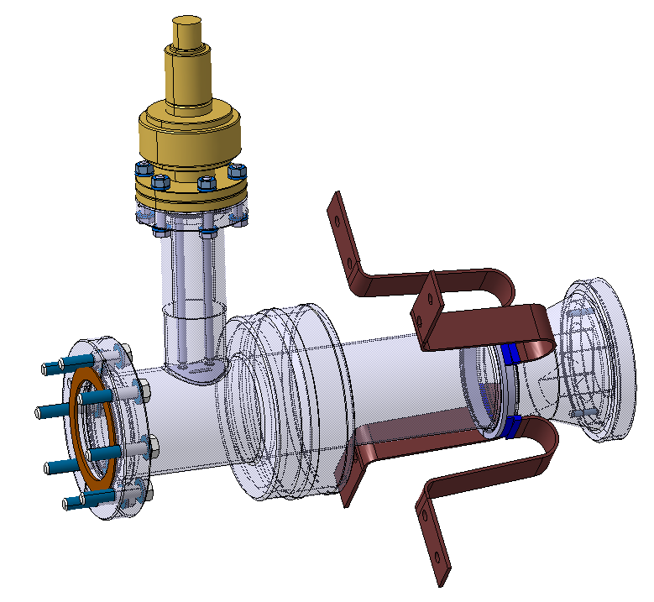
Cold/Warm transition for the collimator by-pass
Vacuum system for the collimator by-pass
New C/W transition with vacuum port integrated
The design is being completed (2D detailed drawings ongoing).
Manufacturing of two pre-series units (straight after) and then the series.

Slide 15
Beam screen concept - Principle
Photons are channelled in the antechamber and stopped onto the ribs.
Photondesorpted gas is channelled in the antechamber and pumped through pumping holes.
Synchrotron radiation power is deposited mainly on the deflector tip and the ribs and is transferred to the cooling circuit by the external copper.

