Slide 1





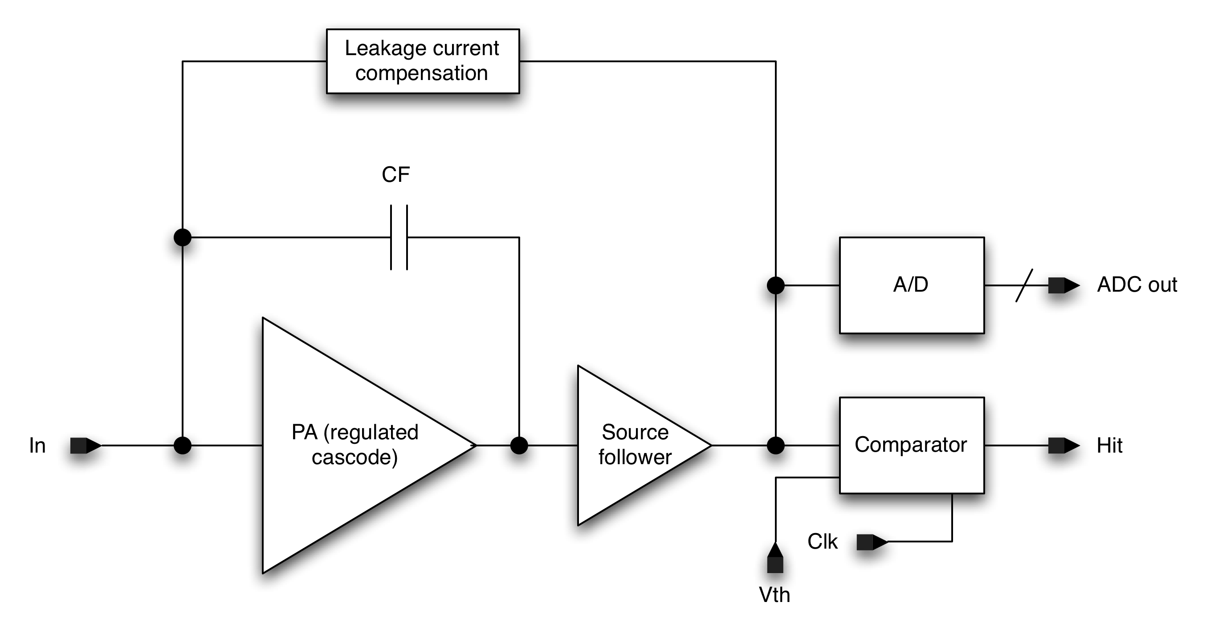
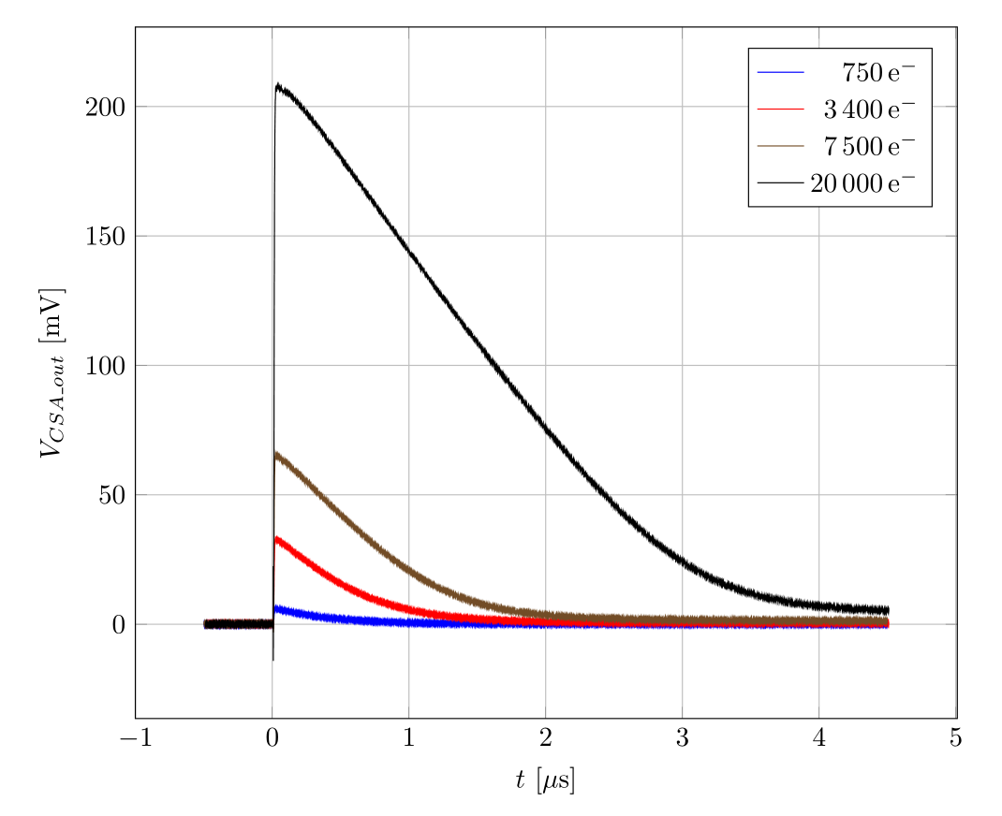
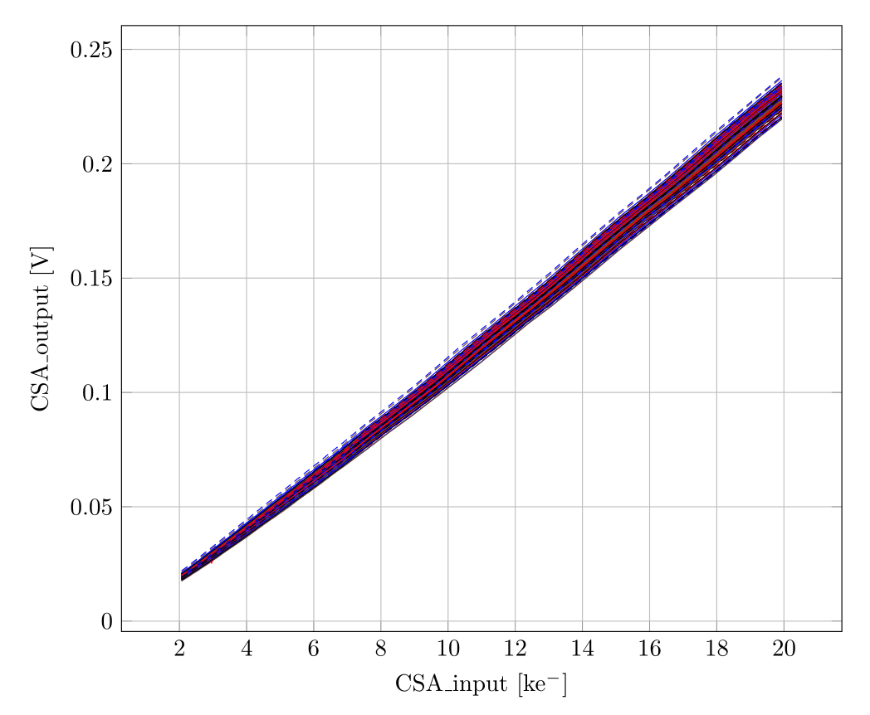
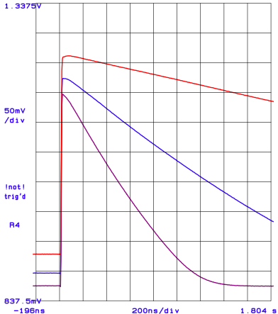
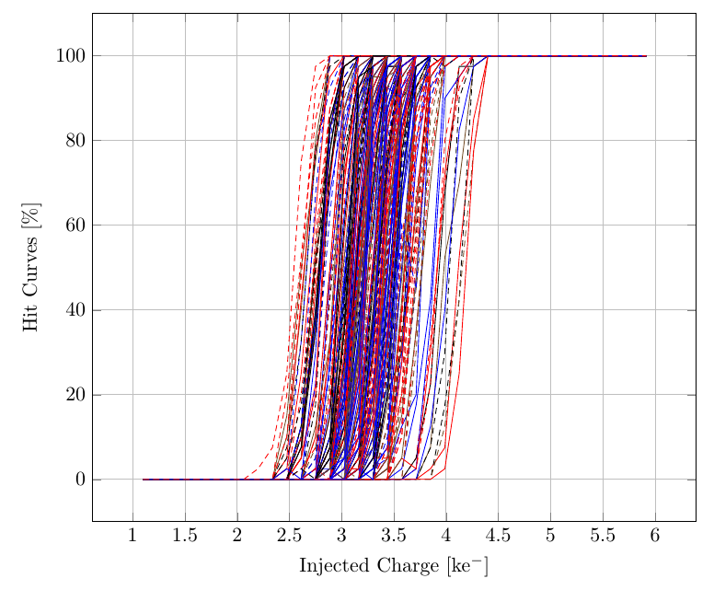
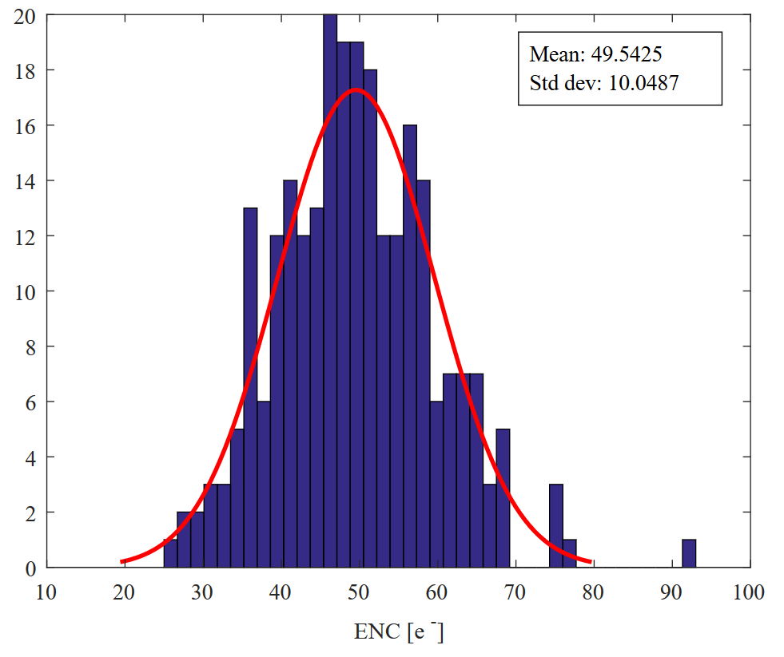
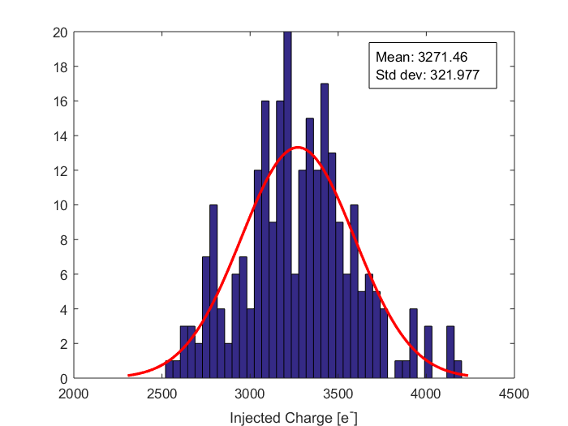
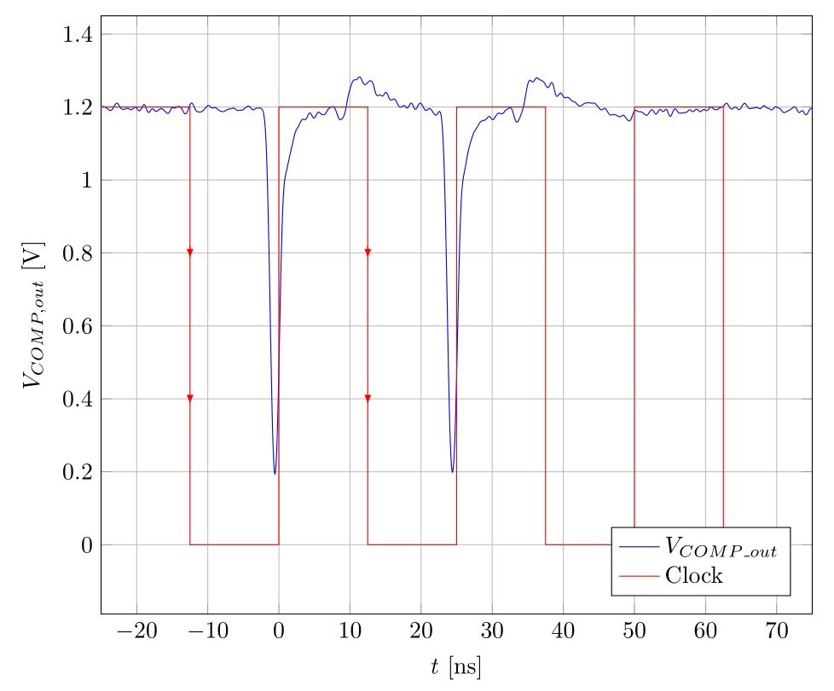
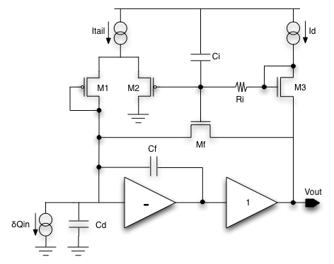
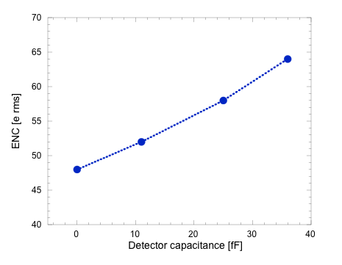
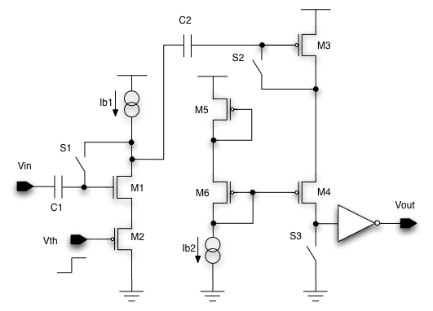
¹ University of Bergamo
Department of Engineering
and Applied Sciences
Dalmine (BG), Italy
A 65nm CMOS Front-End with Zero Dead Time for Next Generation Pixel Detectors
³ INFN
Sezione di Pavia
Pavia, Italy
² University of Pavia,
Department of Electrical, Computer
and Biomedical Engineering,
Pavia, Italy
L. Gaioni^{1,3}, D. Braga⁴, D. Christian⁴, G. Deptuch⁴, F. Fahim⁴, B. Nodari^{5,} L. Ratti^{2,3}, V. Re^{1,3} and T. Zimmerman⁴
⁴ Fermilab
Batavia IL, USA
⁵ Institute of Nuclear Physics (IPNL), CNRS/IN2P3, Lyon, France
Introduction
The Macro Pixel ASIC
Analog Front-end
The next generation of pixel chips at the High-Luminosity LHC (HL-LHC) will operate with extremely high particle rates and radiation levels. In the so-called Phase II upgrade, ATLAS and CMS will need a completely new tracker detector, complying with the very demanding operating conditions and the luminosity delivered by the machine (up to 5 x 10³⁴ cm⁻²s⁻¹ in the next decade). The 65 nm CMOS technology node exhibits a high degree of radiation tolerance and allows the integration of very dense in-pixel analog and digital functions. It is the target technology of the design community for the development of readout chips for the innermost pixel layers of ATLAS and CMS at the HL-LHC.
In the framework of CERN’s RD53 Collaboration, a synchronous analog processor with zero dead time has been designed in a 65 nm CMOS technology. Prototyped in a 16x16 pixel matrix, it includes a low-noise, fast charge-sensitive amplifier featuring a detector leakage compensation circuit and a compact, single-ended comparator with autozeroing capabilities. A 2-bit Flash ADC follows the preamplifier for synchronous conversion.
  Charge sensitive amplifier based on a regulated cascode gain stage and featuring leakage current compensation
  Compact, single-ended threshold discriminator featuring autozeroing, operated with the 40 MHz clock. This implementation is ideally insensitive to device threshold voltage mismatch → trimming DAC not required
  2-bit Flash ADC for digital conversion immediately after the preamplifier
Measurement results
Charge sensitive amplifier
Charge sensitivity across pixels
  ≈ 5 ns rise time @ Q_{in}=750 e⁻
  Changing slope by adjusting the preamplifier Id feedback current
  Charge sensitivity G (evaluated on 256 pixels):
  G_{mean} = 11.0 mV/ke⁻
  σ_{G} = 0.21 mV/ke⁻
  Equivalent noise charge (ENC) smaller than 70 e_{rms} for a preamplifier input capacitance C_{D} =35 fF
  From circuit simulations:
  Leakage compensation circuit for leakage currents up to 14 nA
  Regulated cascode forward gain stage:
    DC Open Loop gain → 53 dB
    Cutoff frequency → 2.3 MHz
Preamplifier output response for small and large signals
  Regulated cascode design
  Active feedback transistor Mf:
    1/gm resistor for small signals
    Constant current source for large signals
    M1 provides a DC path for the detector leakage current
    Ri + Ci ensure low-frequency operation of the leakage compensation circuit
  Power consumption @ 1.2 V_{DD} = 4.8 µW
Qin ≈ 30 ke-
Equivalent noise charge
Comparator
Effect of Id feedback current on the preamplifier response
Hit efficiency
Noise
Threshold
Operated in two different phases:
reset phase → the comparator gets reset and a proper bias is provided to the two stages – S1, S2, S3 closed
active phase → an active comparison takes place by injecting both the input and the threshold signals Vth at the comparator inputs – S1, S2, S3 open
  Comparator able to detect hits in two consecutive bunch crossing periods
  Noise and threshold dispersion data extracted from the hit efficiency curves
  Equivalent noise charge ENC → 50 e_{rms} (σ_{ENC} =10 e_{rms})
  Threshold dispersion close to 320 erms, significantly higher than expected → bad simulations settings for the comparator’s second stage. Re-design needed
Qin1=800e-
Qin2=800e-
QTH=600e-
Topical Workshop on Electronics for Particle Physics, Santa Cruz (CA), USA, September 11 - 14, 2017

