Slide 1
Bulk power for CMS
20170913
M. Hansen, CERN
S. Lusin, CMS TC / UW

Slide 2
Bulk power system
Exploit the fact that we know our environment
  Compare to initial construction
  Allow smaller safety factors

Slide 3
Bulk power system
Tracker
  Will make use of DCDC converters in or close to the front end
  Remote bulk supply
  “Fine grain” power distribution, safety and monitoring
  System will need some space in USC55 for controls
Barrel Calorimeters
  Similar to Tracker
Endcap calorimeter
  Under study; potentially different to barrel as supplied through cable chain or due to internal space limitations

Slide 4
Tracker
Patch panel
Distribution
Monitoring
20-80m
Patch panel
by detector
6m
Patch panel
on detector
2m
Detector
POL
12V
Power bank
Patch panel
by detector
Patch panel
on detector
Detector
POL
Patch panel
by detector
Patch panel
on detector
Detector
POL
100kW
This implementation
  may, depending on the location of the active components, require radiation and / or magnet field qualified equipment

Slide 5
Barrel Calorimeter
Patch panel
In tower
Distribution
Monitoring
15m
Patch panel
on detector
3m
Detector
POL
12V
Power bank
20m
Patch panel
on detector
Detector
POL
Patch panel
on detector
Detector
POL
200kW
This implementation
  implies radiation and magnetic field tolerance qualification of the active equipment

Slide 6
Endcap Calorimeter alt. 1
Patch panel
Distribution
Monitoring
20m
Detector
DCDC
2m
Local
Regulator
20m (fixed, disconnectable)
Detector
DCDC
Local
Regulator
12V
Power bank
Detector
DCDC
Local
Regulator
100kW + 100kW
This implementation
  Allows operation only in a discrete number of positions, e.g. fully closed and fully opened

Slide 7
Endcap Calorimeter alt 2.
Patch panel
Distribution
Monitoring
Detector
DCDC
2m
Local
Regulator
20m (fixed, disconnectable)
Detector
POL
Local
Regulator
12V
Power bank
20m
Line
Protection
35m (chain)
Detector
POL
Local
Regulator
100kW + 100kW
This implementation
  Allows full operation in a discrete number of positions, e.g. fully closed and fully opened and partial operation, e.g. monitoring, in any position

Slide 8
Requirements
Requirements
  About 12V; not much higher at any time
  Modular
  High availability: configured for n+1 or n+2 redundancy
Wishes
  Light and compact
    To make carrying around less demanding
  Affordable
    Low cost would not hurt unless quality suffers
    Generally means high volume COTS

Slide 9
Requirements
In addition…
  Sufficiently magnetic field tolerant
    200 Gauss < Fringe field in CMS cavern < 1100 Gauss
      200 Gauss in X0 and balconies, 1200 in towers around the crack between YB and YE
    Qualification procedure required
  Sufficiently radiation tolerant

Slide 10
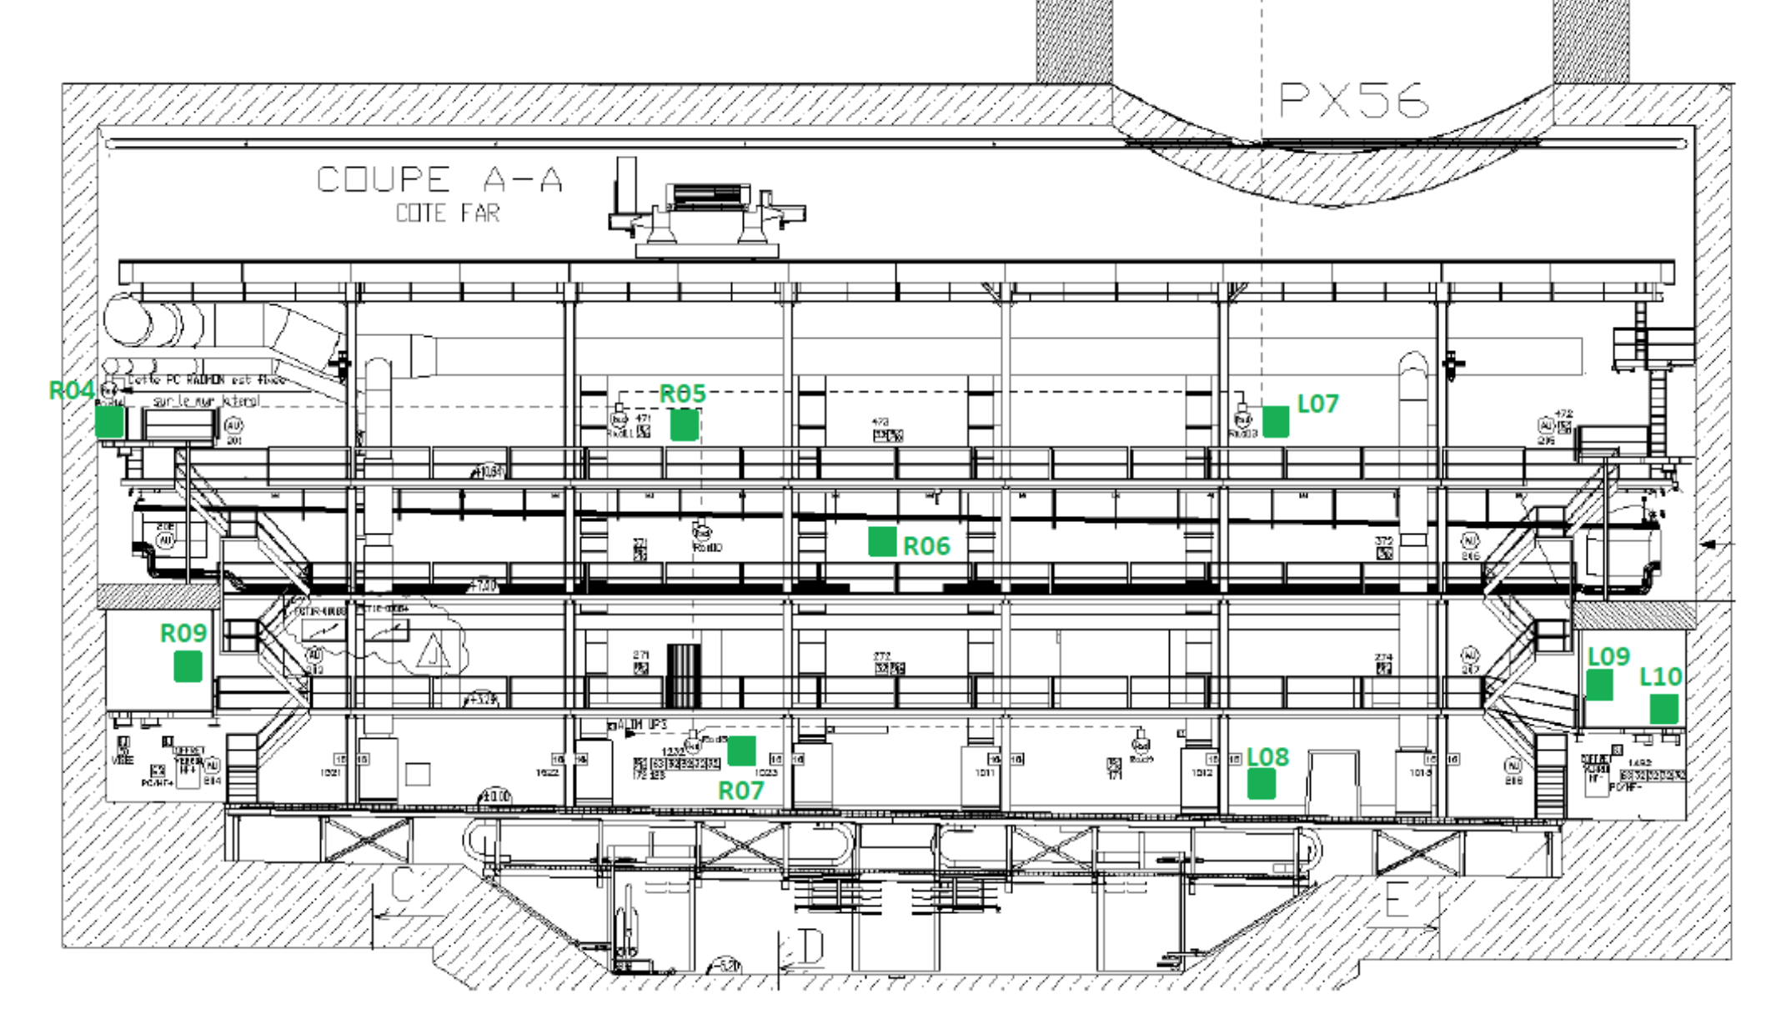
UXC55
X4
X3
X2
X1
X0

Slide 11
Radiation levels
Low total dose in X0
  Estimation after 3000 fb-1:
    Hadrons > 20 MeV = 2.1*108/cm2
    1 MeV-equivalent neutrons = 6.7*109/cm2
  Source: CMS BRIL
Will have to deal with SEE
  SEU, SEB
  i.e. how do the PS fail following SE?
What about X3/X4?
  Will be determined after further simulation by CMS BRIL

Slide 12
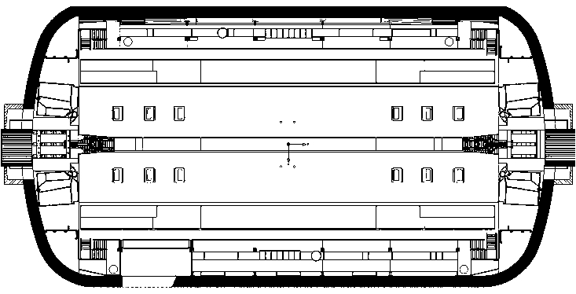
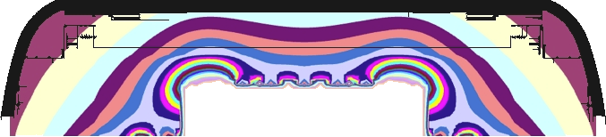
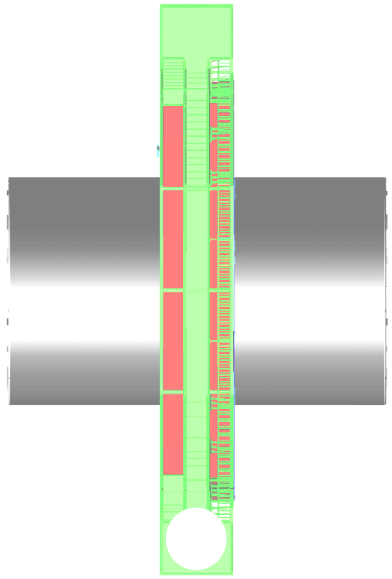
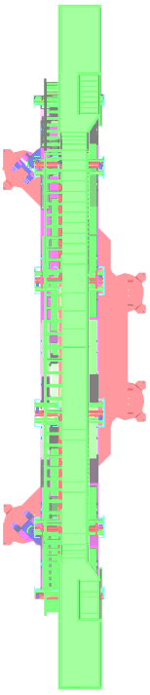
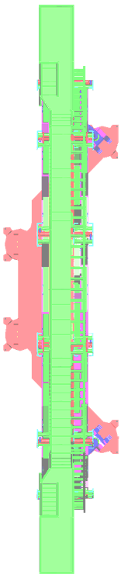
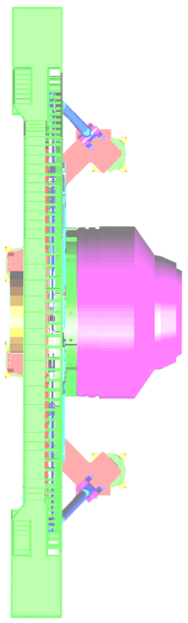
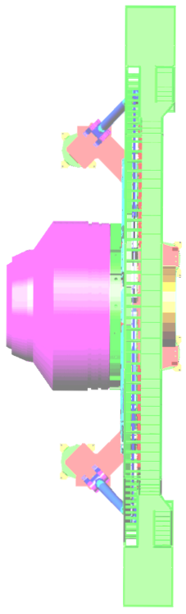
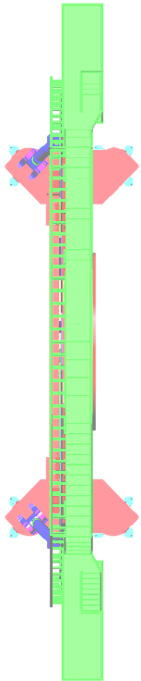
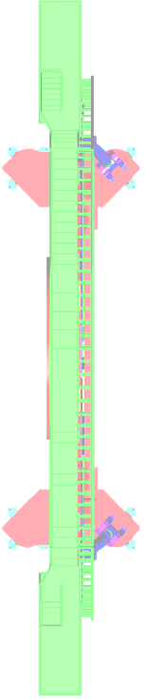
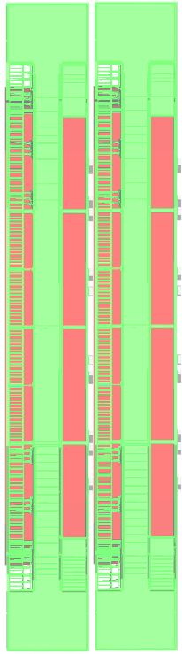
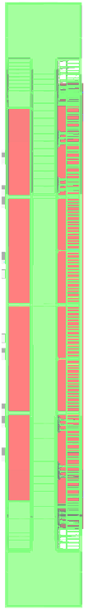
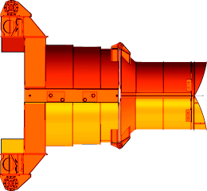
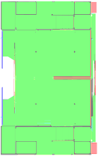
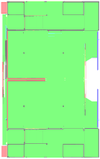
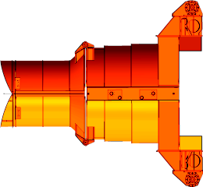
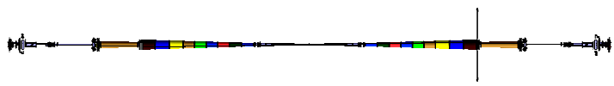
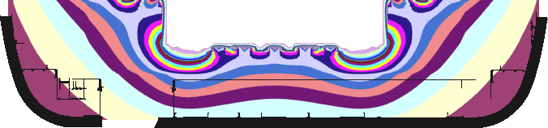
CMS magnet fringe field in UXC55 with 3.8T at IP
Scale in mT, from 0 to 120 mT, with 5 mT increment
Horizontal mid-plane Y=0
10
15
20
25
30
60
55
50
35
₄₀ 45
Prepared by B. CURE with data from V. KLYUKHIN
November 2010

Slide 13
Measurement of the fringe magnetic field (@3.8T)
18 mT
25-31 mT
X0 UPPER LEVEL
25 mT
X3F35
X0R11
X0U11
45 mT
X3F34
X3F31
90%
X3 BALCONY FAR
-Z
90%
-Z
90%
25-27 mT
X0 UPPER LEVEL
-Z
23 mT
X2F37
X2F36
25-27 mT
X0E11
35 mT
X2 BALCONY FAR
-Z
90%
X0 LOWER LEVEL:
21-27 mT
Nicola Bacchetta, Wolfram Zeuner May 19th 2016

Slide 14
COTS Candidate / test engine
PowerOne PFE3000-12-069RA
12v 3kW (244A), 94% efficient
http://www.digikey.com/product-detail/en/bel-power-solutions/PFE3000-12-069RA/179-2714-ND/4439947
  31 in stock 20160429
  937USD for one, 8000 USD for 10 pc
  Estimated product life beyond 10 years

Slide 15
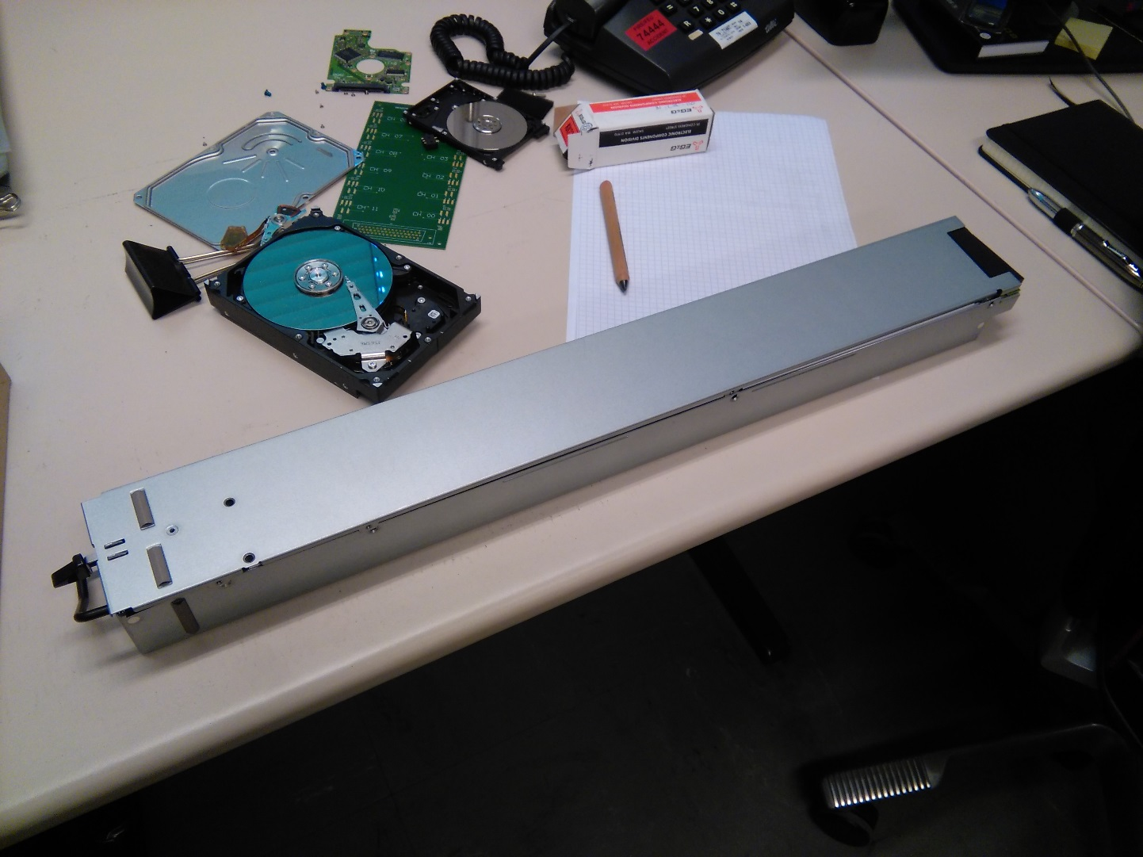
PFE3000-12
S. Lusin

Slide 16
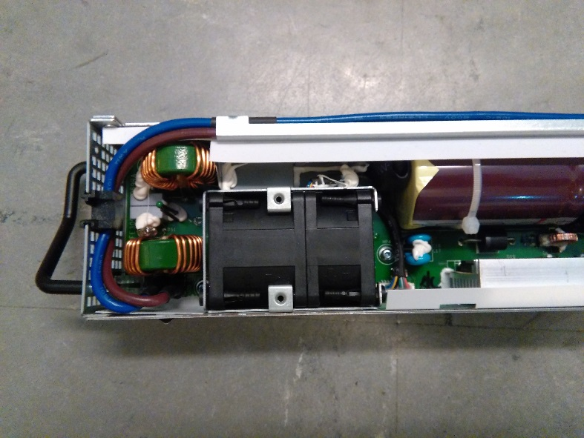
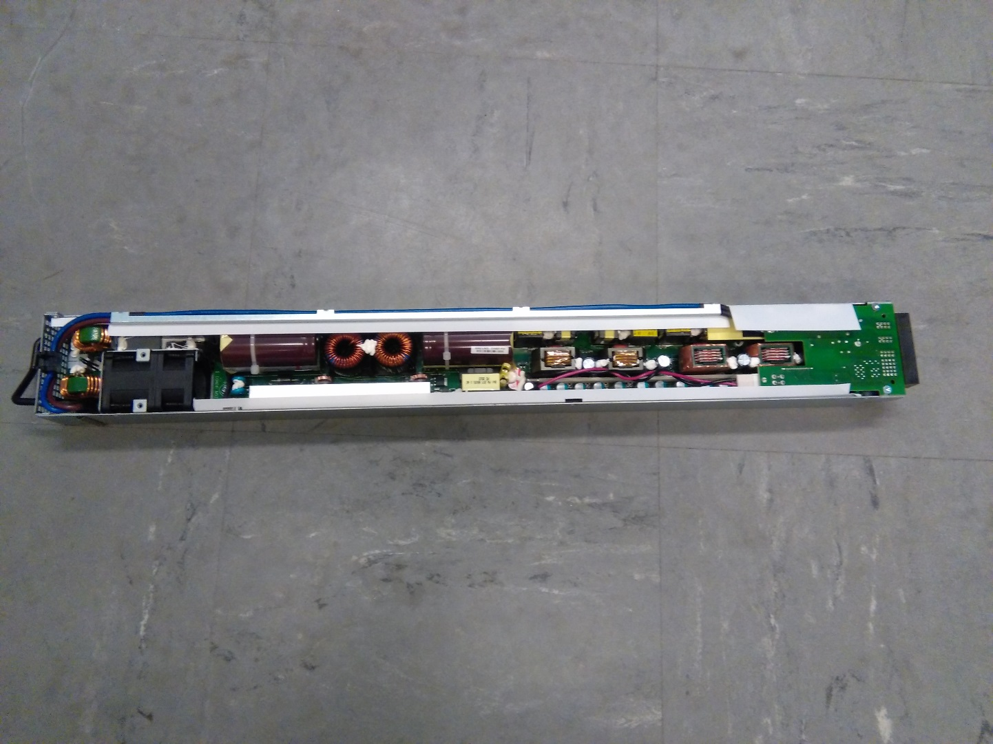
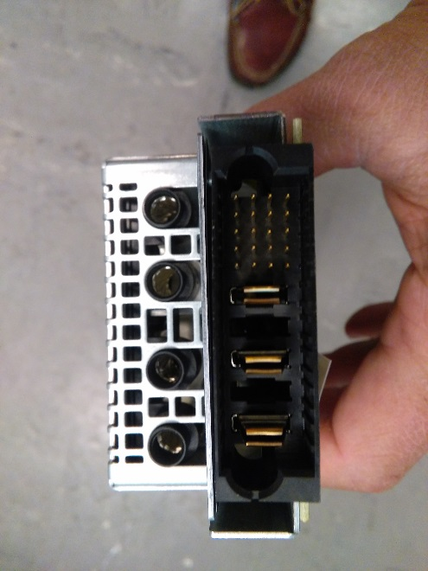
PFE3000-12
S. Lusin

Slide 17
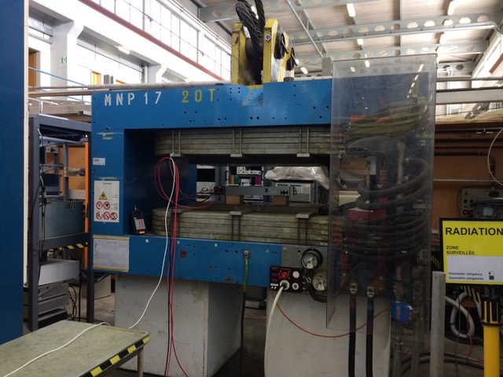
Magnetic field test
S. Lusin

Slide 18
Magnetic field test
S. Lusin, B. Cure

Slide 19
Magnetic field test
Bottom line
  Tolerates 400g from side
  Tolerates 600g from top
  Tolerates 250g longitudinal
    A different test in the M1 magnet at CERN
S. Lusin, B. Cure

Slide 20
Front end power distribution
Finer granularity than a single bulk supply
  Line protection
  Over/Under voltage protection
  Voltage monitoring
  Current monitoring
  (Power monitoring)
Example COTS
  LM25066: System Power Management and Protection with monitoring through PMB (essentially I2C)
Backend could be an ELMB+ system

Slide 21
Front end power distribution
Final development, production and maintenance by Industrial partners
  Tuned to requirements for different users, e.g.
    Trip current depending on cabling to detector
    Combine LV and bias distribution for silicon trackers

Slide 22
Plans
Demonstrate feasibility and reliability
  Performed 3D magnetic field tolerance mapping in M1 magnet
  Install demonstrator in UXC55 X0 lower floor for long term (B field) verification
Mixed field radiation studies
  @ Charm (CERN)
  Need to determine how an SEE affects an n+1 or n+2 redundant power supply system

Slide 23
Plans
Collaboration with industry for development of power distribution and monitoring system
  Positive feedback from industrial partners, e.g. CAEN
  Tuned to each subsystem

