Slide 1
The Ring TRD
Bari Group - TRD SAS meeting, 01/02/2017

Slide 2
Single Ring TRD module
Emission angle ∼1/γ

Slide 3
Multiple module Ring TRD

Slide 4
Fast simulation
We used the angular distribution of TR photons produced at a single interface
We neglect the radiator thickness, i.e. we assume t<<L
In our calculations we assume L=1m and we assume a detector pitch of 25µm
  Configuration with pixel detectors ➔ the real distances (2D) of TR X-rays from the particle are considered
  Configuration with strip detectors ➔ the projected distances (1D) of TR X-rays from the particle are considered

Slide 5
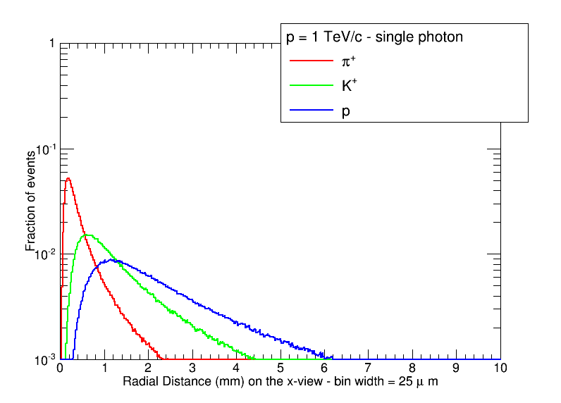
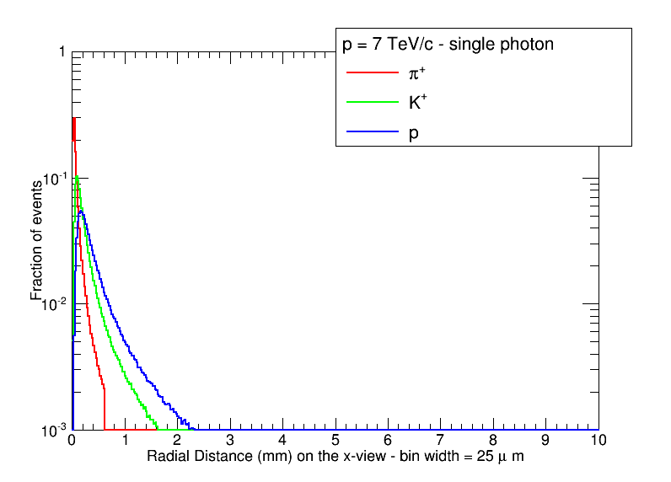
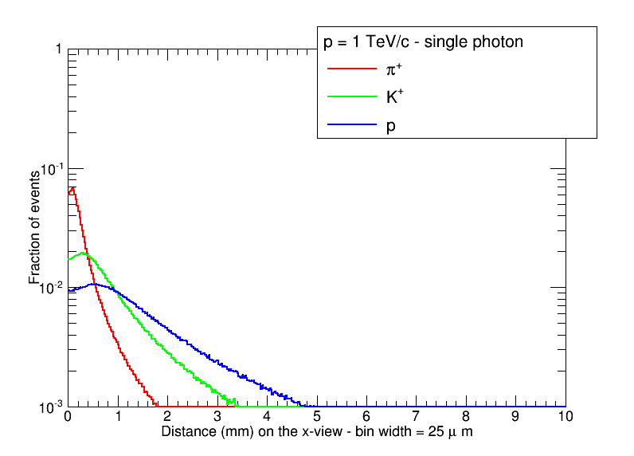
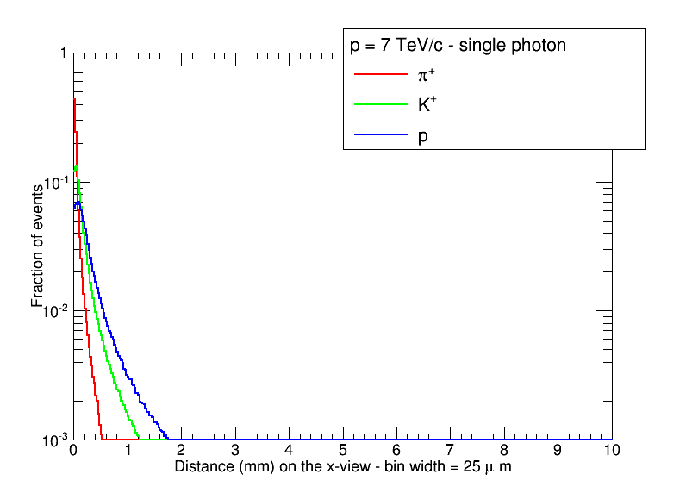
Distance distributions (single photons)

Slide 6
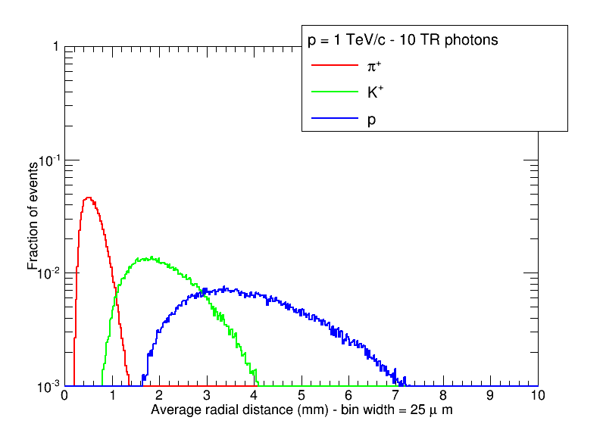
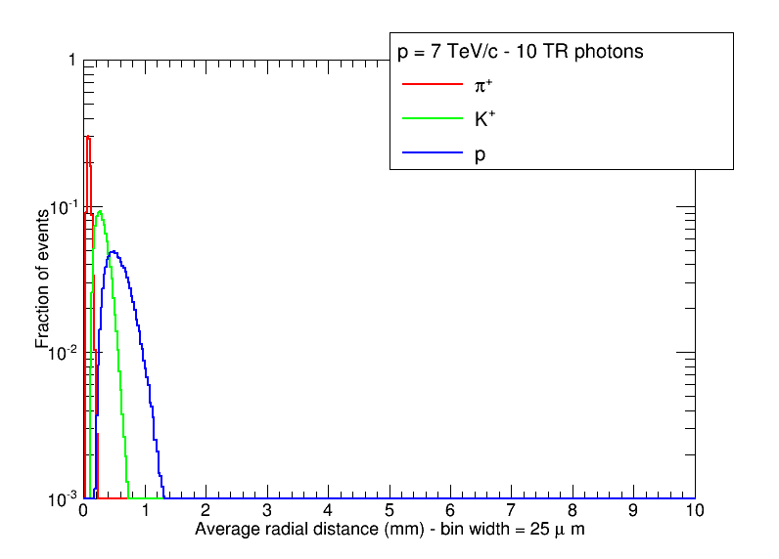
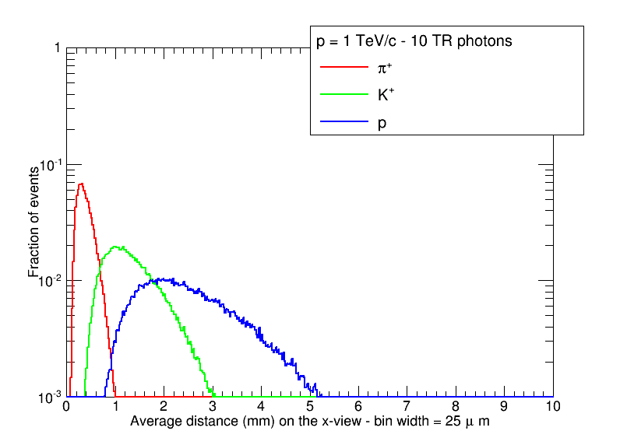
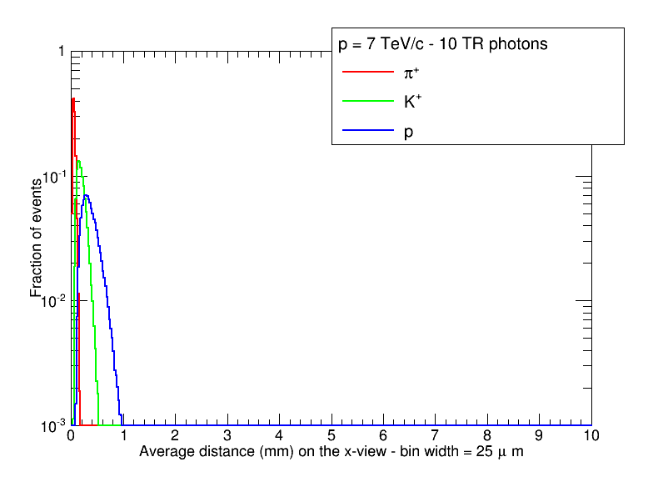
Distance distributions (10 photons)

Slide 7
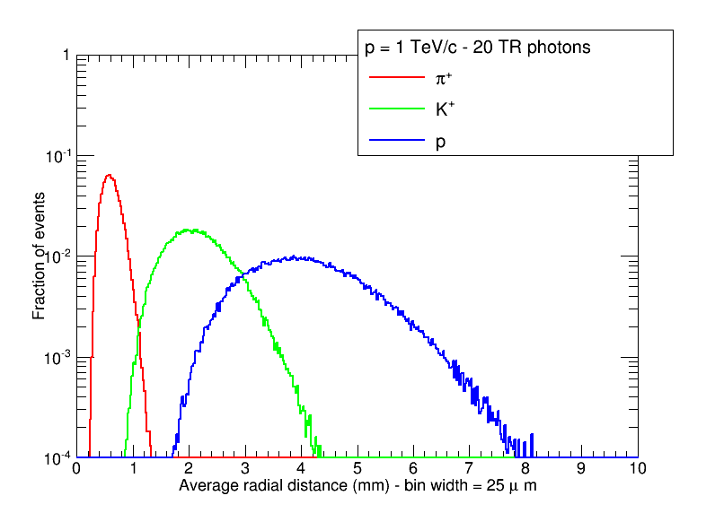
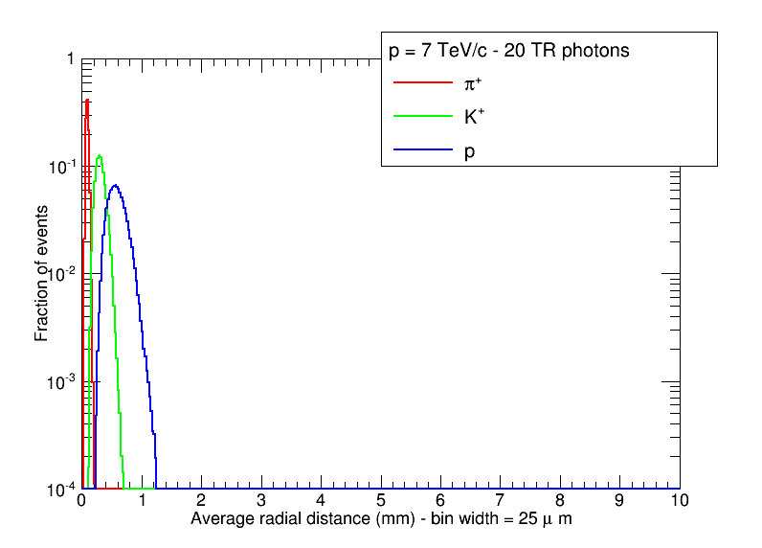
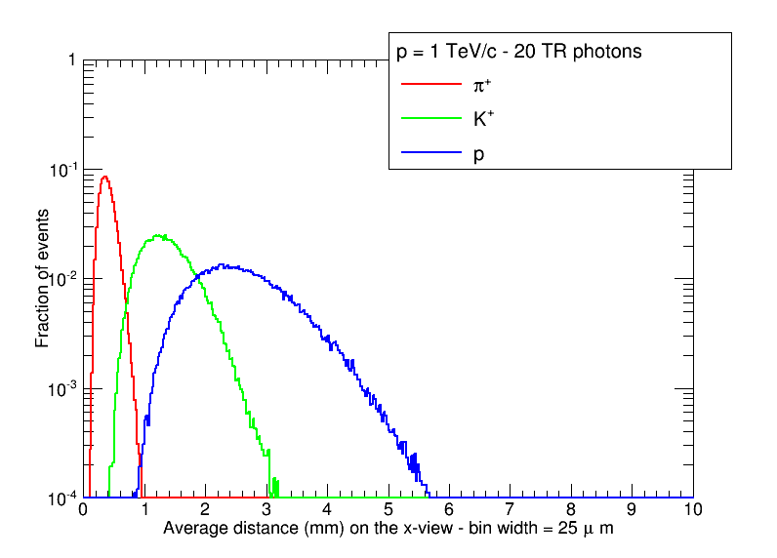
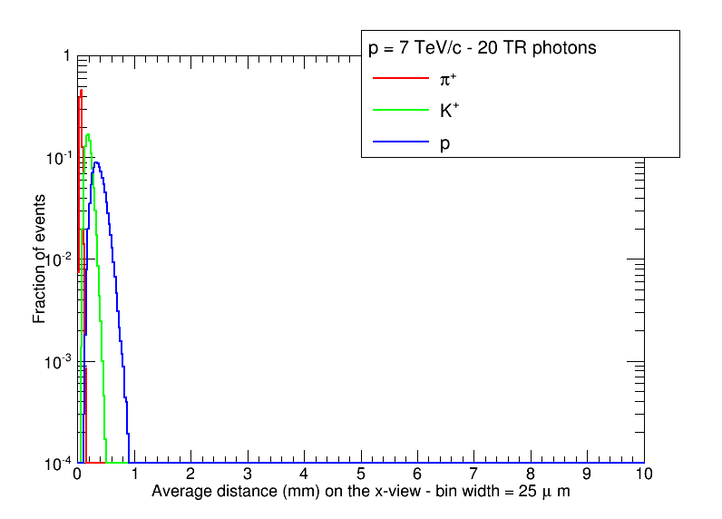
Distance distributions (20 photons)

Slide 8
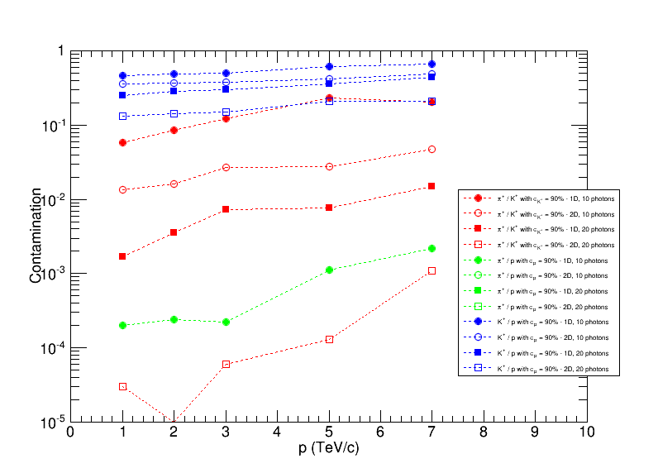
Particle identification

