Slide 1


Exploring Weirdo Regions of WISPy Dark Matter
(and other things)
Heidelberg University
of DM Land
(veeeery)
Weakly Interacting Sub-eV Particle
J. Jaeckel**
Gonzalo Alonso**, J. Berges**, A. Chatrychan**, L. Darme^{tt},
B. Doebrich^{z}, L. Gastaldo**, A. Hebecker**, S. Hoof^{T,} S. Knirck^{zz}, M. Lewicky^{s}, V. Mehta**, J. Redondo^{x}, A. Ringwald*,
F. Rompineve**, U. Schmidt**, L. Witkowski^{XX}
and The FUNK Collaboration
**Heidelberg U.,^{zz}MPP Munich, ^{z}CERN,†IPPP Durham, *DESY,
^{Y}MPIfR Bonn, ^{x}U. Zaragoza, ^{xx}Paris, ^{T}Imperial College London
^{tt}Warsaw INS,^{s}U. of Adelaide

Slide 2
Standard
Axion Dark Matter

Slide 3

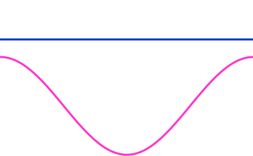





The axion has no clue where to start
H>>m
Field is stuck because of Hubble “breaking”

Slide 4
The axion has no clue where to start
H<<m
Can start moving…

Slide 5
The axion solution to the strong CP problem
Oscillations contain energy
behave like non-relativistic particles (T=0)

Slide 6
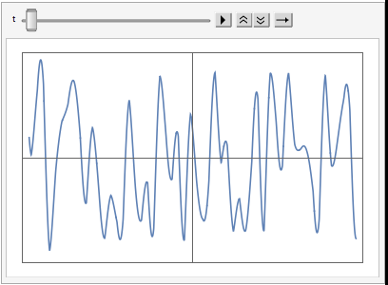
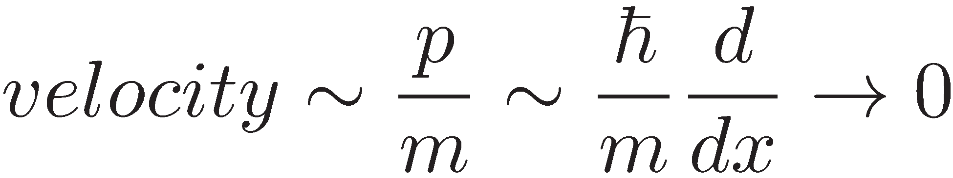
Why Cold? Inflation!
Field
value
space

Slide 7
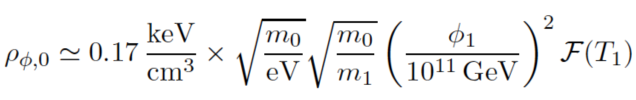


Dark Matter Density
Depends on the initial field value
Pseudo-Goldstone
➔ Field value
Naturally

Slide 8
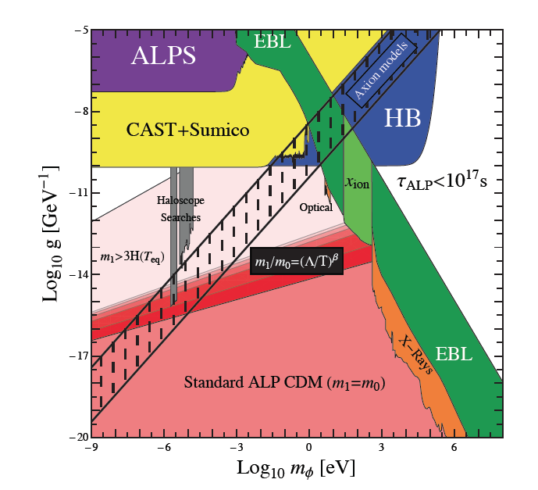
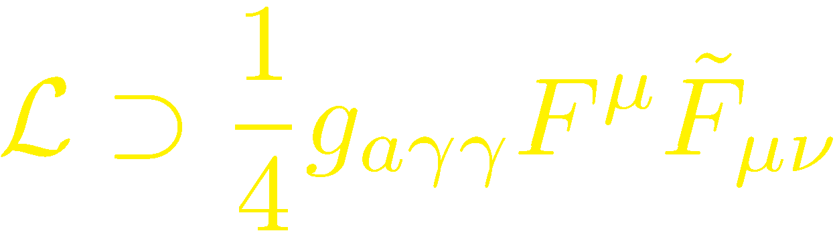
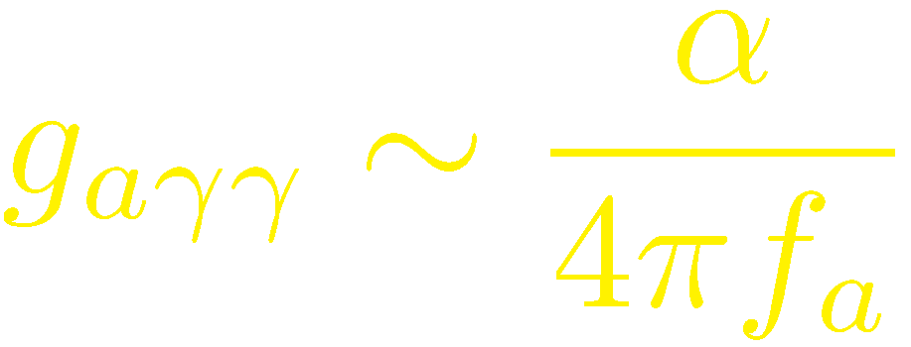
Axion(-like particle) Dark Matter
Natural
Possible

Slide 9
Axion Dark Matter

Slide 10
Axion(-like particle) Dark Matter
Want to get
here!

Slide 11
Detecting WISPy
DM

Slide 12
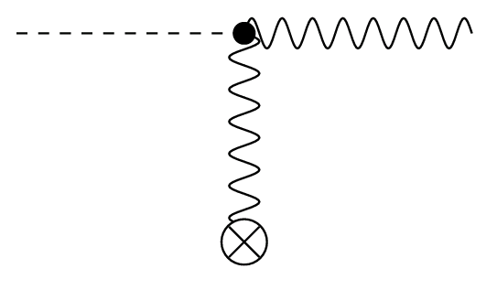
Use a plentiful source of axions
Photon
(amplified in resonator)
axion
(dark matter)
Photon Regeneration

Slide 13
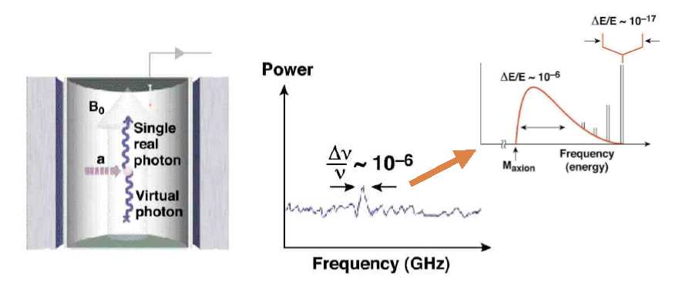

Signal: Total energy of axion
RF Receiver
Virial velocity
in galaxy halo!

Slide 14
An extremely sensitive probe!!!

Slide 15
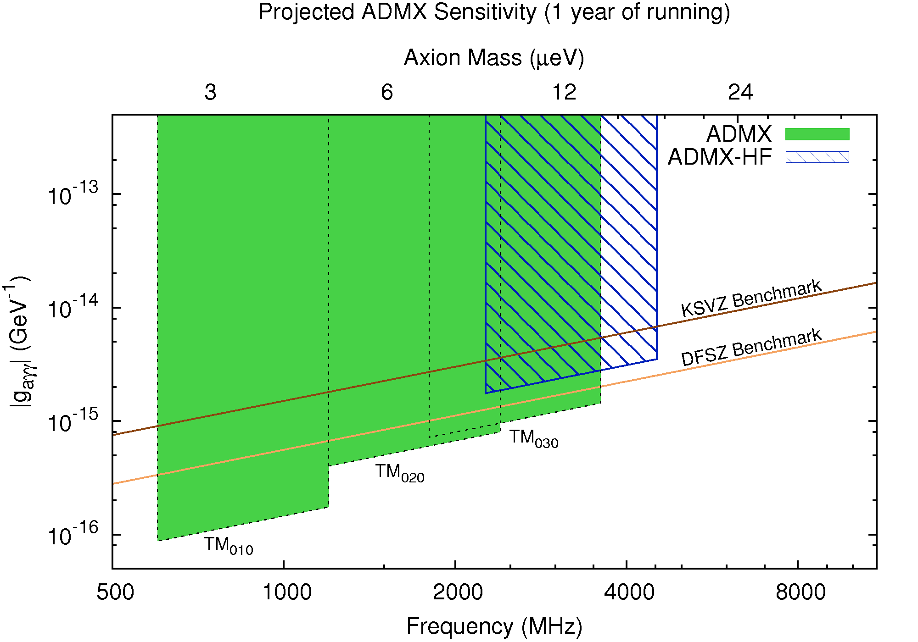
A discovery possible any minute!

Slide 16

Electricity from Dark Matter ;-).
Photon
(amplified in resonator)
axion
(dark matter)
10⁻²³W!
Photon Regeneration

Slide 17
Really sustainable Energy
Galaxy contains (6-30)x10¹¹ solar masses of DM
➔ (3-15)x10⁴³ TWh
@100000 TWh per year (total world today)
➔ 10³⁸ years ☺
DM power
½*v~300 MeV/cm³*300km/s~10 W/m²
compared to 2W/m² for wind

Slide 18
Broadband
Search Strategy
FUNK collaboration

Slide 19
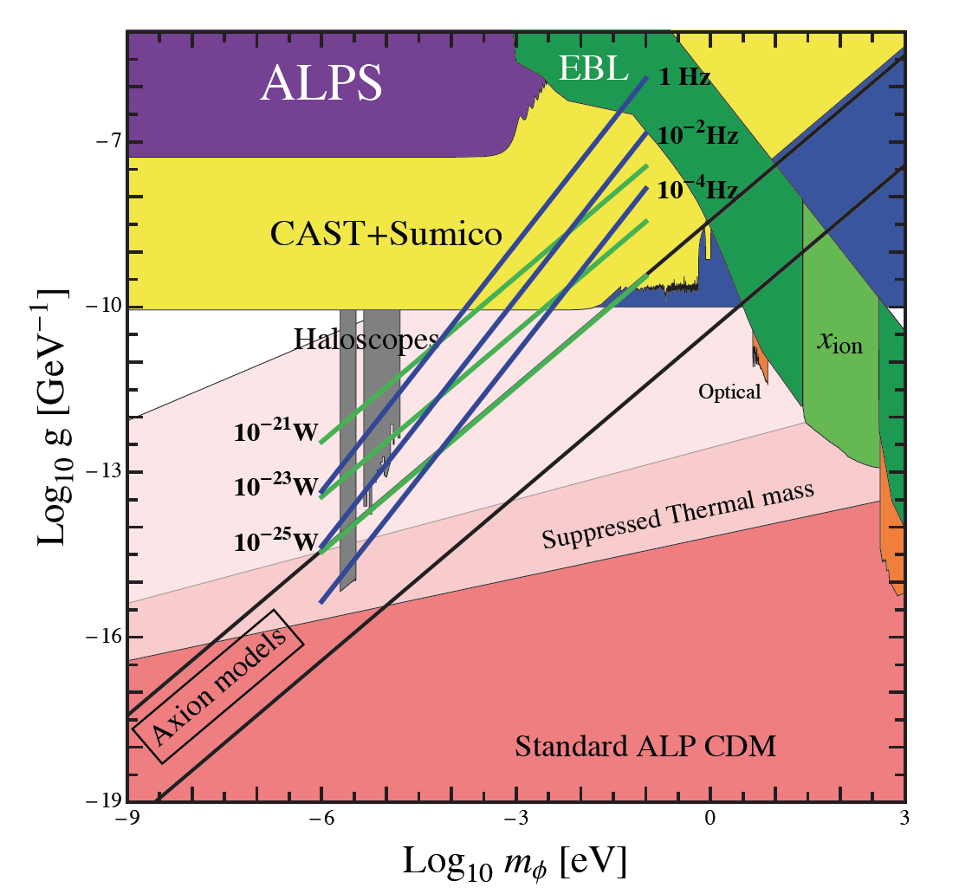
Dark Matter Antenna
Antenna converts axion->photon
Radiation concentrated in center
Detector
B
Probes here;
very sensitive!!

Slide 20
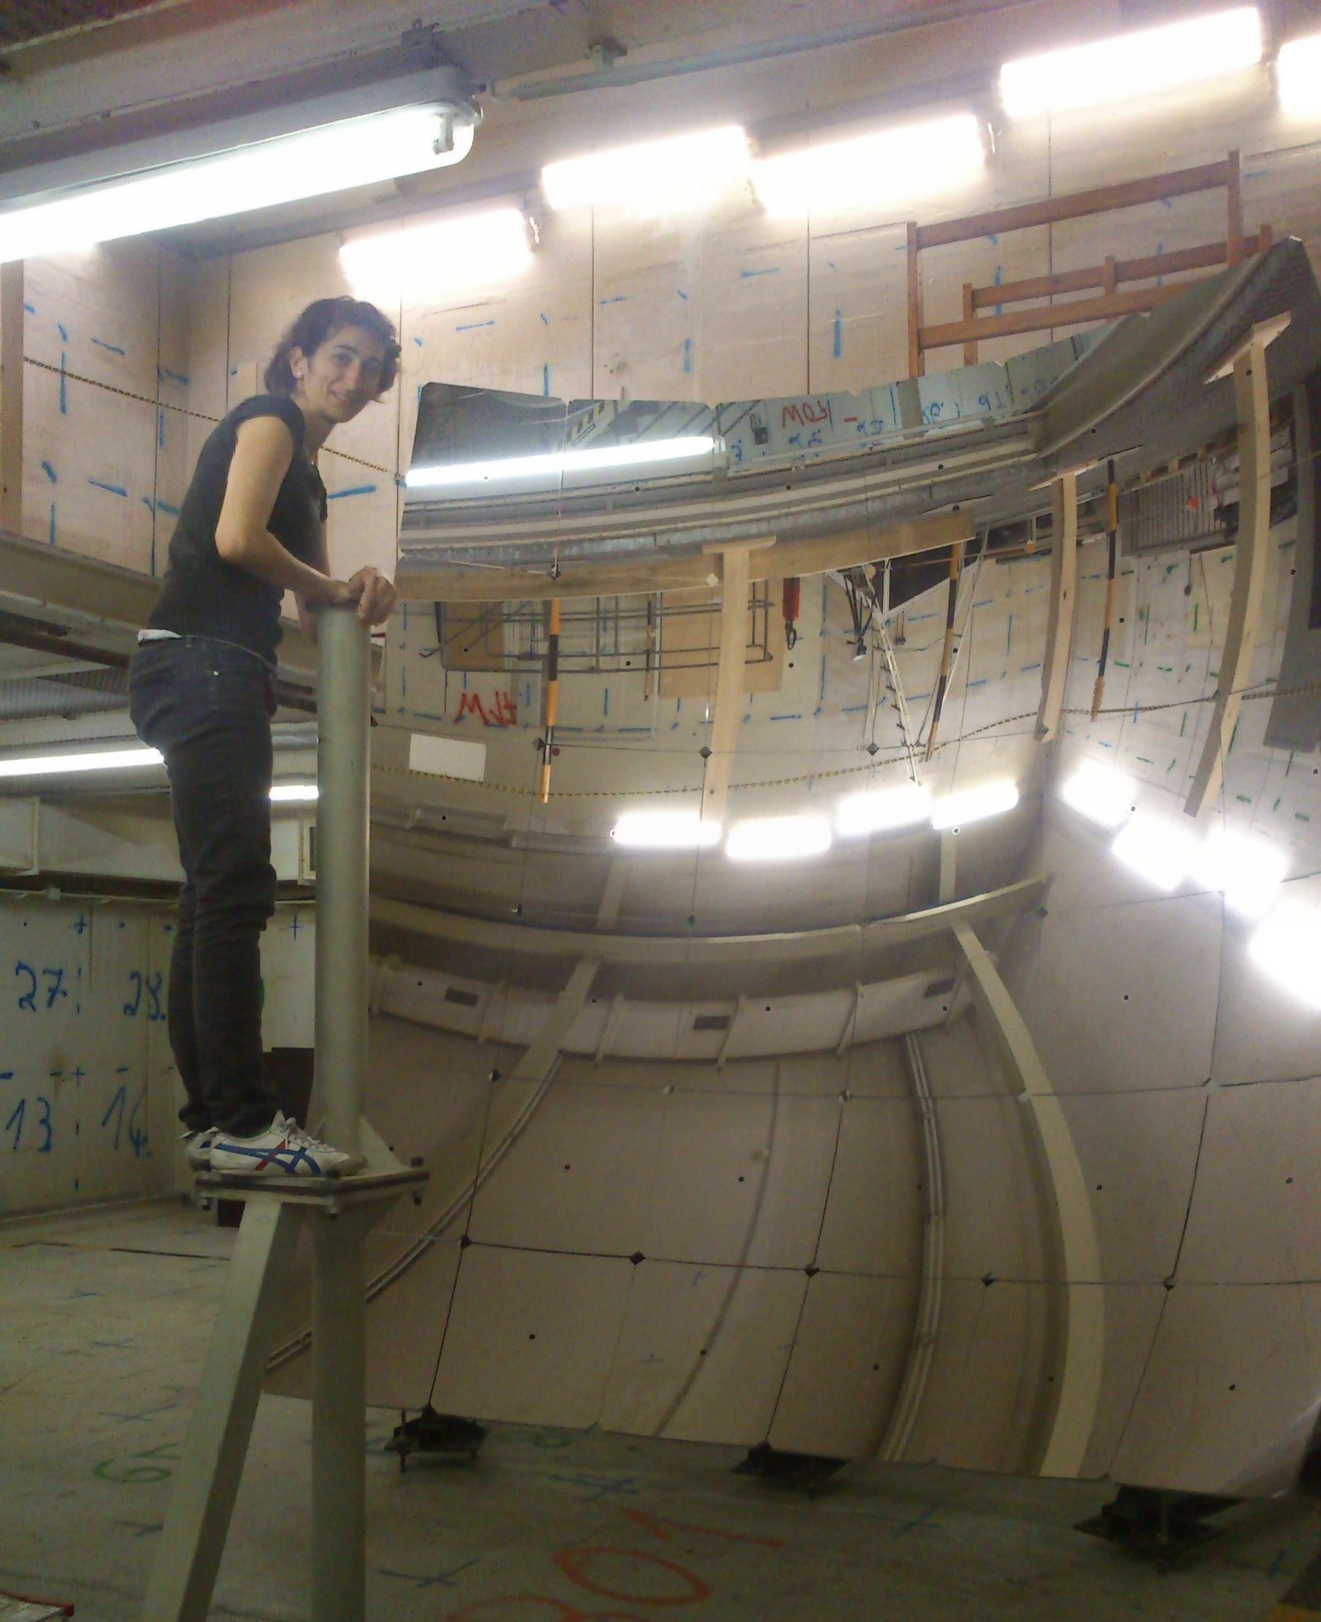
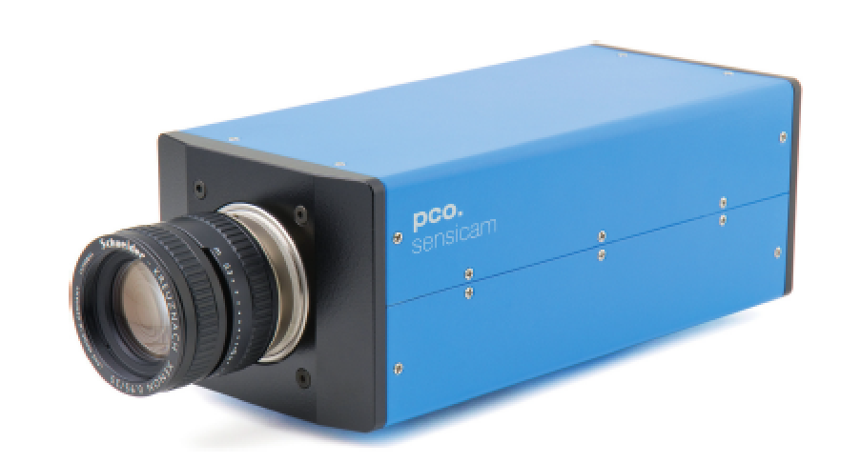
The FUNK Experiment
Recycle Auger mirror
Detector

Slide 21
Dark Matter Antenna
Difficult to
have enough
dark matter
here

Slide 22
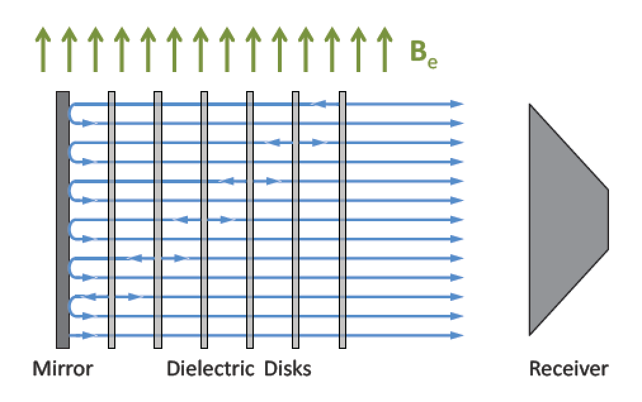
Perhaps even better: MadMax
Ambitious new project at MPP

Slide 23
Dark Matter Antenna
MadMax
aims
to go here…
this is tough!!

Slide 24
New couplings:
A spin experiment
J. Crespo Urrutia , S. Hansmann-Menzemer, S. Kempf , JJ , U. Schmidt

Slide 25
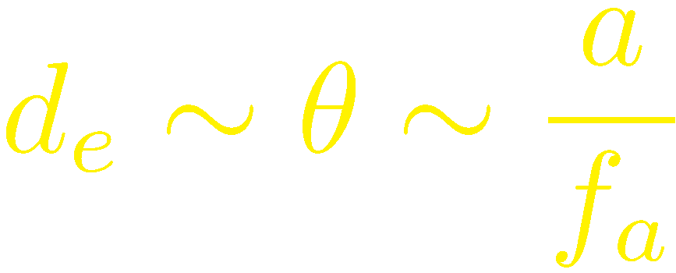
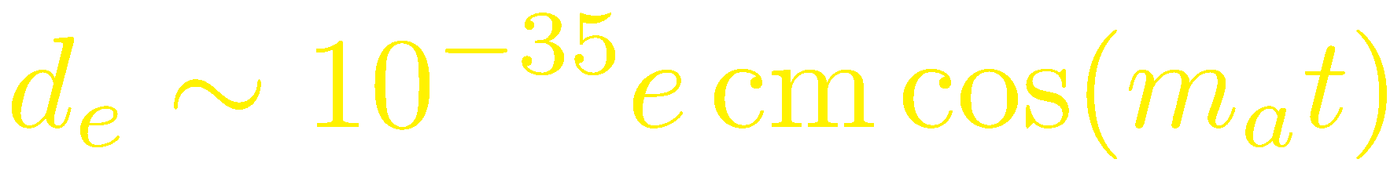

Looking for oscillating dipoles
Remember:
Axion field controls electric dipole moment:
Dipole moments follow the oscillating axion field
➔ Tiny oscillating electric dipole

Slide 26
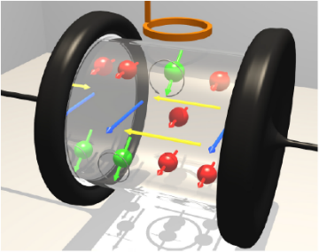
Modification of Xenon EDM
Modification of Xenon EDM experiment
to be sensitive to time varying nuclear EDM

Slide 27
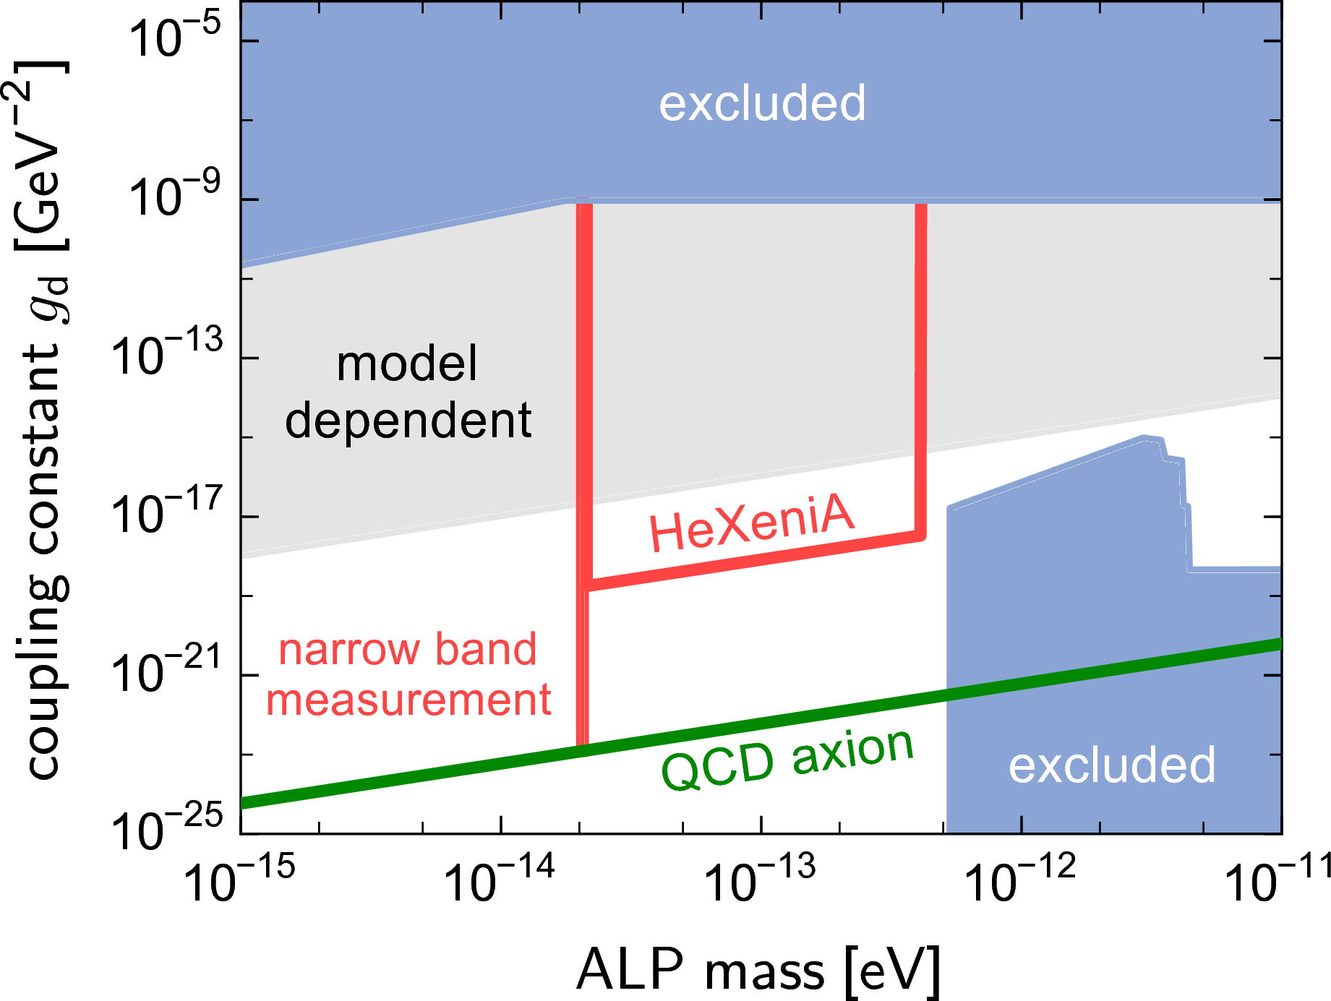
Sensitivity
f_{a} in Plancky region 4*Pi*M_{Pl}~M_{Pl}

Slide 28

Stranger things...

Slide 29
Going
Monodromic
1605.01367
JJ, V. Mehta, L.Witkowski

Slide 30

Monodromy potential
“Axion” potential
(pseudo-Goldstone pot.)
Monodromy add-on

Slide 31
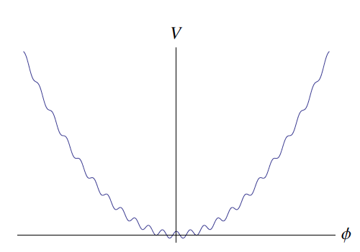
Monodromy potential
Funny potential
+ enlarged
field range

Slide 32
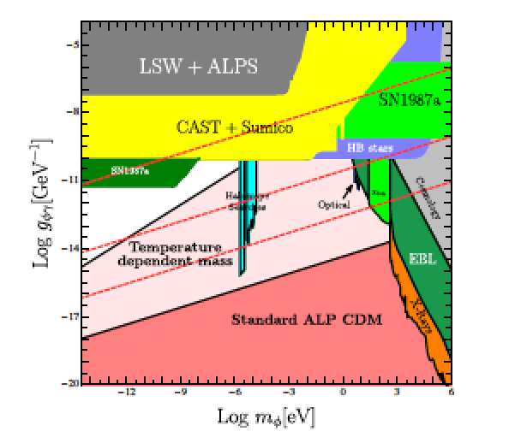
Advantages
Allows to start with higher energy density ➔ More DM
vs
Models
in this region!

Slide 33
Interesting Phenomena??
Could get stuck here
Oscillations like DM!

Slide 34

Interesting Phenomena??
Overdense region?
Could get stuck here

Slide 35
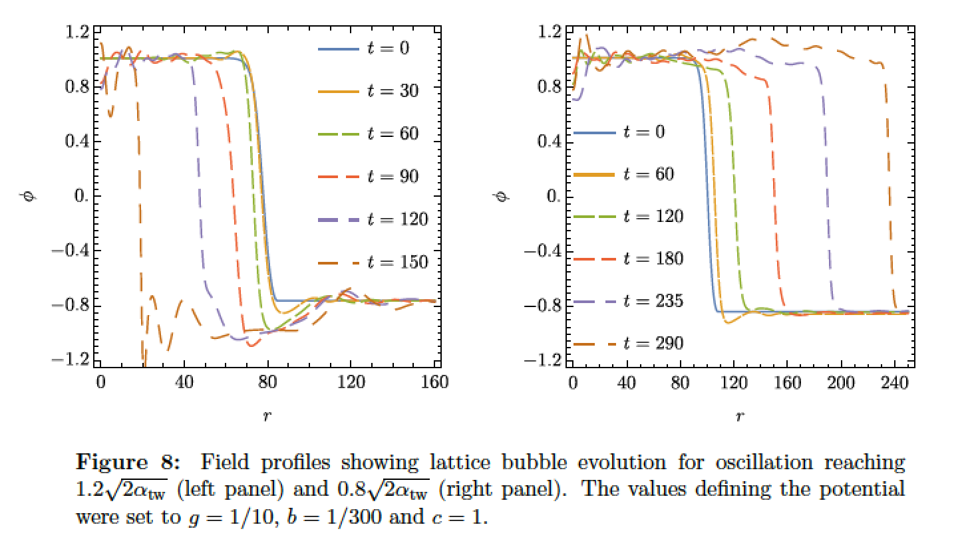
Side Remark:
Tunneling from Oscillating State
Not always what you expect ;-).
1704.06445 L. Darme, JJ, M. Lewicki

Slide 36
Interesting Phenomena??
Regions with “negative mass”
Instability + Parametric Resonance
➔ Particle Production with p≠0?!?

Slide 37
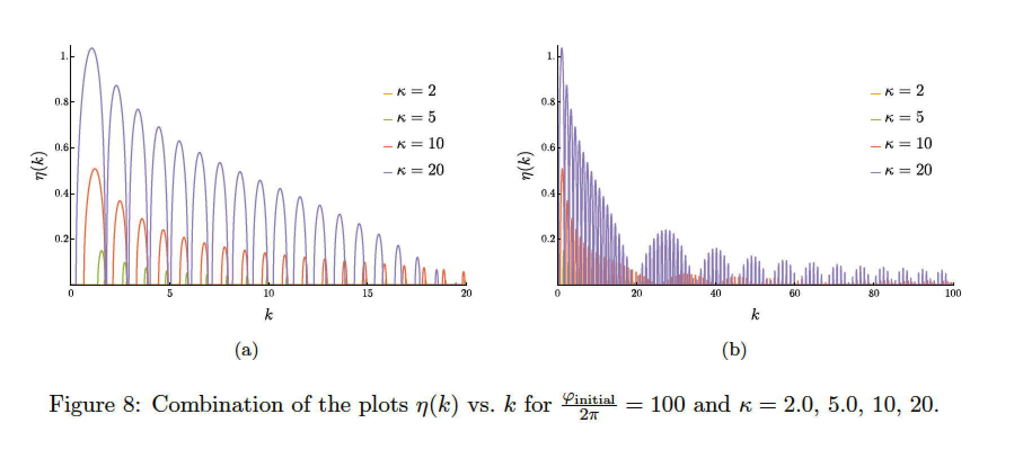
Fluctuations may grow rapidly
➔ New initial conditions for structure formation!

Slide 38
Going Beyond Dark Matter
Exploring inflationary “axions“
with gravitational waves
1606.07812
A. Hebecker, JJ, F. Rompineve, L.Witkowski

Slide 39
Monodromy inflation

Slide 40
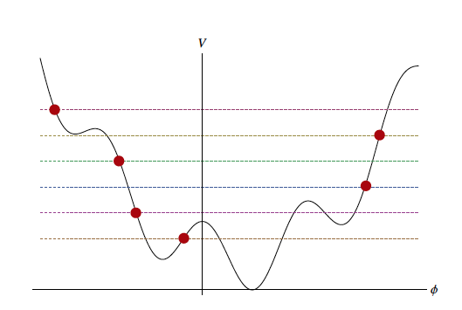
Field oscillations

Slide 41
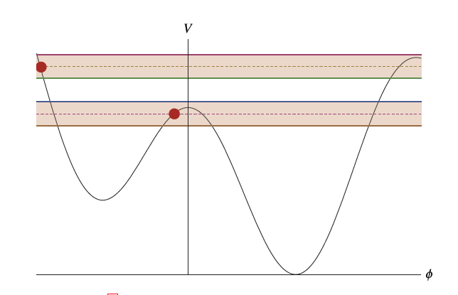
Including fluctuations

Slide 42
Including fluctuations
Different parts of Universe end in different minima
➔ Bubbles form
➔ GW are produced

Slide 43
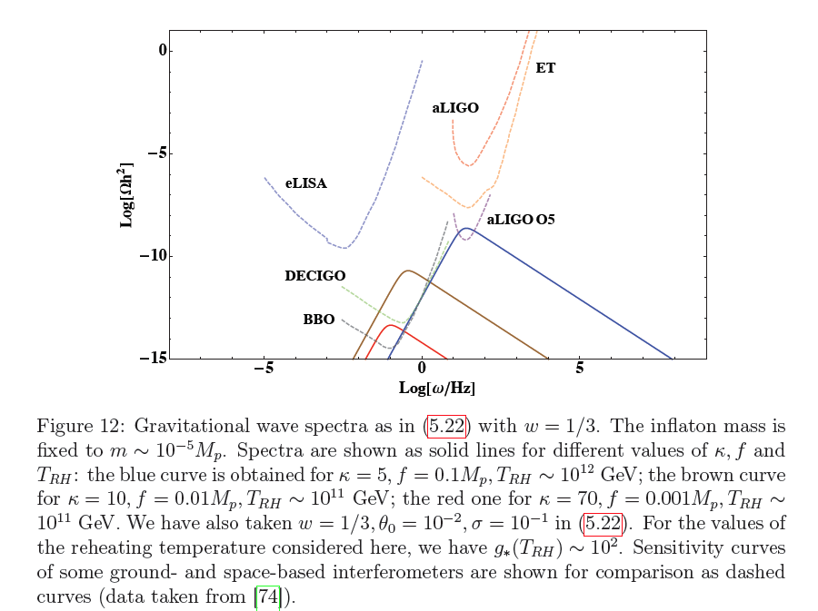
Gravitational wave spectra

Slide 44
Populating
parameter space
+
Evading cosmological limits
G. Alonso, JJ

Slide 45
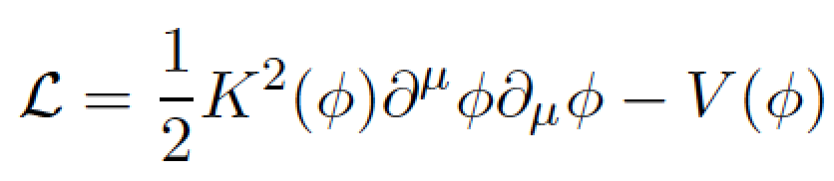
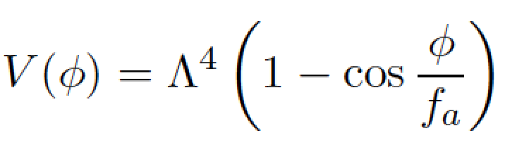
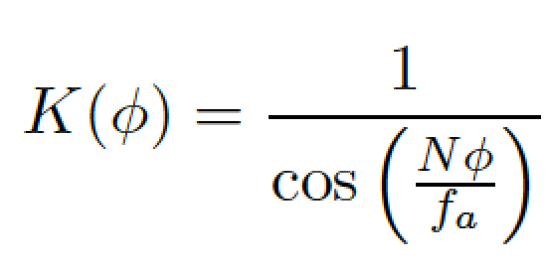
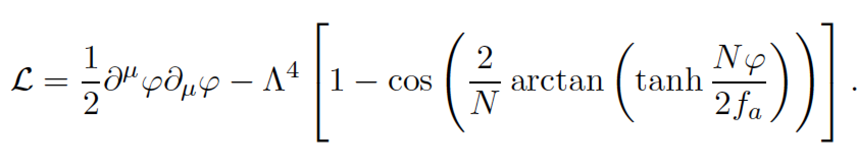
Non Standard Kinetic Terms
Use weird kinetic term
Canonically normalized

Slide 46
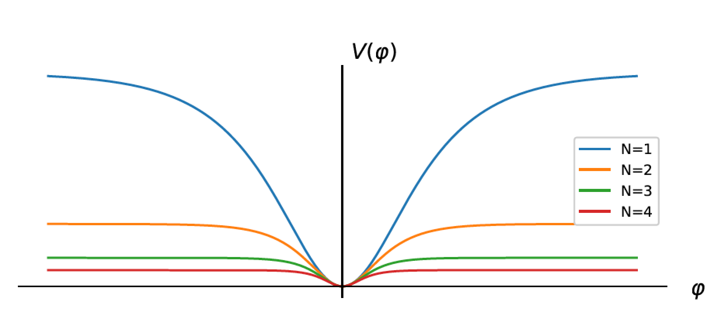
New potential
Field range infinite
Potential flatter at large field values

Slide 47
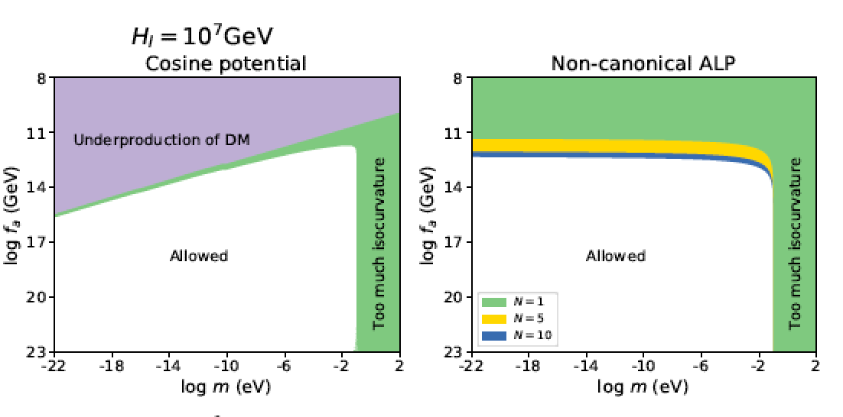
New regions available

Slide 48
Conclusions

Slide 49
Conclusions
Dark Matter may be Axiony/WISPy ☺
➔ New Search opportunities!
➔ Searches ongoing!
➔ Unusual places may be viable
➔ Crazy things to explore!
ALPs may help with Inflation ➔ Grav. waves

Slide 50
More fiddling with the density:
2 periods of inflation
S. Hoof, JJ

Slide 51
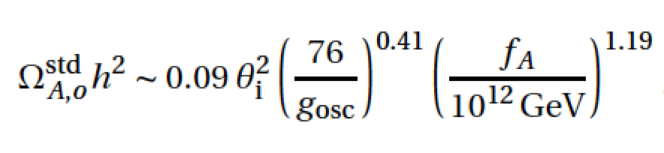
One could also want less DM…
E. g. for QCD axions
Too much DM for £_{i}» 1 and f_{a}& 10¹² GeV
In post inflation scenario £_{i} can’t even be tuned

Slide 52
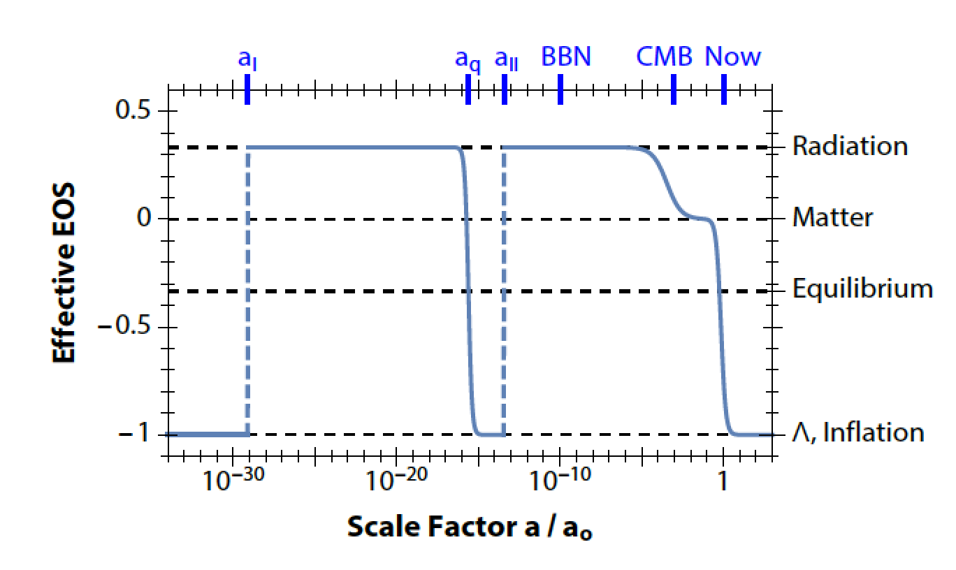
Let’s recycle an old idea…
Introduce second period of low scale
inflation

Slide 53
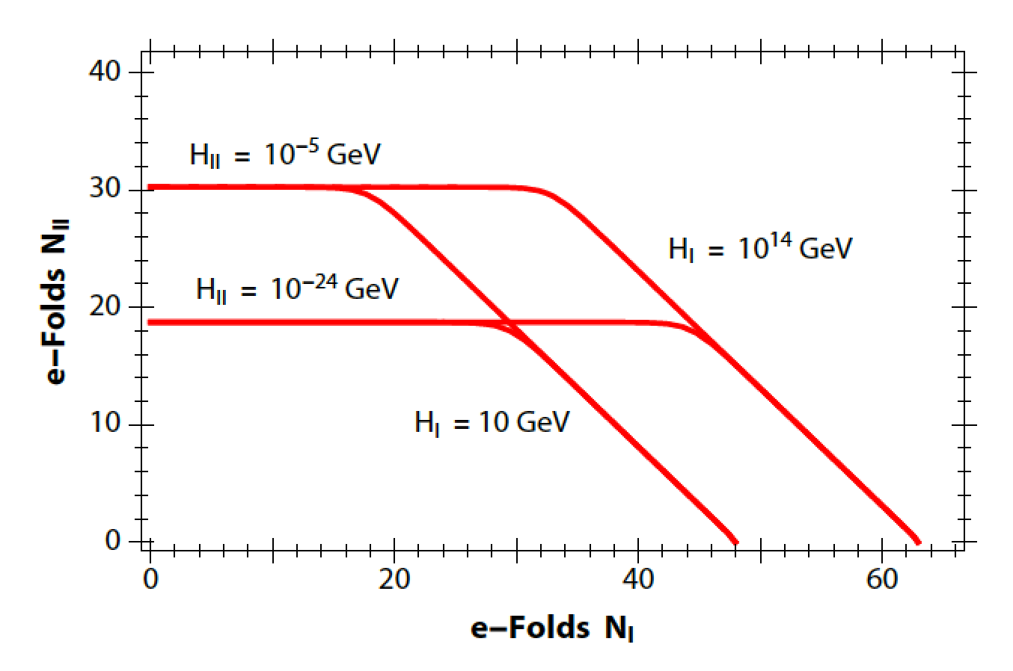
Not just late inflation

Slide 54
Dilution…
If axion behaves like matter during the second inflation, i.e. m_{a}>H_{inflation, II}
Expect dilution by volume factor
➔ get anything you like…
Often true… but not always

Slide 55
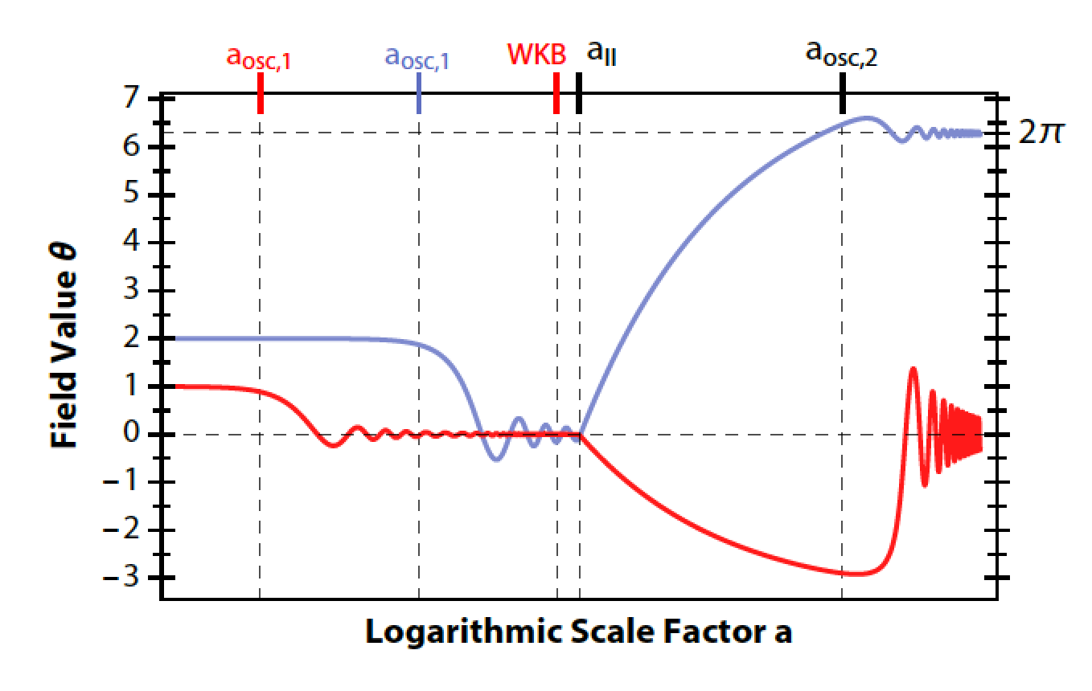
Reheating plays a role
Axions mass drops considerably if reheating temperature >>T_{QCD}

Slide 56
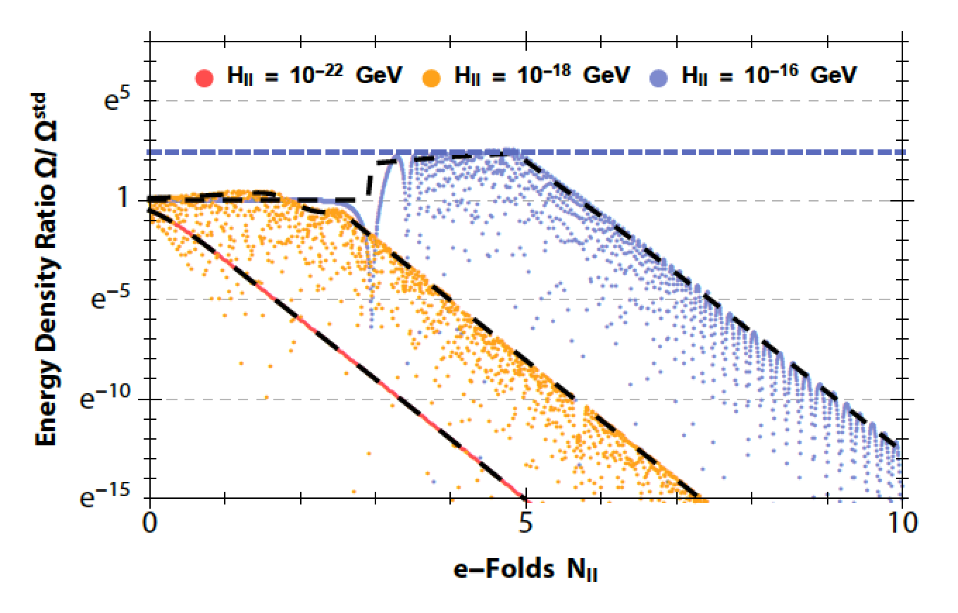
Funny dependence

Slide 57
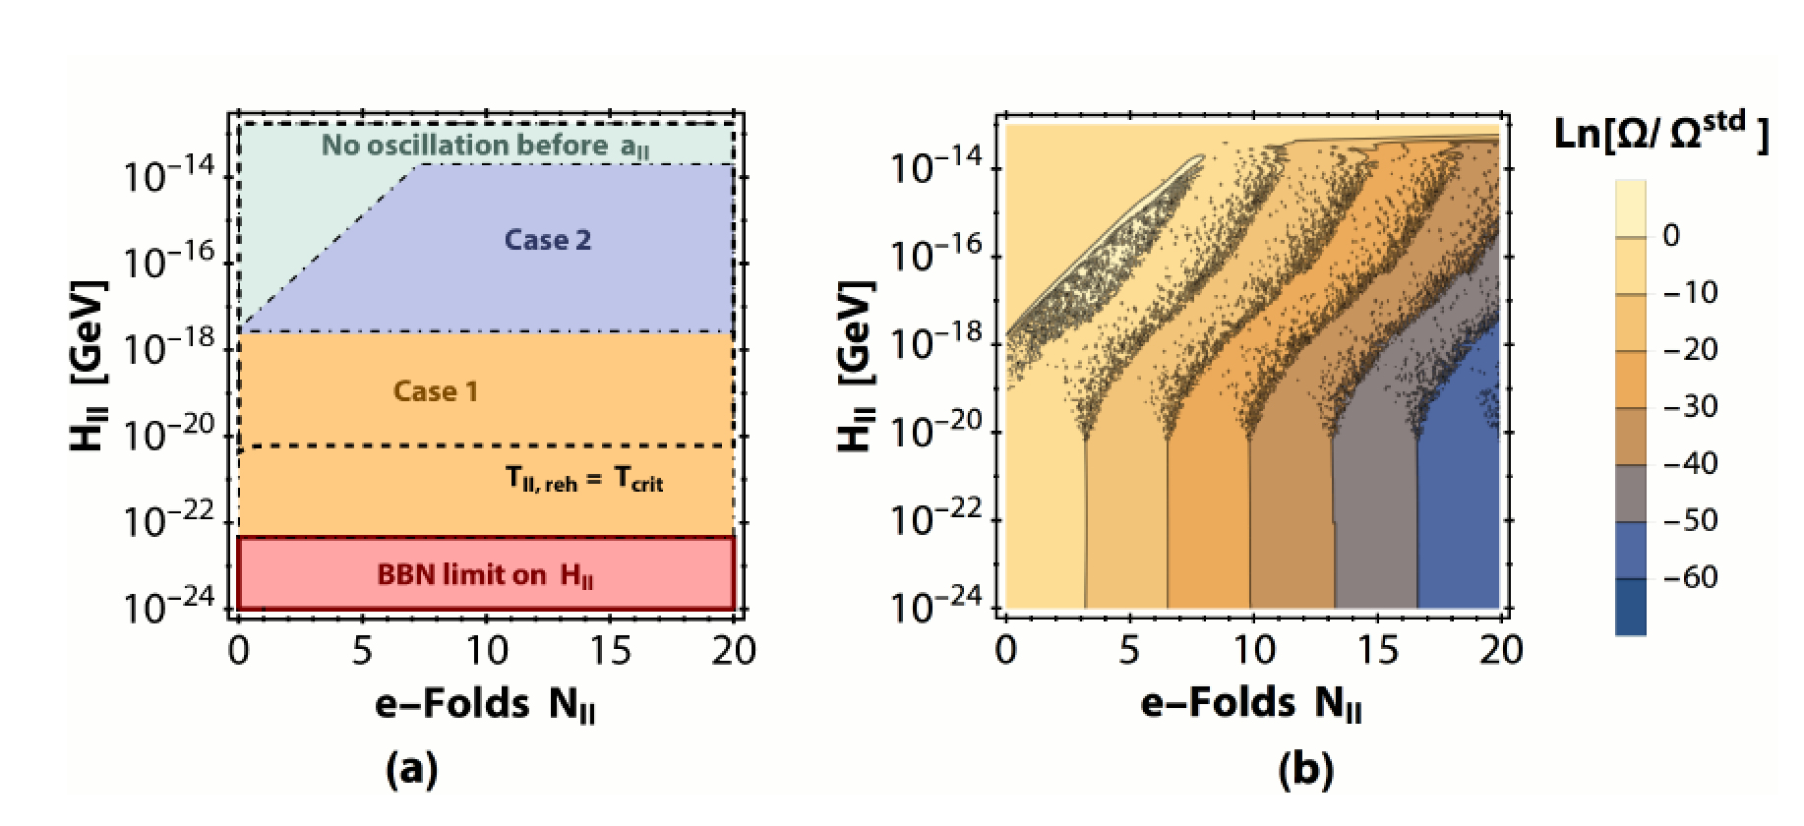
More generally

Slide 58
More interesting things may happen…
Post inflation scenario for axions…
Blown up miniclusters
Reduced strings/domain walls
(maybe close to true average model)

Slide 59


In an electric field
T
Energy in an electric field
d_{e}~s
E
Torque tries to tilt dipole moment/spin

Slide 60


Dealing with oscillation
Problem: the dipole moment is rapidly oscillating ~m_{a}
➔ Danger of cancellation
Solution: Rotate spin to compensate
➔ Use Spin Precession in magnetic field
S
Resonance when

Slide 61
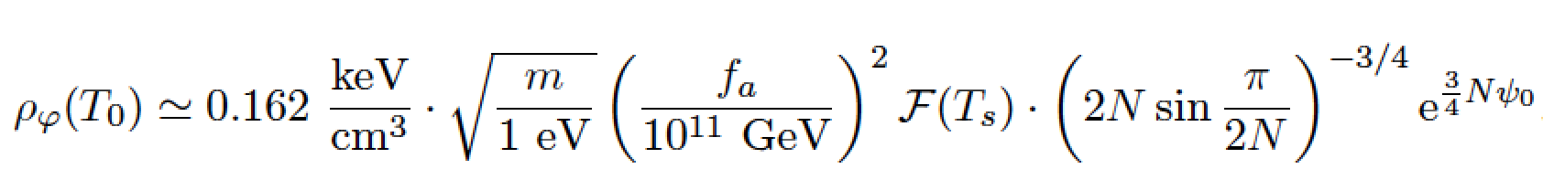
Increased DM density
In flat regions the field starts to roll much later
➔ dilution delayed
➔ density increased

Slide 62
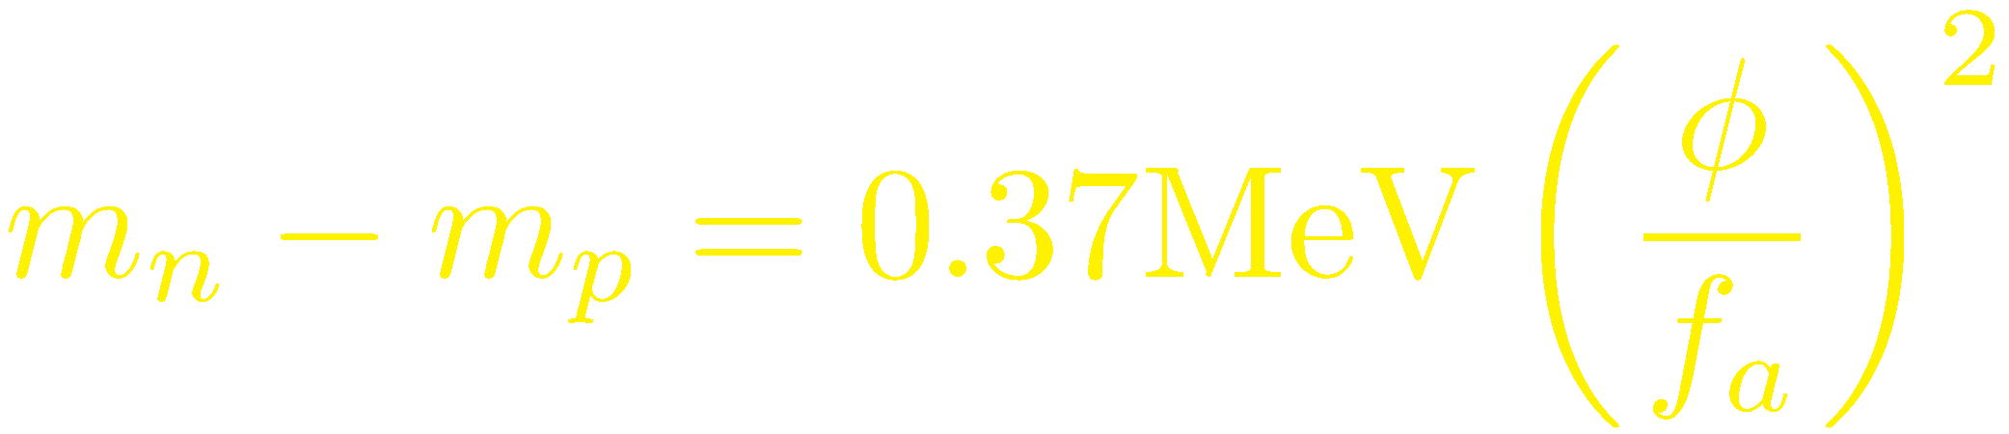
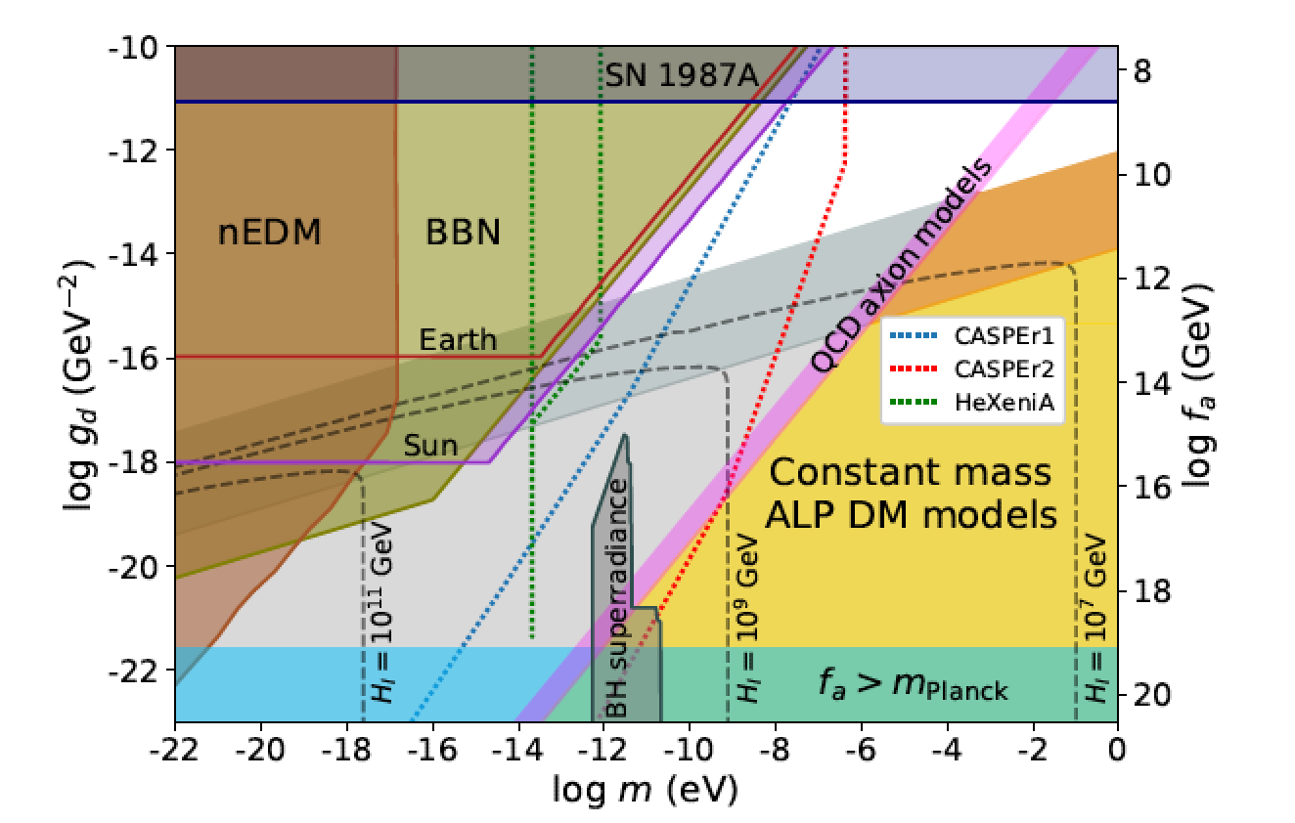
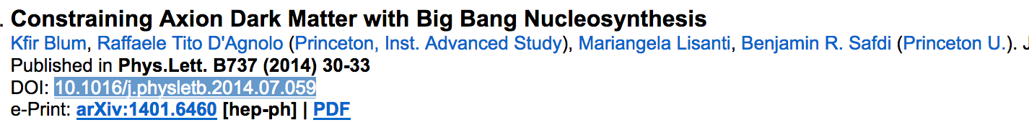
BBN limits
Proton-neutron mass difference depends on £_{QCD}
Depending on f_{a} this can be O(1) at BBN
➔ Helium production changed

Slide 63
Avoiding BBN limits
Kinetic term
Singularities at ¼/(2N)
Á/f_{a} does not cross ¼/(2N), i.e. Á/f_{a} · ¼/(2N)
No problem with BBN if N>~10

Slide 64
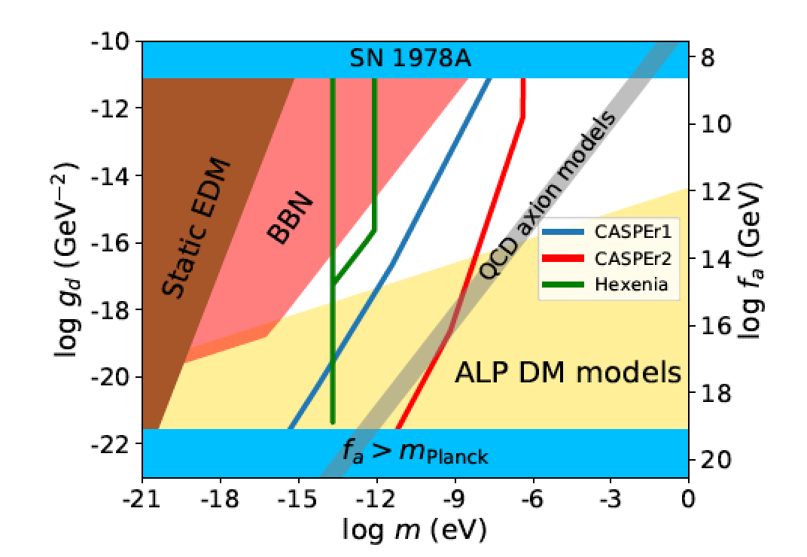
One more difficulty…
QCD coupling generates “minimal” mass
➔ difficult to be lighter than QCD axion

Slide 65
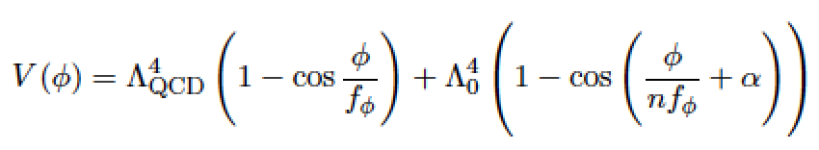
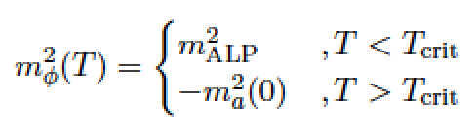
Do some fine-tuning…
Some funny temperature dependence appears

Slide 66
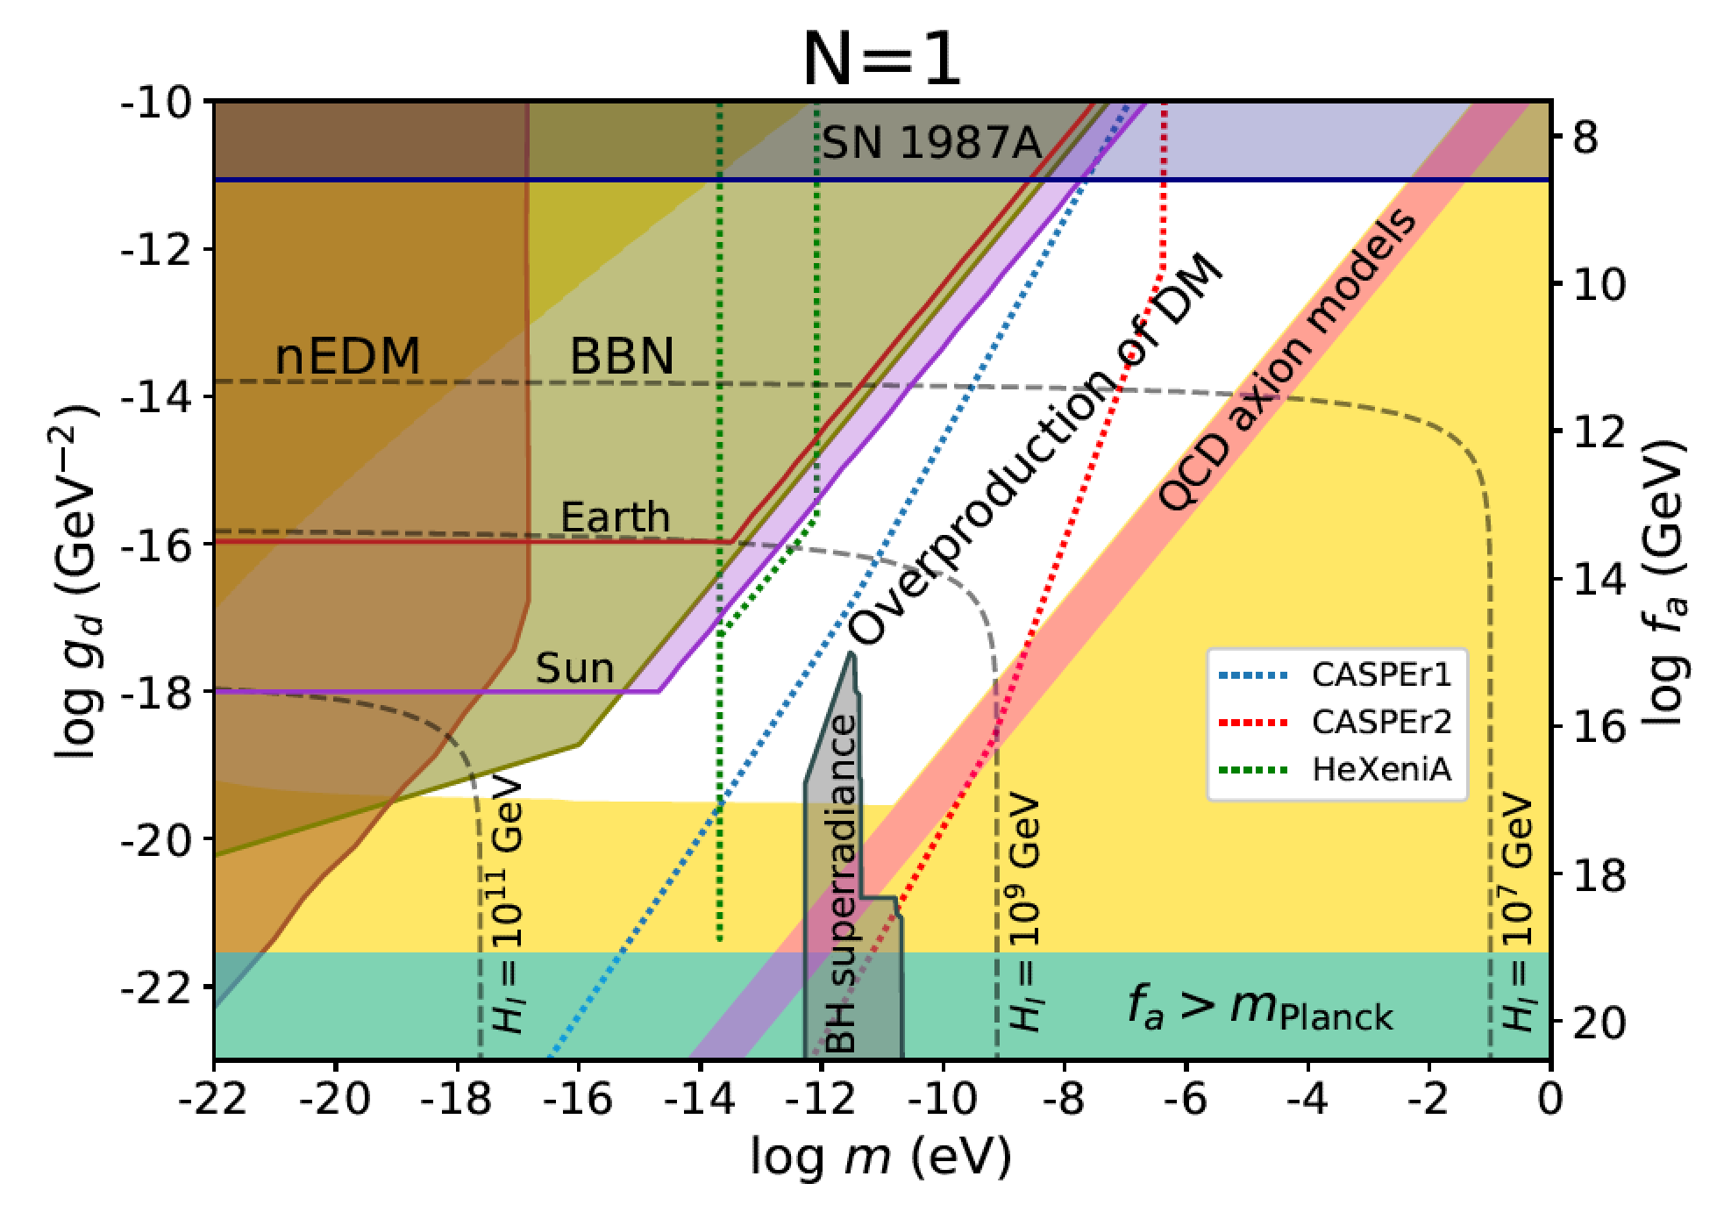
New regions available

Slide 67
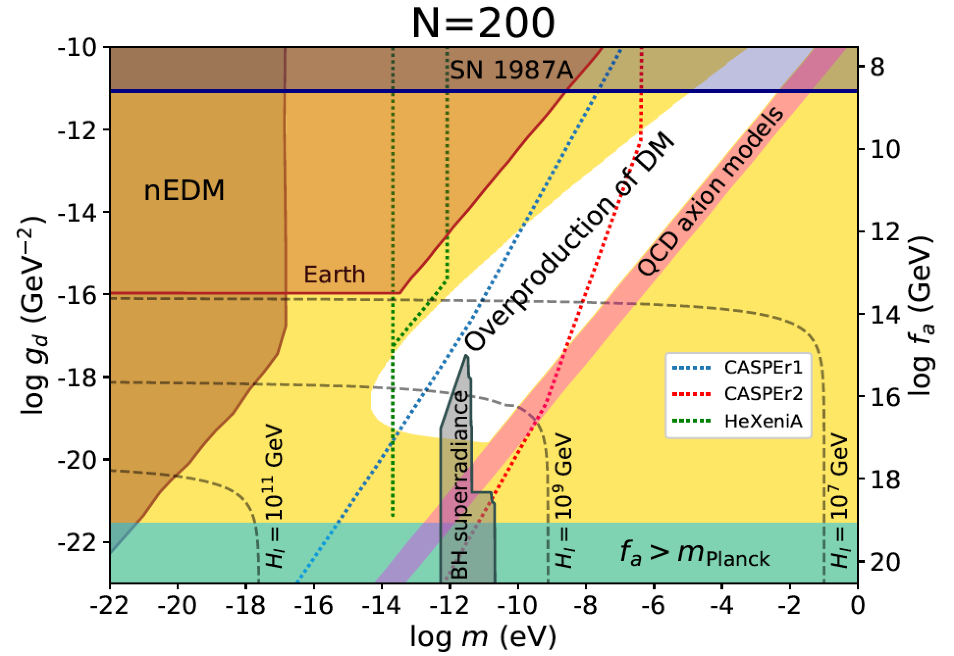
New regions available

Slide 68
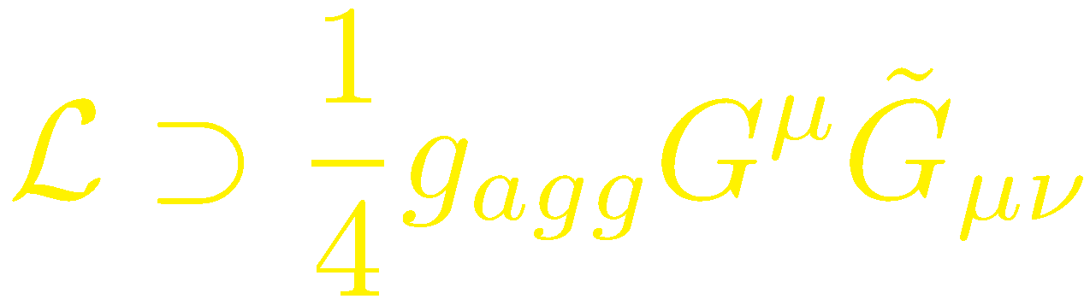
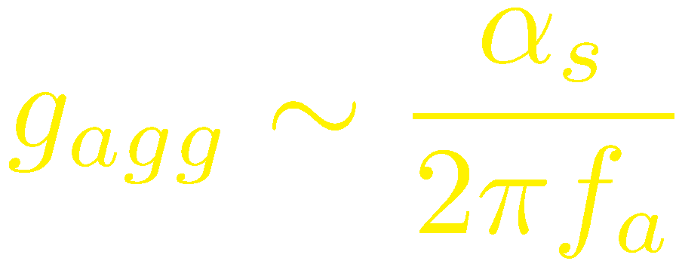
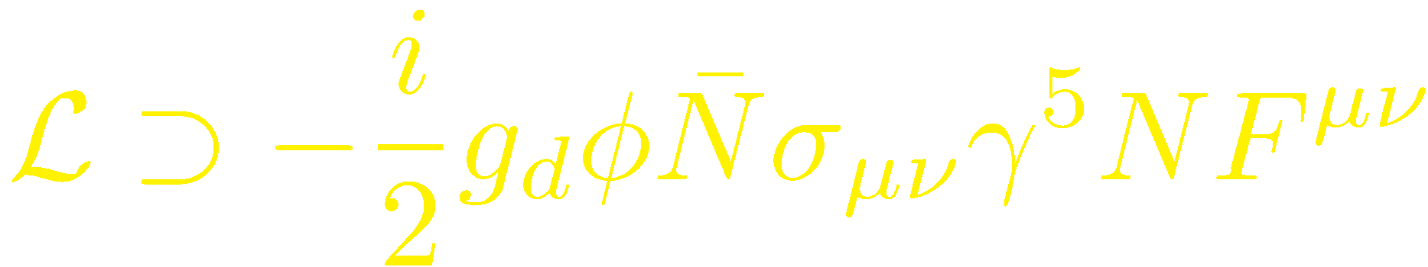
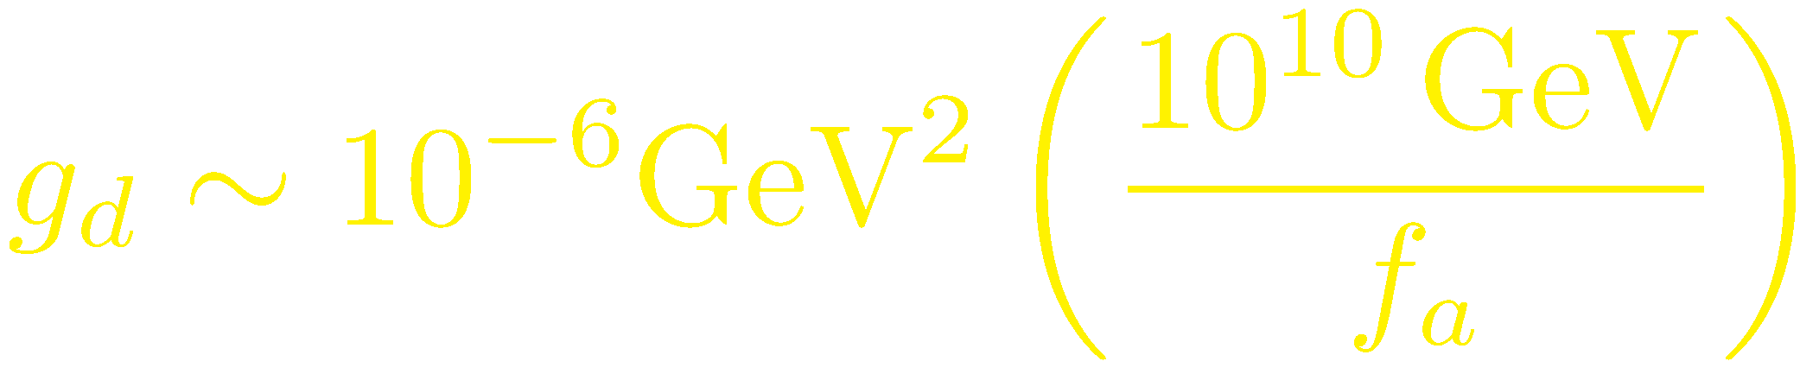
Couplings fixed by f_{a}
Photon coupling
Gluon coupling
At low energies
electric dipole coupling

Slide 69

Couplings fixed by f_{a}
Photon coupling
Gluon coupling
Fermion couplings

Slide 70
New potential

