Slide 1


DM or MOND
From Galactic Rotation Curves
Mads Toudal Frandsen
Arxiv:1805.10706, 1710.03096 with J. Petersen
PACTS 2018

Slide 2
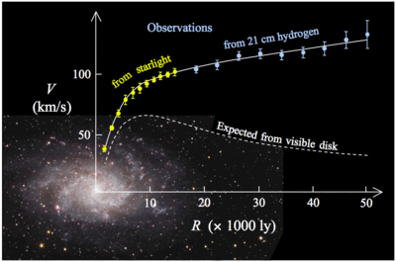
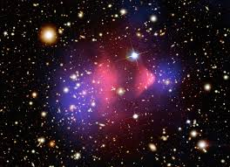
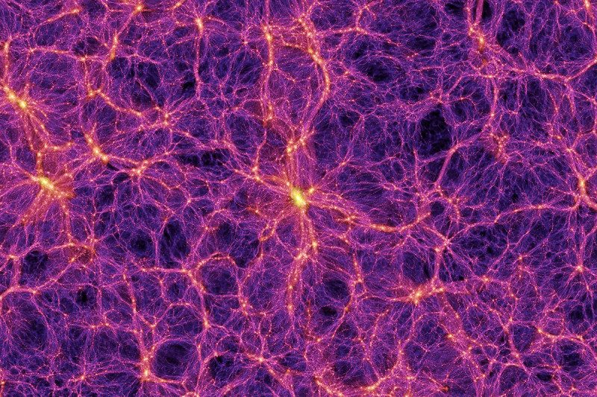
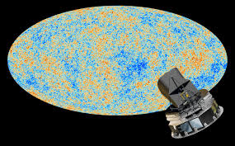
Missing mass problem
Galactic scales
Rotation curves of stars and gas
(Freeman ’70, Bosma ’78, Rubin et al ’78)
Cluster Scales
Galaxy velocity dispersions,
Cluster mergers
(Zwicky ’33, Clowe et al ’06)
Cosmological scales
CMB and LSS
(Davis et al ’82, Peebles ’82)
PACTS 2018

Slide 3
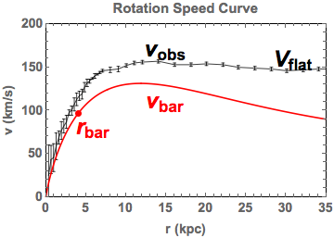
Rotation speed curves
Baryonic and observed speeds and accelerations
Radii r_{bar} of maximum baryonic acceleration
PACTS 2018

Slide 4
Rotation speed curves
Baryonic and observed speeds and accelerations
Newtonian
regime
Mondian regime
Baryonic
Tullly-Fisher relation
Mondian regime
g_{obs} < g₀
Radii r_{bar} of maximum baryonic acceleration
g₀ ~ 10⁻¹⁰ m/s² is characteristic transition regime
PACTS 2018

Slide 5
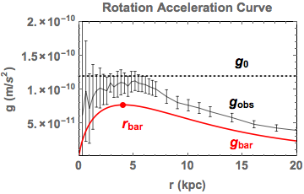
Rotation acceleration curves
Baryonic and observed speeds and accelerations
Mondian regime
Mondian regime
Newtonian
regime
Baryonic
Tullly-Fisher relation
Radii r_{bar} of maximum baryonic acceleration
g₀ ~ 10⁻¹⁰ m/s² is characteristic transition regime
PACTS 2018

Slide 6
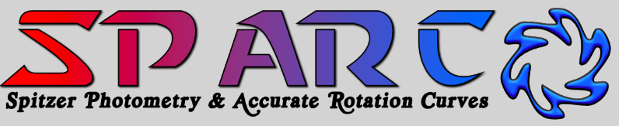
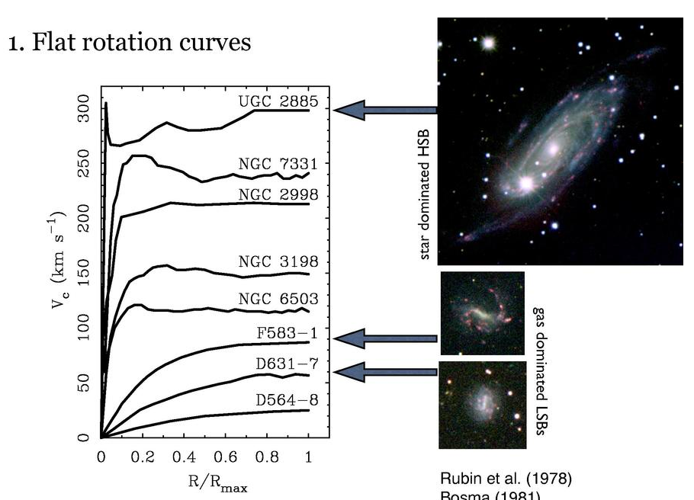
175 late-type spirals and irregulars.
Stellar mass range 5 dex, surface brightnesses 4 dex, range of gas fractions
(From McGaugh, KITP DM workshop ’18)
PACTS 2018

Slide 7
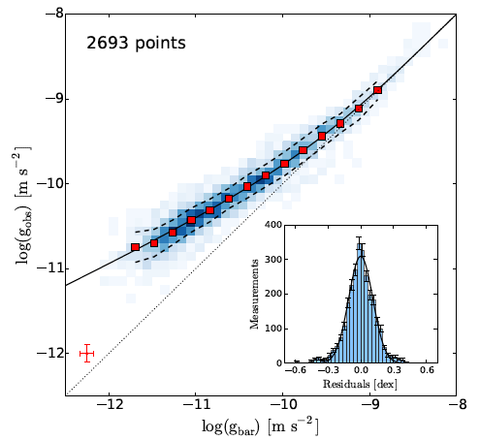
Radial Acceleration Relation
Correlation between baryonic acceleration and total acceleration with 175 galaxies from the SPARC database
(McGaugh, Lelli & Schombert ’16)
g2-space curve
MOND (modified inertia)
model curve
g₀
Newtonian, no missing mass
Fit residuals
Typical error
PACTS 2018

Slide 8
Modified Newtonian Dynamics
Newtonian acceleration modified below g₀ ~ 1.2 x 10⁻¹⁰ m/s²
to account for flat rotation curves
(Milgrom ’83
Bekenstein & Milgrom ’85)
Bekenstein-Milgrom MOND
Newtonian Poisson Equation
MOND acceleration
Baryonic matter distribution ρ_{bar}
Newtonian acceleration
PACTS 2018

Slide 9
Modified Newtonian Dynamics
Newtonian acceleration modified below g₀ ~ 1.2 x 10⁻¹⁰ m/s²
to account for flat rotation curves
(Milgrom ’83
Bekenstein & Milgrom ’85)
Bekenstein-Milgrom MOND
Newtonian Poisson Equation
MOND acceleration
Baryonic matter distribution ρ_{bar}
Newtonian acceleration
Newtonian regime
Mondian regime
MOND interpolation function
PACTS 2018

Slide 10
Modified Gravity vs Inertia
Bekenstein-Milgrom MOND
(modified gravity) solution
(Bekenstein & Milgrom ’85)
MOND modified inertia
Applied to rotation curves
(Milgrom ’83, ’93)
PACTS 2018

Slide 11
Modified Gravity vs Inertia
Bekenstein-Milgrom MOND
(modified gravity) solution
(Bekenstein & Milgrom ’85)
MOND modified inertia
Applied to rotation curves
(Milgrom ’83, ’93)
Inverse interpolation function ν gives exact MOND modified inertia acceleration
Or simplest approximation for MOND modified gravity
Example inverse interpolation function:
(Famaey and McGaugh ’11)
PACTS 2018

Slide 12
Radial Acceleration Relation
1) Correlation between baryonic acceleration and total acceleration
2) MOND modified inertia fit.
3) (Simplest) approximation to MOND modified gravity fit.
g2-space cuve
shows
g2-space curve
MOND (modified inertia)
model curve
Newtonian, no missing mass
Fit residuals
Typical error
PACTS 2018

Slide 13
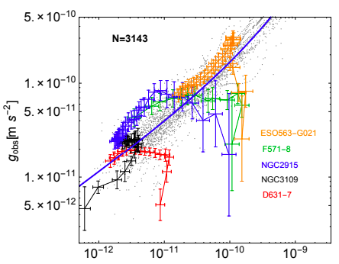
SPARC Individual galaxies
(J. Petersen and MTF ’17
MTF and J. Petersen ’18)
Small radii
g₀
Large radii
(MTF and J. Petersen ’18)
Highlighted galaxies don’t follow Radial Acceleration Relation at smallest radii
Result of baryonic complexities at small radii?
PACTS 2018

Slide 14
MOND models in g2-space
(MTF and J. Petersen ’18)
Radii r_{bar,tot} of maximum baryonic
and total accelerations
Curve segment C⁺ at radii r > r_{bar}
curve segment C⁻ at radii r < r_{bar}
MOND modified Inertia predictions:
r_{tot} = r_{bar} and C⁺ = C⁻
C⁺= C⁻
PACTS 2018

Slide 15
MOND models in g2-space
(MTF and J. Petersen ’18)
Radii r_{bar,tot} of maximum baryonic
and total accelerations
Curve segment C⁺ at radii r > r_{bar}
curve segment C⁻ at radii r < r_{bar}
MOND modified Inertia predictions:
r_{tot} = r_{bar} and C⁺ = C⁻
MOND modified gravity predictions
(approximation Brada & Milgrom ’95)
r_{tot} > r_{bar} and C⁺ ≠ C⁻
PACTS 2018

Slide 16
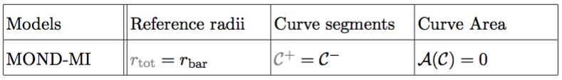
MOND geometry in g2-space
Geometric Classification
MOND Modified Inertia
PACTS 2018

Slide 17
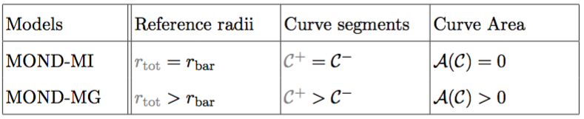
MOND geometry in g2-space
Geometric Classification
Mond Modified Inertia
MOND Modified Gravity
PACTS 2018

Slide 18
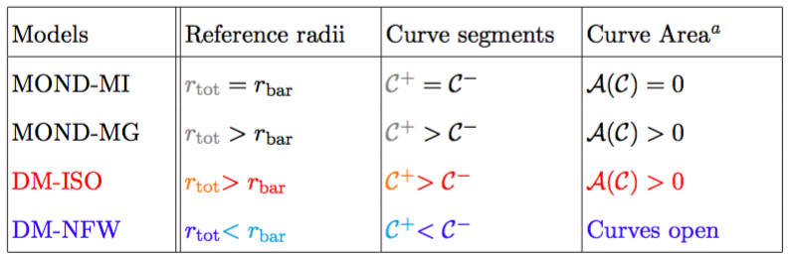
MOND and DM geometry in g2-space
Large radii
Large radii
Geometric Classification
Mond Modified Inertia
MOND Modified Gravity
DM Pseudo-Isothermal
DM Navarro-Frenk-White
PACTS 2018

Slide 19
Comparison to SPARC data
(MTF and J. Petersen ’18)
(NB: For data g_{tot}-> g_{obs})
g_{obs,bar} in terms of measusred quantities:
PACTS 2018

Slide 20
Comparison to SPARC data
(MTF and J. Petersen ’18)
(NB: For data g_{tot}-> g_{obs})
g_{obs,bar} in terms of measusred quantities:
g_{obs} uncertainties: random δv_{obs} , Inclination angle δi , Galaxy distance δD
g_{bar} uncertainties: δv_{gas} , disk and bulge mass to light ratios δΥ_{disk,bulge}
PACTS 2018

Slide 21
Comparison to SPARC data
(MTF and J. Petersen ’18)
(NB: For data g_{tot}-> g_{obs})
g_{obs,bar} in terms of measusred quantities:
g_{obs} uncertainties: random δv_{obs} , Inclination angle δi , Galaxy distance δD
g_{bar} uncertainties: δv_{gas} , disk and bulge mass to light ratios δΥ_{disk,bulge}
Galaxy specific uncertainties δi, δD, δΥ_{disk,bulge} dominate the RAR scatter
Also these will depend on radius
(Li, Lelli, Mcgaugh & Schombert ’18)
PACTS 2018

Slide 22
Acceleration Ratios in ĝ2-space
(MTF and J. Petersen ’18)
Define ratios of accelerations wrt r_{bar}
Systematic uncertainties on inclination angle δi and galaxy distance δD eliminated
Systematic uncertainties on mass to light ratios δΥ_{disk,bulge} reduced
Caveat: Significant radial dependence of systematic uncertainties
PACTS 2018

Slide 23
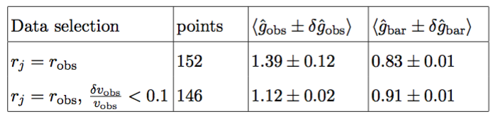
MOND models in ĝ2-space
(MTF and J. Petersen ’18)
MOND modified Inertia consequences:
r_{tot} = r_{bar} and C⁺ = C⁻ so
Ruled out independent of model > 5σ
SPARC data analysis for
(NB: For data points g_{tot}-> g_{obs} , r_{tot}->r_{obs})
PACTS 2018

Slide 24
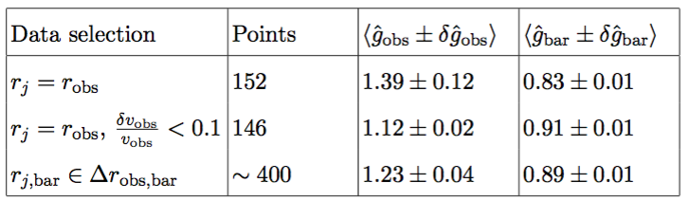
MOND models in ĝ2-space
(MTF and J. Petersen ’18)
MOND modified Inertia consequences:
r_{tot} = r_{bar} and C⁺ = C⁻ so
Ruled out independent of model > 5σ
SPARC data analysis for
(NB: For data points g_{tot}-> g_{obs} , r_{tot}->r_{obs})
PACTS 2018

Slide 25
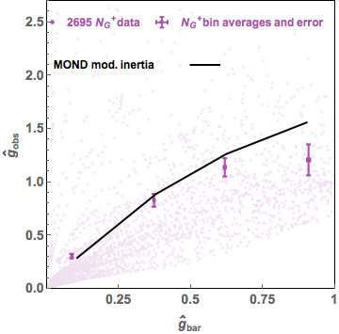
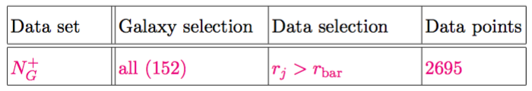
SPARC data in ĝ2-space
(MTF and J. Petersen ’18)
PACTS 2018

Slide 26
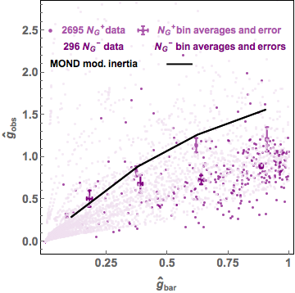
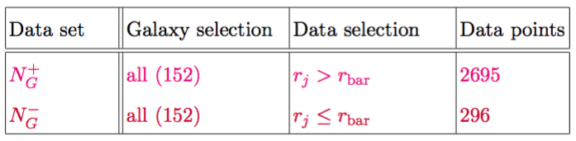
SPARC data in ĝ2-space
(MTF and J. Petersen ’18)
All SPARC data after quality criteria organized wrt r_{bar}
PACTS 2018

Slide 27
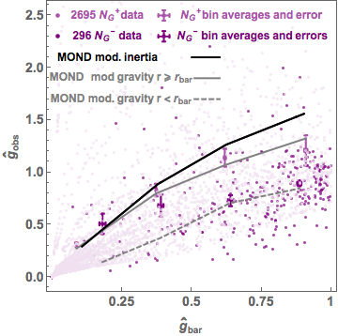
SPARC data in ĝ2-space
(MTF and J. Petersen ’18)
All SPARC data after quality criteria organized wrt r_{bar}
PACTS 2018

Slide 28
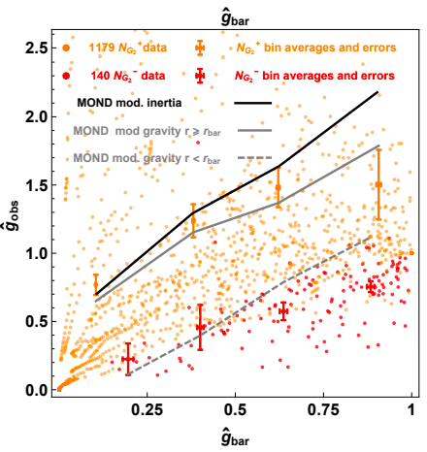
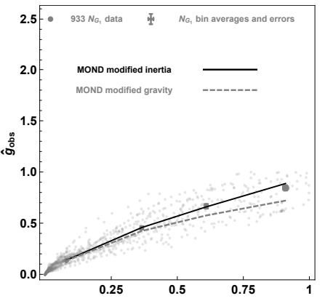
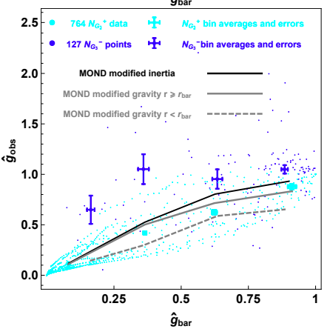



SPARC data in ĝ2-space
(MTF and J. Petersen ’18)
Subdividing galaxies according to overall geometry: r_{obs} vs r_{bar}
PACTS 2018

Slide 29
Summary
Geometries of DM and MOND models classified in g2-space
Rotation curves rule out MOND (modified inertia) >5σ Caveat: Significant residual radial dependence of systematic effects
MOND modified gravity remains to be fully tested beyond Brada-Milgrom approximation
Most galaxies display cored geometry pseudo-isothermal/(approximate) MOND modified gravity
Diversity from baryonic effects and/or DM self-interactions?
PACTS 2018

