Slide 1
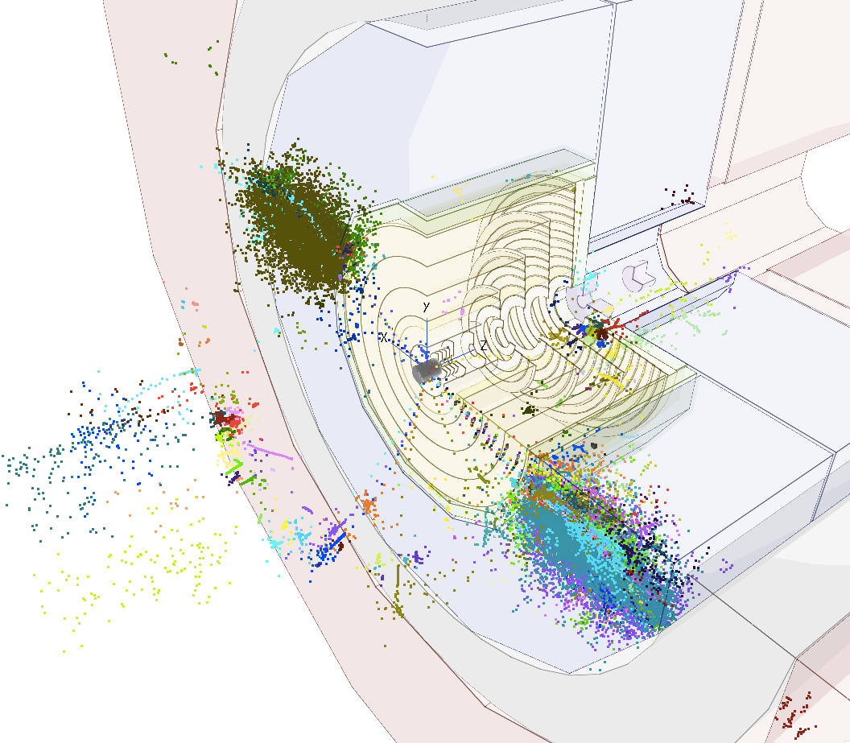
Tracker resolution and boosted objects
Dominik Dannheim (CERN),
Estel Perez (CERN), Philipp Roloff (CERN), Rosa Simoniello (CERN)
Special thanks to Zbynek Drasal (CERN), Valentin Volkl, Andre Sailer(CERN)
CLIC-FCChh tracker and vertex optimization meeting , 2ns Feb 2017

Slide 2
Introduction
Q: What is the requirement on the detector granularity given by our need to resolve close-by hits from decays of very boosted particles?
Our Benchmark: high energy taus decaying to 3 prongs
  tkLayout geom + drivers, new CLIC SW simulation
Notice 2 effects are convoluted:
  small opening angle between the prongs
  very displaced decay vertex
Efficiency of resolving the 3 prongs
  vs tau flight distance
  vs tau energy
  vs detector granularity

Slide 3
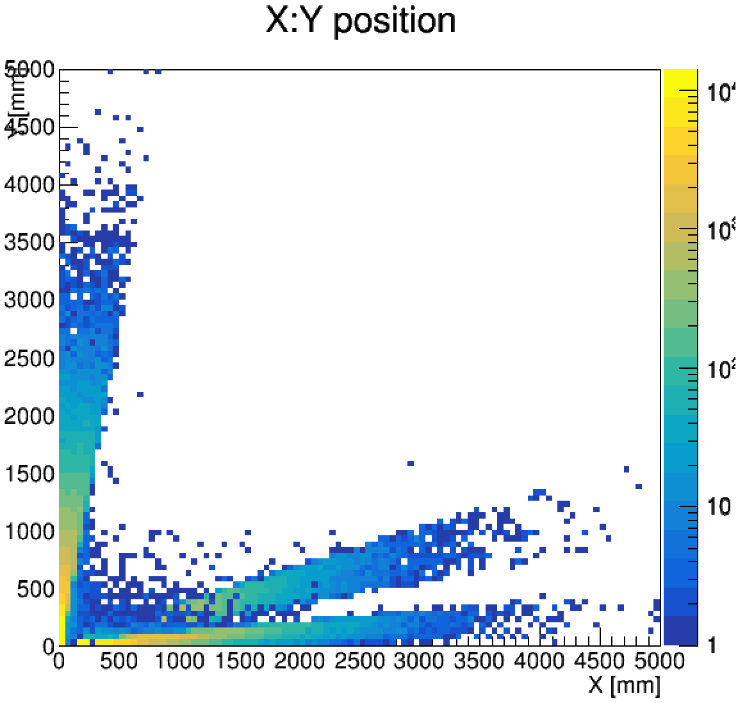
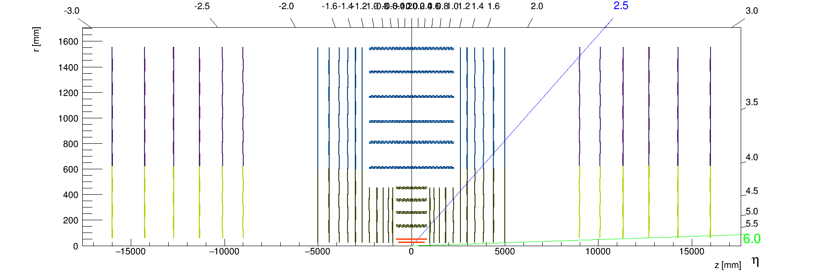
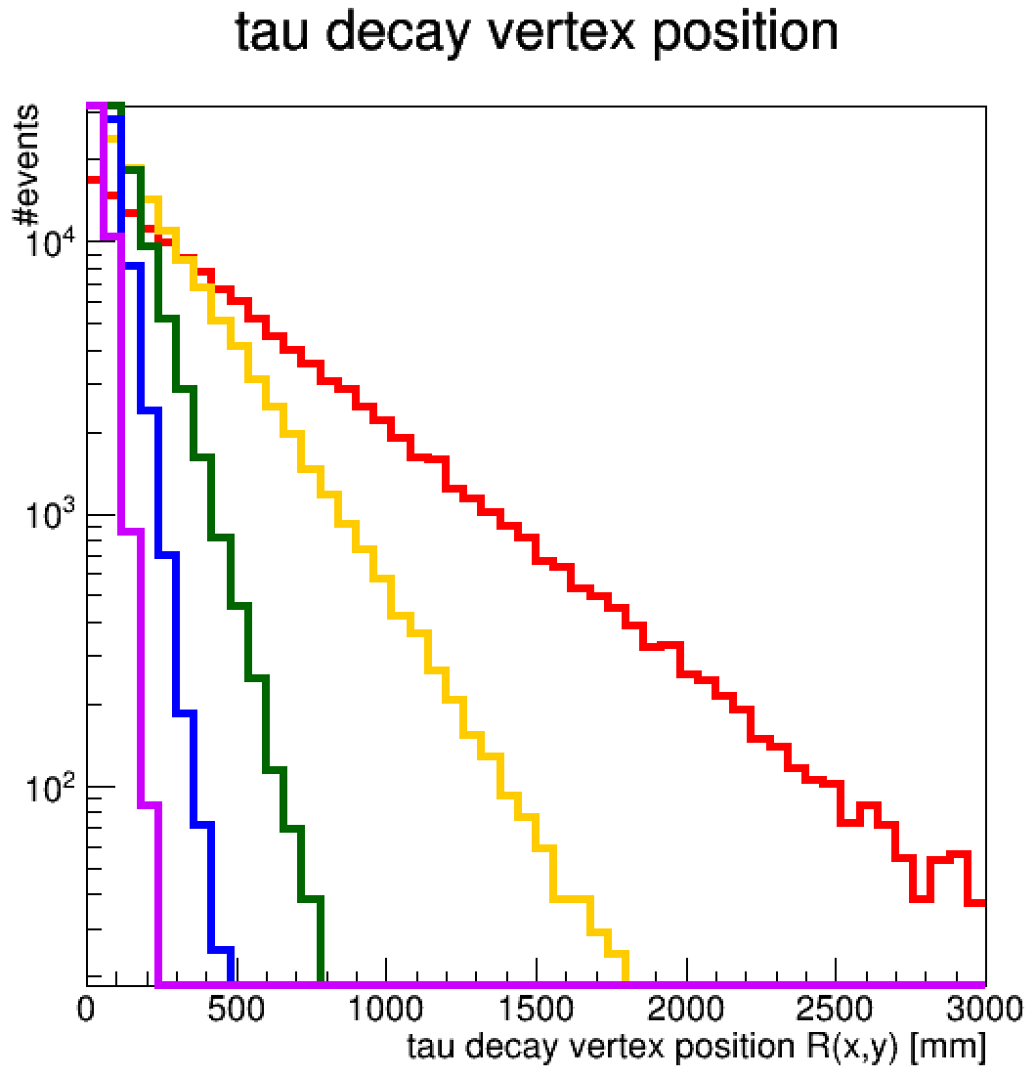
Samples used
tau decay vertex position (Y:X plane)
Z’-> tau tau events with at least one 3-prong tau
Eτ=10TeV
Fraction of central taus decaying
inside the beampipe
(within R(x,y)<20mm )
Etau=10 TeV : 0.045
Etau=5 TeV : 0.088
Etau=2 TeV : 0.201
Etau=1 TeV : 0.357
Etau=0.5 TeV : 0.586
Etau=0.2 TeV : 0.888
Etau=0.1 TeV : 0.987
central
transistion
forward
Central
Etau=10 TeV
Etau=5 TeV
Etau=2 TeV
Etau=1 TeV
Etau=500 GeV
While 99% of central 100 GeV taus decay within the beampipe, only 4% of 10TeV central taus do.

Slide 4
Efficiency definition (I)
Resolve all prongs → reconstruct all tracks → have enough hits per track
Assume: we need at least 4 (non-shared) hits per track
Assume: outside-in tracking
→ the hits from different prongs must be resolved in the 4th-to-last layer of the tracker
Assume: single-hit clusters
→ distance between closest hits > 2*pixel pitch
Efficiency = ΔRPhi (ΔZ) distance between closest hits > 2*Rphi (Z) pixel pitch / closest pair of pion hits in the 4th-to-last layer
[effectively factoring out taus that decay after the 4th-to-last layer]
2*pixel pitch
Fraction of central taus decaying before the 4th-to-last barrel layer
Etau=10 TeV : 0.857
Etau=5 TeV : 0.978
Etau=2 TeV : 0.9999
Etau=1 TeV : 1
Fraction of forward taus decaying before the 4th-to-last barrel layer
Etau=10 TeV : 0.9992

Slide 5
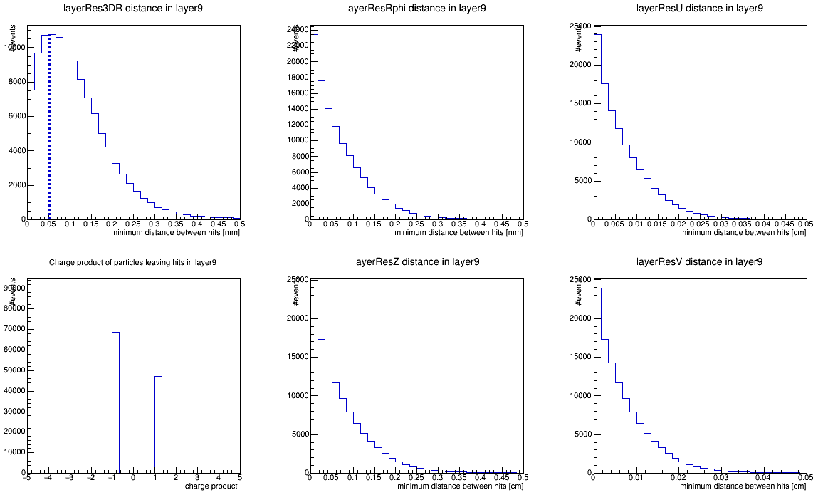
Efficiency definition (II)
Assume: 10x100 [μm] single point resolution
Assume: pixel pitch = single point resolution * √12
→ if ΔRPhi > 2 * 10 μm * √12 ; pass
3D distance
distance in RPhi
distance in u
pass
Central tau of E=10 TeV decaying before 9th barrel layer (86% acceptance)
Distance between the closest pion hits in the 9th barrel layer
Same separation in Rphi and Z, no priviledged direction
Only 41% efficiency
charge product
distance in Z
distance in v
(module local coordinates)

Slide 6
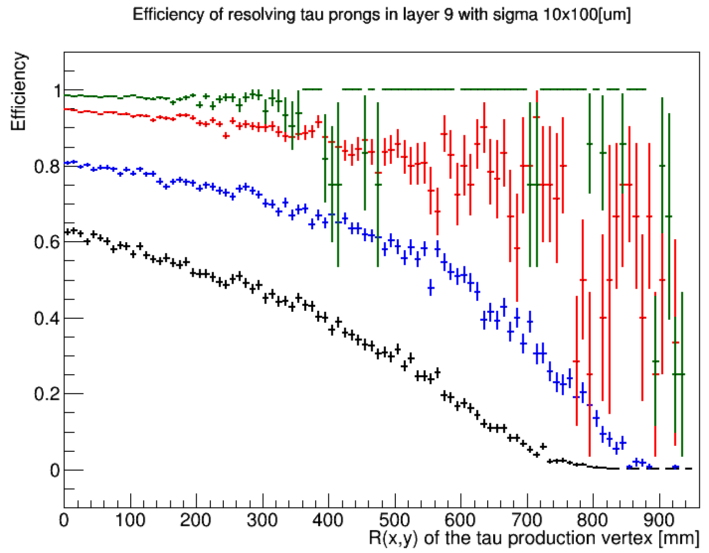
Efficiency vs tau decay vertex position
For various tau energies
For 10 TeV taus decaying before the beampipe: ~60% efficiency only due to the small opening angle between decay products
  Could be improved by using higher detector granularity
Efficiency drops in R due to tau displaced decay
  Could one identify the tau track in the vertex detector?
No significant inneficiency for taus of E < 1 TeV
Central taus
Etau = 1 TeV
Etau = 2 TeV
Etau = 5 TeV
Etau = 10 TeV

Slide 7
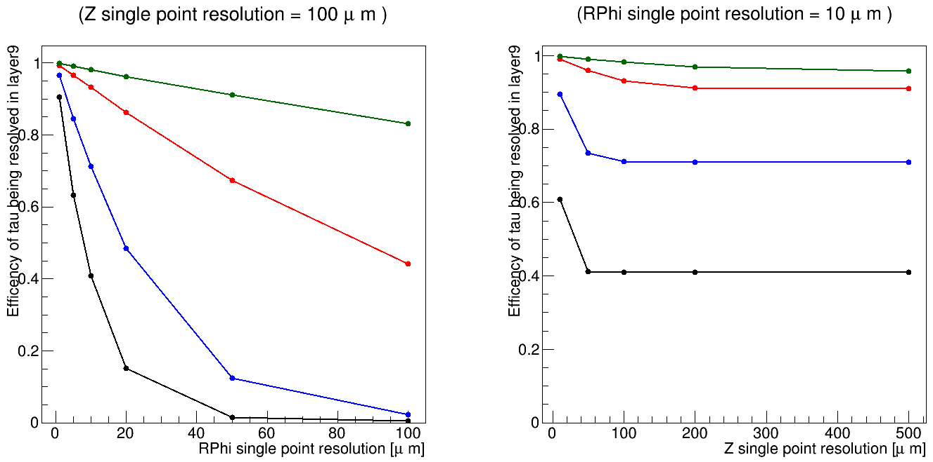
Efficiency vs detector single point resolution
Assuming: pixel pitch = single point resolution * √12
Vertical line shows the default 10x100 [μm]
Etau = 1 TeV
Etau = 2 TeV
Etau = 5 TeV
Etau = 10 TeV
Etau = 1 TeV
Etau = 2 TeV
Etau = 5 TeV
Etau = 10 TeV
Rapid change with single point resolution, specially for highest energy taus
Better to improve the Rphi resolution than the Z resolution

Slide 8
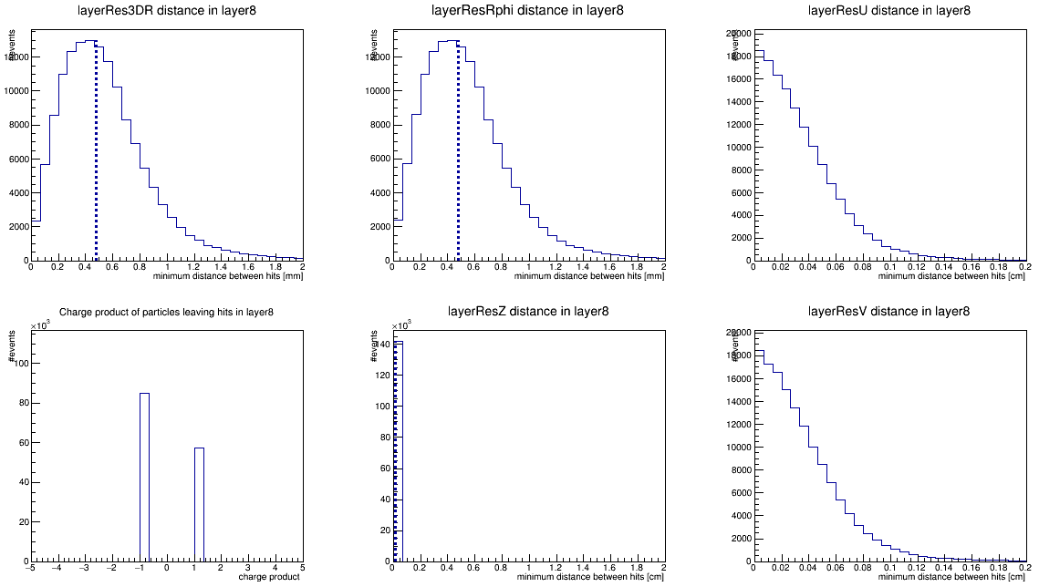
Endcap region
Assume: 10x100 [μm] single point resolution
Assume: pixel pitch = single point resolution * √12
→ if ΔRPhi > 2 * 10 μm * √12 ; pass
pass
Forward tau of E=10 TeV decaying before 8th endcap disk (99.9% acceptance)
  4th-to last layer is more than 3 times further out
global efficiency > 85%

Slide 9
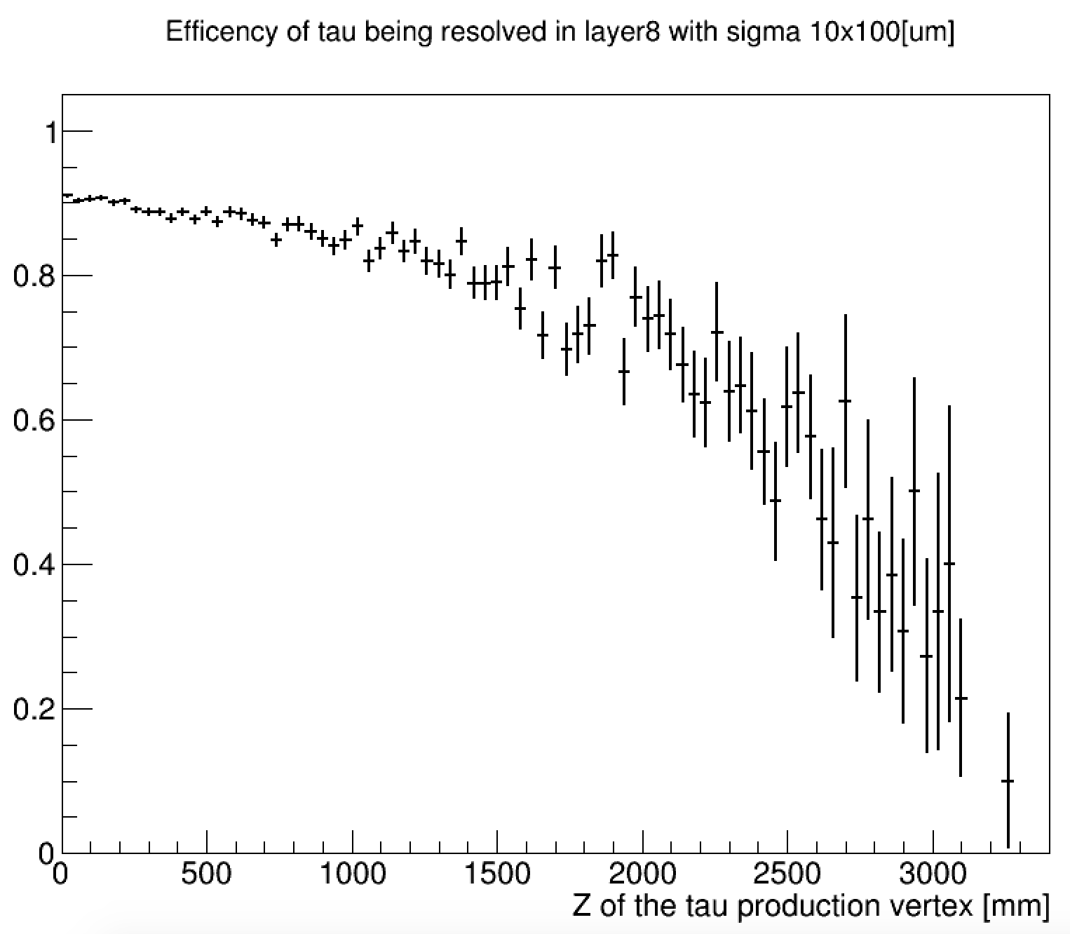
Efficiency vs tau decay vertex position
Etau=10TeV
For taus decaying in the beampipe
efficiency close to 90%

Slide 10
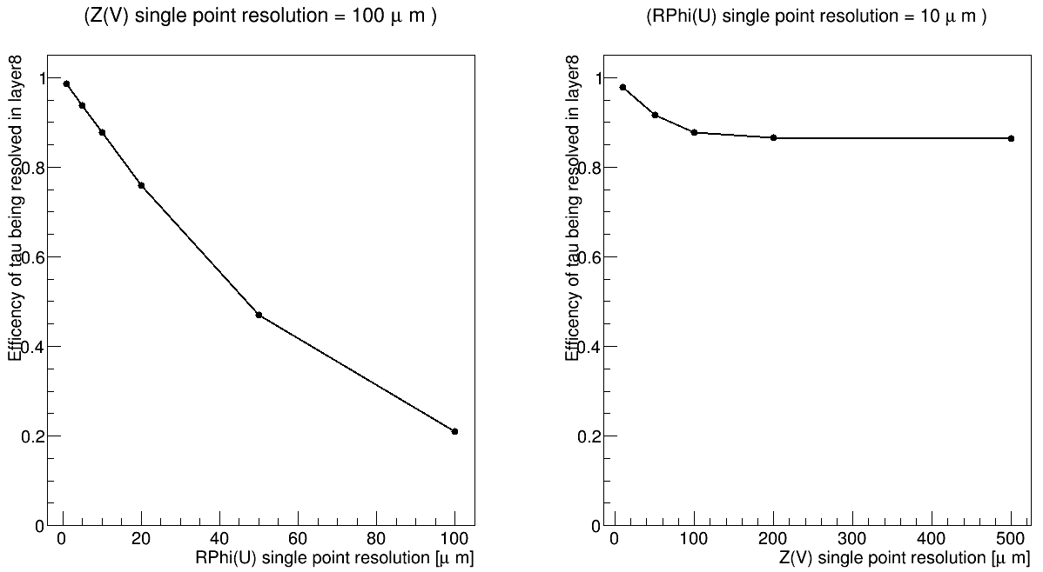
Efficiency vs detector single point resolution
Increase in resolution not so helpful

Slide 11
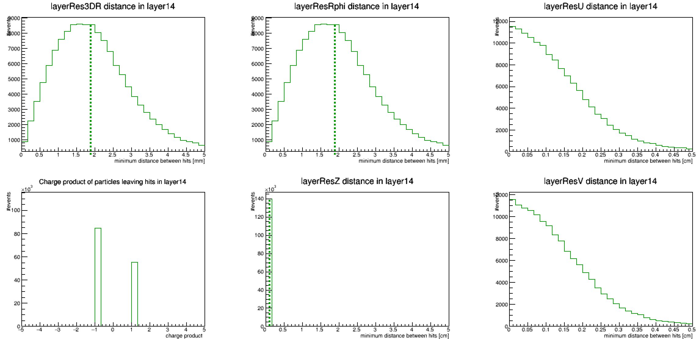
Forward region
tau decay vertex position (Y:X plane)
fraction of E=10TeV taus decaying before this layer = 1
Eτ=10TeV
forward

Slide 12
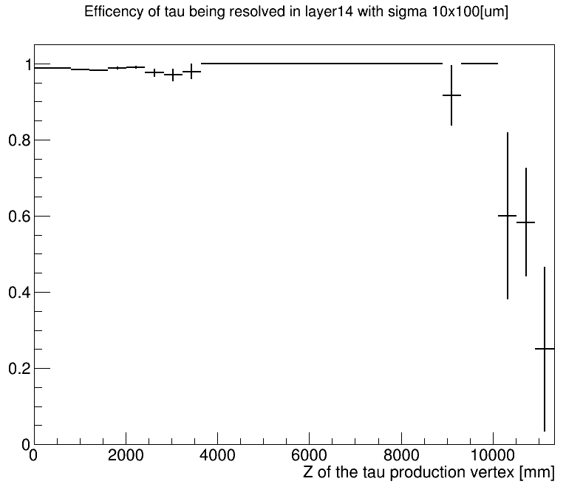
Efficiency vs tau decay vertex position

Slide 13
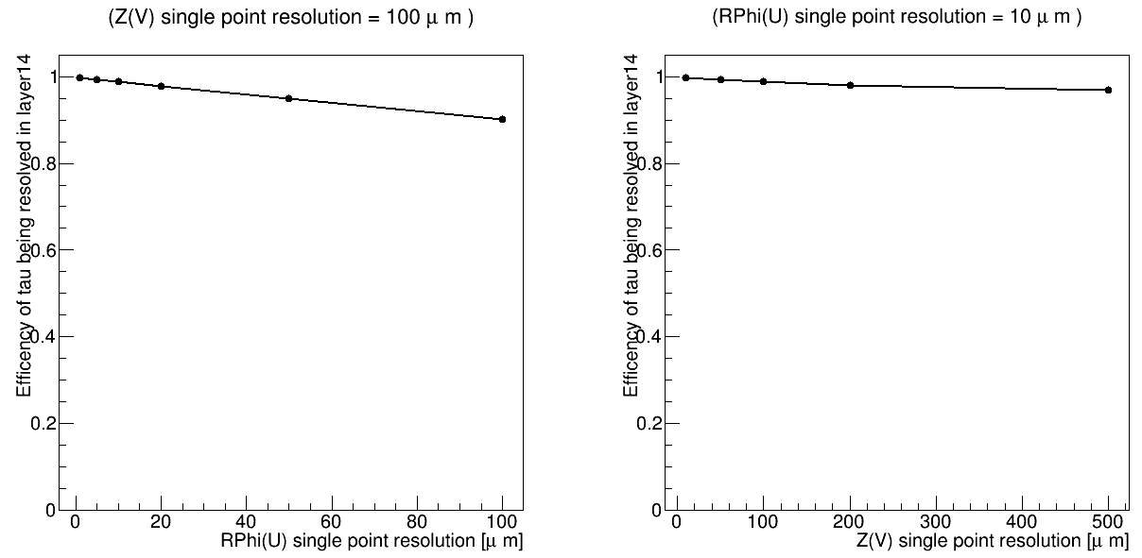
Efficiency vs detector single point resolution

Slide 14
Conclusions
If we need to be highly efficient at 10TeV 3-prong taus, we need to improve the Rphi resolution in the barrel

Slide 15
Backup

Slide 16
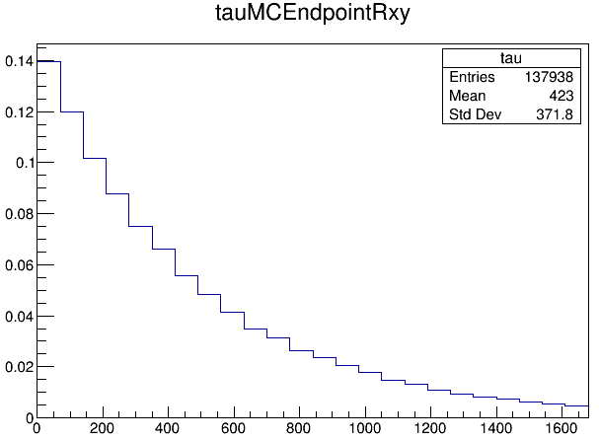
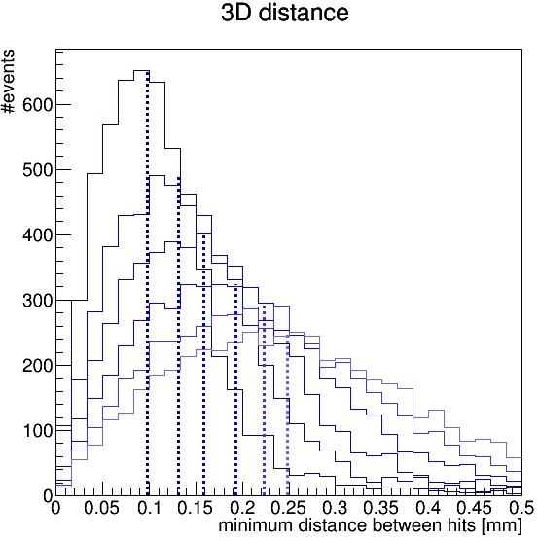
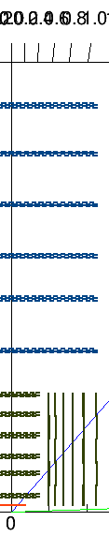
Recap
Q: What is the requirement on the detector granularity given by our need to resolve close-by hits from decays of very boosted particles?
Check in the simulation, what is the distance between the two closest hits
  We studied the benchmark signature of very boosted taus
In the last FCChh meeting presented results for 10TeV taus
Less than 14% of the taus decay before the 2nd vertex layer
layer1
layer2
layer3
layer4
layer5
layer6
The two closest hits would end up in the same pixel in some of the layers
fraction of the taus
-> To study only the effect of the opening angle, require that the tau decays before the first layer
Tracker
(6 layers)
Vertex
(7 layers)
tau endpoint position R(x,y) [mm]
Comments:
- We have to care about boosted particles decaying well into our detector
- Show how efficiency decreases as a function of the tau energy

Slide 17
Progress
Added surfaces for the barrel → Done
Scan on tau energy → Done
Adding surfaces for the endcaps → Ongoing
  Then Look at encap and Fwd region
Run track cheater

Slide 18
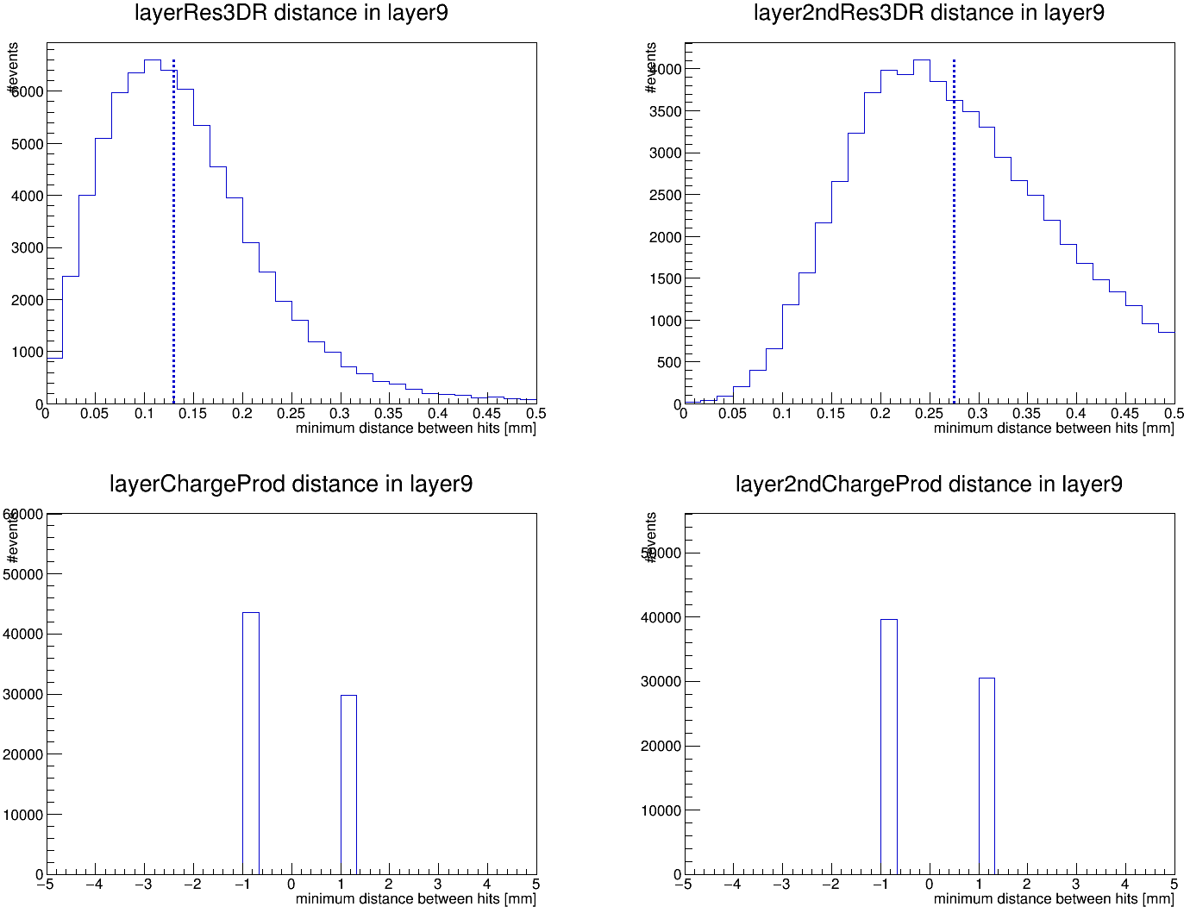
Q1: Is the distance so small because I am looking at particles of the same charge?
closest pair of hits
2nd closest pair of hits
1: Look at the charge product of the particles associated to the two hits: q(hit1) * q(hit2)
2: Look at the 2nd closest pair of hits
→ the 1st closest pair actually contains lower fraction of same-sign pairs than the 2nd closest pair
charge product
charge product

Slide 19
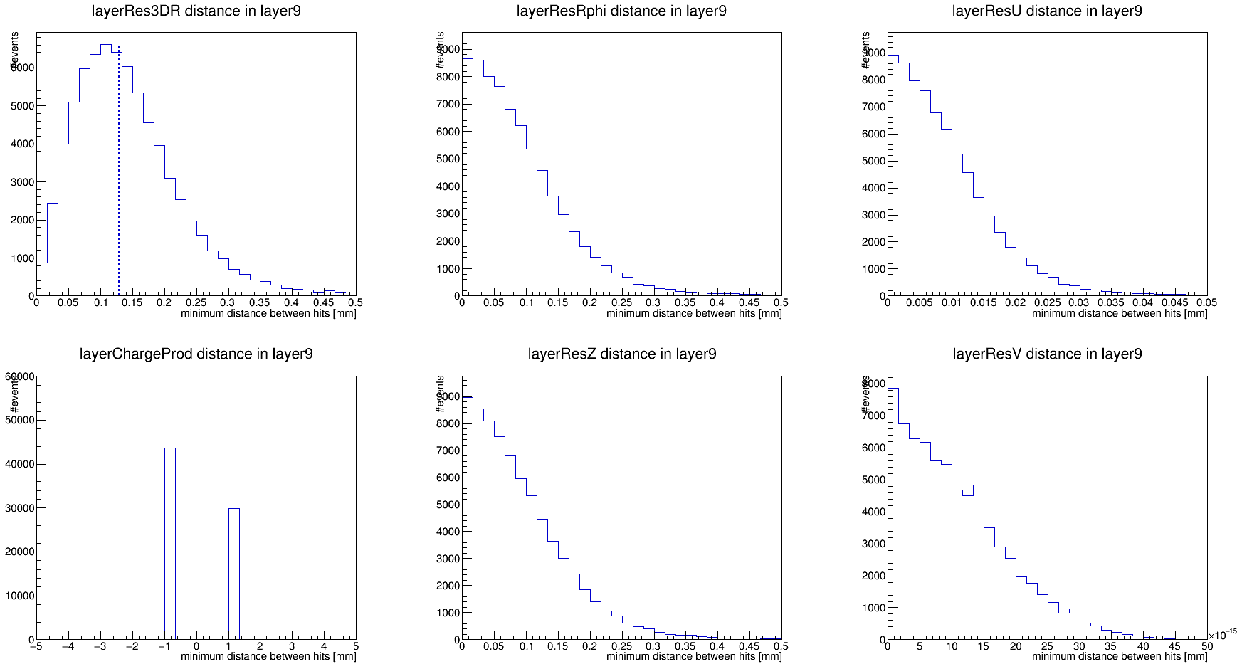
Q2: compare coordinate systems: Central
3D distance
R-Phi / Z
u/ v
to be compared with detector granularity
needed the surfaces to get local coordinates (useful when dealing with endcaps)
V order of 10 ^ -15 ?
Check endcaps when available

Slide 20
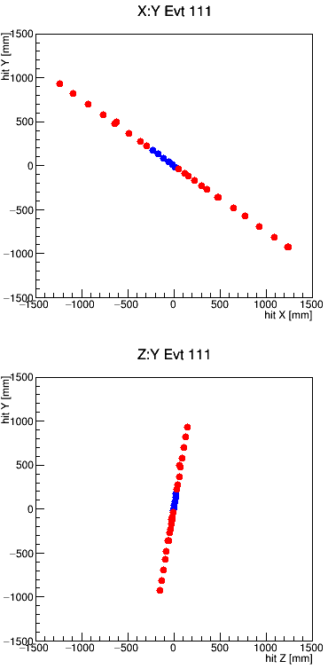
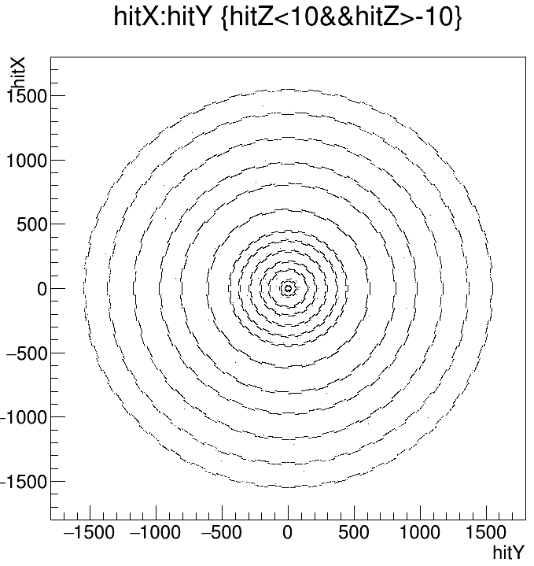
“simple” Efficiency (to track cheater yet)
Assume: to separate the tracks I’ll need the hits to be separated at least in the last 4 layers.
For the hits to be separated I need the distance to be at least twice the pixel pitch (assumed = sigma * sqrt(12) ) in the Rphi OR in the Z direction
Consider 10x100 um single point resolution
  Rphi > 70 um ; Z > 700 um
Efficiency = closest pair of pion hits separated / pairs of pion hits (in the 4rth to last layer)
Plotted vs the tau decay vertex transversal distance to the collision point. (transversal flight distance)
R(x,y) of the tau decay vertex
2*pixel pitch

Slide 21
tau displacement vs energy
Fraction of taus decaying within R<400mm
Etau=10000 GeV : 0.59
Etau=5000 GeV : 0.83
Etau=2000 GeV : 0.987
Etau=1000 GeV : 0.9998
Etau=500 GeV : 1
Fraction of taus decaying within R<20mm
Etau=10000 GeV : 0.045
Etau=5000 GeV : 0.088
Etau=2000 GeV : 0.201
Etau=1000 GeV : 0.357
Etau=500 GeV : 0.586
Etau=200 GeV : 0.888
Etau=100 GeV : 0.987

Slide 22
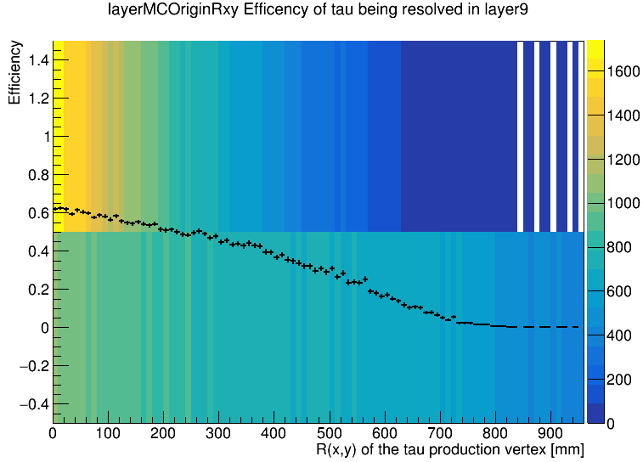
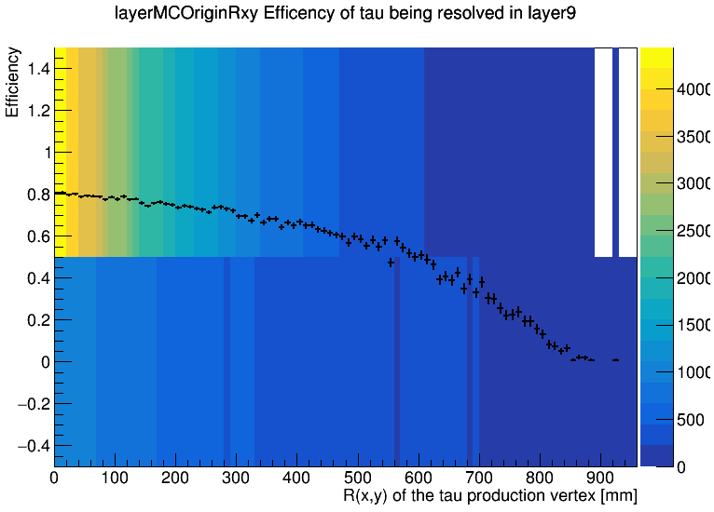
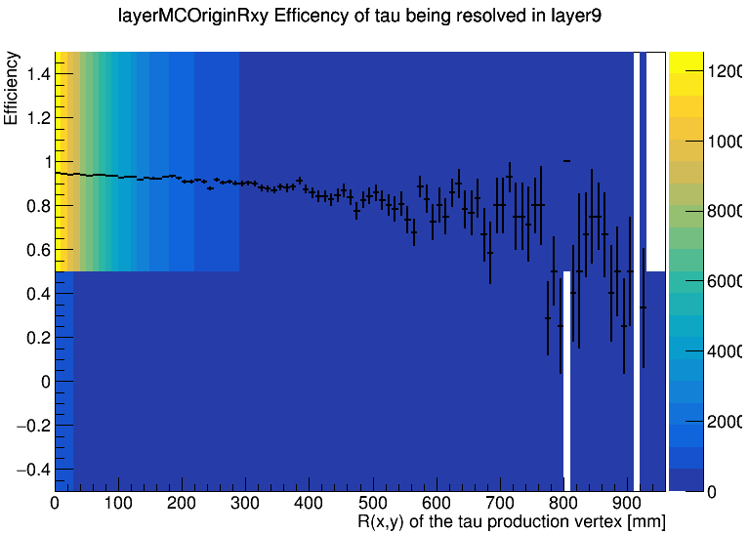
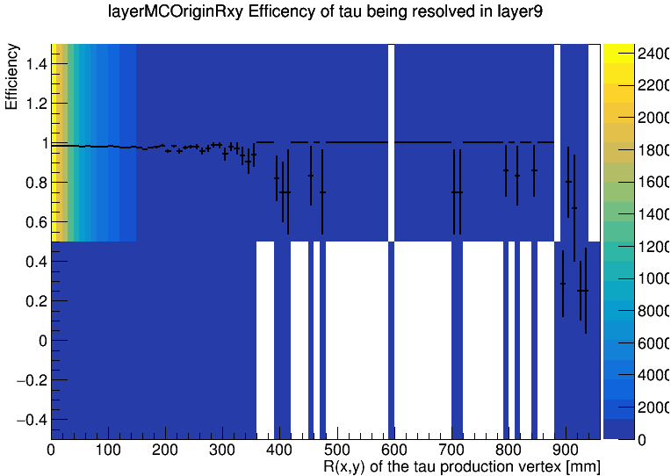
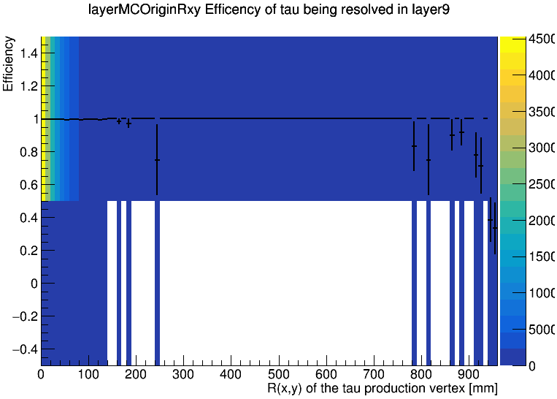
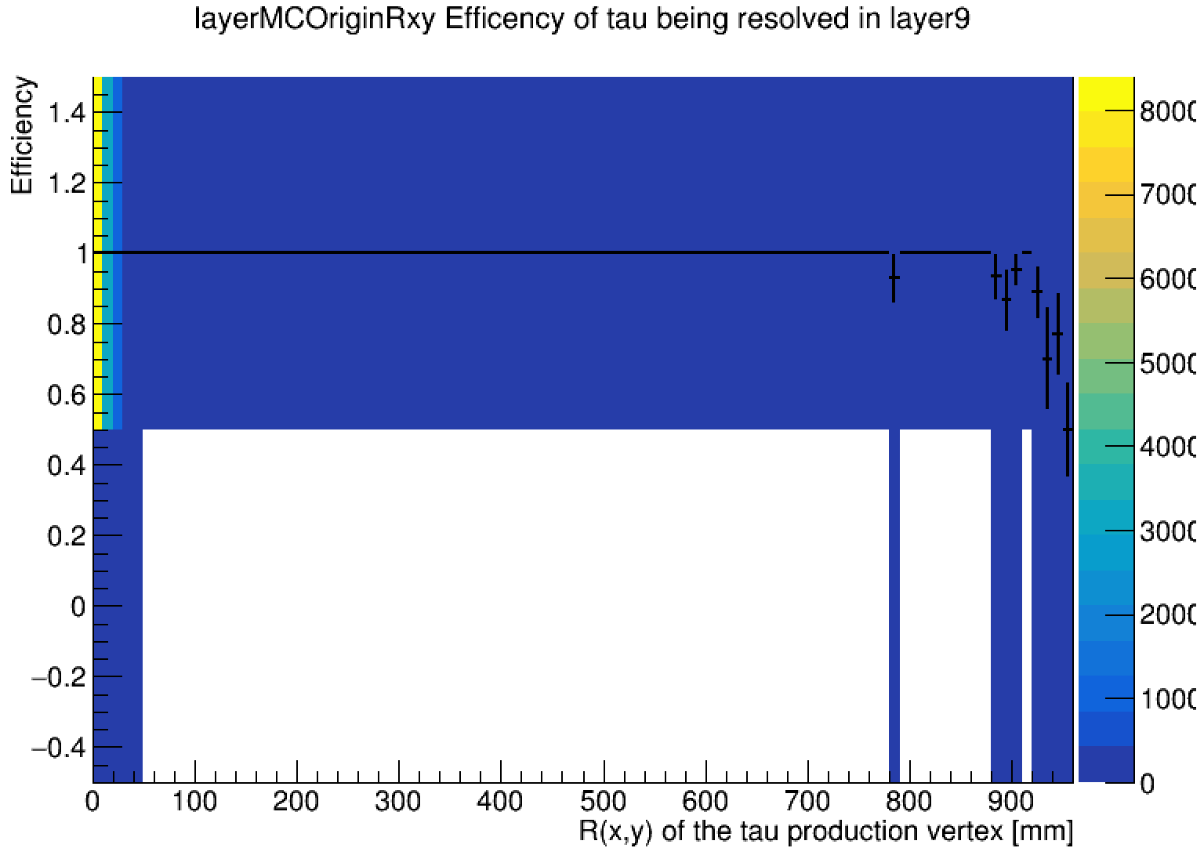
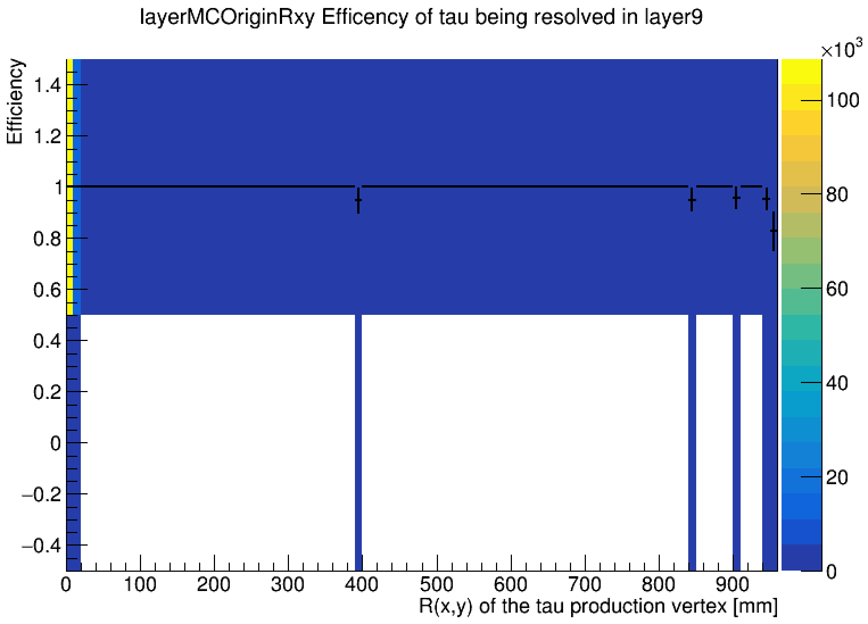
efficiency vs tau decay vertex position for various tau energies
Eτ=10TeV
Eτ=5TeV
Eτ=2TeV
Eτ=1TeV
Eτ=500GeV
Eτ=200GeV
Efficiency drop not significant for taus up to 1TeV
Plot total efficiency vs tau energy → ongoing
Calculate tracking efficiency using track cheater → next
Eτ=100GeV

Slide 23
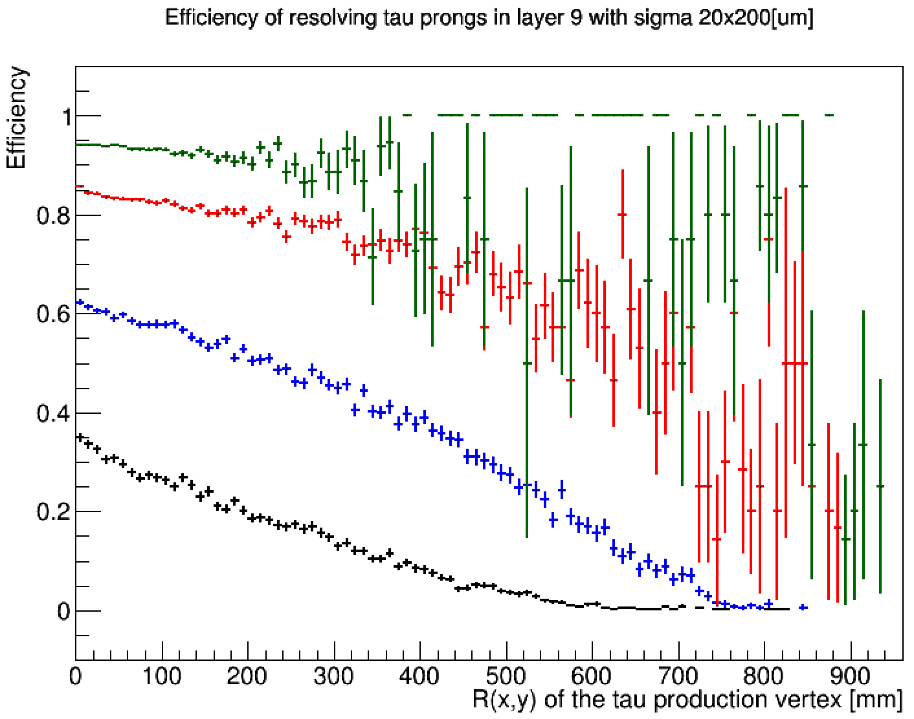
Etau = 10 TeV
Etau = 5 TeV
Etau = 2 TeV
Etau = 1 TeV

Slide 24
Etau = 10 TeV
Etau = 5 TeV
Etau = 2 TeV
Etau = 1 TeV

Slide 25
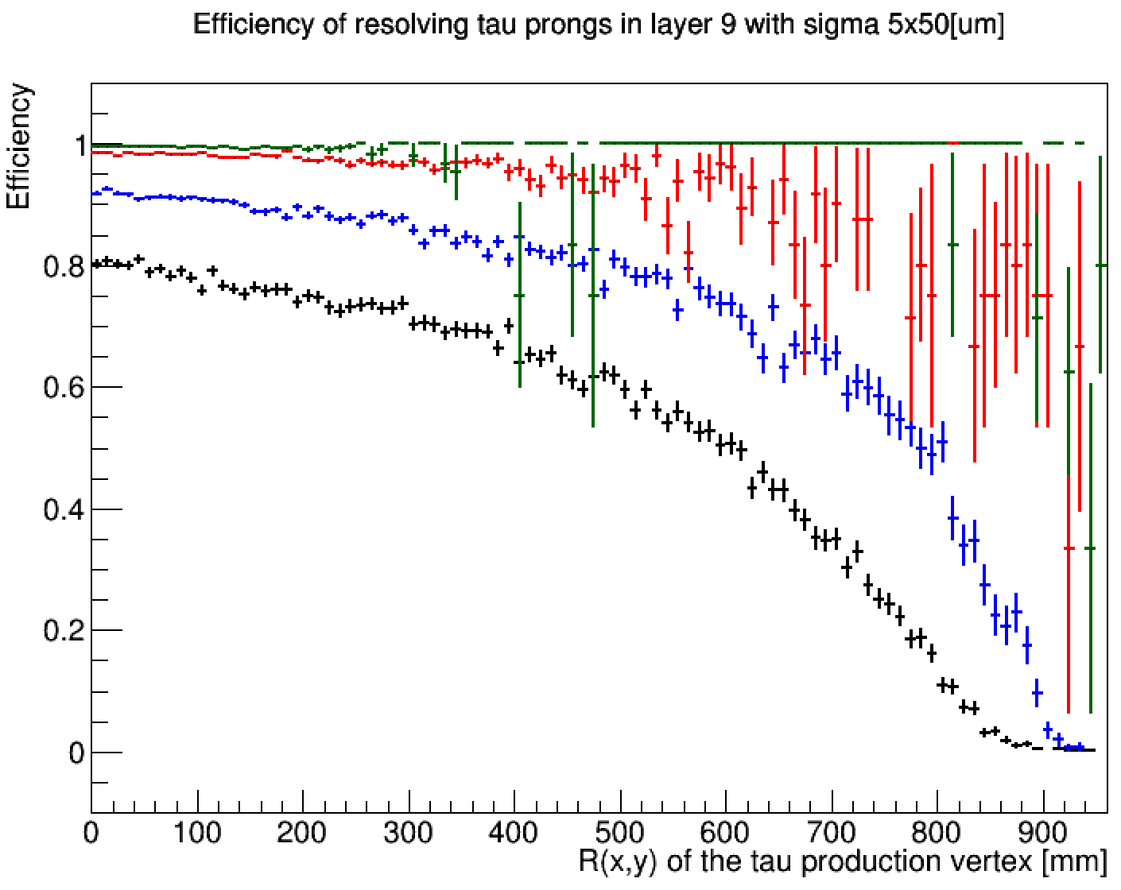
Etau = 10 TeV
Etau = 5 TeV
Etau = 2 TeV
Etau = 1 TeV

Slide 26
Efficiency vs single point resolution
Etau = 1 TeV
Etau = 2 TeV
Etau = 5 TeV
Etau = 10 TeV
Etau = 1 TeV
Etau = 2 TeV
Etau = 5 TeV
Etau = 10 TeV

Slide 27
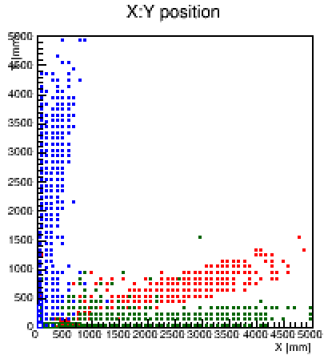
10 TeV tau decay vertex
central
transistion
forward

Slide 28
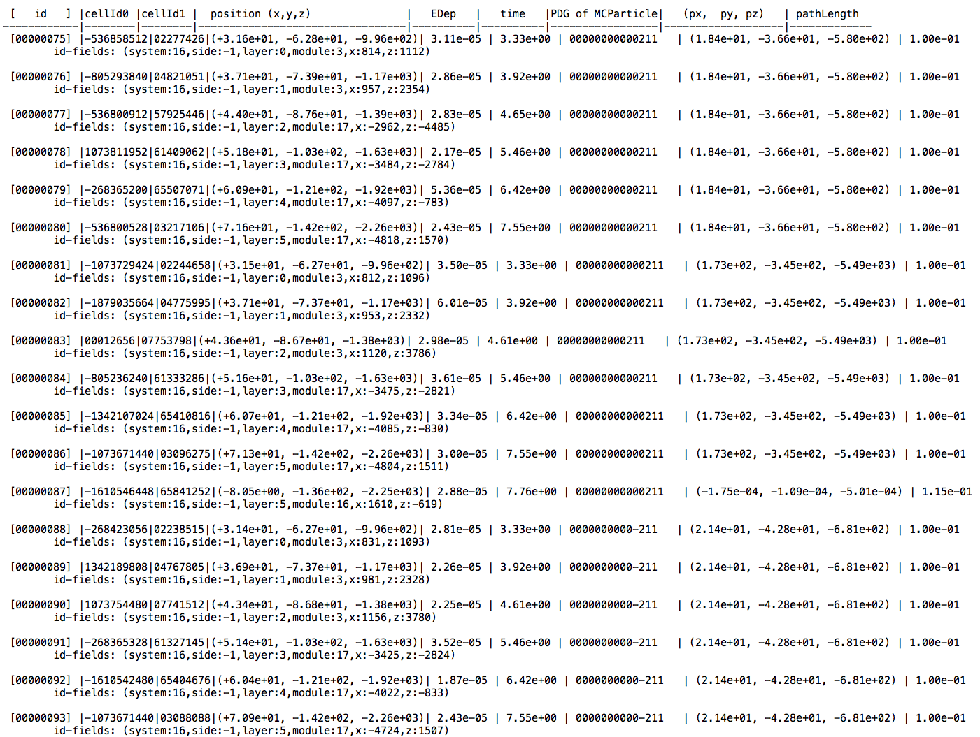

Slide 29
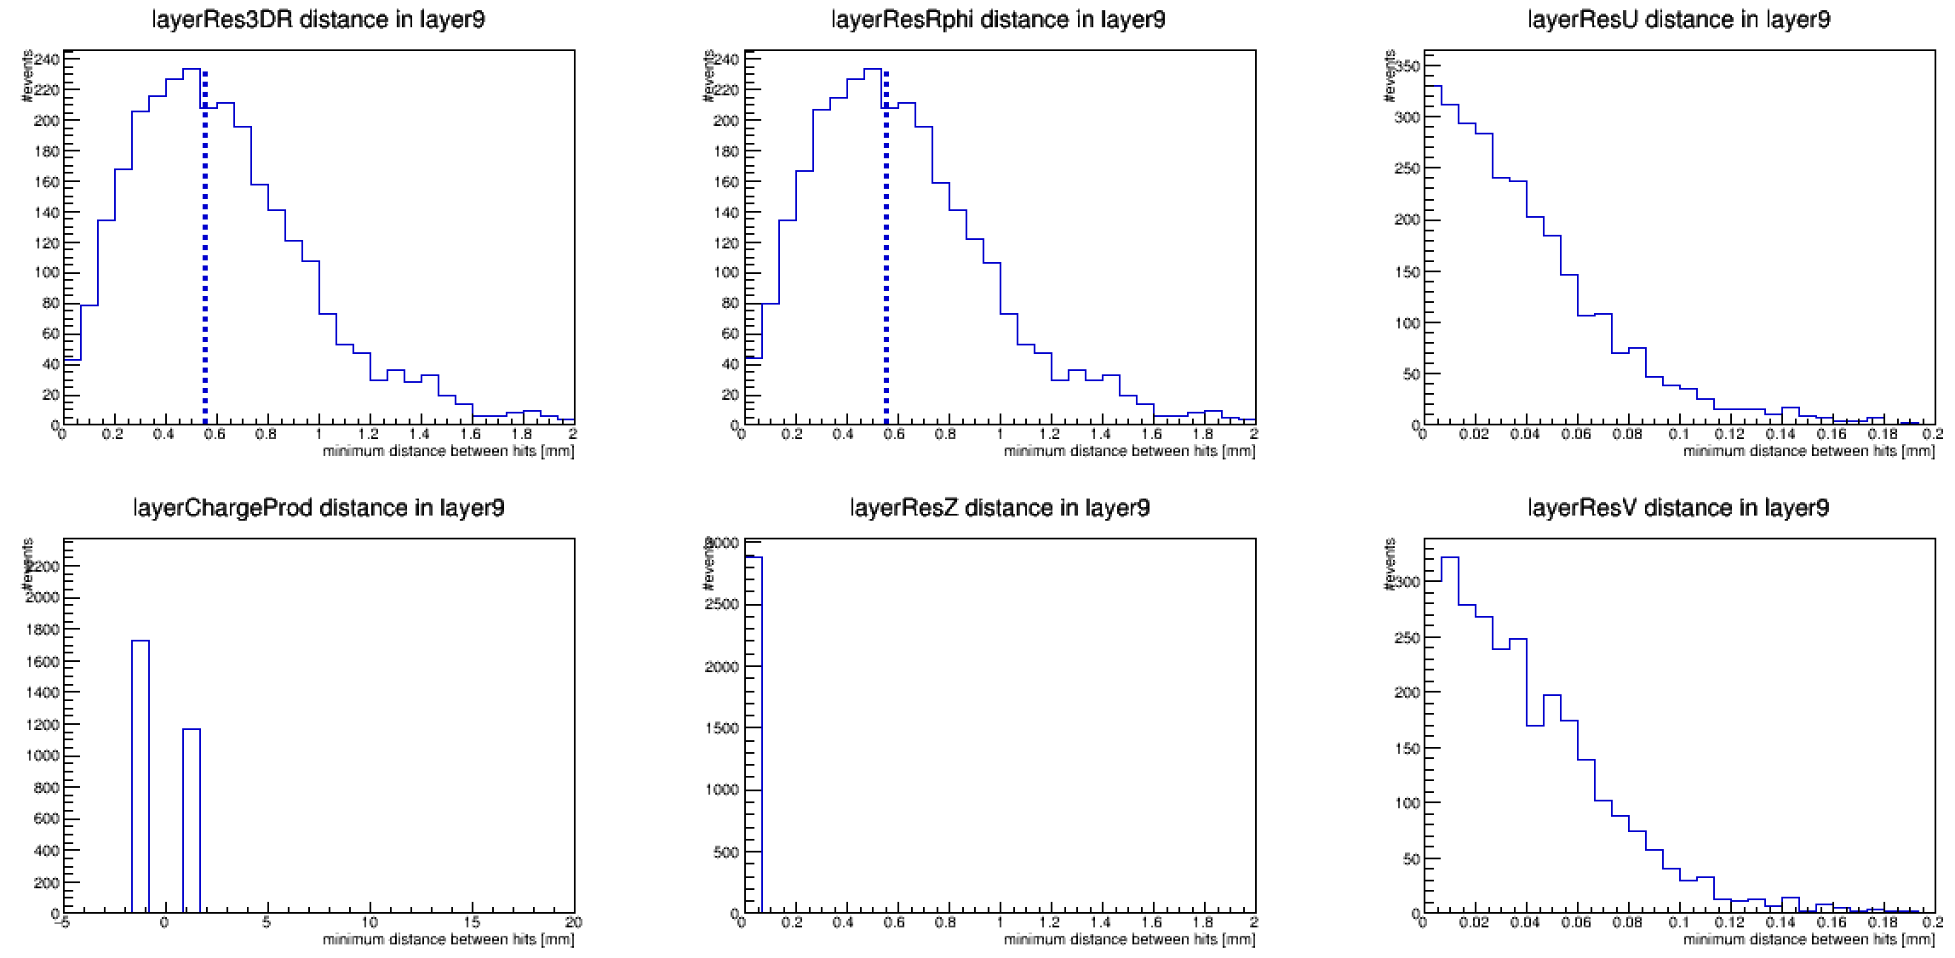

Slide 30
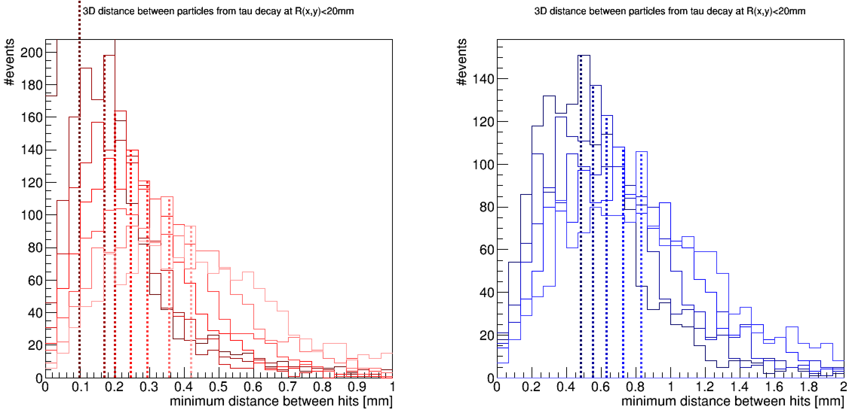

Slide 31
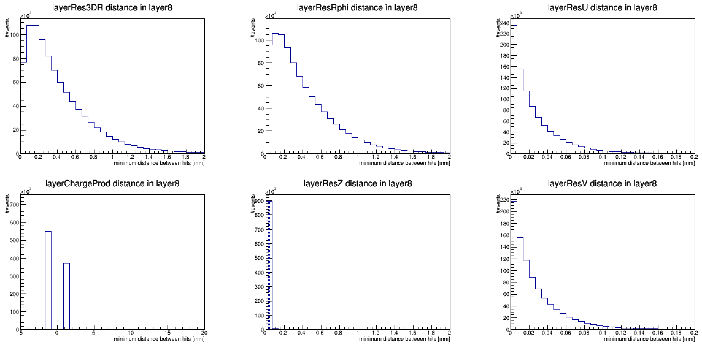
forward 1st

Slide 32
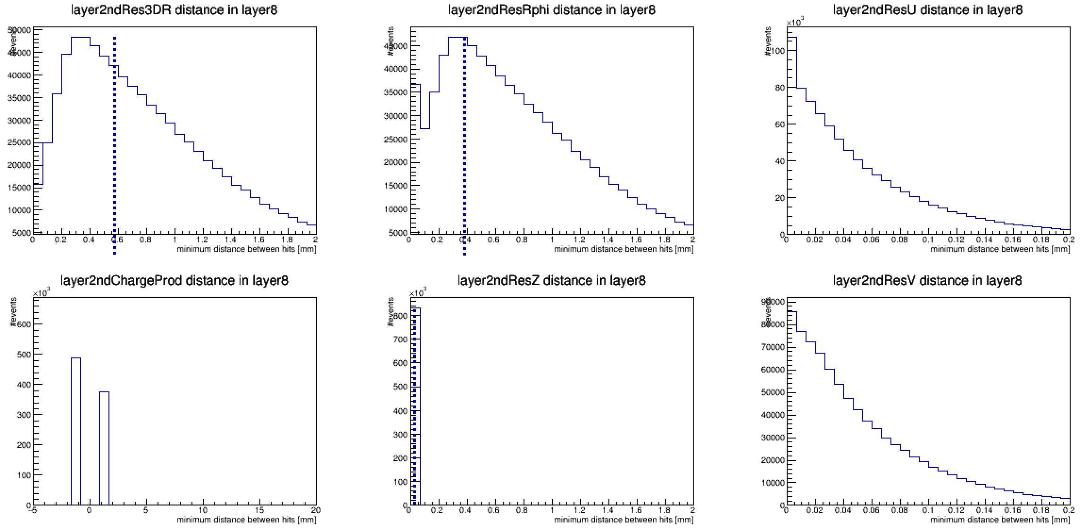
forward 2nd

Slide 33
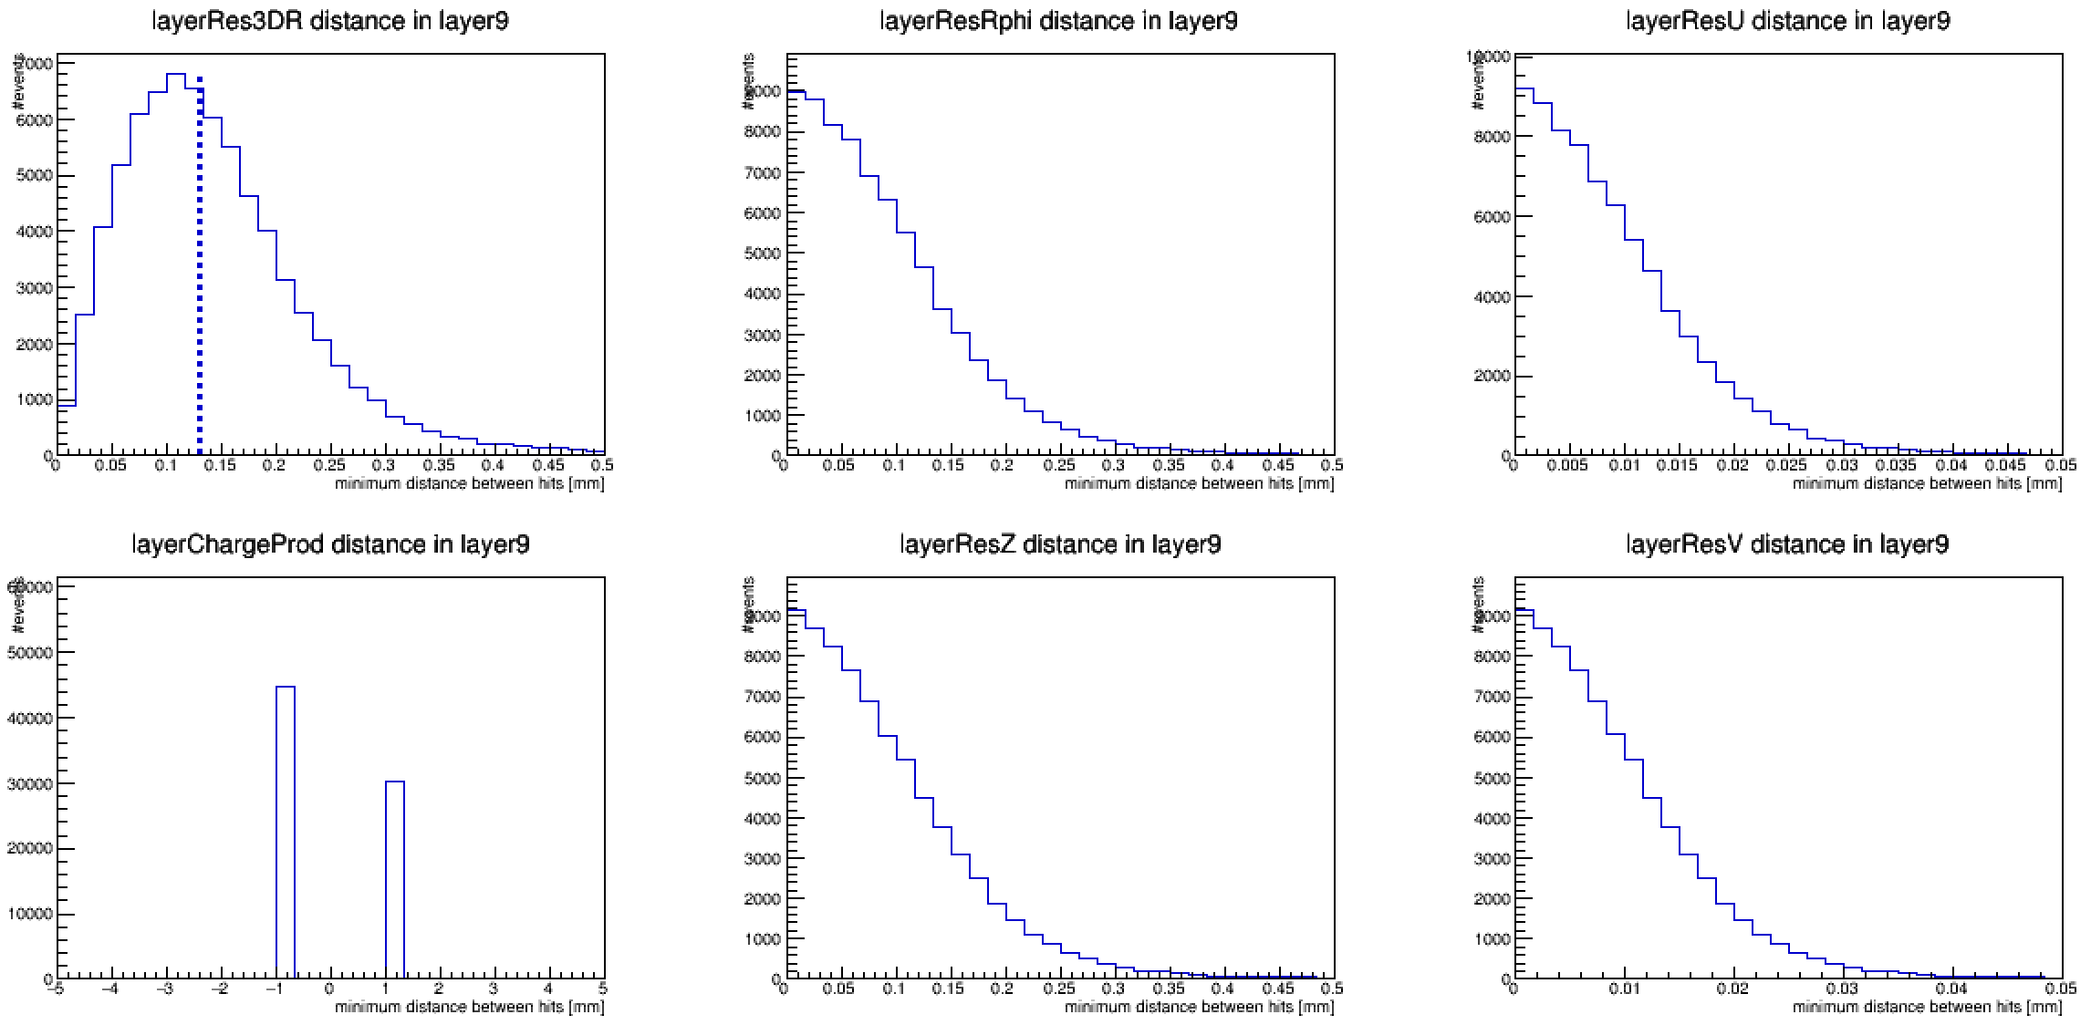
central

Slide 34
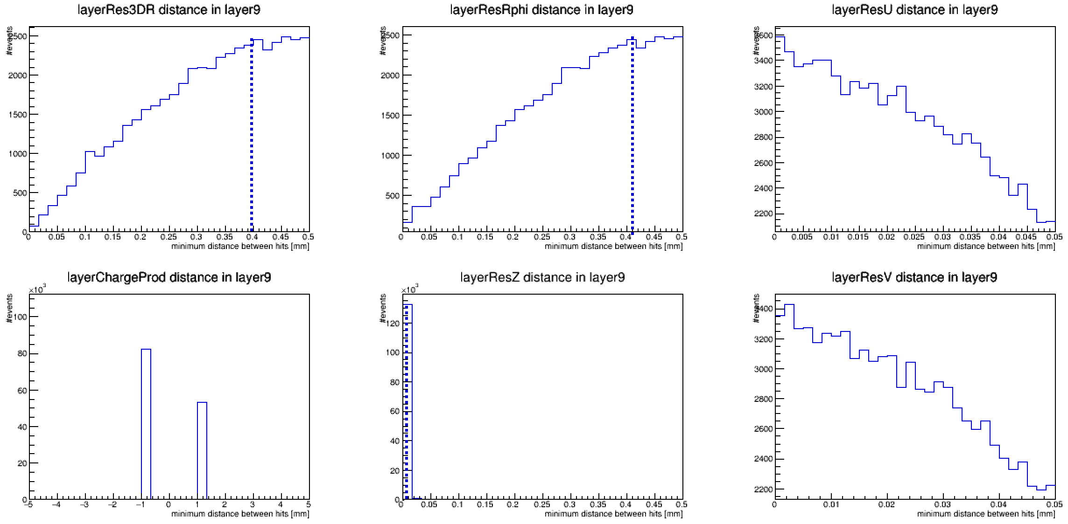
transition (barrel) <!>

Slide 35
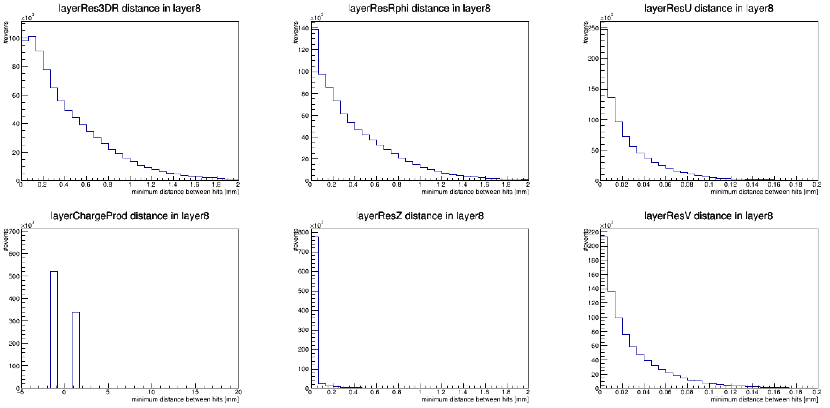
transition (endcap)

Slide 36
1.) /afs/cern.ch/work/p/proloff2/public/tautau_20000_fcc_central/: The same as before, but 10 time more events.
2.) /afs/cern.ch/work/p/proloff2/public/tautau_20000_fcc_forward/: 0.39 < theta(tau) < 5.49 degrees, 174.51 < theta(anti-tau) < 179.61 degrees. 500000 events.
3.) /afs/cern.ch/work/p/proloff2/public/tautau_20000_fcc_transition/: 10.4 < theta(tau) < 18.8 degrees, 161.2 < theta(anti-tau) < 169.6 degrees. 500000 events.

Slide 37
Discussion
Next steps:
  track efficiency
Zbynek Proposed Vertex-Tracking FCC meeting

Slide 38
Backup

Slide 39
Procedure
Generate di-tau events
  Very boosted: E_{tau}=10 TeV
  Central: 80 <θ_{tau}< 100 deg ( |η|<0.2 )
  Select events with at least one tau decaying to 3-prongs (at least 3 charged pions in the event)
Use TkLayout geometry (from Zbynek) compact file + install DD4Hep drivers from Valentin to CLIC New SW chain (NEW!)
Simulate events using CLIC new SW
Calculate minimal distance between two hits
  Require the two hits to be in the same layer, produced by two different charged pions

Slide 40
Geometry used
Position of all the hits in all events
140k events
Does not correspond to the latest version of the geometry, but differences are not very relevant for this particular study.
(only the position R(x,y) of the layers matters (and the material), but not its resolution

Slide 41
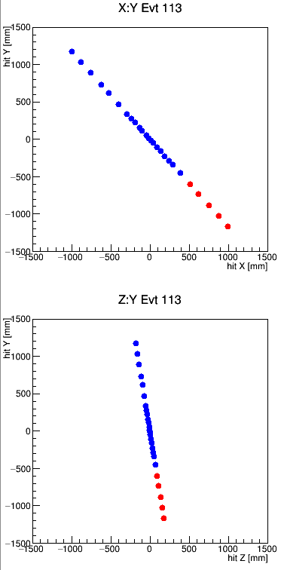
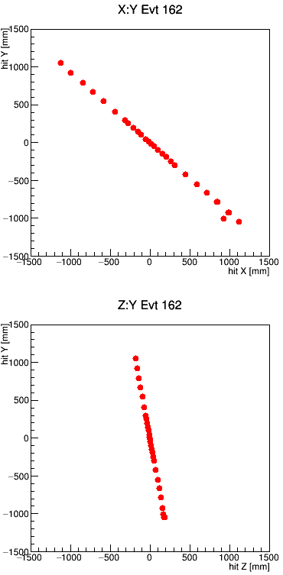
Event Displays
hits from a tau
hits from a charged pion
They look like single points but some of these are actually 3 very close-by hits
Sometimes the tau decay is very displaced→ effect of vertex displacement will be convoluted with effect of opening angle of the decay products, when calculating the distance between hits

Slide 42
Tau flight distance
Less than 14% of the taus decay before the 2nd vertex layer
fraction of the taus
-> To study only the effect of the opening angle, require that the tau decays before the first layer
Tracker
(6 layers)
Vertex
(7 layers)
tau endpoint position R(x,y) [mm]

Slide 43
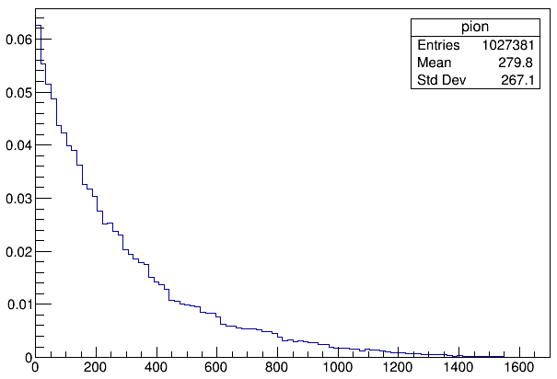
Selection
Origin of the pions hitting any of the layers
Hits from charged pions
  pdg=+/- 211
  status==1
Consider pairs of hits in the same layer (study layer by layer)
From different MCParticle
To disentangle the effects of the tau displacement, Require that the pion originates before the beam pipe (R(x,y)<20mm)
Calculate 3D distance between two hits (for eache layer)
  Since in the same module -> distance on the module plane
  Any direction (not projecting to Rphi-Z coordinates). (Next Step)
Compare this distance to the pixel pitch
require the tau to decay inside the beampipe => 4% of cases
(one entry per hit, area normalized to unity)
pion origin point position R(x,y) [mm]

Slide 44
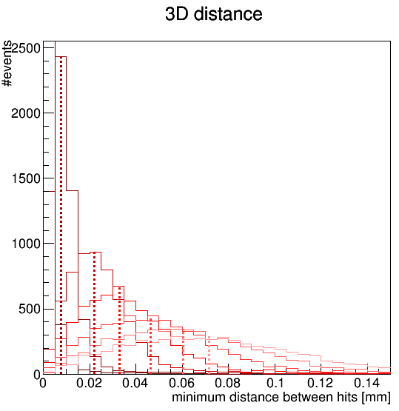
minimum 3D-distance between hits
The peak of the distance distribution shifts with the radius of the layer
Vertex layers
Tracker layers
layer1
layer2
layer3
layer4
layer5
layer6
layer7
layer1
layer2
layer3
layer4
layer5
layer6
vertical lines for visual help only
layer3 (layer4) peak at about 22um (33um)
layer1 (layer3) peak at about 100um (160um)
requirements from occupancy studies (required occupancy 0.2%):
10x15 um single point resolution
= 35x52 um pixel pitch (area=1800um²)
5000x10 um single point resolution
=17320x35 um pixel pitch (area=0.6mm²)
The two closest hits would end up in the same pixel in some of the layers
Notes:
----- Meeting Notes (8/12/16 14:39) -----
worst case barrel,
disentangle flight distance and angle
try endcap
fraction of aus that can be resolved as function of decay length

Slide 45
Considerations
Being able to resolve all 3 charged pions from the decay of a 10TeV tau would require higher granularity in most of the layers
  Not only need to have the particles in different pixels, but also in different clusters
  Need to project to Rphi-Z coordinates (next step), to know the actual requirements
To be able to reconstruct the pion’s tracks, no need to resolve the hits in ALL layers
  minimum number of layers will depend on your tracking algorithm
  On the other hand, for the very displaced taus requirements will be tighter.
To be able to identify the tau, no need to always resolve the 3 prongs
  At the analysis level one would look also at other observables
We cannot make final conclusions on the required resolution only based on this study, but we can provide important information based on full simulation.

Slide 46
Summary & outlook
Calculated distance between 2 closest hits in each layer
  disentangled opening angle from decay length effects
New workflow used
  TkLayout geom -> dd4hep -> CLIC SW
  Thanks to Zbynek, Valentin, Andre, Rosa
  Can benefit from some of the full sim tools already existing in CLIC SW
  Once we add “helper surfaces” (next step) we’ll be able to project distances in Rphi-Z coordinates and run “truth” tracking
Other benchmark processes suggested by Michele:
  W jets, top jets, b jets, light jets uds, gluon jets
  need to consider flavour tagging algorithm

Slide 47
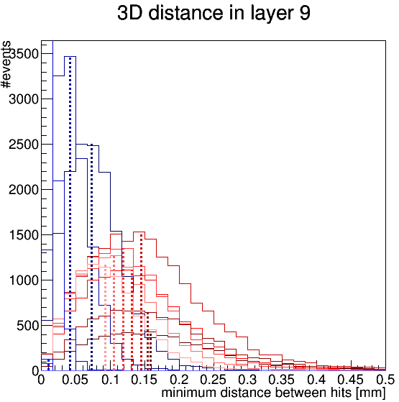
Option A
layer3
for taus that decay before layer:
Assume that taus decaying outside the vertex detector will be identified somehow else (dE/dx?)
Assume we need the particles to be resolved in at least 4 layers to be able to reconstruct both tracks
=> Calculate distance at the 3rd tracker layer (total -4) between hits from taus decaying just before the last vertex layer
= 90 um
=> pixel pitch has to be at least 45 um or smaller in layer3
(if cluster size = 1)
vertex
tracker
layer1
layer2
layer3
layer4
layer5
layer6
layer7
layer1
layer2
layer3
layer4
layer5
layer6
2*pixel pitch

Slide 48
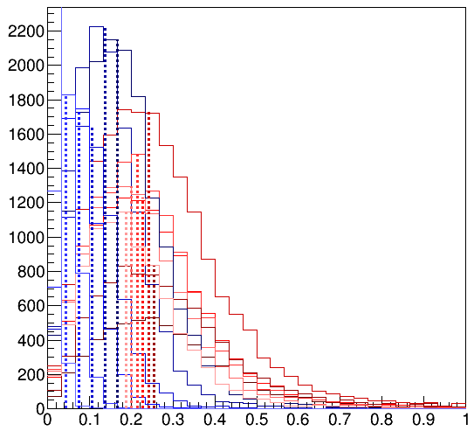
Distance at last layer vs tau decay length
vertex
tracker
distance between two closest hits in the last tracker layer
for tau decay happening:
before layer 1
between layer 1 and layer 2
etc…
layer1
layer2
layer3
layer4
layer5
layer6
layer7
layer1
layer2
layer3
layer4
layer5
layer6
If tau decays before the tracker, we could resolve the 3 prongs on the last layer with pixel pitch < 160um
PRELIMINARY
minimum distance between hits [mm]

Slide 49
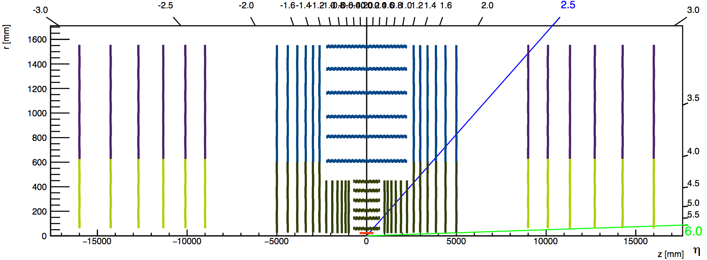
Proposal 1 (from occupancy point of view)
σ
7X5
15x10
5000x10
Need to review also where the transition to σ=10x100 should happen (consider also z0 and d0 resolution)

