Slide 1
Aperture considerations on the proposed CMS experimental vacuum pipe
M. Giovannozzi
Acknowledgements: B. Salvant, W. Zeuner
WP2 meeting, 31 January 2017

Slide 2
Outline
Introduction
Aperture after LS2
Aperture in the HL-LHC era
Conclusions

Slide 3
Introduction
CMS has already changed the layout of the experimental beam pipe during LS1.
Another change is planned for LS2.
Beam aperture evaluations have been carried out to ensure that the proposed layout is compatible with the aperture targets.
The timing of the change is such that aperture compatibility should be checked against
  LHC criteria
  HL-LHC criteria
Proposed layout featured changes (with respect to current layout) in the region between ±16 m around the IP.
The computations suggested to increase the diameter of the so-called CT2 section (around 15 m form the IP). These suggestions are now part of the final layout for installation during LS2.

Slide 4
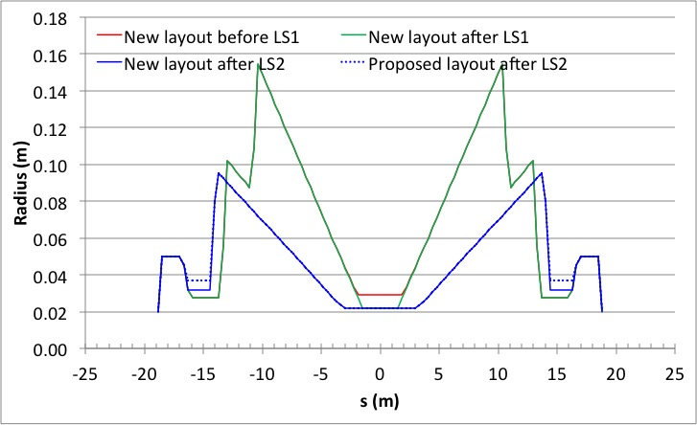
Introduction
CT2 section

Slide 5
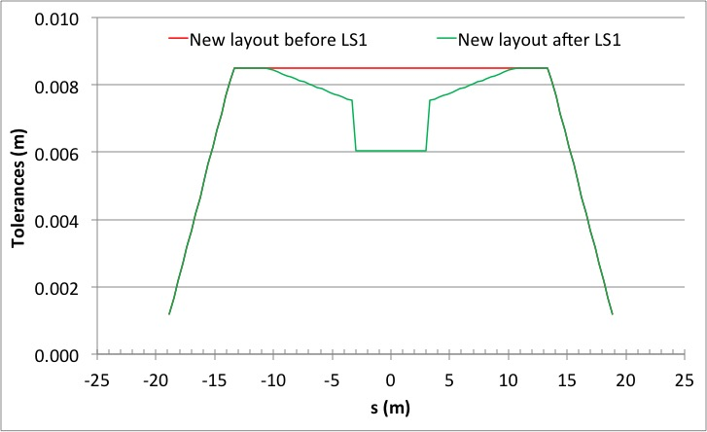
Introduction
No change of mechanical tolerances with respect to previous review
CT2 section

Slide 6
Aperture after LS2 - I
Analysis performed using LHC DR n1 formalism (and related parameters): rather conservative approach.
Target aperture: n1=7 σ.
Analysis considered injection and collision configurations.
Nominal optics used (around the IP no relevant difference between nominal and ATS).
Transverse beam separation always on (injection and collision)

Slide 7
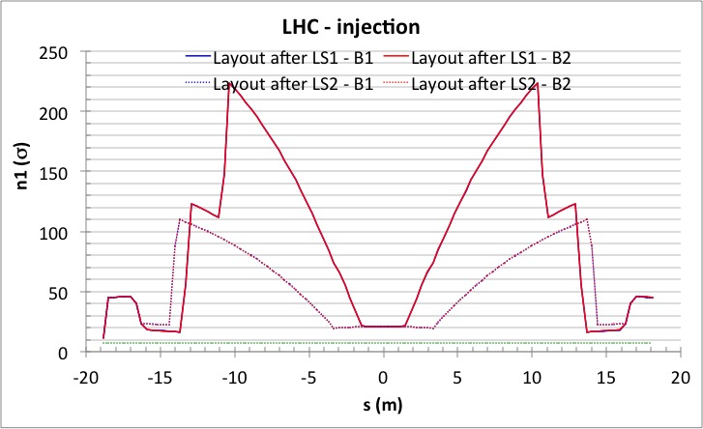
Aperture after LS2 - II
No aperture issues identified (even without considering increase of diameter in CT2 section)

Slide 8
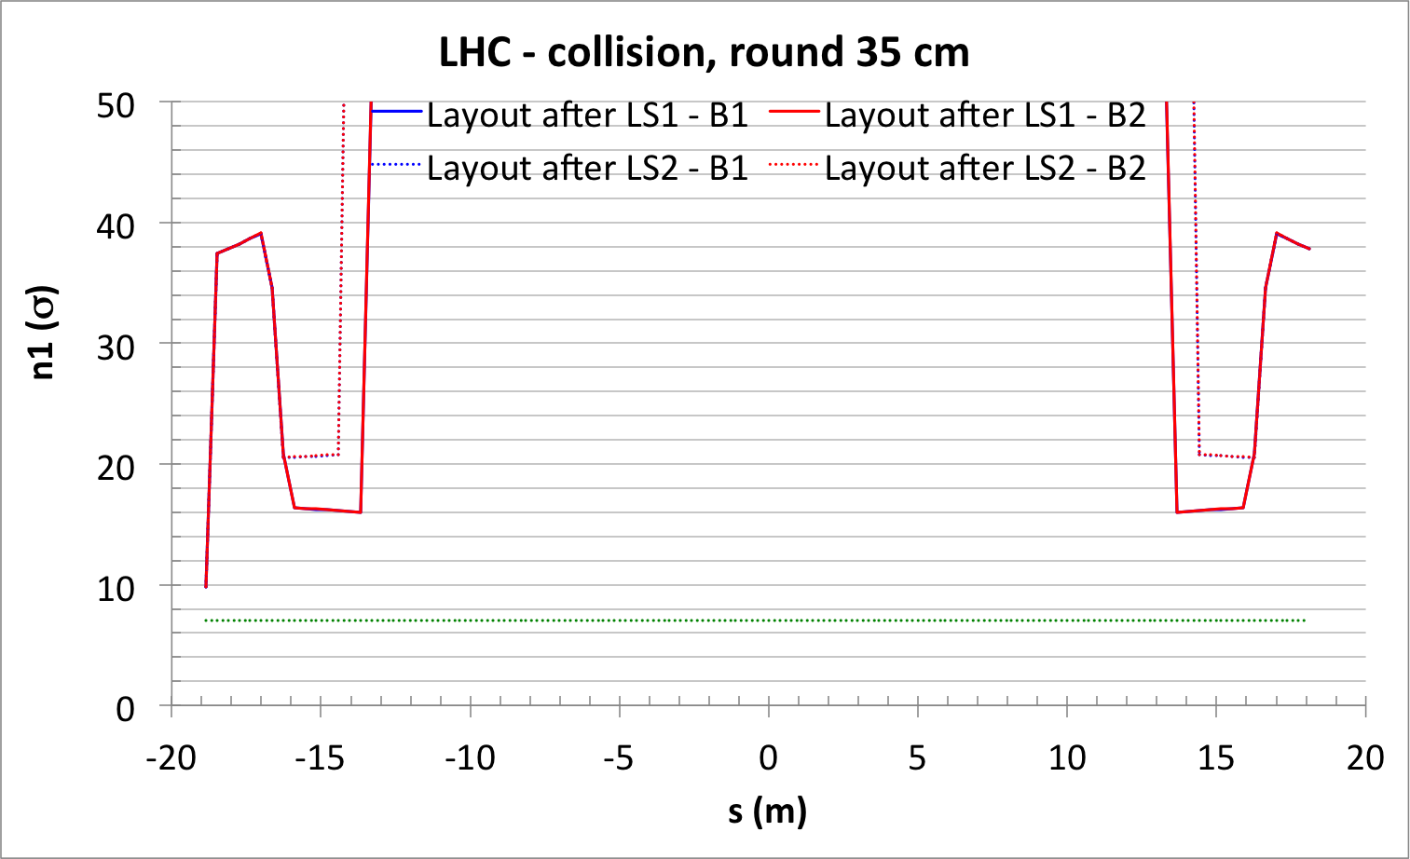
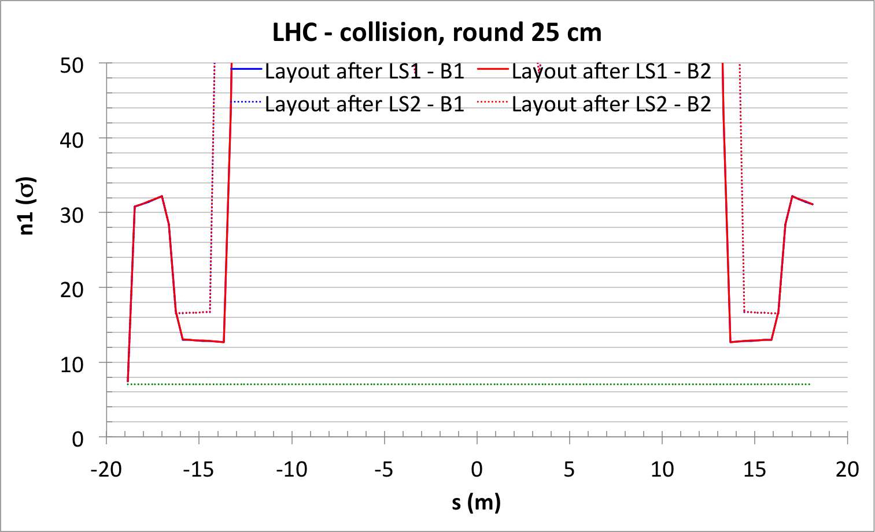
Aperture after LS2 - III
No aperture issues identified (even without considering increase of diameter in CT2 section)

Slide 9
Aperture in the HL-LHC era - I
Analysis performed using new criteria for aperture estimate
  Injection: R. Bruce et al., “Parameters for aperture calculations at injection for HL-LHC”, CERN-ACC-2016-0328.
  Collision: R. Bruce et al., “Parameters for HL-LHC aperture calculations and comparison with aperture”, CERN-ACC-2014-0044.
Analysis considered injection and collision configurations.
ATS optics used: both round and flat options used.
Transverse beam separation always on (injection and collision), together with offset for IP alignment.

Slide 10
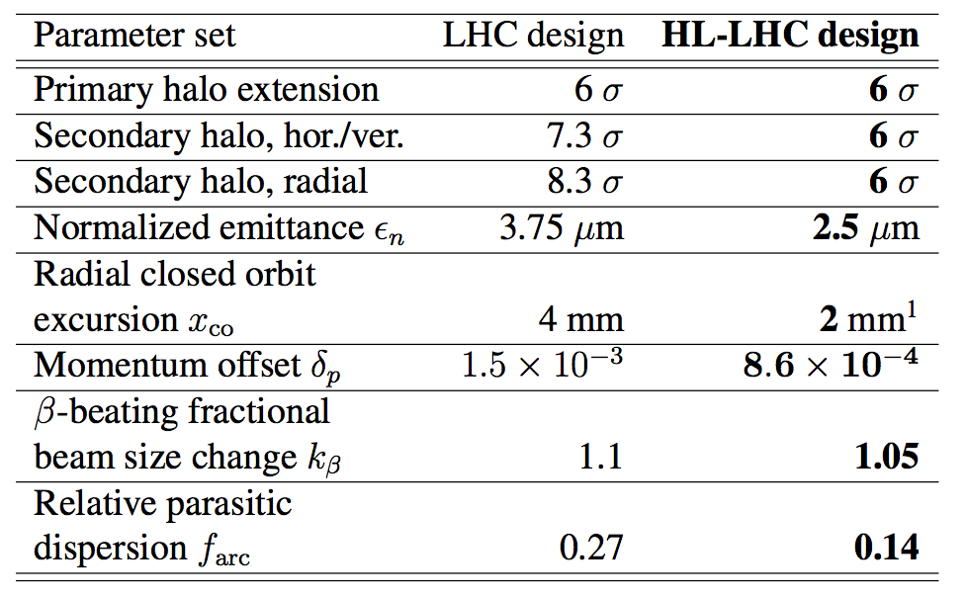
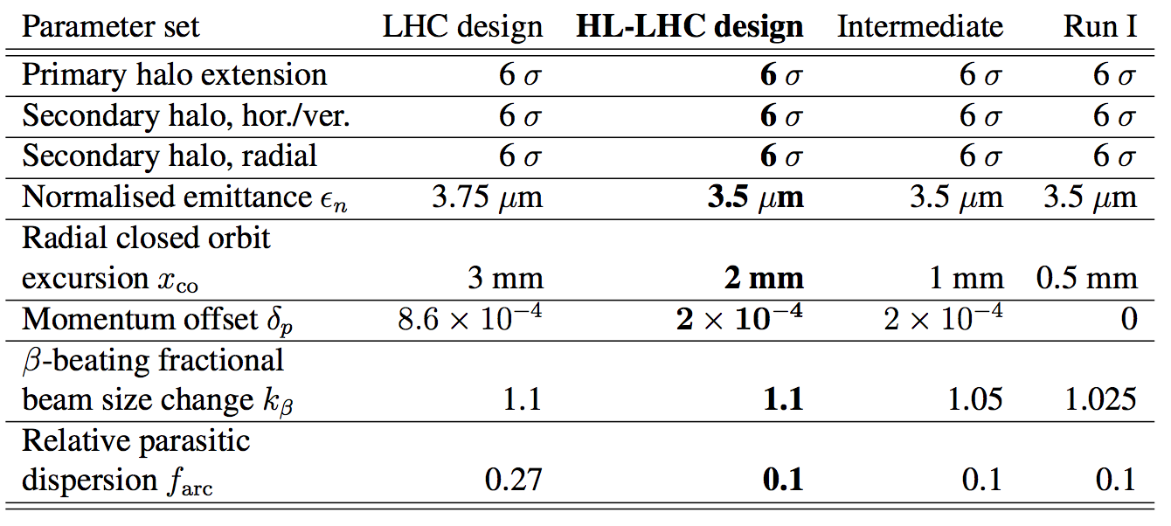
Aperture in the HL-LHC era - II
Parameters for aperture estimates at injection.
Target aperture: 12.6 σ
Parameters for aperture estimates at collision.
Target aperture: 12 σ

Slide 11
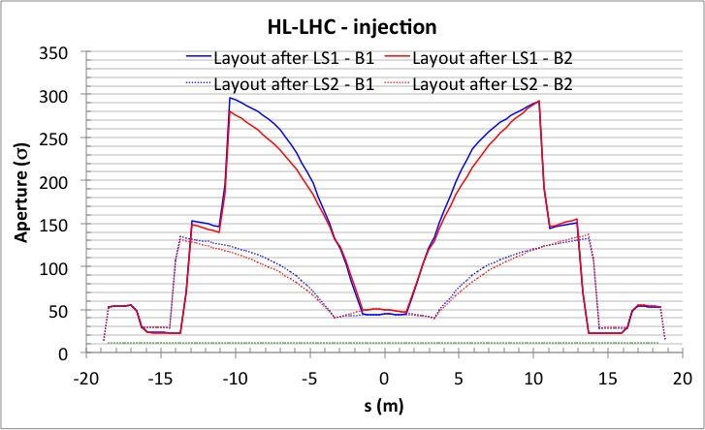
Aperture in the HL-LHC era - III
Gain of about 9 σ in the CT2 section due to radius increase from 31.5 mm to 37 mm
No aperture issues identified

Slide 12
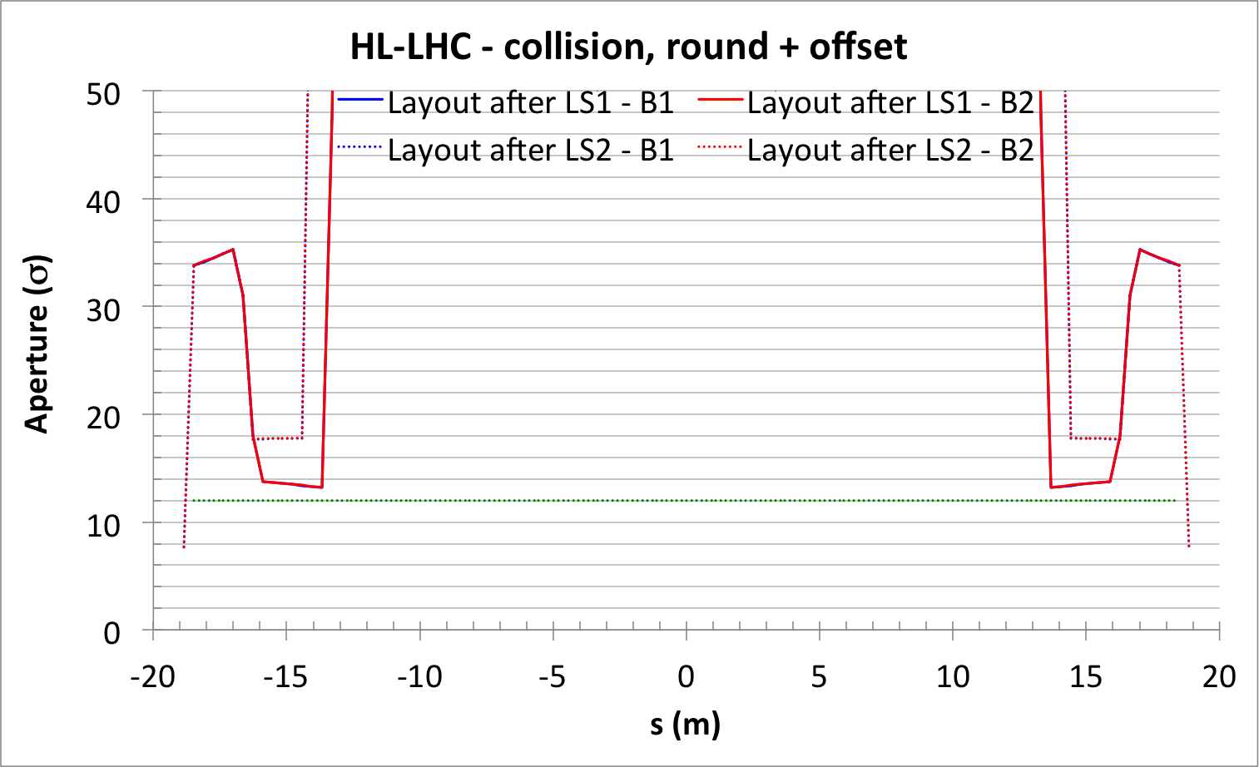
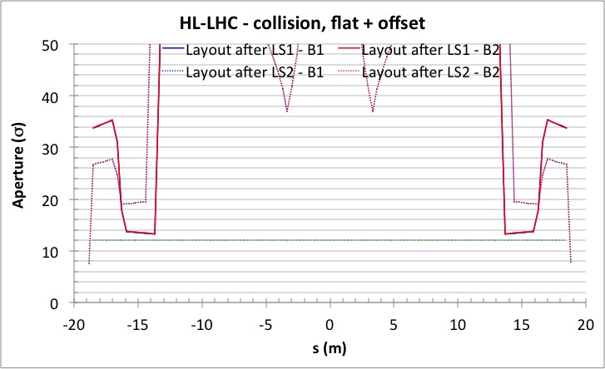
Aperture in the HL-LHC era - IV
Gain of about 6 σ in the CT2 section due to radius increase from 31.5 mm to 37 mm
Gain of about 4 σ in the CT2 section due to radius increase from 31.5 mm to 37 mm
No aperture issues identified

Slide 13
Conclusions
Proposed CMS experimental vacuum pipe for installation during LS2 considered for aperture aspects.
No aperture bottlenecks found for LHC parameters.
For HL-LHC the region around ±15 m from the IP showed some potential dangerous aperture reduction.
It was agreed to increase the aperture of this section, thus lifting the potential aperture limitation.
The final layout can be considered for formal approval by the official bodies.

Slide 14
Thank you for your attention!

