Slide 1
CMS beam pipe

Slide 2
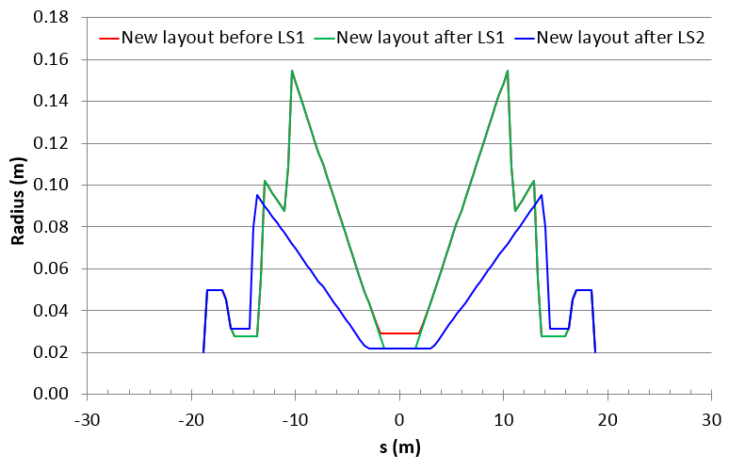
Proposal for CMS beam pipe after LS2

Slide 3
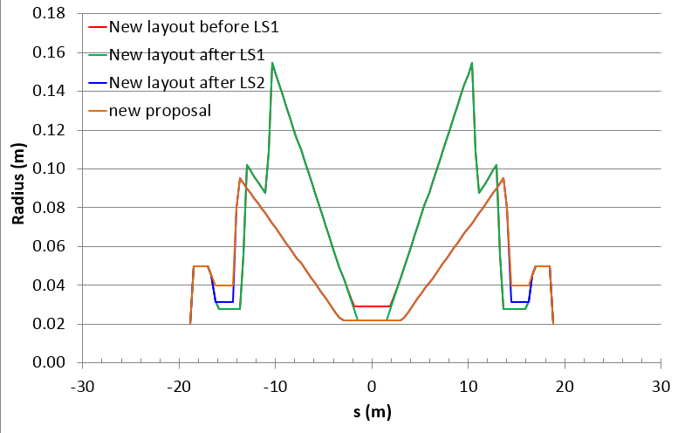
New proposal

Slide 4
Status
Very minor change (31 mm, to 40 mm to 37 mm) from the design already discussed at the impedance working group and WP2
→ not expected to change much
New drawings received this morning
request

Slide 5
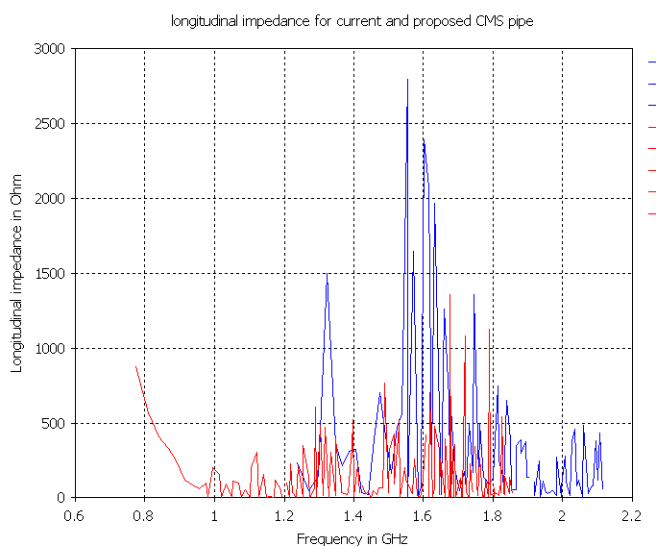
Longitudinal impedance in LinacOhm
New pipe
Current pipe
Modes at much higher frequencies, but larger amplitude (due to the new material)
Little change with respect to 31 mm or 40 mm

Slide 6
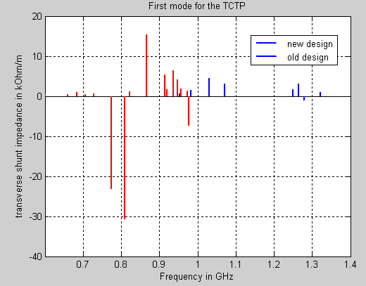
Transverse impedance
New pipe
Old pipe
Lower amplitude and higher frequencies
New design expected to be beneficial

Slide 7
Conclusions
New pipe expected to be better from impedance point of view (higher frequencies)
No issue with the current design
Temperature probes show very little temperature increase, will continue to be followed up.
Will come back with the final installation (including the VAX)

