Slide 2
Feedback from POPS-B explosion analysis
LIU-PSB Meeting 186 07 February 2017
Fulvio Boattini TE/EPC

Slide 3
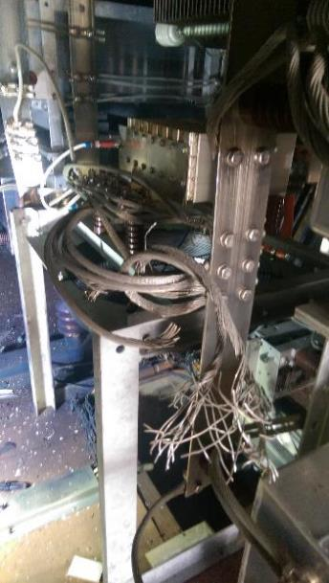
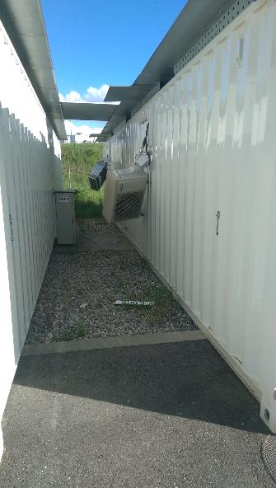
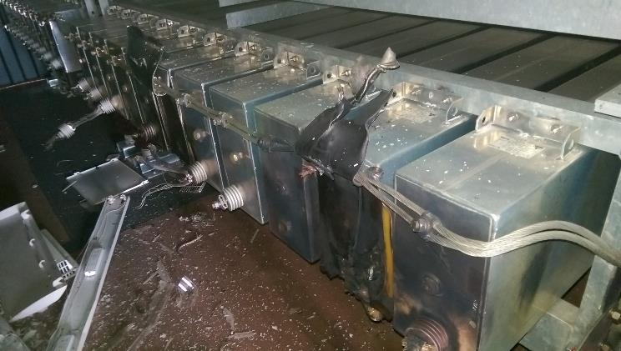
Recall
April 2016: POPS storage capacitors went short circuited. An explosion resulted
POPS-B storage capacitors are in a building. An explosion risk analysis was triggered in November 2016.

Slide 4
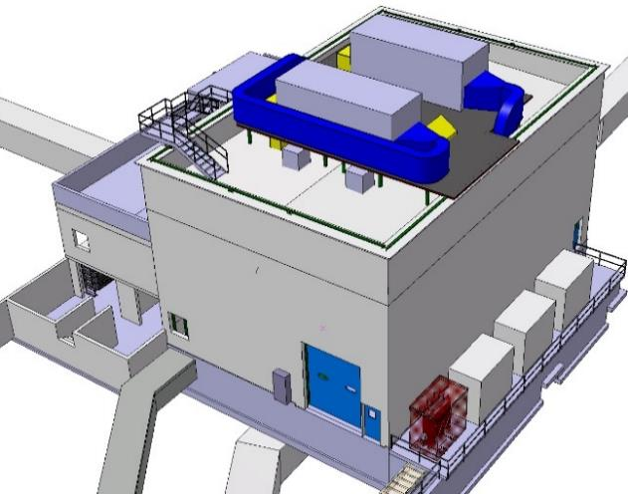
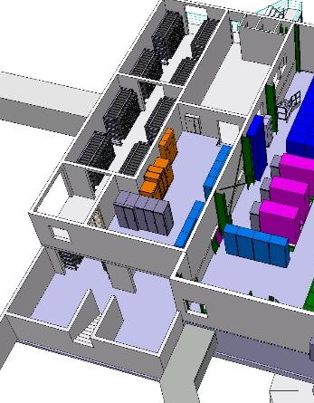
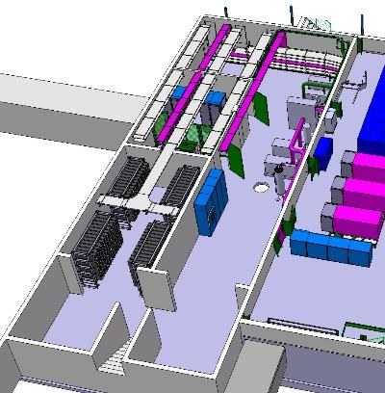
B245 Storage capacitor location
Stairs
Room: R-403
Room: R-401
Entry area
Room: S-401
Parking area

Slide 5
B245 Explosion risk: aim of the Study
Determine the effect of the explosion of one capacitor on the concrete structure;
Eliminate all risks for personnel. Inside and outside the B245;
Minimize effects on equipment. Restart after one explosion.
Analysis performed by external consultant: FCSolutionS

Slide 6
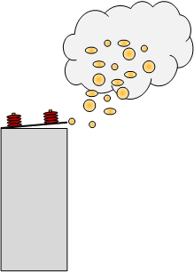
B245 Explosion risk: the approach
A short circuit in the capacitor generates an arc;
Arc Energy calculation
The arc turns oil into gas (1lt -> 100kJ);
Gas type and quantity calculation
Ignition source
Gases exit from capacitors and lead to secondary explosion;
Gas burning and CFD simulation
Secondary explosion
Secondary explosion generates pressure wave in the room.
Structural analysis of concrete

Slide 7
Arc Energy calculation
168 capacitor units divided into 5 blocks each protected by a single fuse.
CS2
CS1
24 Units
40 Units
24 Units
40 Units
40 Units
Arc Energy = 1.5 MJ

Slide 8
Gas type and quantity calculation
Mainly Hydrogen and Acetylene

Slide 9
Gas burning: “Well mixed”
“Well mixed” approach;
  “All the flammables produced during the primary explosion (hydrocarbons and oil mist) are supposed to come out from the enclosure and be perfectly mixed with air at stoichiometric concentration and ambient pressure”
Ignition source
The gas-oil mist cloud is placed on top of capacitors and ignited

Slide 10
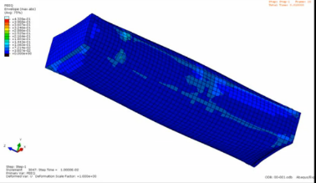
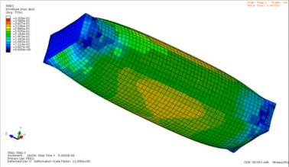
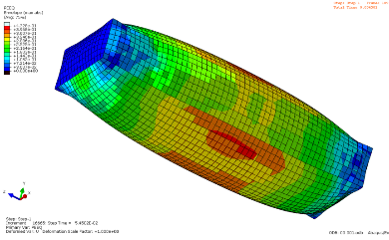
Gas burning: “Burst”
“Burst” Approach;
  “The enclosure is supposed to instantaneously disappear at failure pressure value (30bar). All flammables produced during the accident and the primary explosion phase (hydrocarbons and oil mist) are compressed in an initial volume, at pressure equal to failure pressure of the enclosure, and 100% concentration”
Case disappears and gas-oil mist is at failure pressure.
Ignition source
t0
t1

Slide 11
Gas burning: Results
Vents on the roof 2 x 1mt x 2mt (per room)
Vents on the side 2 x 1mt x 2mt (per room)
Six parameters sensitivity analysis: 60 analysis in total

Slide 12
Gas burning: Results
“Well Mixed” room R-401.
With Vents, doors are replaced with blast resistant doors.
0.12 bar
0.12 bar
0.11 bar
1 vent 0.10 bar
2 vents 0.09 bar
1 vent 0.09 bar
2 vents 0.08 bar
1 vent 0.08 bar
2 vents 0.07 bar
1 vent 0.11 bar
2 vents 0.09 bar
1 vent 0.1 bar
2 vents 0.08 bar
1 vent 0.11 bar
2 vents 0.07 bar

Slide 13
Gas burning: Results
“Burst” room R-401.
With Vents, doors are replaced with blast resistant doors.
0.3 bar
1 vent 0.31 bar
2 vents 0.2 bar
1 vent 0.4 bar
2 vents 0.25 bar

Slide 14
Gas burning: Results
Venting through doors S-401
Venting through roof R-401 R-403
0.03 bar
0.017 bar
0.03 bar
0.013 bar
Venting through walls R-401 R-403
Direttiva Seveso 82/501/CEE
0.03 bar
Venting through doors S-401 requires a wall.
0.013 bar
Venting through walls R-401 & R-403 is better.

Slide 15
B245 Explosion risk: first conclusions
Room S-401 is vented via the door;
  A containment wall for people safety;
Venting from the walls seems the best option for R-401 & R-403;
Capacitor room doors replaced with blast resistant;

Slide 16
B245 Explosion risk: Planning
Complete on February 2017
Choice of venting device and final dimensions;
Structural analysis of the concrete structure;
Complete on April 2017
As built drawings of modifications following explosion analysis;
Specification of modification required by CV;
Complete on Septembre 2017
Realization of all B245 modifications by a general contractor coordinated by SMB
CB: 76805 ?

Slide 17
Thank you for your attention
Questions ?

