Slide 1

EDM kick-off meeting
Introduction
Mike Lamont, Joerg Jaeckel, Claude Vallée
13th March 2017
Acknowledgements: Hans Stroeher (JEDI) and Yannis Semertzidis (srEDM)

Slide 2
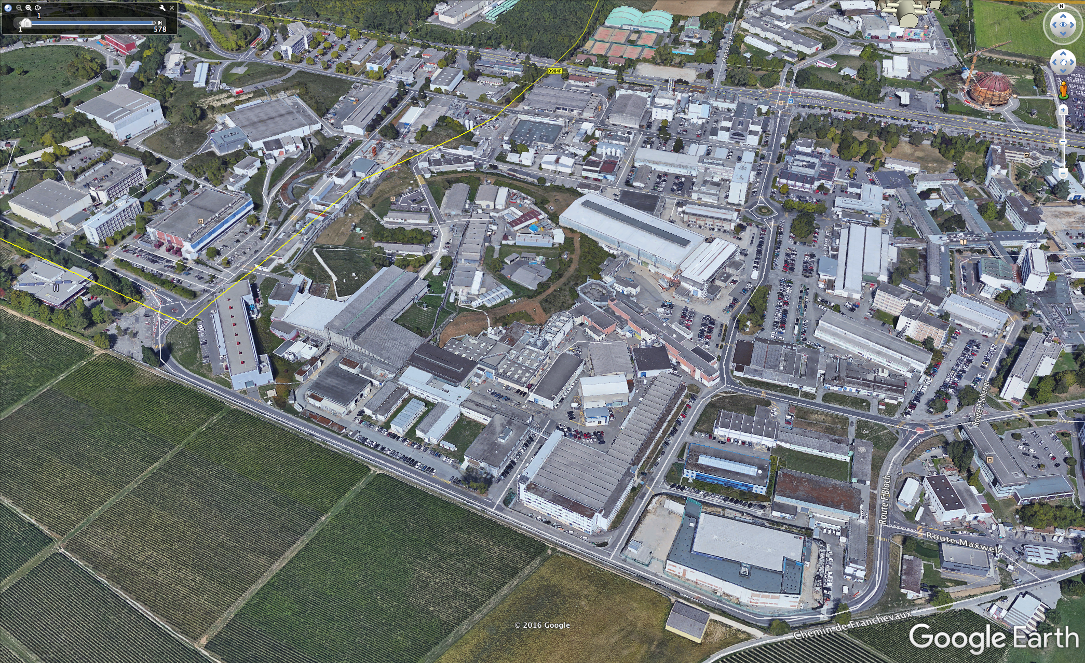

Welcome to CERN!

Slide 3
CERN’s 3 main scientific pillars
Fabiola Gianotti SPC May 2016
Full exploitation of the LHC
Scientific diversity program
  Ongoing experiments and facilities
  Participation in accelerator based neutrino projects outside Europe
Preparation for future
  R&D (superconducting magnets, AWAKE etc.)
  Design studies for future accelerators: CLIC, FCC
  Future opportunities of diversity program (new):
  “Physics Beyond Colliders study group”

Slide 4
PBC - scientific goal
Explore the opportunities offered by the CERN accelerator complex to address some of today’s outstanding questions in particle physics
These experiments would typically:
  enrich and diversify the CERN scientific program,
  exploit the unique opportunities offered by CERN’s accelerator complex and scientific infrastructure,
  complement the laboratory’s collider programme
Examples of physics objectives include searches for rare processes and very-weakly interacting particles, measurements of electric dipole moments, etc.

Slide 5
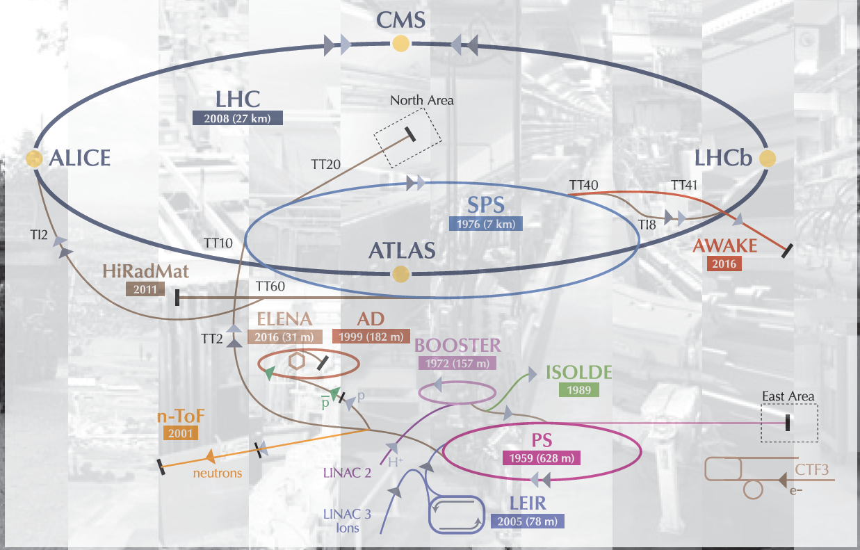
This study should provide input for the future of CERN’s scientific diversity programme, which today consists of several facilities and experiments at the Booster, PS and SPS,
over the period until ~2040.

Slide 6
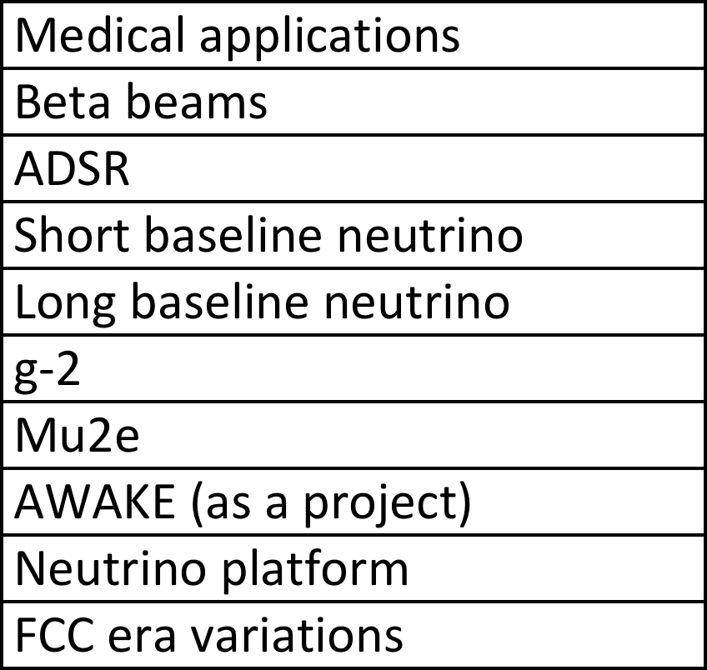
What’s not in!

Slide 7
Working groups
Collected input from the community mainly via the kick-off workshop
Working Groups have been set up to address:
  the physics case of the proposed projects in the worldwide landscape
  their feasibility and possible implementation at CERN (or elsewhere)
  With deliverables being tuned to the level of maturity of the projects
First general working group meeting 1-2 March
  Present plans, deliverables, timeline, resources
Follow-up PBC workshop foreseen in autumn 2017.

Slide 8
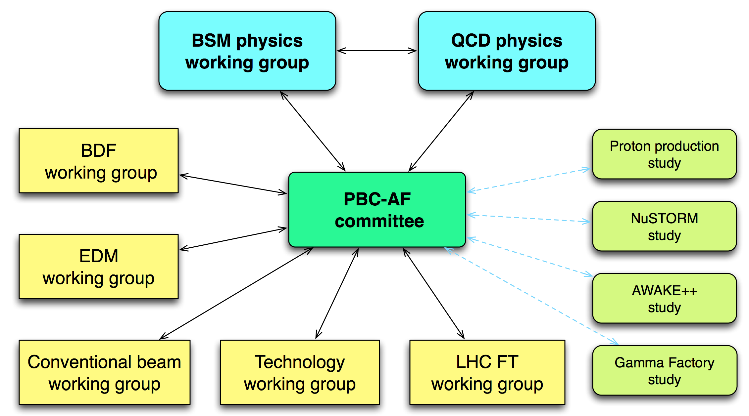
Organization
Conveners have been nominated for each group – see //cern.ch/pbc for details

Slide 9
Physics sub-working groups
BSM subgroup:
  current projects: SHIP; NA64++; NA62++; KLEVER; IAXO; LSW; EDM
QCD subgroup:
  current projects: COMPASS++; μ-e; LHC FT (gas target+crystal extraction); DIRAC++; NA60++; NA61++
The subgroup core members include theory and experimental experts of the corresponding domains as well as representatives of the projects.

Slide 10
Physics domain - deliverables
For each proposed project deliverables will include:
  evaluation of the physics case in the worldwide context;
  possible further detector optimization;
  and, for new projects, investigation of the uniqueness of the CERN accelerator complex for their realization.

Slide 11
Accelerator domain - deliverables
COMPLEX | Fully developed proton performance plan – post LIU era
BDF | Complete technical feasibility studies Preliminary Comprehensive design report
EDM | Fully developed proposal including preliminary costing
CONV. BEAMS | Establish requirements, initiate feasibility studies
LHC FT | Preliminary conceptual design report(s)
GAMMA | Exploratory study, initiate initial tests
nuSTORM | Exploratory study of implementation at CERN Review potential scientific impact
AWAKE+ | Exploratory study for potential application of AWAKE concept
Technology | Explore possible technological contributions by CERN to externally hosted facilities Facilitate potential use of CERN infrastructure Study physics case and technical requirements as input to ESU
We’ll hear from most of these this morning…

Slide 12
Deliverables
Final deliverable due end 2018:
  Summary document as input to the European Strategy Update process (2019-20)
  Foresee executive summaries from each group
Will gather and summarize the status and potential of the projects to help facilitate the update of the ESPP by the ESG group.
The remit of the ESG is to establish a proposal for an Update of the medium and long-term European Strategy for Particle Physics, for approval by the Council.

Slide 13
PBC EDM executive meeting
January 2017
Participants:
  T. Bowcock, C. Carli , G. Guidoboni, M. Lamont,
  J. Pretz, Y. Semertzidis, A. Stahl, E. Stephenson,
  H. Ströher, C. Vallée.
Reviewed activities of JEDI and srEDM
Reviewed development of construction of small ring (ELENA) at CERN
Discussed objectives and scope
Produced preliminary work-package breakdown and initial assignments
Laid foundations for this meeting… subsequent agenda courtesy Hans and Yannis

Slide 14
Initial conclusions
The EDM community would highly appreciate CERN involvement. The expertise at CERN could be very helpful for the development of the experiment.
It looks possible to build an EDM ring at CERN without interfering with other projects if the necessary resources are available.
The deadline to present a document on the EDM project is the end of 2018, before the next European strategy update process (2019-2020).
The proposal should describe the different possibilities for the EDM experiments: proton, deuteron and helium-3.
  At this stage, there is no need to take a decision on the strategy – a program should be presented: each particle could be optimized in a different ring, or a combined function ring considered.
To be thoroughly revisited by the community
in the EDM kick-off meeting

Slide 15
Conclusions
Physics Beyond Colliders study group to look at CERN’s non-collider options out to 2040
Wide range of physics and accelerator domain groups have been set up…
Clearly a lot of support for an EDM initiative out there!
But please bear in mind the competition for resources

Slide 16
Workshop organization
Coffee will be served at each session outside the cafeteria downstairs
Lunch is up to you – the nearest restaurant is just up the road
  sandwiches on the ground floor, full meals upstairs
Dinner 19:30 tonight…

Slide 17
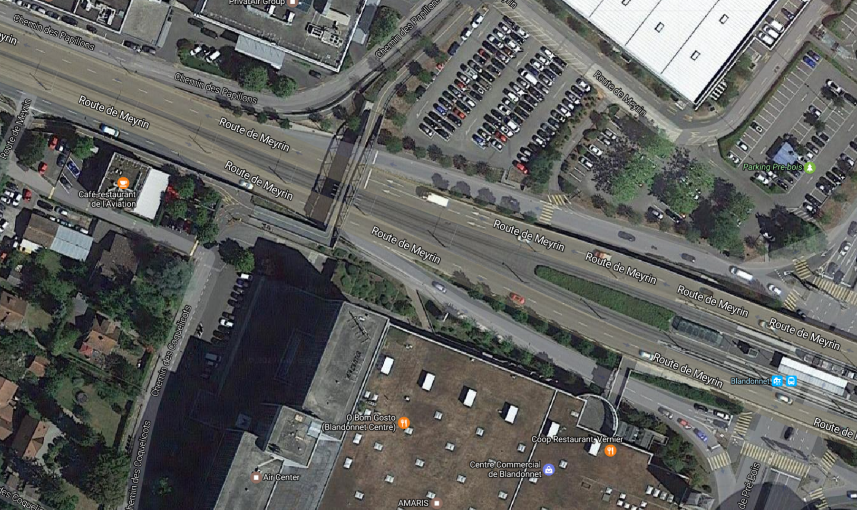
Café de l’Aviation
TRAM 19h 03 14 29 42 50 57 from CERN
10’ on the tram to Blandonnet
Billet Tout Genève validité 60' 3.00 CHF

