Slide 1
EP-NU Meeting: Introduction
Albert De Roeck

Slide 2
Conferences and Meetings
HEP conference: EPS 2017 Venice July
  Deadline for abstracts is April 15
NuInt is this year in Toronto (25-30 July)
  1 or 2 talks can be expected there for us
Other Neutrino conferences?
  Let me know if there is an interest..
ATC on neutrinos (week of 15th March)
Meeting with TH-NU on 8/3 14:00 (TH audi)

Slide 3
Physics Interest@DUNE TDR
ProtoDUNE measurements: all (?)
Oscillation physics: Leigh, Stefania, Albert
Proton decay: Marzio, Paola
General Reco Tools: Robert, Dorota
Structure fuctions/cross sections models: Voica
Exotica (ND): Albert
Non-DUNE activities
SB: Paola, Albert (Sterile)
…

Slide 4
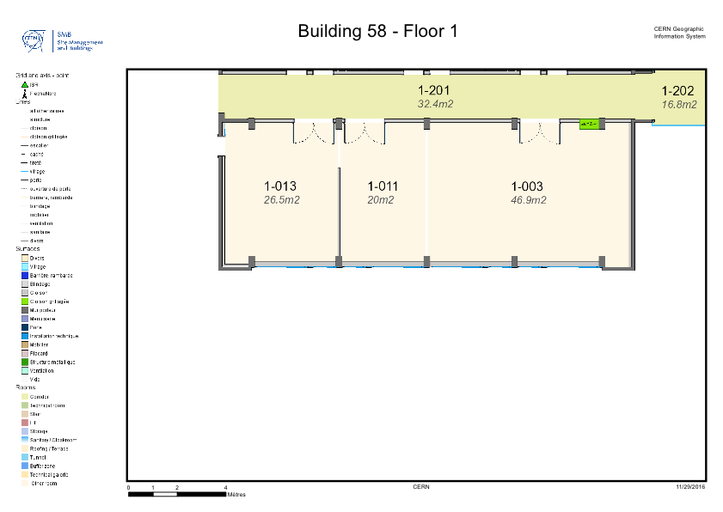
New Rooms Status
Former ep-secretariat will be converted into 4 connected rooms
Expected delivery time: end of May or June
.

Slide 5
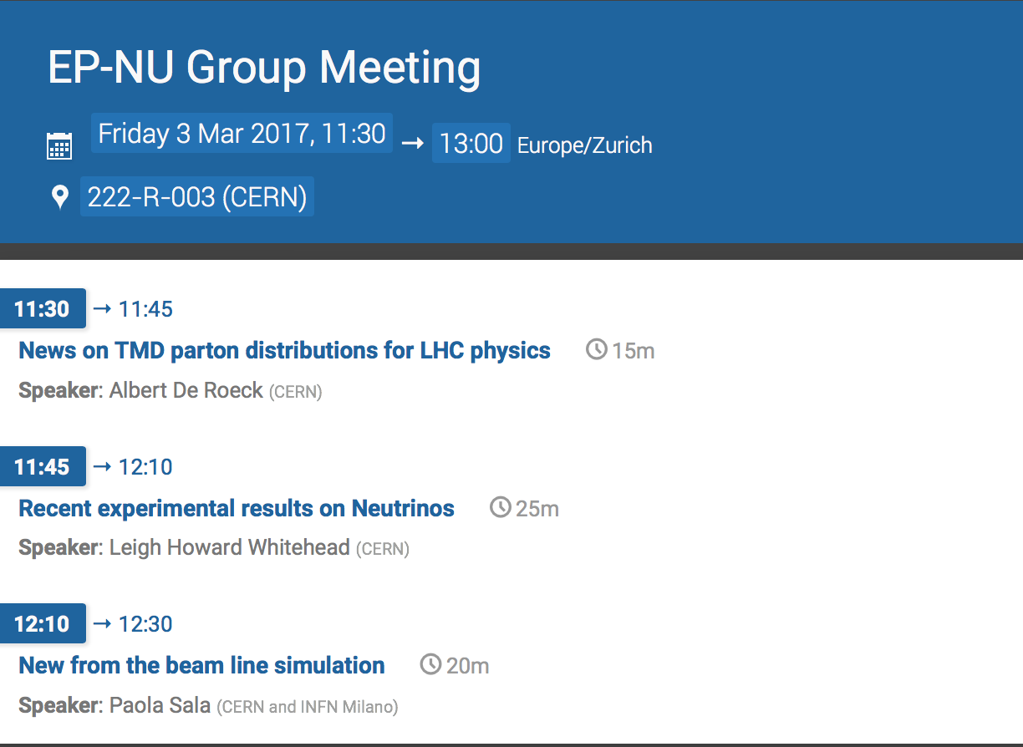
Today’s Agenda

