Slide 1
Introduction: Near Detectors
Albert De Roeck

Slide 2
Discussion Meeting
The Near Detectors are presently being discussed for DUNE and the T2K upgrades.
  CERN EP-nu so far only a member of DUNE, but synergies are possible, and T2K upgrade may be on the horizon.
DUNE is gearing up the discussion/plan for the ND
T2K/DUNE interested people have produced an EOI for HPTPC R&D. CERN has signed this EOI
We have interest in the HPTPC and Argon Cubes (and maybe others..?)
A change for a strong European effort in DUNE. Contacts with eg Italy and UK. We should capture that opportunity!
This is a first informal meeting to collect input from the group and explore strategies how we can get involved

Slide 3
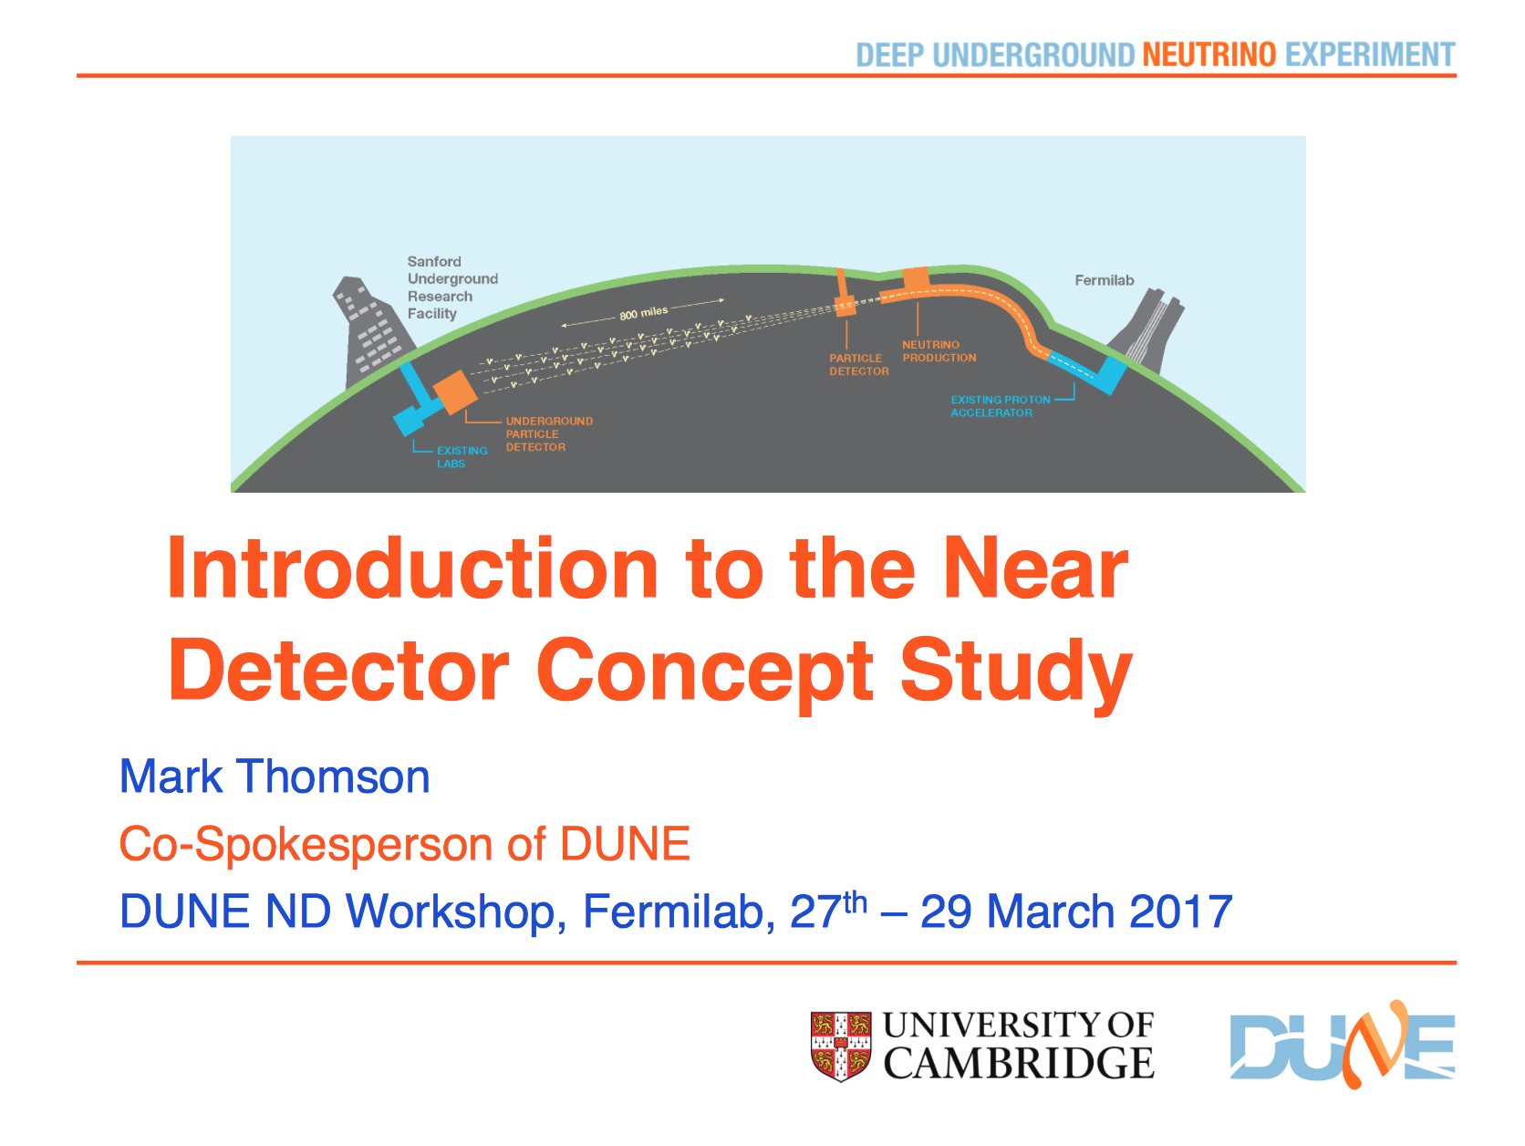

Slide 4
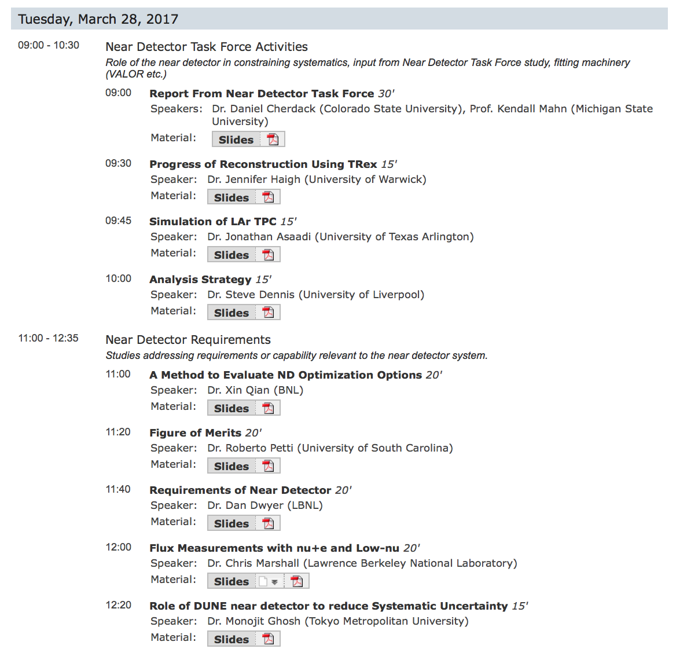
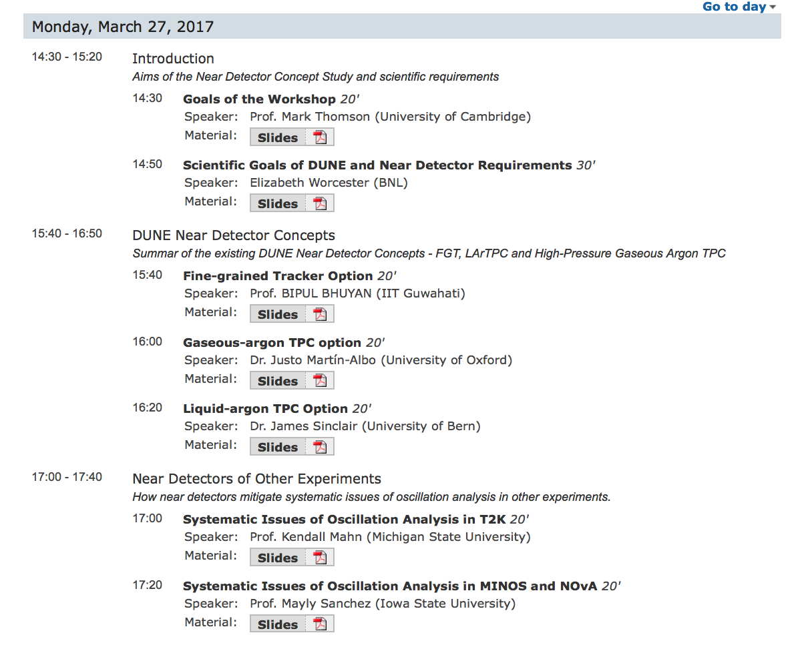
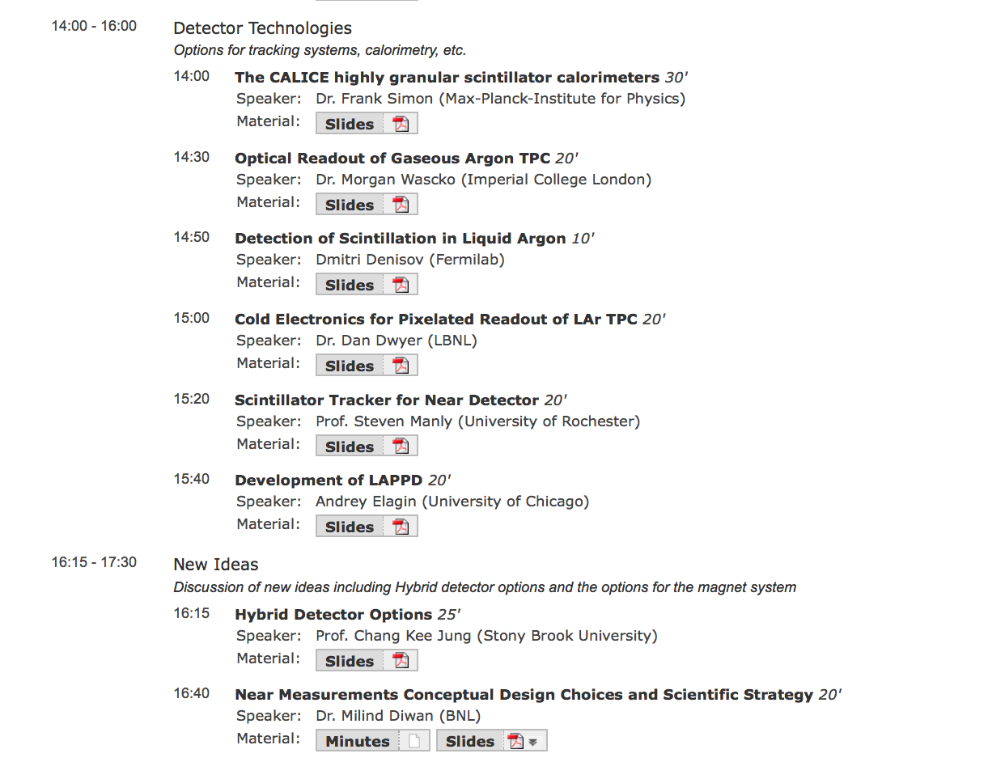
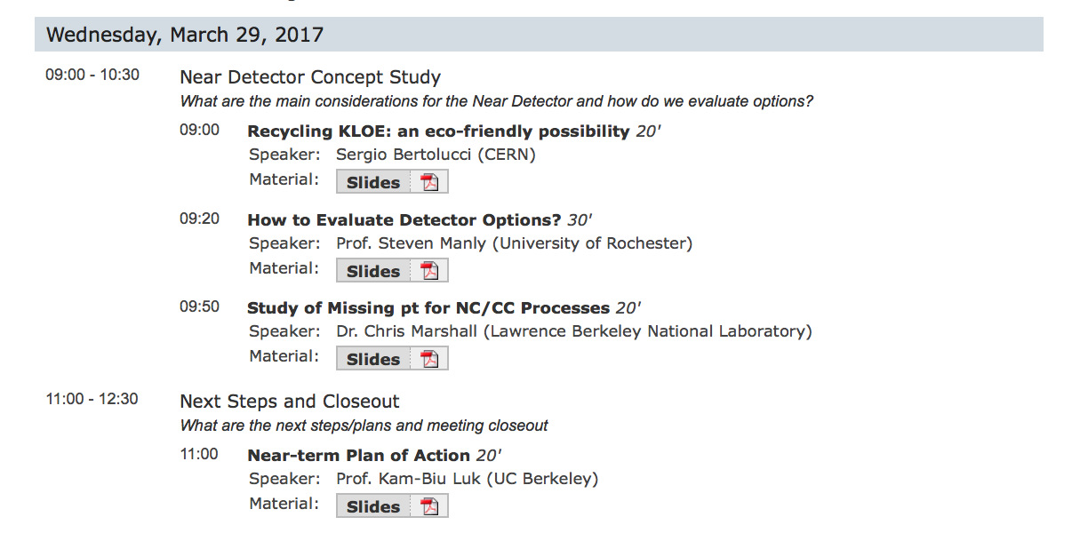
https://indico.fnal.gov/
conferenceOtherViews.py?view=standard&confId=13620

Slide 5
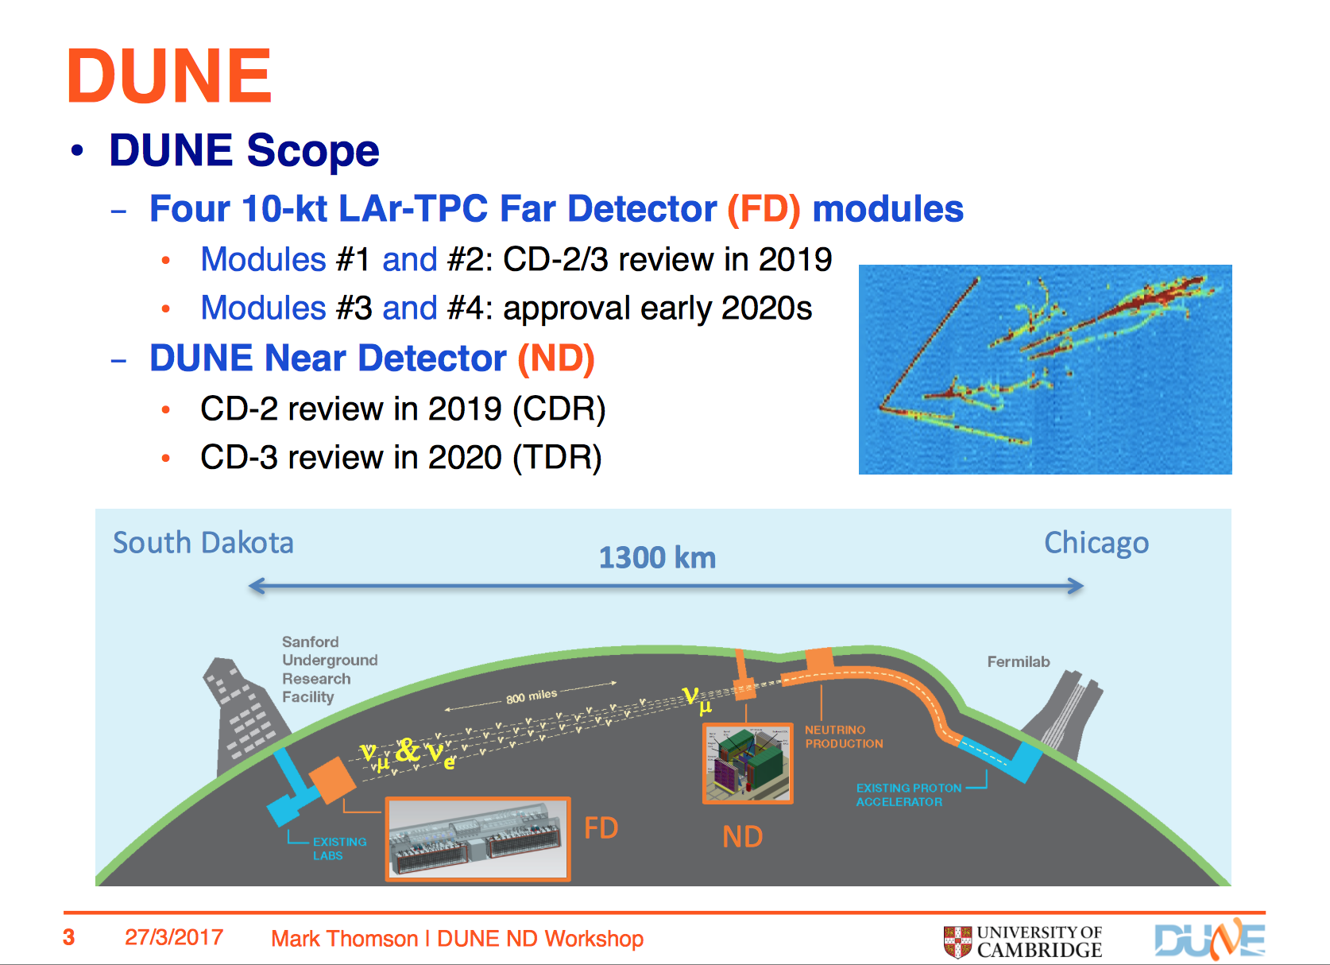

Slide 6
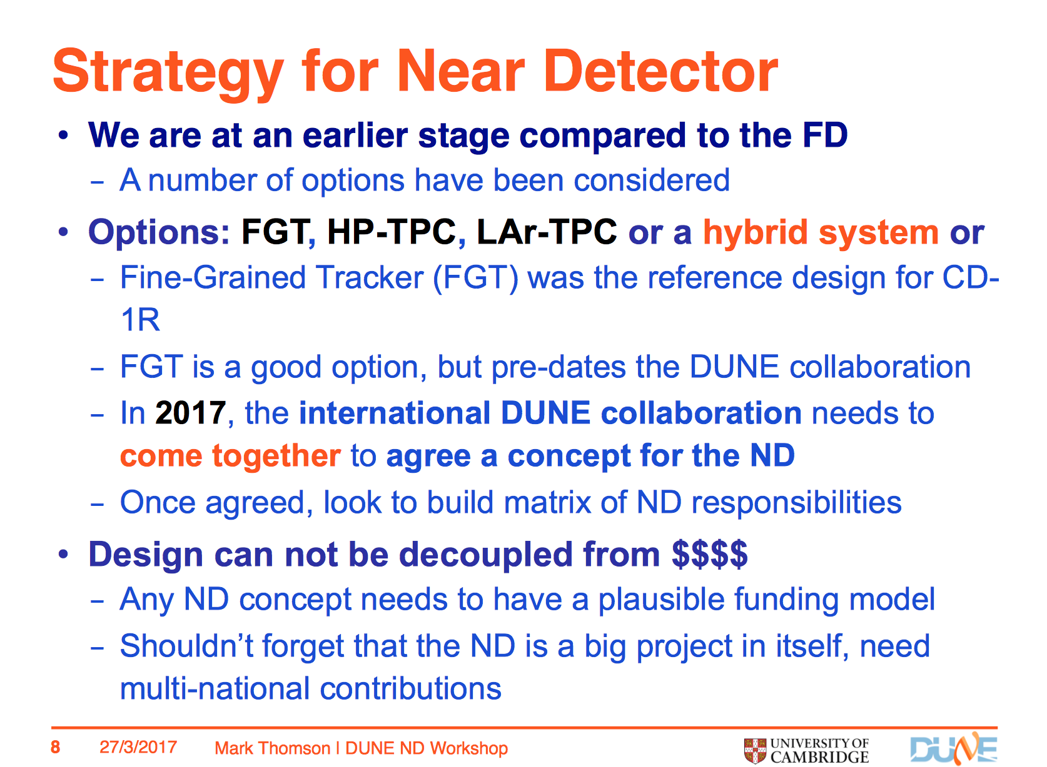

Slide 7
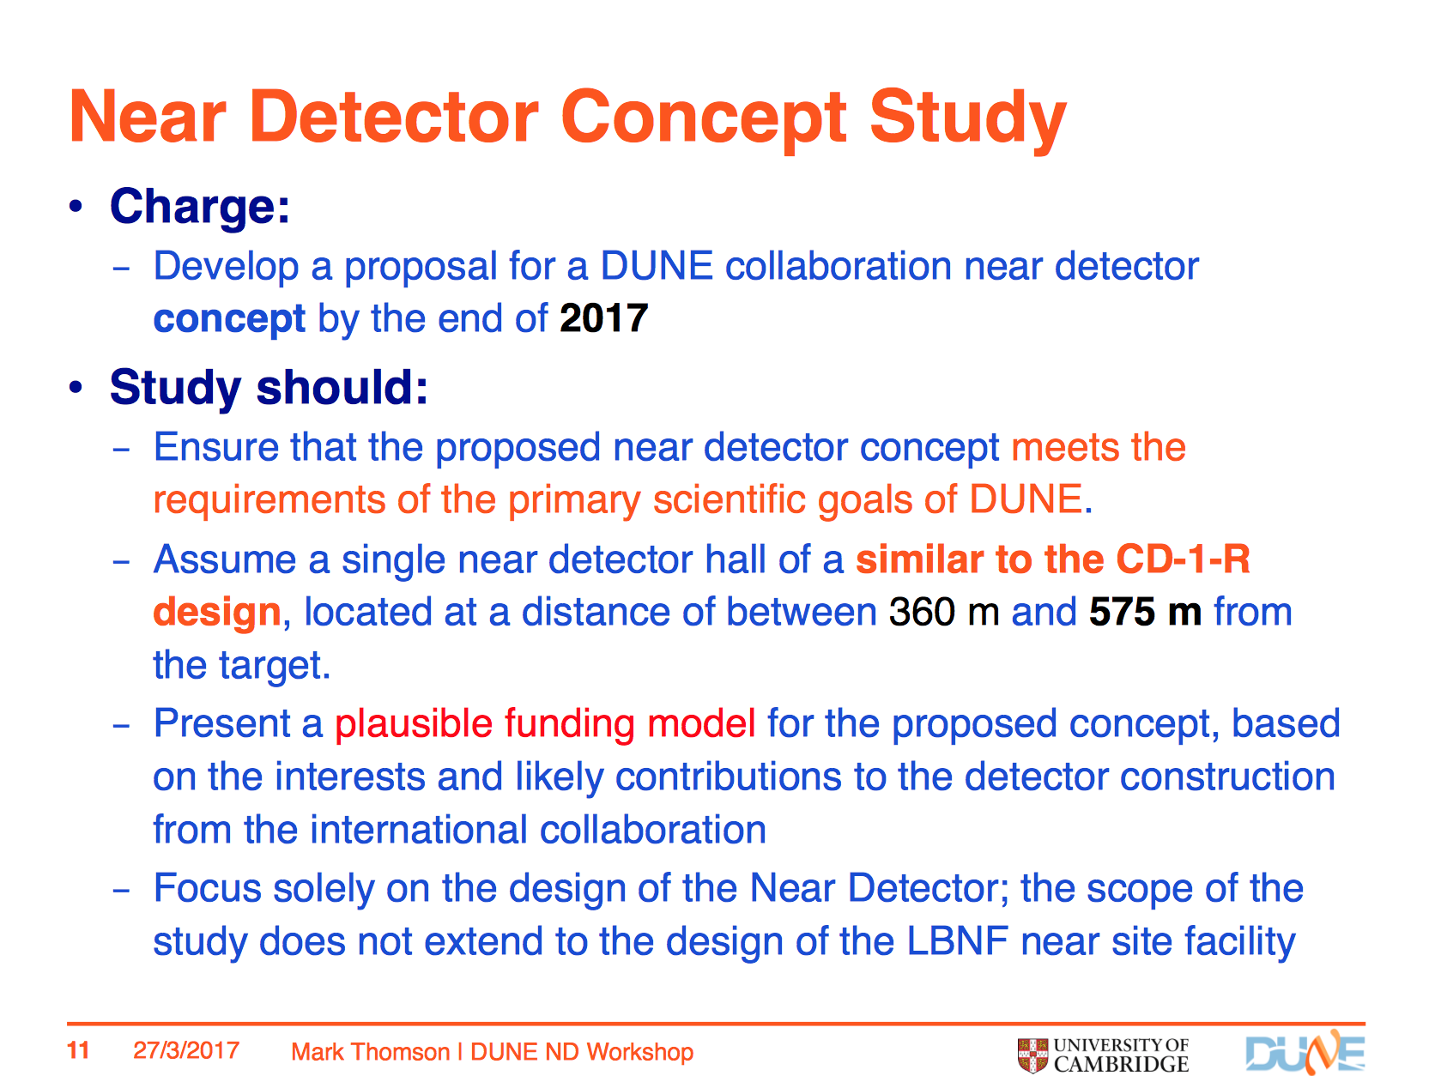

Slide 8
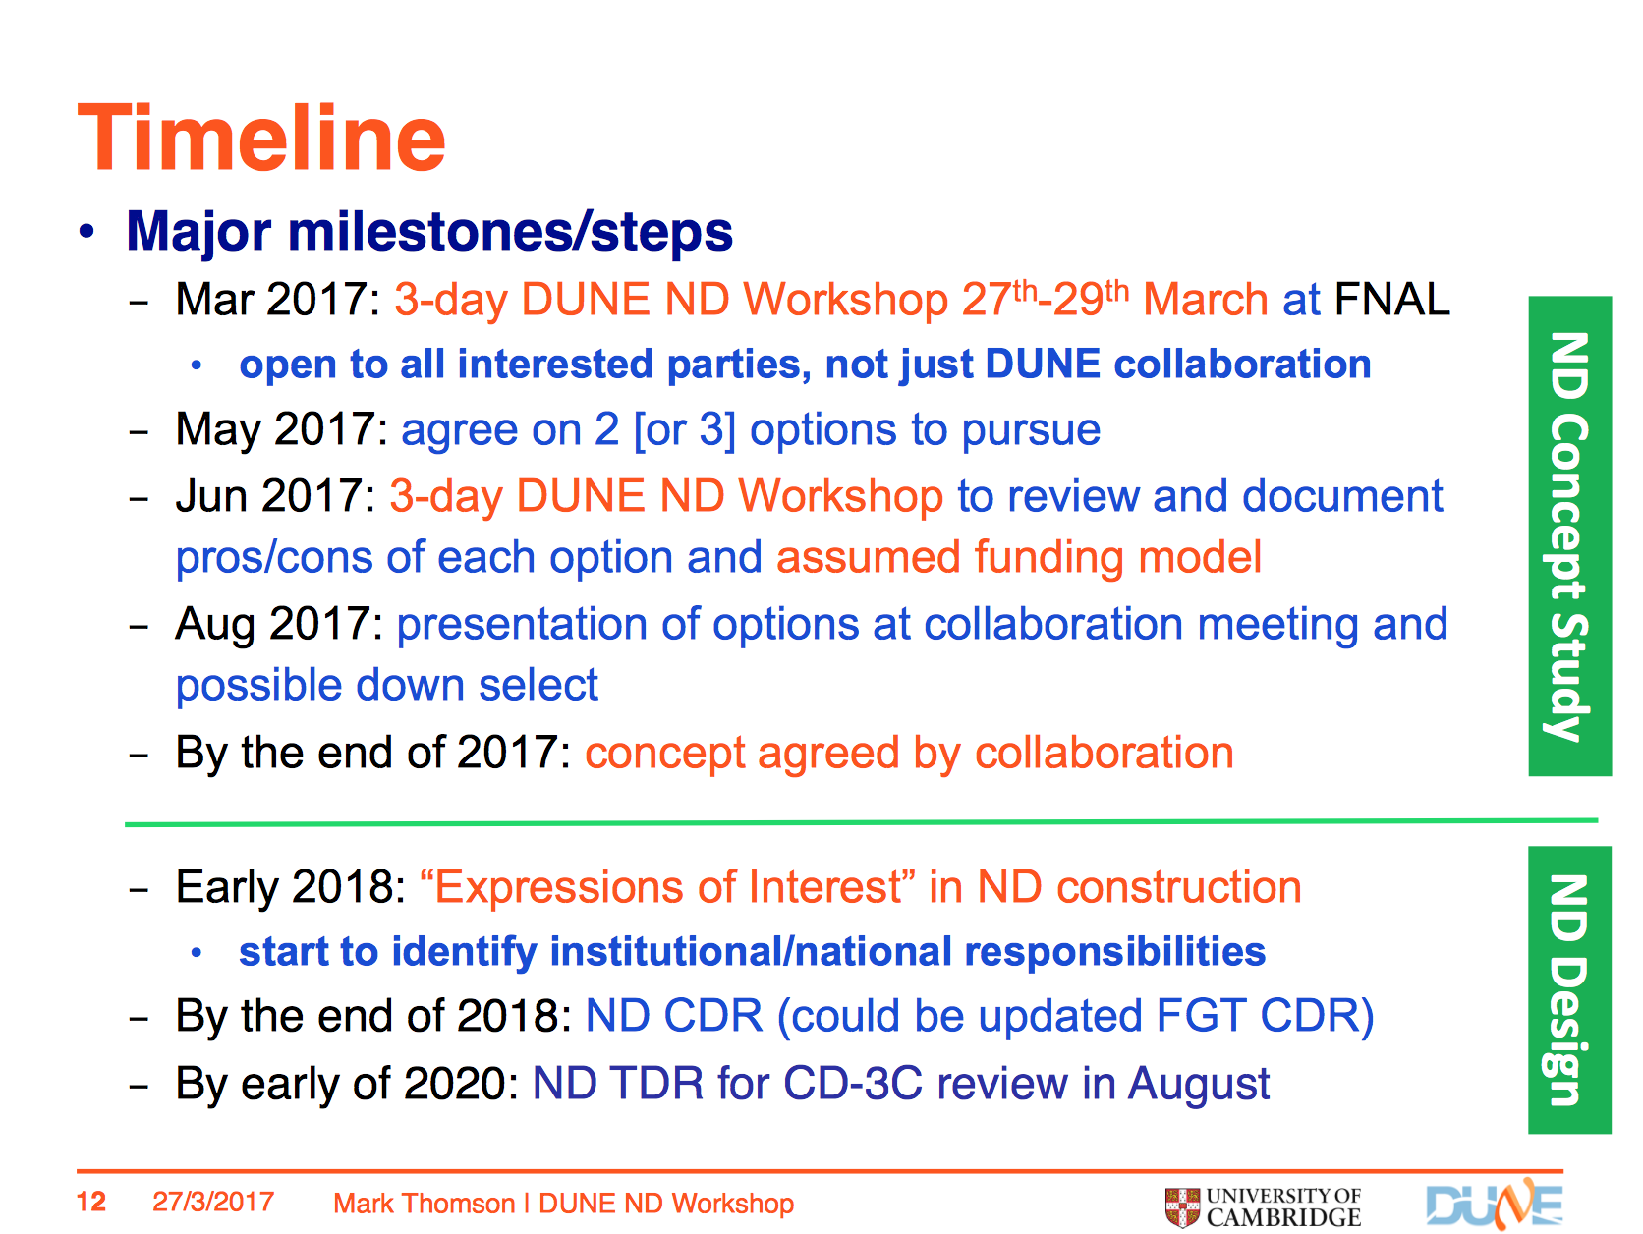
In the best of worlds…

Slide 9
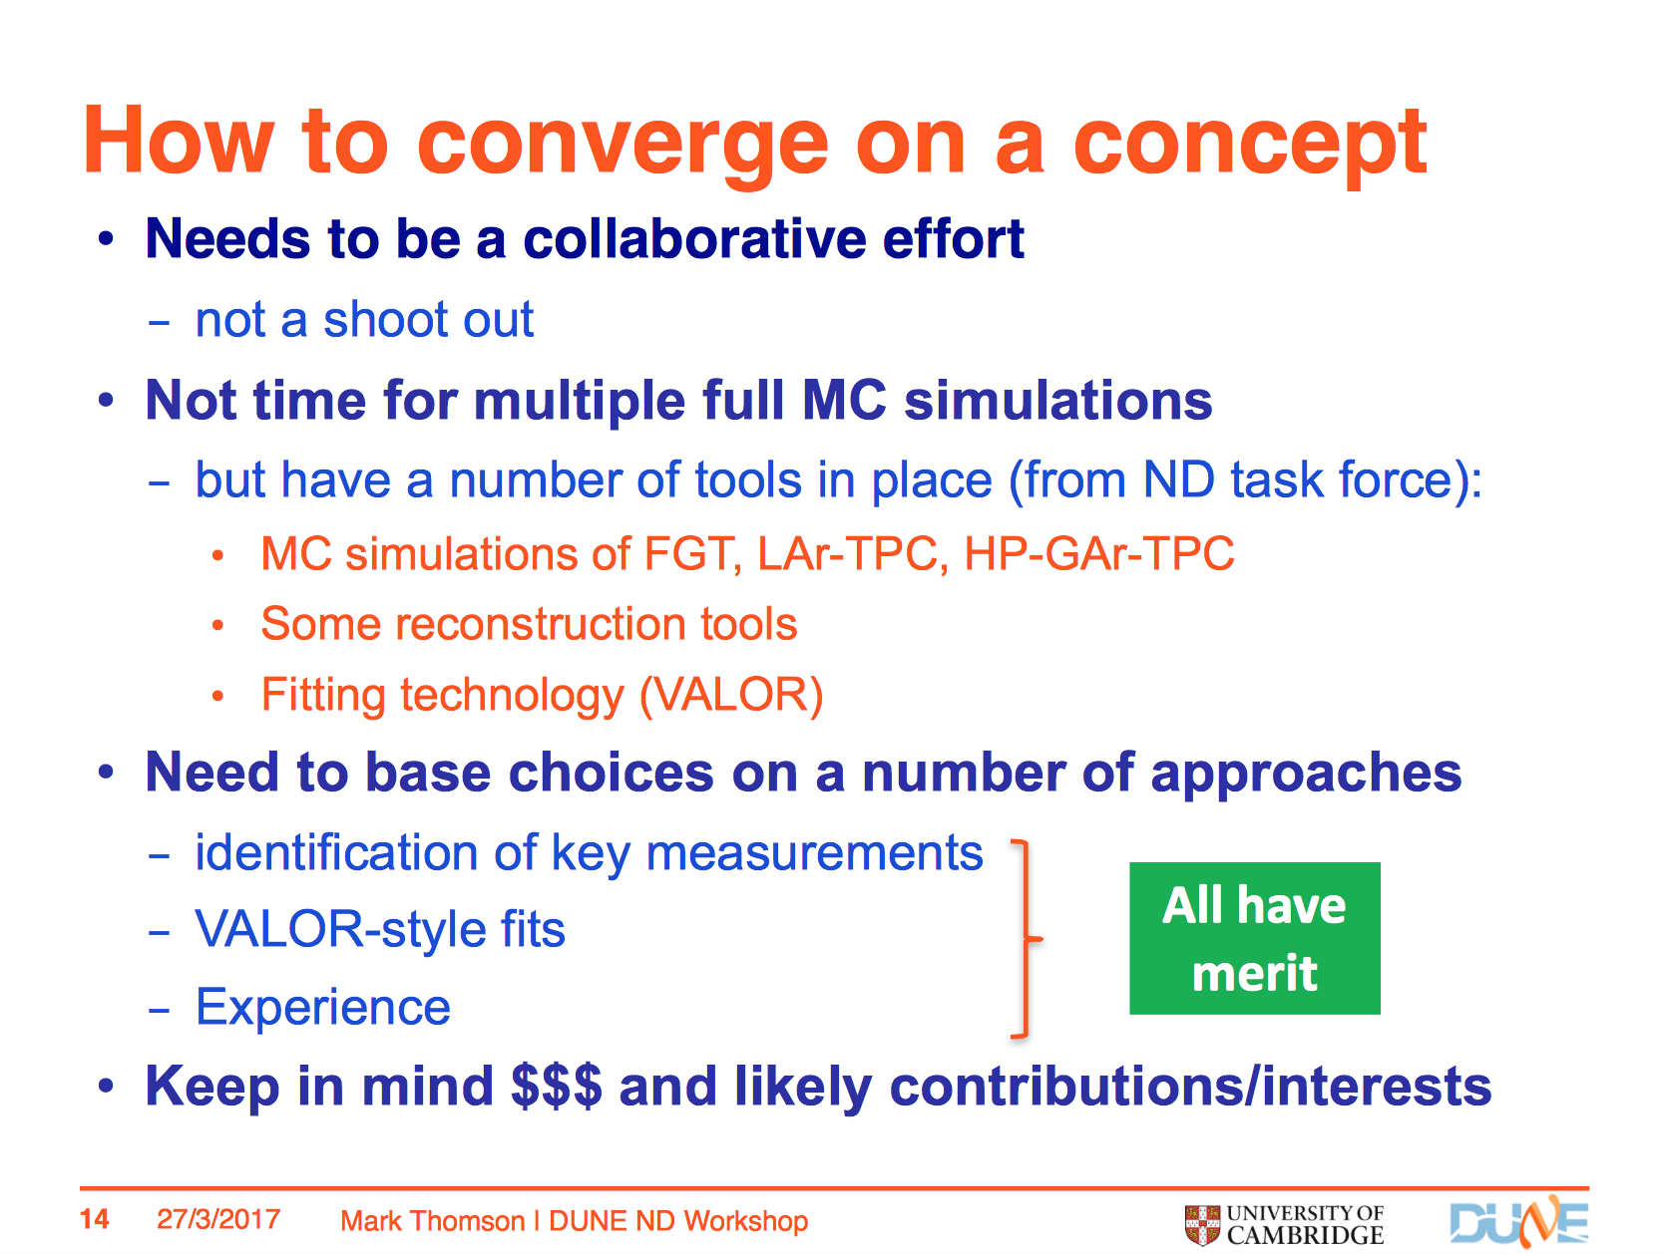

Slide 10
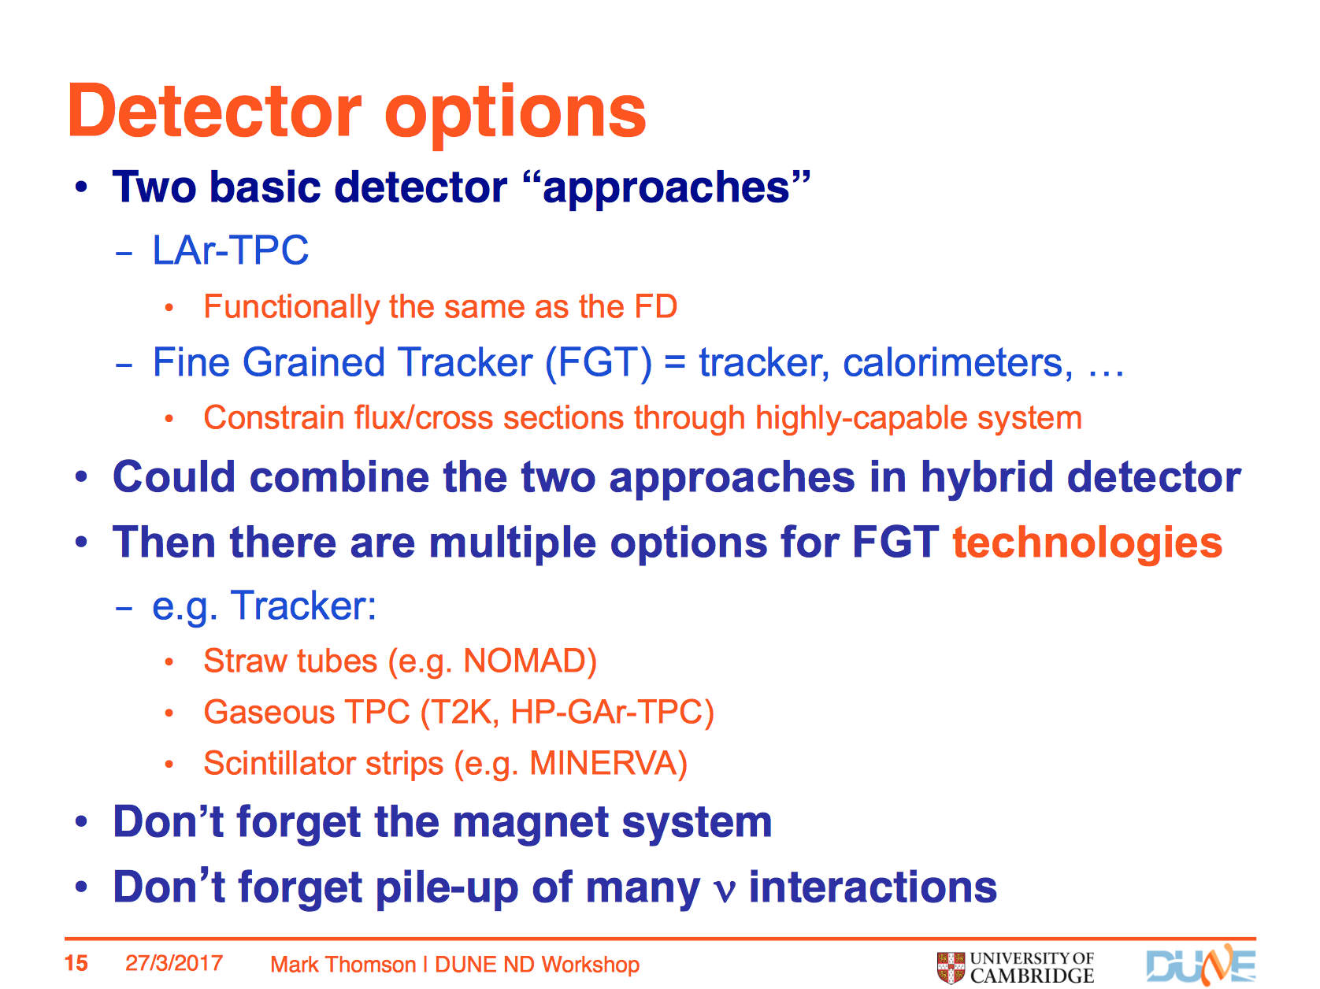

Slide 11
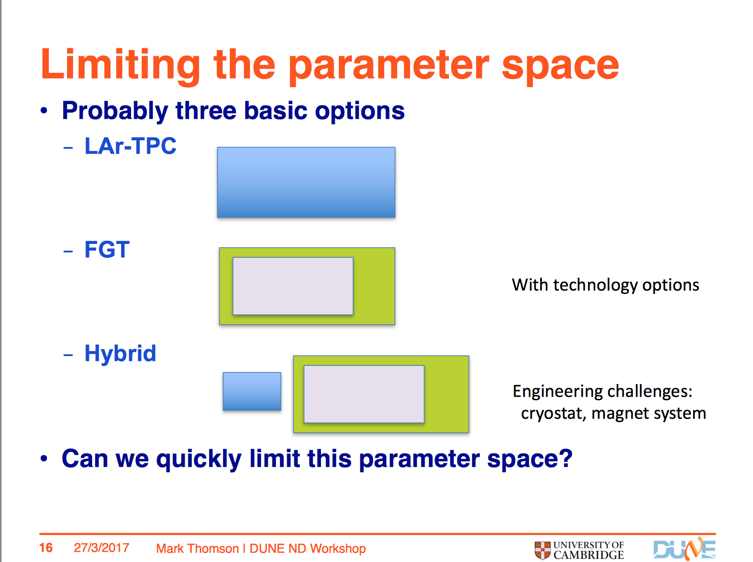

Slide 12
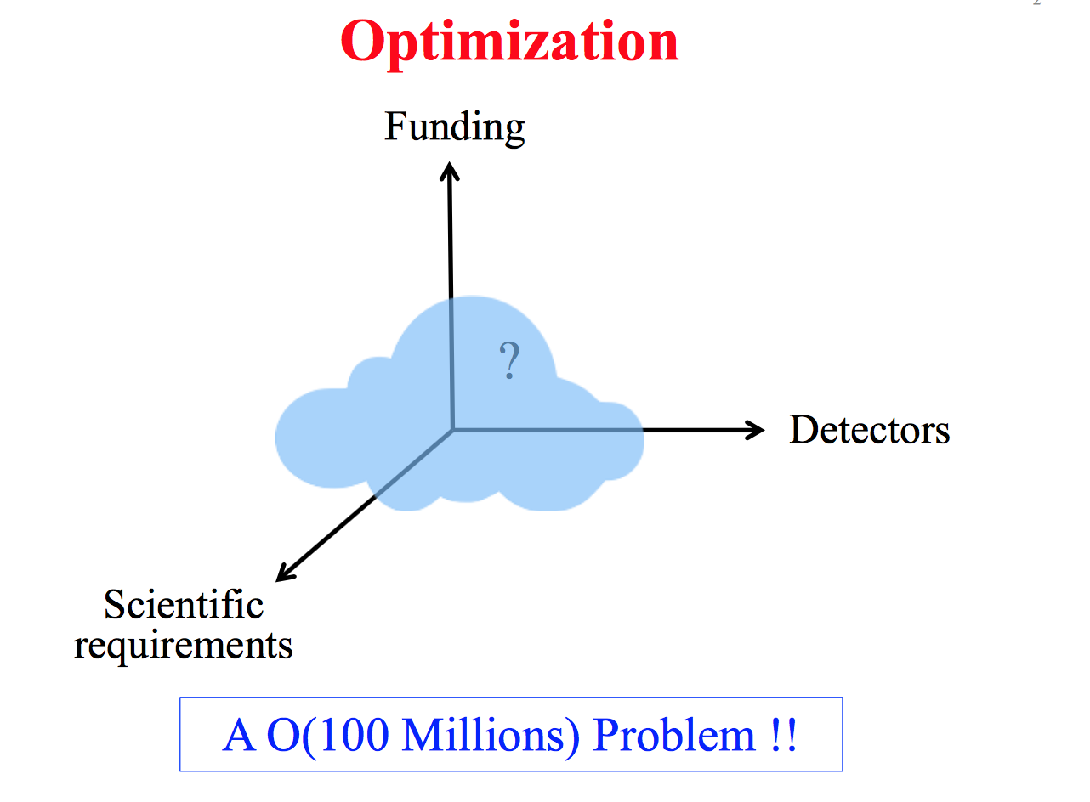
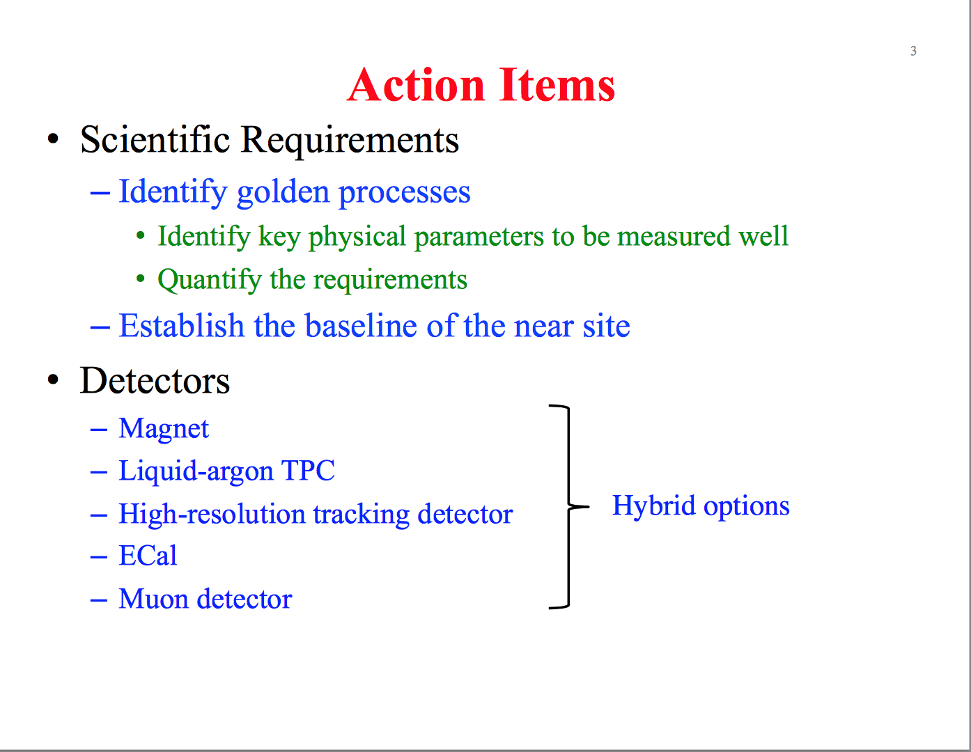
Kam Biu Luk: ND group coordinator
Alfons Weber now co-coordinator

Slide 13
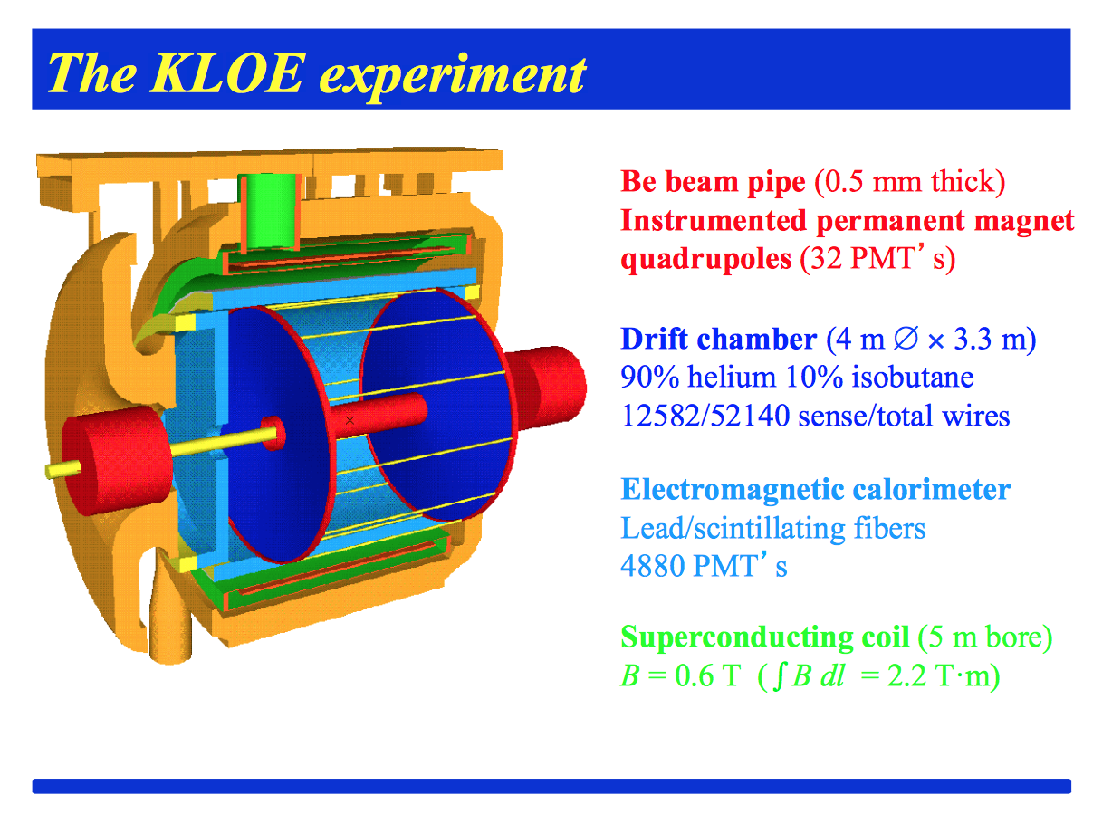
Italy has decided to you the ND effort (S. Bertolucci)

Slide 14
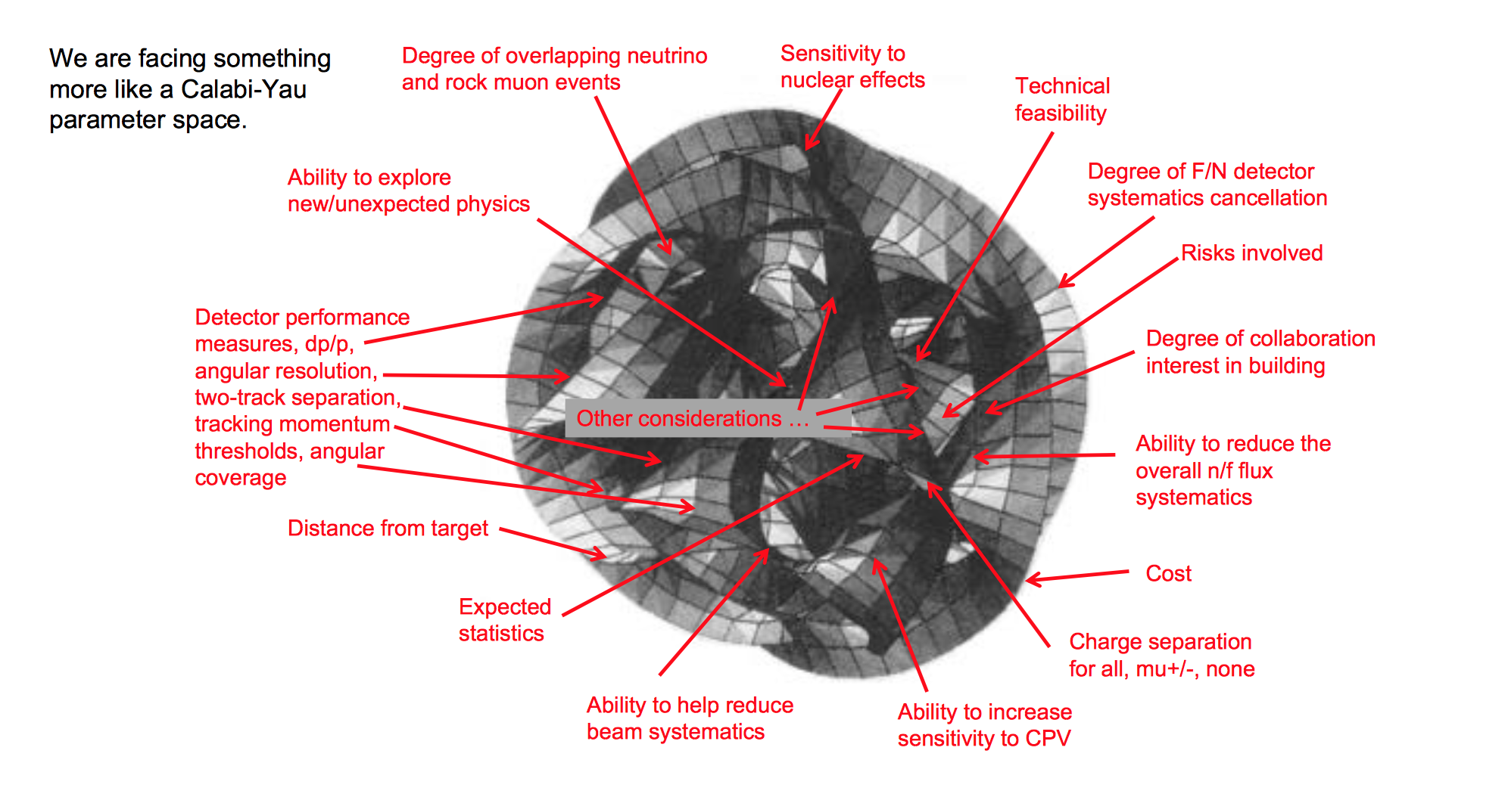
Seems to many open questions to me for ‘fast’ decision

Slide 15
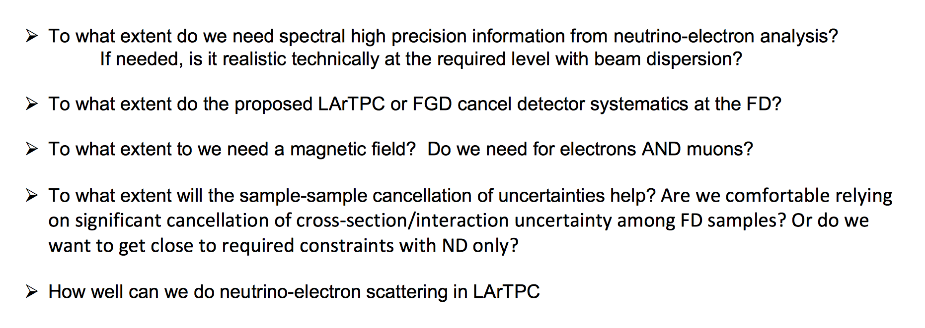
Typical questions

Slide 16
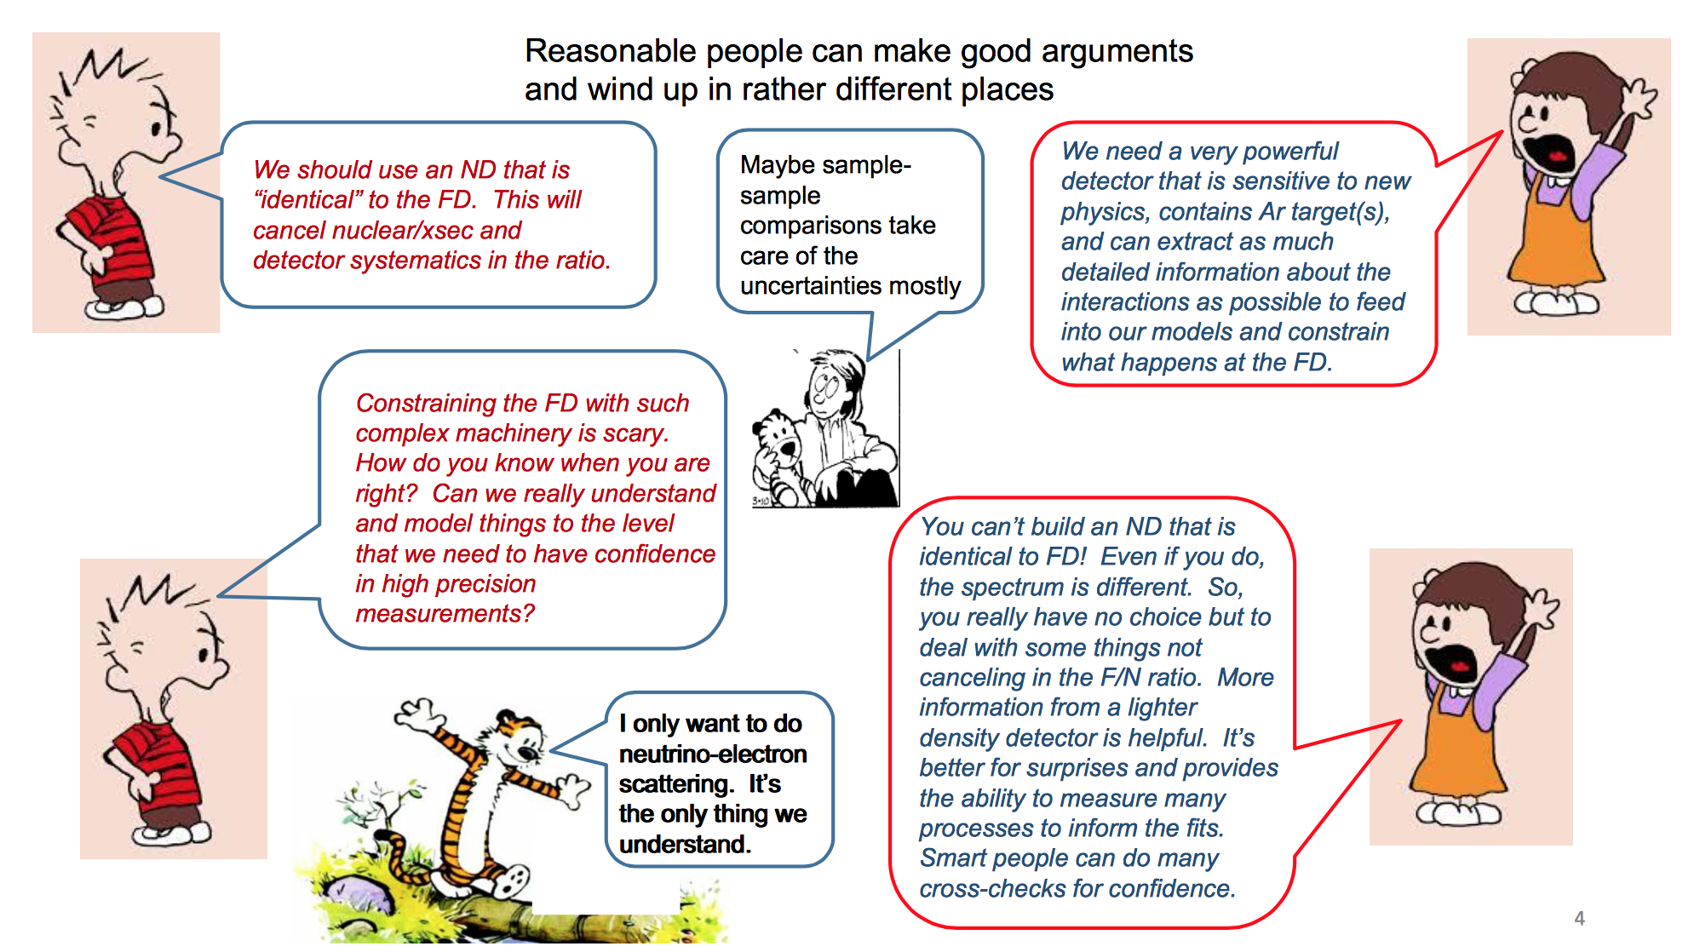
A lot of Discussion…
Convergence?

Slide 17
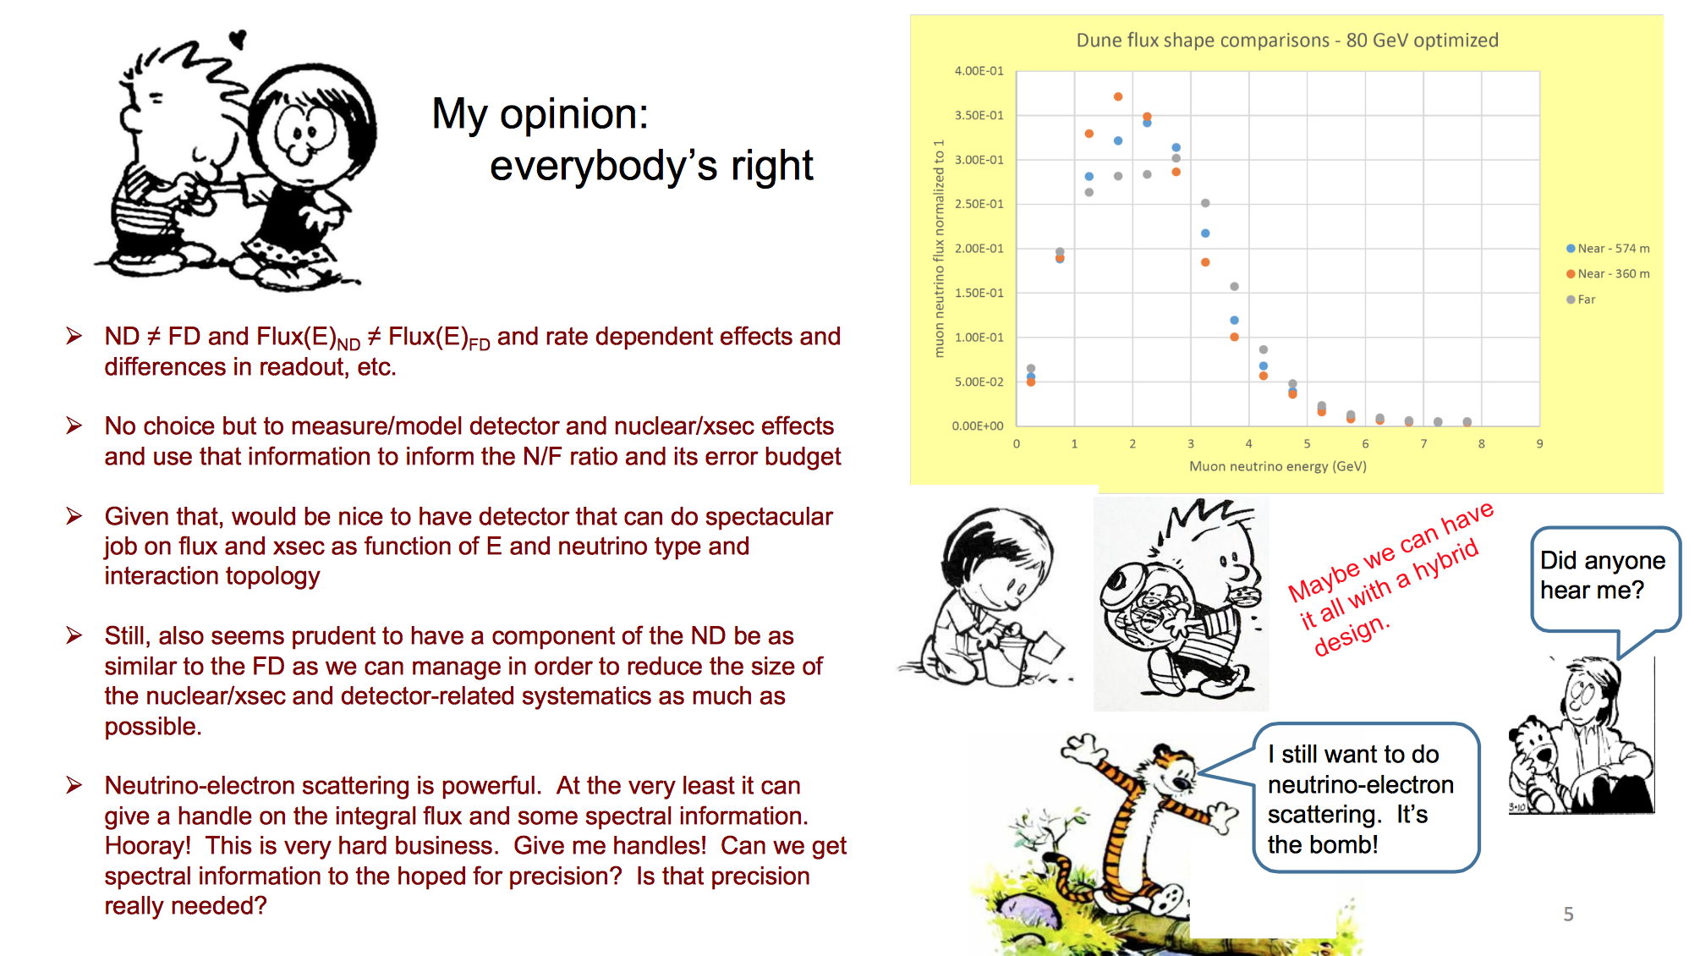
Steven Manly

Slide 18
Interest in EP-nu/nu-Platform/CERN
Hardware activities including electronics, triggers, online etc. Interests?
R&D on new ideas?
  Involve also the EP-DT group
Off-line software development?
Physics studies (not much time for those)?
Of course our prime target at CERN is ProtoDune for the near future. Availability of manpower?

Slide 19
BACKUP

Slide 20
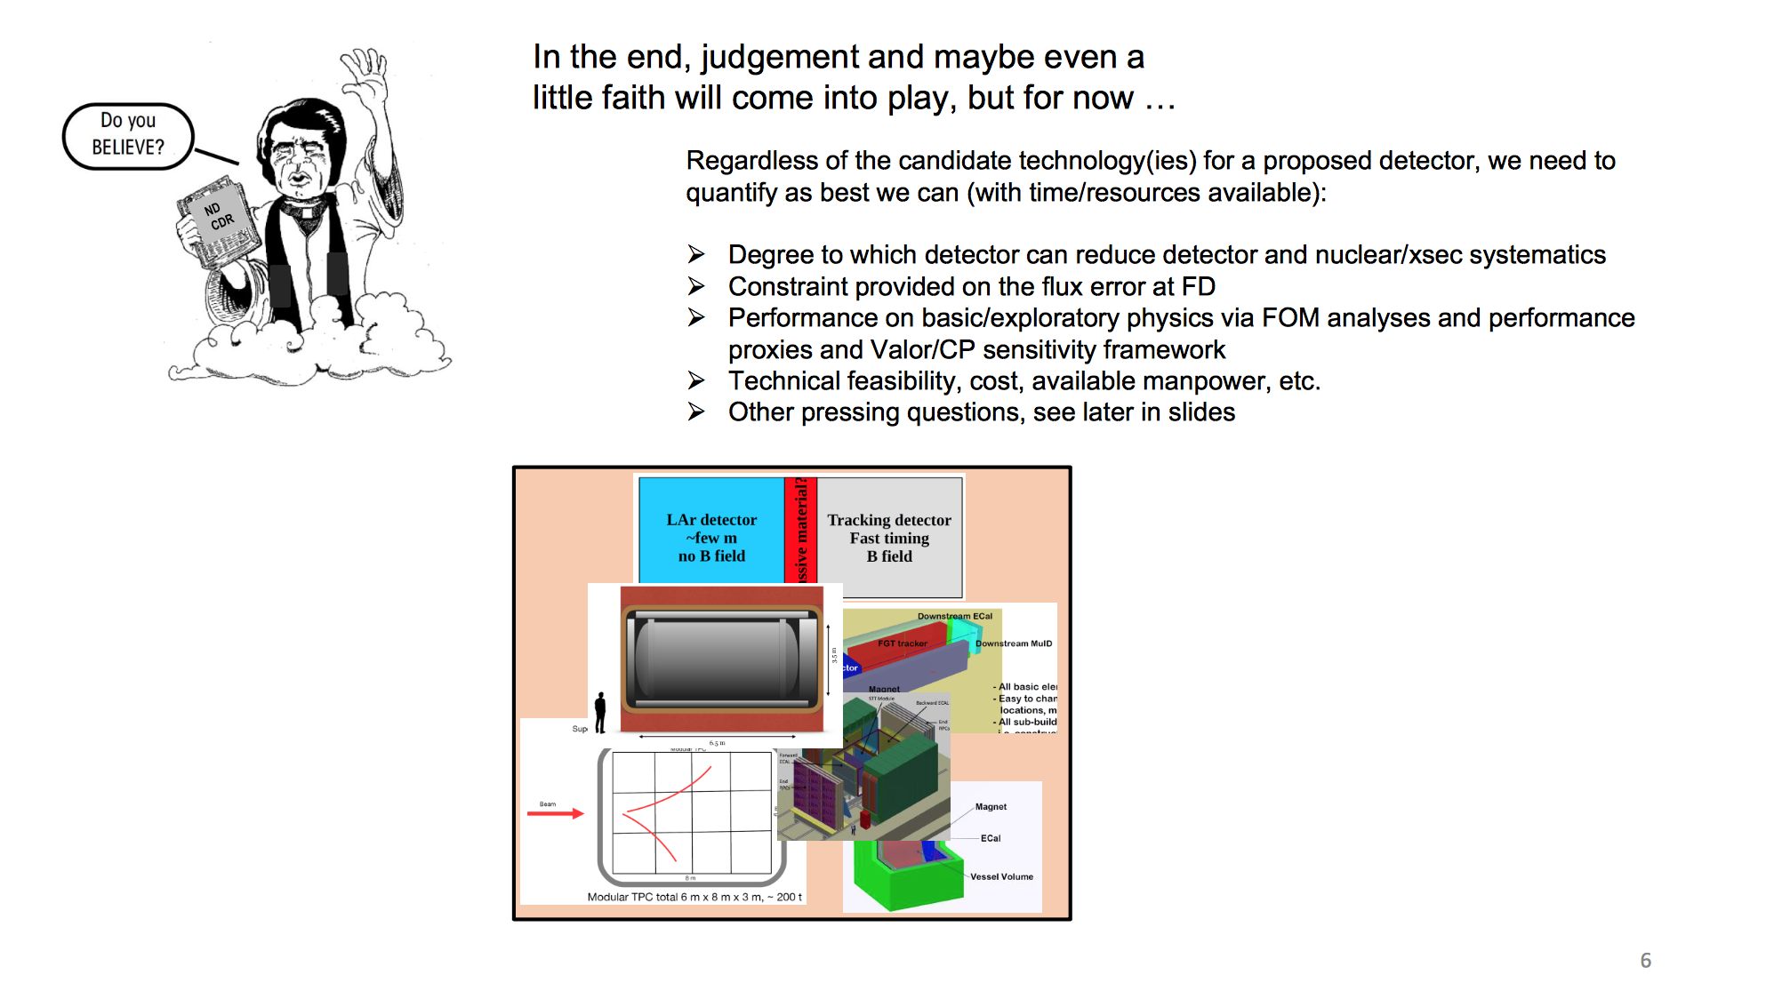

Slide 21
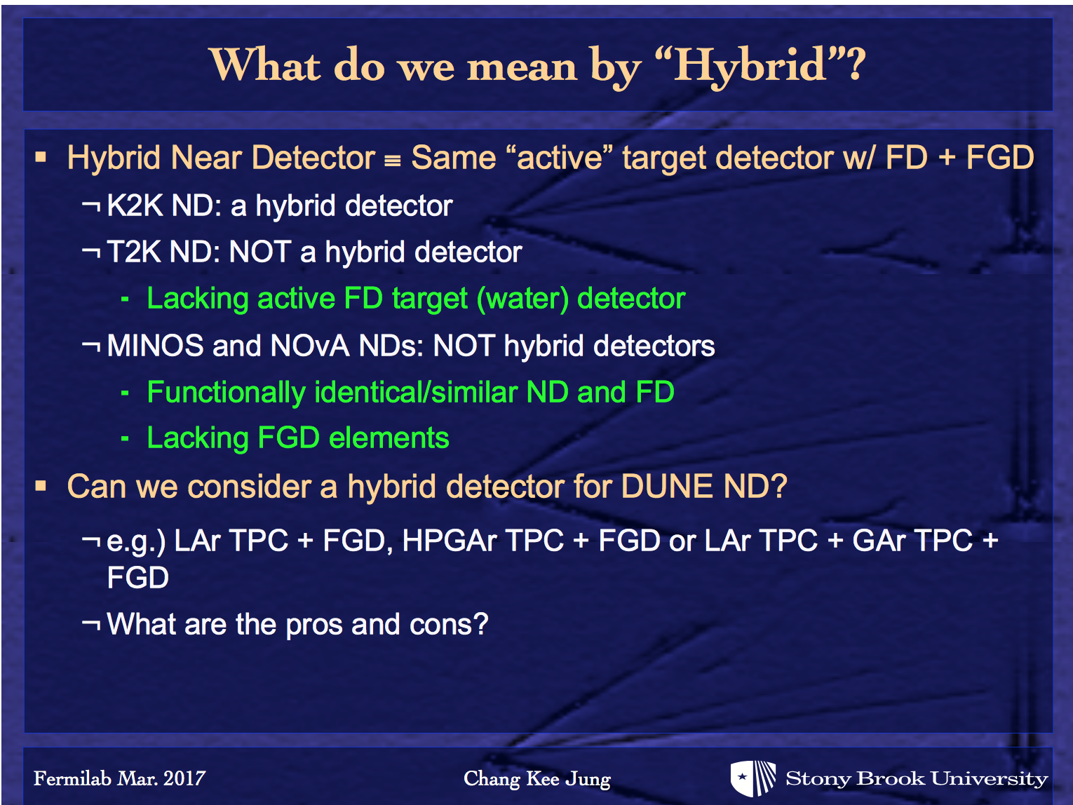

Slide 22
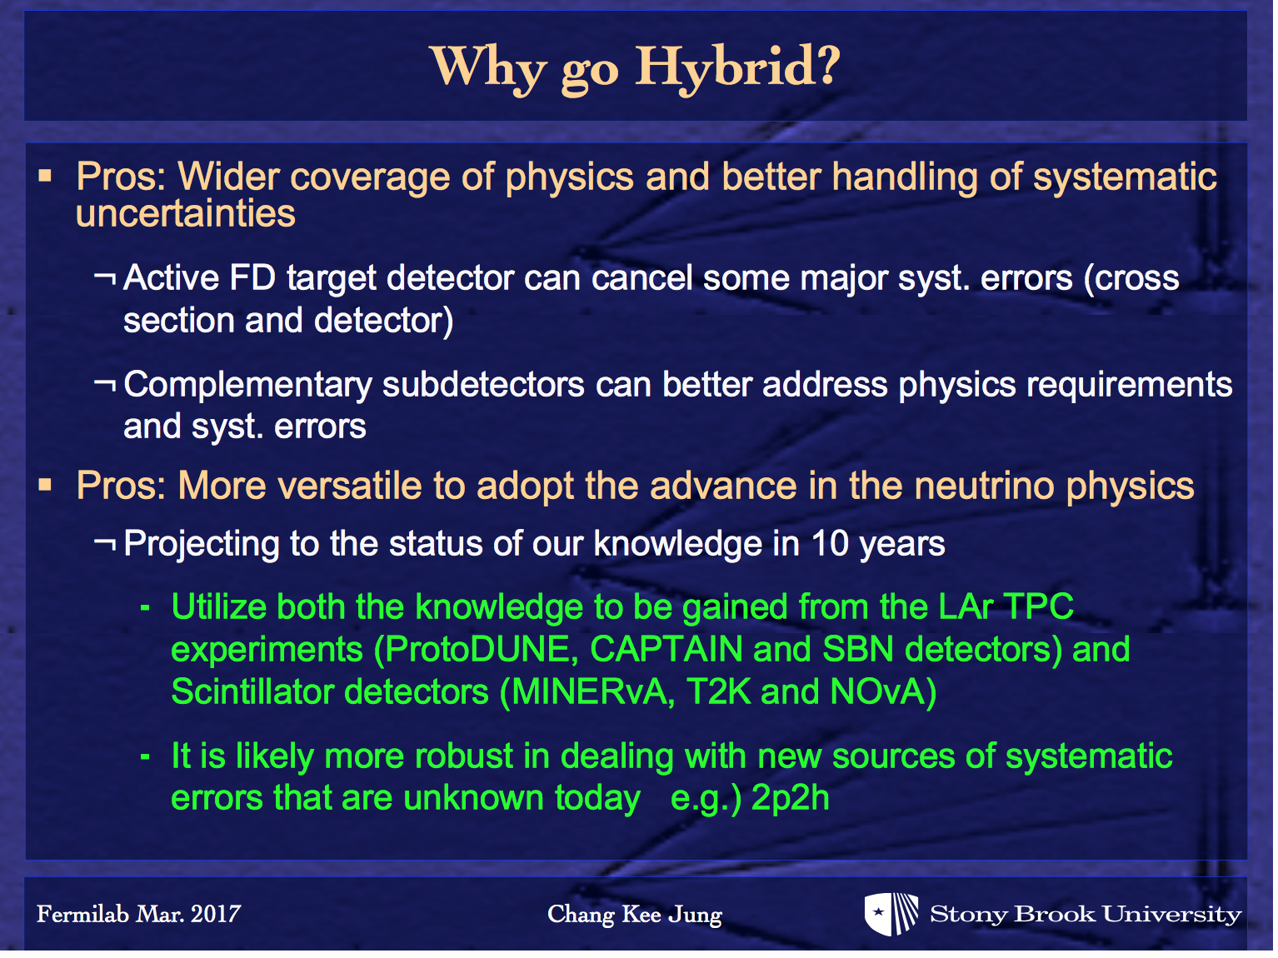

Slide 23
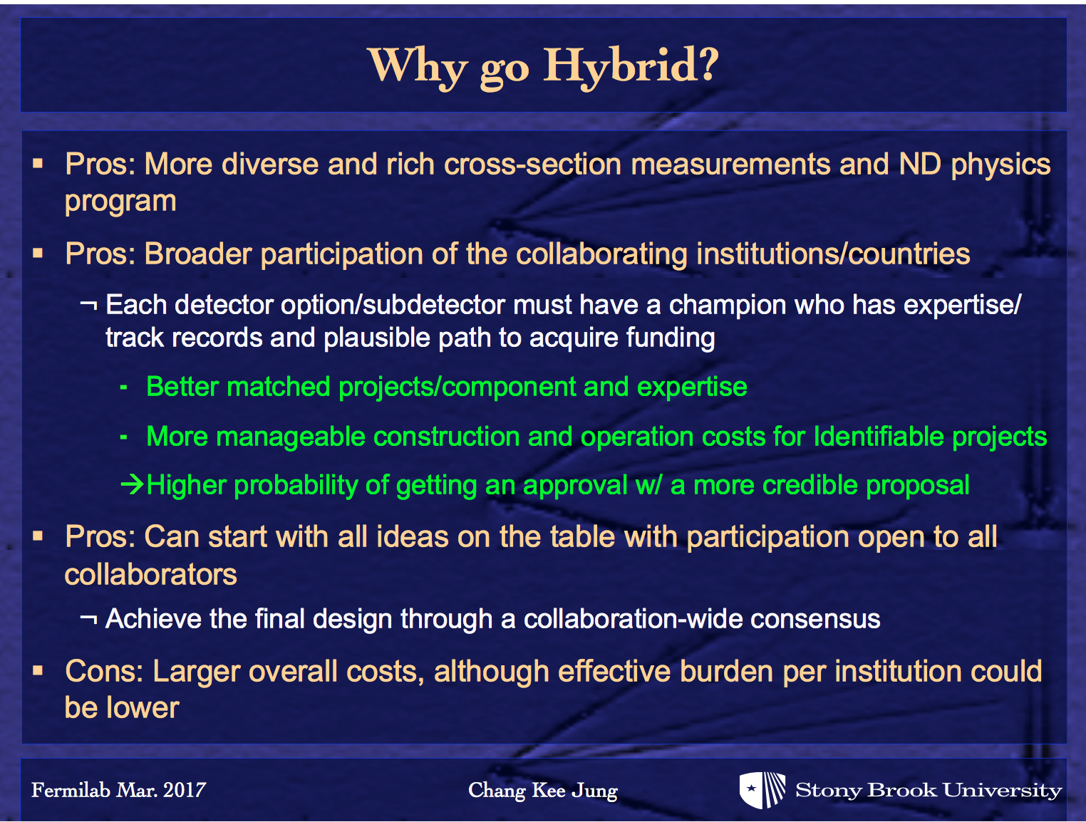

Slide 24
