Slide 1
ELITRANS project and DIRAC
Jiří Chudoba
Coauthors: T. Gaizer , G. Beckett, M. Ciubancan, T. Ivanoaica, L. Fülöp, B. Grenier, P. Kovács, A.I. Nicolin, L. Schrettner, J. van Wezel (PRACE, ELI-BL, ELI-NP, EGI, ELI-ALPS, EUDAT)
29. 5. 2017

Slide 2
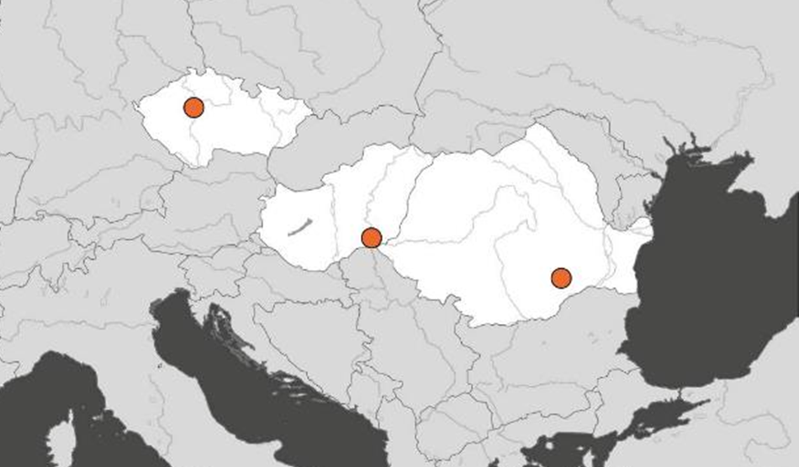
ELI in a Nutshell
ELI: Extreme Light Infrastructure: 3 cutting edge European laser research institutions
ELI-ALPS (Szeged, Hungary):
ultrashort (attosecond) pulses with high repetition rate, frequency range between THz and X-ray
ELI-BL (Dolní Břežany, Czech Republic):
Ultra-high power (10 PW) and intensity up to 10²⁴ W/cm² radiation sources and particle beams
ELI-NP (Măgurele, Romania):
Combined laser and nuclear physics experiments with very high intensity laser system and very intense, brilliant γ-beam

Slide 3
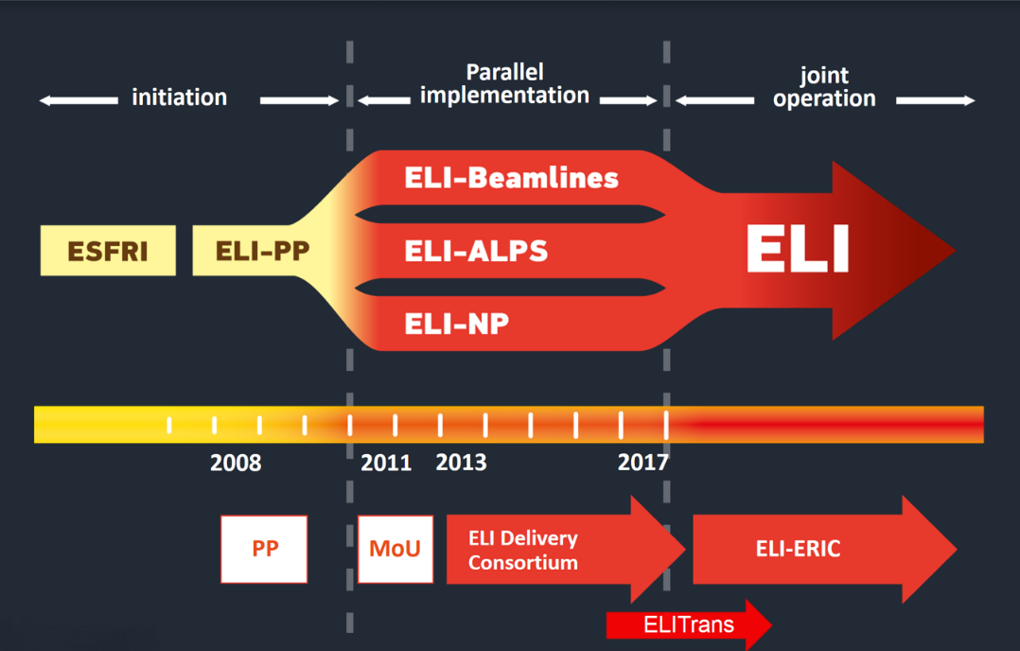
From Conception to Operation
All the three pillars are in implementation phase now
Construction and operation are maintained in different organisational frameworks:
Pillars are developed independently
When completed, pillars will be operated jointly
Joint operation will be controlled by ELI-ERIC
ELITRANS: H2020 project to lay down the organisational, conceptual and legal groundwork for ELI-ERIC and facilitate the transition from development to operation

Slide 4
Main ELITRANS objectives
Developing concepts for ELI-ERIC’s business model:
  essential elements of the future ELI-ERIC’s organisation, legal constitution, financial sustainability, governance, user relations, and international integration
Preparing ELI-ERIC’s “business plan”, adapted to the operation as the world’s first international laser user facility
  concepts for a VRME, definition and standardisation of user-facility interfaces, health and safety regulations, specialized experiment preparation techniques, computing and big-data management, innovation and technology transfer aspects
Facilitating the merger of formally independent construction projects towards one unified pan-European RI
  Steps towards the transformation and unification of ELI’s internal structures and organisational procedures, the creation of an internal corporate identity, harmonisation of international relations, creation of a common scientific profile and competitive user research opportunities.

Slide 5
ELITRANS Facts and Figures
Key objectives:
Developing concepts for ELI-ERIC’s business model
Preparing ELI-ERIC’s “business plan”
Manage the merger of independent developments into one unified RI
Timescale, budget:
September 2015 – August 2018 (36 months)
11 work-packages, a separate one is devoted to „Data and computing”
EC funding of 3.4 m EUR
Consortium members:
Coordinator: Extreme Light Delivery Consortium ASBL
Pillars: ELI-ALPS, ELI-BL, ELI-NP
E-infrastructures specialised at research data handling: PRACE, KIT (EUDAT), EGI
Strategic partners: DESY, STFC, Elettra

Slide 6
Data and Computing Challenges
Technical
When fully operational, the 3 pillars will provide services to thousands of users per year, generating 5-10 petabytes of data at 30 beamlines combined
Some beamlines will operate high repetition light sources (-> in theory, extremely high amount of data can be generated, thus balance must be found between expectations and feasible solutions).
Researches will cover many areas from nuclear physics to life sciences
Organisational, legal
IT governance at ERIC and pillar level has not fully defined yet (financing model, budgeting, procurement rules and control of resources is still to be set up)
Optimal arrangement of common and local resources must be found
Meet the growing demand for openly available research data (given the amount of data, this is also a tech challenge)
Match ELI business / operational rules with that of e-infrastructure providers

Slide 7
ELITRANS WP10 - Task 3
Task 10.3:
Define the common ELI-wide data management service layer
Create an overall strategy and implementation plan that address the identified requirements of the ELI-wide data management service layer.
This layer acts like a bridge toward different e-Infrastructures, integrates their services and fills in the gaps and helps to keep the flexibility and scalability of the ELI-wide data management solution. Execute pilot projects to reduce risks and to support the long term strategic decisions. Involvement of different e-Infrastructures, local data repository partners and user groups is essential in this task.
Data intensive tasks: estimates in tens of PB of produced data per pillar per year

Slide 8
Virtual Organizations
VO eli-beams.eu
Started in 2014 to provide resources for simulations required for ELI-BL
7 active users
Usage decreased since 2015, when a local cluster became available
Users also use HPC resources in IT4I in Ostrava (CZ)
User support via CESNET RT: egee@rt4.cesnet.cz
Resource center prague_cesnet_lcg2 (CESNET)
VO eli-np.eu
Started in 2015
15 active users
Resource centre GRIDIFIN

Slide 9
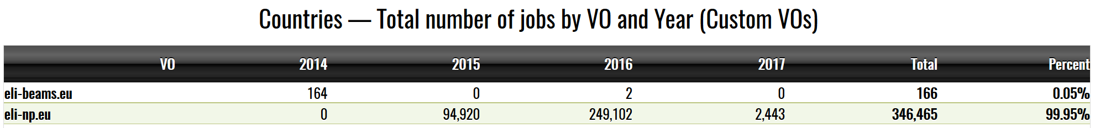
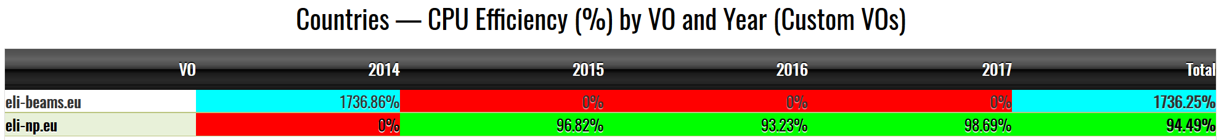
Virtual Organizations
Goal: common VO with DIRAC instead of WMS for job submission

Slide 10
Open Issues
User Management
Internal and external users
Access rights to resources at each pillar
X509 certificates cumbersome for many users
Common VO management
Data Management
Open Access
Responsibility for deletion and archive
Tools for data access and management

Slide 11
Open position
ELI-BL (Prague)
Missing manpower for the task 10.3
Position available immediately

