Slide 1


at JINR
Igor Pelevanyuk, JINR
Andrei Tsaregorodtsev, IN2P3
The 7th DIRAC Users’ Workshop

Slide 2


Motivation
DIRAC as a general solution
DIRAC as a solution for NICA

Slide 3






DIRAC@JINR now
…
Conf
Services
Web
GRID-Director
4
8
4
2
8 GB
16 GB
8 GB
2 GB

Slide 4




DIRAC@JINR resources
CREAM-CE
Host
SE
(just for tests)

Slide 5
Our VOs
For tests
For NICA experiment

Slide 6




Next steps
New VO - edu
New Resource – cloud
New Resource – dCache SE
Propose to physicists

Slide 7
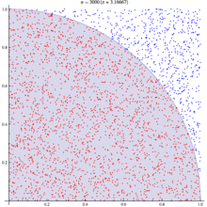




Results
Group of 6 students tried grid with our installation
Get $π$ number by using the Monte Carlo method
SE
3.1415
3.141592…

Slide 8
Thank you for attention

