Slide 1

LHC Interlock BPM
BE-BI-QP

Slide 2
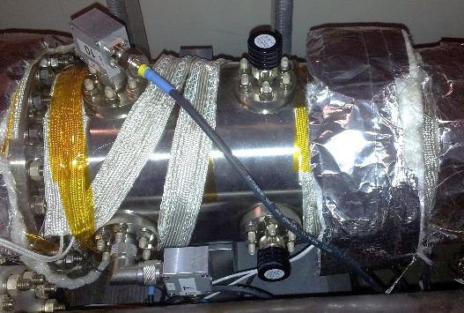
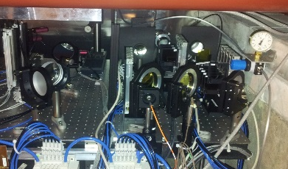
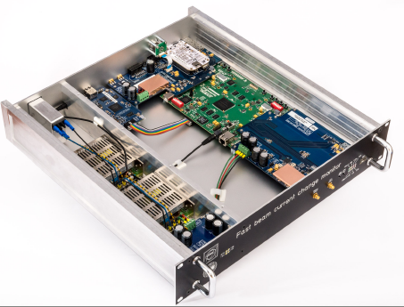
Outline
Status of Interlock BPMs (IP6)
  Performance & Limitations
  Failure scenario
New hardware system under design
  Proposed architecture
  Reviewing Specifications

Slide 3
Status of Interlock BPMs
Hardware modifications during LS1 to improve the dynamic range of the monitors
  New 50Ω terminated strip-line pick-ups and low-pass absorptive filters (suppressing signal reflections)
New Firmware / FESA3 / expert GUI to improve the diagnostics
  Increased Post-mortem buffer memory with beam positions of all bunches during the 154 last turns
Improved long-term stability with BPM acquisition electronic in water-cooled racks

Slide 4
Interlock BPMs
New dynamic ranges
Run 1 Run 2
High Sensitivity 1.5E9 – 3E10 1.5E9 - 1.3E11
Dynamic range improved by more than 10dB
Low Sensitivity 2E10 - >2E11 1.5E10 - >2E11
This value is an Operational choice / compromise
! System limited in sensitivity to 1.5E9 charge !

Slide 5
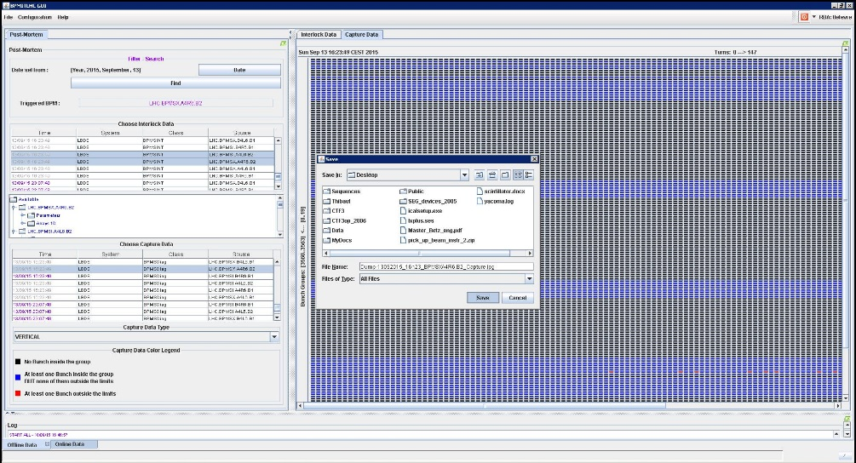
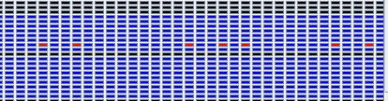
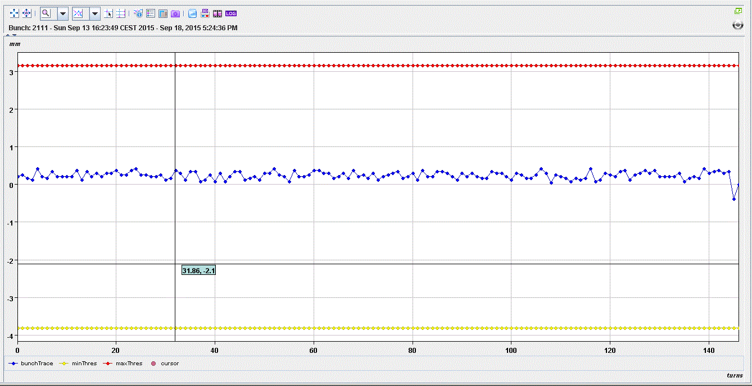
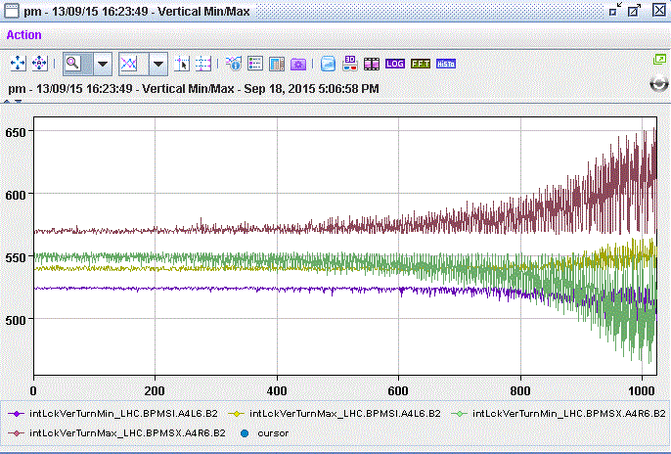
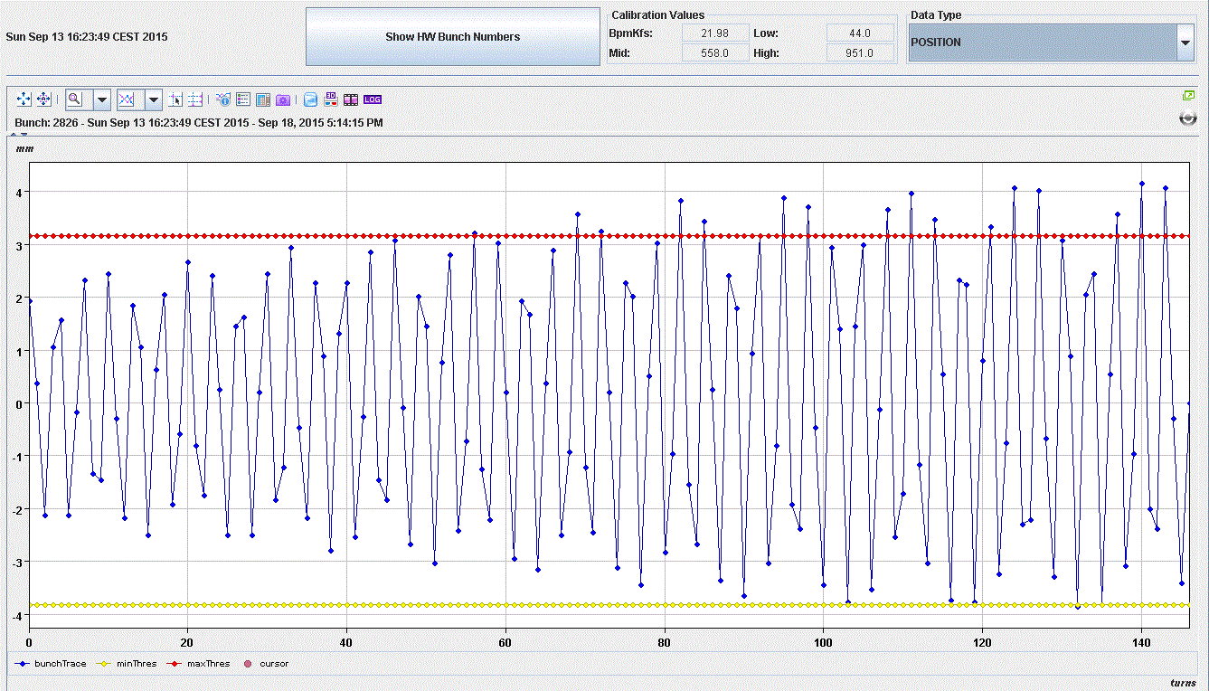
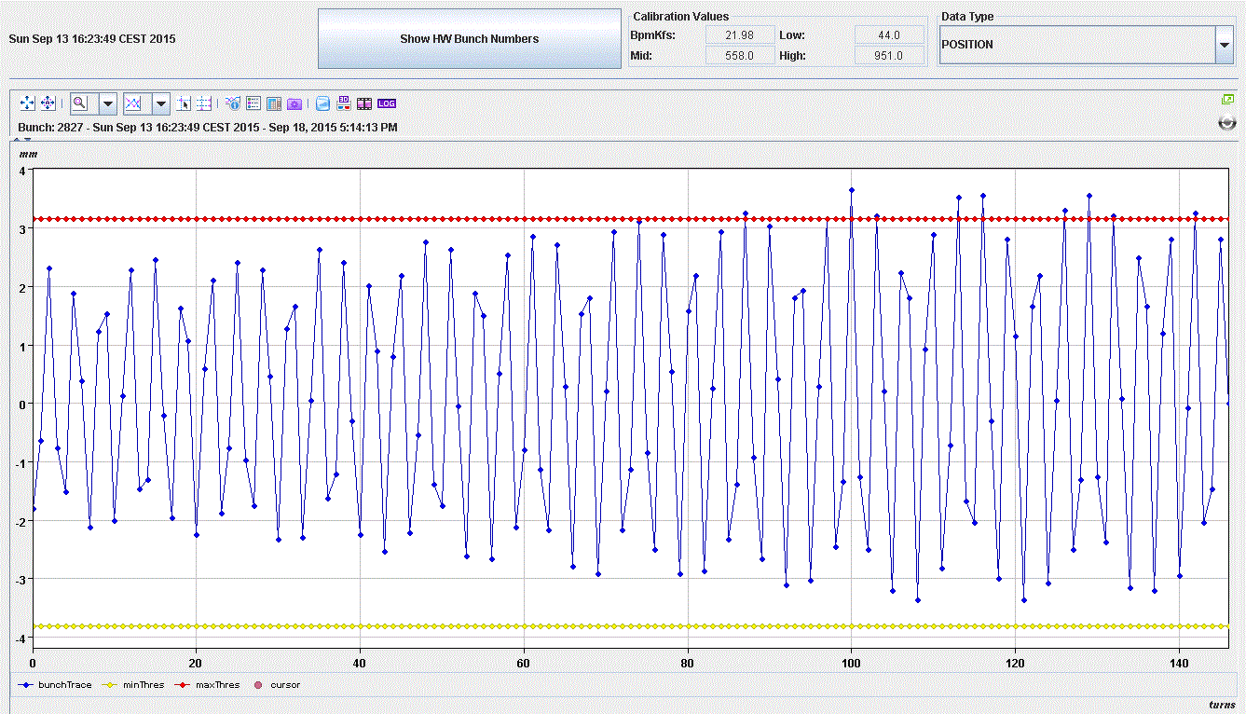
Interlock BPMs
Post-mortem data
Storing the last 154 turns of all bunches (limited by on-board memory)
    Can be used to see which bunches become unstable
Storing min/max positions for the last 1024 turns
    Can be used to measure rise time of instability
Bunch 2111
Bunch 2826
Bunch 2827

Slide 6
Interlock BPMs
Improving Sensitivity by adding an amplification stage at the input of the analogue circuitry
  Initiated by a request from LHC-heavy ions team
  System designed, built, installed, removed, forgotten…(in 5weeks)
    24dB improved sensitivity - down to 1E8 charges
    Implementation could be improved to still allow a full system redundancy if necessary…..probably not ?

Slide 7
Interlock BPMs
Failure scenarios
  If both FE power supplies died during a fill, the system do not see beam signals anymore but it is understood as if the beam was not present – no interlock fired
  Mitigated by a software check/interlock

Slide 8
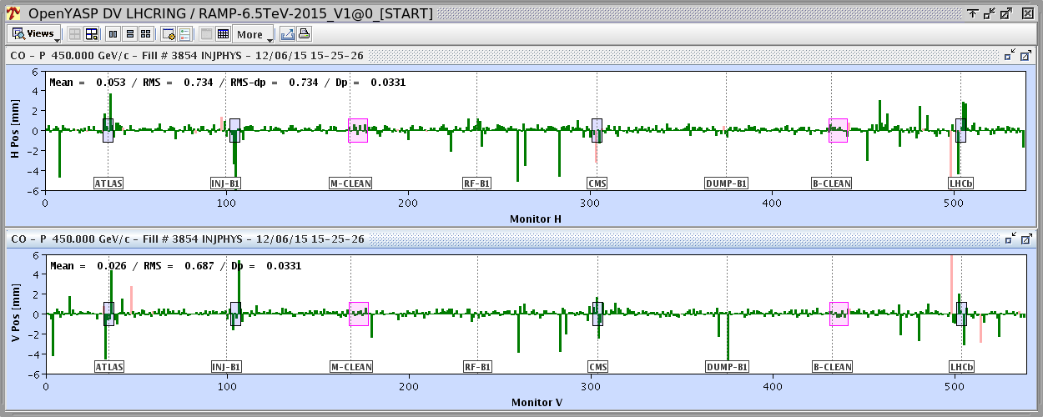
Interlock BPMS
Issues with Doublets (1/2)
BPM electronics not designed to work with bunch spacing shorter than 25ns (worst case for 5ns !)
  Orbit data with doublet is distorted (RMS at 700um)

Slide 9
Interlock BPMS
Issues with Doublets (2/2)
BPM electronics not designed to work with bunch spacing shorter than 25ns (worst case for 5ns !)
  B/B Offset and fluctuations up to 2 mm
No solution in the short term, apart from increasing the limit
  Launched the development of a new B-b-B electronic read-out

Slide 10
LHC Interlock BPM challenge
High dynamic range
  Typical 2e9 – 3e11
Bunch-by-bunch observation
  ”normal” bunch spacing 25 ns.
  ”scrubbing” bunch doublets 5 ns.
High reliability
  Part of the technical interlock
  No false beam dumps allowed
Moderate requirements in terms of resolution, etc.
  ~50 μm range

Slide 11
BPM Signal Processing Schema
Time-multiplexed BPM electrode signal processing (based on DESY HERA-e principles)
BPF
& LPF
Att
position data
B
A
+
ADC
DDC
Ctrl
CLK & Timing
~10 ns delay-line
Single channel, time-multiplexed BPM electrode
signal conditioning and processing schema
  Drifts, aging, LF noise, and many other unwanted effects cancel
  ADC and DDC require min. 10 – 1200 MHz BW, min. 2.5 GSPS
    Acquisition using 3.2GSPS, 12bit commercial mezzanine on BI custom VME board (VFC)
  Dynamic range needs to cover SB intensity range,
  and sufficient beam position range, typically a total of 64 dB:
    ~44 dB for the bunch intensity, e.g. 2e9 – 3e11
    ~20 dB for the beam position, -12.7 – +12.7 mm (BPMSX: 0.79 dB/mm)

Slide 12
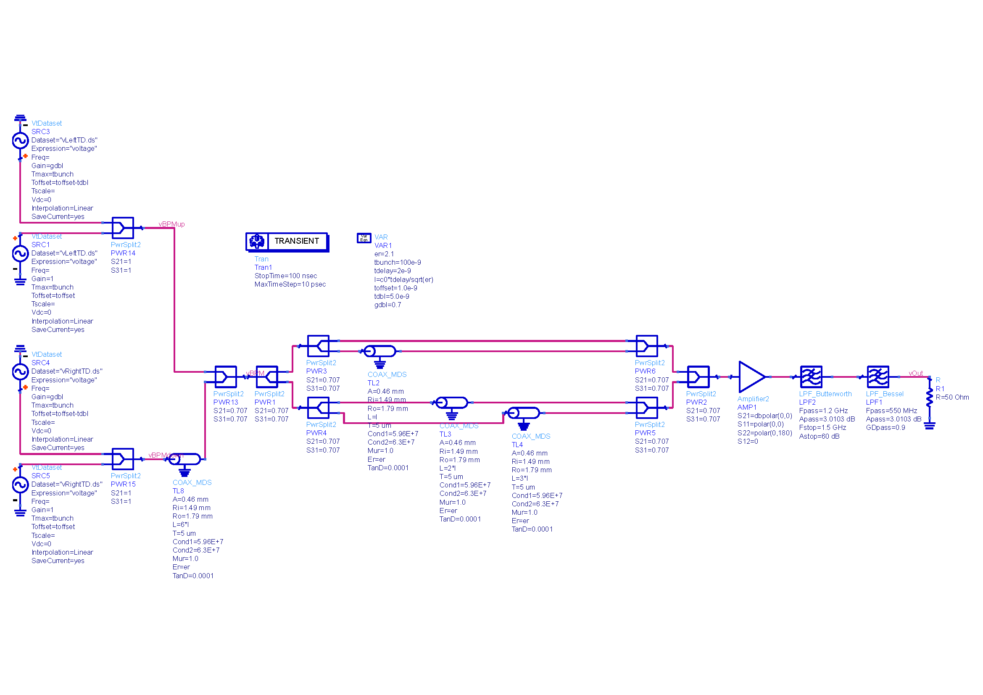
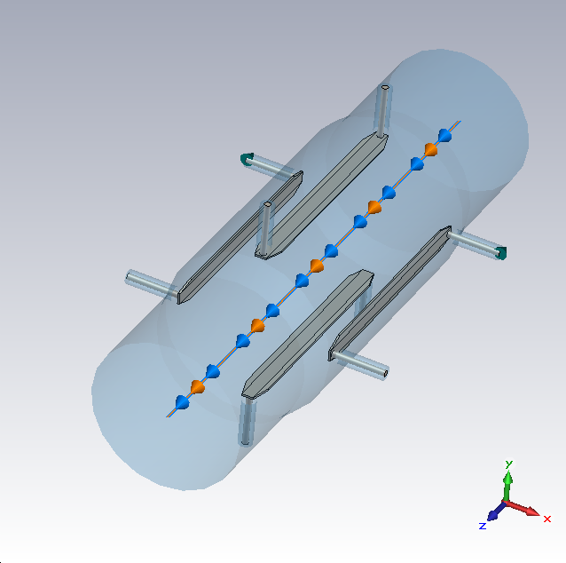
EM and Analog Circuit Simulation
BPMSX
Wakefield solver
1e9 protons / bunch
σ = 50 mm
hor. beam offset = 1 mm
Circuit simulation
based on EM simulation
pickup signals
delay-line
4-stage analog FIR filter
(based on delay-lines)
1.2 GHz Butterworth LPF
(anti-aliasing)
550 MHz Bessel LPF
(cable dispersion)
beam pickup
with or w/o doublets
(70 % intensity)

Slide 13
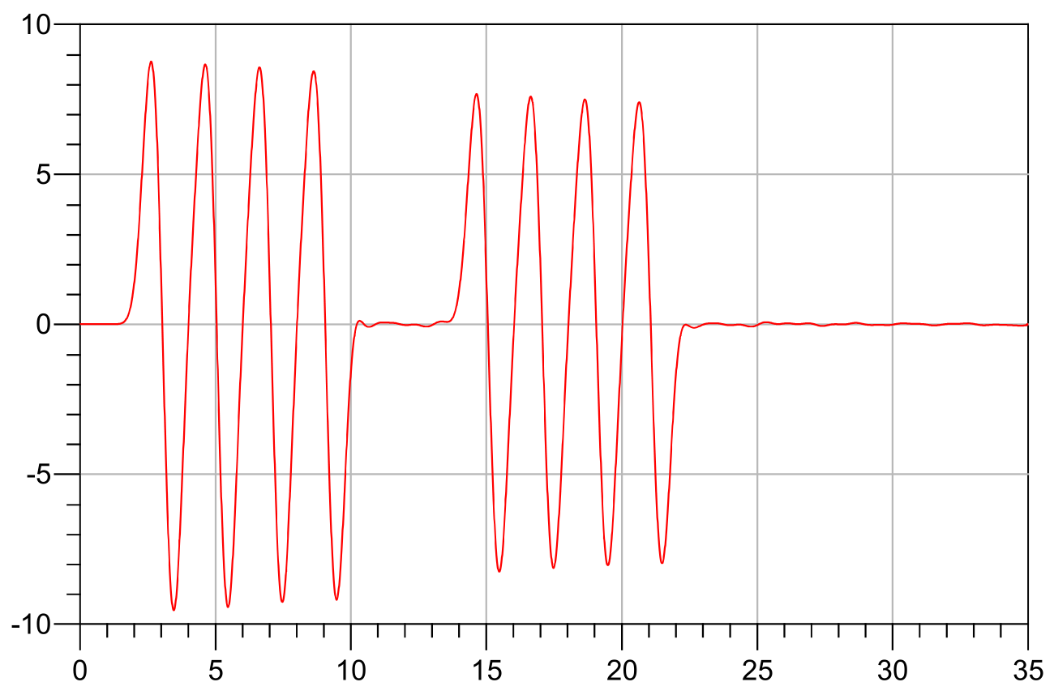
DSP Simulation
Signal Generation
Algorithm Under Test
Results Evaluation
Based on output from simulation (100 GSa/s)
Square Averaging (AVG)
Graph generation
Results save
Frequency Domain Analysis (FDA)
Amplitude quantization
Modifiable: amplitude, sampling phase, noise
Single electrode, single bunch amplitude extraction
Notes:
In MATLAB
Start from easy case (single electrode, single bunch)

Slide 14
Sampling Phase Sensitivity
500 signals tested, full amplitude, no noise
Sampling phase tested: 0-2 samples
Nearly no sensitivity observed
Notes:
Full amplitude = 0.3 V (i.e. 0.6 V p-p, ADC full scale = 0.725 V)

Slide 15

Noise Sensitivity
5000 signals tested, full amplitude, random sampling phase $\left\langle 0;\right.\left.2\right)$
SNR tested: 13 values from 20 to 80 dB

Slide 16
Design of a new acquisition system for Interlock BPMs
Review specifications
  System would provide both position and intensity of each bunches
    Could we use bunch intensity to level the fault count ?
  Energy dependent threshold ?
    Allowing relaxed triggering conditions at injection energy
    Drawback : System dependent on receiving external information from BST
  Necessity for more beam diagnostics / XPOC / Postmortem buffer
    There will be more memory available ….

Slide 17
Conclusions
Interlock BPMs have been working reliably in 2016
  No modification foreseen during this EYETS17/18
New system under development to cope with known limitations and adding new functionalities
  Compatibility with doublet bunches operation
  Information of Bunch intensity
  Larger signal processing capability and larger memory
Prototyping is advancing well
  Good timing to review the specifications
  Possible test with beam (SPS/LHC) during Summer/Fall 2017

Slide 18
Spare Slides

Slide 19
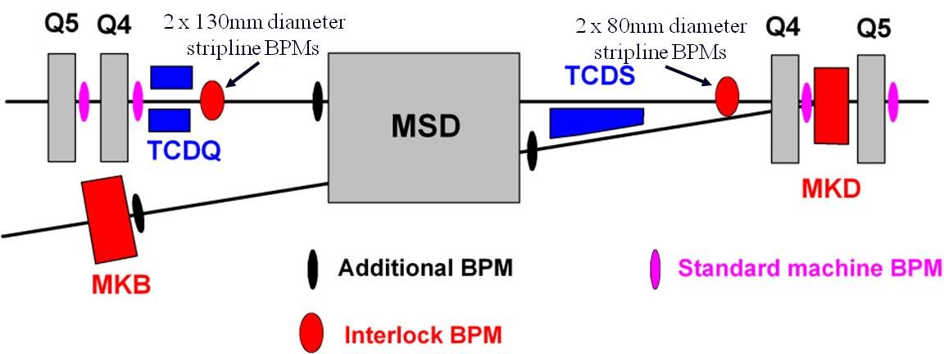
Dump Channel
BPMSI (.A/.B)
BPMSX (.A/.B)
The main aim of these BPMs is to avoid large orbit offsets leading to high losses on the septum protection during a dump

Slide 20
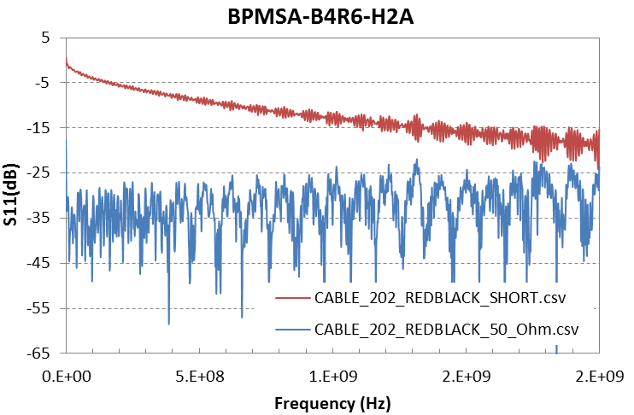
BPMs Reflections
LPF BW
> 20dB
More than a factor 10 improvement on the Pick-up

Slide 21
Reflections in time domain
Shorted strip-lines reflections
Measurement: -27 dB
Simulation: -34 dB
Terminated strip-lines with LPF:
Simulations: <-46 dB

Slide 22
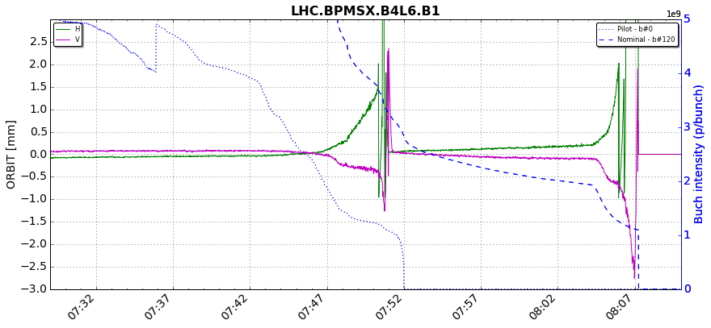
LHC IBPM Re-commissioning
Scrapping one Pilot and one Nominal in High sensitivity mode
Degradation

Slide 23
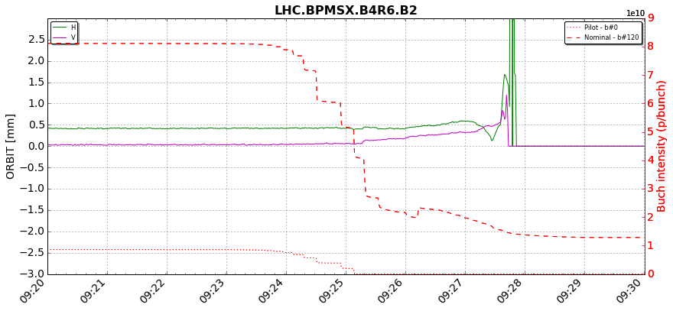
LHC IBPM Re-commissioning
Scrapping one Pilot and one nominal in low sensitivity mode
The pilot is not detected by the system
Interlock level

Slide 24
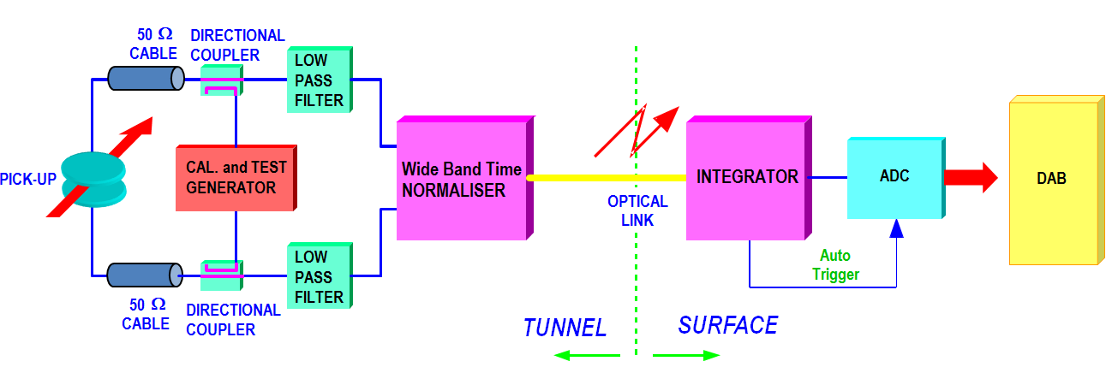
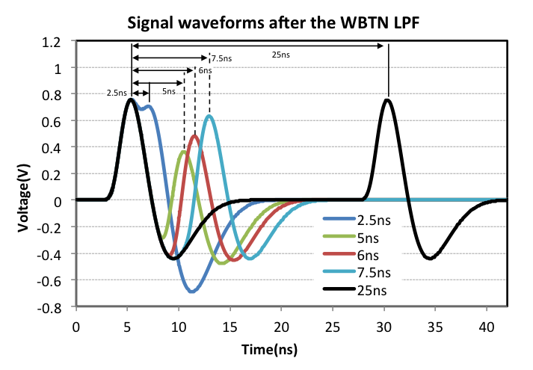
LHC BPM - WBTN
Amplitude to Time conversion
70MHz LPF at the input of the electronic (bunch length independent)
Depending on the bunch spacing , the signal will overlap in different ways.
The system will provide a single measurement for bunches which are spaced by less than ~20ns.

Slide 25
Scrubbing doublets
Beam “simulator” tests (beam signal replaced by pulse generator)
May be possible to test on SPS with beam

Slide 26
Doublets simulations 1
Bunch 1 and bunch 2 with same position
Y scale for arc BPM
Multiply time 2.5 for BPMS

Slide 27
Doublets simulations 2
Bunch 2 always centred

Slide 28
Simulations with Pspice
Bunch 1 and 2 can have different intensities : ‘(Un)Balanced Doublet’
Normalizer model circuit and signals are “ideal”
Realistic Bunch length
(arc BPM ±2.4mm)
(BPMSB ±6.5mm)
(arc BPM ~-24mm)
(BPMSB ~65mm)
Note : Half Aperture of arc BPM = 24mm
Half Aperture of BPMSB = 65 mm

Slide 29
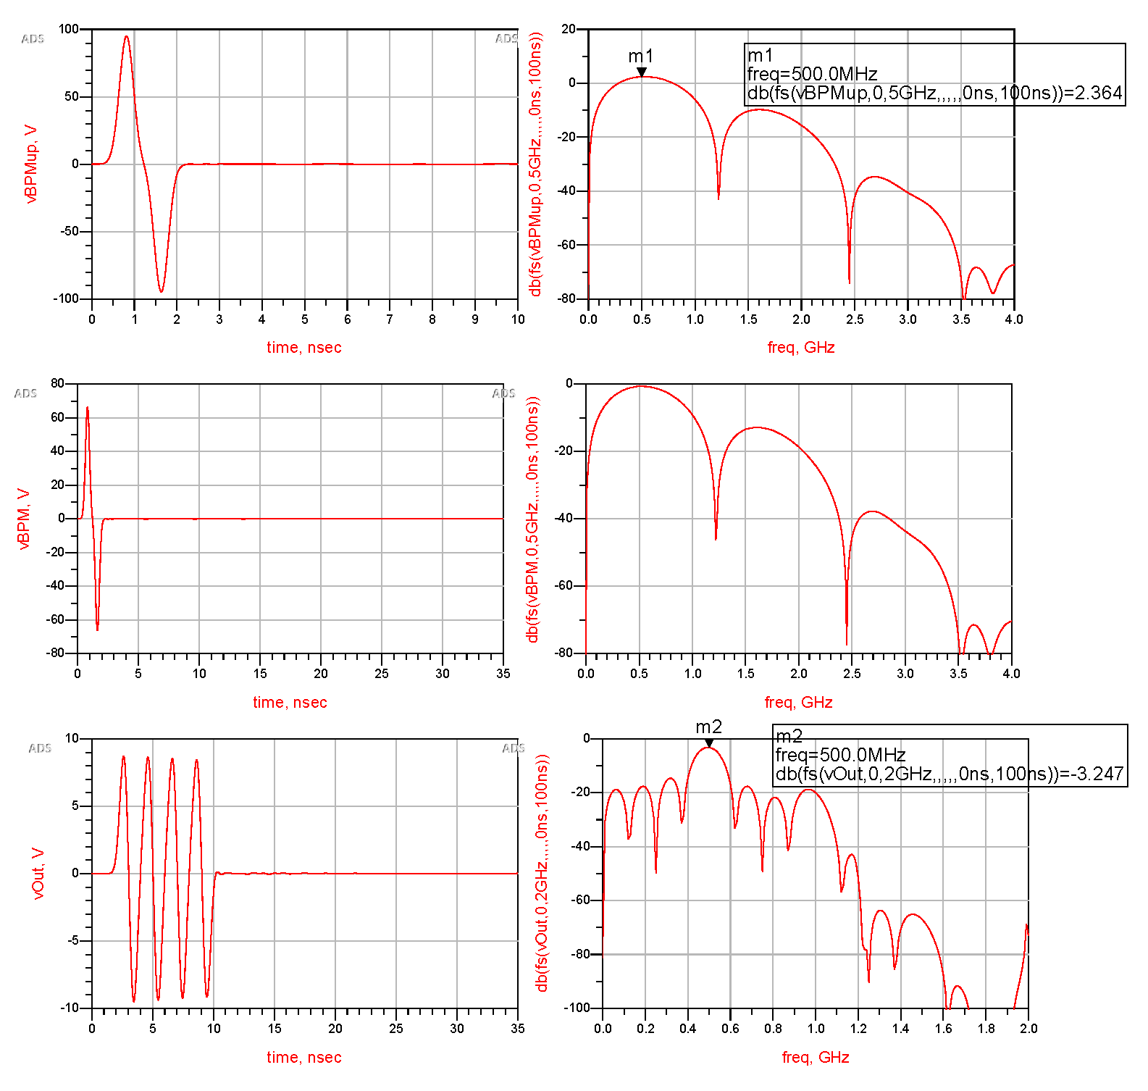
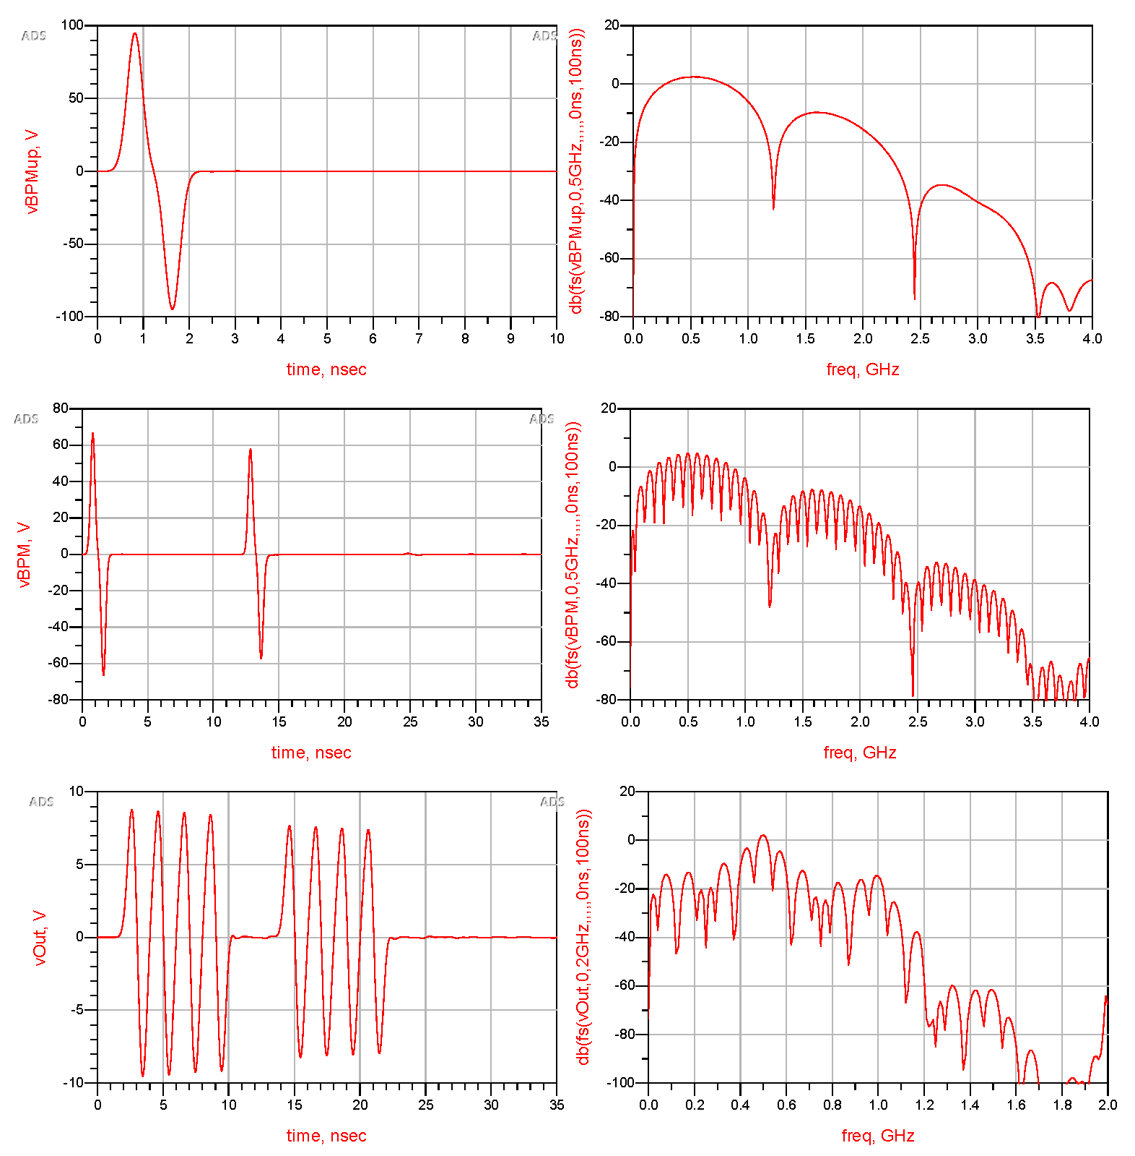
Simulation Results
single BPM electrode, single bunch
both BPM electrodes, single bunch
time-domain
frequency-domain
time-domain
frequency-domain

Slide 30
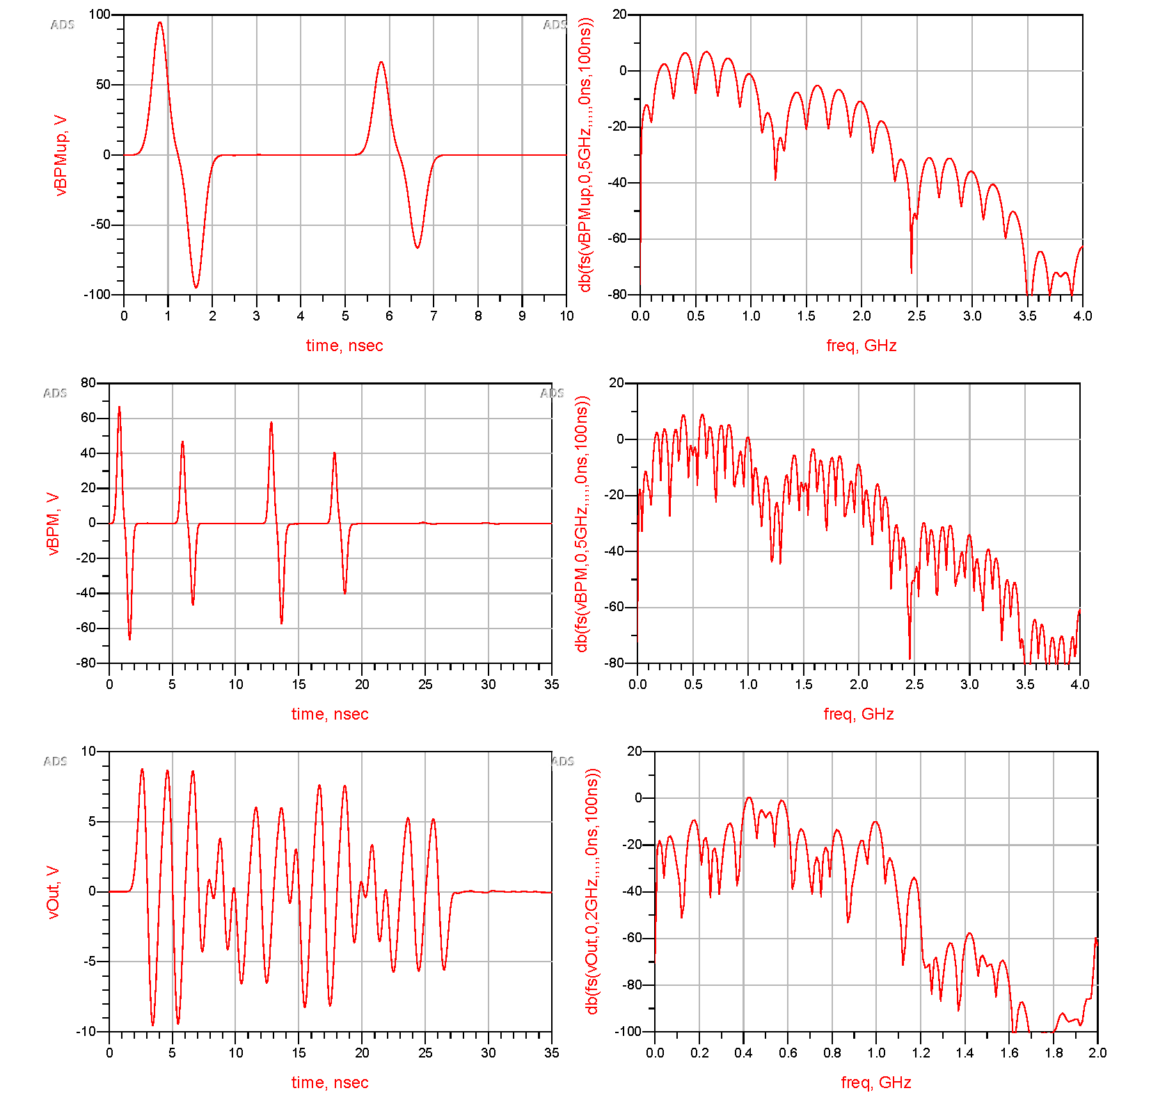
Simulation Results, cont.
time-domain
frequency-domain
both BPM electrodes,
doublet bunch 1 & 2
1
2
Simulation hints feasibility, BUT:
  1.2 GHz analog BW
  Minimize reflection effects in the analog sections
    Sufficient signal levels!
  State-of-the-art ADC and digital section
1
2
1
2
1
2
1
2

Slide 31
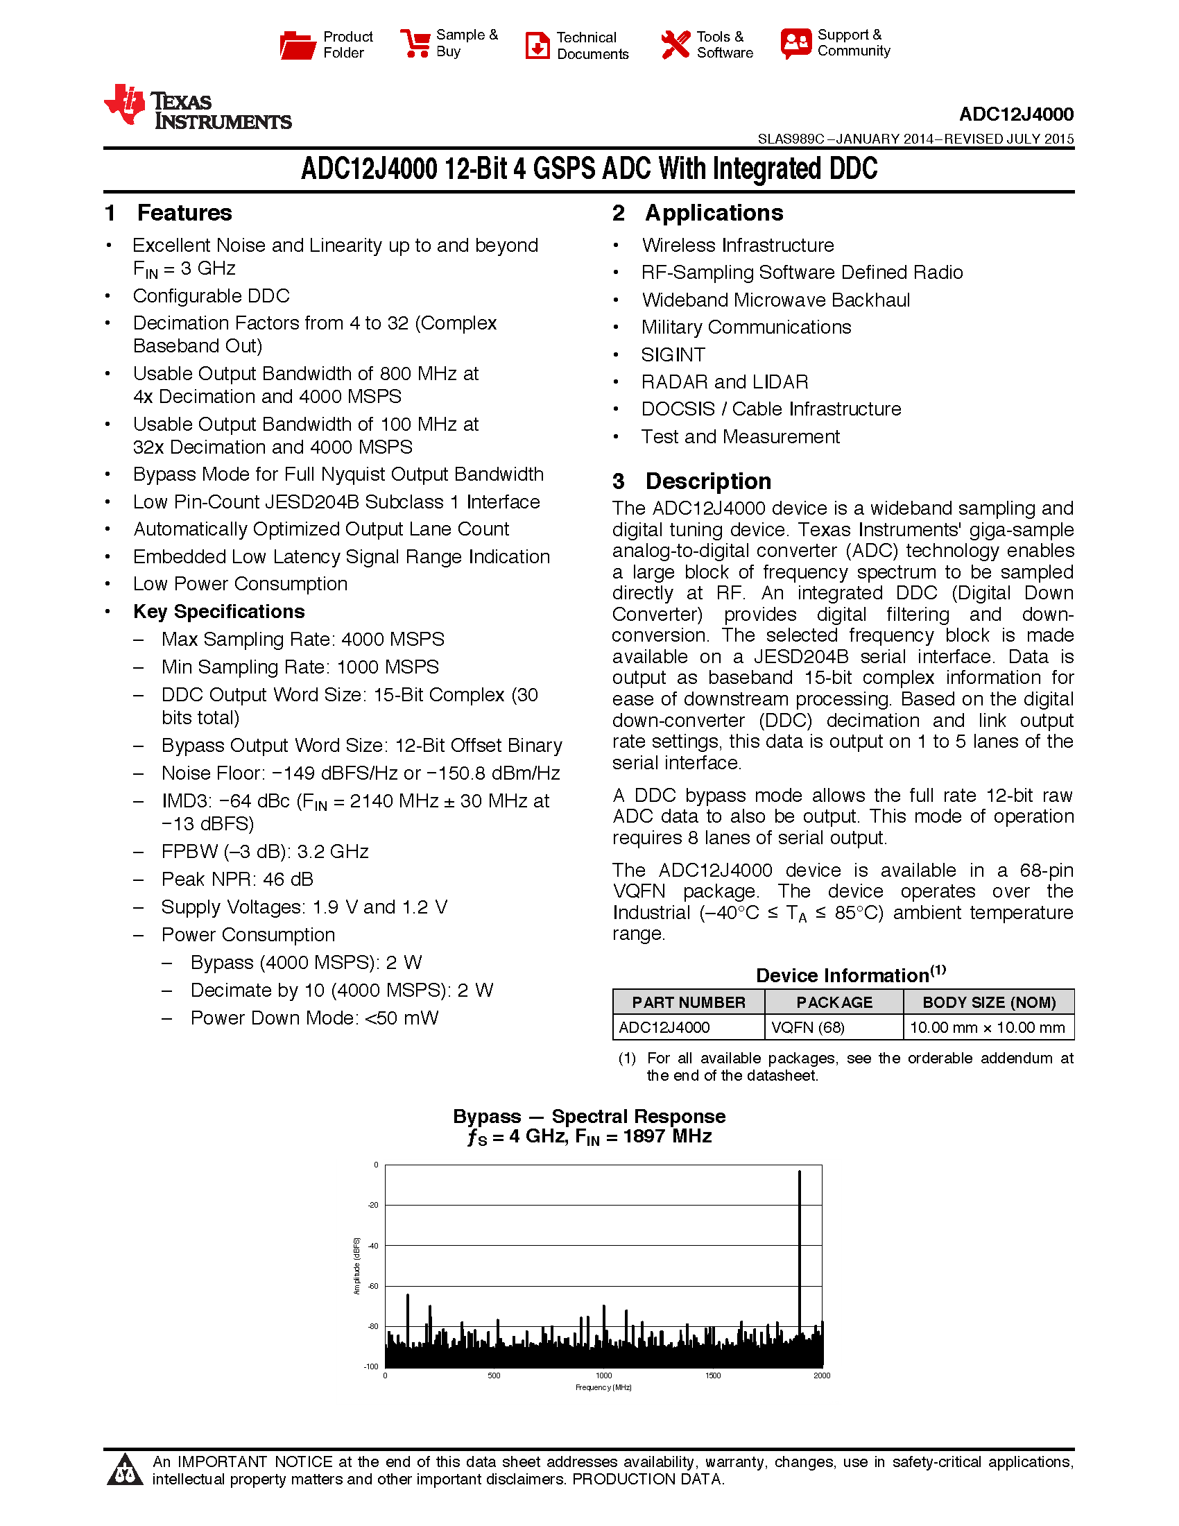
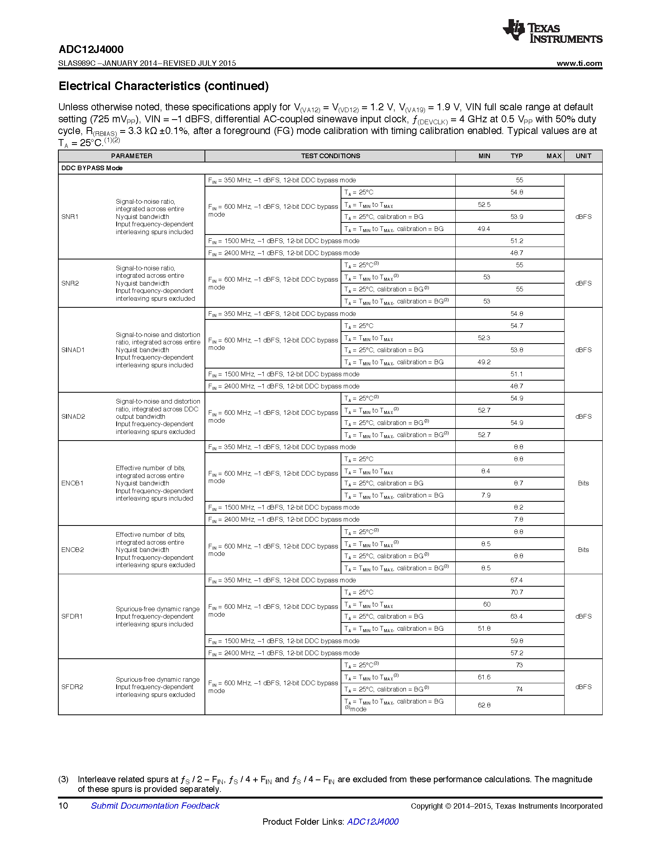
12-bit, 4 GSPS ADC
analog BW > 3 GHz
4 GSPS
60 dB @ 1.5 GHz

Slide 32
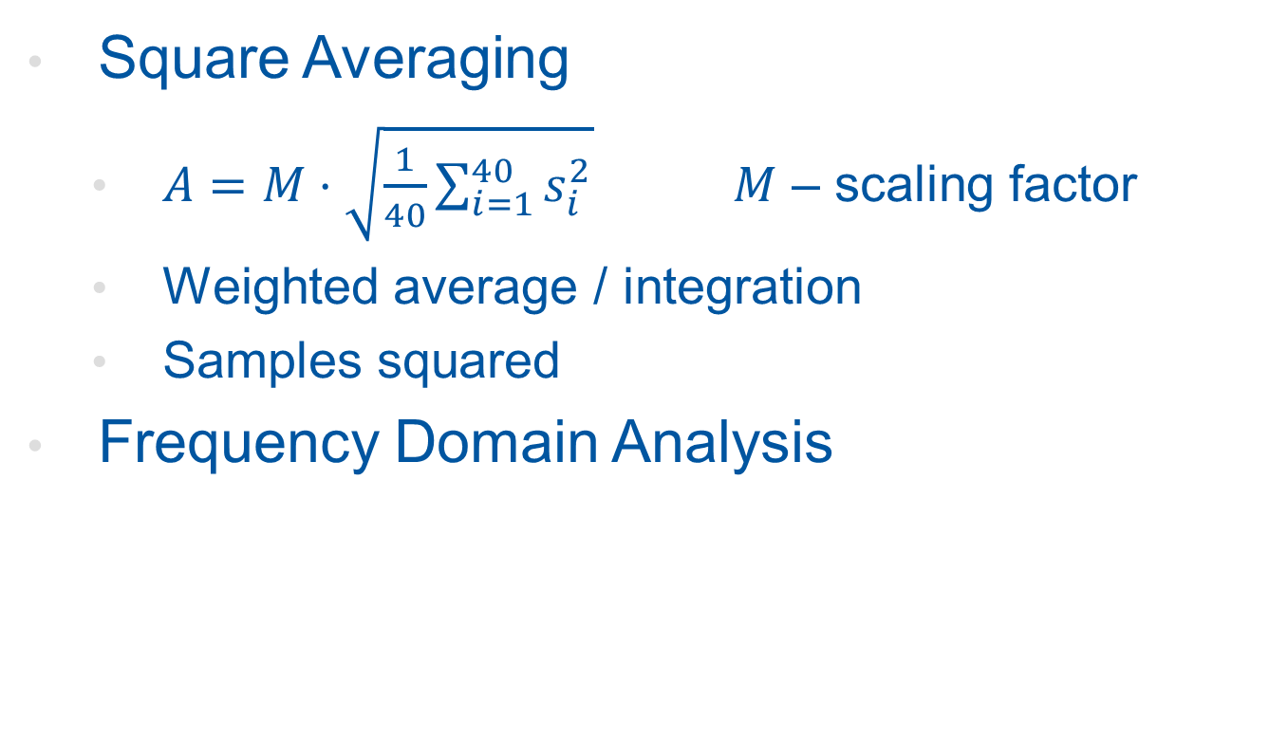
DSP Algorithms Being Studied
Square Averaging
  $A=M⋅\sqrt{\frac{1}{40}\sum_{i=1}^{40}{s_{i}^{2}}}$ $M$ – scaling factor
  Weighted average / integration
  Samples squared
Frequency Domain Analysis
Average of 3 points around carrier
is calculated → amplitude of original signal

Slide 33
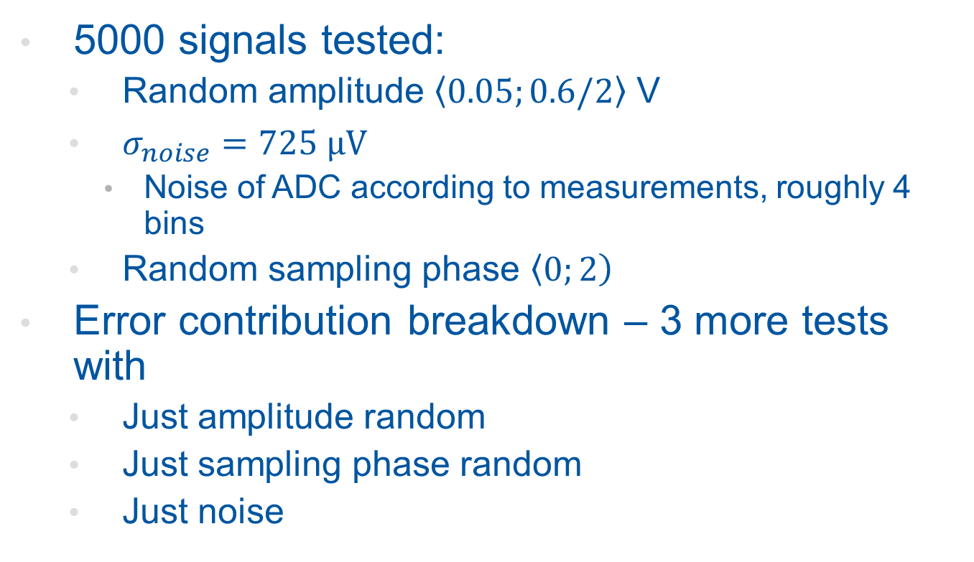
Monte Carlo Error Analysis
ADC full scale input voltage: 0.725 V
5000 signals tested:
  Random amplitude $\left\langle 0.05;0.6/2\right\rangle$ V
  $σ_{noise}=725 \text{μV}$
    Noise of ADC according to measurements, roughly 4 bins
  Random sampling phase $\left\langle 0;\left.2\right)\right.$
Error contribution breakdown – 3 more tests with
  Just amplitude random
  Just sampling phase random
  Just noise

Slide 34
Relative Error
Test | AVG |  | FDA
 | μ | σ | μ | σ
MC Error Analysis | 0.7 . 10⁻⁵ | 16.48 . 10⁻⁴ | 4.5 . 10⁻⁵ | 17.04 . 10⁻⁴
Amplitude random | -7.6 . 10⁻⁵ | 1.12 . 10⁻⁴ | 4.7 . 10⁻⁵ | 1.19 . 10⁻⁴
Time shift random | -5.1 . 10⁻⁵ | 0.57 . 10⁻⁴ | 4.7 . 10⁻⁵ | 0.51 . 10⁻⁴
Noise | -13.4 . 10⁻⁵ | 6.61 . 10⁻⁴ | 0.6 . 10⁻⁵ | 6.95 . 10⁻⁴

