Slide 1


ALICE internal and external network requirements @T2s
WLCG Workshop 2017
University of Manchester
20 June 2017
Latchezar Betev

Slide 2
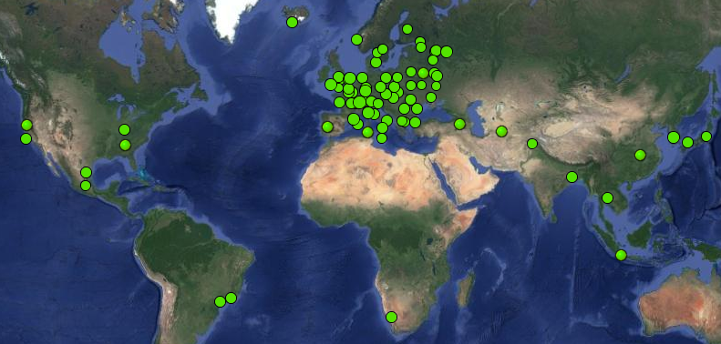

The ALICE Grid today
54 in Europe
3 in North America
9 in Asia
1 in Africa
2 in South America
T0+ 8xT1s+59xT2s

Slide 3

Average CPU count
~130 CPU cores - April 2017
60% @T0+T1s, 40% @T2s

Slide 4
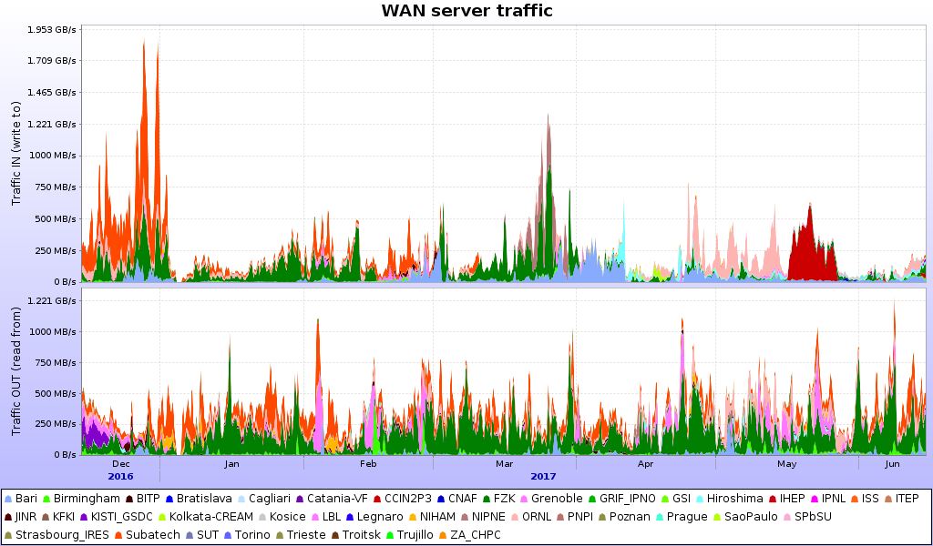
WAN @T2s
4PB = data traffic from external sites (to local SE and clients)
6PB = data traffic to external sites and off-Grid export
(to remote SE + Grid and non-Grid clients)

Slide 5
WAN Numbers @T2s
Total WAN traffic are 1/11 of LAN traffic
  WAN total T2s = 650MB/sec => 12.5KB/sec/core (52K cores)
Our ‘advisory rule’ for T2s is “100Mb WAN network per 1K cores”
  Usually the available bandwidth is superior to the above
  ~Independent of T2 role – a diskless T2 has to export ~2x the produced data; T2 with an SE exports one copy and accepts copies from other centres.

Slide 6
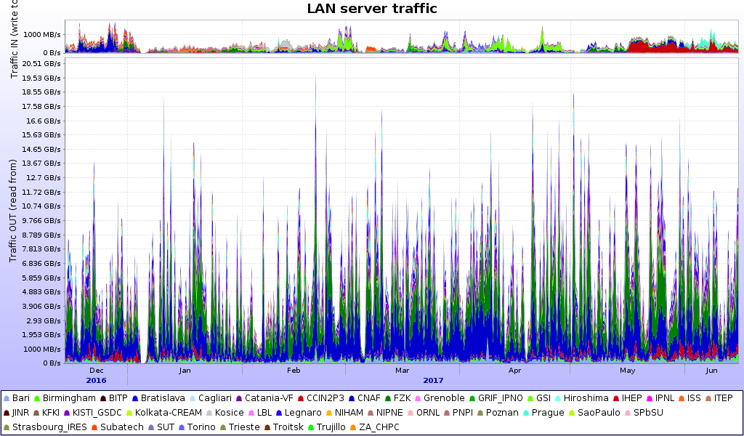
LAN @T2s
7PB = writing to local SE
100PB = reading from local SE
Note the spiky structure – these are analysis trains
running during the night (most of the load on the SEs)

Slide 7
LAN Numbers @T2s
LAN sustains by far the highest traffic (jobs go to data)
  About 2% of data is read remotely (for example, local SE issue)
  90% of the LAN traffic is analysis, 10% is local + remote clients write (for a T2 with SE)
  Diskless T2s - LAN=WAN traffic
Figure of merit (for 85%+ CPU efficiency): 2.5MB/sec/core from local SE
Remote access penalty
  RTT is introducing efficiency penalty of ~15% per 20ms
  Remote read is feasible for small data samples and as failover

Slide 8
Role of tiers
T0/T1/T2s – only differentiation is RAW data storage and processing (T0/T1s)
All tiers with storage do MC and analysis
Diskless T2s can do only MC, all data is exported to close T0/T1s/T2s

Slide 9
Role of network monitoring
ALICE is using in-house measured network map
  Through all-to-all VO-box periodic bandwidth tests
Used to determine the best placement for data from every client (Storage Auto-discovery) in real time
  Based on network topology
  Traceroute/tracepath for RTT (bidirectional)
  1 TCP stream bandwidth tests (like jobs do)
  => Distance metric function of the above measurements plus storage availability and occupancy levels

Slide 10
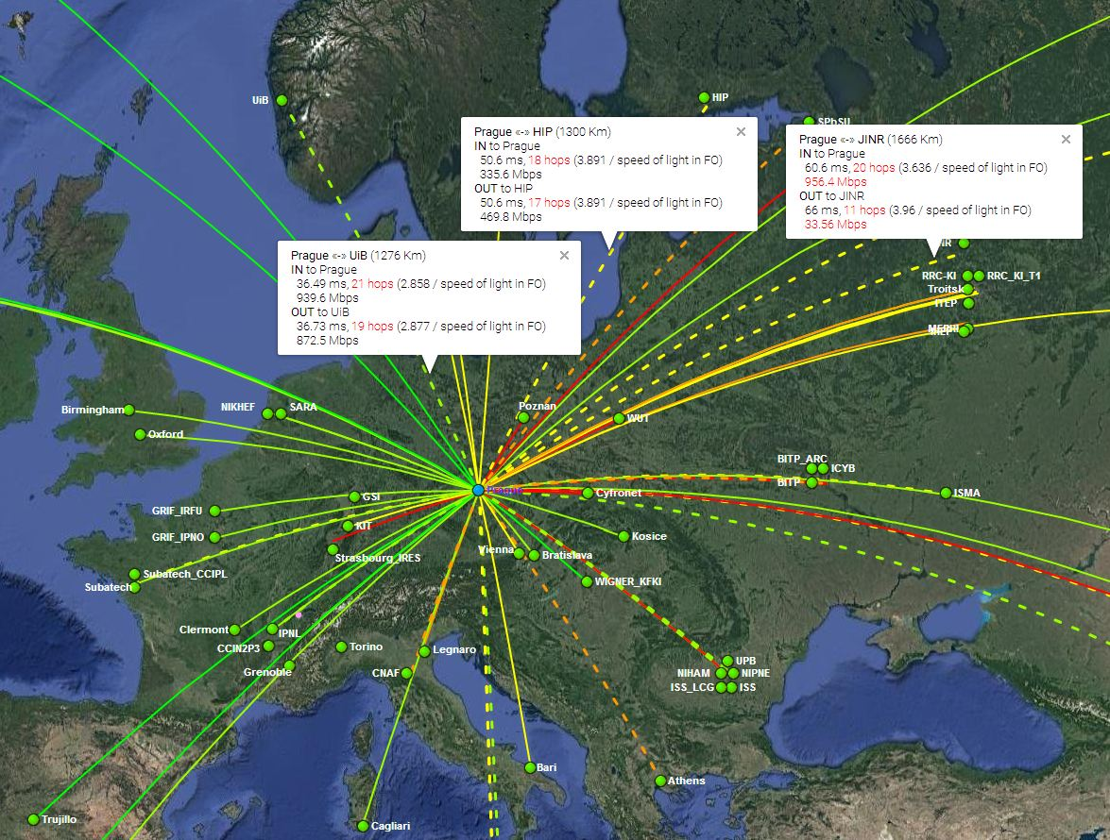
Network paths

Slide 11
Network tuning
Comprehensive WAN network picture is essential for efficient data transfers and placement
ALICE depends on and strongly encourages the full implementation of LHCONE at all sites
  Plus the associated tool (like PerfSONAR), properly instrumented to be used in the individual Grid frameworks
Huge progress (Thank you network experts!)
  Number of sites in well-connected parts of the world still have to join
  Entire regions with high local growth of computing resources, in particular Asia, require a lot of further work

