Slide 1
Sharing Information, Dissemination and Training
“This is not a presentation”

Slide 2
Why this matters
In the next 10 years our community has to go through deeper changes than the transition from FORTRAN to C++ and local batch to the Grid!!
  Yes the world that we know is coming to an end
This requires to rewire many brains!!
  And wire new brains correctly from the start
To do this we need to know what we want to put into these brains.

Slide 3
What is the problem?
There is a lot of knowledge in our community
  Vectorisation
  Memory management
  Efficient numerical code
  The latest machine learning techniques
  Running sites efficiently
  I/O analysis and tuning
  Network tuning
  Parallelisation of code
  Performance analysis tools
  Advanced new features of C++
  Computing on FPGAs .....
You name it, we’ve got it !!!!!
Unless the person who knew it has left the community ........

Slide 4
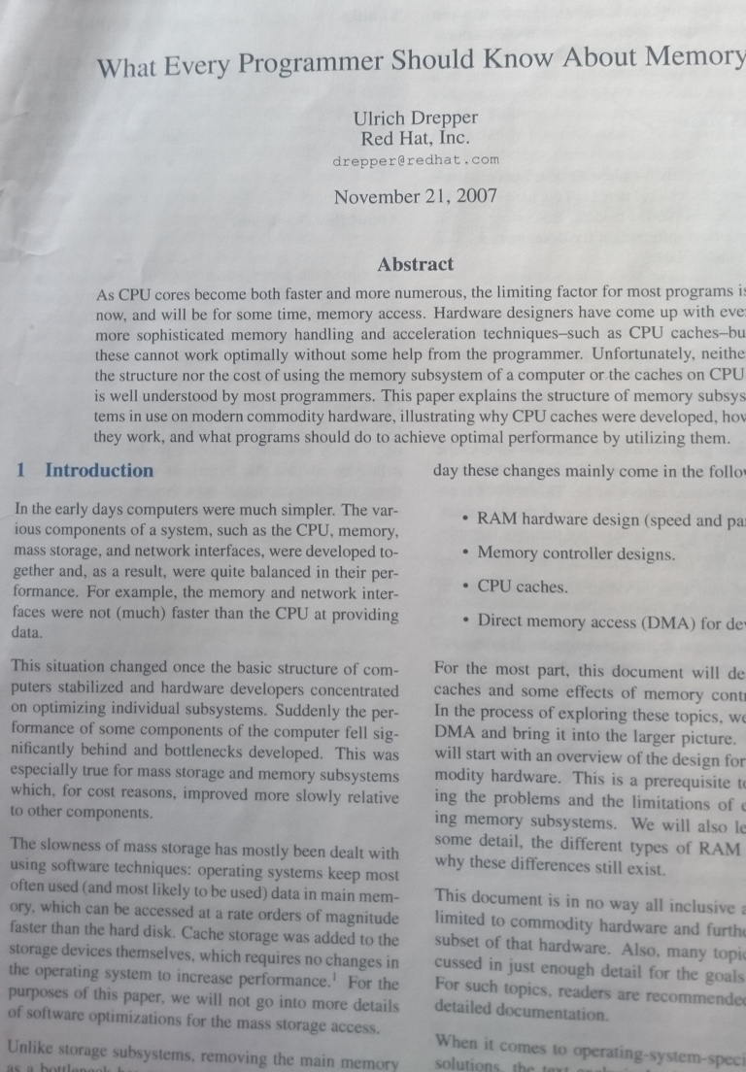
What is the problem?
The knowledge is not accessible in one place
  Presentations at various meetings, conference schools etc.
  Often from experts for experts
Often in one or two people
  Who are not always ”easy” → less persistent
Often not at the right level:
  what every programmer should know on memory.... 100+ pages dense text
  Then you are ready for the next...

Slide 5
Tribes ...
Online / offline
Experiment A,B,C,D
Software / Operations / Fabric
WLCG:

Slide 7
Summary
As a community we have forgotten more knowledge about computing efficiency than most communities ever had!!!
A lot of knowledge is fragmented
Almost impossible to tell what is relevant and what isn’t

Slide 8
When I was young everything was better!
C++ was new and Paul Kunz the prophet from SLAC
  C++ for Particle Physicists “just enough"
Rene Brun gave us ROOT for object persistency and everything else
There was GEANT
For UNIX you had 3 books
  + 2 from Stevens
“canonical curriculum” at the CERN School of computing
Very much in the form of recipes.....

Slide 9
Vision
Develop a culture with a strong focus on efficiency
Bring experts from ALL areas together and develop a new curriculum
  One version for new members
  One for updating old hands
Collect information that has been “blessed” in a “library” (QA for information like stackoverflow.com)
Make R3 experience from LHCb and ALICE accessible
This cannot be done by HSF or HEPIX alone
  Fabric and applications can be only separated at a cost → which we can’t afford....

Slide 10
How?
Tell me!!!!

