Slide 1

WP14 Coordination meetings
C. Bracco and B. Goddard

Slide 2
Outlook
WP14 Scope
WP14 coordination meetings
  Periodicity
  Core team
  Milestones
  Status
Overview on present estimates for:
  Budget and Manpower
  Make or buy plan

Slide 3
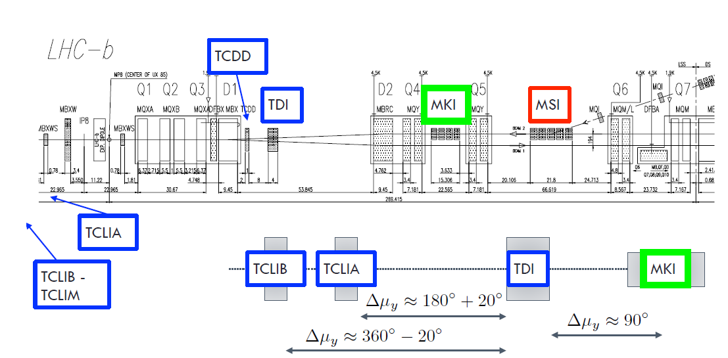
WP14 Scope
Scope: upgrade of the LHC injection and extraction system to adapt to increased beam brightness and intensity
Injection system
MKI: impedance, vacuum and e-cloud improvements. TE-ABT
TDIS: upgraded with a new version, IP2 & IP8. EN-STI
D1: shielding insert in D1, IP2 and IP8. TE-MSC
Diamond BLMs. BE-BI
TCLIA: displace toward IP (IP2 only). EN-STI

Slide 4
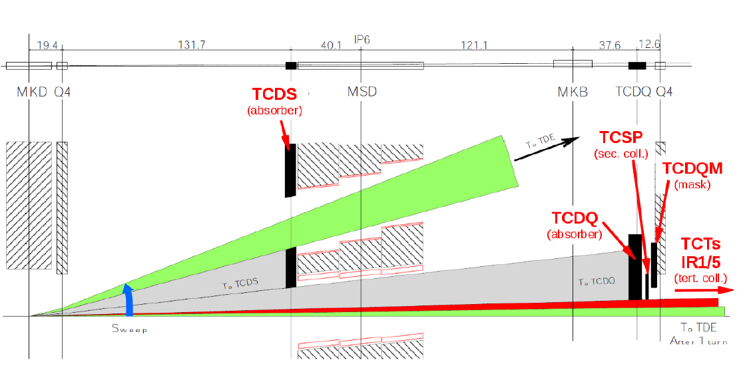
WP14 Scope
Scope: upgrade of the LHC injection and extraction system to adapt to increased beam brightness and intensity
Dump system
TCDS: upgrade with additional (third) module. TE-ABT
MKD: switch, triggering and controls upgrades. TE-ABT
MKB-TDE: additional dilutors or dump upgrade.
TE-ABT/EN-STI
TCDQ: performance validation (end 2016). TE-ABT/EN-STI

Slide 5
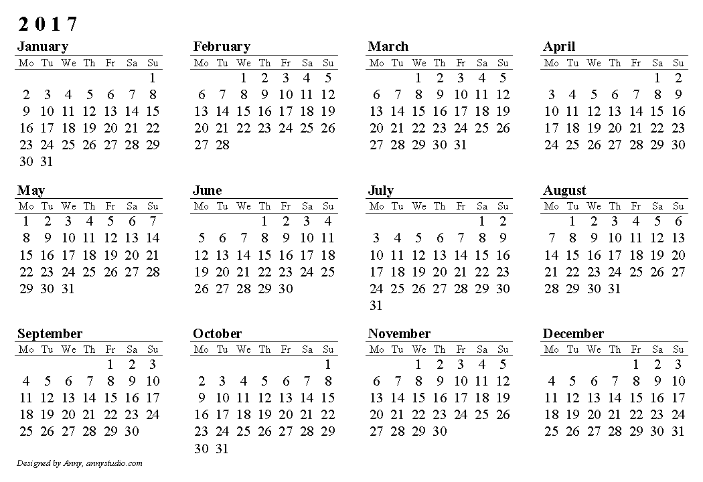
WP14 Coordination Meetings
Regular follow-up of WP14 activities with particular focus on equipment which has to be installed in LS2 (keeping an eye also on budget and manpower…)
Meeting every last
Tuesday in room
865-1-D17 at 10:30
Scientific secretaries:
  C. Wiesner
  M.I. Frankl
Indico Webpage: http://indico.cern.ch/category/5132/

Slide 6
WP14 Coordination Meetings
Core team
Baglin V. | Vacuum (TDIS, MKI, D1, TCLIA, TCDS, TDE)
Barnes M. | MKI
Borburgh J. | TCDS and TCDQ
Bracco C. | WP leader
Calviani M. | TDIS, TCLIA and TDE
Carlier E. | MKD/MKB controls
Ducimetiere L. | MKD/MKB HW
Frankl M. | EN-STI-FDA Fellow (TCDQ, TCDS and TDE)
Goddard B. | Deputy WP leader
Jones R. | Diamond BLMs
Lechner A. | FLUKA studies (D1, TDIS, TCDQ, TCDS and TDE)
Perillo Marcone A. | TDIS
Polzin T. | EN-STI-TCD fellow (TDE)
Wiesner C. | TE-ABT-BTP Fellow (MKD/MKB failures --> FLUKA team)
Information list
Atanasov M.
Bartmann W.
Carbajo D.
Fraser M.A.
Gilardoni S.
Lamas Garcia I.
Masi A.
Prin H.
Schwarz P.
Senaj V.
Weterings W.
Wollmann D.
Dedicated topics
O. Aberle (TCLIA)
P. Fessia (TCLIA, TDIS)
L. Gentini (TDIS)
G. Iadarola (TDIS)
J. Jowett (TCLIA)
W. Riegler (TCLIA)
B. Salvant(TDIS)
L. Vega (MKI)
V. Vlachodimitropoulos (MKI)
……
A detailed agenda will be sent in advance for each meeting!

Slide 7
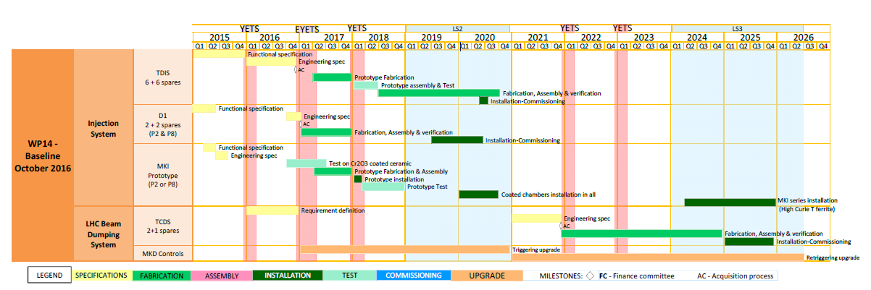
Milestones
Courtesy of Planning team
Main milestones:
Specifications for MKI, TDIS, D1 and TCDS ➔ end 2016
MKI coated vacuum chambers:
  Test short coated liner in the SPS (e-cloud monitoring) ➔ Q2 2017
  Prototype fabrication and assembly ➔ end 2017
  Prototype installation in the LHC ➔ YETS 2017-2018 ➔ tests with beam until end of Run II
  Installation of MKIs with coated chambers in LHC ➔ LS2

Slide 8
Milestones
Courtesy of Planning team
Main milestones:
TDIS:
  Prototype fabrication ➔ end 2017
  Prototype assembly and test ➔ Q2 2018
  TDIS series production ➔ Q3 2020 (spares)
  Installation in the LHC ➔ Q2 2020
D1:
  Implementation of absorber on spares ➔ 2017 (2 weeks)
  Installation in the LHC ➔ LS2 (2020, 6 weeks including vacuum conditioning)

Slide 9
Milestones
Courtesy of Planning team
Main milestones:
TCDS:
  Design ➔ 2021
  Procurement ➔ 2024
  Installation in the LHC ➔ 2025
MKD:
  Upgrade triggering unit ➔ end LS2
  Upgrade re-triggering unit ➔ end LS3

Slide 10
Milestones
Courtesy of Planning team
Main milestones:
TCDS:
  Design ➔ 2021
  Procurement ➔ 2024
  Installation in the LHC ➔ 2025
MKD:
  Upgrade triggering unit ➔ end LS2
  Upgrade re-triggering unit ➔ end LS3
Complete studies for TDE/MKB upgrade ➔ 2020 ➔ possible installation during LS3

Slide 11
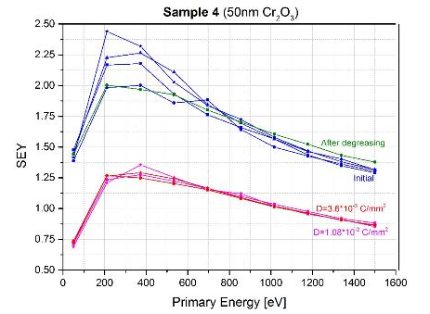
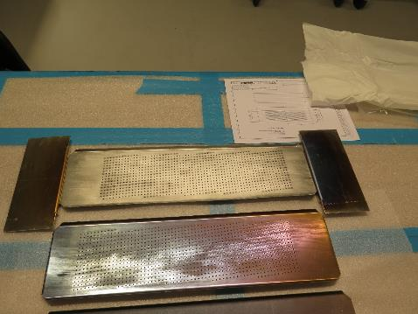
MKI
On time
The beam circulates inside the ceramic tube that hold the screen conductors
Present strategy aims to reduce the SEY of the ceramic surface
Cr₂O₃ coating could lower the SEY from 10 to ~1.4
and is expected to increase the surface flashover voltage.
Liners
Uncoated
Coated with Cr₂O₃
Cr₂O₃ coating development is ongoing with Polyteknik, Denmark. Two sets of liners have ben Cr₂O₃ coated. Planned to put one in the SPS during EYETS.
L. Ducimetiere, Chamonix Workshop 2017

Slide 12
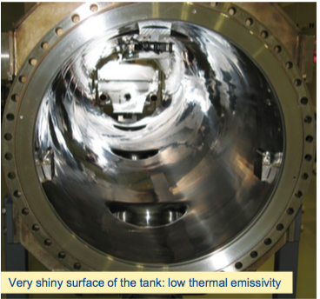
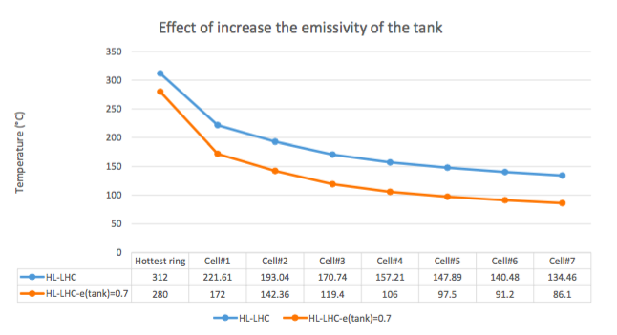
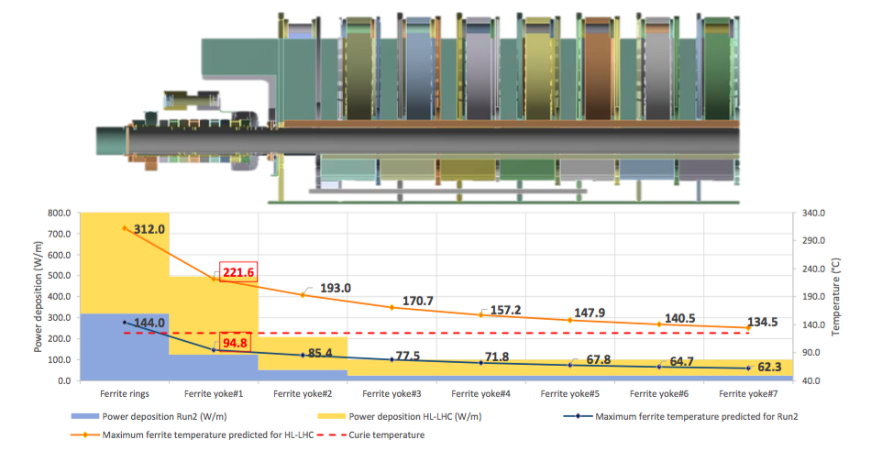
MKI Open Questions
Prototype installation during LS2 in IP2-IP8 or dummy element somewhere else?
Beam induced heating (Run3):
  New ferrite (first cells)
  Increase vacuum tank emissivity
L. Vega Cid

Slide 13
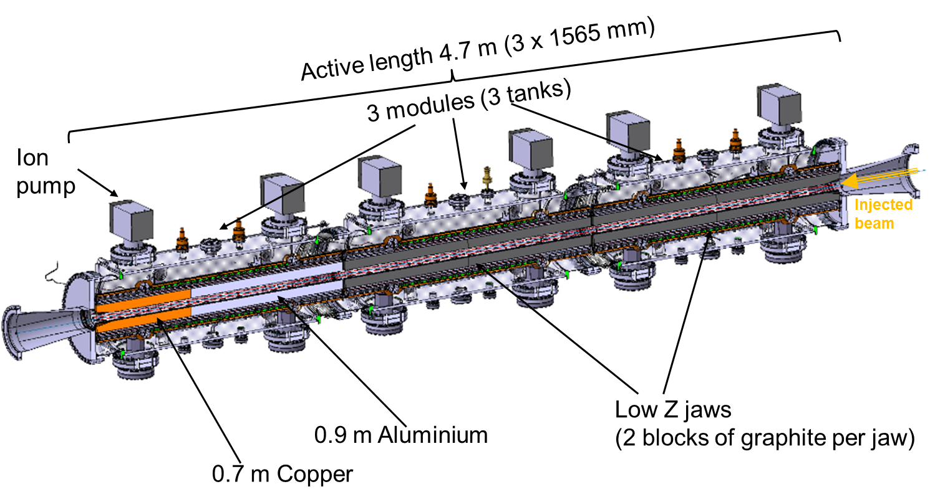
TDIS
On time
Internal review on December 1st 2016
Proposed design to replace current TDI endorsed by reviewers.
Main conclusions:
Cooling – significant improvement wrt current TDI
3-module design expected to guarantee better alignment and thermo-mechanical stability
In-depth analyses recommended to select materials to optimise jaw robustness (graphite or 3D CC? HiRadMat tests)
Comparative e-cloud simulations between TDI and TDIS recommended to help understand current vacuum spikes observed during 2016 operation
Comparative simulations between TDI and TDIS in terms of RF and HOM heating to identify possible local heating (Cu coating? HiRadMat test)
Details in http://indico.cern.ch/event/579995/
A. Perillo Marcone, Chamonix Workshop 2017
Status: Advanced design
Procurement strategy defined
Prototyping 2018

Slide 14
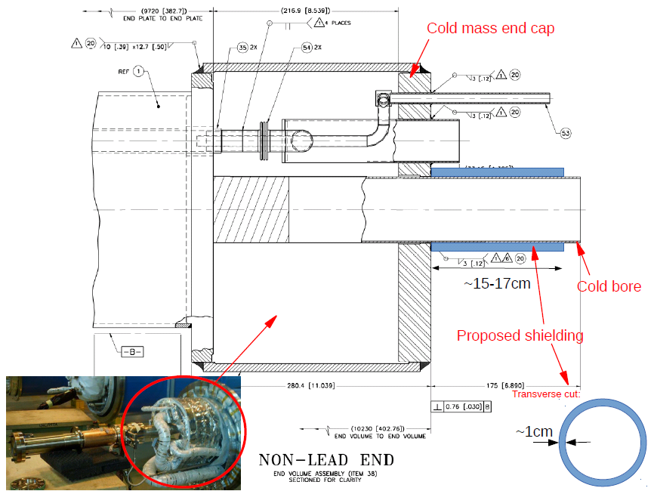
D1 Mask
Delay
Mask-like protection element inside the insulation vacuum of the D1 magnet to absorb showers from TDIS.
Possible material: W alloy (same as used for warm quads). Thermo-mechanical calculations still to be performed before taking final decision ➔ procurement (installation: 2 weeks work).

Slide 15
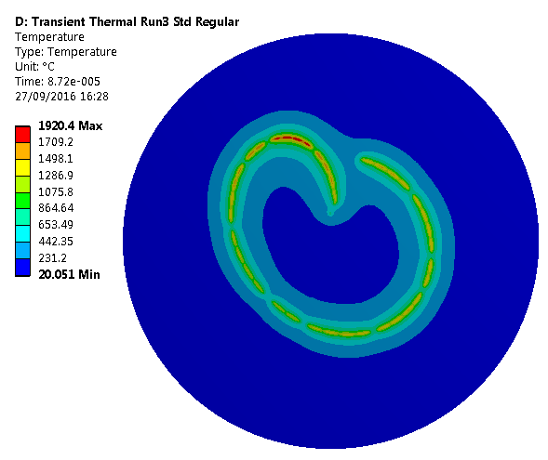
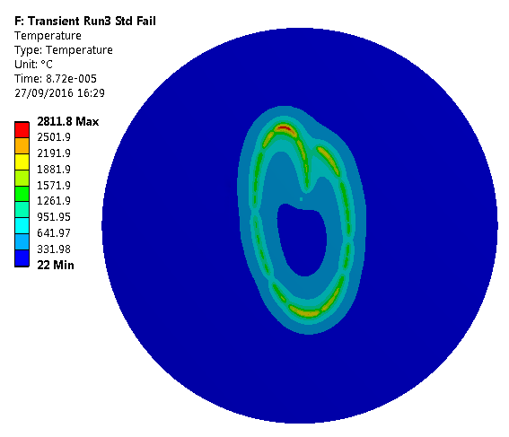
TCDS-TCDQ-TDE
On time
FLUKA energy deposition studies: DONE
Thermo-mechanical calculations: DONE (more detailed studies needed for TDE)
Outcomes:
  TCDQ: OK for all identified MKD erratic types, provided gap ≥ 4 mm. Need for a mask in front of Q5 to be further evaluated (HiRadMat tests on damage limit of NbTi coils at cryogenic temperatures). Improve accuracy interlock BPMs.
  TCDS:
    Ti block will suffer plastic deformation ➔ to be replaced
    Need to evaluate risk of pressure rise and shockwave in MSD cooling pipes
    Additional low-Z block to further reduce energy deposition on extraction septa
  TDE: core, upstream and downstream window damaged in case of failure of 2 MKBH ➔ TDE upgrade or more MKBH
E. Lopez Sola

Slide 16
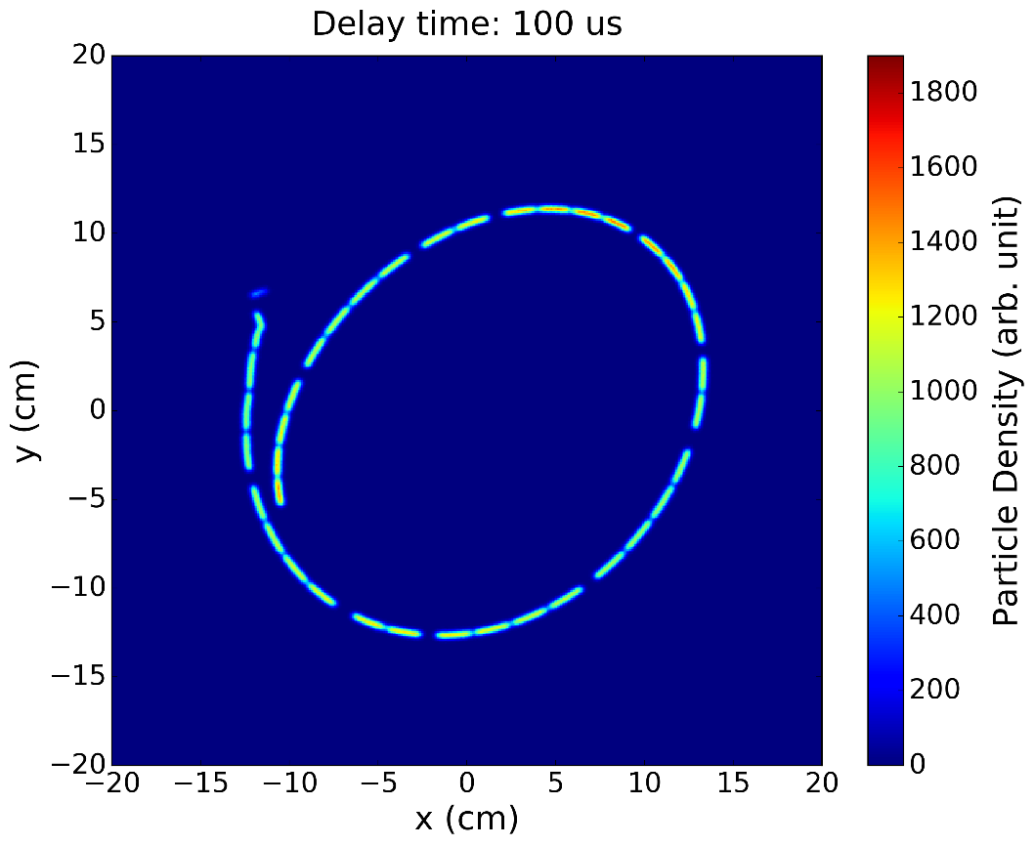
MKD-MKB
Close synergy with MKD-MKB generator meetings (W. Bartmann)
MKD-MKB “failure catalogue”
MKBH parasitic retrigger coupling
  Local tests on MKBH at 7 TeV demonstrated that a self-trigger on a MKBH can parasitically trigger up to two adjacent generators after a few microseconds ➔ up to 3 MKBH self-triggered on fault, possibly with phase opposition !
  Parasitic coupling found to be linked to grounding problem and solved by common mode filtering and insulation of retrigger boxes. Present immunity margin to be further validated.
Explore option of re-triggering MKBs ➔ synchronous beam dump but different MKD/MKB delay
Adding dilution kickers (aperture, integration, etc.)
Details on MKD-MKB HW, generators and controls discussed in Wolfgang’s meetings
Interface ABT➔ EN-STI studies discussed in this meeting
C. Wiesner

Slide 17
TCLIA in IP2 (not in baseline)
Urgent!
Studies shown that there is no need to replace the absorber material (also for TCLIB)
Need to improve acceptance of ALICE Zero-Degree Calorimeter (ZDC) if operation with 50 ns heavy-ions requires increasing the crossing angle to 100 μrad.
Presently maximum TCLIA gap = 56 mm ➔ maximum allowed crossing angle ~ 60 μrad
Possible gain 2 mm gap without major HW modifications
Move TCLIA 1.8m closer to IP2
Sufficient for operation with 25 ns bunches?

Slide 18
Impact on Integration
P. Fessia’s integration meetings
LS2
TDIS: keep same occupancy
TCLIA: yes, mainly integration work!
MKI: only if need for installation of dummy prototype in a location different from IP2 and IP8
MKB: if need to install additional dilution kickers (extraction line and generators in UA)
TCDS: where install third module (up-stream-downstream or middle?)
TDE: keep same occupancy and shielding
LS3

Slide 19
Next Meeting: TCLIA
ALICE requirements: recap. of past studies and new requirements based on present experience (J. Jowett, W. Riegler)
Possible gain in gap with present HW (O. Aberle)
Vacuum related works in case of TCLIA displacement (including time, cost and manpower). (V. Baglin)

Slide 20
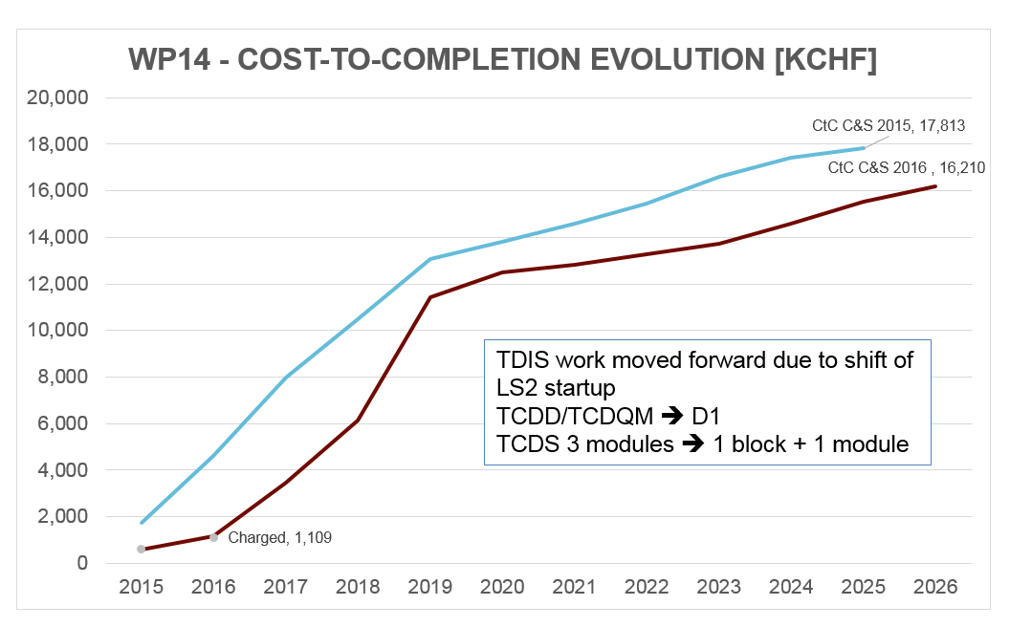
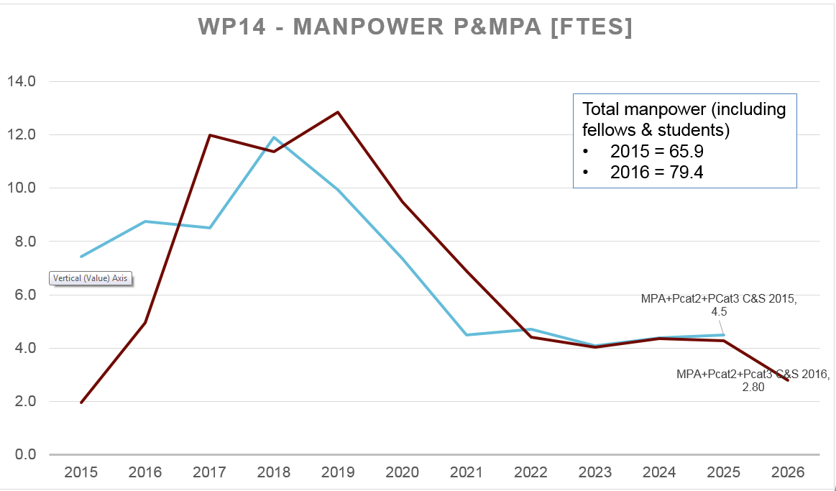
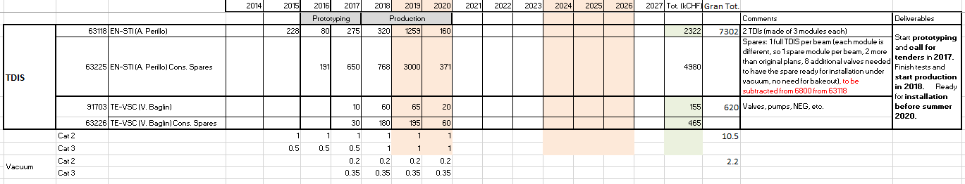
Budget and Manpower
Last Cost&Schedule review
Detailed table with estimated spending profile and relative manpower (including fellows, PhD and PJAS) for each BC will be sent around ➔ please check, update and send it back to me before next meeting (28/02)

Slide 21
Make or Buy Plan
Strategy for procurements and purchasing, first version issued in June 2015 (all needed info in EDMS document 1684323, H. Garcia Gavela) .
To be updated twice a year (meeting next Friday). Main points:
Identification of new procurement needs for each WP.
Definition of the deliverables that are linked to the budget requested by each WP for the next two years (last year: TDIS and MKI prototype, any other item for this year?).
Schedule of the forthcoming Purchasing Orders. This also includes the foreseen schedule for the Tendering Documents that have to pass through the Specification Committee.
Possible combining orders with other WPs (D1).

Slide 22
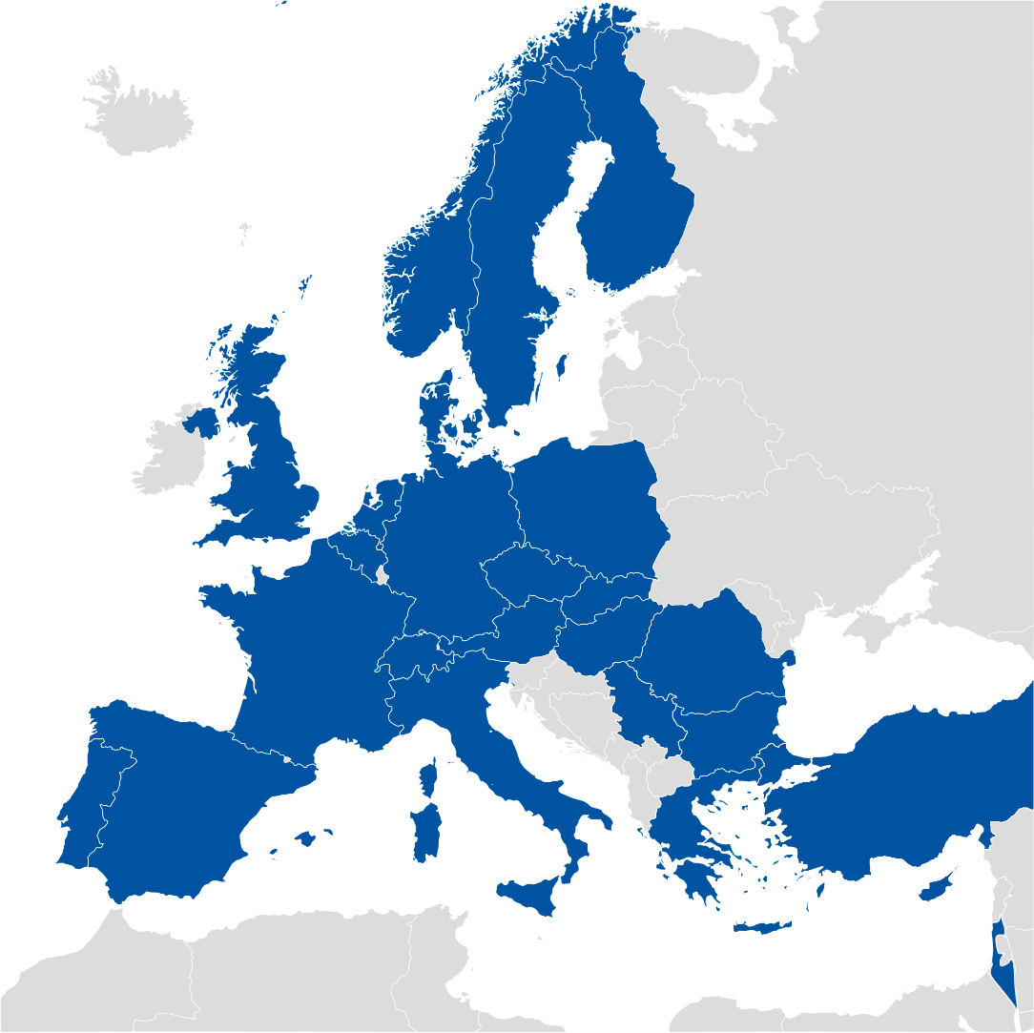

Domains of Activity
Graphite – Raw material and machining
Presently identified as potential suppliers
MS | Firms | MS | Firms
AT |  | IL
BE |  | IT
BG |  | NL
CZ |  | NO
CH |  | PK
CY |  | PL
DE | SGL | PT
DK |  | RO
ES |  | RS
FI |  | SE
FR | Mersen | SK
GR |  | TR
HU |  | UK
Looking for…
Material to be used for Beam Absorbing blocks Highly purified Graphite

Slide 23
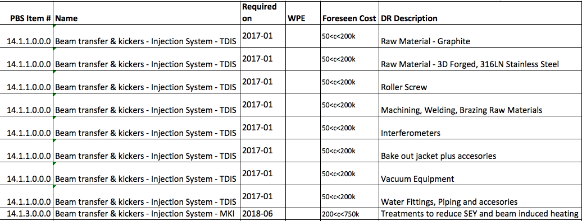

What and When
2018

Slide 24
What and When
2018
Distribute to equipment responsible!
Looking for (short term)
Potential suppliers from MS on Raw Materials (Glidcop, Graphite, 3D C-C composites), machining of components, Welding (Electro Beam Welding), Brazing, Interferometers, Bake out coating, Vacuum equipment and Water System equipment – Before 2017 Alumina tube treatments – 2017

Slide 25
Thank you for your attention

