Slide 1
WP10.2 – Status
L. Bottura and C. Senatore
on behalf of WP10.2
February 7th, 2017

Slide 2
Status of work - production
Completed the FAT of new PLD300 machine for 2G tape processing for CERN:
  New features : "concentration" of laser plume in the deposition of a wide electronic "time‎-window".
  50% gain of throughput
  New champion values for J_{E} (reaching 956 A/mm² at 4.2 K and 18 T)
  Further steps for process improvement (e.g. controls and diagnostics)
Production results
  Improvement of tape performance and quality
  Dog boning suppressed in final Cu-coating
New high-field measurement from Tallahassee on 609 m long, 4 mm tape, demonstrate on long lengths value as close as 90 % of earlier Ic in “champion” short tapes:
  Ic = 448 A at 18 T, B//c, 4.2K
  Ic = 280 A at 31 T, B//c, 4.2K

Slide 3


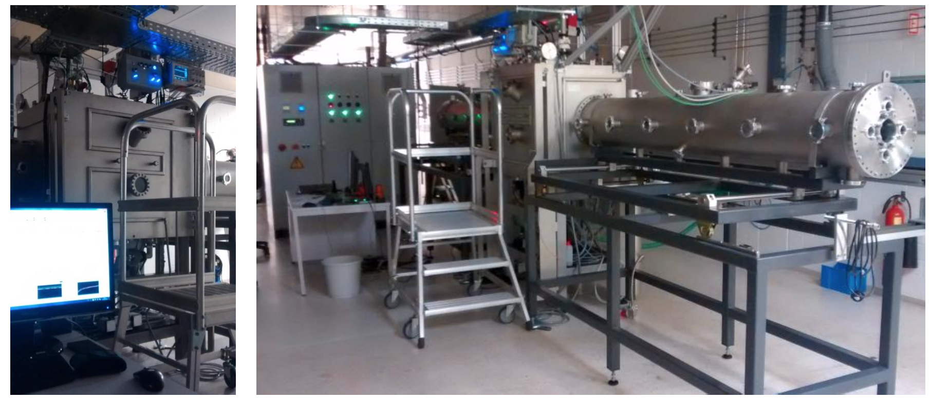
PLD-300

Slide 4
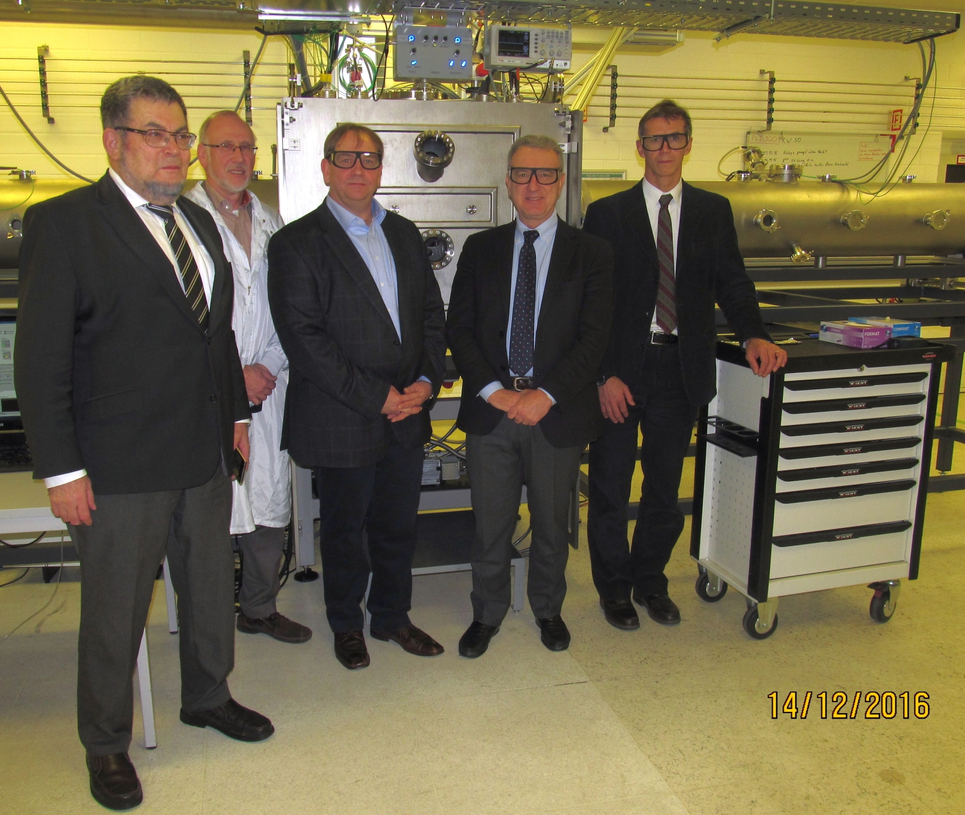
PLD-300 FAT

Slide 5
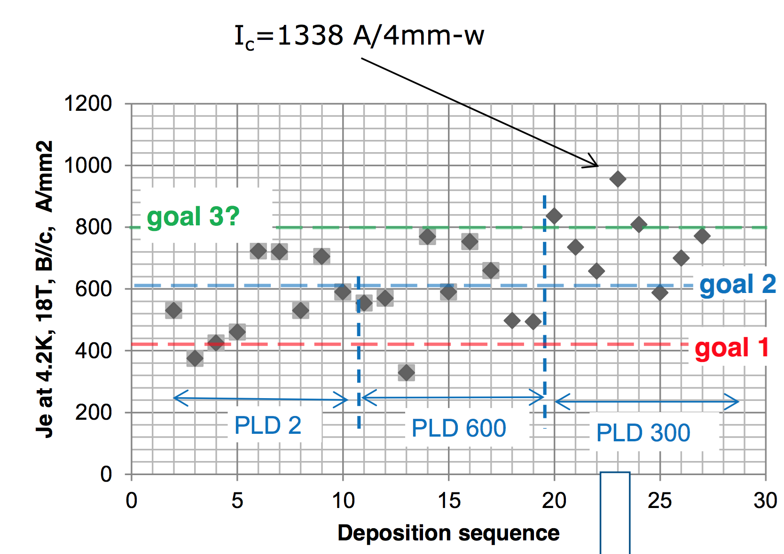
Record of results
12 mm tapes
20 to 30 m unit length
Compiled by A. Usoskin, Bruker

Slide 6
Status of work - tape
Total 850 m of cable produced by partner Bruker-HTS, this completes the EuCARD2 contractual obligations, and with very good performance (exceeding largely the targets set in 2012)
CERN has procured 800 m of tapes procured from alternative sources (A. Ballarino)
  200 m SuperOx (June 2015) – 100 m cabled
  100 m Sunam (July 2015) – cabled
  300 m Fujikura (December 2015) – attempted cabling
  200 m (15% Zr) SuperPower (June 2016) – 100 m cabled
Nearly 2 km of tape produced/procured
Next step: CERN is procuring of a total of 3.1 km of tape (A. Ballarino)

Slide 7
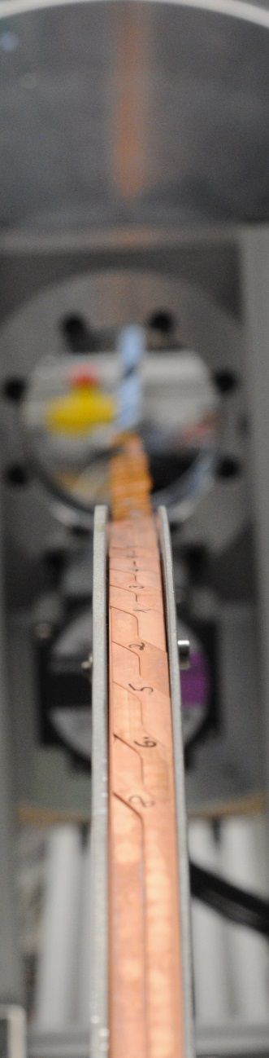
Status of work - cable
Cable production on-going at KIT (A. Kario)
  All Feather.M0 lengths produced and delivered
  First Feather.M2 UL delivered to CERN
  Short length for Ic test in FRESCA produced
  Second Feather.M2 UL in production (March 2017)
CERN has procured 32 m of Roebel cable from SuperOx (Sunam tape) (A. Ballarino) and 60 m of dummy from GCS
Next step: production of additional UL’s using optimized tooling at KIT (4 UL’s, A. Kario), as well as SuperOx lengths (2 UL’s, A. Ballarino)

Slide 8
Further activities
Ic surface characterization (C. Senatore)
Ic measurement on Roebel cables (J. Fleiter)
Transverse pressure experiment on Roebel cable (M. Dhalle)
AC loss measurement and analysis (M. Dhalle, Y. Yang)
Quench experiment (M. Dhalle, Y. Yang)
BSCCO cable test (LBNL, NHMFL, M. Dhalle)

Slide 9
Ic(B,T,α)
Samples delivered by Bruker-HTS (now at University of Geneva)
Measurements to start next: first results by WAM-HTS4 ?
Very important measurement, will provide a benchmark value for “our” tape (not available at present)
Reference person: C. Senatore, U. Geneva

Slide 10
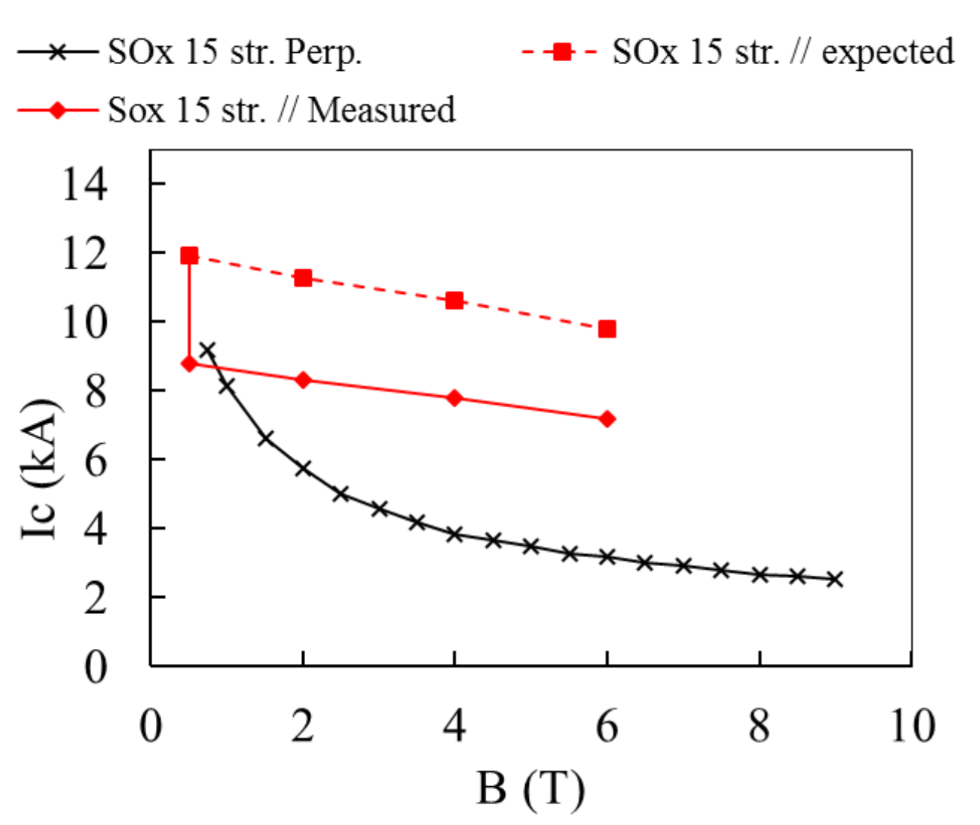
Ic measurement on Roebel cables
SuperOx cable, 15 strands, provided as a short sample for testing
By courtesy of J. Fleiter, CERN

Slide 11
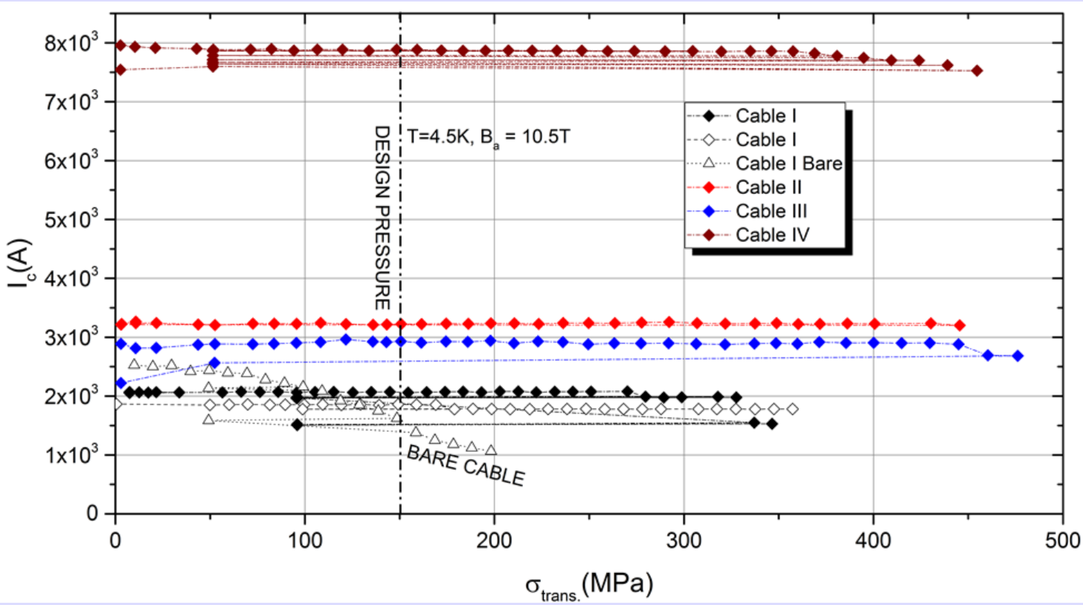
Ic vs. transverse pressure
Program approaching completion of initial scope:
  Cable I: SuperPower tape, Lp=126 mm, KIT impregnation
  Cable II: SuperPower tape, Lp=226 mm, KIT impregnation
  Cable III: SuperPower tape, Lp=226 mm, CERN impregnation
  Cable IV: Bruker-HTS tape, Lp=226 mm, CERN impregnation
By courtesy of M. Dhalle, U. Twente

Slide 12
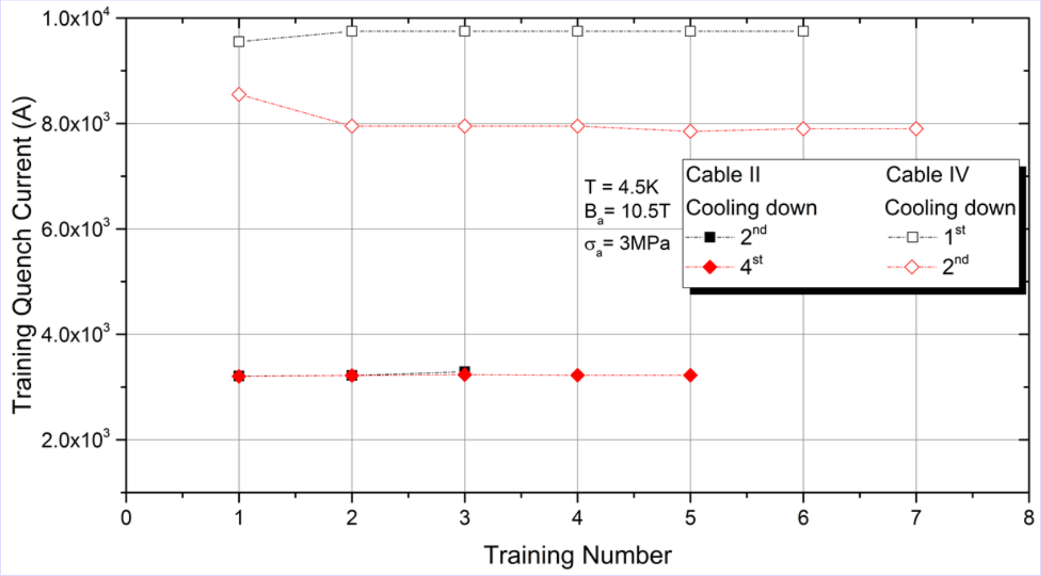
Is the insulation system optimal ?
Significant loss of Ic observed after a thermal cycle
  Is this a problem with the sample ?
  Is this a problem with the insulation system ?
By courtesy of M. Dhalle, U. Twente

Slide 13
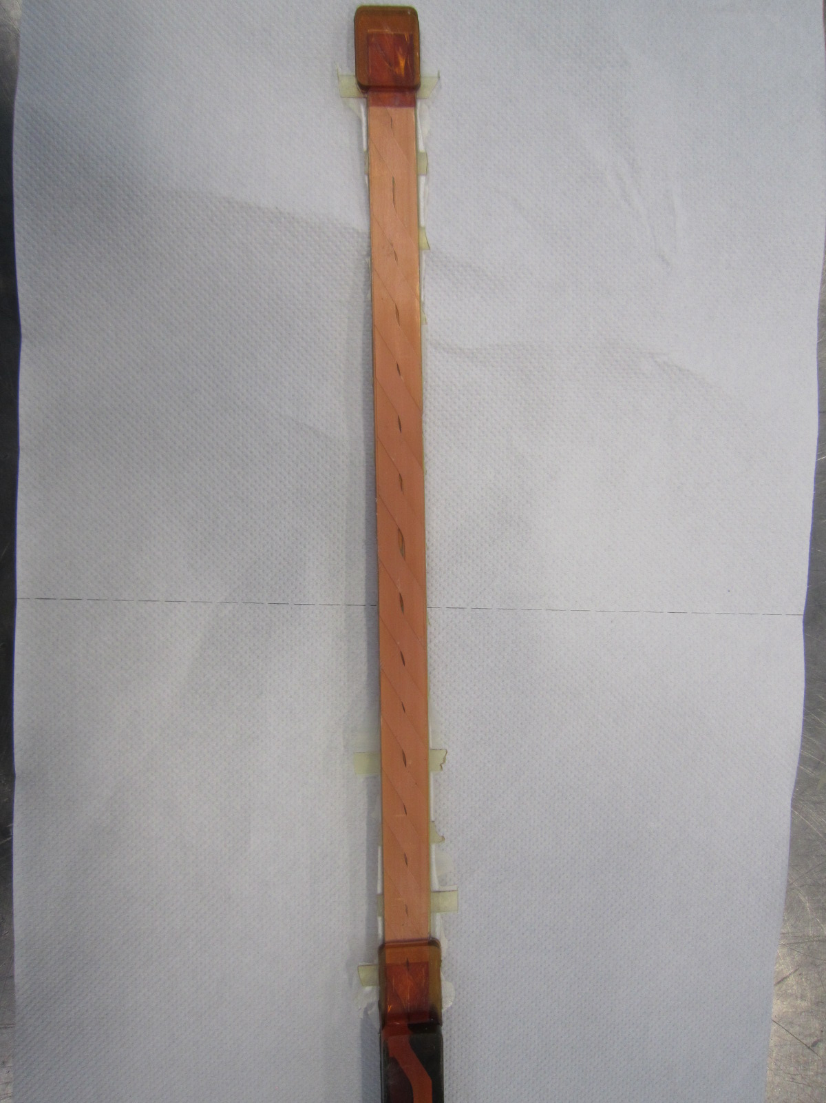
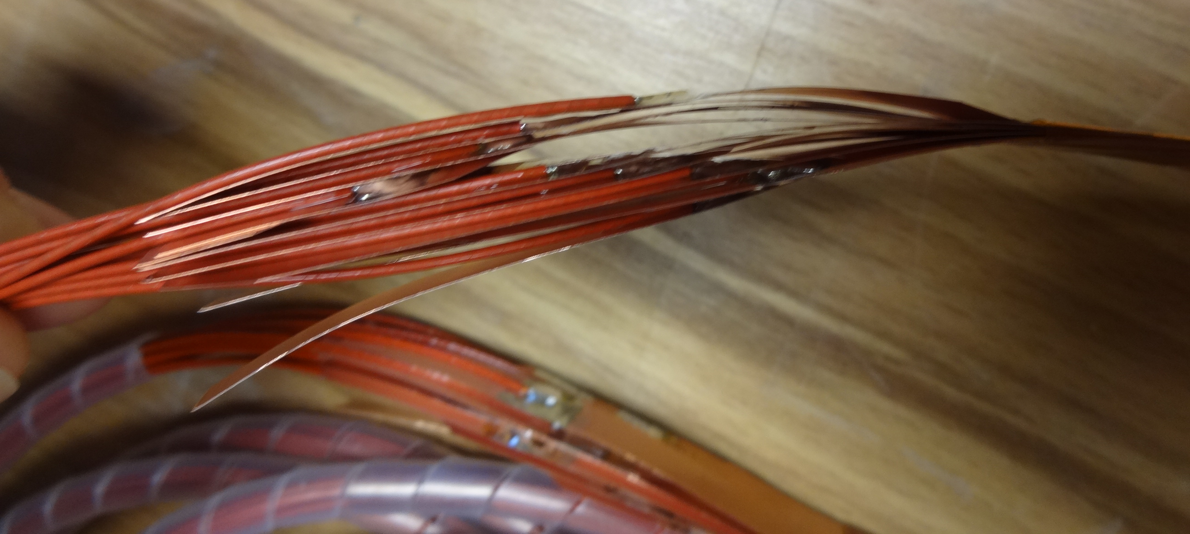
AC loss/Magnetization/Rc
First measurement performed at U. Twente
Surprisingly “low” Rc values observed
By courtesy of M. Dhalle, U. Twente

Slide 14
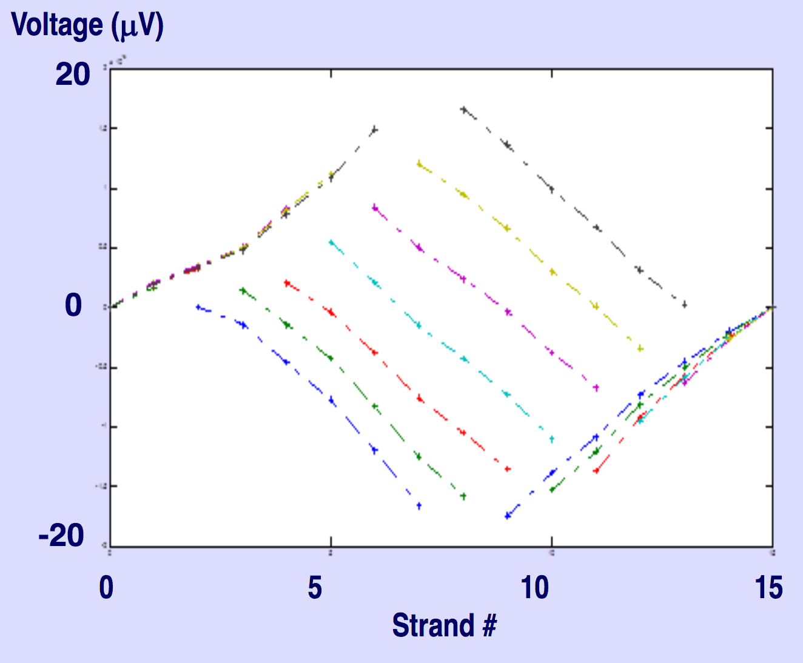
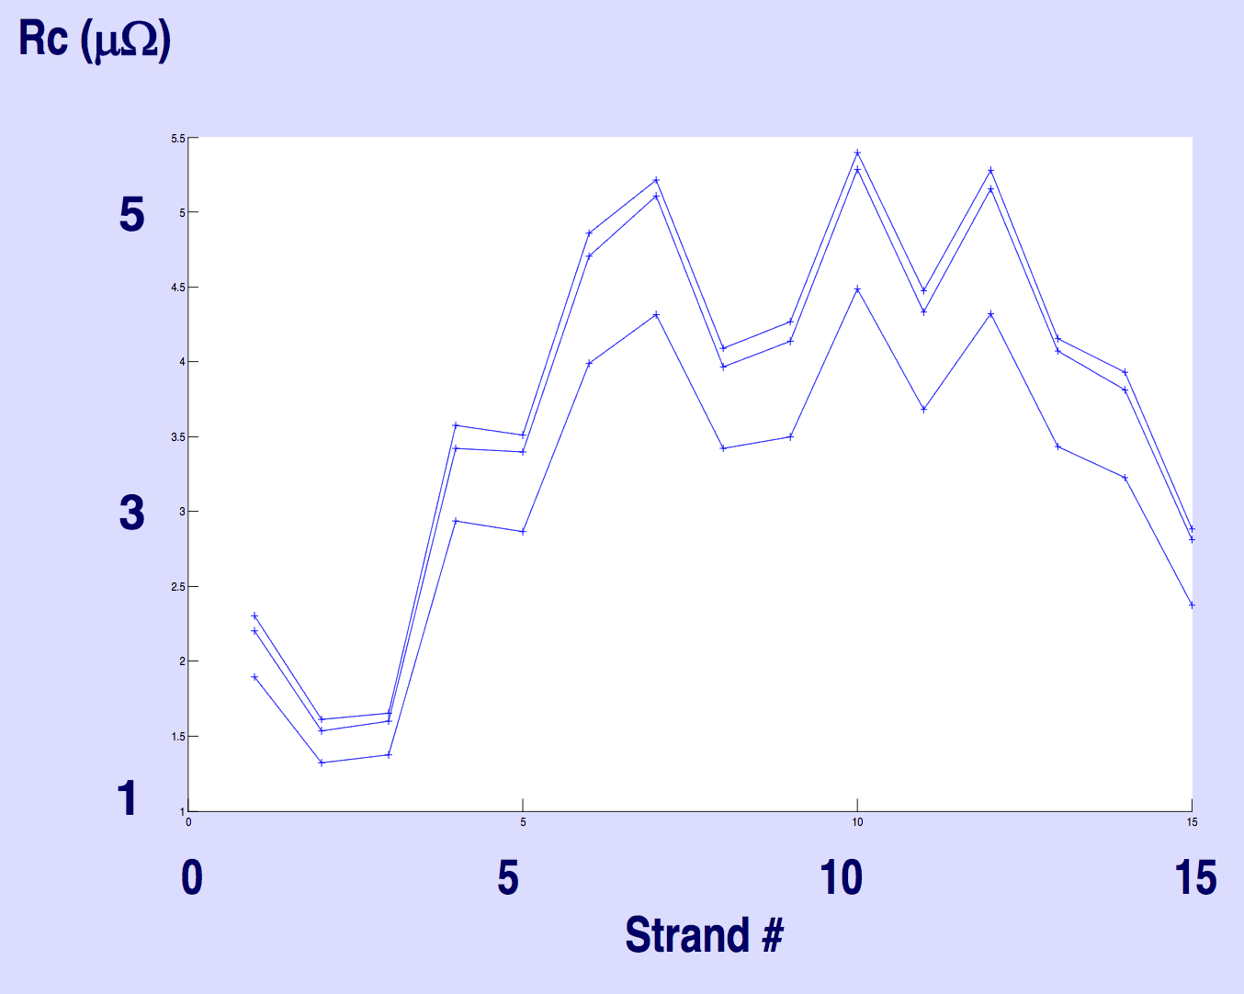
AC loss/Magnetization/Rc
4 to 5 μΩ
Liquid Nitrogen
Measurement current 2A
Potential referenced at strand 15
Measured reduction to 2 μΩ at 4.2 K
By courtesy of M. Dhalle, U. Twente

Slide 15
Quench experiment
2-mm tape length (Cu-coated) at Twente (measurements in Spring 2017) (M. Dhalle)
2m length of “Frankenstein” cable (E2B-15/5.5-003) shipped to Southampton to attempt a cable quench measurement at high temperature (self field) (Y. Yang)
First considerations on the test set-up provided by Y. Yang, proposal for measurement
Reference person: M. Dhalle, U. Twente and Y. Yang, U. Southampton

Slide 16
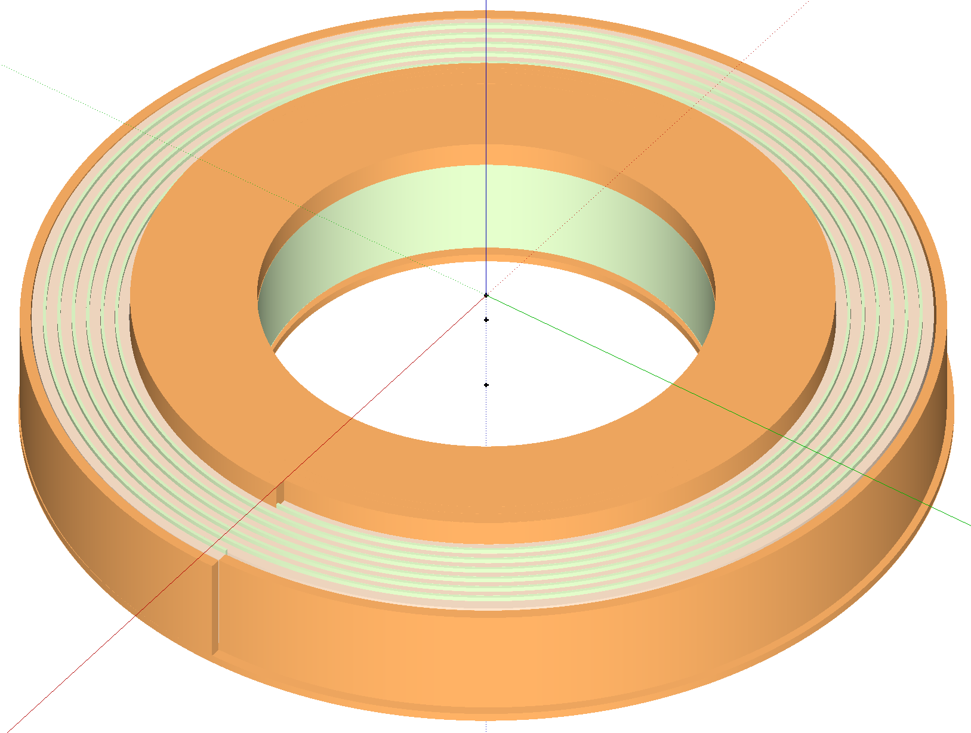
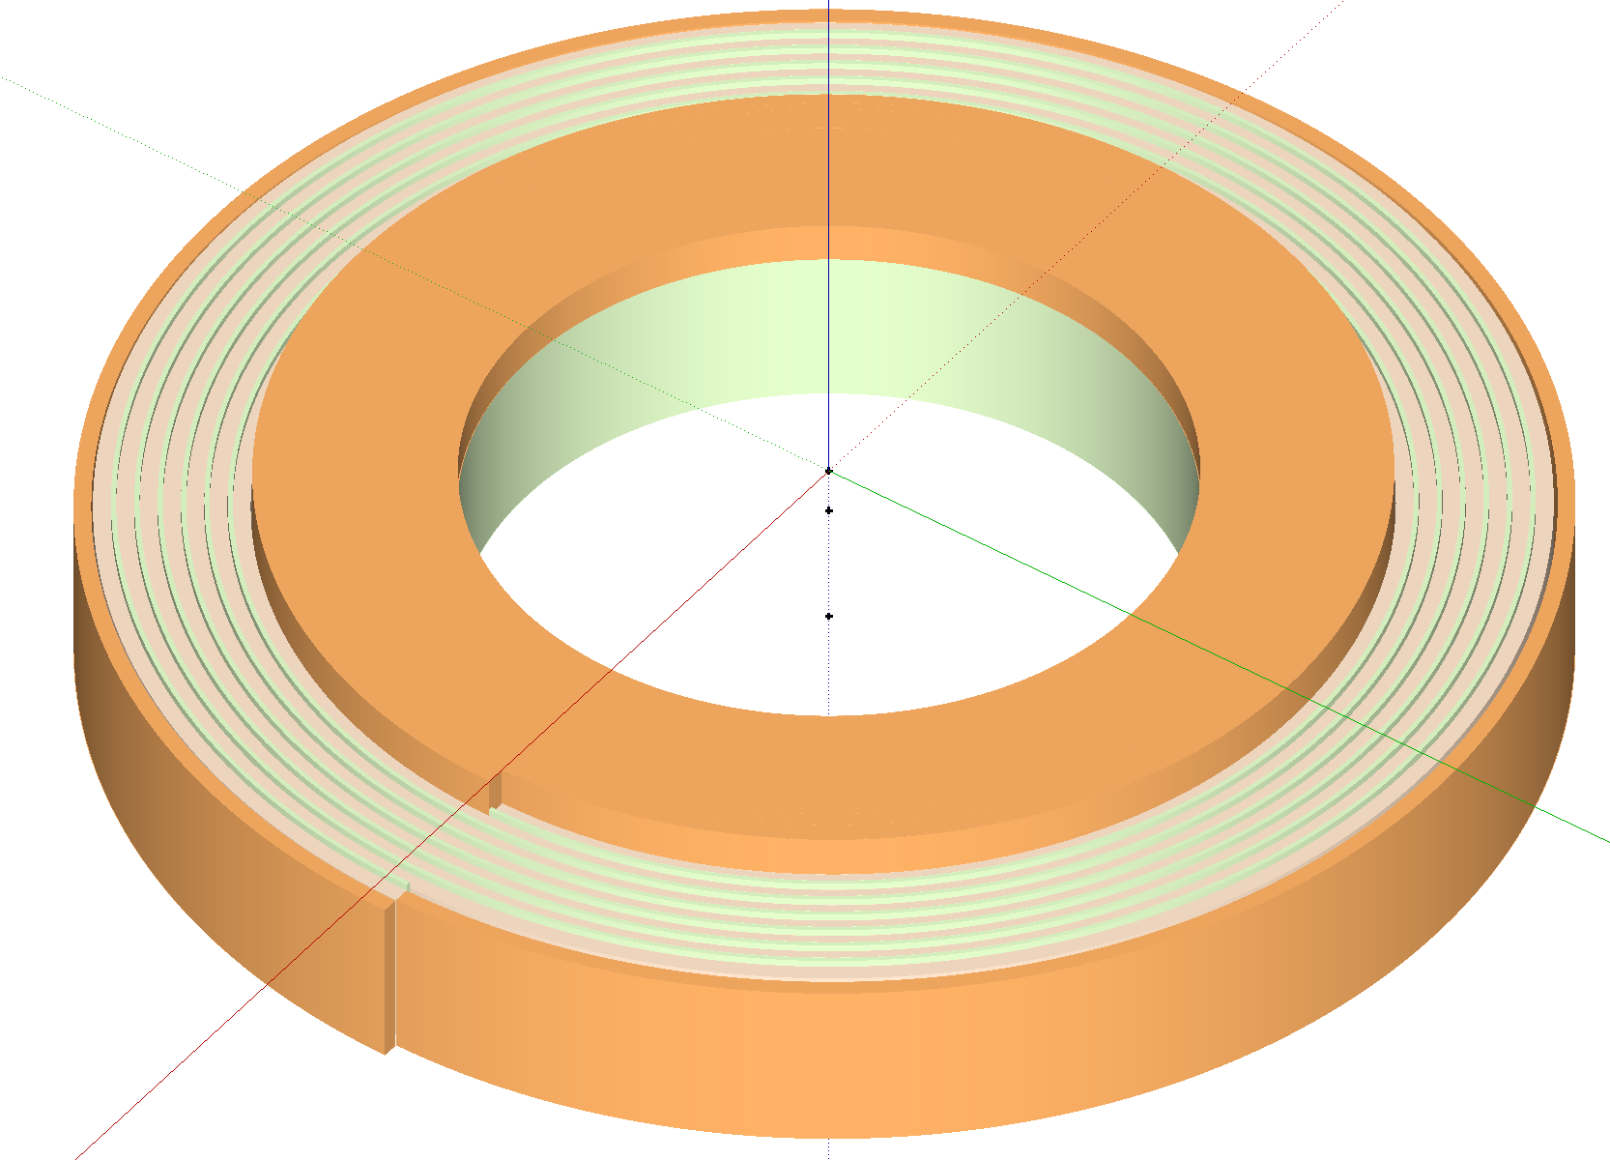
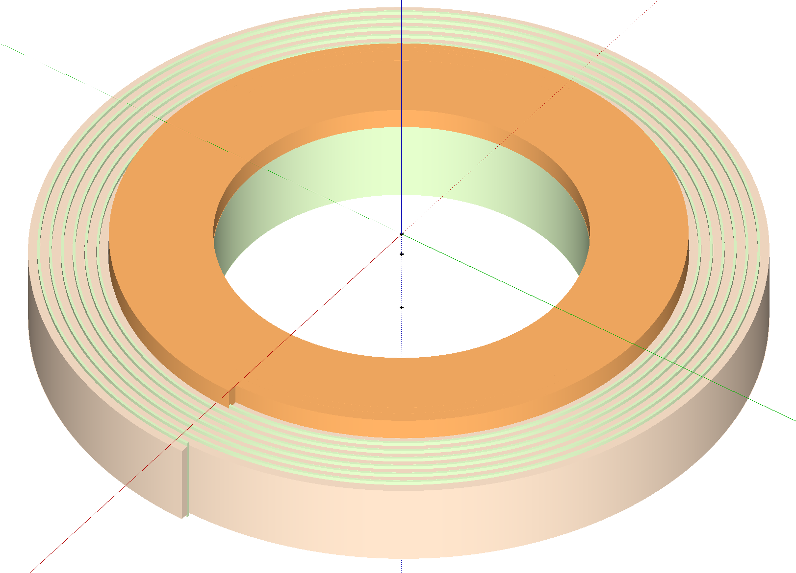
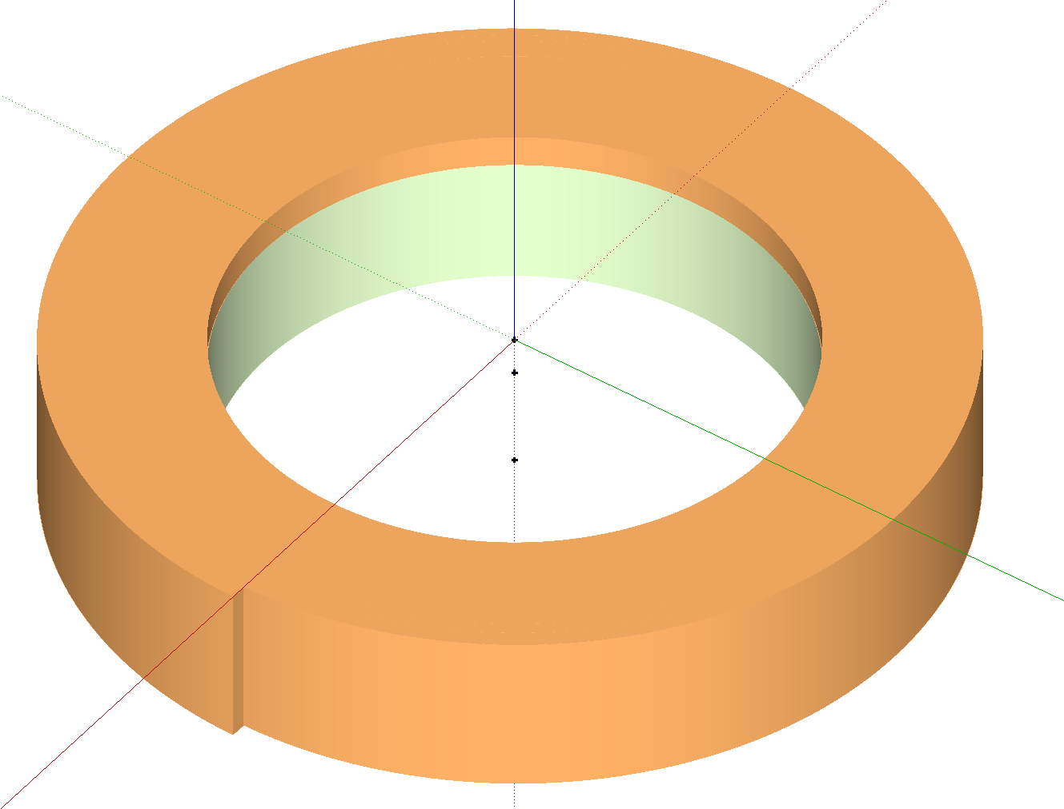
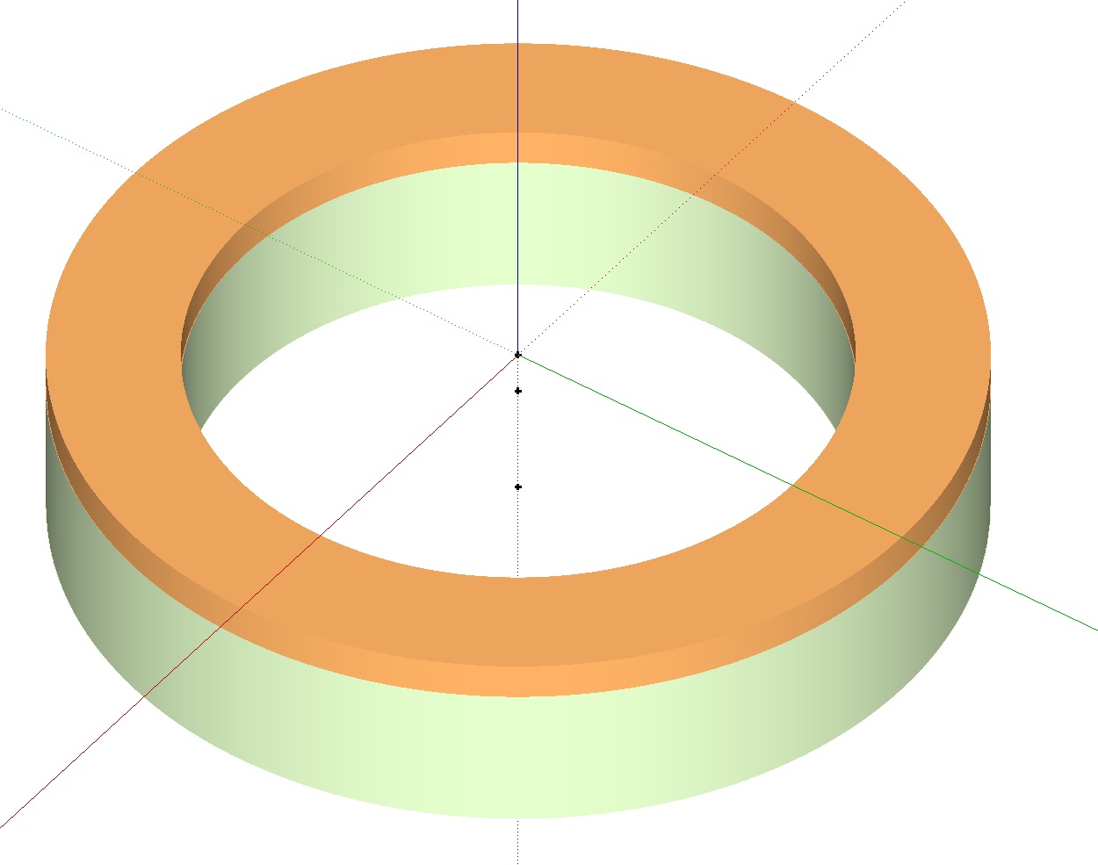
Roebel Pancake Coil for Quench Measurements
G10 former with inner current injection terminal
Inner current contact to a whole turn, CNC machined to fit cable thickness
Soldering cable to contact and then start winding with fibre-glass insulation tape
Instrumentation/Heater attached during winding
Solder the outer contact to a whole turn
Attached outer terminal at the same time
Epoxy impregnation
By courtesy of Y. Yang, U. Southampton

Slide 17
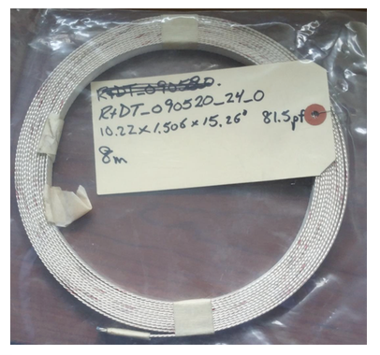
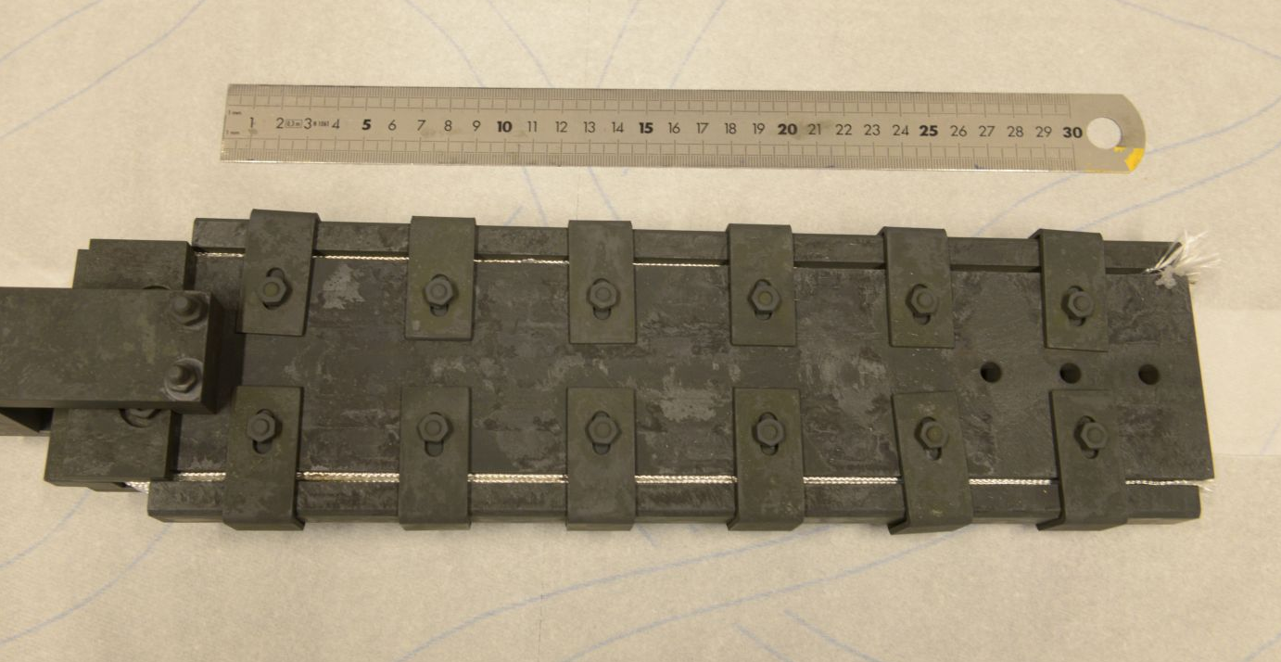
BSCCO cable test
Discussion at ASC-2016, activities restarted, backed by E. Hellstrom (NHMFL) and T. Shen (LBNL)
Cable HT on CERN sample holder, shipped to U. Twente

Slide 18
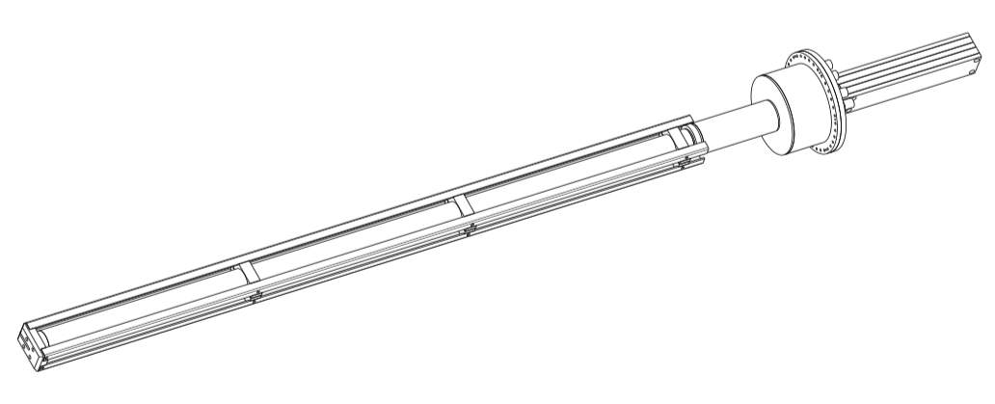
Other items (outside the scope)
Test of Feather.M0 in SULTAN to profit from (unique) variable temperature and field conditions

