Slide 1
Roebel Pancake Coil for Quench Measurements
Taking on board questions on the suitability/relevance of quench measurement on a u-bend cable.
Noting the cable is about 1.4m long, allowing ~1m length after current contacts of 1 pitch length of 0.2m.
Sufficient for 6-7 turn coil: more relevant for EUCARD2, better mechanical stability with impregnation.
So we propose:

Slide 2
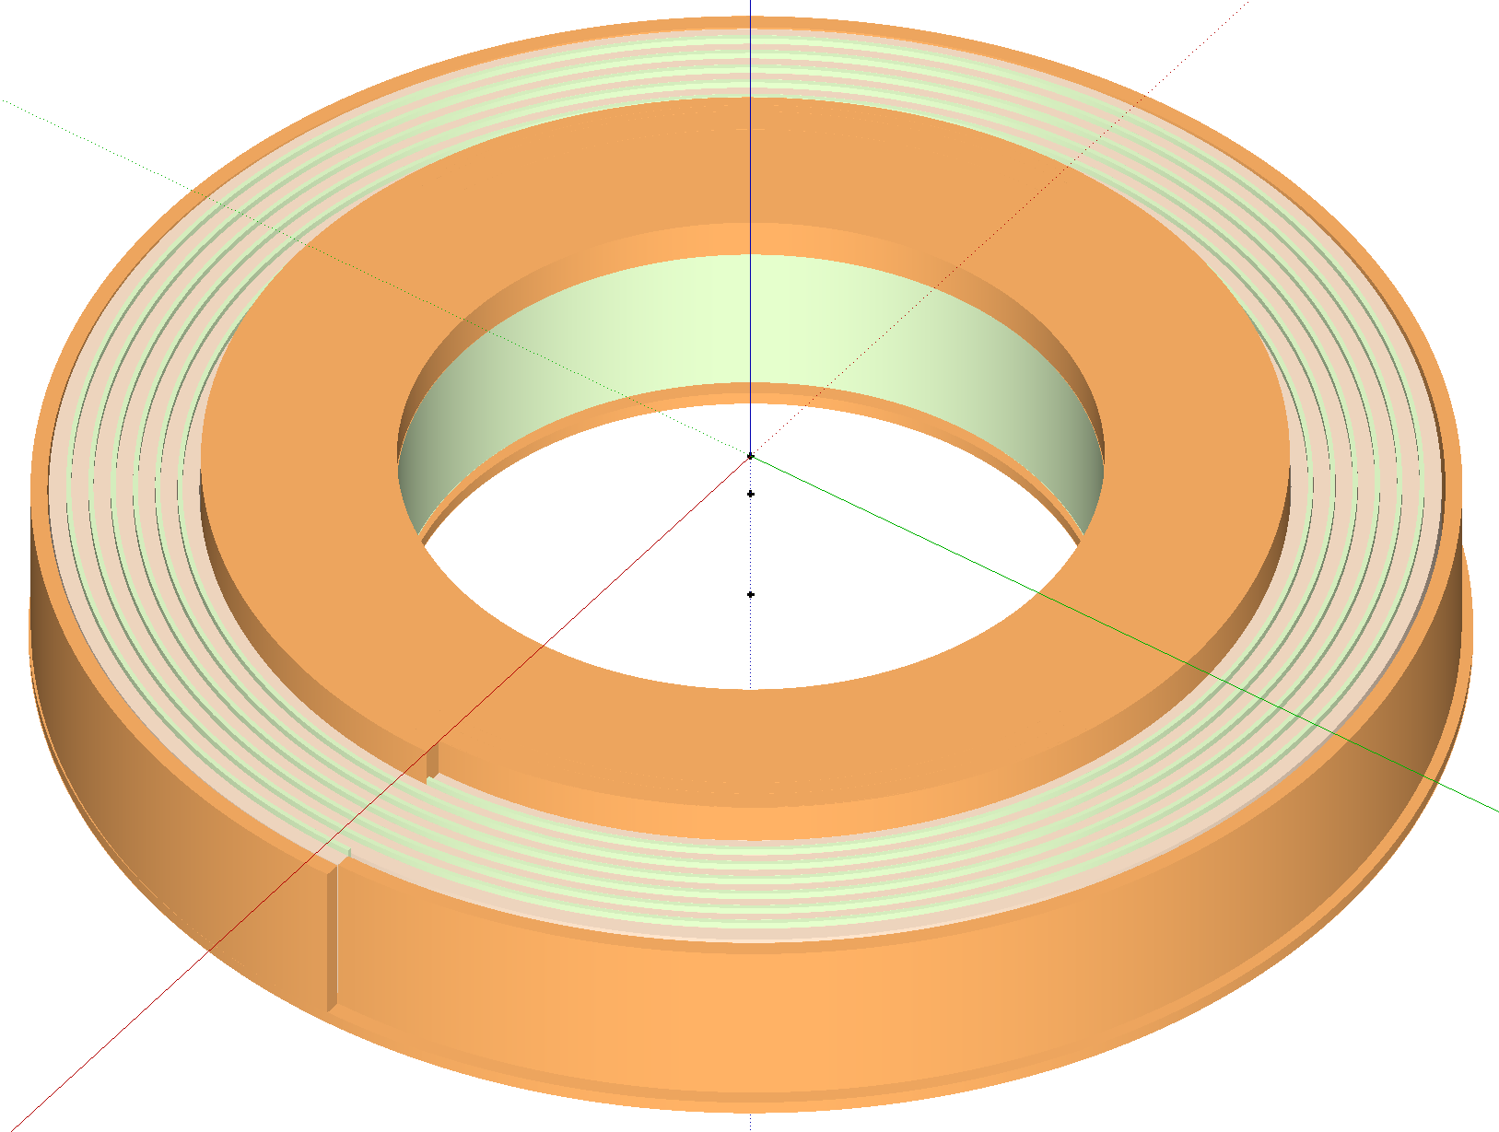
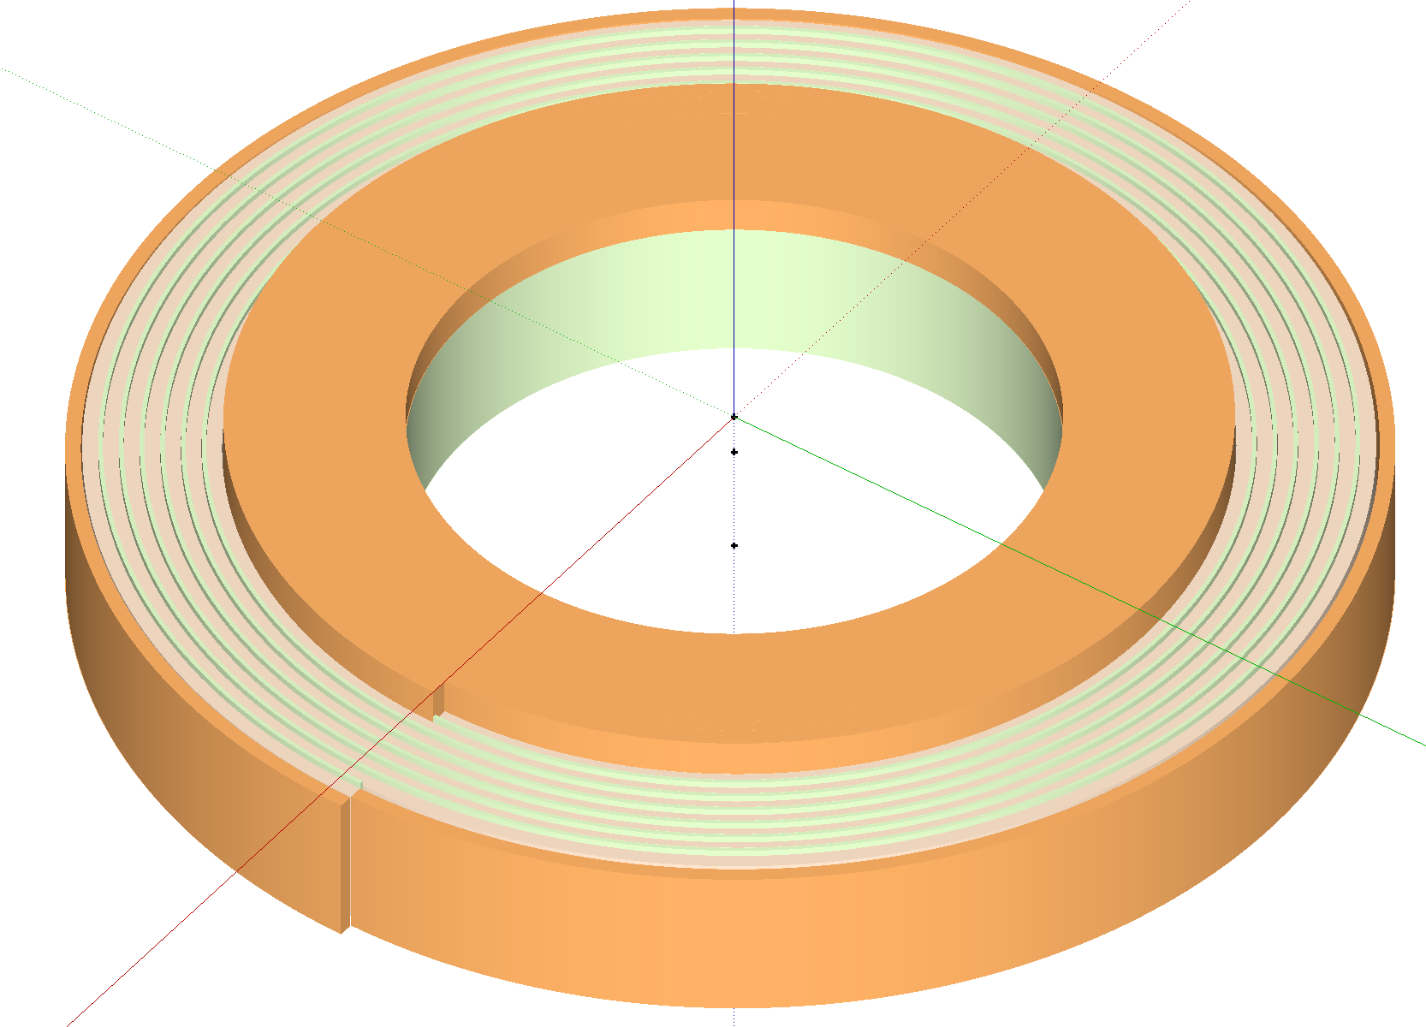
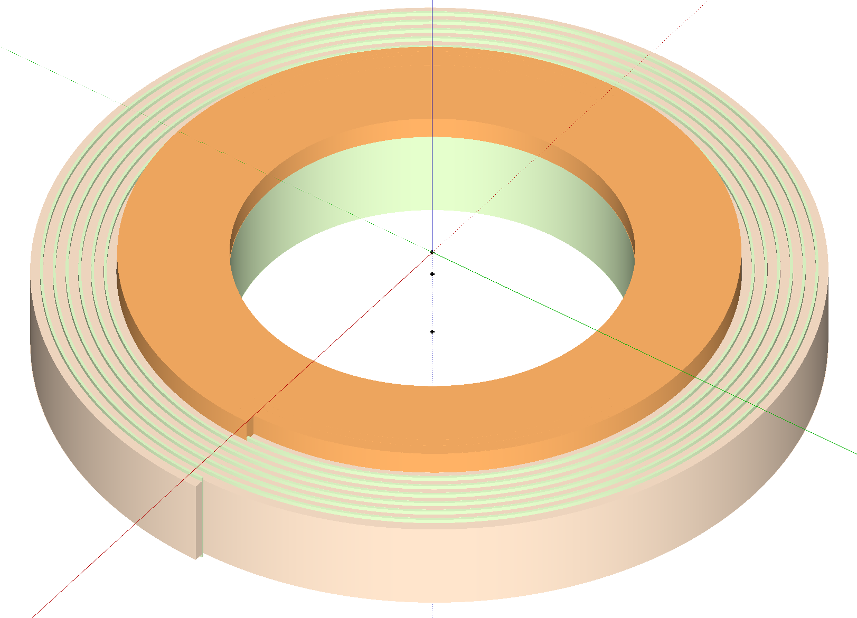
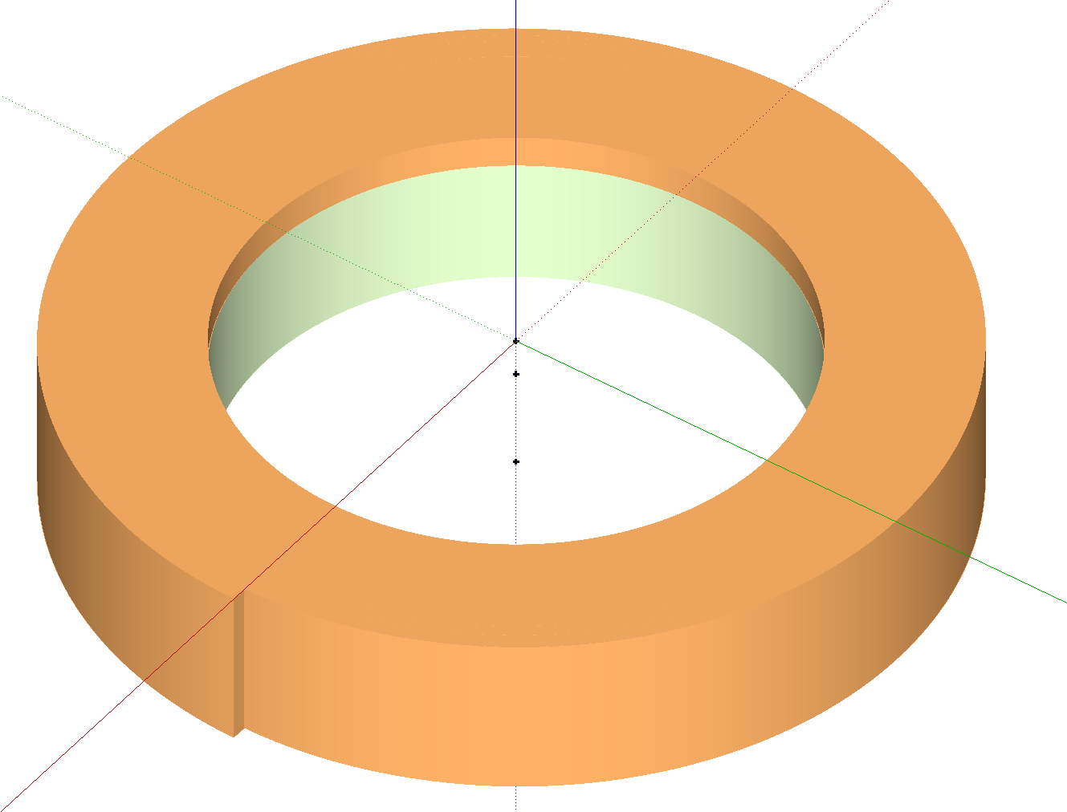
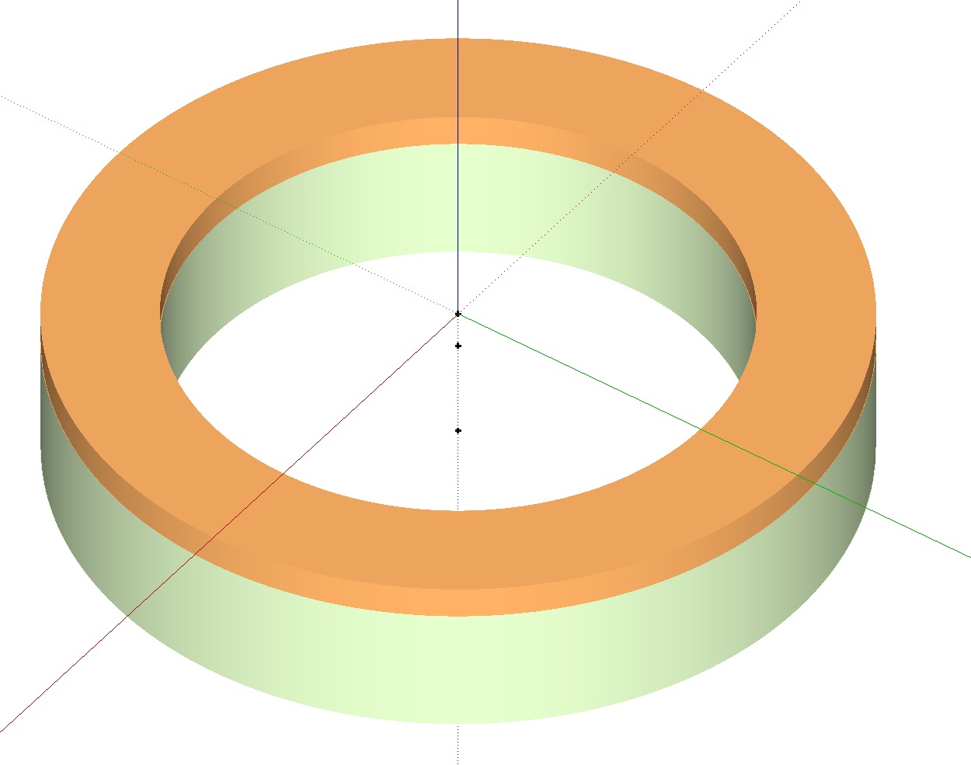
Roebel Pancake Coil for Quench Measurements
G10 former with inner current injection terminal
Inner current contact to a whole turn, CNC machined to fit cable thickness
Soldering cable to contact and then start winding with fibre-glass insulation tape
Instrumentation/Heater attached during winding
Solder the outer contact to a whole turn
Attached outer terminal at the same time
Epoxy impregnation

Slide 3
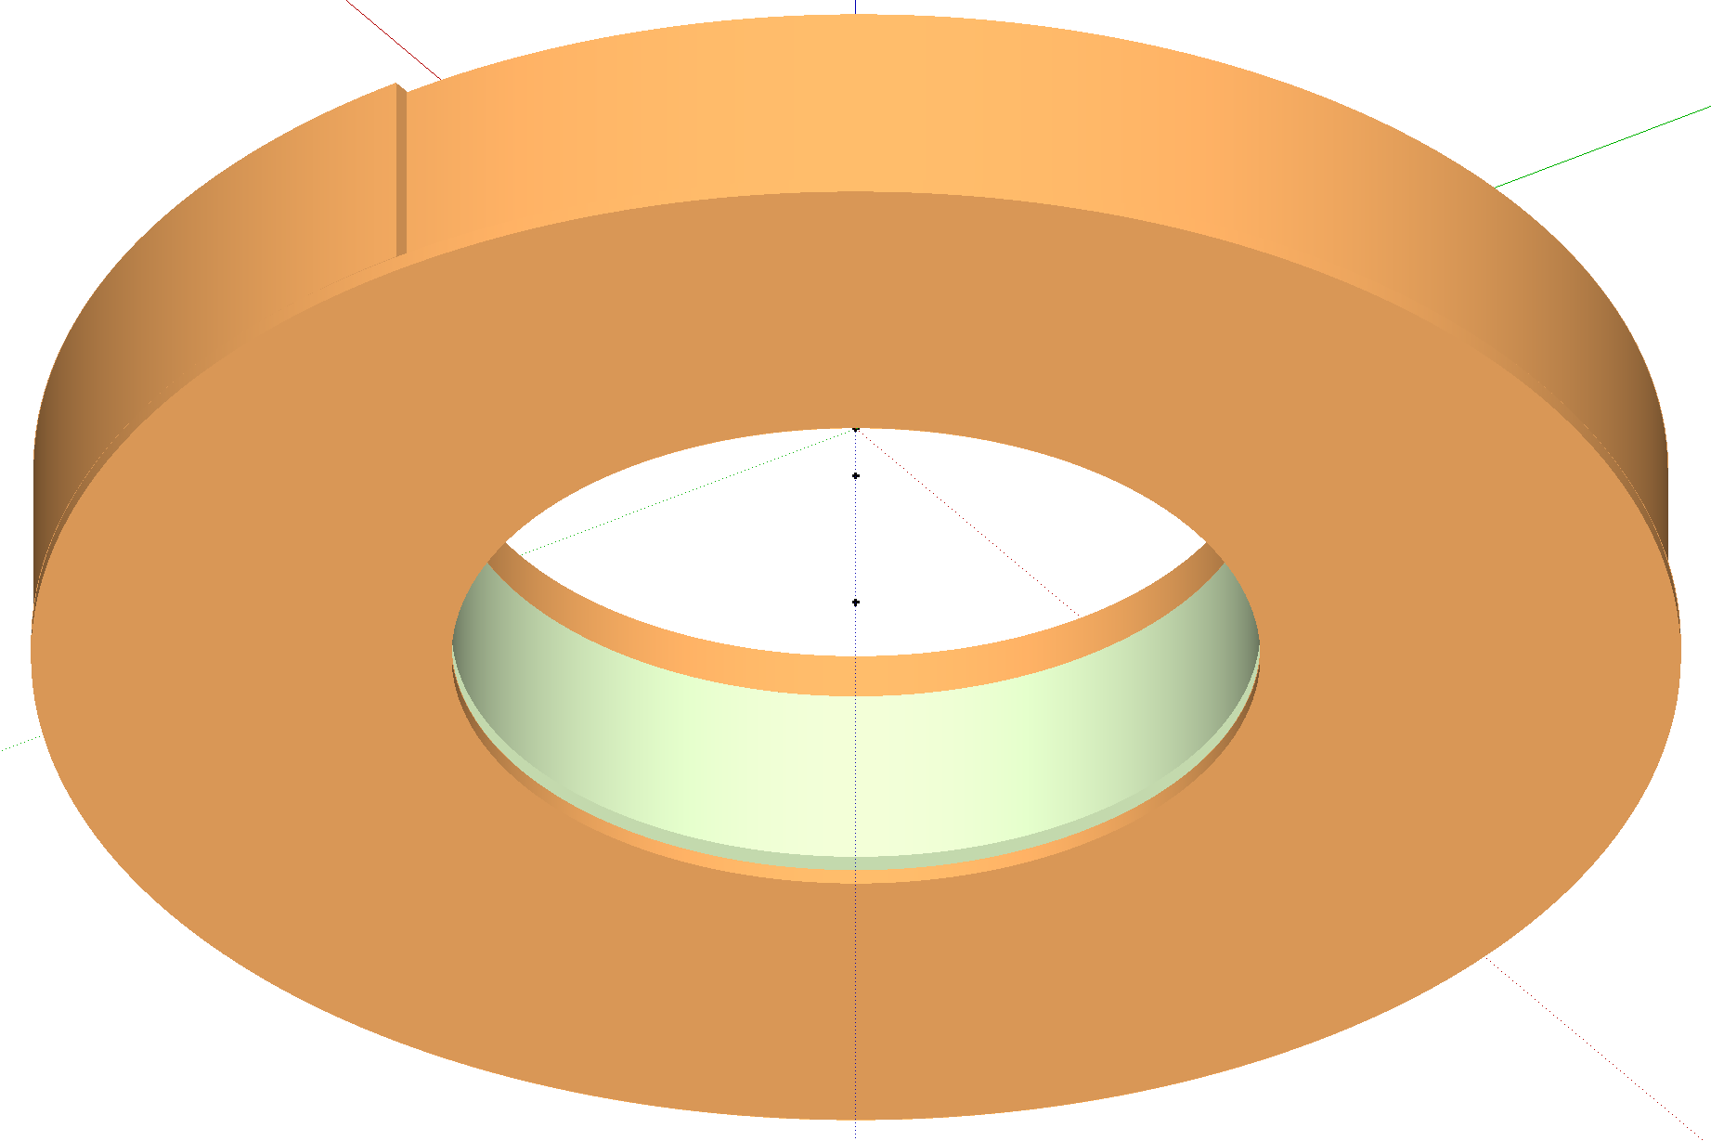
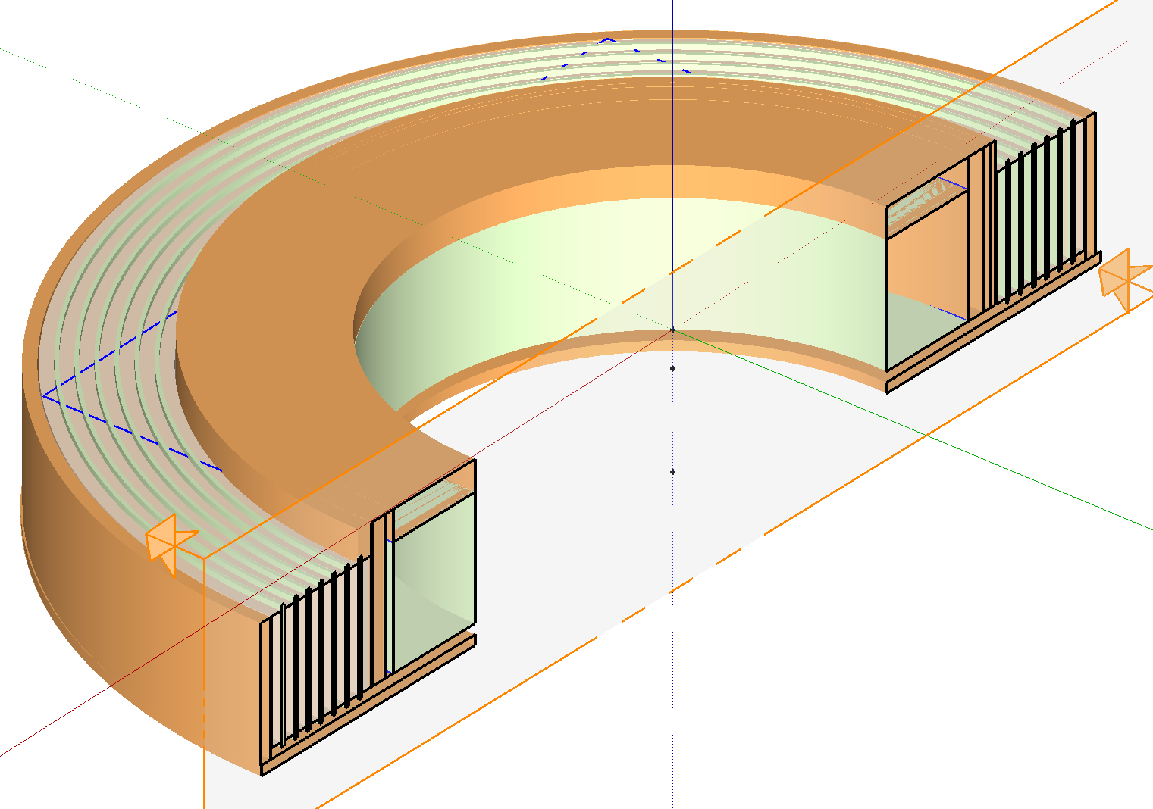
Outer current terminal on the reverse side
Cross-section of the winding structure and current contacts

