Slide 1
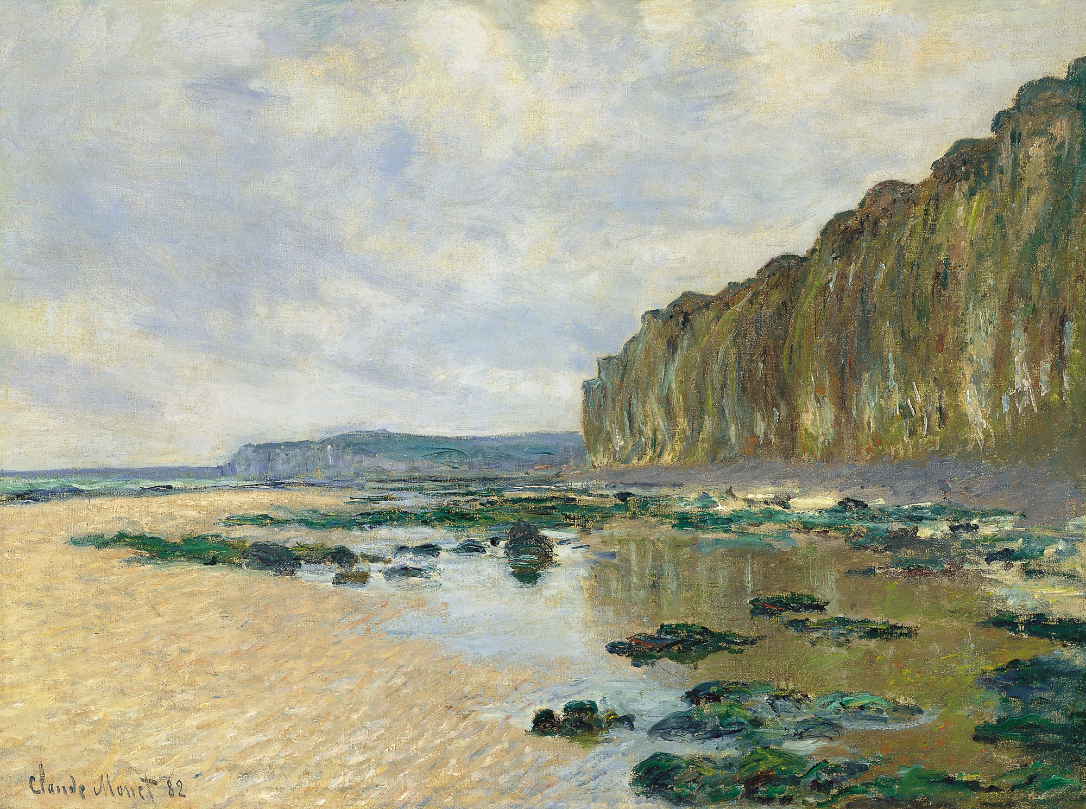


Invisibles 2015, Madrid June 22nd 2015
Composite resonance effects on the EW chiral lagrangian at NLO
PRELIMINARY
J.J. Sanz-Cillero (UAM/CSIC-IFT)
In collaboration with:
A.Pich, J.Santos, I.Rosell
[1501.07249]; forthcoming
PRL 110 (2013) 181801 [arXiv:1212.6769]
JHEP 01 (2014) 157 [arXiv:1310.3121]
[arXiv:1501.07249 [hep-ph]]

Slide 2
OUTLINE
Compositeness, non-linearity, chiral low-E counting
Custodial sym. & Resonances:
Contribution to the EFT @ NLO, i.e., L_{p4}
Simple pheno:
Easy to avoid bounds with M_{R} ∼ 4πv ≈ 3 TeV

Slide 3
Composite theories:
the Resonance + EFT program
Custodial symmetry
+
Resonance Lagrangian
+
UV completion hypothesis
Resonance contributions
to the NLO low-energy couplings
Prediction for low-energy observables
E
SU(2)_{L}⊗SU(2)_{R}/SU(2)_{L+R}
V,A,S,P singlet & triplet
4πv ≈3 TeV
M_{R}
Sum-rules
THIS WORK
Tree-level
t
h
Loops
SM content
Bosons χ:
singlet h,
EW Goldstones U(ωª),
bosones gauge
Fermion doublets ψ
W,Z

Slide 4
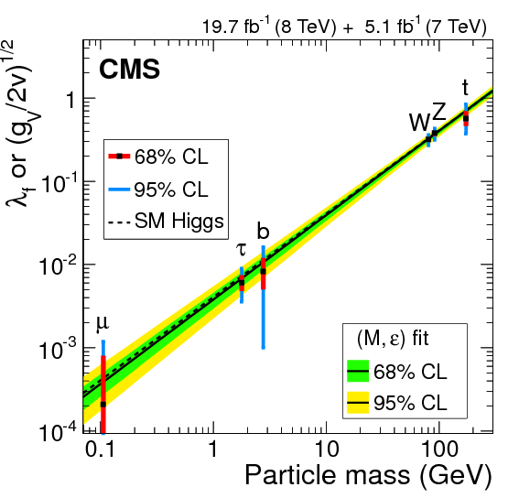
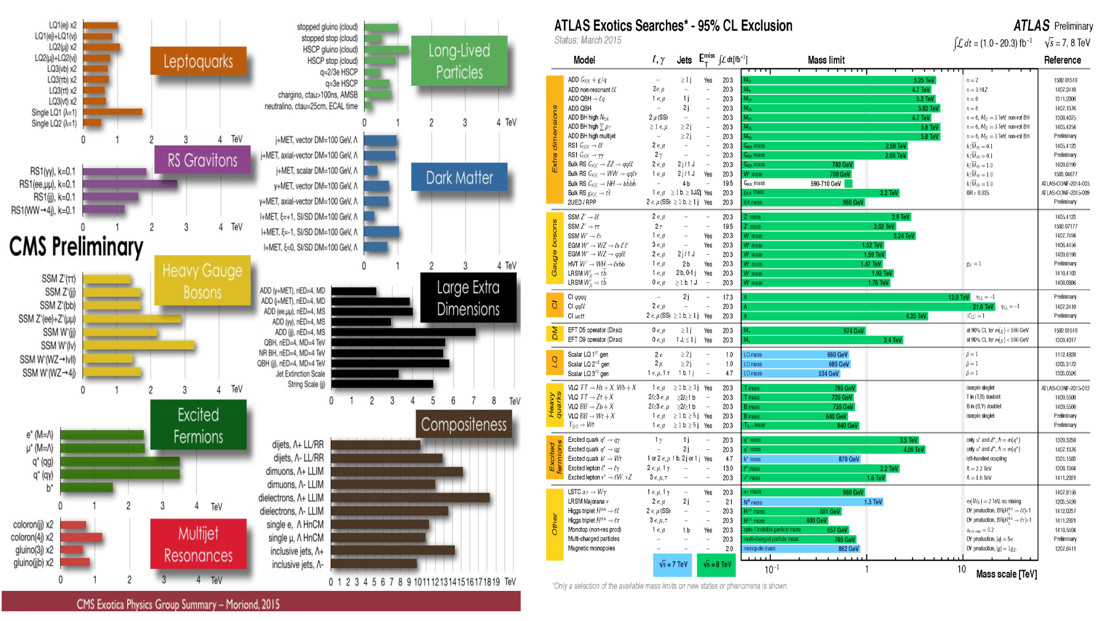
Close to the SM
J. Alcaraz @ Blois 2015

Slide 5
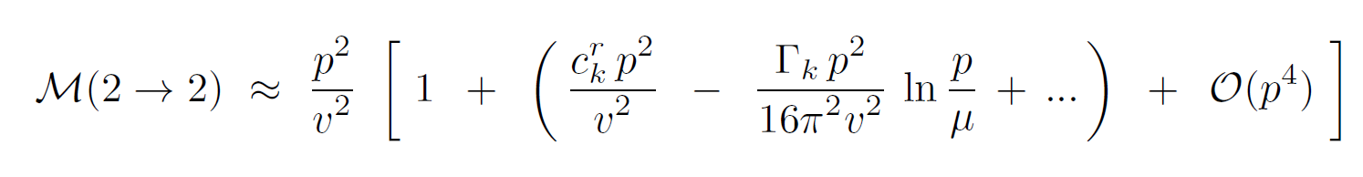
What is the meaning of “close to the SM”?
If Higgs (pseudo) Goldstone boson ➔ Non-linearity for h + ωª
Chiral expansion in non-linear EFT’s: *
Finite pieces from loops
(amplitude dependent) ⁽⁺⁾
LO (tree)
NLO (tree)
NLO (1-loop)
Typical tree
suppression
1/M_{R}²
(other states)
Typical loop suppression
1/ (16π²v²)
(non-linearity)
THIS WORK
** Catà, EPJC74 (2014) 8, 2991
** Pich,Rosell,Santos,SC, [1501.07249]; ‘forthcoming
** Pich,Rosell and SC, JHEP 1208 (2012) 106;
PRL 110 (2013) 181801
(x) Contino,Salvarezza, [1504.02750]
(x) Contino,Marzocca,Pappadopulo,Rattazzi,
JHEP 1110 (2011) 081
* Weinberg ‘79
* Manohar,Georgi, NPB234 (1984) 189
* Urech ’95
* Georgi,Manohar NPB234 (1984) 189
* Buchalla,Catà,Krause ‘13
* Hirn,Stern ‘05
* Delgado,Dobado,Herrero,SC,JHEP1407 (2014) 149
* Pich,Rosell,Santos,SC, forthcoming
- Espriu,Yencho, PRD 87 (2013) 055017
- Espriu,Mescia, Yencho, PRD88 (2013) 055002
- Delgado,Dobado,Llanes-Estrada, JHEP1402 (2014) 121
- Delgado,Dobado,Herrero,SC,JHEP1407 (2014) 149
- Gavela,Kanshin,Machado,Saa, JHEP 1503 (2015) 043
- Guo,Ruiz-Femenia,SC, [1506.04204]
- Azatov, Contino,Di Iura,Galloway, PRD88 (2013) 7, 075019
- Azatov,Grojean,Paul,Salvioni, Zh.Eksp.Teor.Fiz. 147 (2015) 410, J.Exp.Theor.Phys. 120 (2015) 354

Slide 6



Values of the NLO low-energy couplings?
Resonances at M_{R} ∼ 4πv ≈ 3 TeV compatible with
➔ LHC narrow resonance searches
➔ Strong limits on low-energy EFT operators (???)
Meaning?
Suppresion
of the EFT couplings
?
Suppresion
of the EFT operators
Chiral expansion
(non-linear EFT)
Relaxed bounds

Slide 7
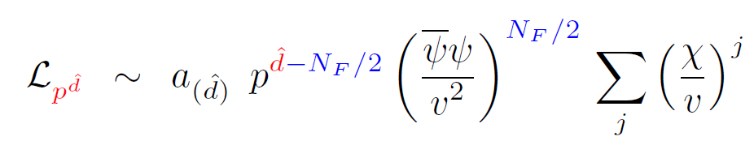
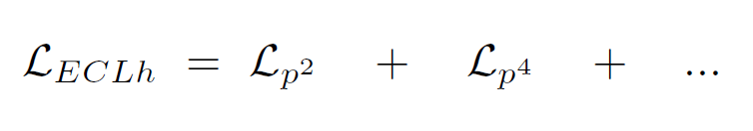

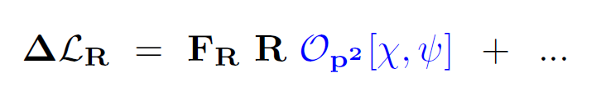
‘CHIRAL’ COUNTING
Assignment of the ‘chiral’ dimension: *
with the low-energy scaling
Low-energy EFT (ECLh) * ➔ Classification of the operators according to `chiral’ dimension:
High-energy theory for Resonances + χ + ψ
➔ General ΔL_{R} `of O(p²)’ **
* Weinberg, 79; Manohar,Georgi, NPB234 (1984) 189
* Gasser,Leutwyler ‘84 ‘85
* Hirn,Stern ‘05
* Buchalla,Catà,Krause ’13
* Delgado,Dobado,Herrero,SC,JHEP1407 (2014) 149
* Henning,Lu,Murayama, [1412.1837]
* Pich,Rosell,Santos,SC, [1501.07249]; forthcoming
* Apelquist,Bernard ‘80
* Longhitano ‘80, ‘81
* Alonso,Gavela,Merlo,Rigolin,Yepes ‘12
* Brivio,Corbett,Eboli,Gavela,Gonzalez–Fraile,Gonzalez–Garcia,Merlo,Rigolin ’13
** Ecker et al. ’89
** Cirigliano et al., NPB753 (2006) 139
** Pich,Rosell,Santos,SC, [1501.07249]; forthcoming

Slide 8
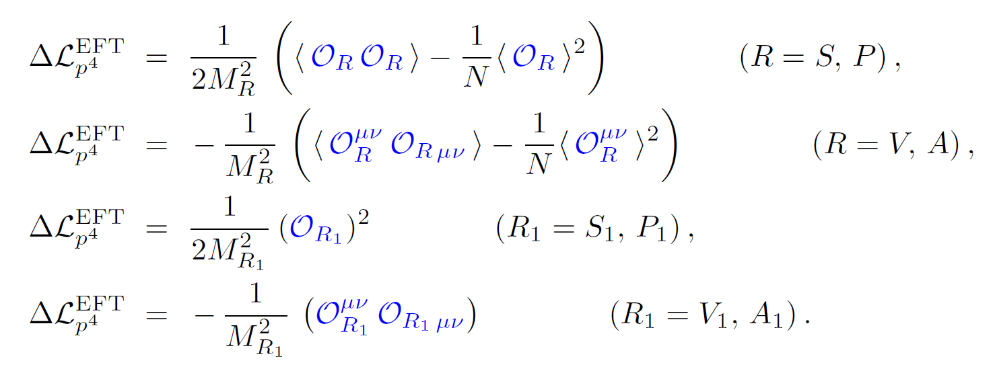
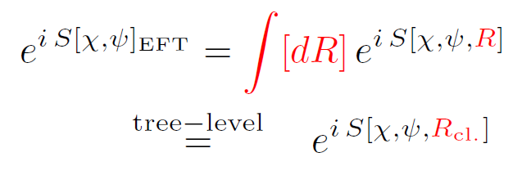
Res. contributions to the O(p⁴) EFT couplings
1.) Only R operators O(p²) : ** singlets V₁, A₁, S₁, P₁ + triplets V, A, S, P + ...
2.) Tree-level contribution to the O(p⁴) ECLh for p<<M_{R}:
[antisymetric-tensor formalism R_{μν}
for spin-1 Resonances **]
1/M_{R}²
O(p²)
O(p²)
** Ecker et al. ’89
** Cirigliano et al., NPB753 (2006) 139
** Pich,Rosell,Santos,SC, [1501.07249]; forthcoming

Slide 9


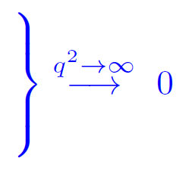
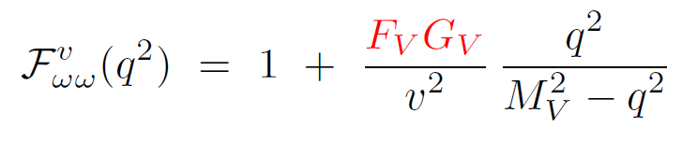
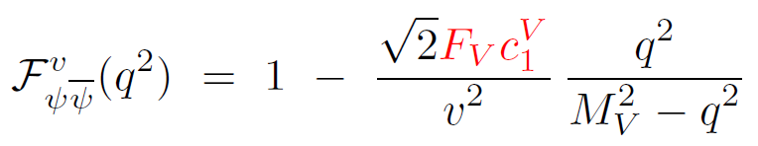
BASIC TREE-LEVEL EXAMPLE: form-factors &
Triplet V contribution in C & P-even strongly couple theories (full R Lagrangian in *)
Contribution from V,
to the EFT @ NLO:
i (a₂-a₃)/2
C^{ψ2h0}₁₀
Impose UV constraints on L_{R}, predict in the EFT: *, **
(a₂-a₃) = -v² /(2M_{V}²)
c^{ψ2h0}₁₀= v²/(2M_{V}²)
** Peskin,Takeuchi, PRL65 (1990) 96; PRD46 (1992) 381
** Orgogozo,Rychkov, JHEP1203 (2012) 046; 1306 (2013) 014
** Pich,Rosell, SC, PRL110 (2013) 181801; JHEP01 (2014) 157
* Pich,Rosell,Santos,SC, [1501.07249]; forthcoming

Slide 10
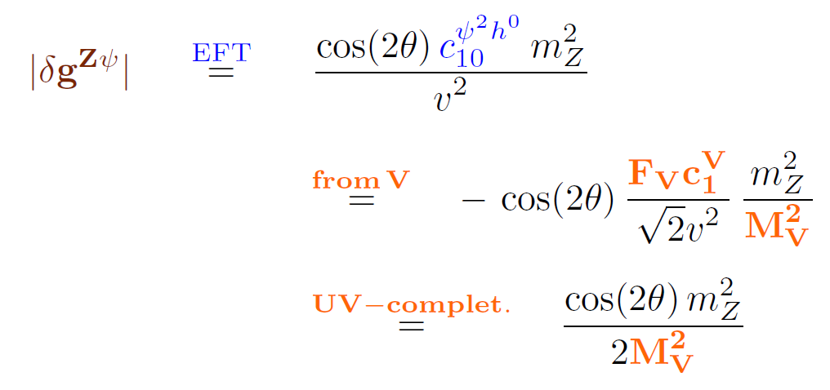
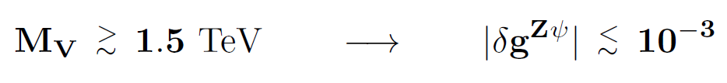
Contributions to
Ruled by the previous couplings
How strong are the bounds? Not difficult to make them* small enough**
* Pich,Rosell,Santos,SC, fothcoming
** Agashe,Contino,Da Rold,Pomarol, PLB641 (2006) 62
** Efrati ,Falkowski,Soreq, [1503.07872]
** LEP [0511027]

Slide 11
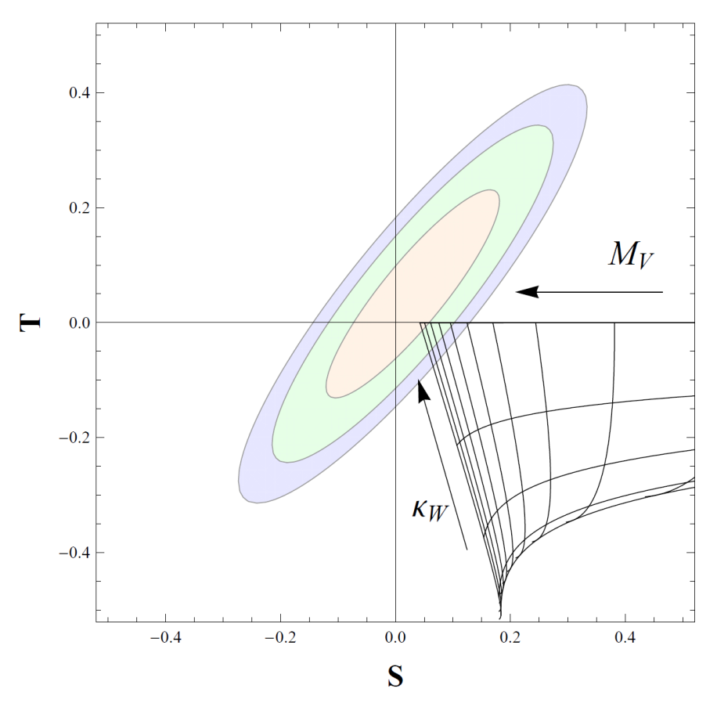
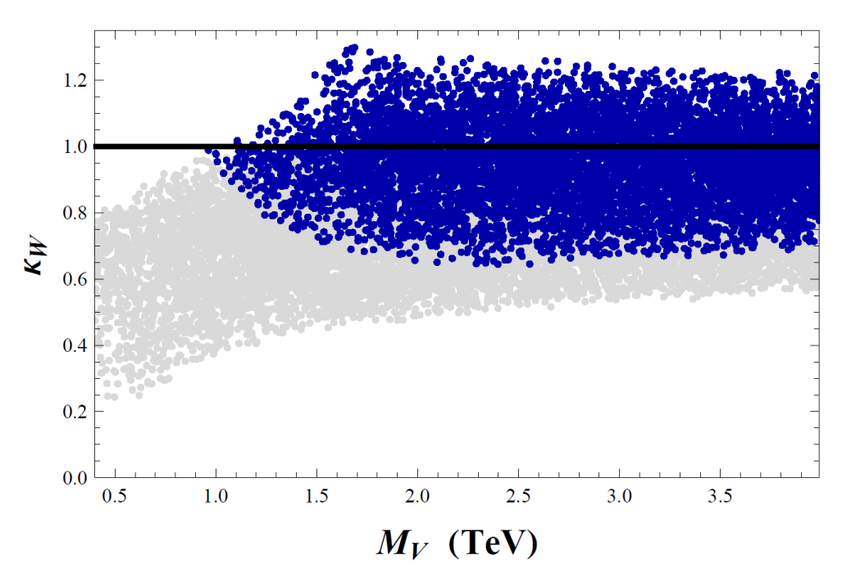
( S , T ) oblique parameters:
ONE-LOOP results + UV-constraint
C & P-even
1.5 TeV < M_{V} < 6.0 TeV
0 < a < 1
ii) NLO results: 1st and 2nd WSRs*
1 > a > 0.94
M_{A}≈ M_{V} > 4 TeV
(95%CL)
a
iii) NLO results: 1st WSR and M_{V} < M_{A}*
68% CL
Similar conclusions, but softened
a
For M_{V}<M_{A}:
  M_{A} > 1 TeV at 68% CL.
0.2 < M_{V}/M_{A} < 1
0.02 < M_{V}/M_{A} < 0.2
* Pich,Rosell, SC, PRL 110 (2013) 181801; JHEP 01 (2014) 157

Slide 12
Conclusions

Slide 13
Chiral power counting in the low-energy non-linear EFT (ECLh)
Build custodial-invariant Lagrangian w/ light dof χ + ψ + R
Low-energy matching: Res. contributions to the EFT @ O(p⁴)
UV-completion assumptions: further constraints on the predictions
Tree-level predictions of the O(p⁴) low-energy couplings
Natural suppression in low-energy observables for M_{R} ∼ 4πv ≈ 3 TeV
- Z→bb: Ok for M_{V} > 1.5 TeV
- S & T param: Ok for a ≈ 1 M_{V} > 4 TeV (1 TeV) for 1st+2nd WSR (only 1st WSR)

