Slide 1
Update on beam induced heating in HL-LHC
Benoit Salvant
With acknowledgment to all equipment groups and in particular:
Nicolo Biancacci, Giuseppe Bregliozzi, Rhodri Jones, Elias Metral, James Storey, Christoph Schwick, Giovanni Iadarola, Giacomo Mazzacano

Slide 2
Agenda
Scalings
Filling schemes
Current issues in LHC
Items to follow up

Slide 3
General comments
Scaling heat load (intensity):
Factor from situation in 2016 | Nominal (25 ns) | ultimate (25 ns) | Before LS1 (50 ns) | 2016 (25 ns) | 2017 | HL-LHC (25 ns)
M | 2808 | 2808 | 1374 | 2200 | 2748 | 2748
Nb | 1.15 | 1.7 | 1.6 | 1.15 | 1.3 | 2.2
Broadband (M*N_{b}²) | 1.3 | 2.8 | 1.2 | 1.0 | 1.6 | 4.6
Narrow band (M*N_{b})² | 1.6 | 3.6 | 0.8 | 1.0 | 2.6 | 5.7

Slide 4
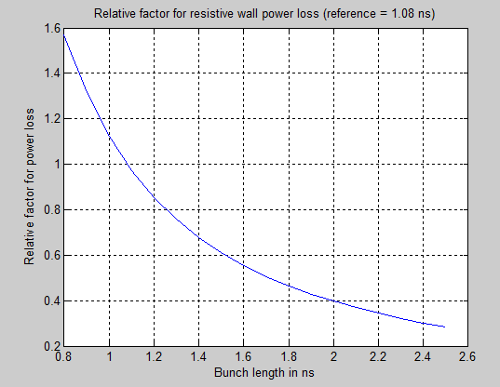
Bunch length effect
For resistive wall type of impedance:
15% gain in power loss with moving to 1.2 ns baseline
Further gain with larger bunch length

Slide 5
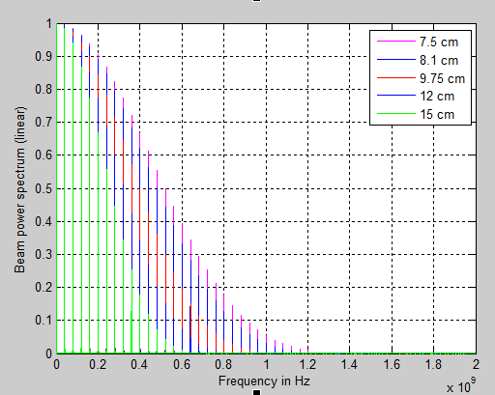
Beam spectrum
1 ns
1.08 ns
1.3 ns
1.6 ns
2 ns
→ Clear beneficial impact of increasing bunch length for all resonant modes

Slide 6
Agenda
Scalings
Filling schemes
Current issues in LHC
Items to follow up

Slide 7
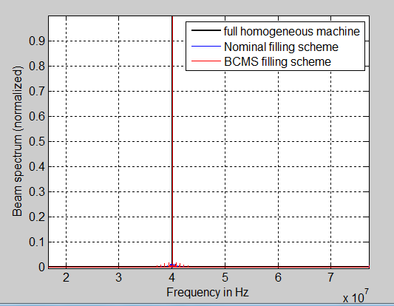
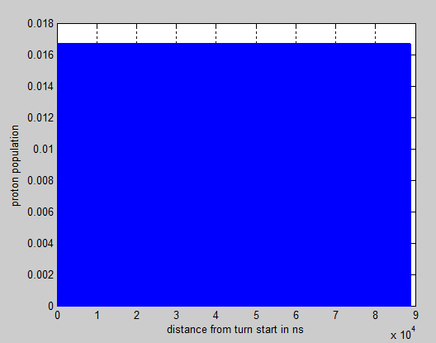
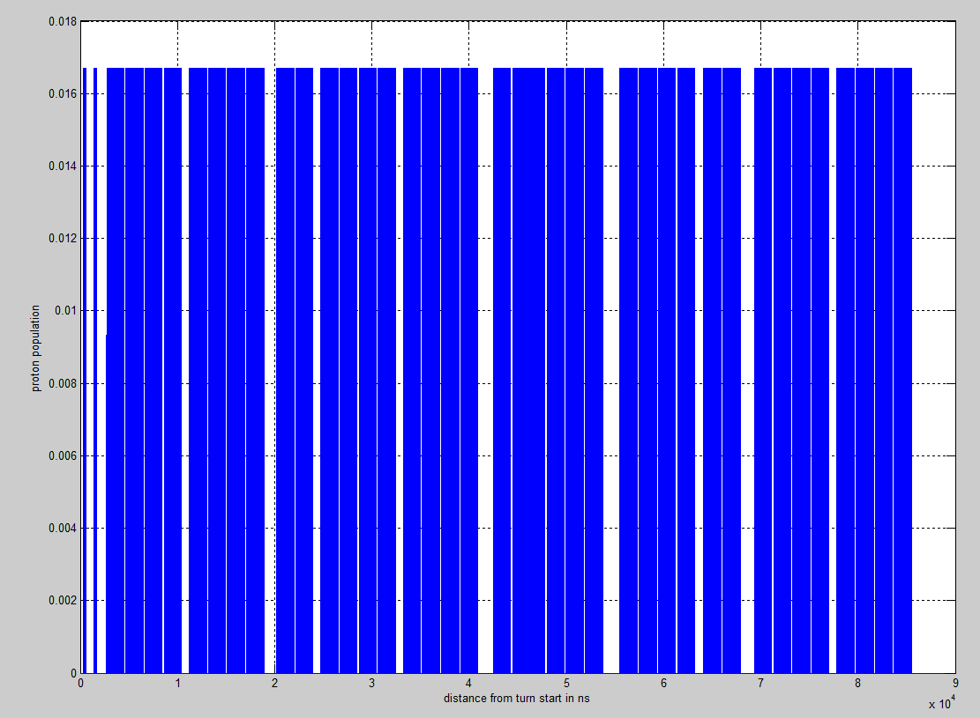
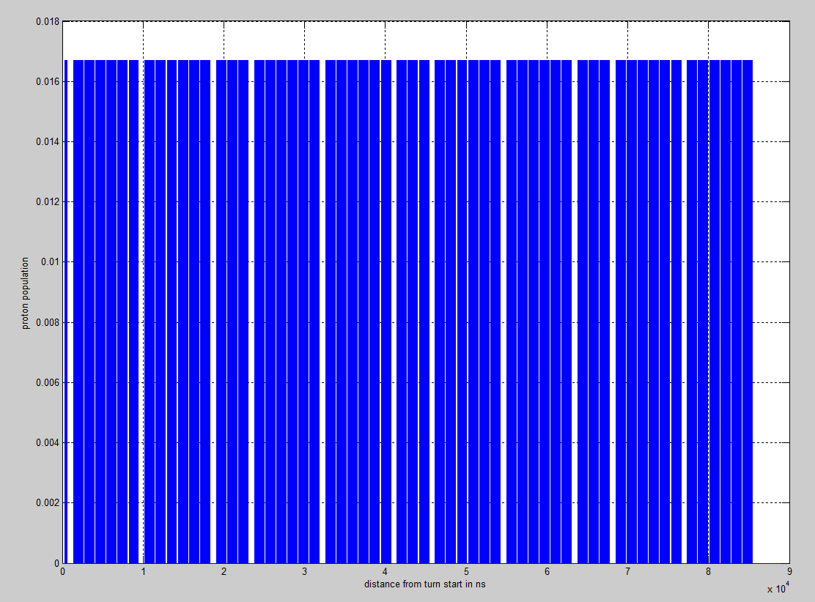
HL-LHC filling schemes
Full homogeneous machine
Nominal filling scheme
25ns_2760b_2748_2494_2572_288bpi_13inj_800ns_bs200ns
BCMS filling scheme
225ns_2748b_2736_2258_2378_288bpi_12inj_800ns_bs200ns

Slide 8
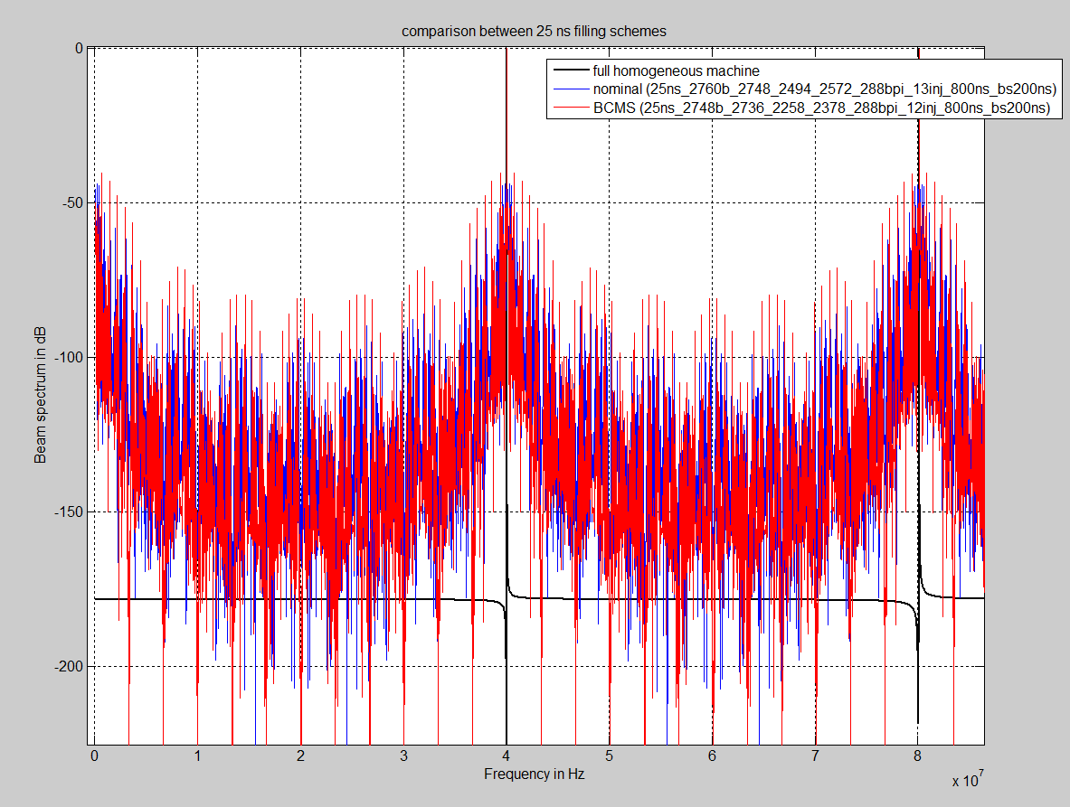
Difference between BCMS and nominal?
Slightly stronger satellites for BCMS due to larger number of 48 bunch patterns
Interesting point in case of issue with resonant mode at the side bands with one of the filling schemes

Slide 9
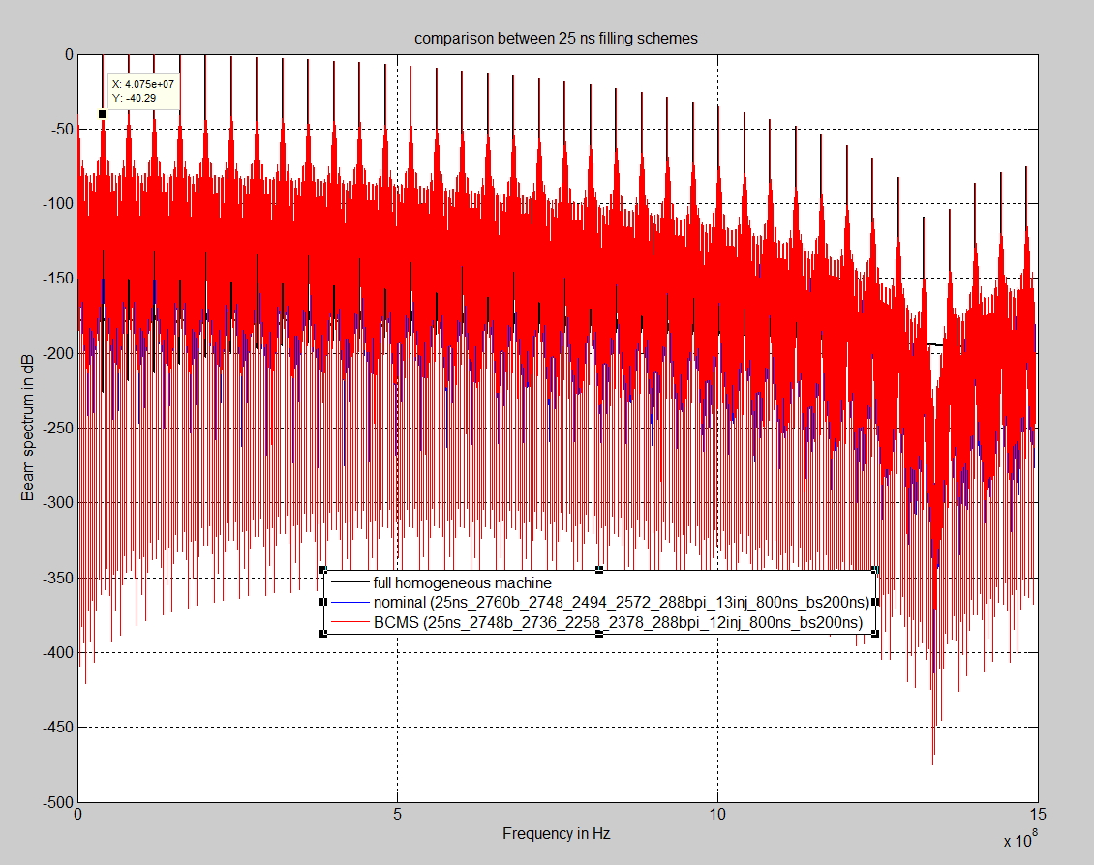
Are these satellites an issue?
These sidebands
Have the same
amplitude as
modes at ~1 GHz
(-40 dB)

Slide 10
Agenda
Scalings
Filling schemes
Current issues in LHC
Items to follow up

Slide 11
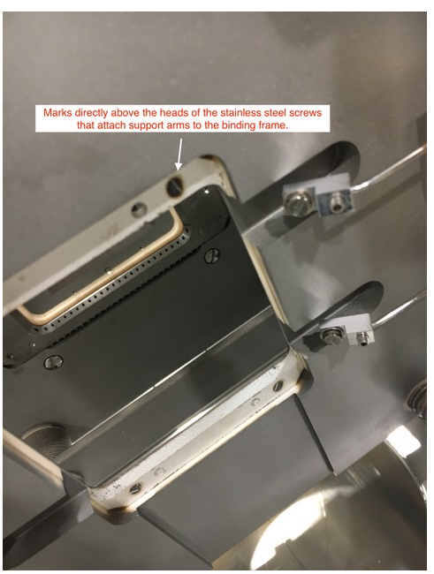
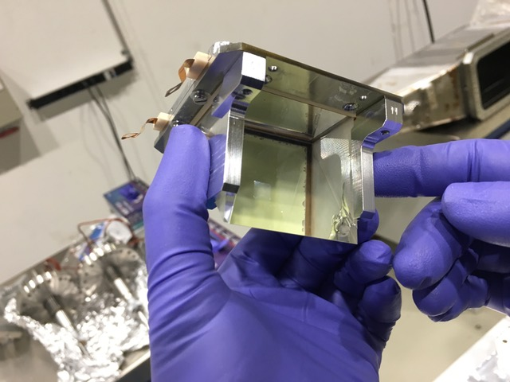
Current issues: BGI
2 BGIs taken out of the machine.
Probably thermal issues, but not clear if due to beam induced RF heating
Temperature of the tank did not increase significantly
Other 2 BGIs may also be removed during this EYETS
More robust design needed

Slide 12
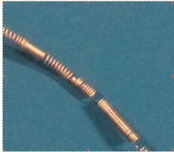
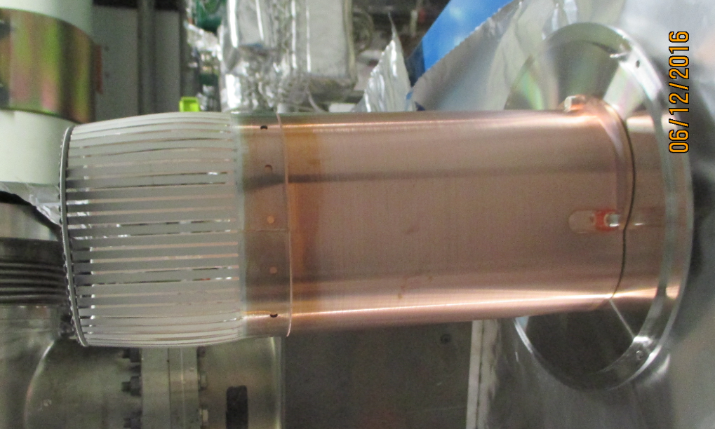
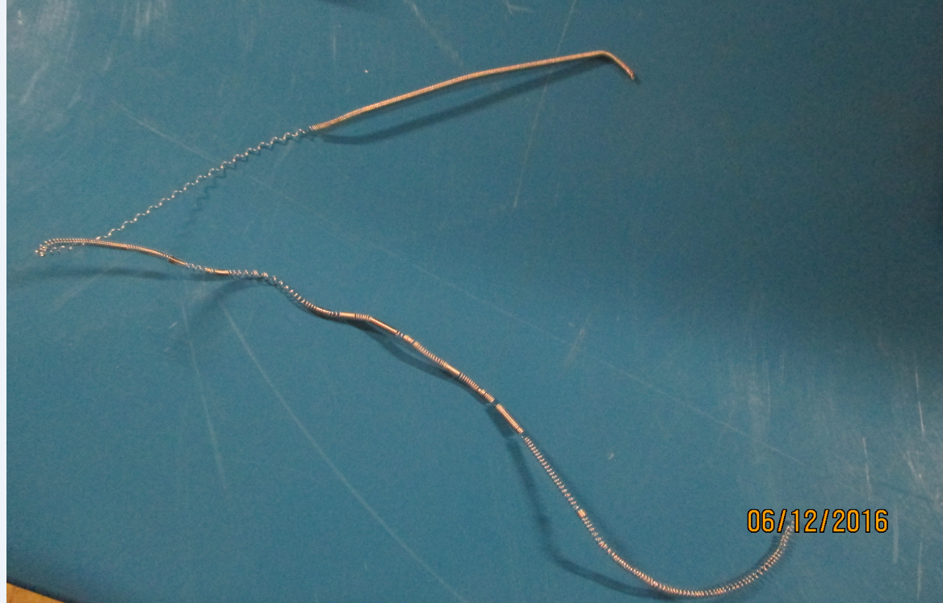
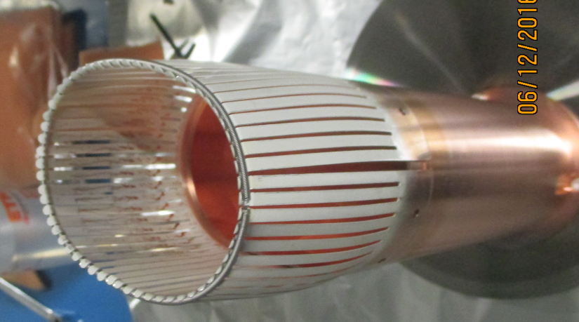
Current issues: VMSI
Module already repaired
(new spring attached, no spare fingers)
Some welding and loss of elasticity
Same issue as pointed out by the RF fingers
task force (led by Elias in 2012): no funnelling

Slide 13
Agenda
Scalings
Filling schemes
Current issues in LHC
Items to follow up

Slide 14
To be followed up
MKI (see dedicated talk at this meeting)
Electron lens
LHCb VELO
New CMS pipe (see talk at the last meeting)
Y chamber
[11T dipole]
[Beam-beam wire compensation]
Upgraded collimators with coating and RF fingers

Slide 15

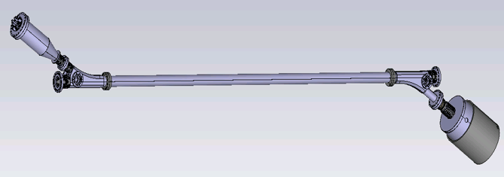
Electron lens:
ongoing study by Giacomo

Slide 16
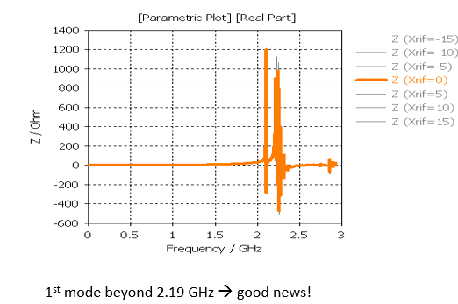
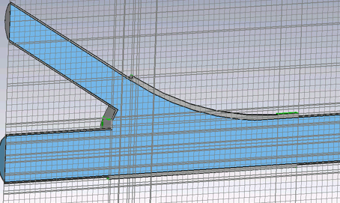
Electron lens
ongoing study by Giacomo
Very high frequency
Close to the cut-off of the outgoing pipes.
Small shunt impedance expected
Design quite well optimized already compared to the initial design from Fermilab
Volume of the y chamber could be further reduced if possible.

Slide 17
LHCb VELO RF box
Our request to decrease the convolution depth could not be met (reported by Massimiliano), as this had a large impact on efficiency
Open points:
  At what distance is the resistive beam induced heating dangerous for the Al foil?
  → need to know at what distance to put the BCM threshold to dump the beam
  → power loss vs distance provided to LHCb
  → proposed potential solutions to study the thermal effects in simulations
  → resources needed from their side and asked for machine help (e.g. EN-MME)
  → important also to simulate what is currently happening (including cooling).
  Our request to perform bench measurements to crosscheck simulations before installation:
    Difficult to measure the real foil. Massimiliano agreed to check if prototypes could be built and provided to us in advance
    Possibility to check for surprises and for mitigations (e.g. EM couplers or contacts).
  Can we do meaningful tests with beam?
    Cooling can not be easily turned off
    Could move the beam towards the foil with increasing number of bunches to simulate the HL-LHC conditions. Not trivial.

Slide 18
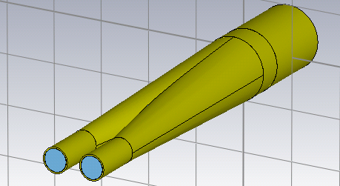
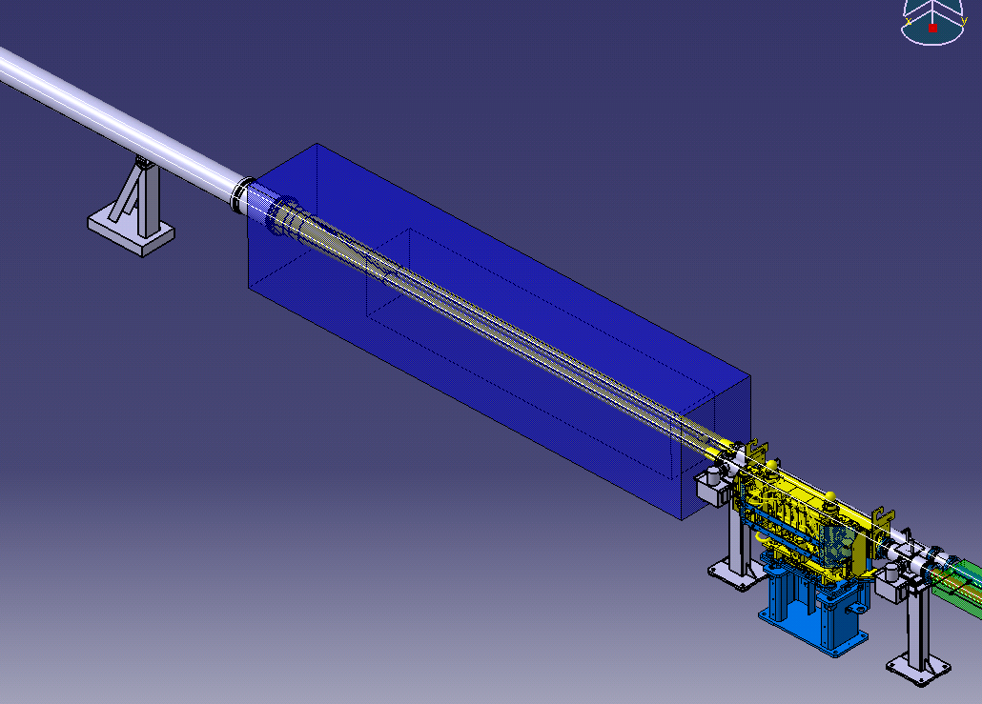
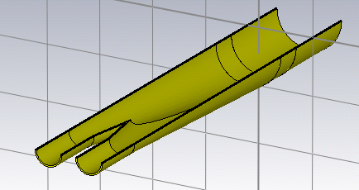
Y chamber
Strictly follows the recipes by Bruno Spataro and Fritz
Work ongoing, but no harmful longitudinal mode identified so far

Slide 19
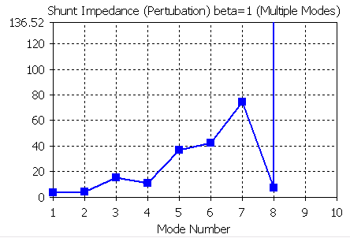
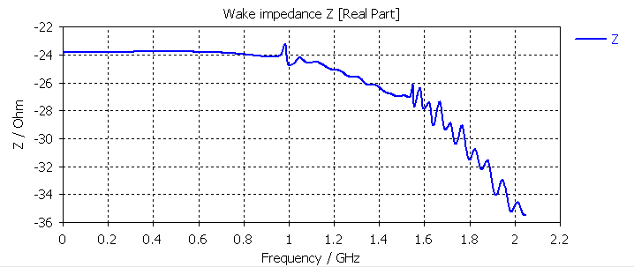
Y chamber
Strictly follows the recipes by Bruno Spataro and Fritz
Work ongoing, but no harmful longitudinal mode identified so far

Slide 20
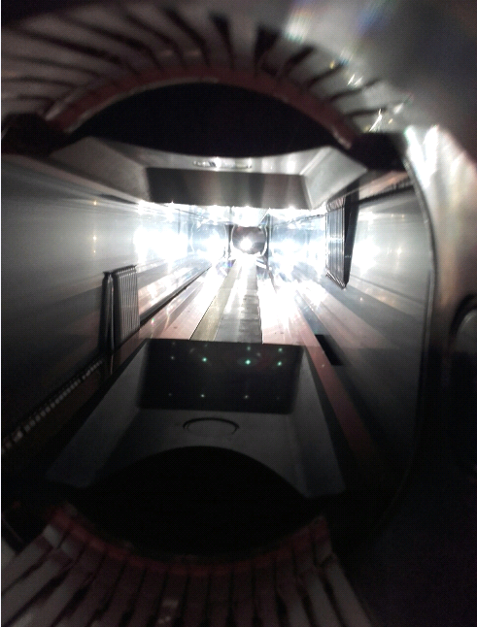
Collimators
Large beneficial impedance reduction campaign
RF fingers vs ferrites:
→ Source of non conformities?

Slide 21
Summary
Number of issues with beam induced heating strongly decreased in 2016
Still a large gap to reach HL-LHC power loss
→a lot of room for issues on the way
Need to tackle the interference between beam and temperature probes
As of today, main limitations seems to come from MKIs. Many studies ongoing.

