Slide 1
Flat beams: parameter choice and energy deposition issues
Jose L. Abelleira on behalf the JAI-FCC team
University of Oxford
6 February 2017
Thanks to Ilaria Besana and Francesco Cerutti (CERN)

Slide 2
contents
1. Flat beam parameters
2. Luminosity evolution model
3. flat beam optics
4. Flat beams: Energy deposition
5. TAS and shadowing

Slide 3
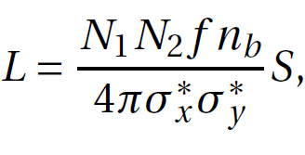
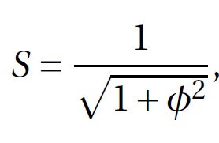
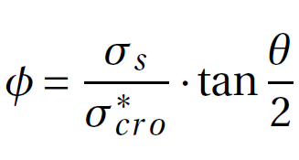
1. Flat beam parameters
 | Case 1 | Case 2 | Case 3 | Case 4
 | Round 1.1 | Round 1.1 | Round 1.1 ultimate | Possible flat
N [10¹¹] | 1.0
e_{N} [μm] | 2.2
nb | 10600
σz[cm] | 8
Betx[m] | 1.1 | 0.3 | 0.3 | 1.0
Bety[m] | 1.1 | 0.3 | 0.3 | 0.2
Ѳ [μrad] for 15σ | 92 | 176 | 176 [0] | 96
S | 0.88 | 0.45 | 1.0 | 0.86
Total tune shift [2 IPs] | 0.010 | 0.005 | 0.011 | 0.012
L [x10³⁴ cm⁻²s⁻¹] | 5.0 | 9.0 | 20 | 12

Slide 4
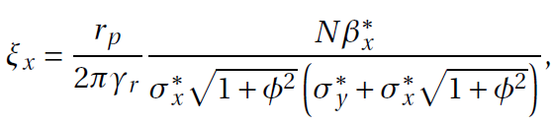

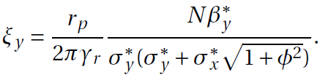

2-Luminosity evolution model
JAI-Oxford has developed a luminosity evolution model to evaluate the influence of beam parameters in luminosity production. Taken into account:
  Luminosity burn off (2 IPs).
  Transverse emittance damping (1 hour)
  Artificial transverse emittance blow up.
  No longitudinal damping (σs=constant).
  No IBS or coupling.
  Tune shifts computed as
For the total tune shift:
Alternate crossing IPA/IPG
Same crossing IPA & IPG

Slide 5
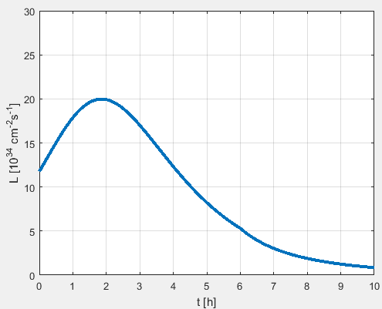
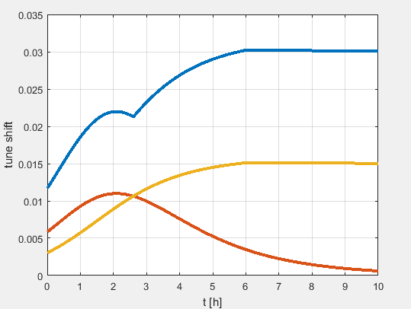
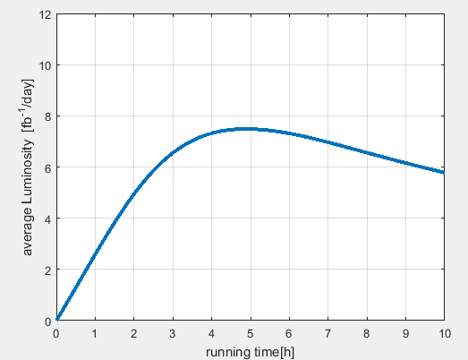



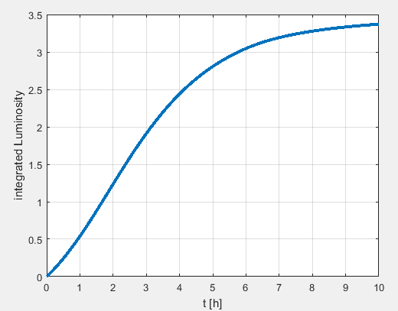
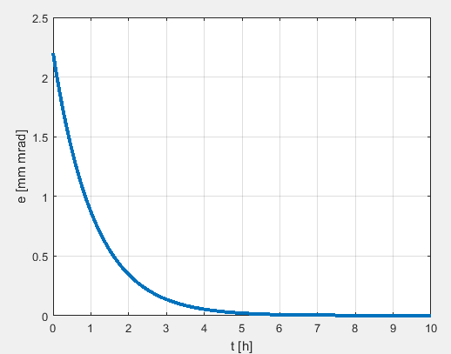
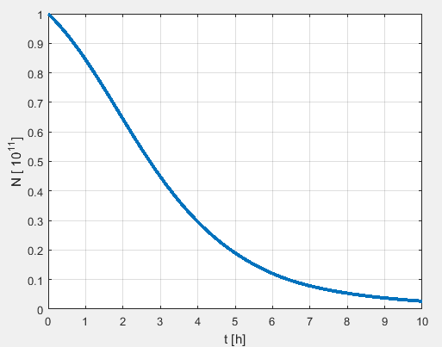
2-Luminosity evolution model
Turnaround time= 4 h
Optimum run time =4.8 h
Artificial blow up
(not needed)
Equilibrium emittance 0.05 not taken into account but ok

Slide 6
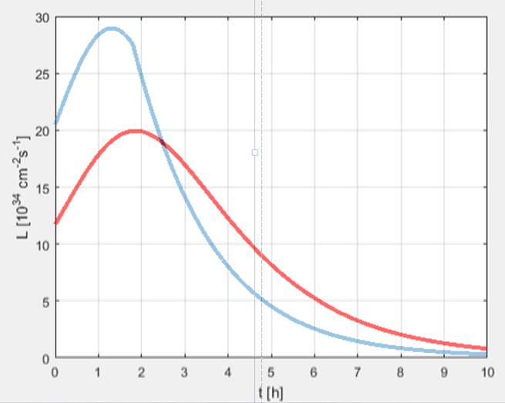
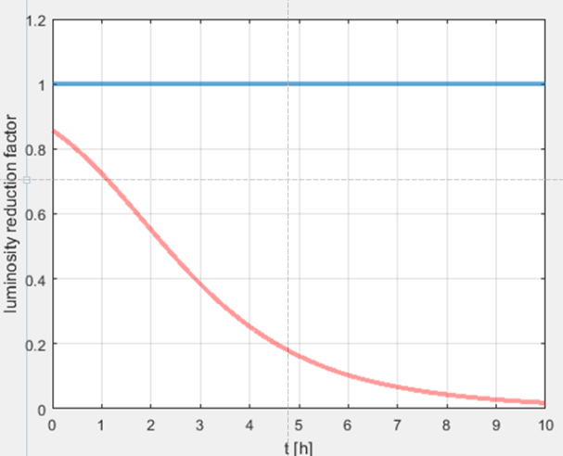
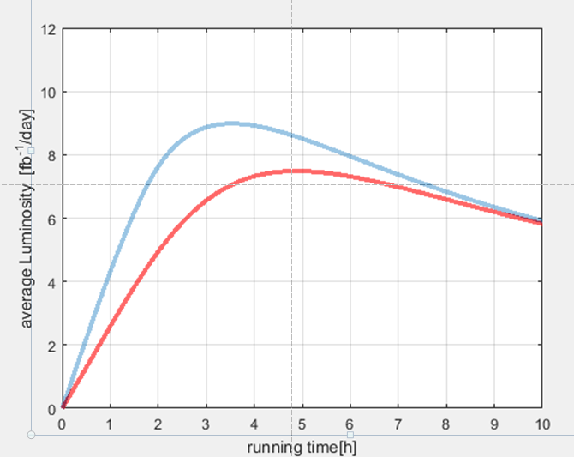
2-Luminosity evolution model
Bet=0.3,
crab cavities
Bety=0.2, betx=1.0
bet | Lpeak | Lint
0.3,0.3 m | 28 cm⁻²s⁻¹ | 9 fb⁻¹ day⁻¹
1.0,0.2 m | 20 cm⁻²s⁻¹ | 7.5 fb⁻¹ day⁻¹
Piwinski ~ 5
The large Piwinski reduces tune shift and allows getting smaller σ_{xy} (no artificial blow up)
less L peak, a little bit less int L, but a more stable luminosity production

Slide 7
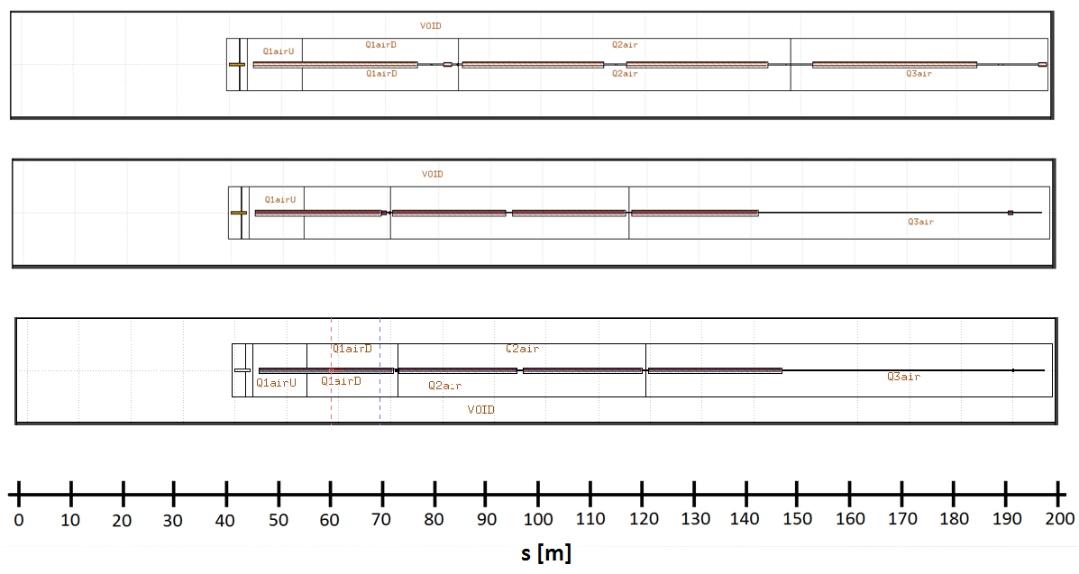
3-Flat beam optics
Nominal triplet
Q1
Q2A
Q2B
Q3
JAI Nov 2016 triplet
Q1
Q2A
Q2B
Q3
JAI Feb 2017 (flat-optics) triplet
Q1
Q2A
Q2B
Q3
IP

Slide 8
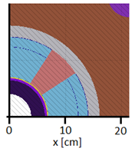
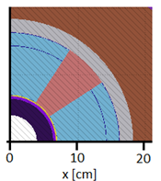
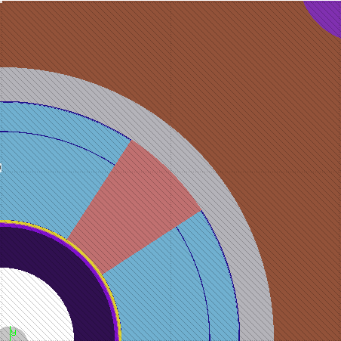
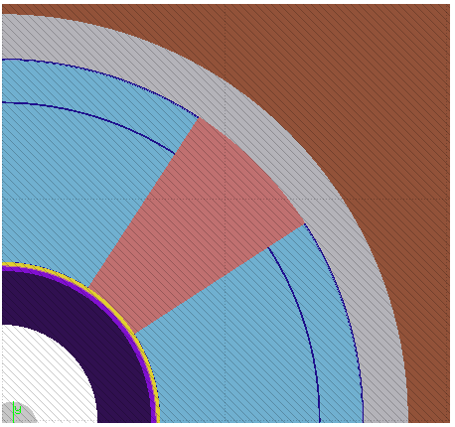
3-Flat beam optics
Q1
Q2-Q3
JAI Nov 2016 triplet
Abs: 4-6.42 cm
Q1
Q2-Q3
JAI Feb 2017 (flat-optics) triplet
Abs: 4.30-6.72 cm
Q1
Q2-Q3
Minimum acceptance: 16.5 σ

Slide 9
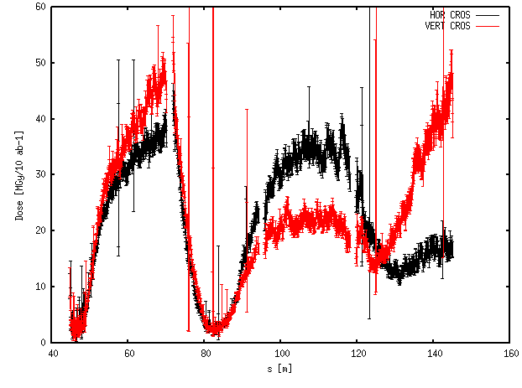
4-Flat beams: Energy deposition
Horizontal/vertical crossing: shielding 2.4 cm
Note the units in dose: MGy/10 ab-1, easily scalable to the different scenarios

Slide 10
Flat beams: Energy deposition
I have run these cases:
IPA | Hor_r | Hor_l | Ver_u | Ver_d
Case 1 | 50 % | 0 | 50 % | 0
Case 2 | 50 % | 0 | 25 % | 25 %
Case 3 | 33.33 % | 0 | 33.33 % | 33.33 %
Case 4 | 25 % | 25 % | 25 % | 25 %
IPG | Hor_r | Hor_l | Ver_u | Ver_d
Case 1 | 50 % | 0 | 50 % | 0
Case 2b | 50 % | 0 | 25 % | 25 %
Case 3 | 66.66 % | 0 | 33.33 % | 0 %
Case 4 | 25 % | 25 % | 25 % | 25 %
Hor_r: crossing in the horizontal plane, right side
Hor_l: crossing in the horizontal plane, left side
Ver_u: crossing in the vertical plane, up
Ver_d: crossing in the vertical plane, down
Switching ‘up/down’ in the vertical plane feasible
‘Crossing in the left side’: tilt instead
Alternate crossing IPA-IPG. Assume we need compensation by crossing then we have an additional case (2b). But if we have wire compensation then crossing we assume IPA crossing plane and IPG crossinh plane the same

Slide 11
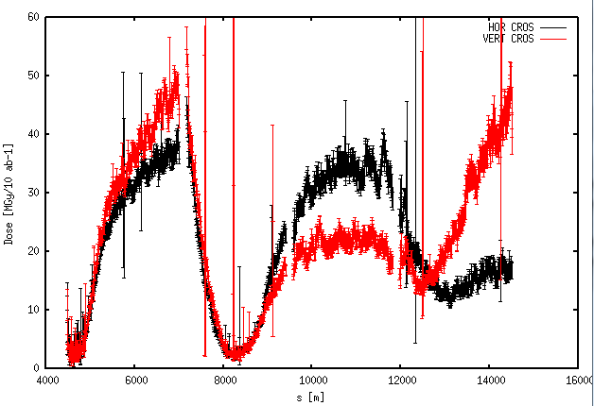
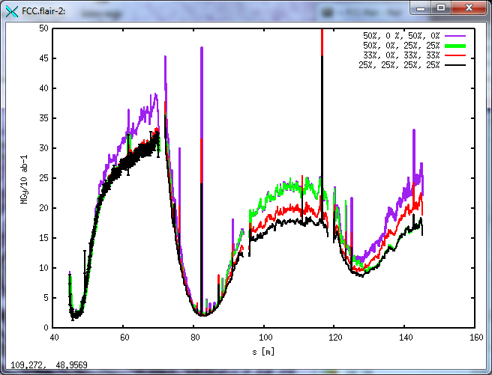
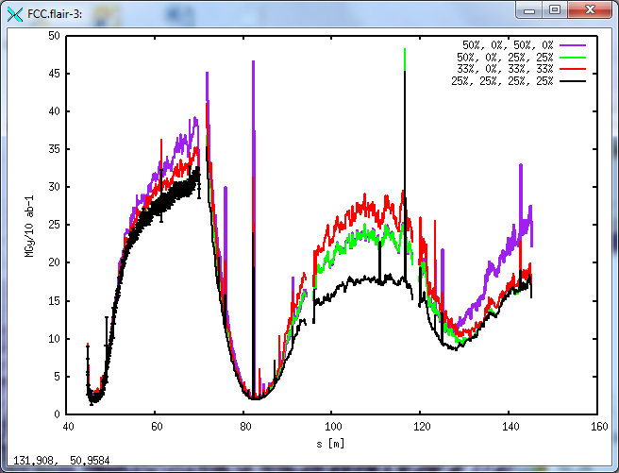
4-Flat beams: Energy deposition
Q1 : vertical crossing dominated
Q2A : horizontal plane dominated
Q2B : horizontal crossing dominated
Q3 : vertical crossing dominated
The % refer to the time in IPA
IPA
IPG

Slide 12
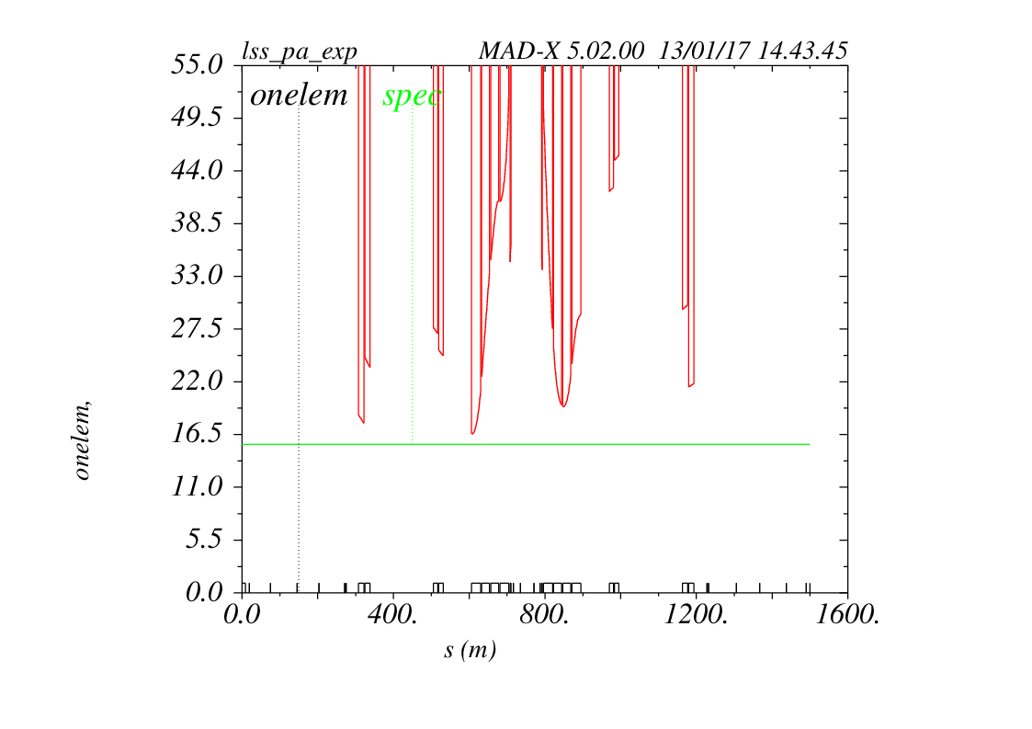
Flat optics benefits
By having a look to the available aperture plot, we see that the bottleneck is Q3
Shielding in Q1 can be increased without compromising minimum acceptance.
*Leon’s talk

Slide 13
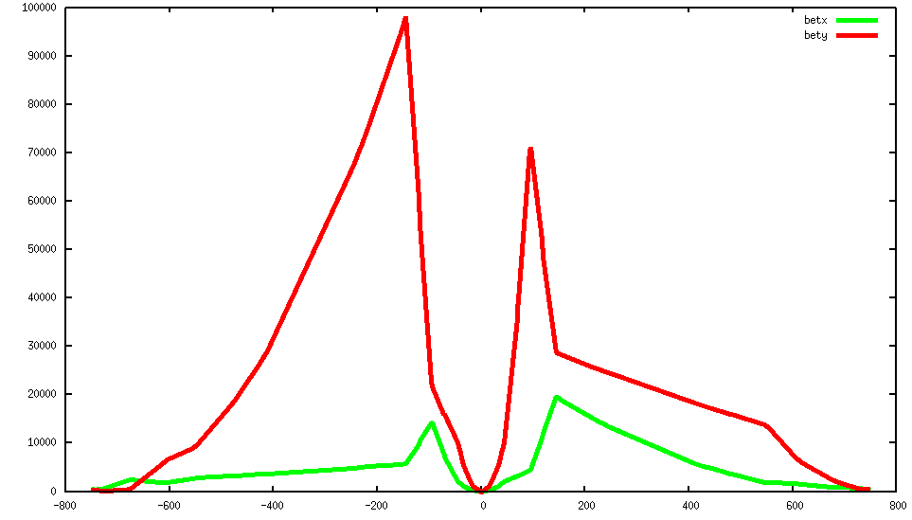
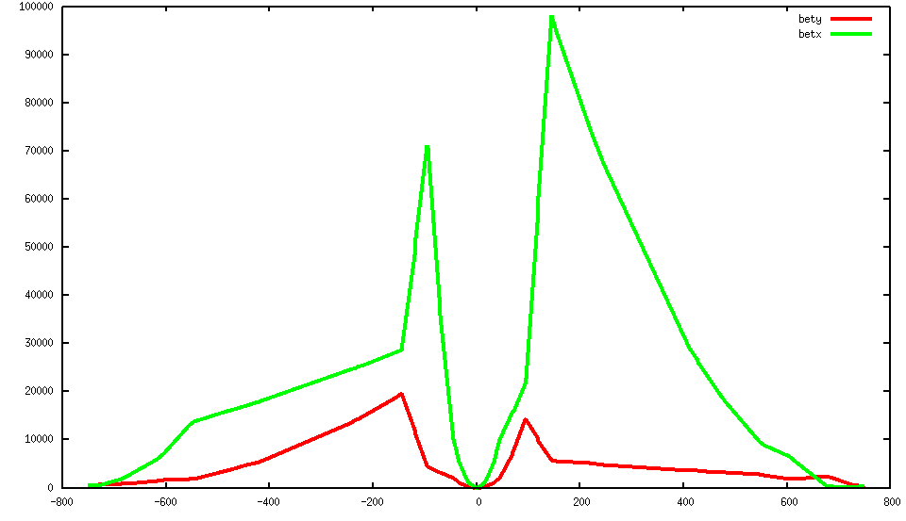
4-Flat beams: Energy deposition
HOR CRO beam 1
VER CRO beam 1
HOR CRO beam 2
VER CRO beam 2
Q3
Q1
Large difference between MAX beta in Q1 and Q3
We can increase shielding in Q1

Slide 14
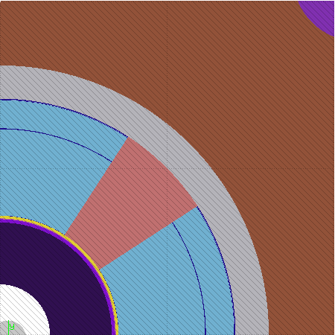
4-Flat beams: Energy deposition
Q1
Q2-Q3
JAI Nov 2016 triplet
Abs: 4.-6.4 cm
Q1
Q2-Q3
JAI Feb 2017 (flat-optics) triplet
Abs: 4.3 -6.7 cm
Q1
Q2-Q3
shielding increase in Q1 only
Q1
Q2-Q3
Abs: 3.0- 6.7 cm

Slide 15
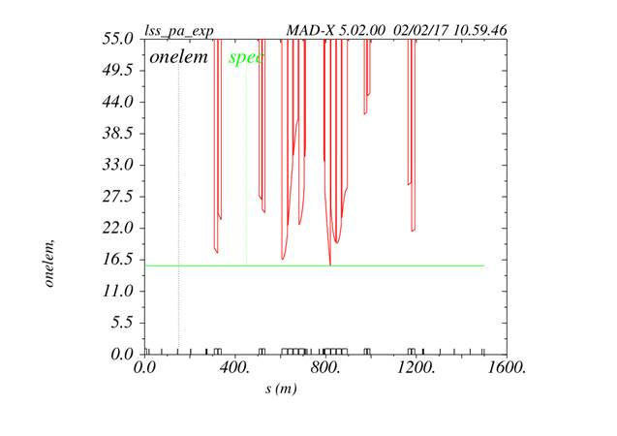
4-Flat beams: Energy deposition
2.4 cm shielding in Q1
3.7 cm shielding in Q1
*Leon’s talk

Slide 16
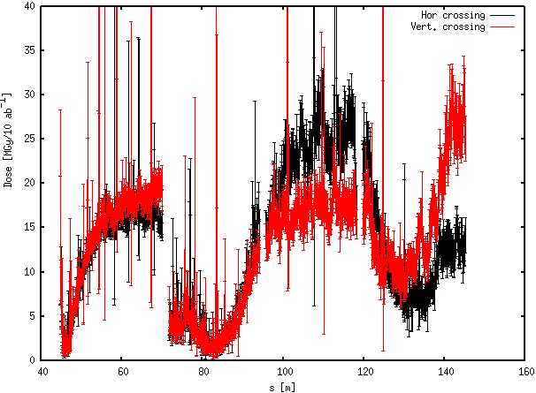
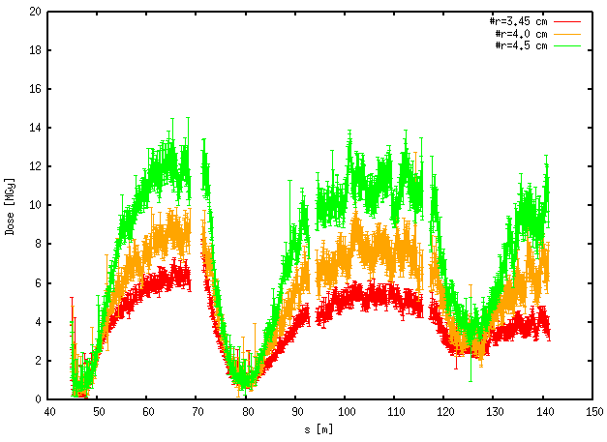
4-Flat beams: Energy deposition
Horizontal/vertical crossing. Shielding in Q1 2.4 → 3.7 cm
Comparison with JAI Nov triplet (3 ab-1)
27 MGy/10 ab-1
3.7 cm shielding
Maximum dose reduced from 50 to 25 Mgy/10 ab⁻¹.
Maximum occurs now for Q3, but dose reduced in all magnets. Q1 ‘shadows’ them.
Difference between planes not as large as before

Slide 17
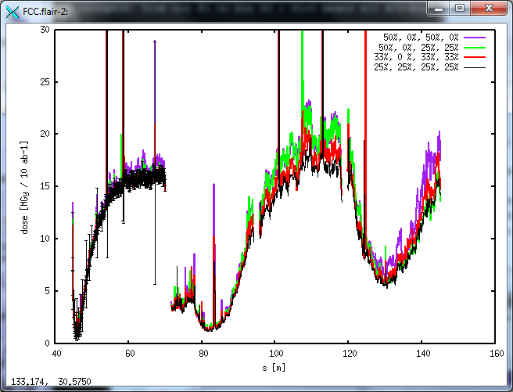
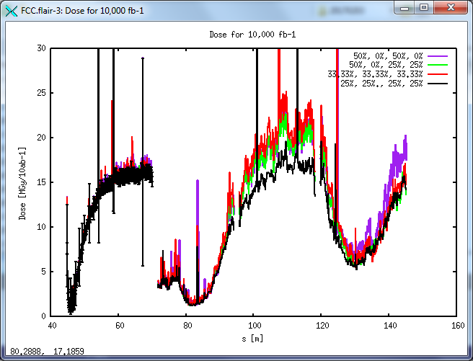
4-Flat beams: Energy deposition
Maximum dose reduced to 20 Mgy/10 ab⁻¹.
Almost no difference between the mixing of crossing possibilities
IPA
IPG

Slide 18
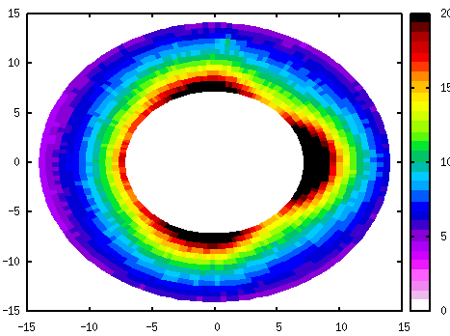
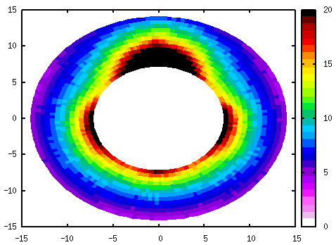
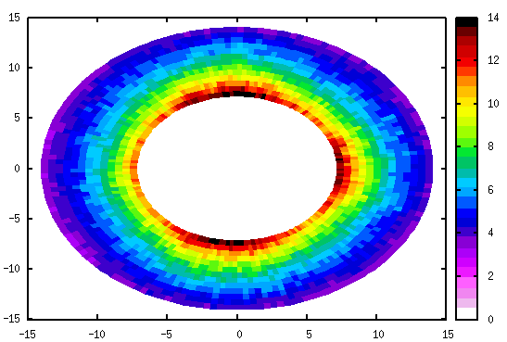
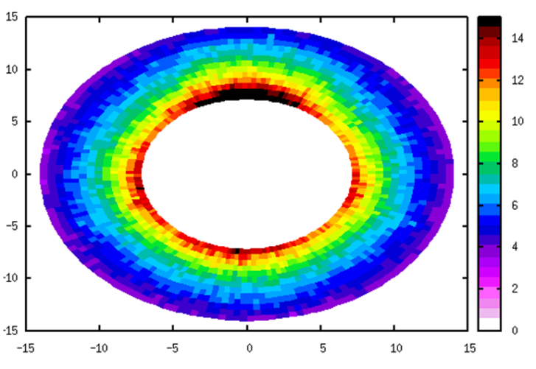
4-Flat beams: Energy deposition
Dose at the end of Q1
Horizontal crossing
vertical crossing
2.4 cm shielding
3.7 cm shielding

Slide 19
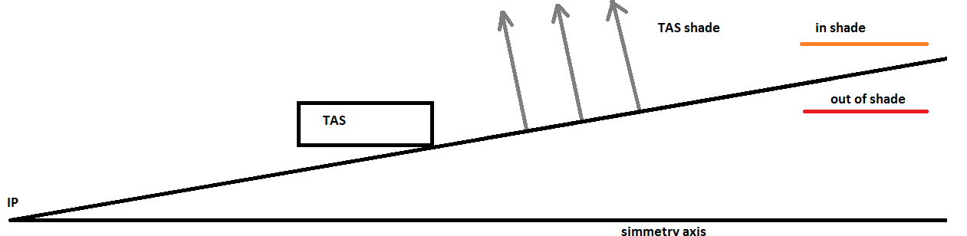
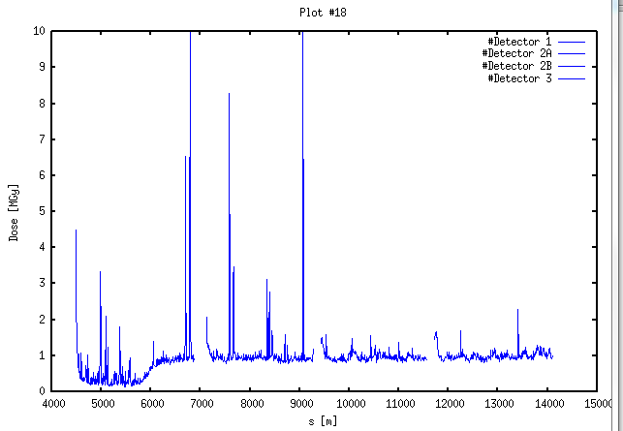
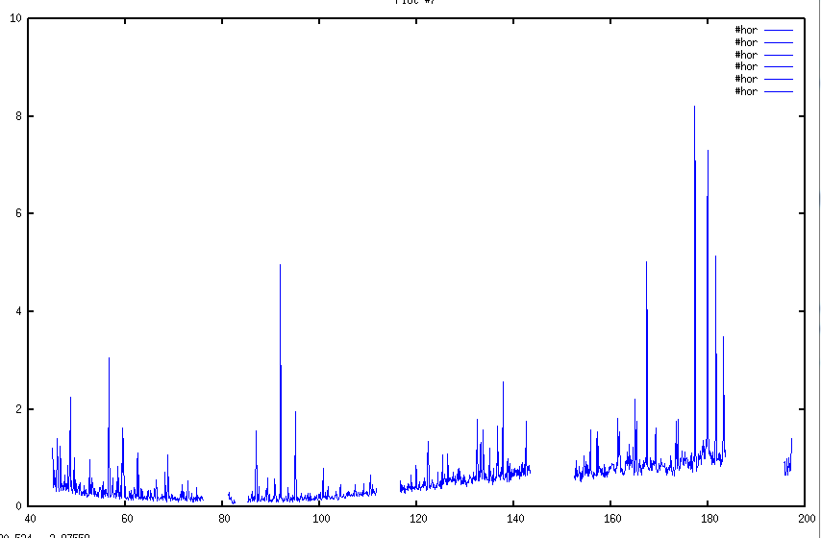
TAS shadowing
Jai NOV 2016
Nominal triplet

Slide 20
Conclusions
A set of flat beam parameters is proposed: betx=1.0 m, bety=0.2 m.
From a simple luminosity production model, it gives smaller integrated luminosity but with a safer production rate.
The reason for that is the low tune shift.
The flat beam optics has the advantage of breaking symmetries between quads, allowing for increase in Q1 shielding, critical for protection.
From the protection point of view it seems a better choice.

