Slide 1
Three Remarks On d=4 N=2 Field Theory
Gregory Moore
Rutgers University
CERN, July 10, 2017

Slide 2
1
A Little Gap In The Classification Of Line Defects
2
Comparing Computations Of Line Defect Vevs
3
Some New d=4, N=2 Superconformal Field Theories?
4
Conclusion

Slide 3


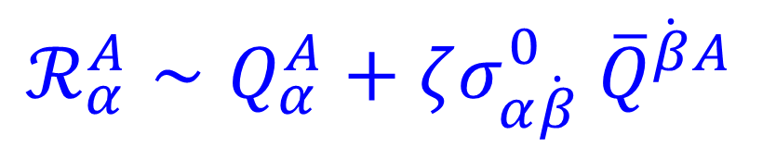
Line Defects
Supported on one-dimensional submanifold of spacetime.
Defined by UV boundary condition around
small tubular neighborhood [Kapustin].
This talk: Focus on half-BPS d=4 N=2 defects on
straight lines along time, sitting at points in space.
Our defects preserve $osp{\left(4^{∗} | 2\right)}_{ζ}⊂su\left(2,2 | 2\right)$ fixed subalgebra under P(arity) and $U{\left(1\right)}_{R}$rotation by $ζ$
t
$$\vec{x}=0$$
$$ℛ_{α}^{A}∼Q_{α}^{A}+ζσ_{α\dot{β}}^{0} {\overline{Q}}^{\dot{β}A}$$

Slide 4
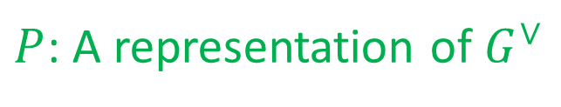

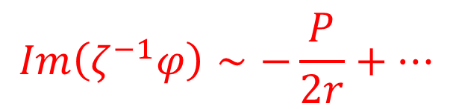



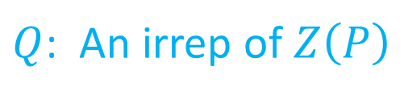
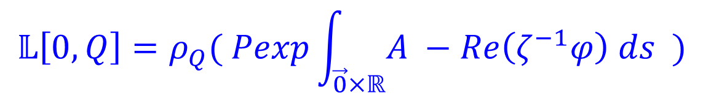

Example: ‘t Hooft-Wilson Lines
In Lagrangian Theories
$G$ is a compact semisimple Lie group
Denote ‘t Hooft-Wilson line defects $𝕃\left[P,Q\right]$
$P$: A representation of $G^{∨}$
or, $P∈Hom\left(U\left(1\right),T\right)≅Λ_{cochar}⊂𝔱$
$Q$: An irrep of $Z\left(P\right)$
$$𝕃\left[0,Q\right]=ρ_{Q}( Pexp\int_{\vec{0}×ℝ}{A −Re\left(ζ^{−1}φ\right) ds )}$$
$$Im\left(ζ^{−1}φ\right)∼−\frac{P}{2r}+⋯$$
$$𝕃\left[P,0\right]$$
$$F∼P vol\left(S^{2}\right)+⋯$$

Slide 5
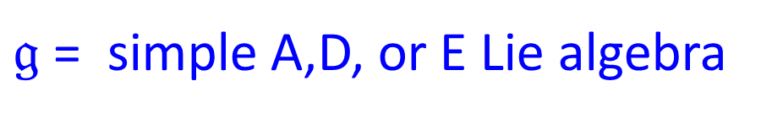
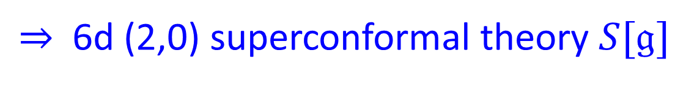
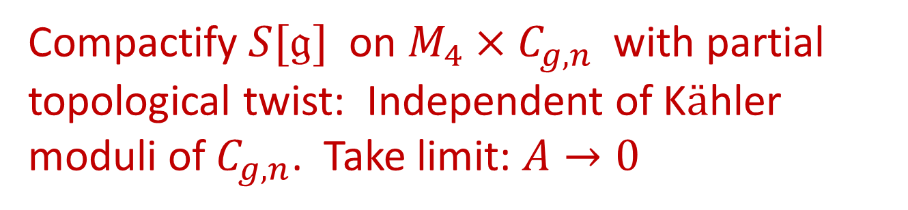
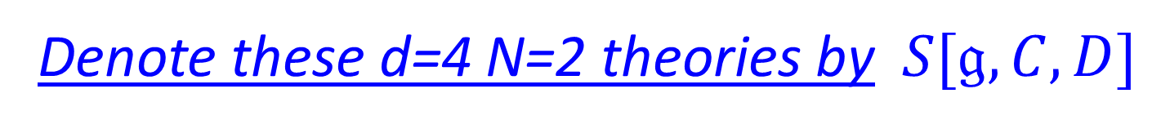
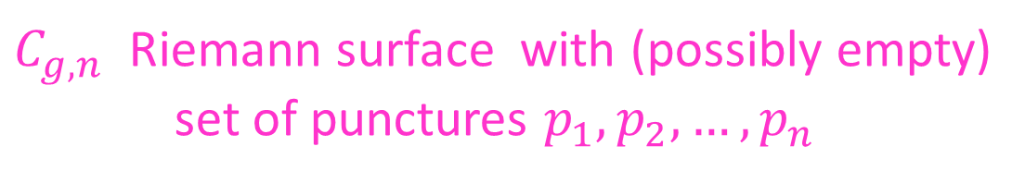
Class S
$𝔤$= simple A,D, or E Lie algebra
$⇒$ 6d (2,0) superconformal theory $S[𝔤]$
$C_{g,n}$ Riemann surface with (possibly empty)
set of punctures $p_{1},p_{2},…, p_{n}$
D = collection of ½-BPS cod=2 defects $D\left(p_{1}\right), …, D\left(p_{n}\right)$
Compactify $S[𝔤]$ on $M_{4}×C_{g,n}$with partial topological twist: Independent of K$ä$hler
moduli of $C_{g,n}$. Take limit: $A→0$
Denote these d=4 N=2 theories by $S[𝔤,C,D]$

Slide 6
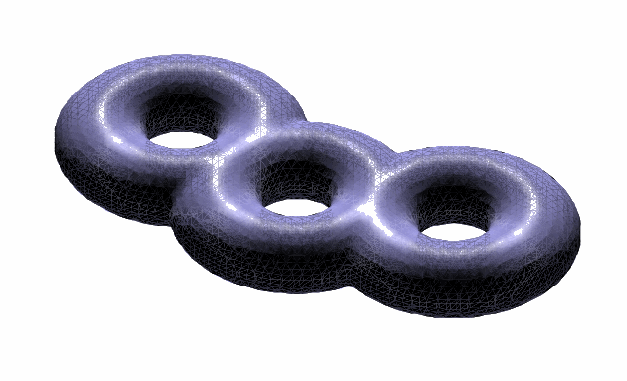
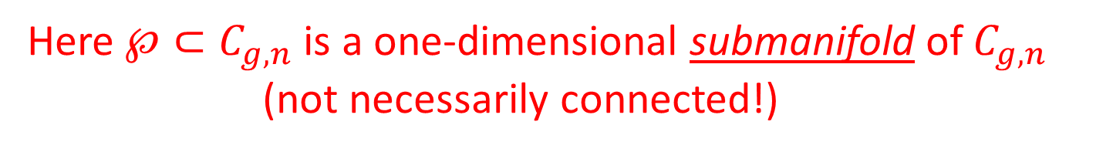

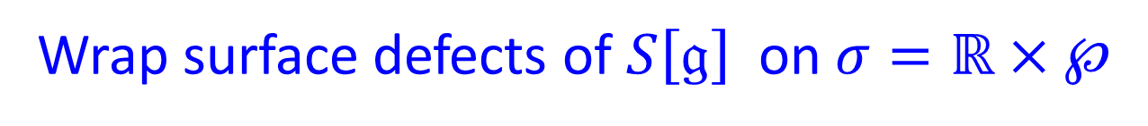

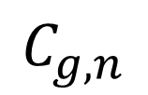
Line defects in $S[𝔤,C,D]$
Wrap surface defects of $S\left[𝔤\right]$ on $σ=ℝ×℘$
Here $℘⊂C_{g,n}$is a one-dimensional submanifold of $C_{g,n}$
(not necessarily connected!)
$$C_{g,n}$$
Line defect in 4d labeled by ℘
and rep $ℛ$ of $𝔤$ and denoted $L\left(℘,ℛ\right)$

Slide 7
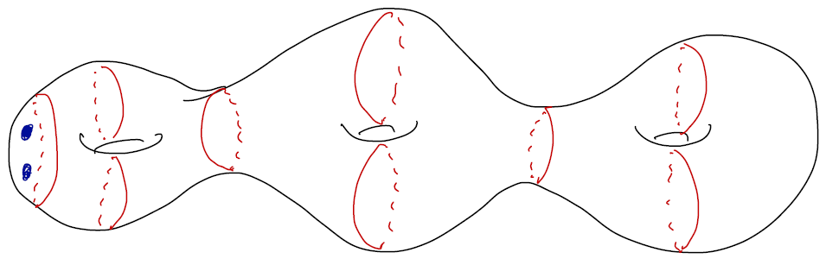
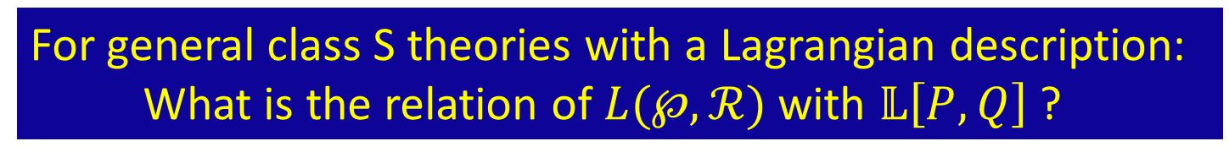

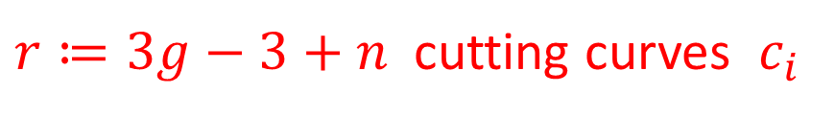

Lagrangian Class S Theories
Weak coupling limits are defined by trinion decompositions of $C_{g,n}$
(``Gaiotto gluing’’)
$$c_{i}$$
$r≔3g−3+n$cutting curves $c_{i}$
Example: $S\left[𝔰𝔲\left(2\right),C_{g,n},D\right]$is a d=4 N=2 theory with
gauge algebra $𝔰𝔲{\left(2\right)}^{r}$ with lots of hypermultiplet matter.
For general class S theories with a Lagrangian description:
What is the relation of $L(℘,ℛ)$ with $𝕃\left[P,Q\right]$ ?

Slide 8
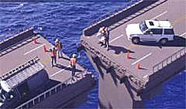
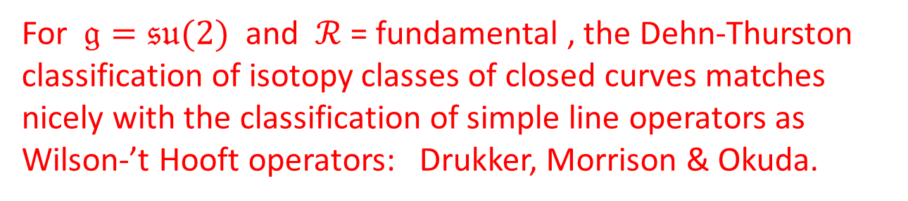
Classifying Line Defects
For $𝔤=𝔰𝔲(2)$ and $ℛ$ = fundamental , the Dehn-Thurston classification of isotopy classes of closed curves matches nicely with the classification of simple line operators as Wilson-’t Hooft operators: Drukker, Morrison & Okuda.
The generalization of the Drukker-Morrison-Okuda result to higher rank has not been
done, and would be good to fill this gap.
Notes:
After 2: There are two things to note about this old slide – First, I made a mistake – I should have said one-dimensional submanifolds, not closed curves. (DMO made the same mistake.) Second – the higher rank gap
Is still not filled.

Slide 9
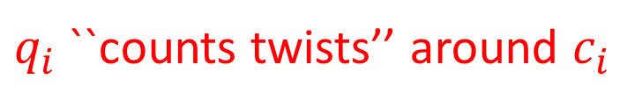
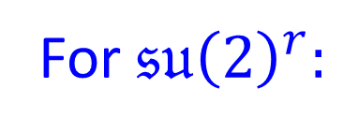

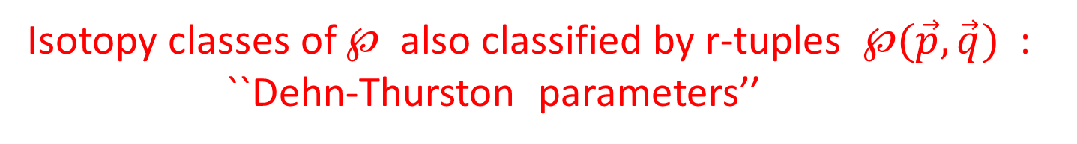
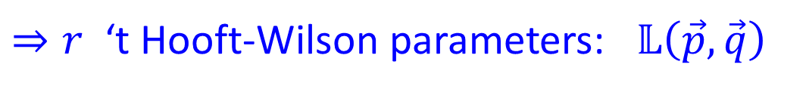
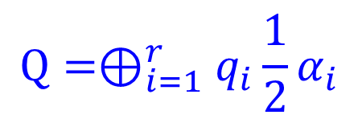
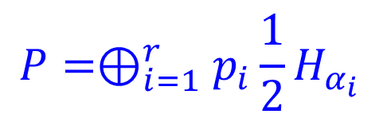
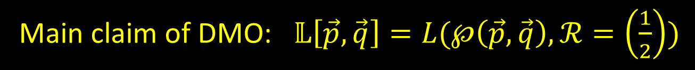
But even DMO is incomplete!!
(Noted together with Anindya Dey)
$$P=⊕_{i=1}^{r}p_{i}\frac{1}{2}H_{α_{i}}$$
$$Q=⊕_{i=1}^{r}q_{i}\frac{1}{2}α_{i}$$
For $𝔰𝔲{\left(2\right)}^{r}:$
$⇒r$ ‘t Hooft-Wilson parameters: $𝕃\left(\vec{p}, \vec{q}\right)$
Isotopy classes of $℘$ also classified by r-tuples $℘(\vec{p},\vec{q})$ :
``Dehn-Thurston parameters’’
$$p_{i}=\#(℘∩c_{i})$$
$q_{i}$ ``counts twists’’ around $c_{i}$
Main claim of DMO: $𝕃\left[\vec{p},\vec{q}\right]=L(℘\left(\vec{p},\vec{q}\right), ℛ=\left(\frac{1}{2}\right))$

Slide 10
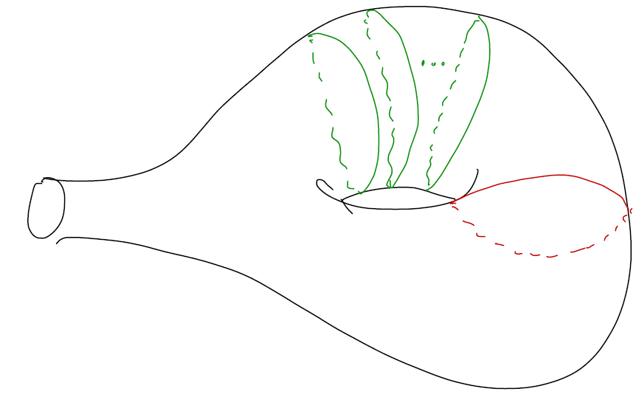
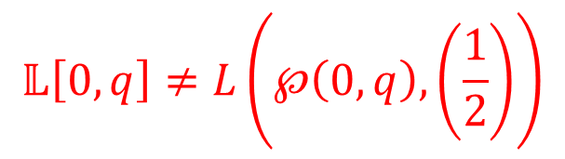



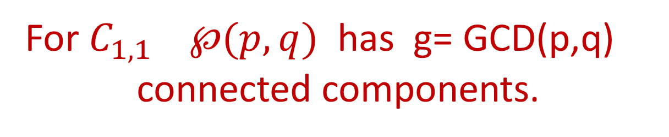
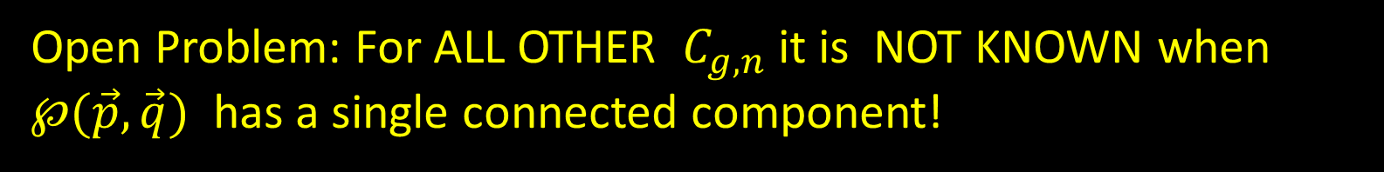
Main claim of DMO: $𝕃\left[\vec{p},\vec{q}\right]=L(℘\left(\vec{p},\vec{q}\right), ℛ=\left(\frac{1}{2}\right))$
Actually, it cannot be true in this generality!
q
$$𝔰𝔲\left(2\right) 𝒩=2^{∗}$$
$$℘\left(0,q\right)$$
$$𝕃\left[0,q\right]≠L\left(℘\left(0,q\right), \left(\frac{1}{2}\right)\right)$$
For $C_{1,1}$ $℘(p,q)$ has g= GCD(p,q)
connected components.
Open Problem: For ALL OTHER $C_{g,n}$ it is NOT KNOWN when $℘(\vec{p},\vec{q})$ has a single connected component!

Slide 11
1
A Little Gap In The Classification Of Line Defects
2
Comparing Computations Of Line Defect Vevs
3
Some New d=4, N=2 Superconformal Field Theories?
4
Conclusion

Slide 12

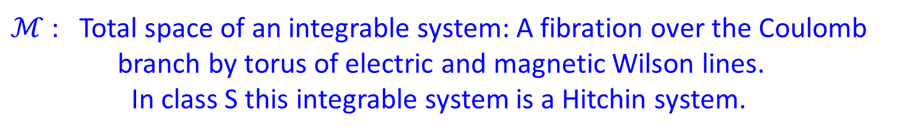

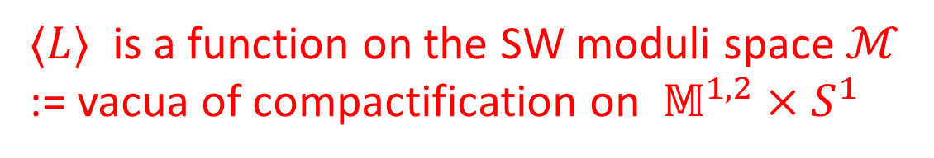
VEV’s On $ℝ^{3}×S^{1}$
Consider path integral with L inserted at $\{\vec{0}\}×S^{1}$
$〈L〉$ is a function on the SW moduli space $ℳ$
:= vacua of compactification on $𝕄^{1,2}×S^{1}$
$ℳ$ : Total space of an integrable system: A fibration over the Coulomb
branch by torus of electric and magnetic Wilson lines.
In class S this integrable system is a Hitchin system.
$ℳ$ is a hk manifold. $〈L〉$ is a holomorphic function on $ℳ$
in the complex structure selected by the phase $ζ$.
(The projection of the integrable system is not holomorphic.)
Part 2 of the talk focuses on exact results for
these holomorphic functions.

Slide 13



Types Of Exact Computations
Localization [Pestun (2007); Gaumis-Okuda-Pestun (2011) ;
Ito-Okuda-Taki (2011) ]
Applies to $𝕃\left[P,0\right]$in Lagrangian theories.
2. AGT-type [Alday,Gaiotto,Gukov,Tachikawa,Verlinde (2009);
Drukker,Gaumis,Okuda,Teschner (2009)]
Should apply to $L(℘,ℛ)$ in general class S.
3. Darboux expansion

Slide 14
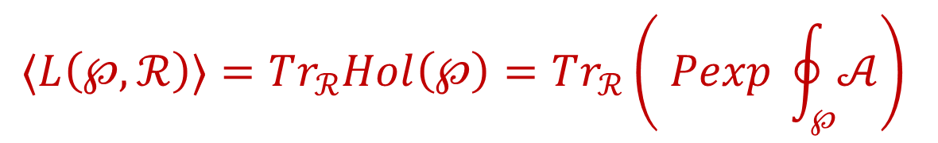
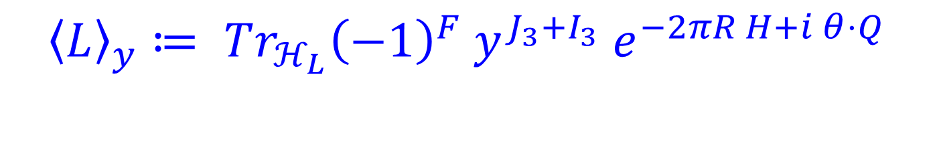


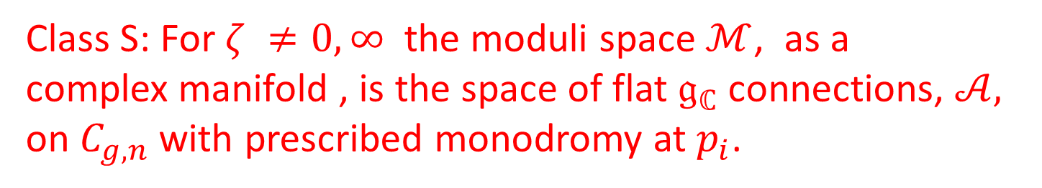
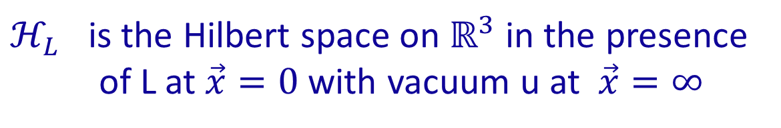
$〈L〉$ As A Trace
$${〈L〉}_{y}≔ Tr_{ℋ_{L}}{\left(−1\right)}^{F} y^{J_{3}+I_{3}} e^{−2πR H+i θ⋅Q}$$
$ℋ_{L}$ is the Hilbert space on $ℝ^{3}$ in the presence
of L at $\vec{x}=0$with vacuum u at $\vec{x}=∞$
We study ${〈L〉}_{y=1}$ $as a function on ℳ:$ That is: as a function of $(u,θ)$
Class S: For $ζ ≠0,∞$ the moduli space $ℳ$, as a
complex manifold , is the space of flat $𝔤_{ℂ}$connections, $𝒜,$
on $C_{g,n}$ with prescribed monodromy at $p_{i}$.
$$\left(u,θ\right)↔ 𝒜$$
$$〈L\left(℘,ℛ\right)〉=Tr_{ℛ}Hol\left(℘\right)=Tr_{ℛ}\left( Pexp \oint_{℘}{𝒜}\right)$$

Slide 15
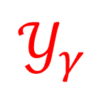

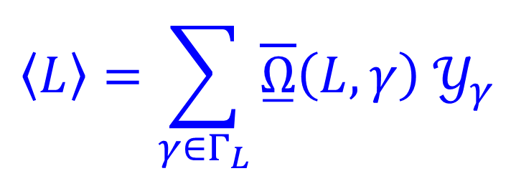
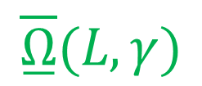
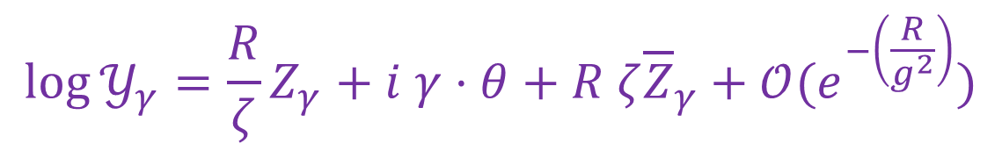

Darboux Expansion
$$〈L〉=\sum_{γ∈Γ_{L}}{\overset{̲}{\overline{Ω}}{\left(L,γ\right) 𝒴}_{γ}}$$
$$\overset{̲}{\overline{Ω}}(L,γ)$$
Framed BPS state degeneracies.
$$𝒴_{γ}$$
Locally defined holomorphic functions on $ℳ$ .
At weak coupling, or at large R we can write them explicitly
in terms of $(u,θ)$ and parameters in the Lagrangian:
$$\log{𝒴_{γ}=\frac{R}{ζ}Z_{γ}+i γ⋅θ+R ζ{\overline{Z}}_{γ}+𝒪(e^{−\left(\frac{R}{g^{2}}\right)})}$$

Slide 16

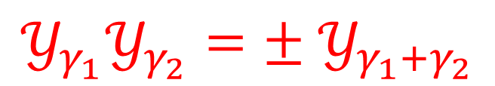

A Set Of ``Darboux Coordinates’’
$$𝒴_{γ_{1}}𝒴_{γ_{2}}={± 𝒴}_{γ_{1}+γ_{2}}$$
Choose basis $γ_{i}$for $Γ$ gives a set of coordinates
Conjecture: Same as:
Shear/Thurston/Penner/Fock-Goncharov coordinates
Checked in many cases.
$〈L〉$ is a Laurent polynomial in these coordinates

Slide 17
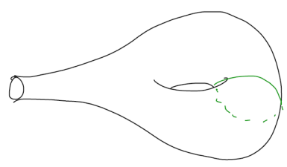
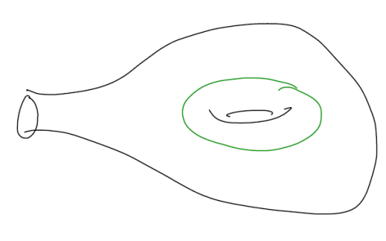
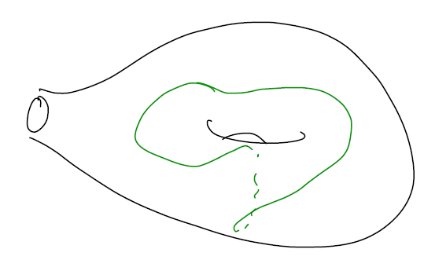




Example: SU(2) $𝒩=2^{∗}$
$$〈L_{0,1}〉=Tr A=α$$
$$〈L_{1,0}〉=Tr B=β$$
$$〈L_{1,1}〉=Tr AB=γ$$
Can reduce $Tr\left(W\right)$ W = any word in $A^{±1},B^{±1}$ to polynomial in $α,β,γ$
$$x∈SL\left(2,ℂ\right) ⇒ x+x^{−1}=1⋅Tr(x)$$
$$e^{2πi m}+e^{−2πi m}=Tr\left(ABA^{−1}B^{−1}\right)=α^{2}+β^{2}+γ^{2}−αβγ−2$$
Notes:
So the SW moduli space in this case is just the space of three complex numbers (alpha,beta,gamma) satisfying this polynomial equation.

Slide 18

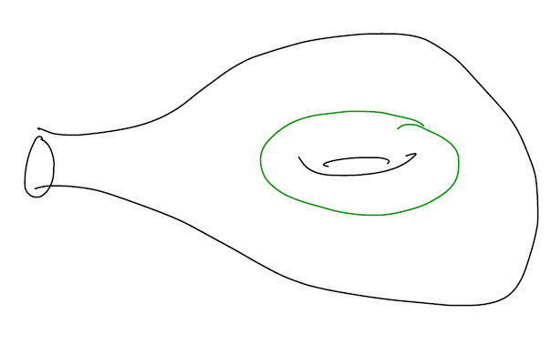
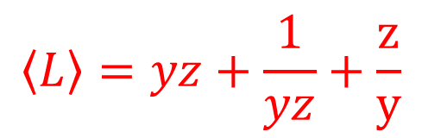



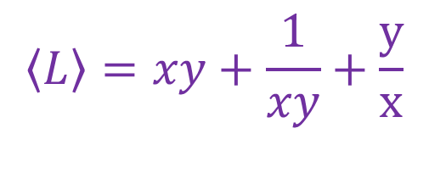
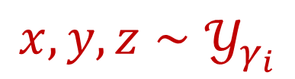

Shear Coordinates On $ℳ$
Ideal triangulation $⇒$Coordinate chart
$$〈L〉=yz+\frac{1}{yz}+\frac{z}{y}$$
$$〈L〉=xz+\frac{1}{xz}+\frac{x}{z}$$
$$〈L〉=xy+\frac{1}{xy}+\frac{y}{x}$$
$$x,y,z∼𝒴_{γ_{i}}$$
$$xyz=i e^{−i π m}$$

Slide 19



Relation Of Shear Coordinates To Physical Quantities
$$\log{x=\frac{R}{2ζ}\left(m−a\right)−\frac{i}{2}θ_{e}+\frac{Rζ}{2}\left(\overline{m}−\overline{a}\right)+NP }$$
$$\log{y=−\frac{R}{2ζ}a_{D}−\frac{i}{2}θ_{m}−\frac{Rζ}{2}\overline{a_{D}}+NP }$$
$$\log{z=\frac{R}{2ζ}\left(a_{D}+a\right)+\frac{i}{2}\left(θ_{e}+θ_{m}\right)+\frac{Rζ}{2}(\overline{a_{D}}+\overline{a})+NP }$$

Slide 20







Complexified Fenchel-Nielsen Coordinates
Localization and AGT formulae are
expressed in terms of CFN coords:
[Nekrasov, Rosly, Shatashvili; Dimofte & Gukov]
$$Pexp\oint_{c_{i}}{𝒜}$$
Half the coordinates:
$$e^{2πi 𝔞_{i}}∈𝔱_{ℂ}$$
$$π≔\int_{C}{Tr\left(δ𝒜∧δ𝒜\right)}$$
$ℳ$ is holomorphic symplectic:
$$π=\sum_{i}{〈d𝔞_{i}∧d𝔟^{i}〉}$$
Darboux-conjugate coordinates:
$$𝔟→𝔟+f\left(𝔞\right)$$

Slide 21






General Form Of Localization Answers
$${〈𝕃\left[P,0\right]〉}_{y}=\sum_{v∈Λ_{cochar}\left(G\right)}{e^{2πi v⋅𝔟}Z_{P,v}(𝔞,y)}$$
GOP [For $S^{4}]$
IOT [For $ℝ^{3}×S^{1}$]
$$Z_{P,v}\left(𝔞,y\right)=Z_{P,v}^{1−loop}\left(𝔞,y\right)Z_{P,v}^{monopole}\left(𝔞,y\right)$$
$Z_{P,v}^{monopole}(𝔞,y)$ is an equivariant integral over
Kapustin & Witten’s ``monopole bubbling locus’’ $ℳ\left(P,v\right)$
$ℳ\left(P,v\right):$ Via Kronheimer correspondence is the space
of U(1)-invariant instantons on $ℝ^{4}$ for a U(1) action on ADHM data V,W
$$W\left(P\right)=W\left(v\right)+\left(ρ−2+ \overline{ρ}\right)V$$

Slide 22




Comparing Computations
Work in progress with Anindya Dey & Daniel Brennan
$$〈L〉=\sum_{γ∈Γ_{L}}{\overset{̲}{\overline{Ω}}{\left(L,γ\right) 𝒴}_{γ}}$$
$${〈𝕃\left[P,0\right]〉}_{y}=\sum_{v∈Λ_{cochar}\left(G\right)}{e^{2πi v⋅𝔟}Z_{P,v}(𝔞,y)}$$
$$\underline{\overline{Ω}}\left(L,γ\right)= Ker_{L^{2}} D_{ℳ}$$
$$Z_{P,v}\left(𝔞,y\right)∼\int_{ℳ\left(P,v\right)}{char. class }$$
(Manton,Schroers; Sethi, Stern, Zaslow; Gauntlett , Harvey ; Tong; Gauntlett, Kim, Park, Yi; Gauntlett, Kim, Lee, Yi; Bak, Lee, Yi ; Moore-Royston-van den Bleeken; Moore-Brennan)
View the equality as an index theorem!
Need to clarify what characteristic class on $ℳ\left(P,v\right)$
Need to compare coordinates
Notes:
Say – So we view this as a very interesting new kind of index theorem – but for it to be useful we need to know:

Slide 23
















Some New Results
Work in progress with Anindya Dey & Daniel Brennan
$ℳ\left(P,v\right)$ is just a quiver variety
Example: $G=SU(2)$
$$P=\left(\begin{matrix}p & 0 \\ 0 & −p\end{matrix}\right)$$
$$v=\left(\begin{matrix}u & 0 \\ 0 & −u\end{matrix}\right)$$
$$2u$$
$$1$$
$$2$$
$$⋯$$
$$p−u$$
$$⋯$$
$$p−u$$
$$⋯$$
$$1$$
$$2$$
$$1$$
$$1$$

Slide 24






General Prescription
Kronheimer correspondence: Identify singular monopoles
with U(1)-invariant instantons on TN
Bubbling locus: U(1) invariant instantons at NUT point
Identify with U(1)-invariant instantons on $ℂ^{2}$
Make ADHM complex U(1) equivariant: As U(1) modules:
$$W\left(P\right)=W\left(v\right)+\left(ρ−2+ \overline{ρ}\right)V$$
Kapustin & Witten
$$ι^{∗}\left(W\left(v\right)⊗ρ_{q}\right)= ⊕_{i=0}^{n−1}W_{i}⊗R_{i}$$
$$ι:ℤ_{n}↪U\left(1\right)$$
$$ι^{∗}\left(V⊗ρ_{q}\right)= ⊕_{i=0}^{n−1}V_{i}⊗R_{i}$$
Stabilizes for $n>N_{0}(v,q)$.

Slide 25








Expressions For $Z_{P,v}^{monopole}$
Moreover, for a VM with G = U(N) and HMs in any rep R, $Z_{P,v}^{monopole}$coincides with the Witten index of the SQM for this quiver: (Resolve with $ζ→0 .)$
$$Z_{P,v}^{monopole}=Z_{quiver SQM}$$
$$=\int_{\tilde{ℳ}(P,v;ζ)}{e^{ω+μ⋅𝔞}C(𝔞)}$$
$$C\left(𝔞\right)=A\left(T\tilde{ℳ}\right)S(𝒱_{R})$$
$$S\left(𝒱_{R}\right)=\prod_{i}{sinh⁡(x_{i})}$$
ch$\left(𝒱_{R}\right)=\sum_{i}{e^{x_{i}}}$
$$=\oint_{𝔱}{\left[dφ\right]Z^{vm}Z^{hm}}$$
[Moore, Nekrasov, Shatashvili 1997]

Slide 26
Applications to d=3, N=4
The same functions are claimed by
Bullimore-Dimofte-Gaiotto to appear in an ``abelianization
map’’ for monopole operators in d=3 N=4 gauge theories.

Slide 27




Relation Between Coordinates?
Both shear and CFN coordinates are holomorphic Darboux coordinates
$〈L〉$ has a finite Laurent expansion in both.
But the relation between them is very complicated !
Comparison with Darboux expansion in shear coordinates
in a weak-coupling regime shows:
$$2πi 𝔞=\frac{R}{ζ}a+i θ_{e}+Rζ\overline{a}+NonPerturbative$$
$$2πi 𝔟=\frac{R}{ζ}a_{D}+i θ_{m}+Rζ\overline{a_{D}}+NonPerturbative$$
N.B. Literature misses the nonperturbative corrections.

Slide 28








Localization Results For SU(2) $𝒩=2^{∗}$
$$〈L_{0,1}〉=λ+λ^{−1}$$
$$λ=e^{2πi 𝔞}$$
$$〈L_{1,0}〉=\left(β+β^{−1}\right)F$$
$$〈L_{1,1}〉=\left(βλ+β^{−1}λ^{−1}\right)F$$
$$β=e^{2πi 𝔟}$$
$$F=\frac{{\left(λ^{2}+λ^{−2}−ℓ^{2}−ℓ^{−2}\right)}^{\frac{1}{2}}}{λ−λ^{−1}}$$
$$ℓ=e^{i πm}$$
$$〈L_{2,q}〉=\left(β^{2} λ^{q}+β^{−2}λ^{−q}\right)F^{2}+\left(λ+λ^{−1}\right)\left(F^{2}−1\right)$$
Valid for q odd.
Heroic computation by Anindya Dey using AGT approach.
Can also be done in shear coordinates
but with more complicated answer.

Slide 29





Comparison Of Coordinates In SU(2) $𝒩=2^{∗}$
$$x=\frac{\frac{i}{ℓ}\left(\tilde{β}−{\tilde{β}}^{−1}\right)}{\tilde{β}λ−{\left(\tilde{β}λ\right)}^{−1}}$$
$$y=i\frac{\tilde{β}λ−{\tilde{β}}^{−1}λ^{−1}}{λ−λ^{−1}}$$
$$z=−i\frac{λ−λ^{−1}}{\tilde{β}−{\tilde{β}}^{−1}}$$
$$\tilde{β}=β{\left(\frac{λℓ−λ^{−1}ℓ^{−1}}{λℓ^{−1}−λ^{−1}ℓ}\right)}^{\frac{1}{2}}$$
Dimofte & Gukov, 2011
Inverting these equations and using the weak coupling
expansion of x,y,z gives weak coupling expansion of
complexified FN coordinates.

Slide 30

Such direct comparison of line defect VEV’s is
the only way I know how to express CFN
coordinates in a weak-coupling expansion.
But, it gets rather complicated in other examples …
A more promising route is to use the observation of Hollands and Neitzke that in some situations spectral networks degenerate to foliations defined by Strebel differentials. In this special case the $𝒴_{γ}$ are much more closely related to $𝔞,𝔟$

Slide 31
1
A Little Gap In The Classification Of Line Defects
2
Comparing Computations Of Line Defect Vevs
3
Some New d=4, N=2 Superconformal Field Theories?
4
Conclusion

Slide 32




New Superconformal Theories From Old
Given a superconformal theory T and a $β=0$
subgroup $H⊂Glob\left(T\right)$we can gauge it to form
a new superconformal theory T/H.
In particular, given two theories with a
common subgroup $H⊂Glob\left(T_{1}\right)$ and $H⊂Glob\left(T_{2}\right)$
and a $β=0$embedding:
$$H↪Glob\left(T_{1}\right)×Glob(T_{2})$$
Gauge the embedded $H$with gauge-coupling
q to produce $T_{1}×_{H,q}T_{2}$
Argyres-Seiberg, 2007

Slide 33




Class S
$𝔤$= simple A,D, or E Lie algebra
$C_{g,n}$ Riemann surface with (possibly empty)
set of punctures $p_{1},p_{2},…, p_{n}$
D = collection of ½-BPS cod=2 defects $D\left(p_{1}\right), …, D\left(p_{n}\right)$
For suitable D the theory $S\left[𝔤,C,D\right]$is superconformal
Lie algebra of global symmetry contains:
$$⊕_{p_{i}}𝔣\left(D\left(p_{i}\right)\right)$$
``Full (maximal) puncture’’ : $𝔣\left(D\right)=𝔤$

Slide 34








Gaiotto Gluing – 1/2
Given $S\left[𝔤,C_{1},D_{1}\right] \& S[𝔤,C_{2},D_{2}]$
Suppose we have full punctures $D\left(p_{1}\right) \& D\left(p_{2}\right)$
with $p_{1}∈C_{1} \& p_{2}∈C_{2}$
The diagonal $𝔤$ – symmetry
$𝔤_{diag}⊂𝔤⊕𝔤$ has $β=0$
Gauge it to produce a new superconformal theory:
$$S\left[𝔤,C_{1},D_{1}\right]×_{𝔤,q}S\left[𝔤,C_{2},D_{2}\right]$$
$$q=e^{2πi τ}$$

Slide 35




Gaiotto Gluing -2/2
$$S\left[𝔤,C_{1},D_{1}\right]×_{𝔤,q}S\left[𝔤,C_{2},D_{2}\right]$$
$$=$$
$$S[𝔤,C_{1}×_{q}C_{2},D_{1}∪D_{2}− \{D\left(p_{1}\right),D\left(p_{2}\right)\}]$$
$$z_{1}z_{2}=q$$

Slide 36








Theories Of Class H
Ongoing work with J. Distler, A. Neitzke, W. Peelaers & D. Shih.
$S[𝔤_{1},C_{1},D_{1}]$
&
$S[𝔤_{2},C_{2},D_{2}]$
$𝔤_{1}≠𝔤_{2}$
$$𝔥⊂𝔣\left(D\left(p_{1}\right)\right)$$
&
$$𝔥⊂𝔣\left(D\left(p_{2}\right)\right)$$
$$𝔥_{diag}⊂𝔣\left(D\left(p_{1}\right)\right)⊕𝔣\left(D\left(p_{2}\right)\right)$$
$$β\left(𝔥_{diag}\right)=0$$
$$S\left[𝔤_{1},C_{1},D_{1}\right]×_{𝔥_{diag}, q}S[𝔤_{2},C_{2},D_{2}]$$
Notes:
We call these ``theories of class H’’ where “H” stands for “hybrid” ,
Or “hippogriff” or – as we’ll soon see - “hypothetical”

Slide 37






Partial No-Go Theorem
Important class of punctures: ``Regular Punctures’’
$$D\left(𝔤,ω, ρ\right)$$
$$ρ:𝔰𝔲\left(2\right)→{\left(𝔤^{ω}\right)}^{∨}$$
Theorem: Gluing two regular punctures is only superconformal
for the case of full punctures. In particular: $𝔤_{1}=𝔤_{2}$
Proof: Condition for $β\left(𝔥_{diag}\right)=0$:
$$−4h^{∨}\left(𝔥\right)+ κ_{1}+κ_{2}=0$$
Use nontrivial formulae for $κ$ from
Chacaltana, Distler, and Tachikawa.

Slide 38

Other Punctures
But! There are other types of punctures!
f
s
f
f
s
“Superconformal irregular
puncture” (SIP)
If you can now insert SIP’s just like other punctures
then there appear to be Hippogriff theories.
Geometrical interpretation?
Seiberg-Witten curve?
AdS duals?

Slide 39




Superconformal Theories From (Hitchin) Irregular Singular Points
SIPs are related (somehow….)
to ISP’s of Hitchin systems:
$$φ=ℜ\frac{dz}{z^{ℓ}}+⋯$$
Usually $ℜ$ is taken to be semi-simple (c.f. Biquard & Boalch, … )
But for superconformal theory need a fixed-point
of the $ℂ^{∗}$ action: $Tr\left(φ^{s}\right)=0$
Special cases (AD-type theories) rely on an isometry on $ℙ^{1}:z→e^{i θ}z$
But, there are stable Higgs bundles with ISP’s fixed
under $ℂ^{∗}$. Similarly, one can construct solutions to Hitchin’s equations with nilpotent ISP and $Tr\left(φ^{s}\right)=0 .$
This is WIP with E. Diaconescu & A. Neitzke .

Slide 40

1
A Little Gap In The Classification Of Line Defects
2
Comparing Computations Of Line Defect Vevs
3
Some New d=4, N=2 Superconformal Field Theories?
4
Conclusion

