Slide 2
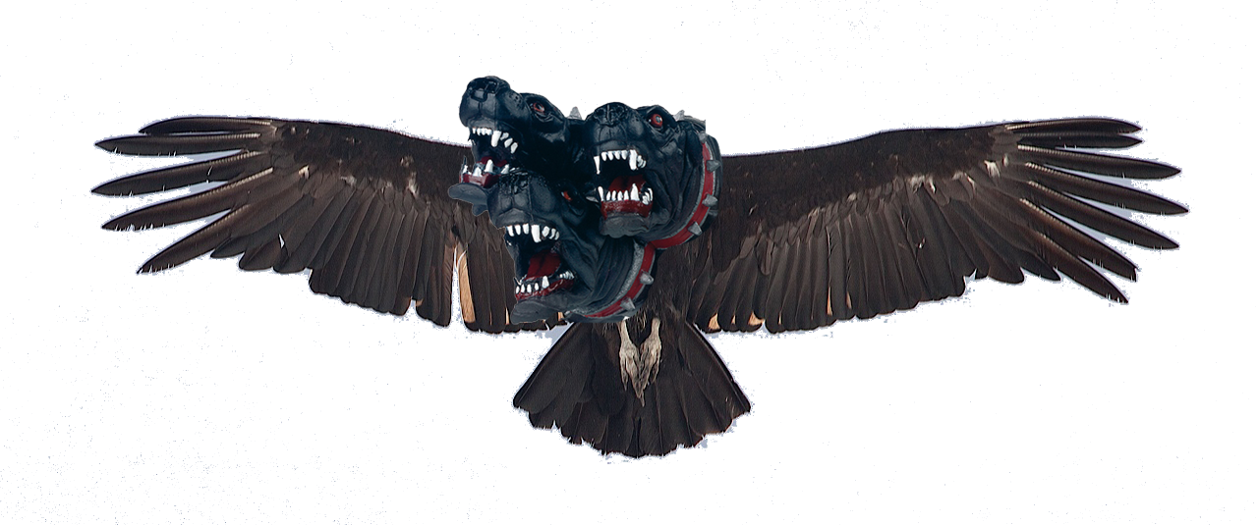
Kerberos token renewal & HTCondor
Ben Jones

Slide 3
Why do we need token renewal?
Broadly speaking, there are two submission methods for batch compute at CERN
  Grid submissions (no need for kerberos)
  Local submissions
Local submissions have always relied on AFS for shared storage – AFS means AFS tokens (and more or less means kerberos too)
Kerberos / AD ticket renewal policy doesn’t match job queue + run length
  24h tokens renewable for 7 days

Slide 4
Wait… isn’t CERN deco’ing AFS?!
Migration away from AFS driven by concern at health of upstream project
  releases, mail traffic, conferences, associated companies
  no new features like IPv6, DES
  ecosystem – little beyond two companies
Slow migration – goal is no critical AFS deps by LHC Run 3 (2020+)
No perfect drop-in replacement
EOS for most data (via FUSE + CERNBox)
  Perhaps for $HOME on LXPLUS

Slide 5
Other uses for tokens
General purpose kerberos token & imaginative users == lots of kerberos dependencies
One dependency we plan for: EOS FUSE uses kerberos tokens
Others include other storage services, and any other service in CERN
Even self contained user groups, such as ATLAS Tier-0 don’t understand all kerberos dependencies

Slide 6
Compute workflow
Desktop
LXPLUS
(interactive)
LXBatch
Remote
AFS

Slide 7
Compute workflow
Desktop
LXPLUS
(interactive)
LXBatch
Remote
AFS
EOS FUSE

Slide 8
HTCondor integration
The following touchpoints govern the integration with condor:
  SEC_CREDENTIAL_PRODUCER
  SEC_CREDENTIAL_MONITOR
  SEC_CREDENTIAL_DIRECTORY
Submit node is responsible for obtaining a token and sending to schedd
Schedd turns submit token into kerberos TGT
Execute node needs token, maintained as kerberos TGT

Slide 9
Submit node
Active Directory
SEC_CREDENTIAL_PRODUCER
Submit Node
AP-REQ
Credd on Schedd
X509 encrypted AP-REQ

Slide 10
Schedd
SEC_CREDENTIAL_MONITOR
NGAuth Server
1. Monitor for new AP-REQ
(username.cred)
2. Request kerberos TGT from
server with AP-REQ
3. Run (condor_)aklog
4. Monitor tokens requiring renewal
SEC_CREDENTIAL_DIRECTORY

Slide 11
Execute node
SEC_CREDENTIAL_MONITOR
NGAuth Server
1. Monitor for new AP-REQ
(username.cred)
2. Request kerberos TGT from
server with AP-REQ
3. Run (condor_)aklog
4. Monitor tokens requiring renewal
5. Copy tokens to job sandbox & set
KRB5_CCNAME
SEC_CREDENTIAL_DIRECTORY
Sandbox

Slide 12
NGAuth
Service takes AP-REQ from credmon, extracts user info
Uses privileged AD certificate to request kerberos TGT
Encrypts TGT to x509 key deployed on schedds & worker nodes
In principle multiple ngauth servers can be used
  in practice some care is needed for DNS aliased names (rdns = false in krb5.conf)

Slide 13
Constrained Delegation (KCD)
Rather than general purpose token, provides token that can be used with pre-defined subset
  Less scary from security perspective
Would require users to pre-define which services they want to use
  This probably means we can’t do it
Extension to KCD where services register
  Not available

Slide 14
NGAuth issues
Server with privilege to acquire tickets for any user
  Could improve, but only to any user who opts in to batch service
AP-REQ is effectively immortal
No longer tied directly to AFS as per previous LSFAuth, but code & approach similar

Slide 15
Other options
Certificates
  Rather than AP-REQ, request certificate or proxy
  Certificate could be used to then request the TGT
  Easier to revoke certificates?
  Time limited proxy?
Longer expiry on kerberos tokens
  Team responsible for AAA now responsible for NGAuth
    Conway’s Law might help improve the situation

Slide 16
Experience
If ngauth server is overloaded, and no TGT is produced:
  schedd – submission fails as log/out/err can’t be initialised
  execute – random job failures as paths can’t be accessed
  transient failures on exectute nodes can black hole jobs till detection
Deploying new versions of credmon can be painful
Can’t set remote initialdir if it requires auth
In general, mechanism works well

Slide 17
Links
NoAFS:
  CHEP-2016 - https://indico.cern.ch/event/505613/contributions/2230944/
  HEPIX-2016-2 - https://indico.cern.ch/event/531810/contributions/2326350/

Slide 18
Questions?

