Slide 1

New Magnetic Phase in the Nickelate Perovskite TlNiO₃
Lukas Korosec
ETH Zürich, Department of Physics
Joint Annual Meeting of SPS and ÖPG 2017

Slide 2








Slide 3
Outline
Why are RNiO₃ perovskites interesting?
Investigations via NMR and µSR
Two magnetic phase transitions in TlNiO₃
Conclusions

Slide 4
RNiO₃: introduction
Phase diagram of RNiO₃
Korosec et al., PRB 95, 060411(R) (2017).
Notes:
Simultaneous MIT and structural transition
Transition temperature depend continuously on bond angle (features of crystal structure)

Slide 5
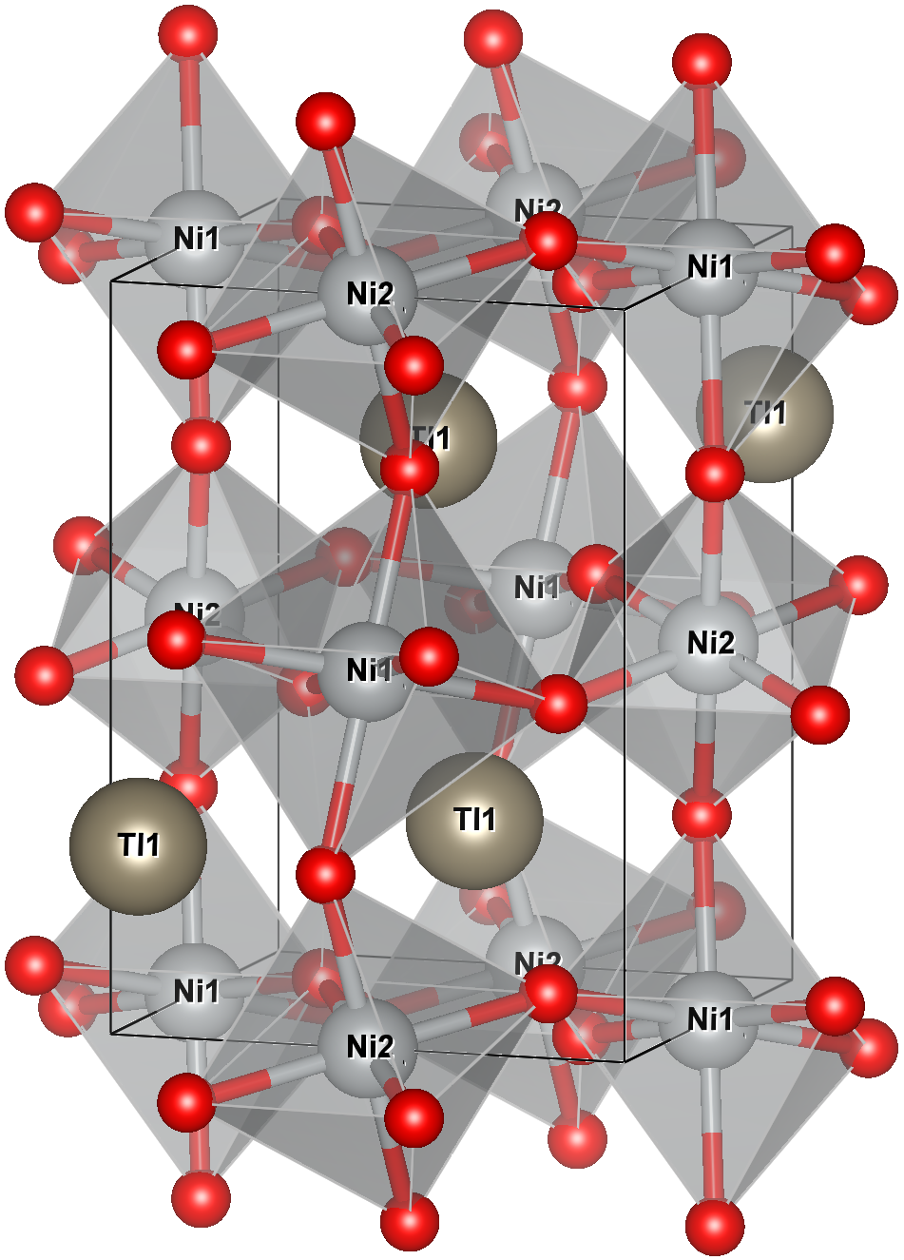
RNiO₃: introduction
Phase diagram of RNiO₃
Insulating phase: structure
Large
Small
Korosec et al., PRB 95, 060411(R) (2017).
Kim et al., Chem. Mater. 14, 4926 (2002).
Notes:
Insulating phase: Large and small octahedra alternate (rocksalt pattern) -> “charge disproportionation”? “site-selective Mott?”
Same distortion found in TlNiO3

Slide 6
RNiO₃: magnetic structure
Phase diagram of RNiO₃
Possible magnetic structures
Korosec et al., PRB 95, 060411(R) (2017).
Giovannetti et al., PRL 103, 156401 (2009).
Notes:
Propagation vector known from neutron powder diffraction (4 Ni / period), multiple structures give same powder pattern
Collinear or non-collinear, equal or unequal moments? TlNiO3: TN = 104 K
Breaking of inversion symmetry -> electric polarization (not yet detected)?

Slide 7
Experimental techniques
NMR + µSR:
Zeeman Hamiltonian
Nucleus | γ / 2π
²⁰⁵Tl | 24.56 MHz/T
²⁰³Tl | 24.32 MHz/T
µ | 135.5 MHz/T
Notes:
Use spin ½ to probe electronic system-> Zeeman Hamiltonian
If spin not parallel to B, precession, frequency measures of B-field at nucleus

Slide 8
Experimental techniques
NMR + µSR:
Zeeman Hamiltonian
Spin-echo + T₂ decay
Nucleus | γ / 2π
²⁰⁵Tl | 24.56 MHz/T
²⁰³Tl | 24.32 MHz/T
µ | 135.5 MHz/T
From Wikipedia
Notes:
Spin echo: refocus spins with slightly different frequencies
T2 = dephasing time (fluctuations or nuclear-spin – nuclear-spin interactions)

Slide 9
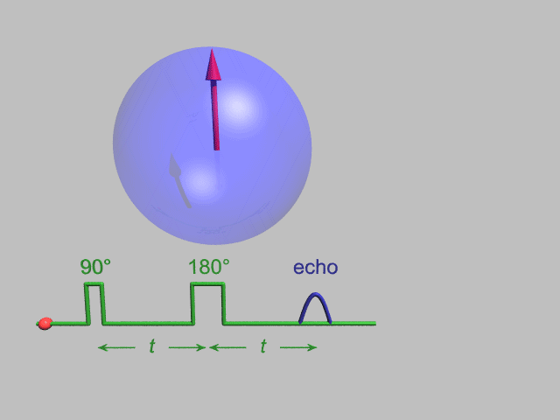
Experimental techniques
NMR + µSR:
Zeeman Hamiltonian
Spin-echo + T₂ decay
Nucleus | γ / 2π
²⁰⁵Tl | 24.56 MHz/T
²⁰³Tl | 24.32 MHz/T
µ | 135.5 MHz/T
From Wikipedia
Notes:
Spin echo: refocus spins with slightly different frequencies
T2 = dephasing time (fluctuations or nuclear-spin – nuclear-spin interactions)

Slide 10
Experimental techniques
NMR + µSR:
Zeeman Hamiltonian
NMR on AFM powders
Nucleus | γ / 2π
²⁰⁵Tl | 24.56 MHz/T
²⁰³Tl | 24.32 MHz/T
µ | 135.5 MHz/T
Yamada and Sakata, JPSJ 55, 1751 (1986).
Notes:
H = internal field of antiferromagnet, HA = applied field. Powder pattern has edges at HA +/- H

Slide 11
Why TlNiO₃?
Same RT insulating phase as rare-earth nickelates [1]
Same low-T magnetic propagation vector [1]
Tl³⁺ is diamagnetic
²⁰⁵Tl and ²⁰³Tl are good nuclei for NMR
TlNiO₃ is an ideal system for NMR on RNiO₃!
[1]: Kim et al., Chem. Mater. 14, 4926 (2002).
Notes:
For NMR, Tl better than all rare-earths
Ni, O: rare isotope with S > ½ -> quadrupole

Slide 12
Tl-NMR spectra
NMR in applied field
PM phase: Narrow line
AFM phase: Two wide patterns
Korosec et al., PRB 95, 060411(R) (2017).
Notes:
PM phase: expect narrow line for each isotope;
AF phase: expect broad pattern, edges at shift corresponding to internal field

Slide 13
Tl-NMR spectra
NMR in applied field
Zero-field NMR frequencies
PM phase: Narrow line
AFM phase: Two wide patterns
Broad ZF signals
Magnetic order up to ~200 K!
Korosec et al., PRB 95, 060411(R) (2017).
Notes:
ZF: Resonances at expected frequencies (but broad), one vanishes at 200 K! (No NMR near transition for technical reasons)

Slide 14
Zero-field µSR
Time-domain asymmetries
Frequencies vs T
Rapid signal decay: broad spectrum
Two magnetic transitions!
T_{N} = 104 K, T_{N}* = 202 K
Korosec et al., PRB 95, 060411(R) (2017).
Notes:
T > 105 K: single damped cosine; T < 105 K: Multiple damped cosines
Four resonances at low temperatures -> different stopping sites. Strange temperature-dependences presumably because of combination of two magnetic orders.

Slide 15
Magnetic susceptibility
Visible transition at T_{N} = 104 K, but not at T_{N}* = 202 K.
Korosec et al., PRB 95, 060411(R) (2017).
Notes:
Phase transition does not occur in applied fields? Not seen in SQUID magnetometry!

Slide 16
NMR T₂ relaxation
Hysteresis of single T₂ between T_{N} = 104 K and T_{N}* = 202 K
=> Entire sample is affected by T_{N}*
B₀ = 3.5 T
Activated behavior at low T with Δ = 82 ± 5 K
=> gap in magnetic excitation spectrum?
Korosec et al., PRB 95, 060411(R) (2017).
Notes:
In a few Tesla, transition at TN* does not occur
T2 relaxation shows that the entire sample knows about both phases

Slide 17
Conclusions
NMR and µSR offer new insights into RNiO₃
TlNiO₃ admits two magnetically ordered phases
New phase is easily suppressed by magnetic fields
New phase has not been found in rare-earth nickelates

