Slide 1
Diagnostic Spectrometers (single-shot) for SwissFEL
Jens Rehanek, M. Makita, C. David, G. Seniutinas, J. Szlachetko, J. Czapla-Masztafiak, C. Milne, L. Patthey, P. Juranic :: Paul Scherrer Institut
SPS / APS Annual Meeting 2017, August 23, 2017

Slide 2
Outline
Hard X-ray Single-Shot-Spectrometer (PSSS)
      Single-shot measurements at Aramis beamline (4 keV – 15 keV)
      Tests @PSI
      Installation/Further Steps
Tender X-ray Single-Shot-Spectrometer (TX-SSS)
      Possible Single-shot spectrometer at ESA (2 keV – 4 keV)
      Principle
      Test @PSI
      Further Steps

Slide 3
PSSS
Hard X-ray Single-Shot-Spectrometer (PSSS)
      Single-shot measurements at Aramis beamline (4 keV – 15 keV)
      Tests @PSI
      Installation/Further Steps
Tender X-ray Single-Shot-Spectrometer (TX-SSS)
      Possible Single-shot spectrometer at ESA (2 keV – 4 keV)
      Principle
      Test @PSI
      Further Steps

Slide 4
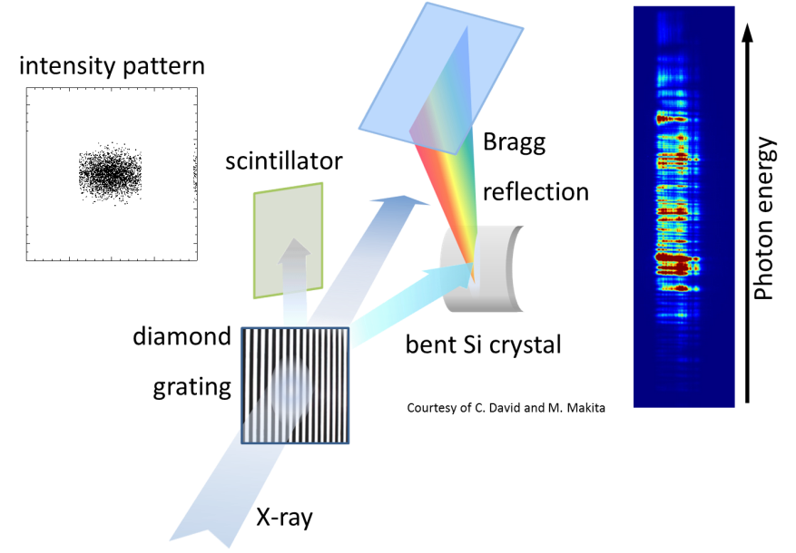
PSSS – working principle
[Makita et al., Optica 2, 10 (2015)]

Slide 5
PSSS – working principle
Energy resolution [P. Karvinen, “Design report for SSS based in bent Si crystal”]
Slot # | Orientation | R / mm | Energy range / keV
1 | (111) | 155 | 4 – 5.5
2 | (220) | 75 | 5.5 – 8
3 | (220) | 145 | 8 – 10.25
4 | (220) | 200 | 10.25 – 12
- 1m detector distance
- 10μm Si crystals
- Bandwidth: 0.5%

Slide 6
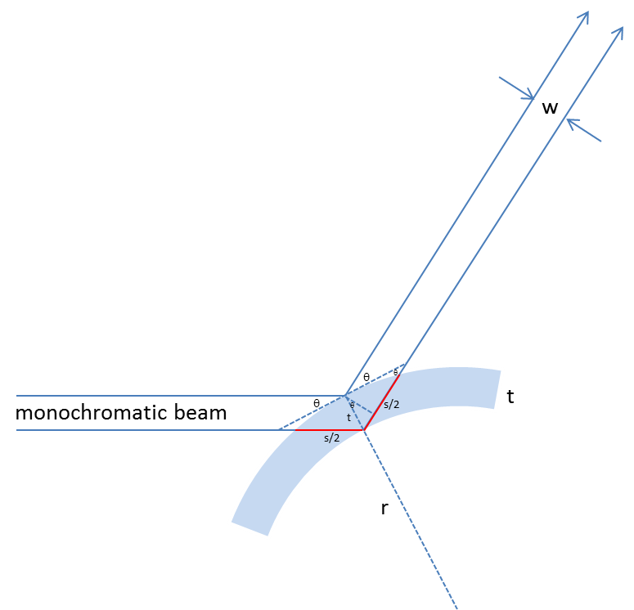
PSSS – thin Silicon crystal
courtesy of P. Karvinen, C. David
Why thin Si-crystals (10μm for PSSS)?
w = t × cos(θ_{B})
w – width, t – crystal thickness, θ_{B} – Bragg angle for given energy
best energy resolution possible

Slide 7
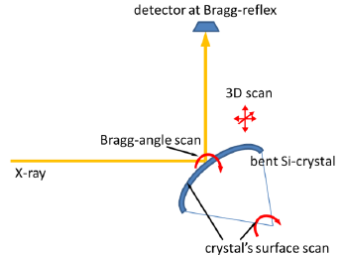
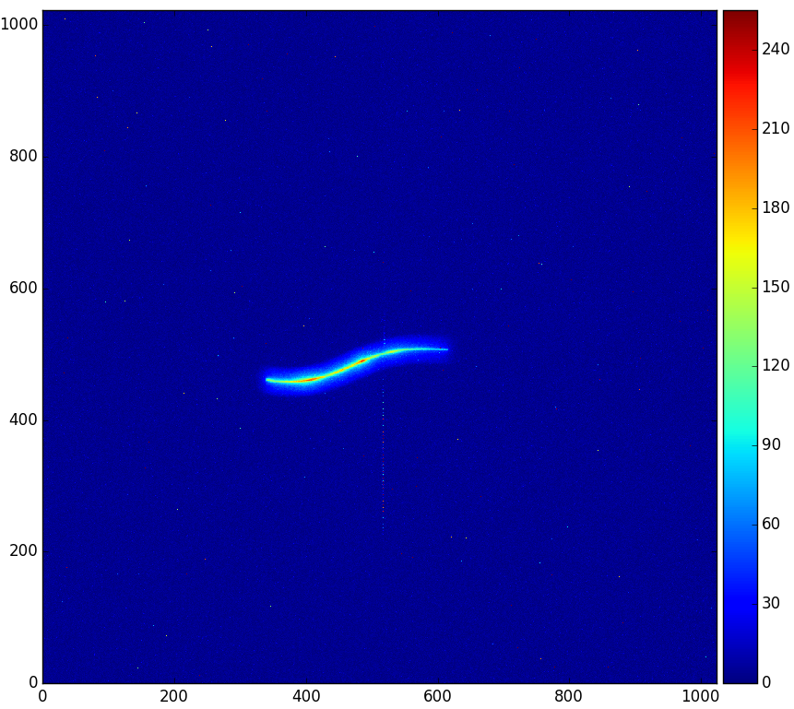
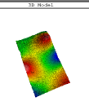
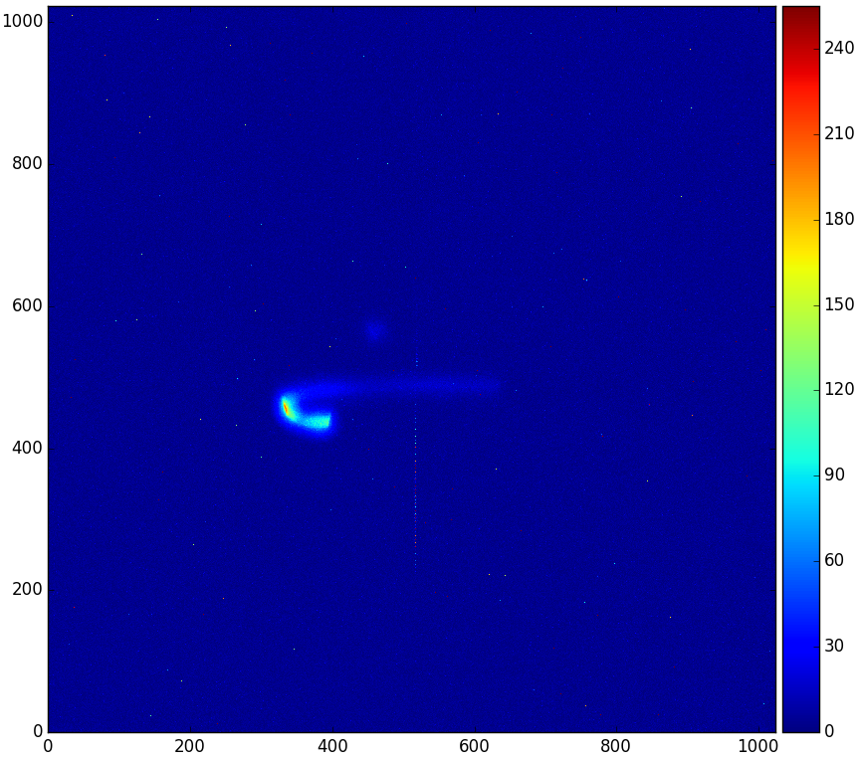
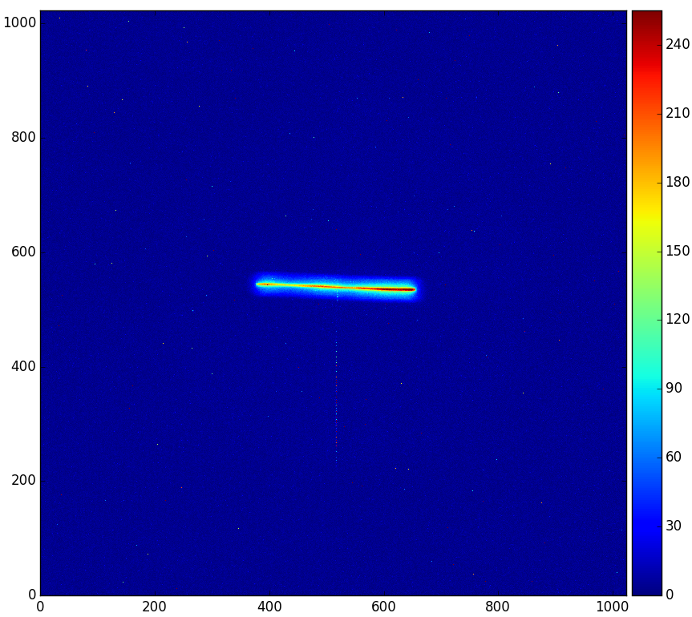
PSSS – thin Silicon crystal
Quality (bending radius, mounting, surface) of crystals benders of high importance
Test @ X05
(thanks to U. Flechsig, A. Jaggi, C. David)

Slide 8
PSSS – thin Silicon crystal
Quality of crystals of high importance – especially for alignment/running the instrument in tunnel
tests @ 8333 eV
found evidence of miscut (reflex on detector was displaced in both directions x and y)
performed tests at diffractometer (thanks to Christoph Schneider):
confirmed miscut
Si <111> +0.65° (long side)
-0.54° (short)
Si <110> +1.04°(long)
+0.9°(short)
Before final installation of crystals in front-end, the miscut of each crystal has been measured inside bender and fed into controls of PSSS.
Test @ X05

Slide 9
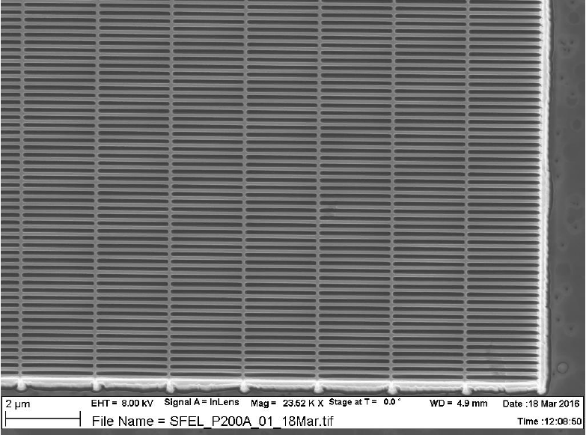
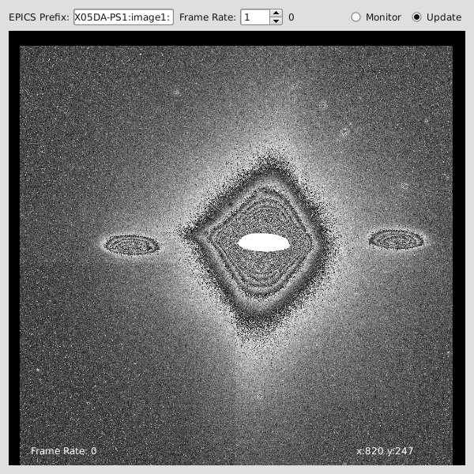
PSSS – diamond grating
diffraction orders
direct beam
courtesy of M. Makita (grating 200nm pitch)
200nm pitch, 12keV
radiation stable [David et al., Sci.Rep.1, 57 (2011)]
does not interfere with either of the transmitted or diffracted beam profiles (spectral, pulse duration, intensity distribution, polarization)
3 gratings: 100nm (higher energies), 150nm, 200nm (lower energies)
turnable (to maximize efficiency) up to 60°[David et al. APL81, 17 (2002)]

Slide 10
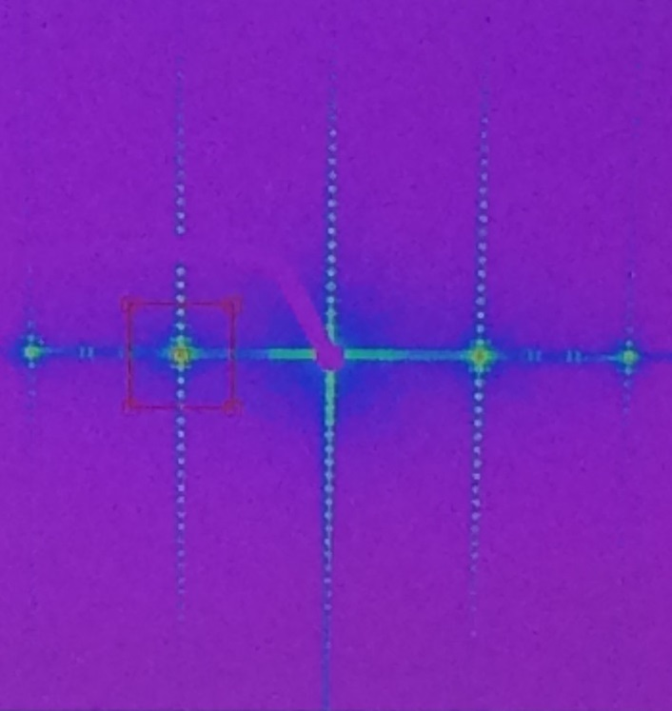
PSSS – diamond grating
diffraction orders
support structure
side lobes
courtesy of M. Makita
Intensity in log-scale!
courtesy of N. Kujala, J. Grünert (XFEL.EU), from beamtime @ P10 (DESY)
technologically necessary: support structure (else, gratings would simply collapse)
duty cycle of the support structure: 1:20 (grating: 1:1)
automatically of much lower efficiency than the grating!

Slide 11
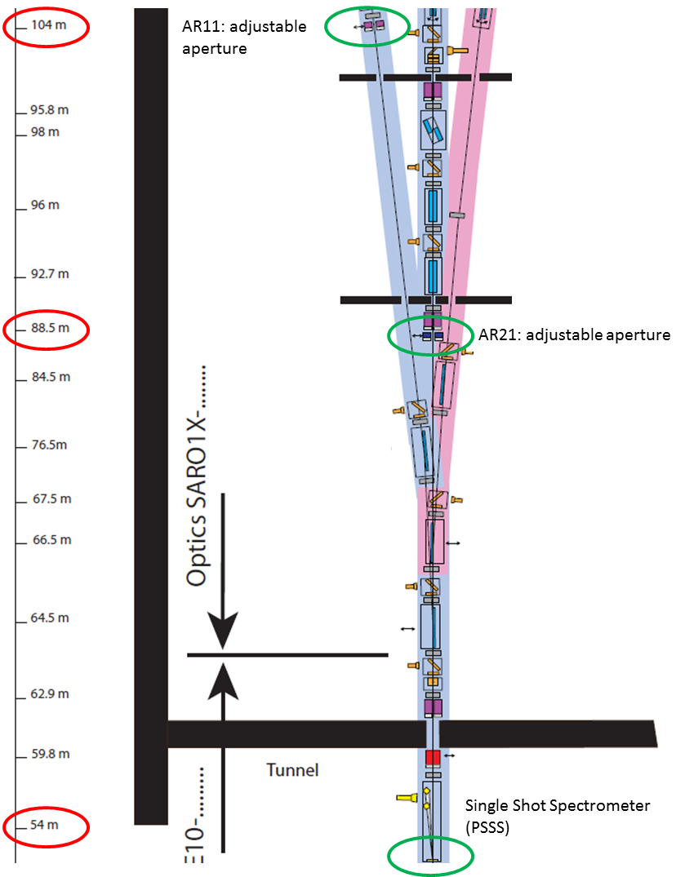
PSSS – diamond grating
Transmission grating
+1st
slit
SwissFEL
0th
-1st
pitch 2000nm (as most extreme case)
photon energy | eV | 3540 | 5320 | 7090 | 8860 | 10600 | 12400
divergence (rms) | mrad | 5.2 | 3.7 | 3.0 | 2.5 | 2.2 | 2.0
diffraction | mrad | 17.5 | 6.68 | 5.01 | 4.01 | 3.35 | 2.86
5s @ 90m (from divergence) | mm | 1.17 | 0.83 | 0.68 | 0.56 | 0.495 | 0.45
dist 1st to 0th order @36m (hor.)* | mm | 63 | 42 | 31.5 | 25.2 | 21.1 | 18
vertical | mm | 6.3 | 4.2 | 3.15 | 2.52 | 2.11 | 1.8
The slits can be closed sufficiently to avoid seeing the diffraction orders further downstream. (discussion with R. Follath)
Would these diffraction orders and side lobes disturb further downstream?

Slide 12
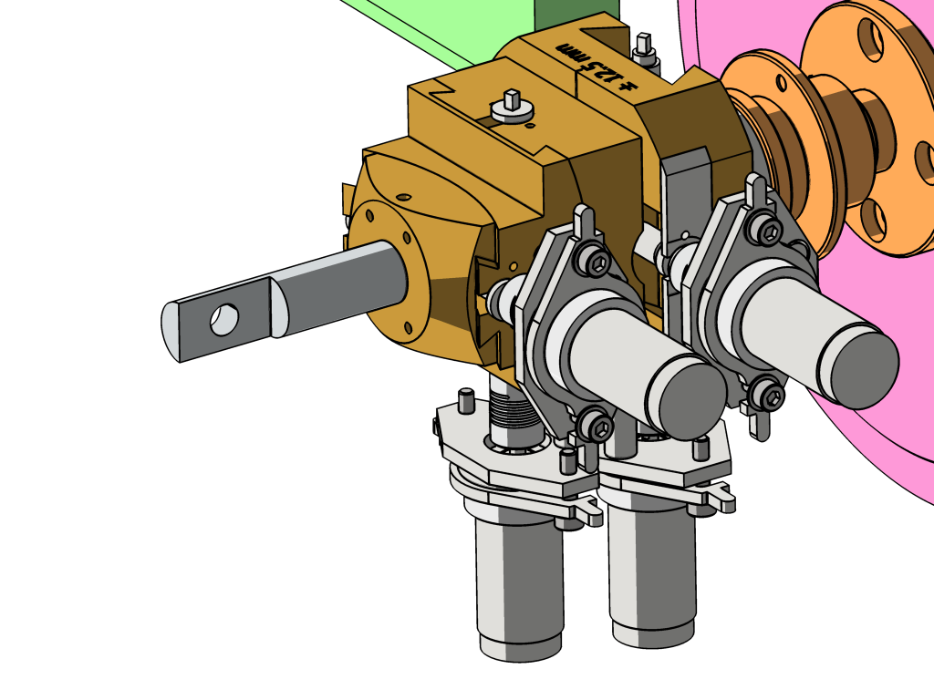
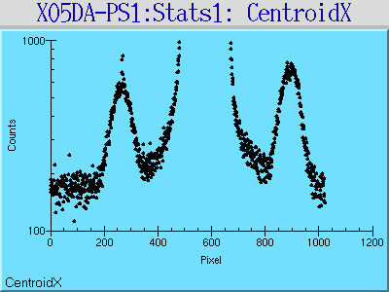
PSSS – diamond grating
Test beamtime @ X05 (SLS, Optics Beamline, thanks to U. Flechsig)
150nm & 200nm pitches @ 8keV, 10keV, 12keV
on detector (@1.8m)
y
z
x
courtesy of U. Flechsig, A. Jaggi
0th
+1st
-1st
X-ray
grating

Slide 13
PSSS – intensity correction
Why is intensity correction needed?
X
insert a beam profile monitor (YAG-screen)
to inspect -1st diffraction order
(transverse beam profile)
true Intensity
Intensity
measured Intensity
Photon energy
Position
Photon energy
A
B
C
0th
0th
0th
-1st
+1st
-1st
+1st
-1st
+1st

Slide 14
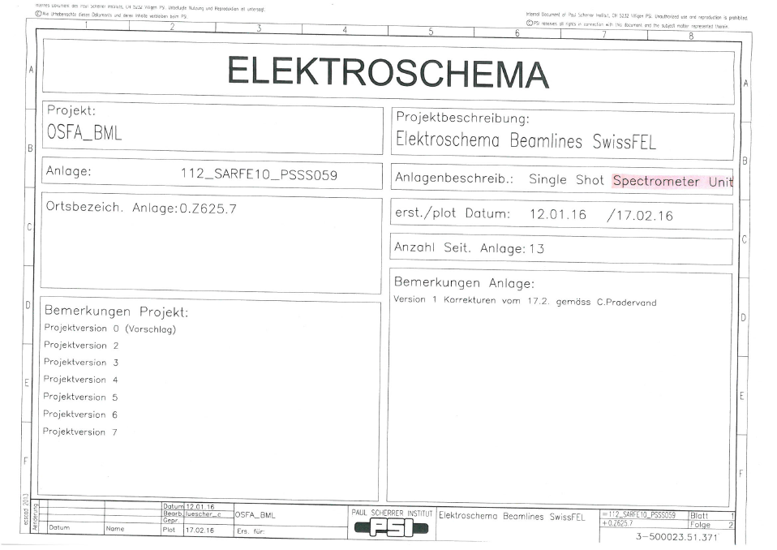
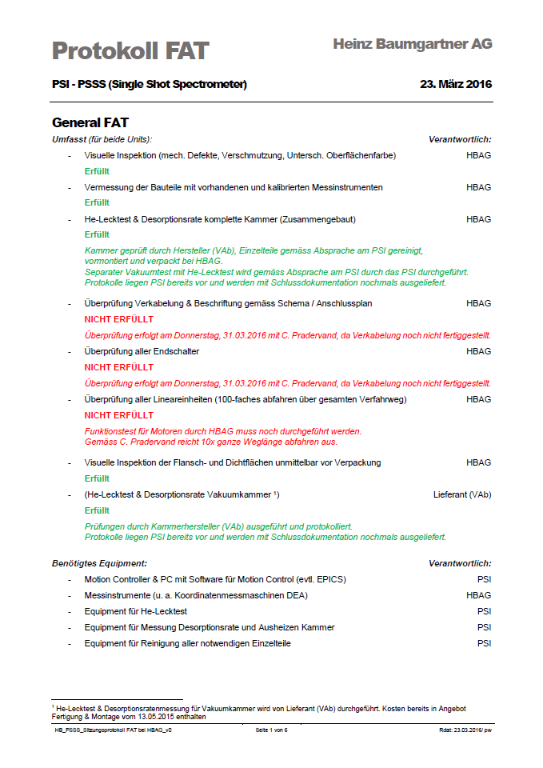
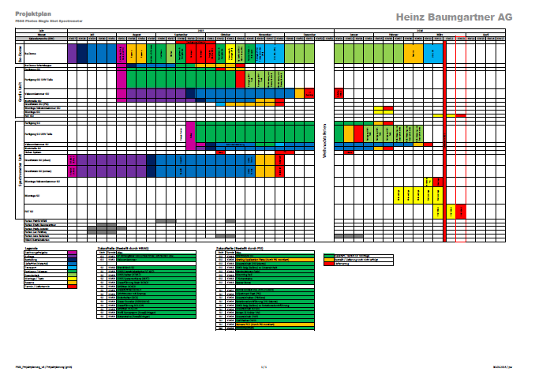
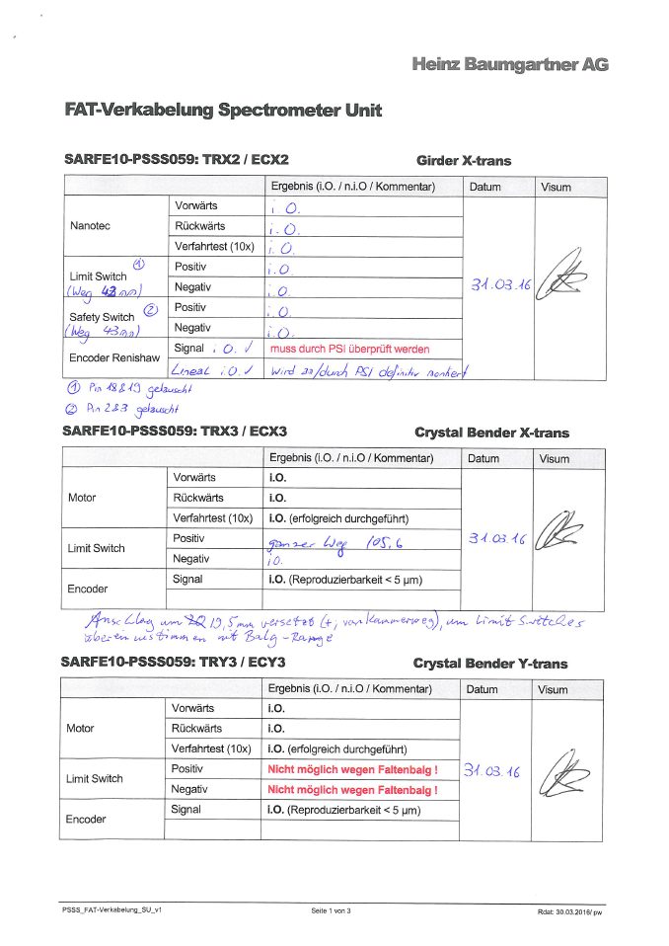
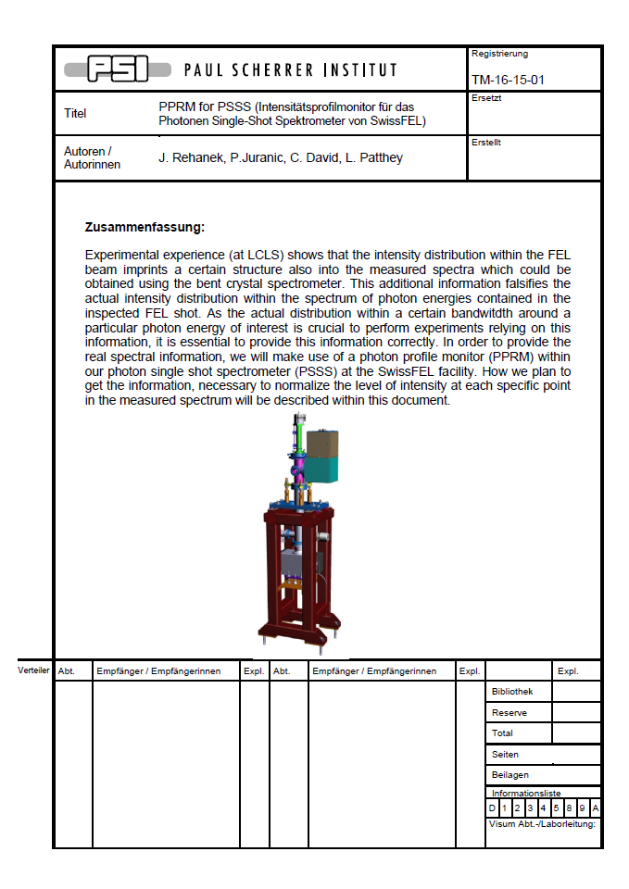
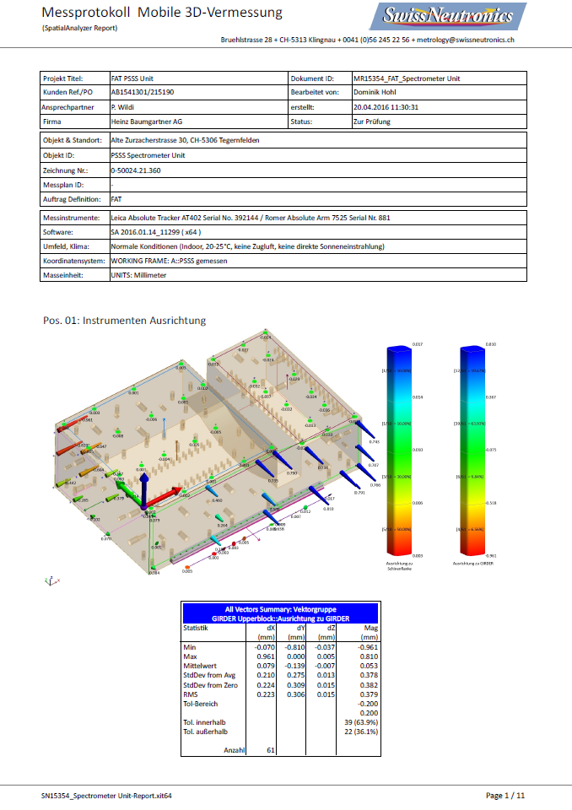
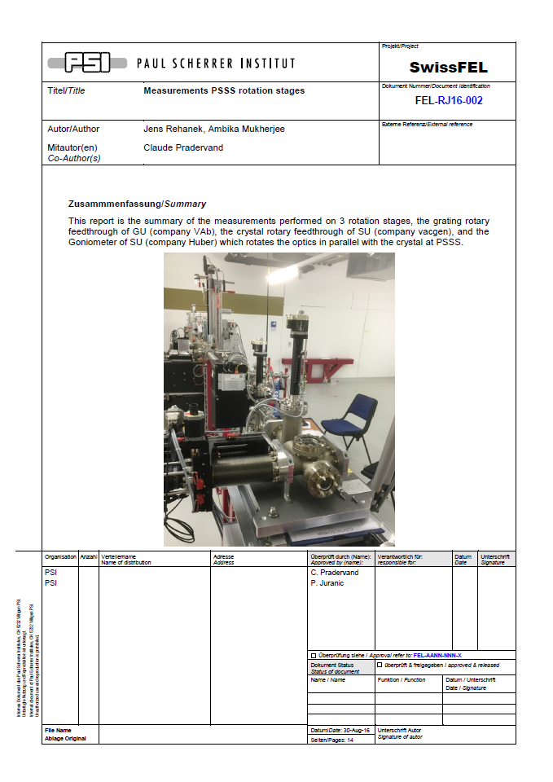
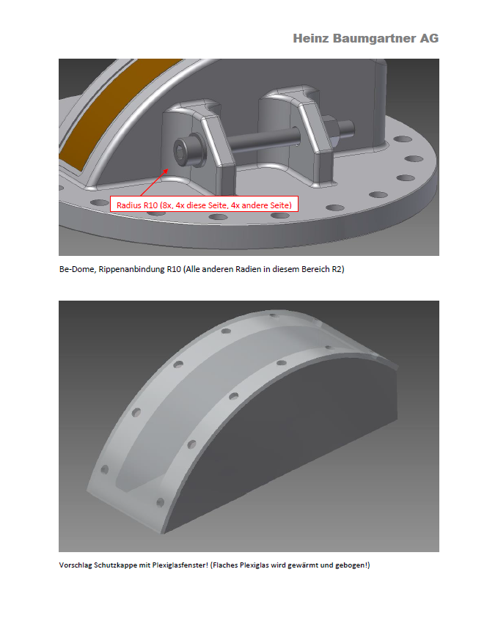
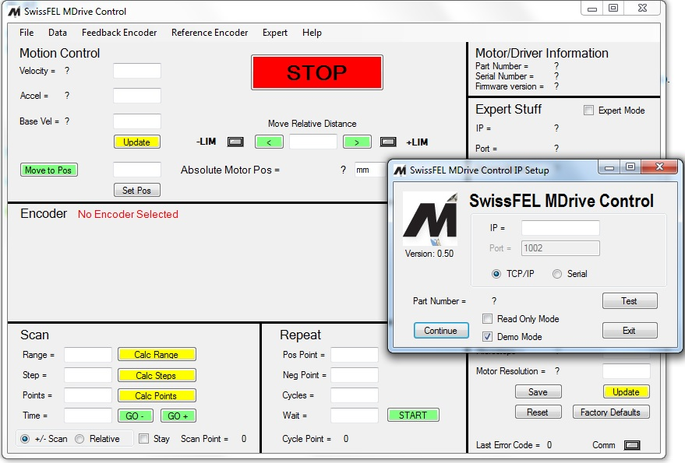
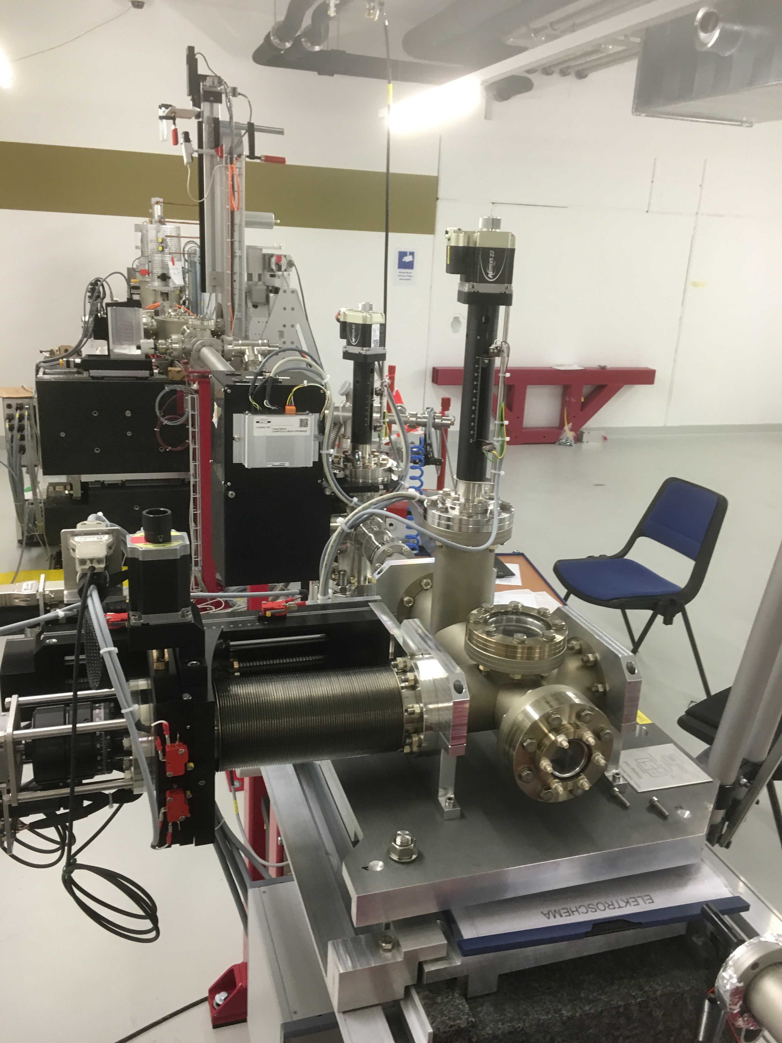
PSSS – hardware, motors, stages,…
All motors, stages, hardware tested successfully (thanks to C. Pradervand, L. Schmid, K. Dreyer, T. Höwler, T. Mühlebach, P. Wildi (HBAG), C. Hess, A. Mukherjee,…)

Slide 15
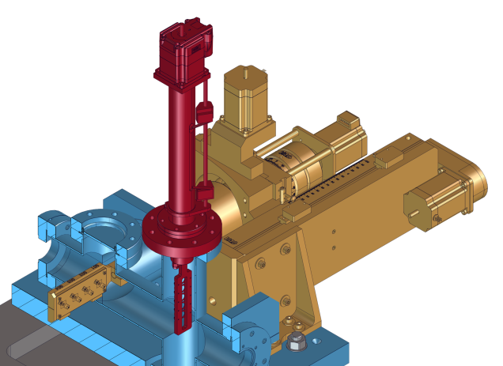
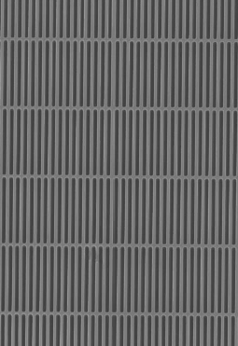
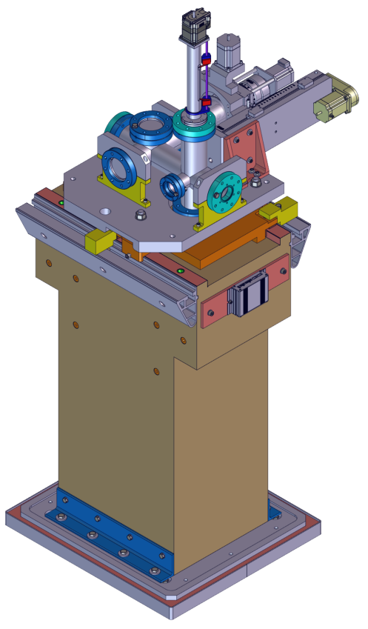
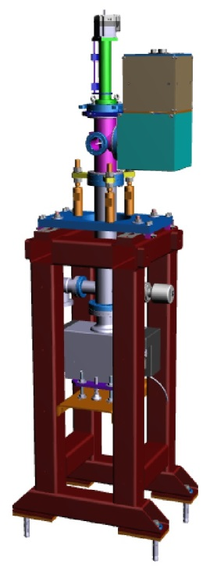
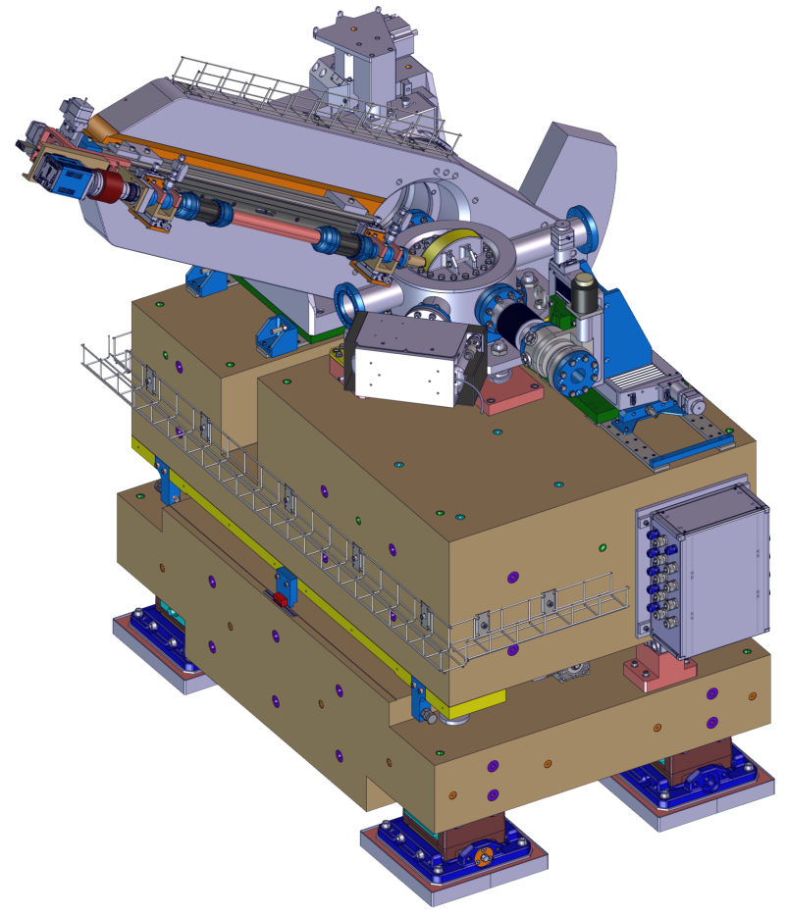
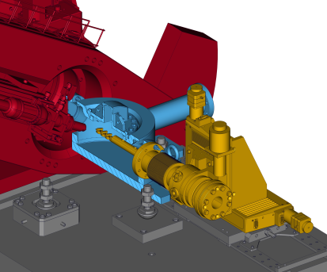
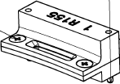
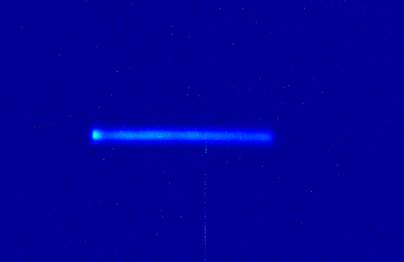
PSSS – components work!
GU
courtesy of P. Heimgartner and P. Wiegand
courtesy of J. Stettler
SU
[Rehanek et al., The hard X-ray Photon Single-Shot Spectrometer of SwissFEL – initial characterization, J.Instr., Vol.12, P05024 (2017)]

Slide 16
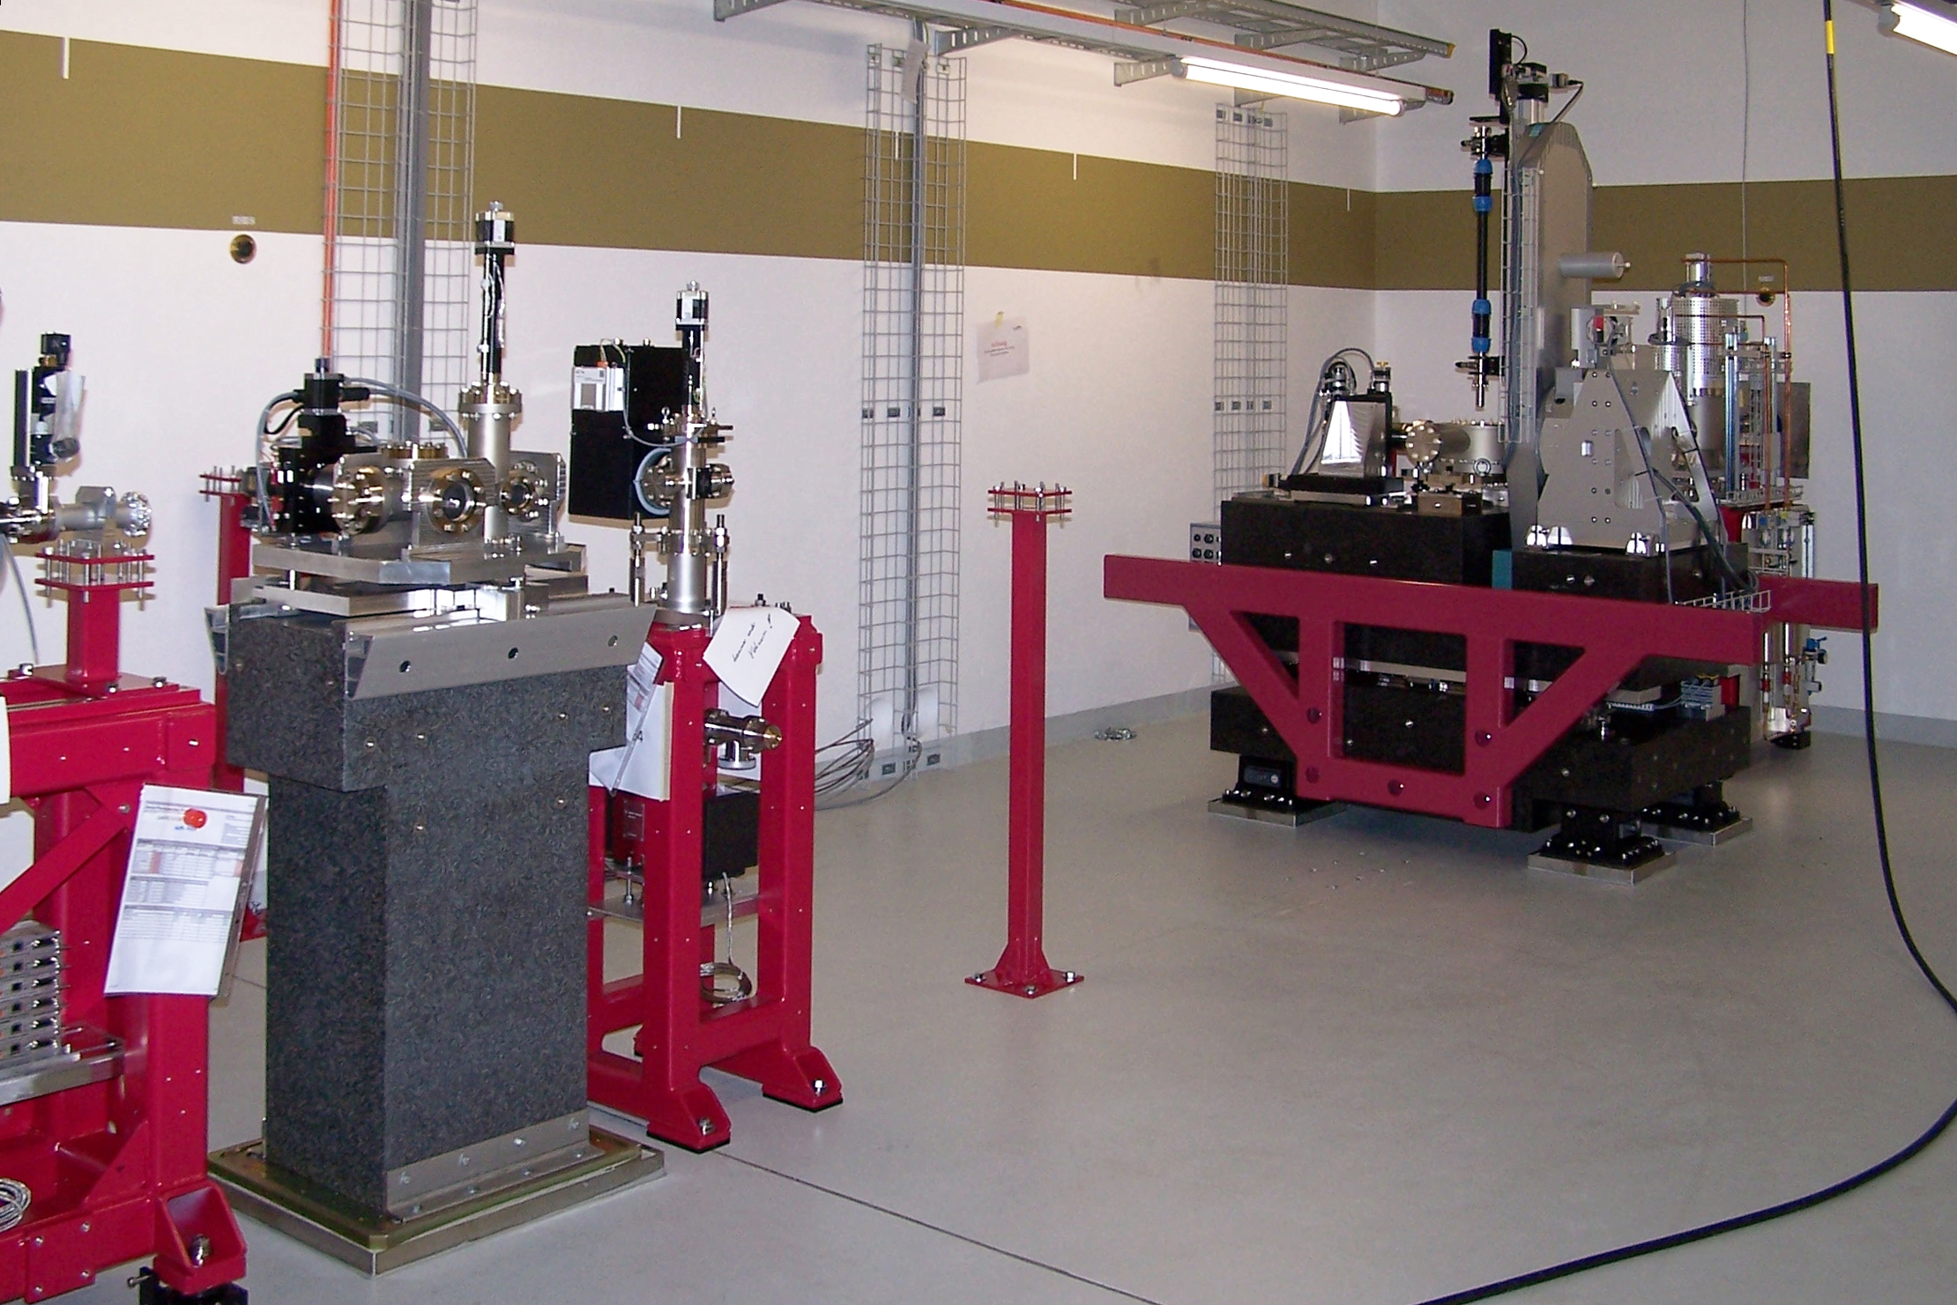
PSSS – components work!
GU
courtesy of P. Heimgartner and P. Wiegand
courtesy of J. Stettler
SU
[Rehanek et al., The hard X-ray Photon Single-Shot Spectrometer of SwissFEL – initial characterization, J.Instr., Vol.12, P05024 (2017)]

Slide 17
TX-SSS
Hard X-ray Single-Shot-Spectrometer (PSSS)
      Single-shot measurements at Aramis beamline (4 keV – 15 keV)
      Tests @PSI
      Installation/Further Steps
Tender X-ray Single-Shot-Spectrometer (TX-SSS)
      Possible Single-shot spectrometer at ESA (2 keV – 4 keV)
      Principle
      Test @PSI
      Further Steps

Slide 18
TX-SSS – requirements
Requirements on the device:
Application for ESA of Aramis beamline
Energy range: 2 keV – 4 keV (“tender” X-rays)
Non-destructive measurements of the incoming radiation
Shot-to-shot
Online device
Sufficiently high energy resolution

Slide 19
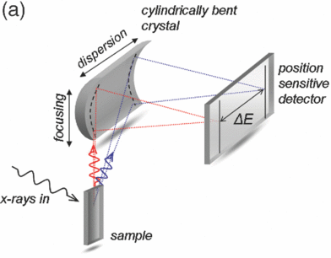
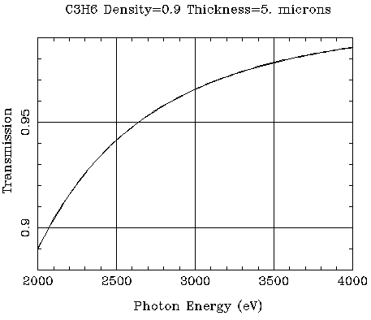
TX-SSS – general idea / working principle
http://cxro.lbl.gov/
Matlab script, [J. Hubell et al., J. Phys. Chem. 4, 471(1975).]
[Szlachetko et al., J.Elect.Spectr.&Rel.Phen. 188, 161-165 (2013)]
very promising candidate
well known technology, developed @PSI
Make use of elastic scattering as “fingerprint” employ von Hamos spectrometer
Which material can serve as scattering body?
transmission > 90% (towards experiments)
sufficient No. of photons to be detected/used
survive the direct beam
PMMA, Polypropylene, HOPG (highly-ordered pyrolytic graphite)
Polypropylene smallest density, smallest cross-section
Calculation:

Slide 20
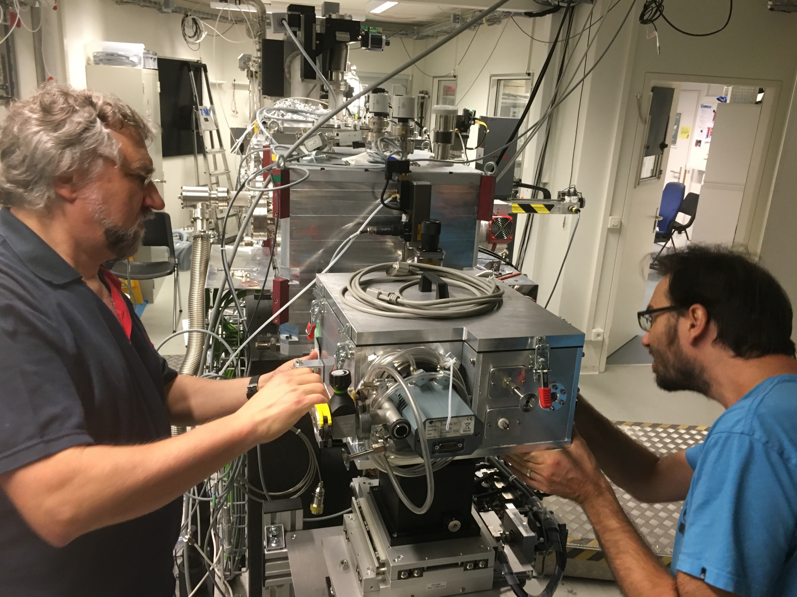
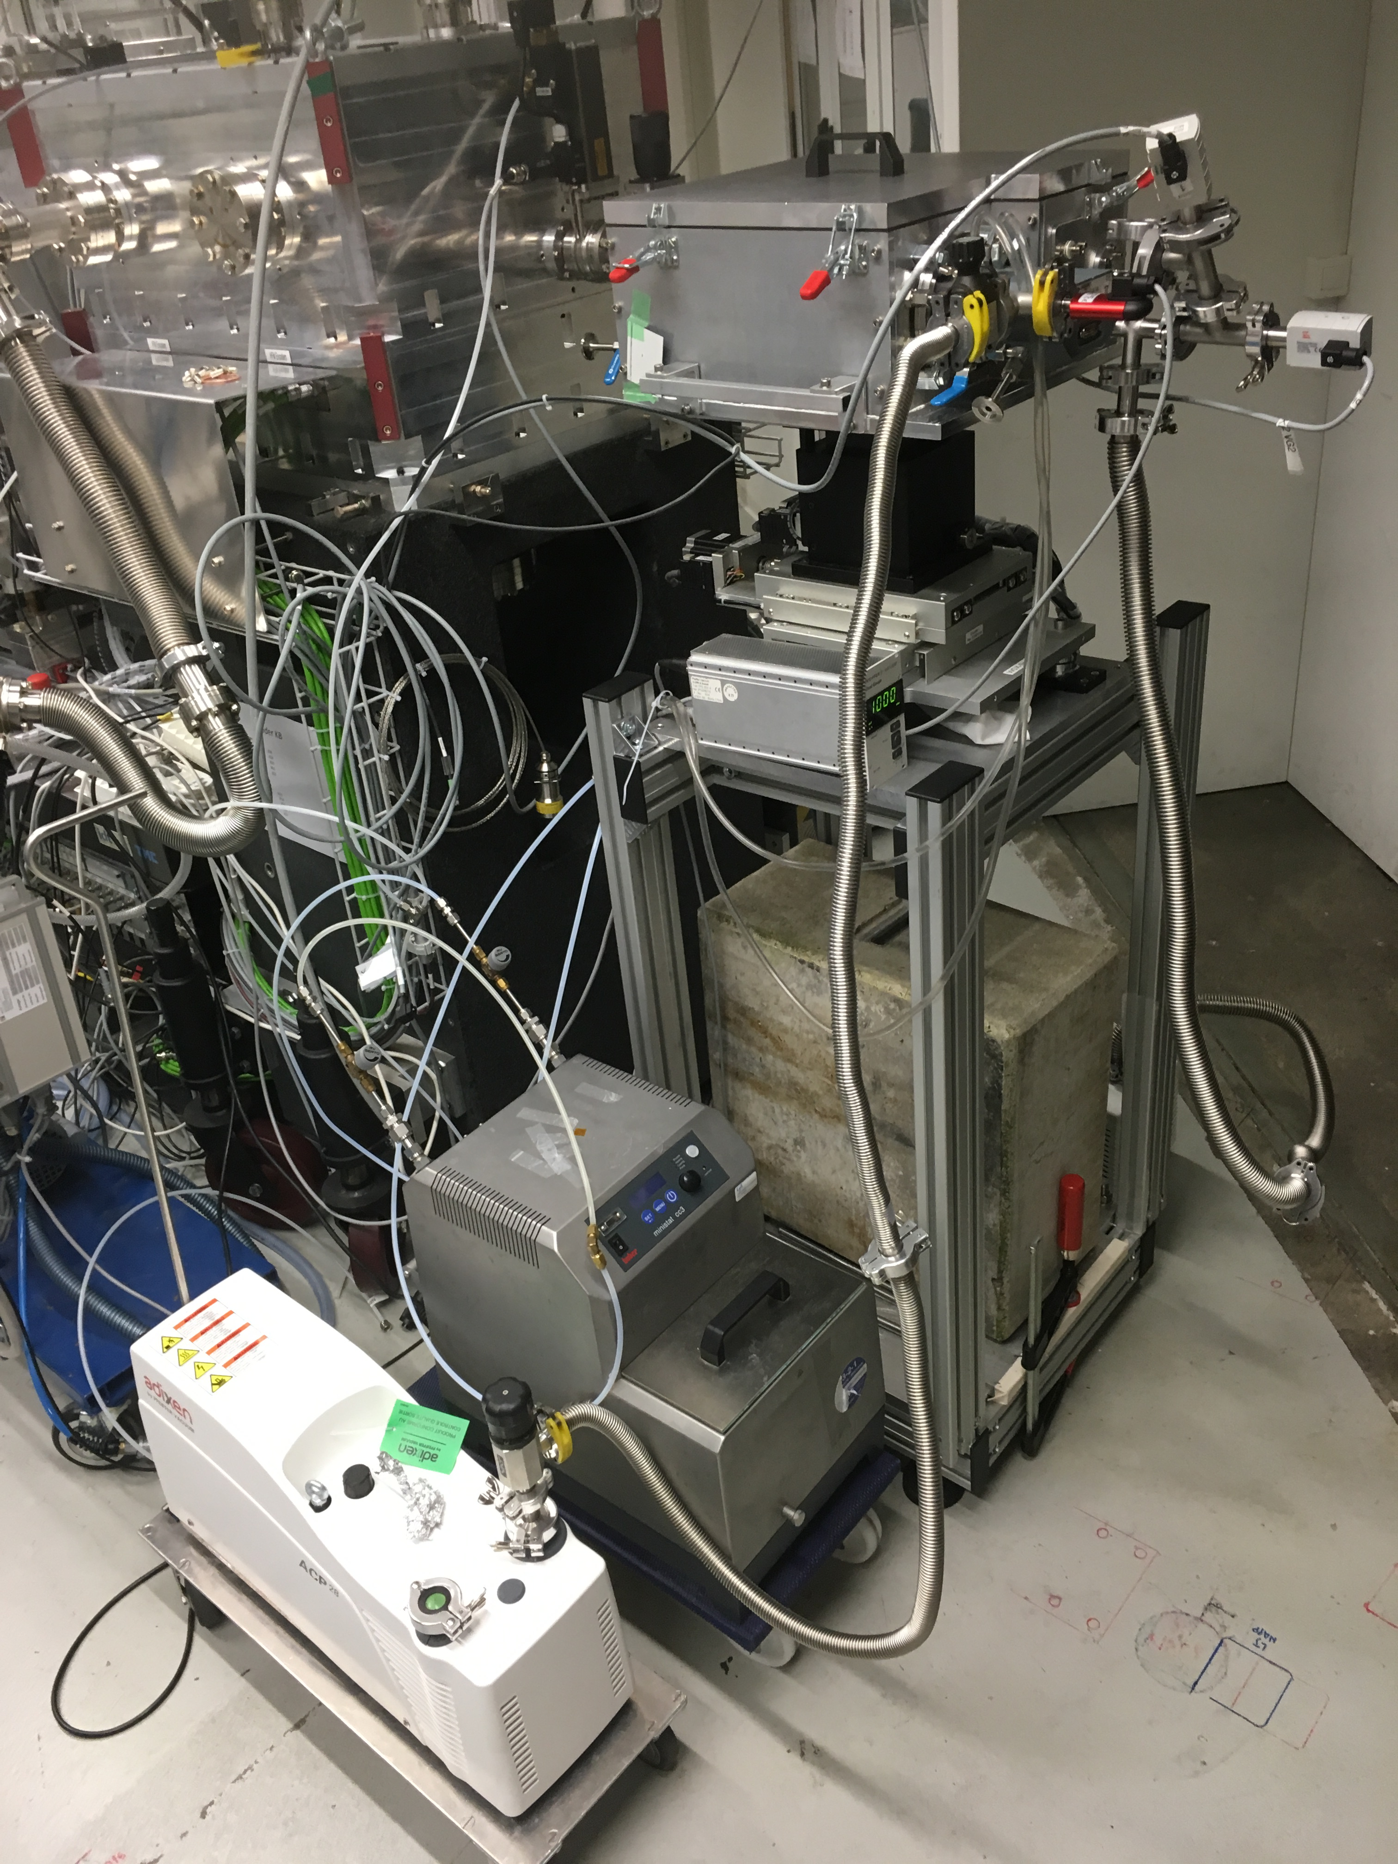
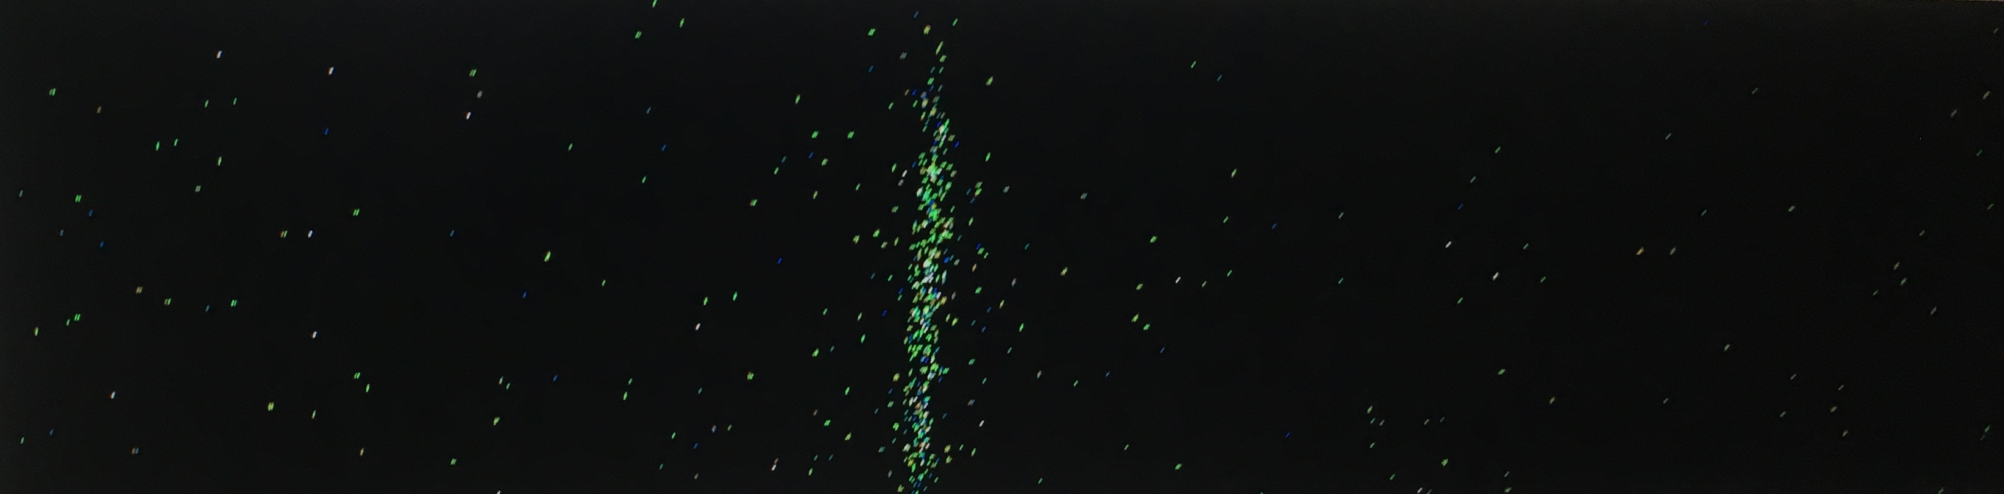
TX-SSS – experimental proof of principle
Test @ X07 MB PHOENIX (thanks to T. Huthwelker, R. Wetter, CN Borca)
made tests at
fixed geometry:
sample-crystal = 103mm
sample-detector = 206mm
2140 eV (using Si <111>)
3495 eV (using Si <220>)
sample: 5μm of C3H6 (polypropylene)
experiment for proof of
principle is done
courtesy of J. Czapla-Masztafiak, J. Schneider, C. Milne, J. Szlachetko
photon energy

Slide 21
TX-SSS – experimental proof of principle
Test @ X07 MB PHOENIX (thanks to T. Huthwelker, R. Wetter, CN Borca)
2140 eV (using Si <111>)
sample: 5μm of C3H6 (polypropylene)
ΔE/E: 1.9x10⁻⁴, ± 21.3eV (2% bandwidth)
3495 eV (using Si <220>)
sample: 5μm of C3H6 (polypropylene), 10μm Kapton (polyimide)
Signal sufficient!
#photons_{calc.} = 150
#photons_{meas.} = 135
in cone between source and crystal
10¹¹ photons in
Code can be used for further design of TXS!
ΔE/E: 1.4x10⁻⁴
± 34eV
(2% bandwidth)

Slide 22
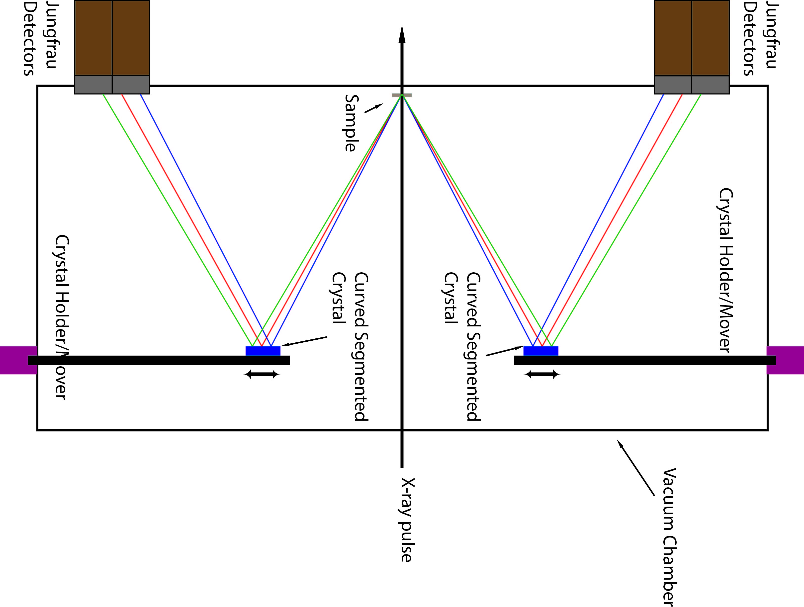
Summary, Outlook
Courtesy of P. Juranic
Hard X-ray Single-Shot-Spectrometer (PSSS)
Successfully installed in front end
All (key) components tested and installed in spectrometer
Next: commissioning as soon as we see X-rays at 4 keV
Tender X-ray Single-Shot-Spectrometer (TX-SSS)
Experiment for proof of principle successfully performed
Comparison of experiment vs. calculation successful
Ongoing: Design of the entire instrument (vacuum chamber, switchable crystals and samples,…), ready to be used as soon as we see X-rays in ESA at ≥ 2 keV

Slide 23
Many thanks go to
Uwe Flechsig, Vincent Thominet, Andreas Jaggi, Rolf Follath, Sibylle Spielmann-Jäggi, Christian David, Mikako Makita, Maxime Lebugle, Angel Rodriguez-Fernandez, Claude Pradervand, Lukas Schmid, Peter Heimgartner, Christoph Hess, Peter Wiegand, Peter Ming, Haimo Jöhri, Rico Nicolini, Samuel Bugmann, Christof Schneider, Thierry Zamofing, Karsten Dreyer, Tino Höwler, Thomas Mühlebach, Chris Milne, Jakub Szlachetko, Joanna Czapla-Masztafiak, Jörg Schneider, Thomas Huthwelker, Reto Wetter, Camelia Borca, Patrik Wildi (HBAG)

Slide 24
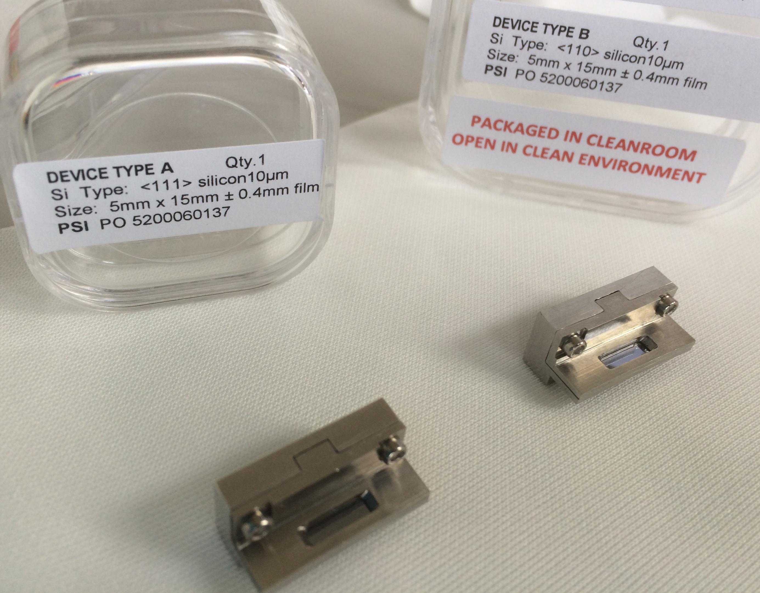
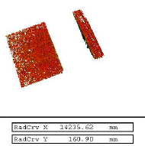
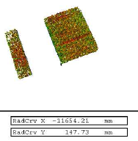
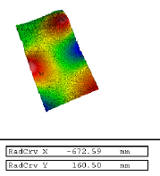
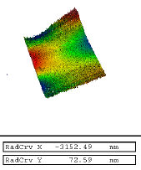
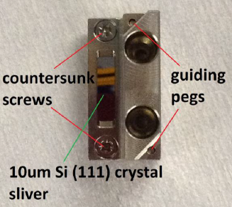
PSSS – thin Silicon crystal
Quality (bending radius, mounting, surface) of crystals benders of high importance
with WLI (thanks to Vincent Thominet):
benders’ surface
crystals’ surface

Slide 25
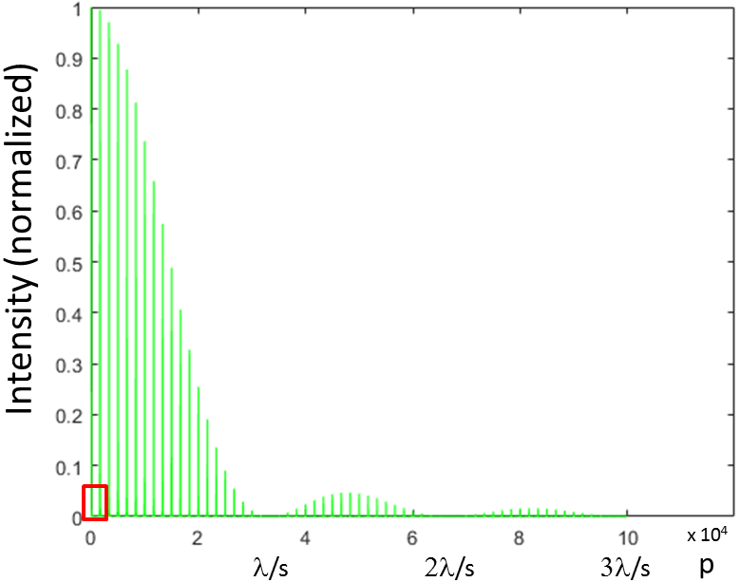
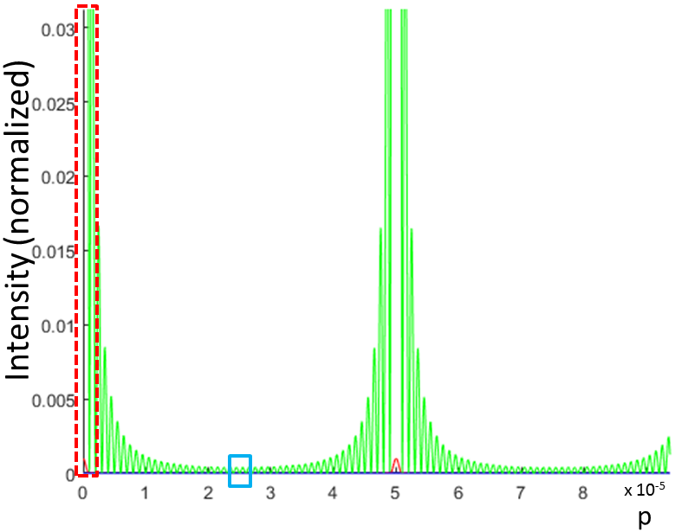
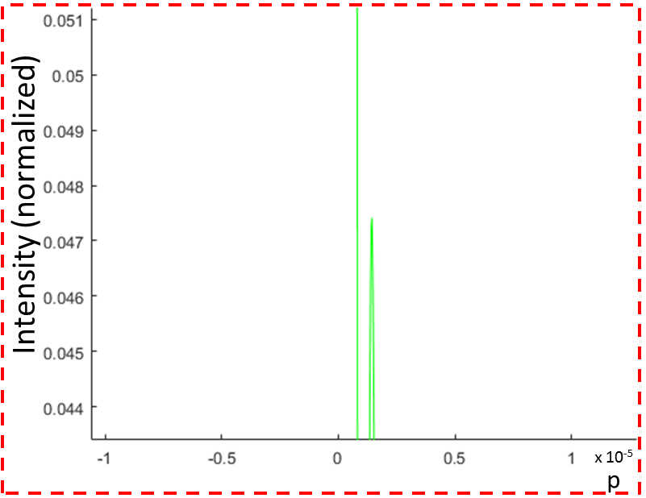
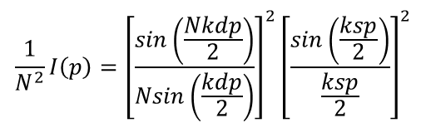
PSSS – diamond grating
Would these diffraction orders and side lobes disturb further downstream?
support structure acts as grating consisting of N similar equidistant parallel slits
normalized intensity function [Born, Wolf, p. 450+451]
N=50, support pitch: d=2μm, support width: s=0.1μm, wave-vector: k=2π/λ, normalized incident energy density: E/R²=1, λ is wavelength, p distance from 0th order.
1st side lobe 21 times weaker than 1st order, second side lobe intensity 60 times weaker,…
supporting structure within the diamond gratings does not significantly disturb the direct beam
$${\frac{1}{N^{2}}I\left(p\right)=\left[\frac{sin\left(\frac{Nkdp}{2}\right)}{Nsin\left(\frac{kdp}{2}\right)}\right]}^{2}{\left[\frac{sin\left(\frac{ksp}{2}\right)}{\frac{ksp}{2}}\right]}^{2}$$

