Slide 1
Joint Annual Meeting of the Swiss Physical Society / Austrian Physical Society CICG, Geneva (25.08.2017)
Lionel Haemmerlé
Observatoire de Genève
The Evolution of Supermassive Pop III stars
collaborators: Ralf Klessen (ITA Heidelberg)
Alexander Heger & Tyrone Woods (Monash Melbourne)
Daniel Whalen (ICG Portsmouth)
references: Haemmerlé, Woods, Klessen, Heger, Whalen 2017 arXiv:1705.09301
Woods, Heger, Whalen, Haemmerlé, Klessen 2017 ApJ 842 L6

Slide 2
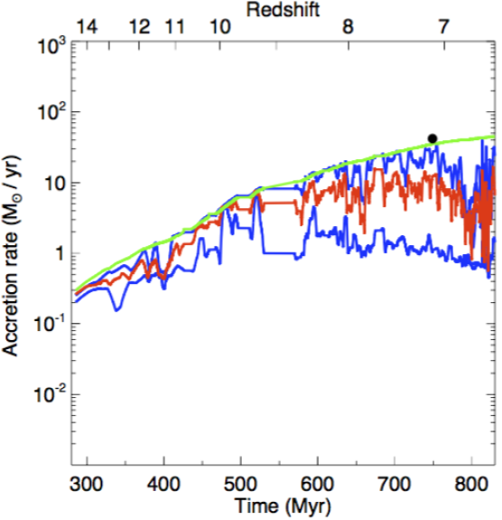
SuperMassive Stars (SMS): progenitors of high redshift quasars?
- M > 10⁴ M_{sun}: radiation dominated, General Relativistic (GR) effects (Hoyle & Fowler 1963, Hoyle et al. 1964, Chandrasekhar 1964)
- Quasars z≈7: ULAS J1120+0641 (M=2×10⁹ M_{sun}, z=7.1 , Mortlock+11)
SDSS J010013.02+280225.8 (M=1.2×10¹⁰ M_{sun}, z=6.3 , Wu+15)
=> dM/dt ≈ 1 M_{sun} yr⁻¹
- Direct Collapse scenario:
External Lyman-Werner (LW) radiation field
dissociates H₂. => no molecular cooling
=> T ≈ 10⁴ K
=> Jeans mass ≈ 10⁷ M_{sun}
=> One central stellar object forms by
accretion at high rate (0.1-10 M_{sun} yr⁻¹).
In agreement with hydrodynamical simulations
of primordial halos (e.g. Latif+13, Smidt+17).
BUT: The ionising feedback has to remain weak!
Smidt+17

Slide 3
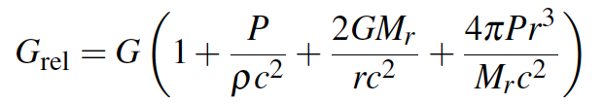
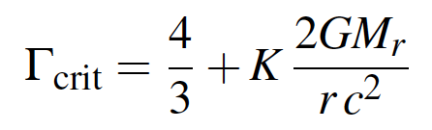
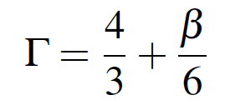
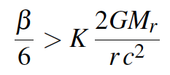
SuperMassive Stars (SMS): general properties
- radiation dominated: => β:=P_{gas}/P_{tot}<<1 => Γ₁ ≈ 4/3
=> The star is trembling on the verge of instability (Fowler 1964).
- GR effects: Post-Newtonian correction to hydrostatic equilibrium
- Chandrasekhar (1964): GR stability criterion for polytropes
- 1st order GR correction to Γ_{crit}:
- 1st order "gas" correction for Γ:
=> The star is GR stable only if: ...pulsational instability!
(R > Schwarzschild radius)
(Fuller, Woosley & Weaver 1986)

Slide 4
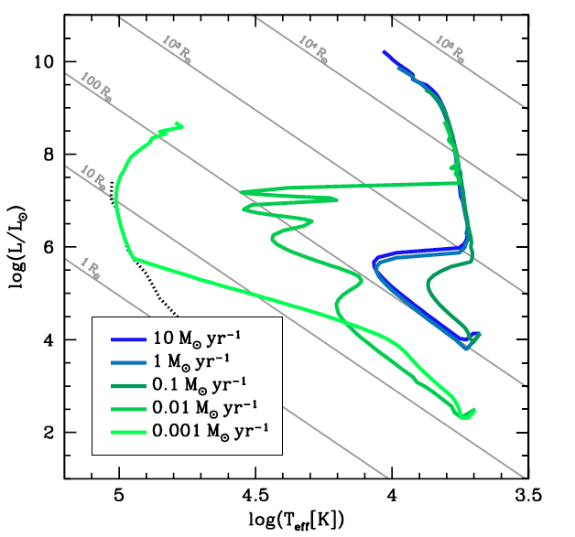
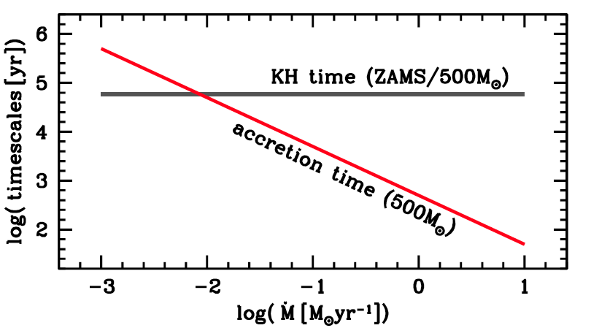
Models of accreting PopIII protostars:
- GENEVA: 1D hydrostatic stellar evolution code
- accretion of mass: 0.001-10 M_{sun} yr⁻¹, towards the highest mass-range >10⁵M_{sun}
- accretion of entropy: cold disc accretion, lower limit
- convection: mixing-length theory, Schwarzschild criterion, no overshooting
- GR effects: post-Newtonian correction to hydrostatic equilibrium
Results: 2 asymptotic regimes
- low dM/dt : accretion time > KH time
=> compact blue -> ZAMS
- high dM/dt : accretion time < KH time
=> puffed red -> Hayashi limit

Slide 5
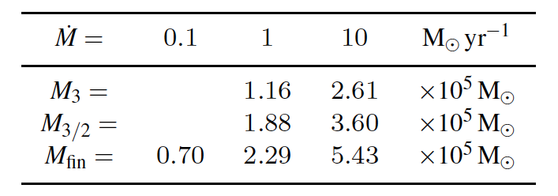
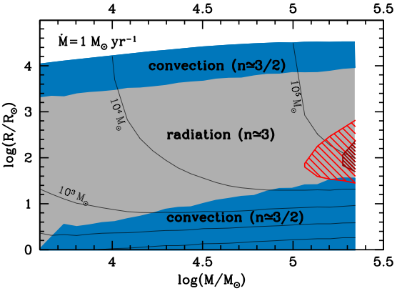
GR instability & final masses:
Structure in the SMS range:
- convective core (H-burning)
- intermediate radiative region
- convective envelope (Hayashi line)
Polytropic criterion
for GR stability:
Radiation: n≈3 => K=1.12
Convection: n≈1.5 => K=0.64

Slide 6
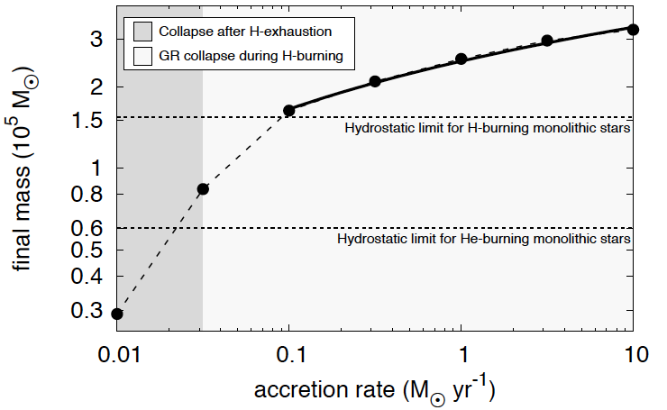
KEPLER code:
- 1D hydrodynamical stellar evolution code
- accretion of entropy: cold disc accretion + advection term
- convection: mixing-length theory, Ledoux criterion + overshooting
- GR effects: post-Newtonian correction to hydrostatic equilibrium
Woods, Heger, Whalen, Haemmerlé, Klessen 2017 ApJ 842 L6
...the most massive stars that ever existed?

Slide 7
CONCLUSIONS:
Supermassive Pop III stars accreting at rates > 0.01 M_{sun}yr⁻¹ evolve along the Hayashi line.
They keep a weak ionising feedback until they collapse into a black hole, supporting the direct collapse scenario.
The mass at collapse depends on the accretion rate (the higher is the rate, the larger is the final mass), but remains in the same order of magnitude (1-5×10⁵M_{sun}) for rates 0.1 – 10 M_{sun}yr⁻¹.
Since we do not expect accretion rates > 10 M_{sun}yr⁻¹, these objects might be the most massive stars ever formed in our Universe.
We provide numerical tables of the surface properties of supermassive Pop III stars accreting at various rates:
Haemmerlé, Woods, Klessen, Heger, Whalen 2017 arXiv:1705.09301

