Slide 1
David Cameron, University of Oslo, ATLAS Experiment and NorduGrid Collaboration
Introduction to Distributed Computing

Slide 2
The Changing Scale of Particle Physics
A discovery in 1930s
~2 scientists in 1 country
pen-and-paper
A discovery in 1970s
~200 scientists in ~10 countries
mainframes
A discovery today
~2000 scientists in ~100 countries
Distributed Computing
Graphics by O. Smirnova

Slide 3
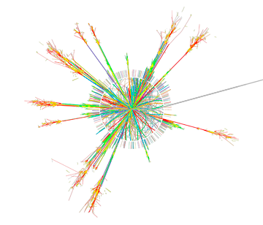
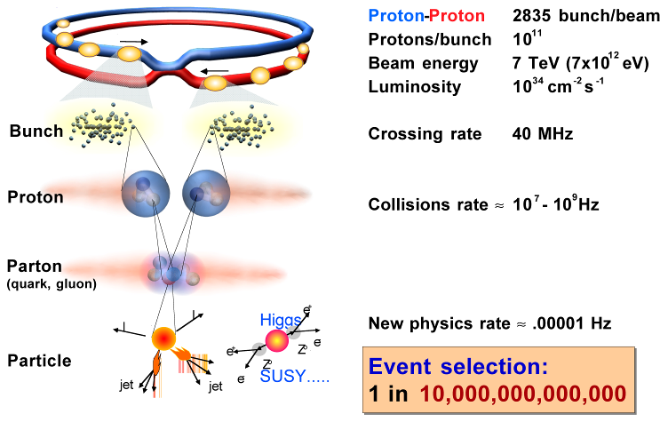
Event Collection in ATLAS
40 MHz
L1 trigger (hardware)
75 kHz
L2 trigger (software)
~3 kHz
Event Filter (software)
~1 kHz
Graphic by CERN
1 GB/s

Slide 4
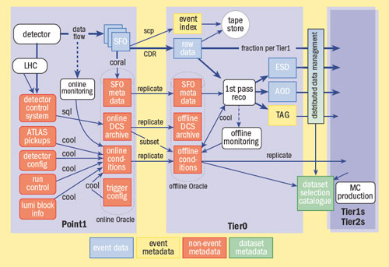
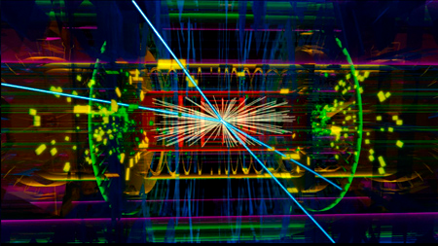
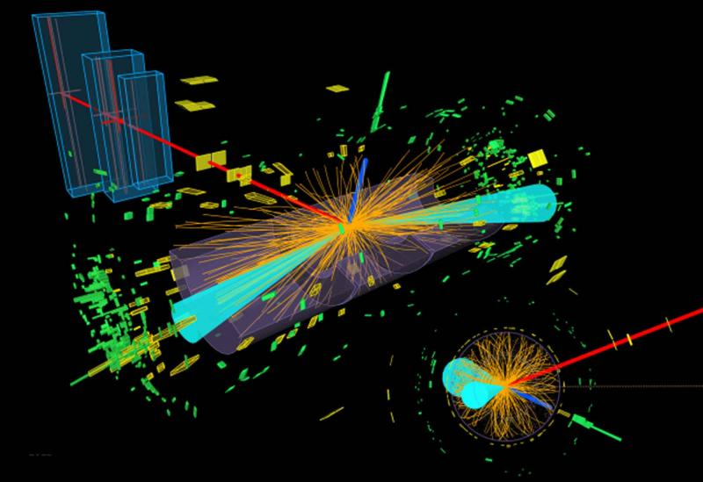
What is the data?
C++ objects representing tracks, parts of detector etc, saved in files. Some geometry information in databases
Data is reconstructed and reduced through various formats
  RAW -> ESD -> AOD -> DAOD
Figure from http://cerncourier.com/cws/article/cnl/34054

Slide 5
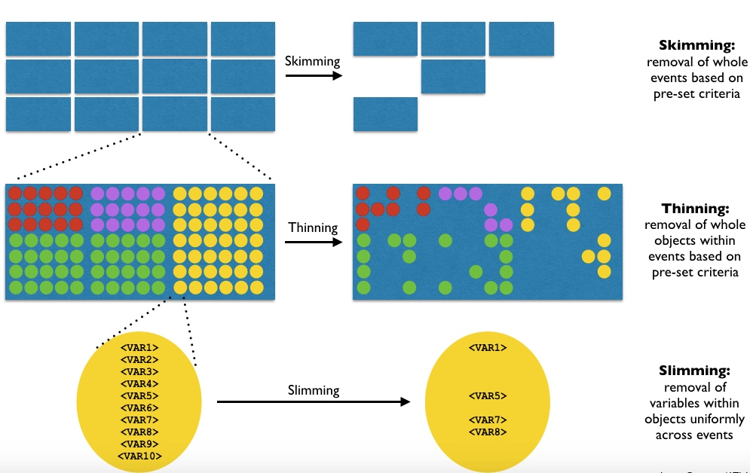
ATLAS Derivation Framework

Slide 6
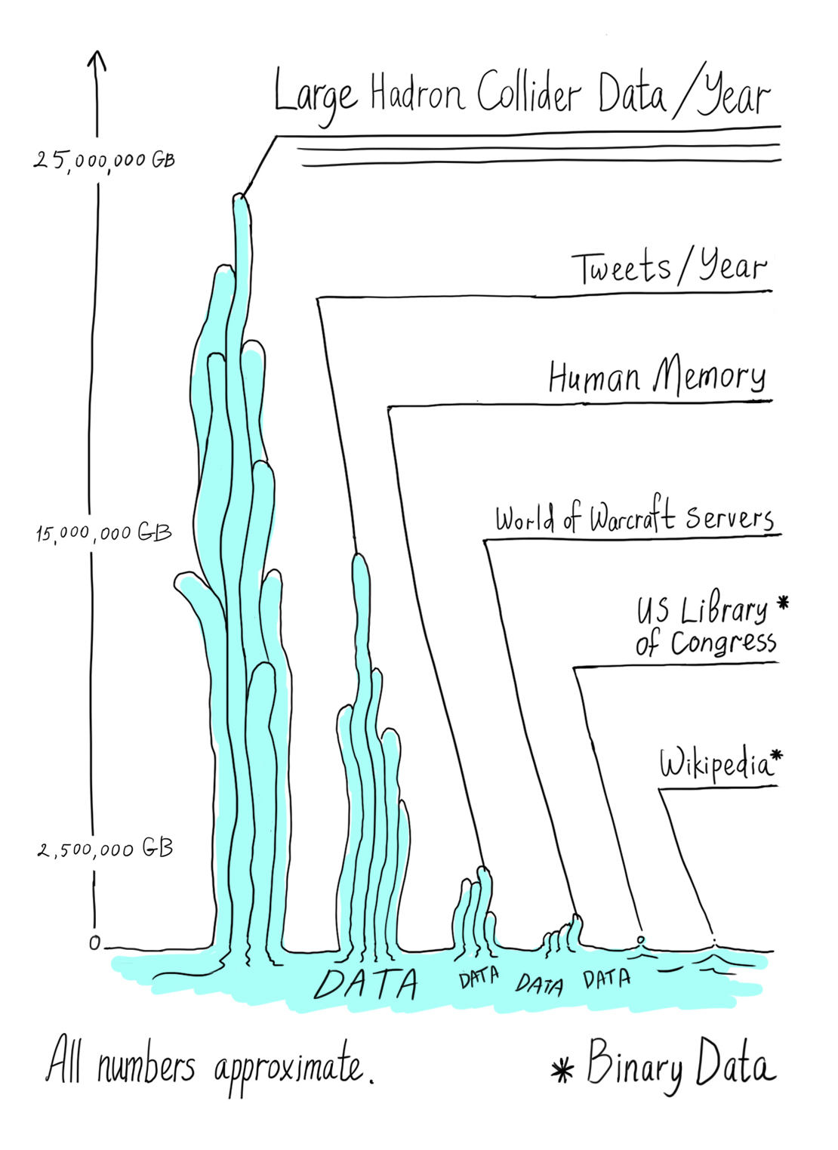

Big Data?
LHC data output
(2012): 15 PB
Business emails per
year: 3000 PB
Total ATLAS data (2017): 250PB
Google search index
(2013): 98 PB
YouTube uploads
per year: 15 PB
Content uploaded to
Facebook per year: 182 PB
Illustration by Sandbox Studio, Chicago
Taken from http://www.symmetrymagazine.org/image/august-2012-big-data
WIRED.com © 2014 Condé Nast.
Taken from http://www.wired.com/2013/04/bigdata/

Slide 7
Do everything at CERN?
All this requires (just for ATLAS)
  250,000 CPU constantly processing data
  Storing 10s of PetaBytes (million GB) of data per year
CERN cannot physically handle this
Grid Computing!

Slide 8
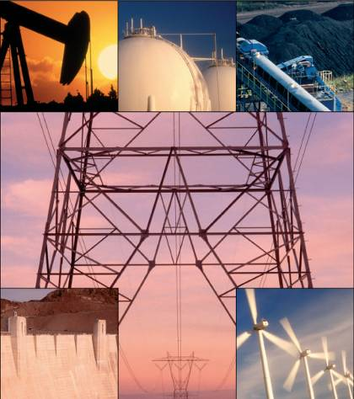
Grid Computing
Idea started in late ‘90s
Like the electricity Grid
Grid is a technology that enables optimized and secure access to widely distributed heterogeneous computing and storage facilities of different ownership

Slide 9
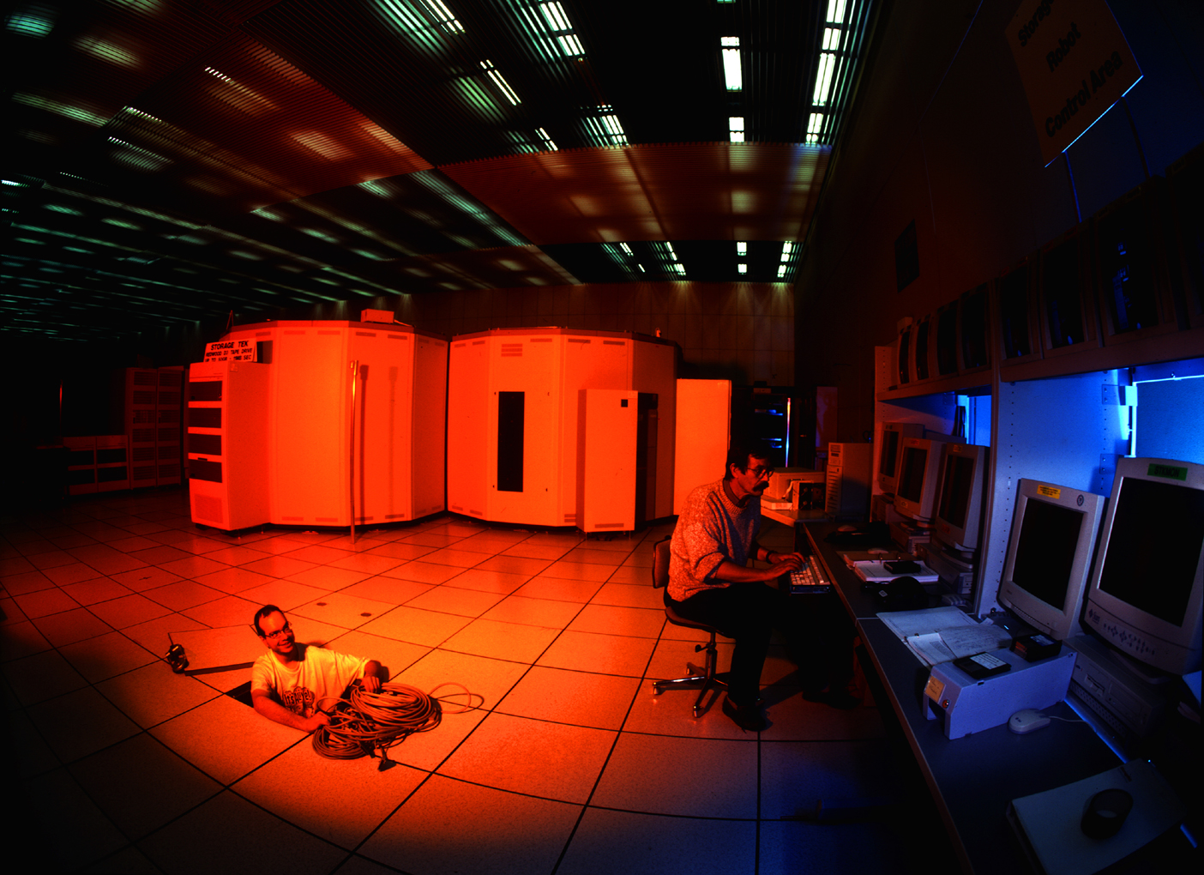
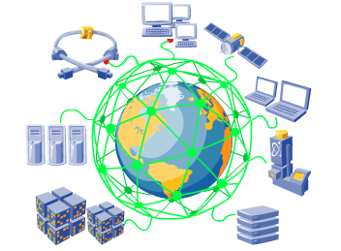
From WWWeb to WWGrid
From WWWeb to WWGrid
→ World Wide Web allows
  - access to information
→ World Wide Grid allows
  - access to computing capacity and data storage all over the world
→ Grid is a technology to share and access seamlessly computing resources
→ A “glue”, Middleware, binds resources
  into a Virtual Supercomputer.
Slide by F. Ould-Saada

Slide 10
How to make a Grid
The “Grid middleware” exposes heterogeneous resources to the Grid in a uniform interface
  Computing Elements give access to CPUs
  Storage Elements give access to data
  Information systems describe the Grid
How to allow access to resources?
  Cannot give usernames and passwords for hundreds of sites to thousands of people!
  Fundamental basis is X509-based cryptography (digital certificates)

Slide 11
Grid Security (your “passport”)

Slide 12
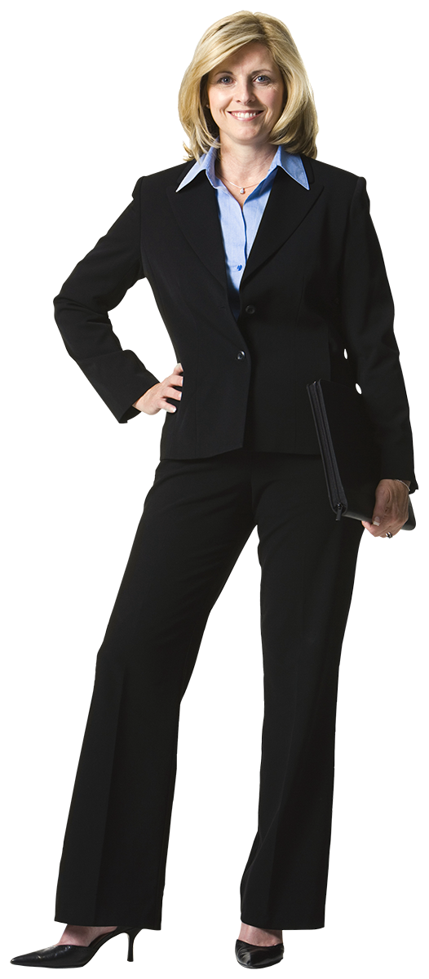
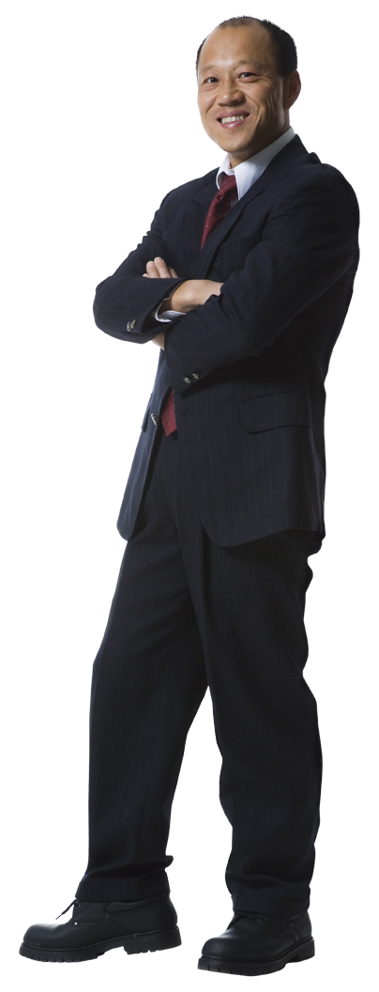


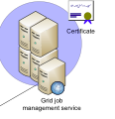
Virtual Organisations (your “visa”)
ATLAS
“Allow ATLAS members
to access /data/atlas/”
X
CMS

Slide 13
Computing Element in more detail
X509 certificate ➔ local account

Slide 14

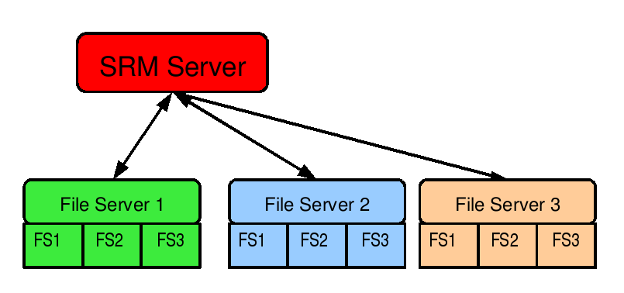
Storage Element in more detail
Graphics by G. Stewart

Slide 15
Copying data around
Replica
Catalog
File Transfer Service
data flow

Slide 16













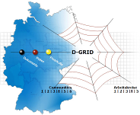
















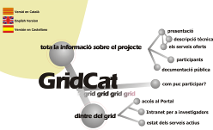






Many Grids!
Some Grid projects; originally byVicky White, FNAL

Slide 17
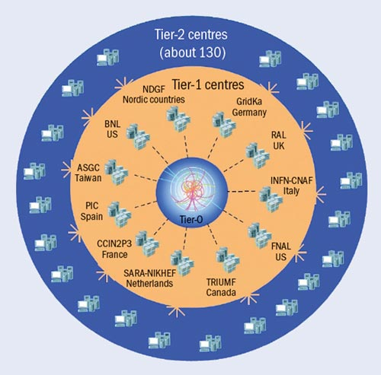

The (Worldwide) LHC Computing Grid
1 Tier 0: CERN
  Data processing
11 Tier 1s
  Simulation
  Reprocessing
~130 Tier 2s
  Simulation
  User Analysis
Total storage space:
  364,389,470 GB (disk)
  330,703,439 GB (tape)
Total processors available: 644,129
Numbers taken from http://wlcg-rebus.cern.ch/apps/capacities/pledge_comparison/ March 2017

Slide 18
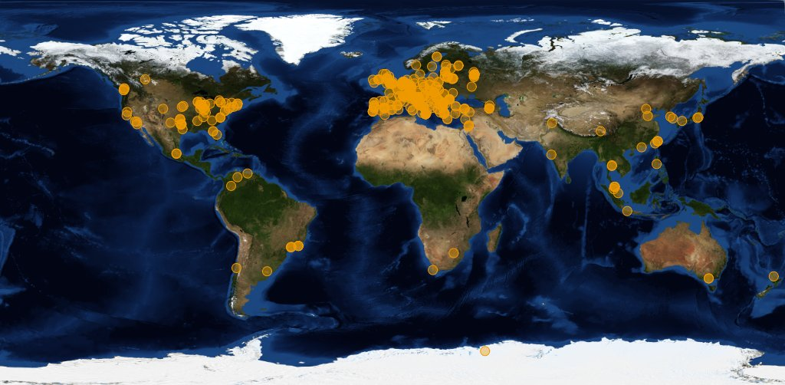
WLCG Sites

Slide 19


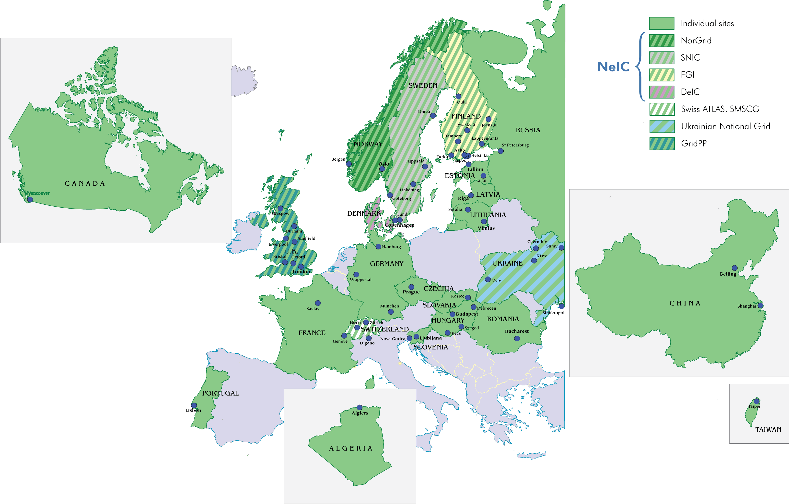
NorduGrid
Conceived in 2001 as Scandinavian Grid
  UiO heavily involved in coordination and development
Now 93 sites in 20 countries
Software: Advanced Resource Connector (ARC)
  Computing Element
  (Basic) Storage Element
  Information System
Scandinavian design principles: clean and simple!

Slide 20
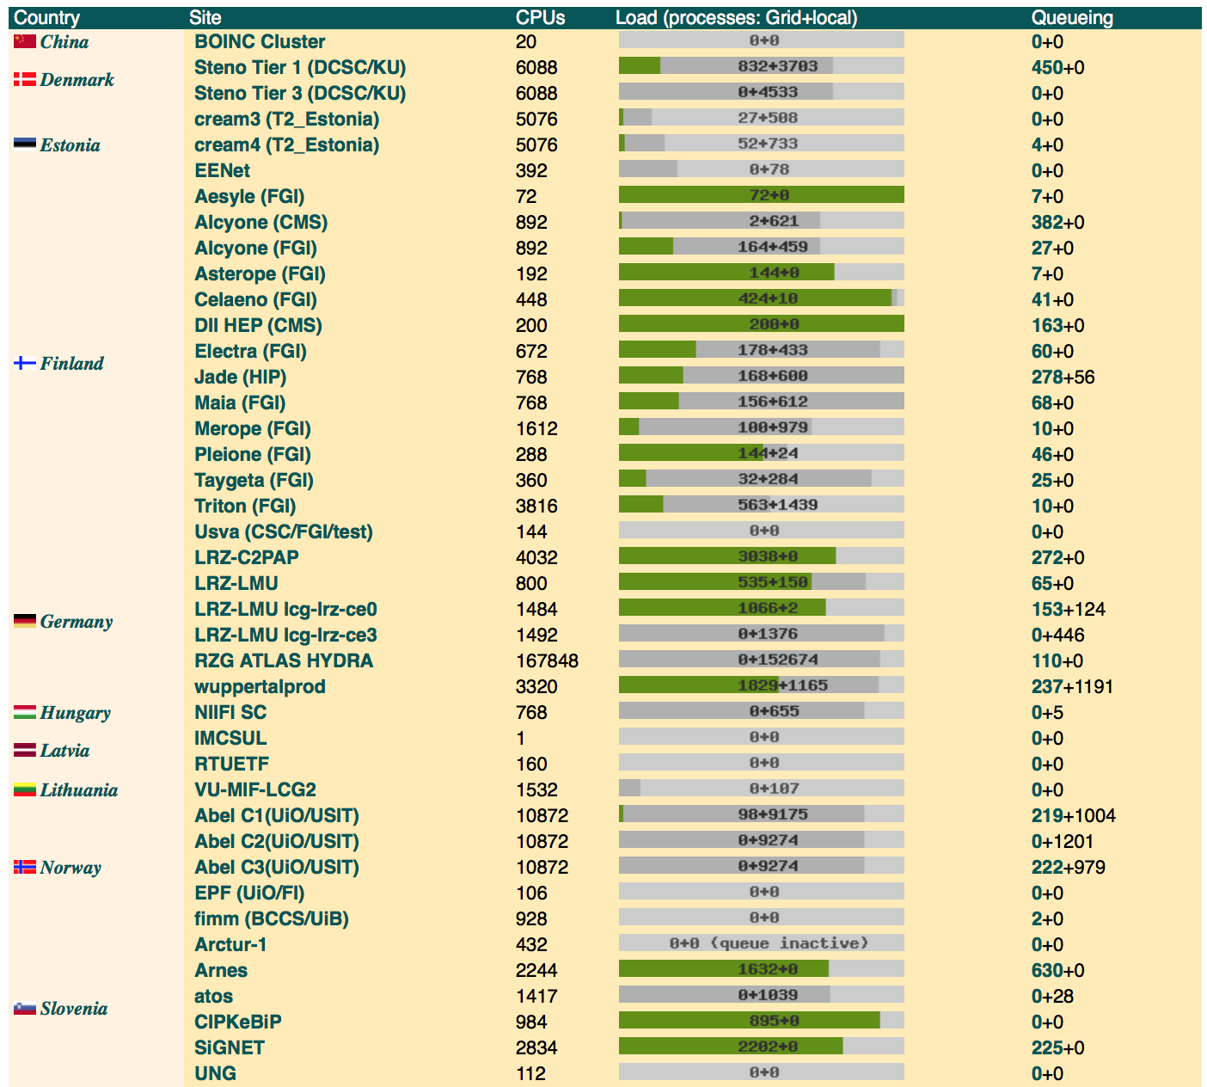
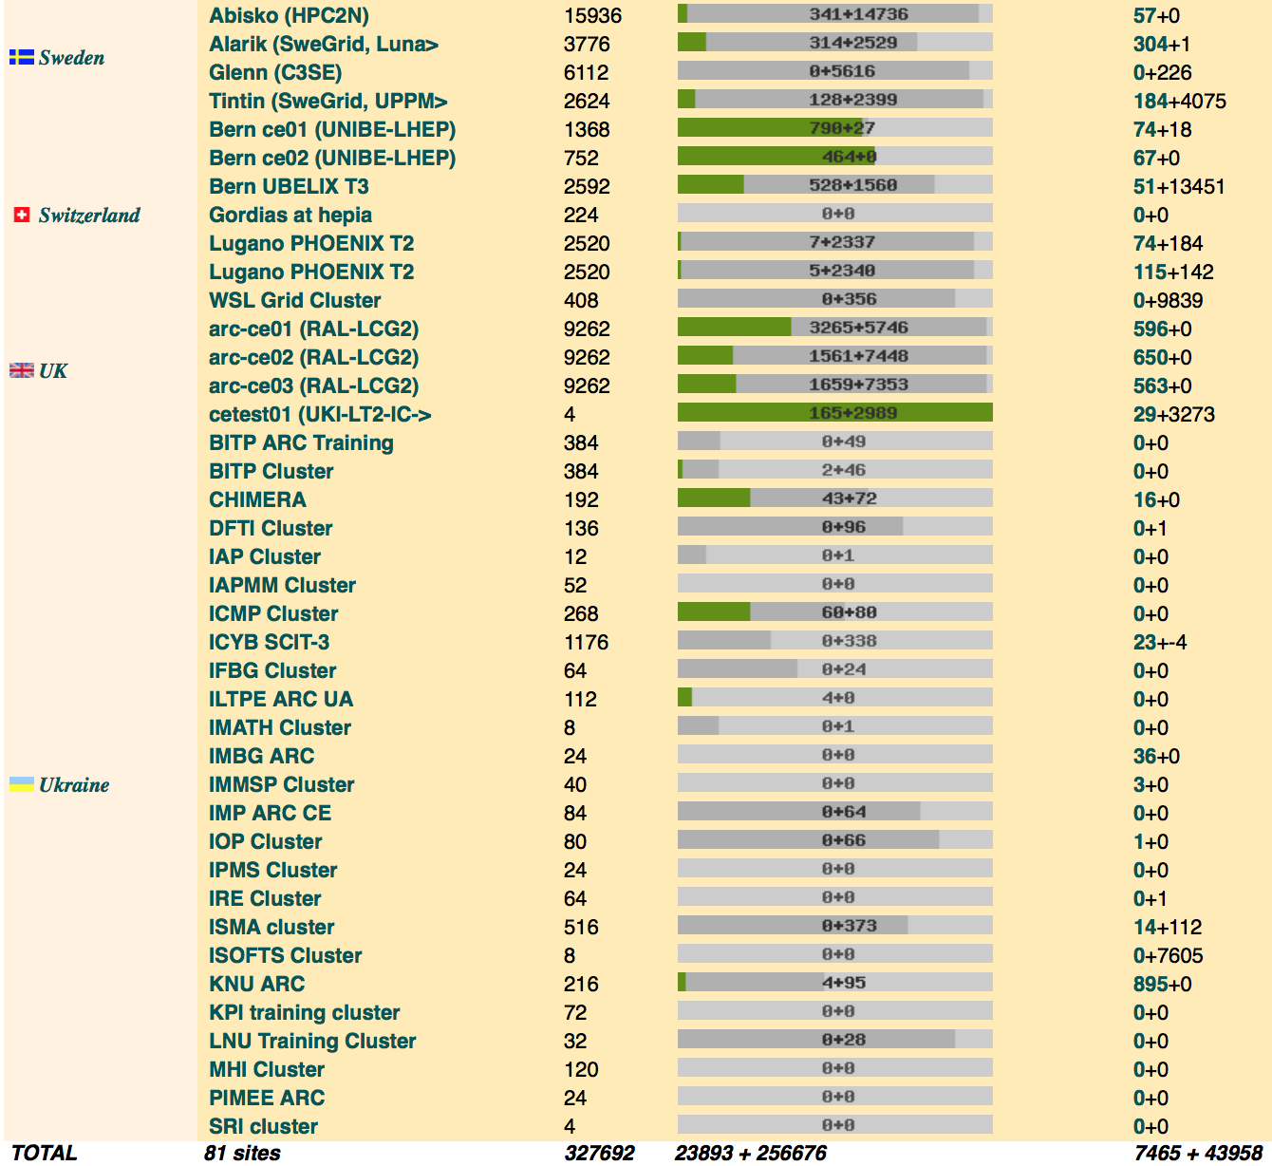
NorduGrid Monitor
Sites: 81 Running jobs: 23893

Slide 21
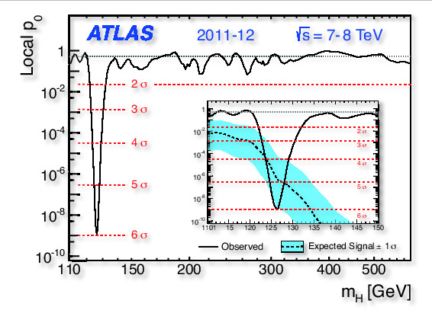
ATLAS Data Processing
Three main kinds of processing
  Analysis of data
    Plots and papers!
  Simulation of data
    Why?
    At design phase to optimise the detector layout
    In running phase to validate real data
    The only way to know we have discovered something new
  Reprocessing data
    Re-reconstruct the RAW data using improved software or knowledge of detector conditions
  Simulation is the most CPU-intensive process in LHC experiments

Slide 22
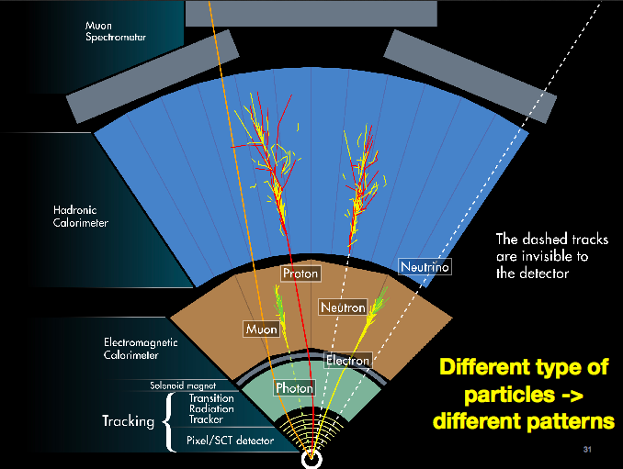

Slide 23
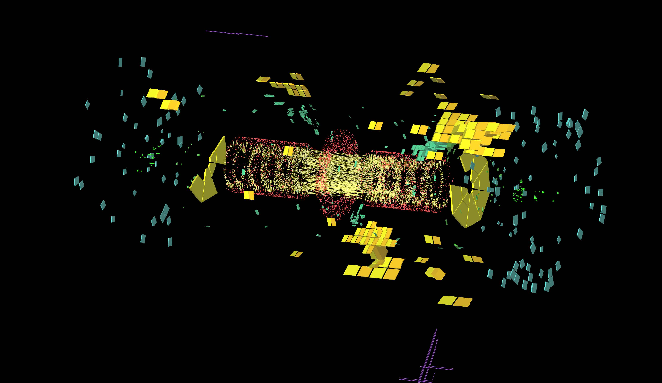
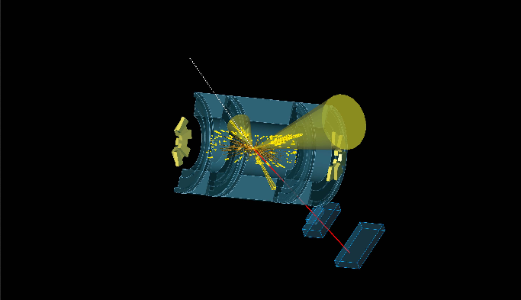
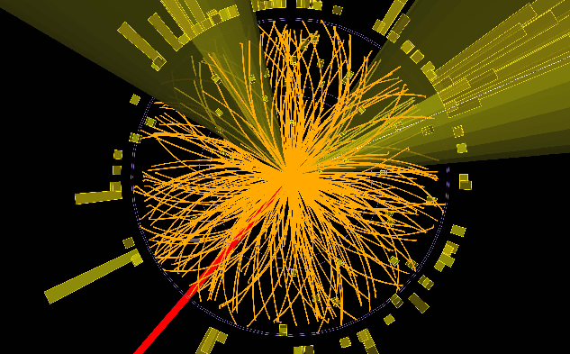
Simulation steps:
Event generation
Detector simulation
Track reconstruction

Slide 24
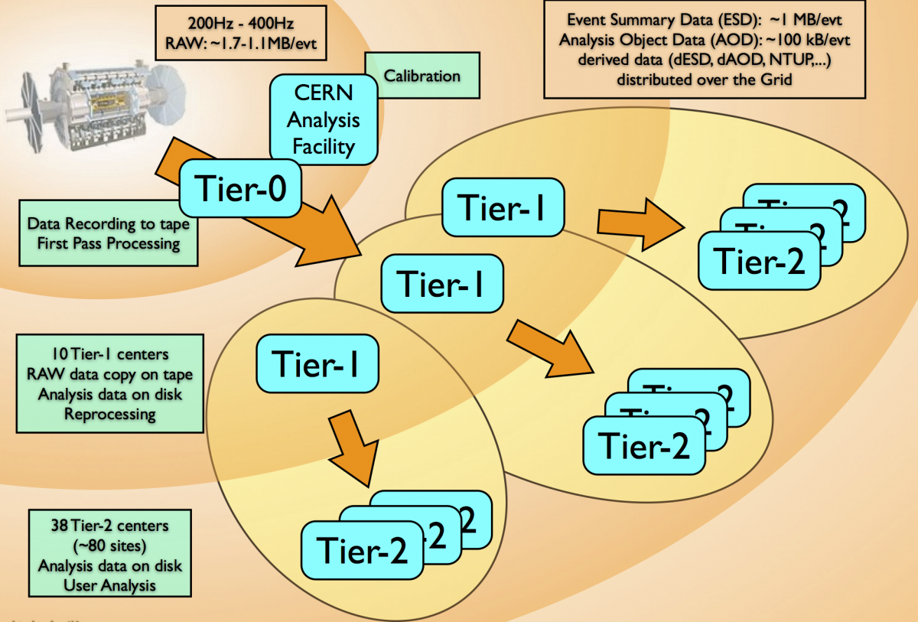
Initial ATLAS Computing Model

Slide 25
Current ATLAS Computing Model
Network proved better than anyone imagined
Any job can run anywhere

Slide 26
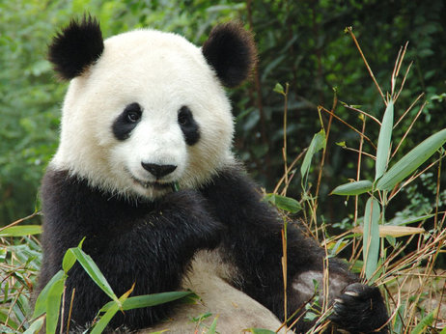

The ATLAS Grid(s)
ATLAS has its own systems on top of the Grids
  PanDA (Production and Data Analysis) for job management
  Rucio for data management
istockphoto.com

Slide 27
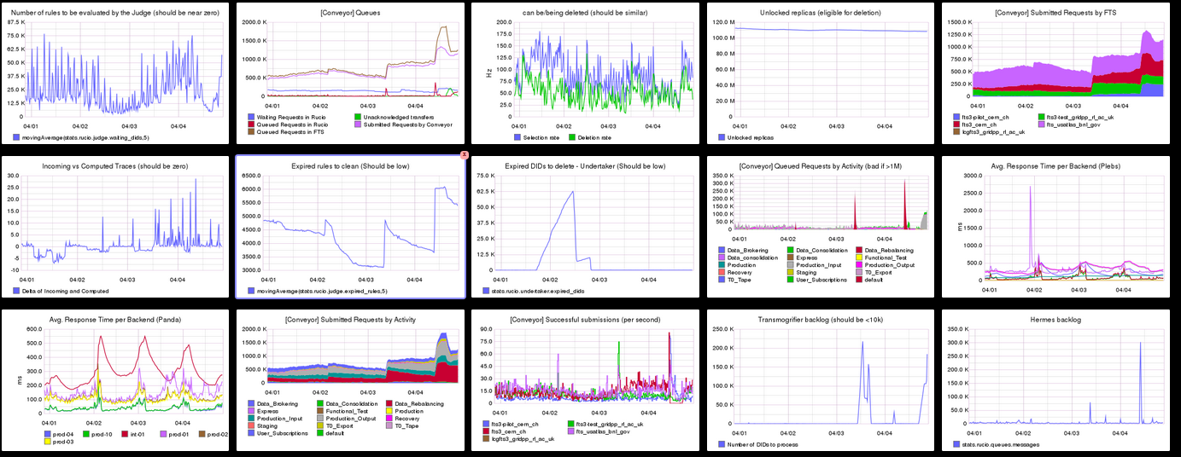
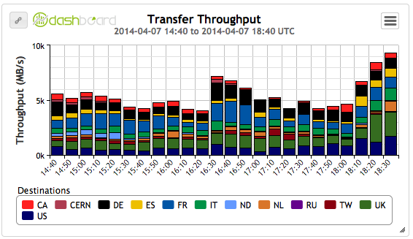
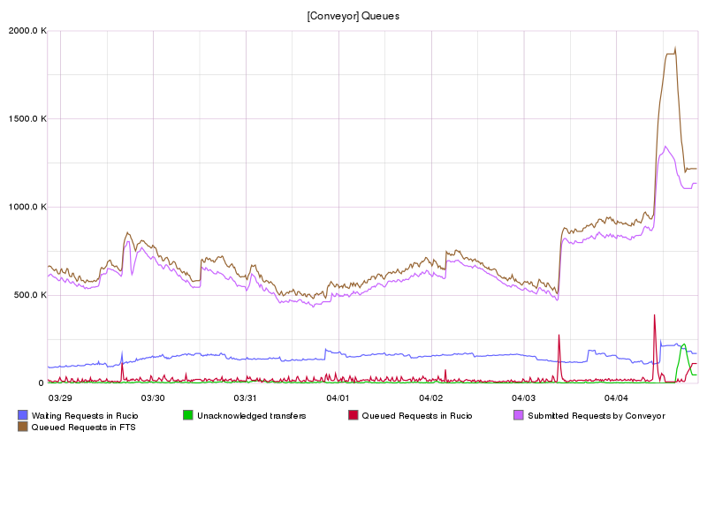
Rucio
A data management system to implement the ATLAS computing model
  A dataset catalog and transfer system, and more
  deletion, quota management, consistency, accounting, monitoring, end-user tools, …

Slide 28
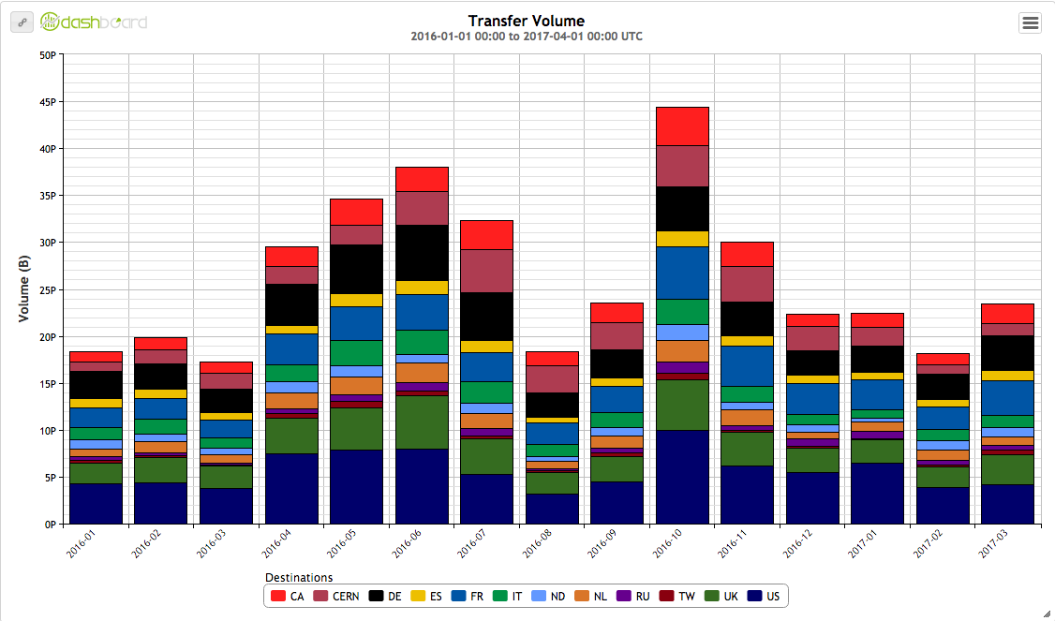
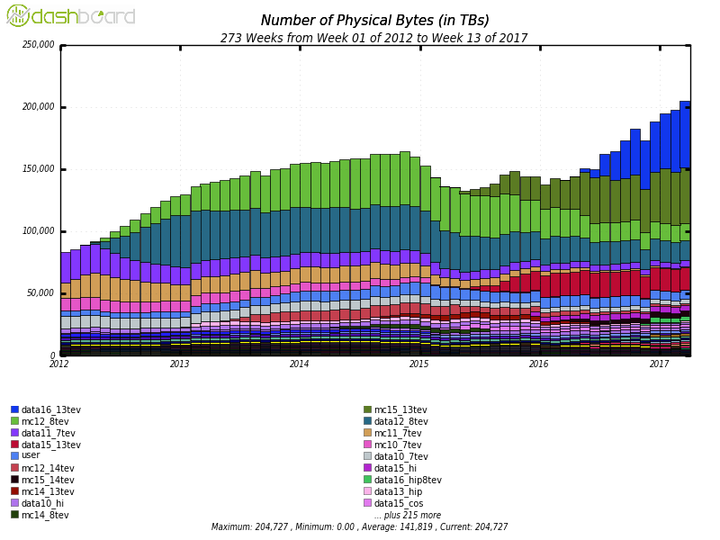
It’s a lot of data
1 PB/day
Average ATLAS traffic: 10GB/s
200 PB
2016 data
2012 data
Simulations of 2015/6 data
Simulations of 2012 data
2015 data

Slide 29
Grid job management
Classic “push” model
Pilot “pull” model
Job
Job
VO Job Management System
Pilot Factory
Resource Broker
Job
Get job
Pilot

Slide 30
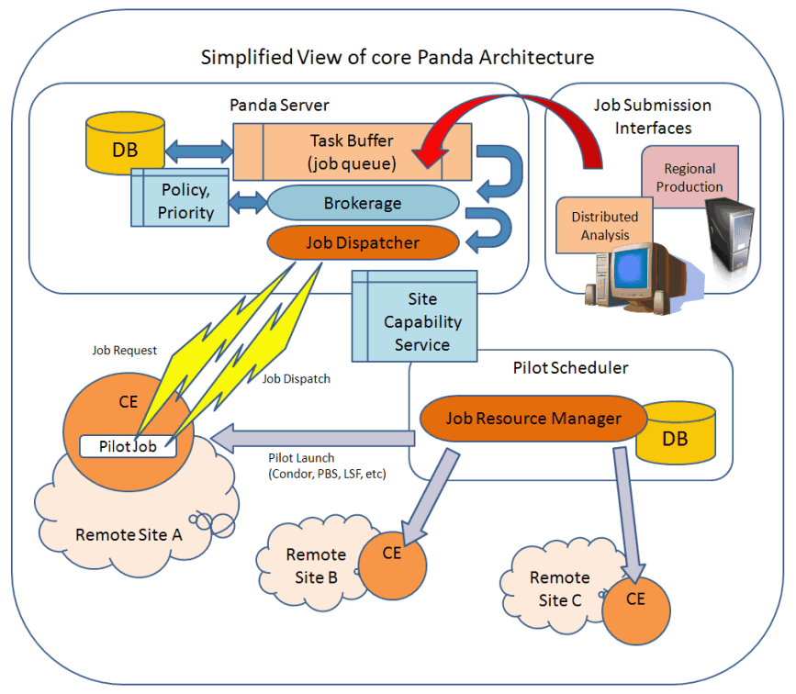
Image by BNL

Slide 31
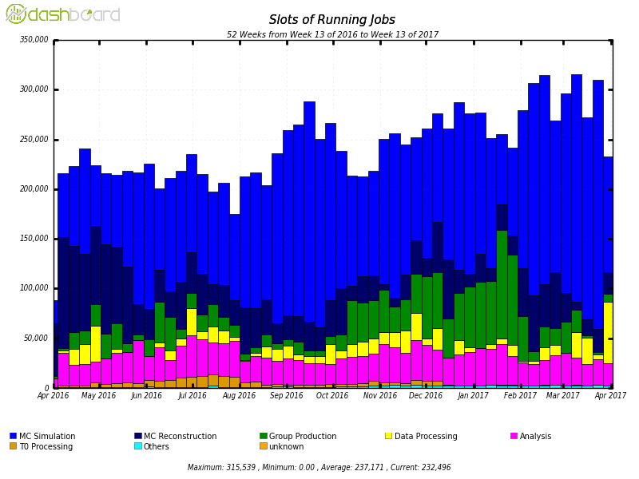
Job stats
250,000 jobs running continuously
Pledged resources

Slide 32
Current Challenges
New trends in data management
  Original model was based on network being the weak point
  But network has proven to be cheaper and better than expected
  Break the rigid hierarchical model of data flow and sending jobs to data
    Dynamic data placement
    Remote data access over wide area network
Event-level workflow instead of file-level
Computing architecture changes
  More cores per CPU, less memory
Need more CPU and disk but with flat budget -> opportunistic resources
  High Performance Computing (supercomputers)
  Volunteer Computing (general public)

Slide 33
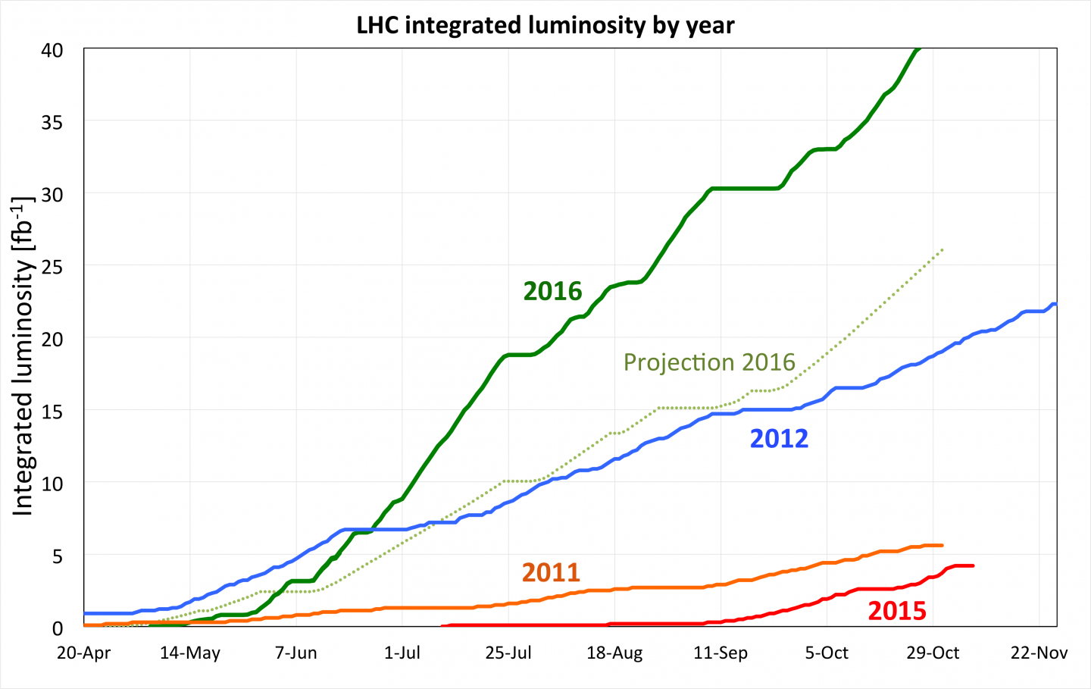
Current Challenges
… and getting more data than expected!

Slide 34
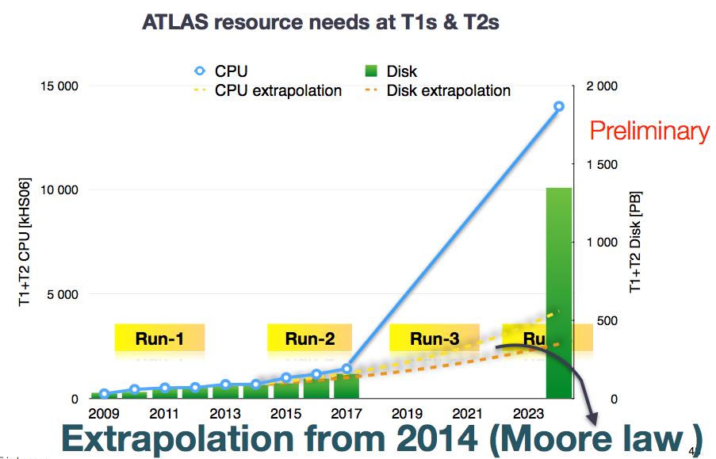
Slide by E. Lancon

Slide 35
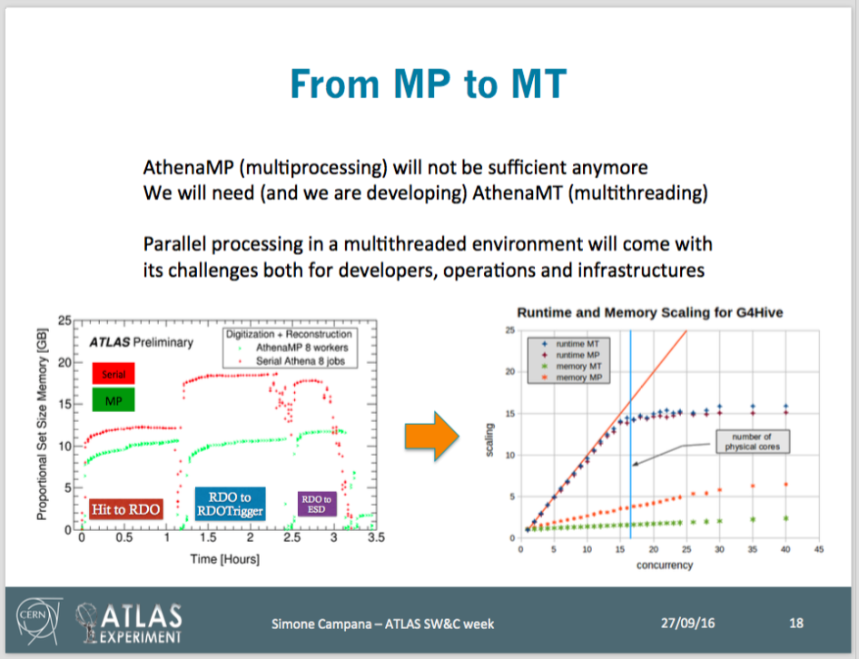
Software: from multi-process to multi-threading

Slide 36
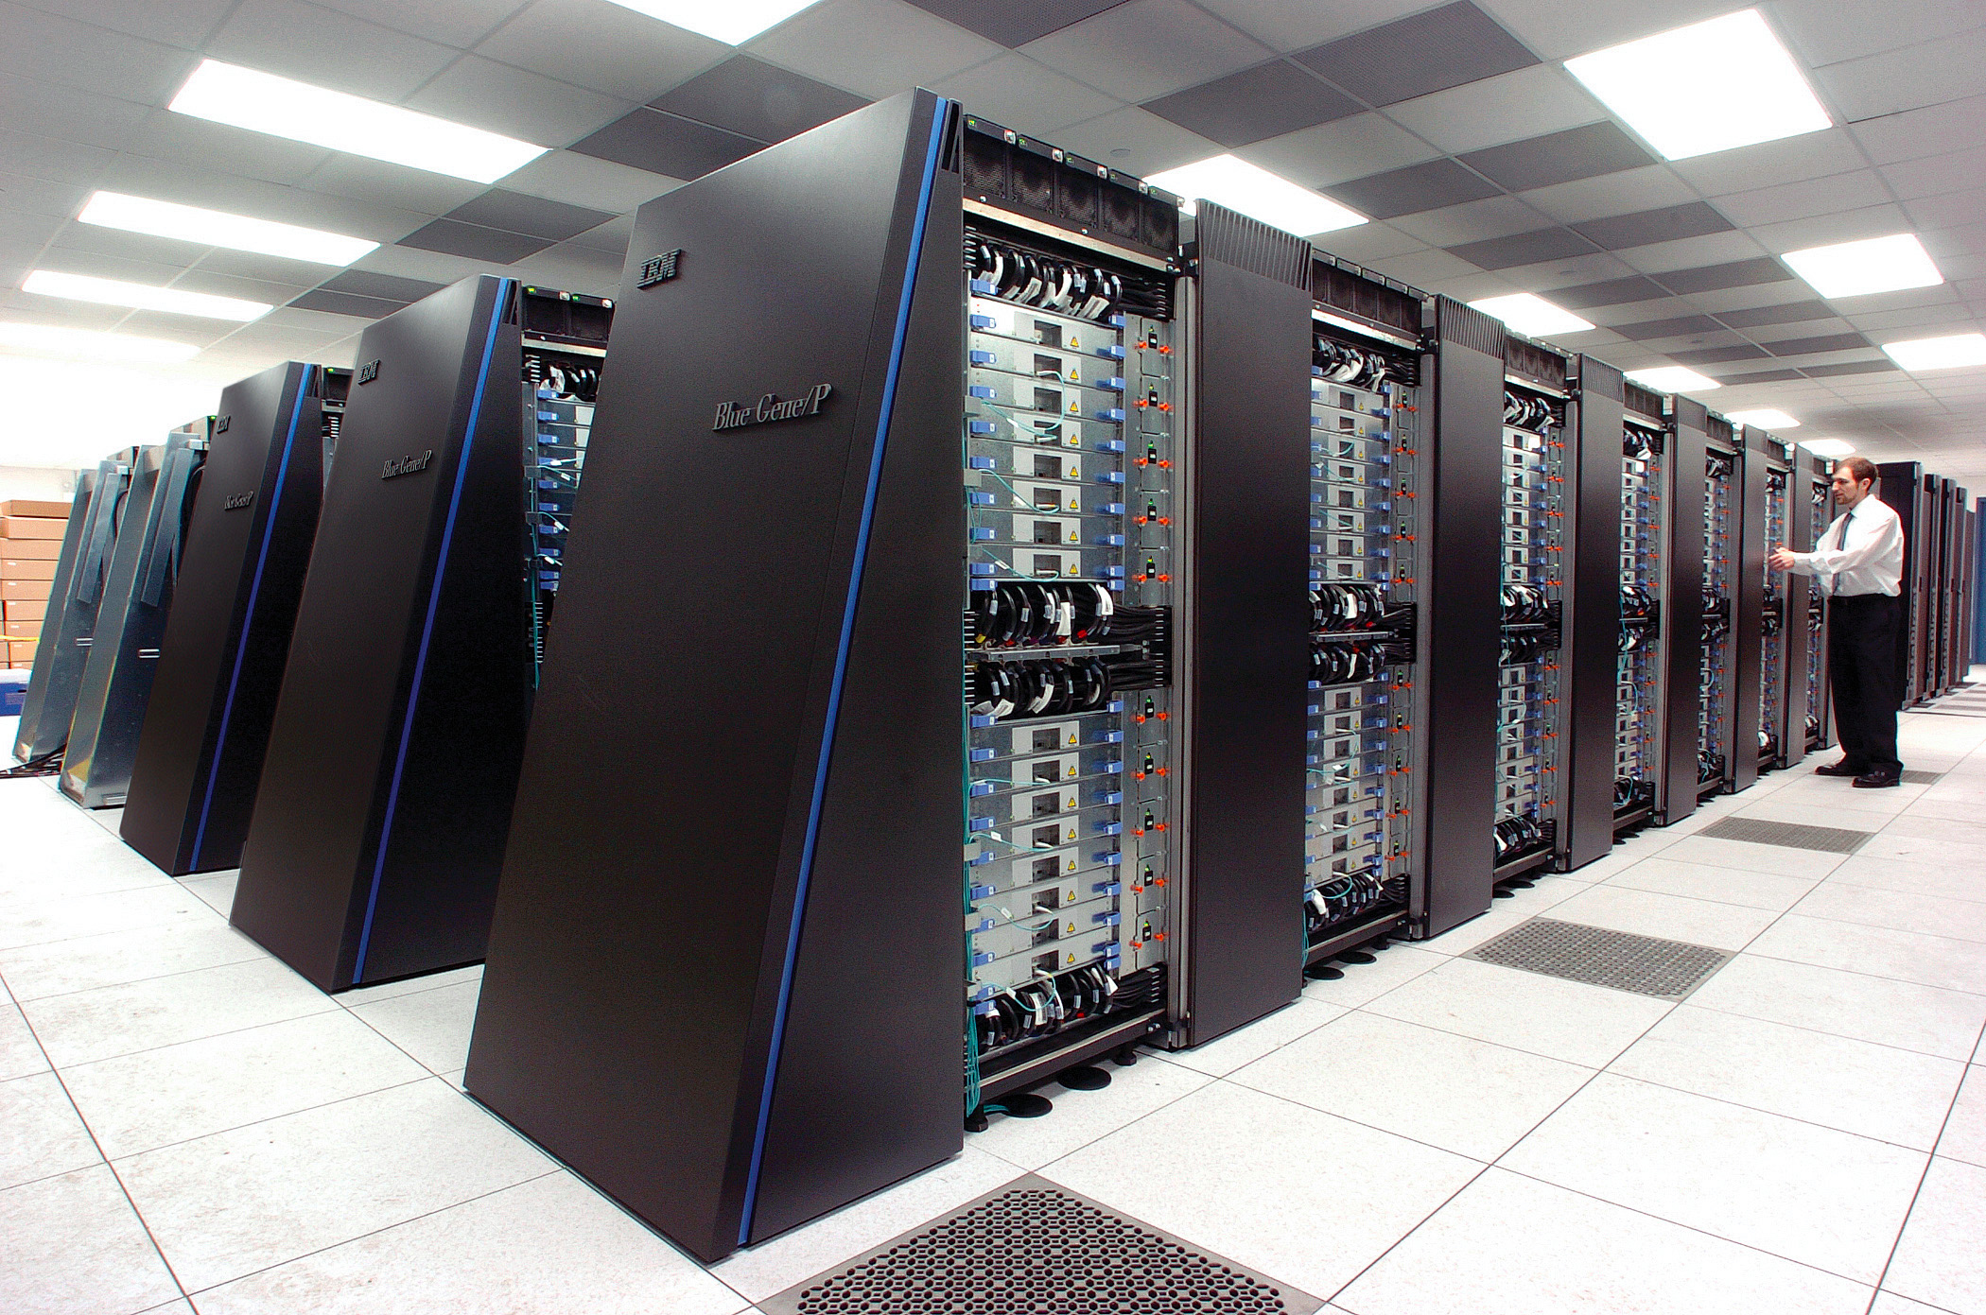
High Performance Computing (HPC)
The Grid is made up of dedicated computing clusters
Most other scientific computing takes place on HPC
Differences HPC vs Grid:
  Massively parallel vs single-node workload
  Low vs high I/O
  Restricted vs open enviroment
  Multiple vs single CPU/OS flavours
  username/password vs x509 cerfiticate

Slide 37
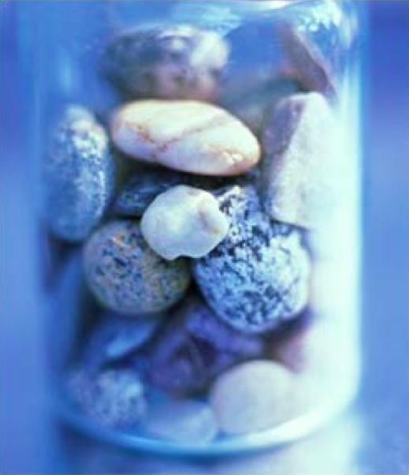
HPC potential - backfilling
HPCs are used at 80-90% capacity
Fill in scheduling holes between big jobs with our small jobs
  Resources would not be used anyway so we can get them for free
  The HPC gets higher utilisation and recognition in papers

Slide 38
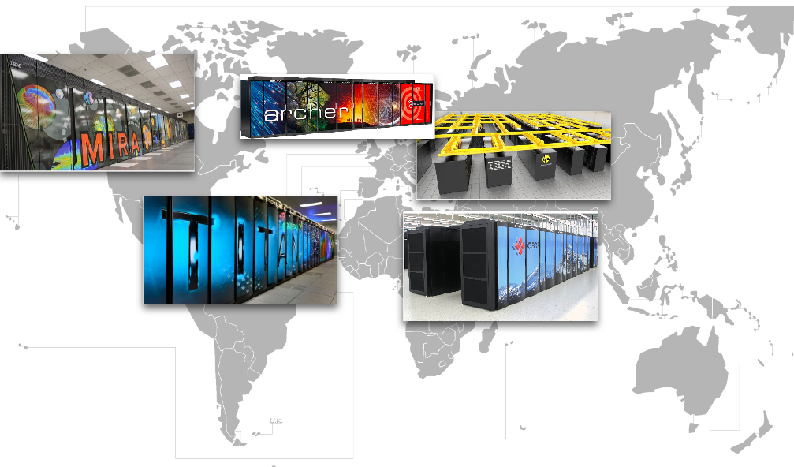
Targeting HPC centres in Scandinavia, USA, France, Germany, Switzerland, UK, China, …

Slide 39
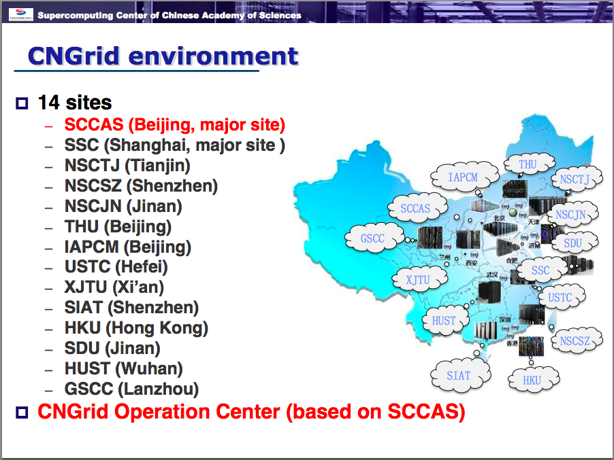
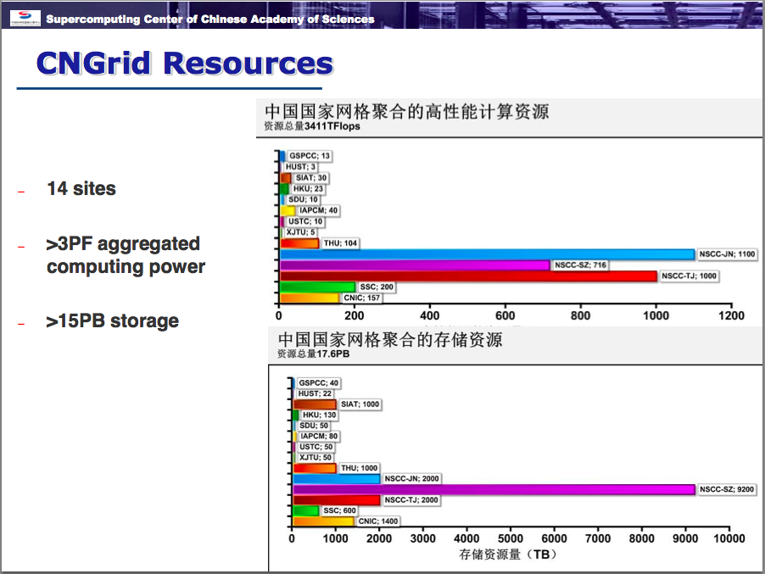
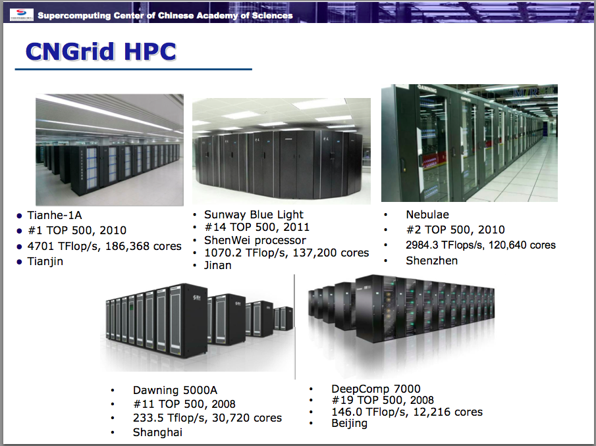
ATLAS and Chinese HPC Grid

Slide 40

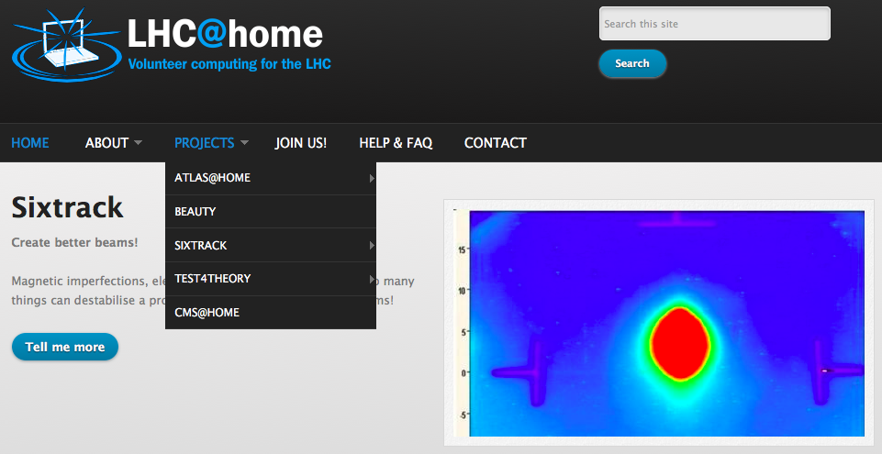
Volunteer Computing
How YOU can help LHC experiments including ATLAS!
Run simulation of collisions inside the ATLAS detector at home

Slide 41

History of Volunteer Computing at CERN
2004: LHC@Home: Sixtrack
  LHC beam simulations
2011: LHC@Home: Test4Theory
  Pioneered virtualisation within BOINC
2014: ATLAS@Home, CMS@Home, Beauty@Home (LHCb)
2017: All projects under one umbrella: LHC@Home

Slide 42


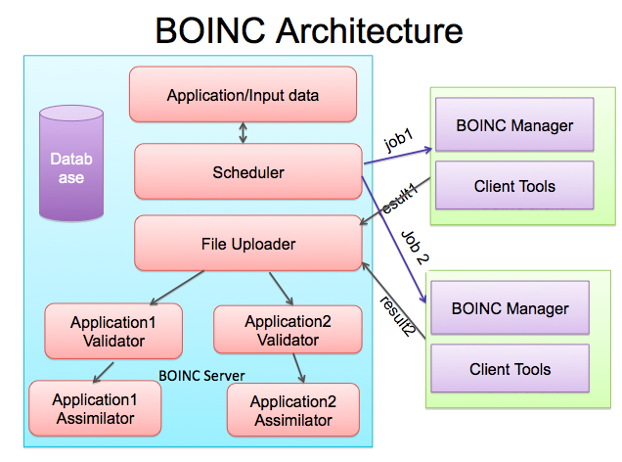

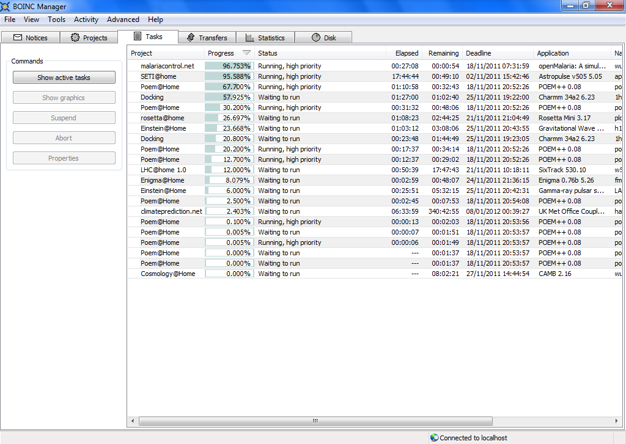

Volunteer Computing via BOINC

Slide 43
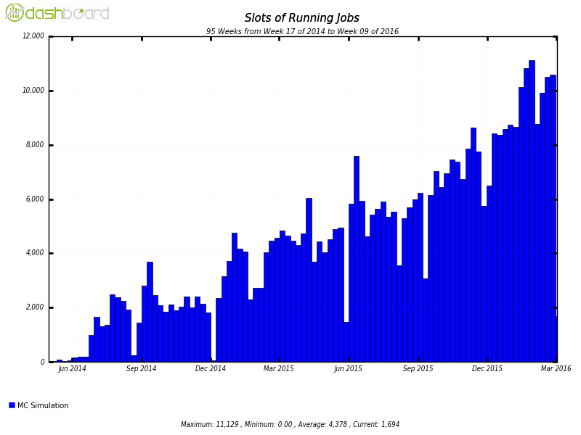
ATLAS@Home
  Producing ~1% of all ATLAS simulation
Like getting a large computing centre for free
Not quite for free, volunteers expect a certain level of support
Large potential in idle institute desktops

Slide 44
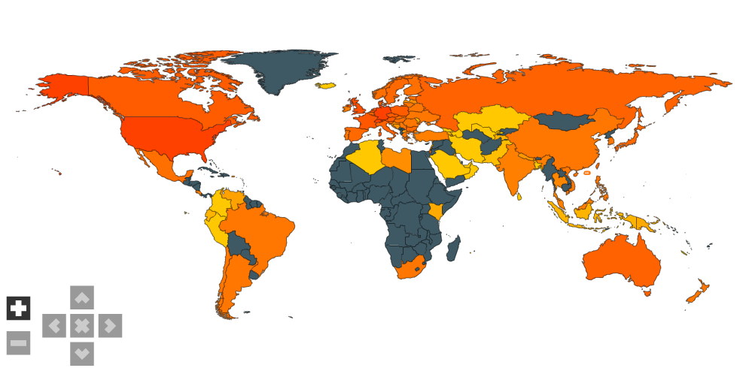
Volunteers
BOINC has a huge dedicated community
Many volunteers are active in several projects
http://boincstats.com/en/stats/152/project/detail/country

Slide 45
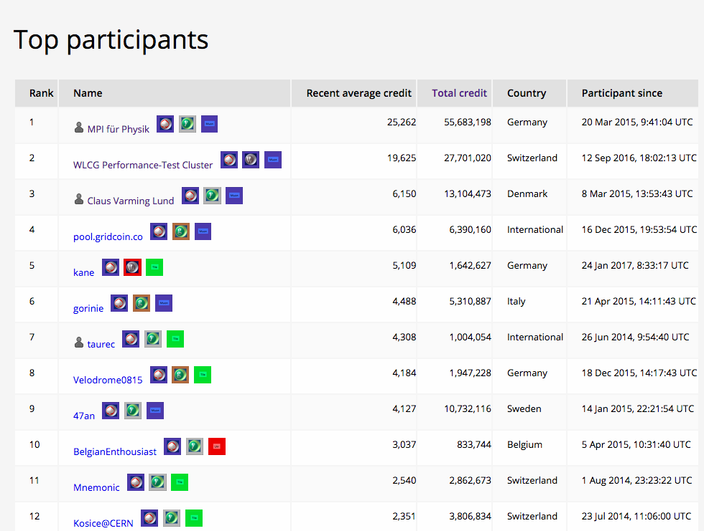
Who are the volunteers?
Credit
  Allocated by BOINC for successfully completed jobs
  Very roughly 3 credits/event
  No monetary value but a strong motivator
Golden rule: always give credit for work done!
  If a job crashes but used significant CPU, credit is still given
  If a job is cancelled by ATLAS, don’t cancel volunteer’s job
http://atlasathome.cern.ch/top_users.php

Slide 46


UiO Involvement
David C in charge of the project
Last year a bachelor thesis by Giulio Isacchini to make a graphical interface
Many more potential things to work on!

Slide 47
Join us!
http://lhcathome.cern.ch
BUT!
  You need a fairly good machine to run ATLAS software
  4GB of RAM per job
  And download a 500MB file to get started

Slide 48
Why not just use “the cloud”?
We do!
  But on a small scale
  Or in a way where we don’t notice it (eg CERN’s OpenStack cloud)
Historical reasons
  Grid infrastructure has developed and stabilised over many years
Funding
  Research agencies prefer to pay for in-house expertise
Sustainability
  LHC will be taking data for the next 20+ years, data must be kept for even longer than that…
Cost
  Data-intensive computing 5-10 times more expensive (but falling) using commercial cloud providers

Slide 49

Summary
Distributed computing is a vital part of LHC physics
For the average user it is really like the Electric Grid
UiO plays a strong part at many levels of Grid computing work
Many interesting challenges ahead, especially looking to HL-LHC
New technologies may save us: machine learning, analytics, etc
Slide by Rolf Heuer, 4 July 2012

