Slide 1
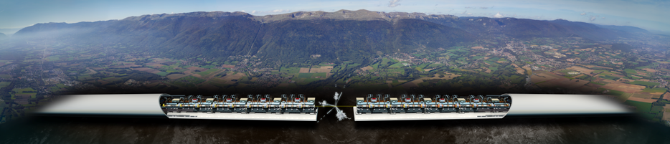
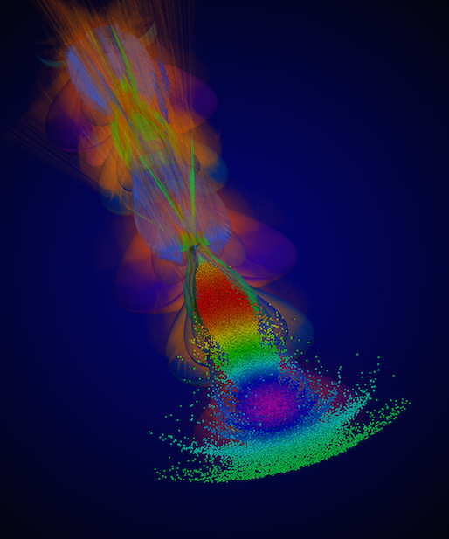
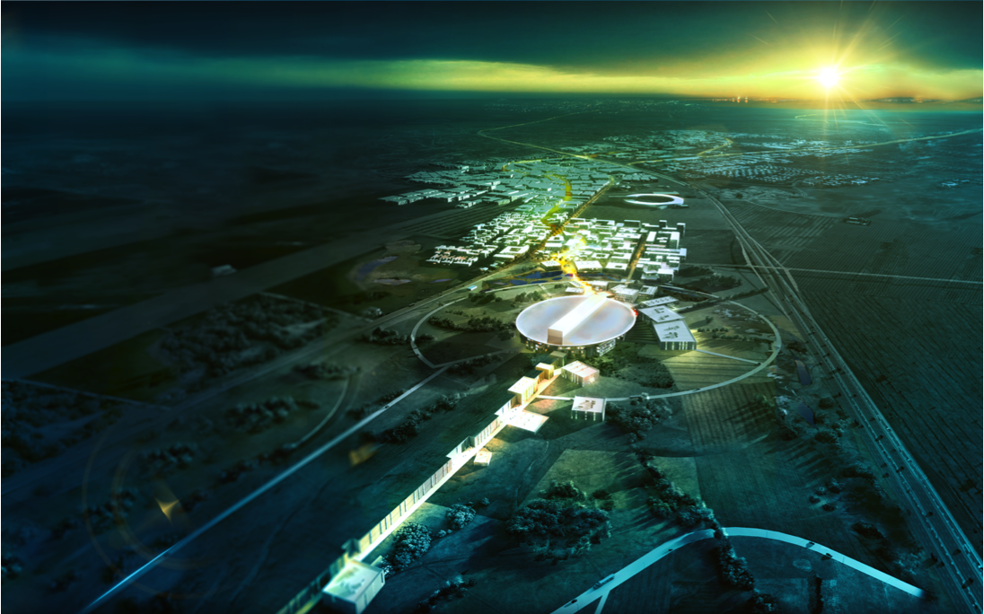
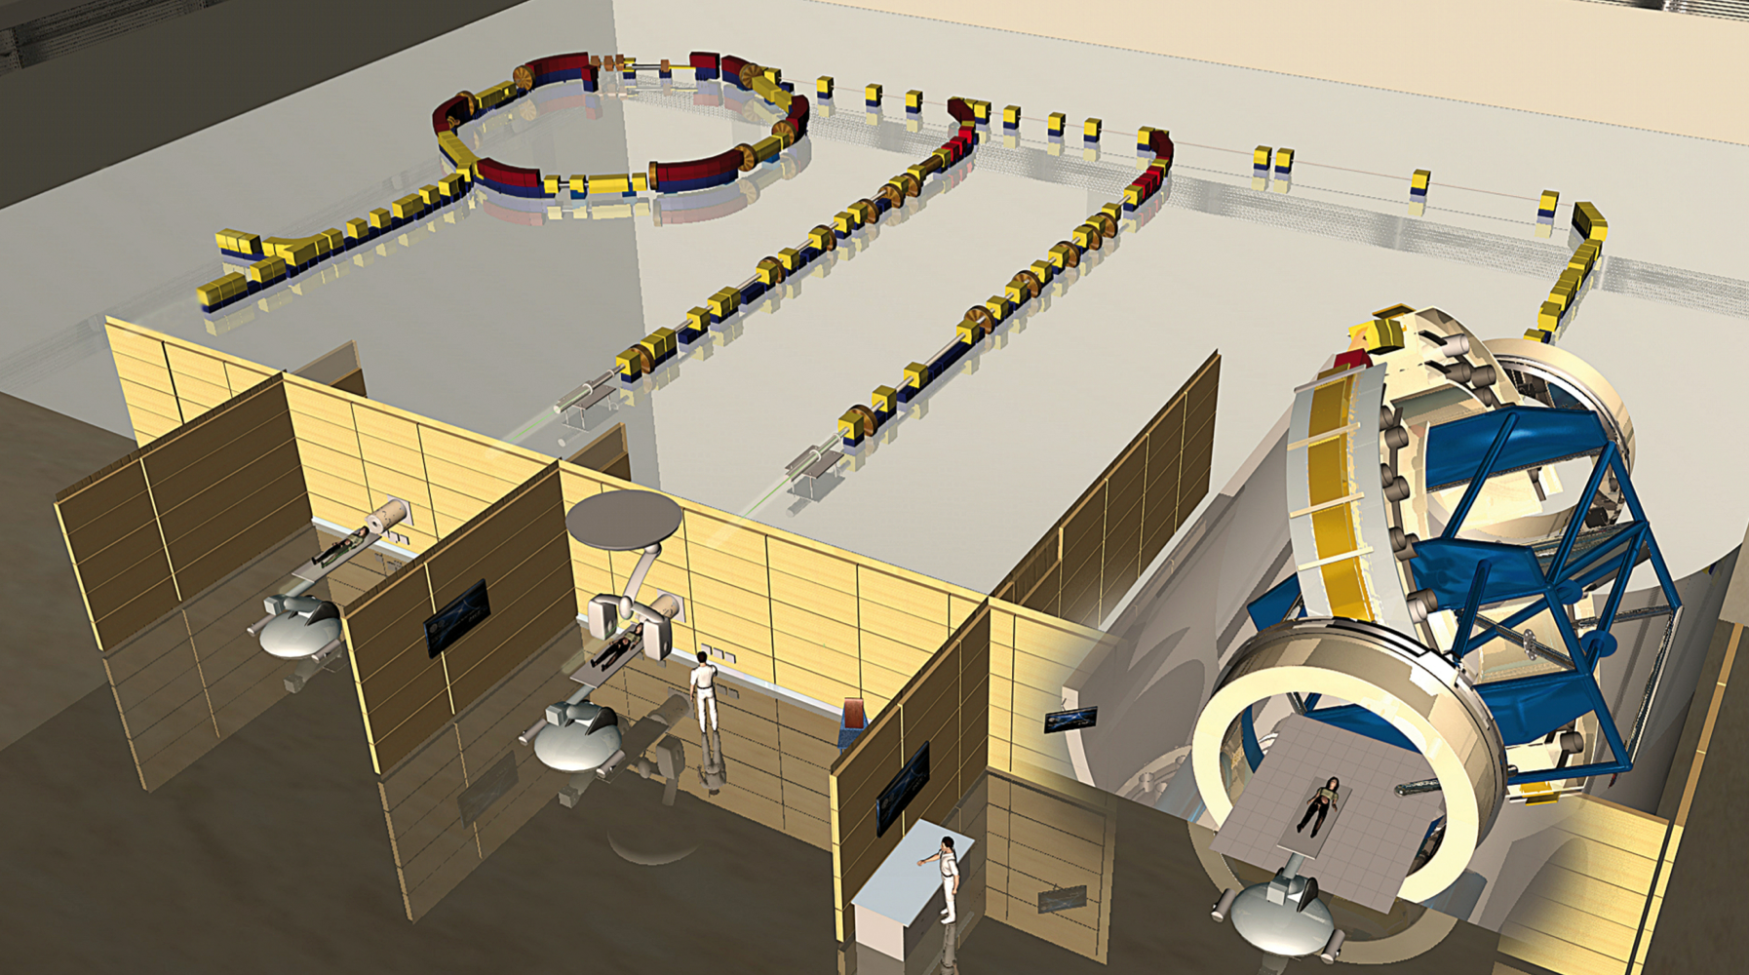
Accelerator R&D at the Univ. of Oslo
Compact Linear Collider
(Next generation high energy physics experiment)
European Spallation Source
(Most powerful proton accelerator)
Plasma acceleration
(Future particle accelerators)
New method for cancer treatment
Erik Adli, Jürgen Pfingstner

Slide 2
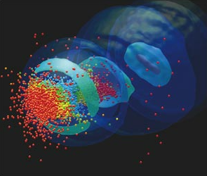
Content
Introduction to particle accelerator science.
R&D program at the UiO.
  The Compact Linear Collider.
  Wakefield acceleration.
  European Spallation Source.
  Hadron therapy.
  Free-Electron Lasers.
Summary

Slide 3
1. Introduction to particle accelerator science

Slide 4
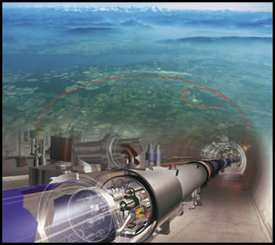
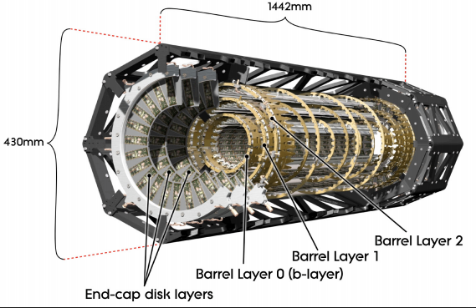
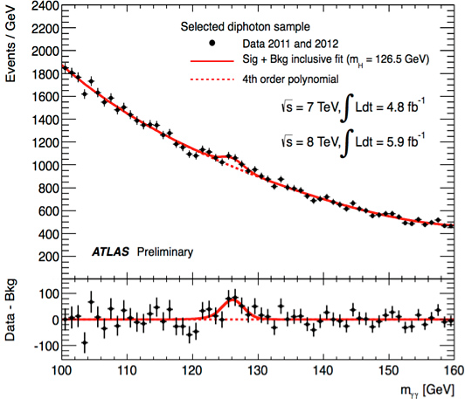
High energy physics at CERN
Particle accelerator physics
Particle detectors
Data analysis

Slide 5
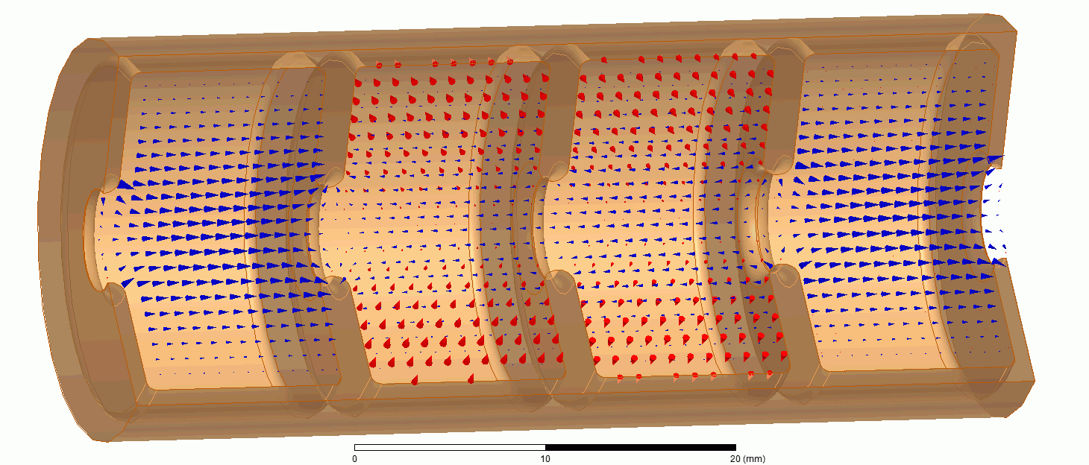
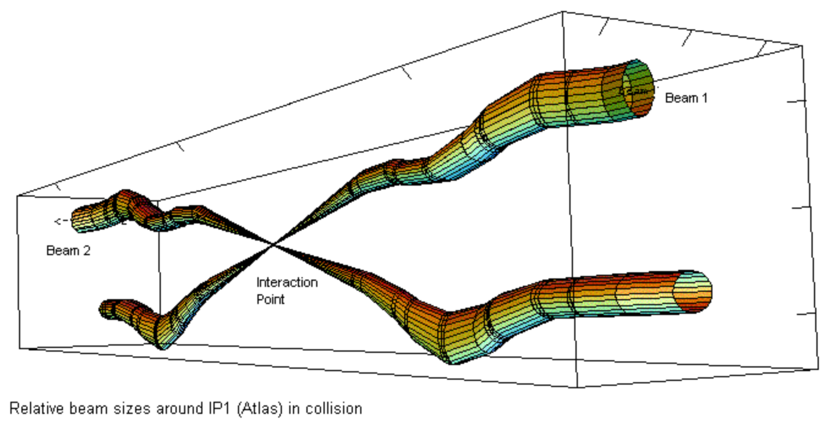
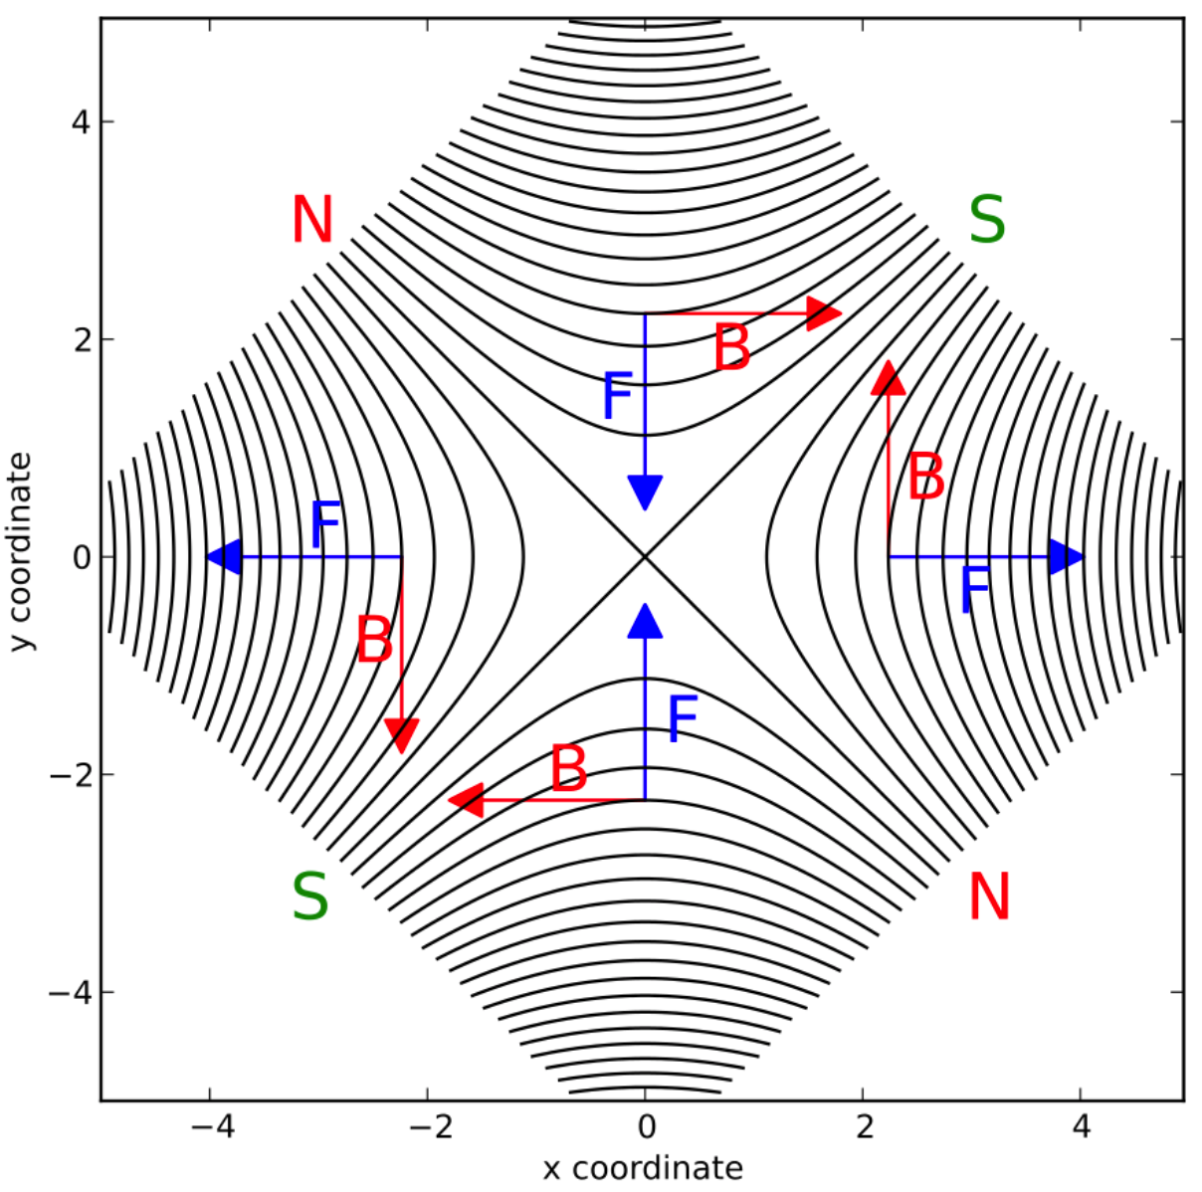
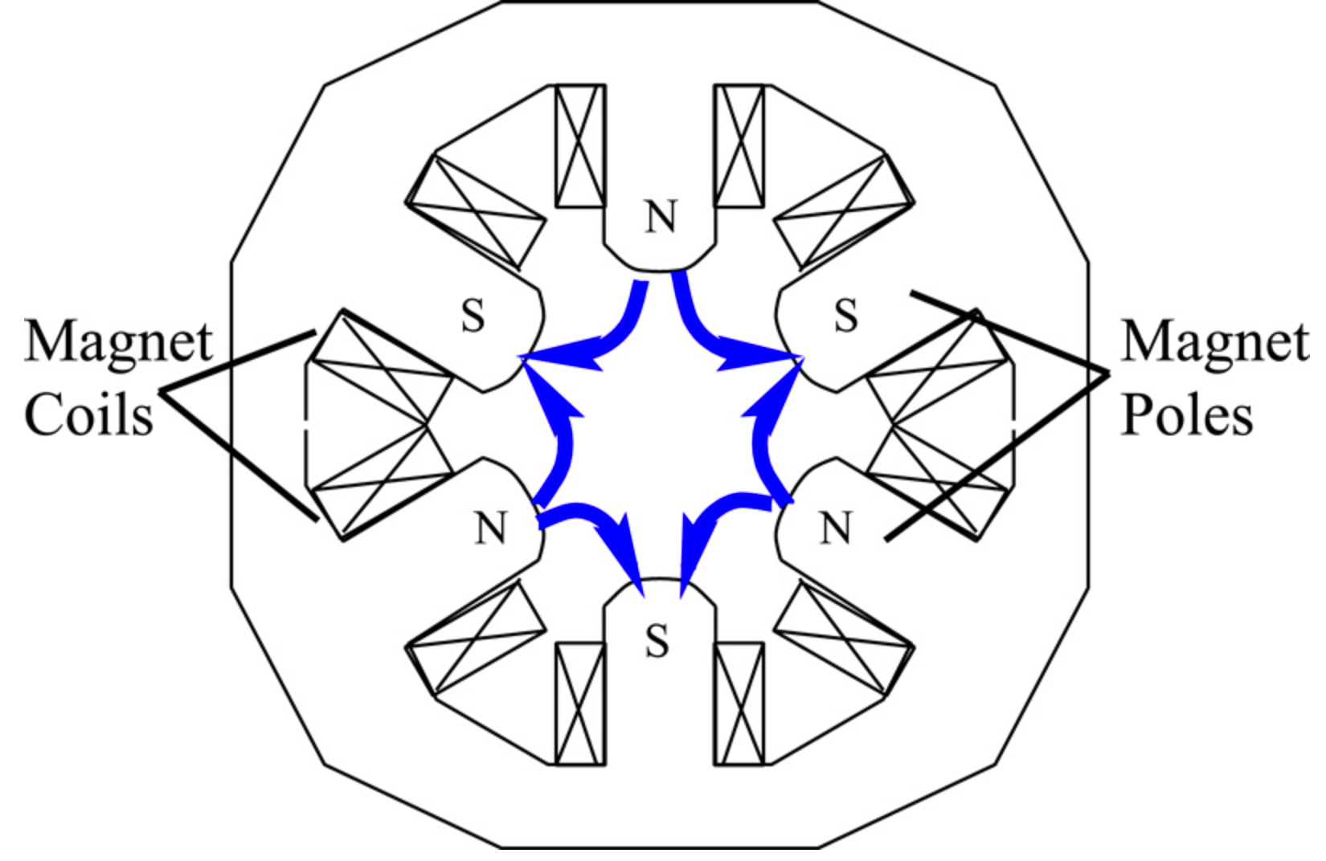
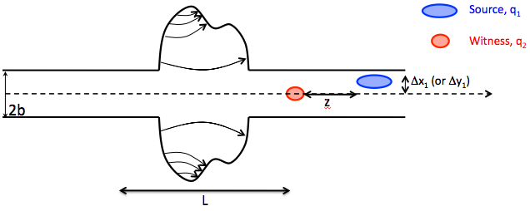
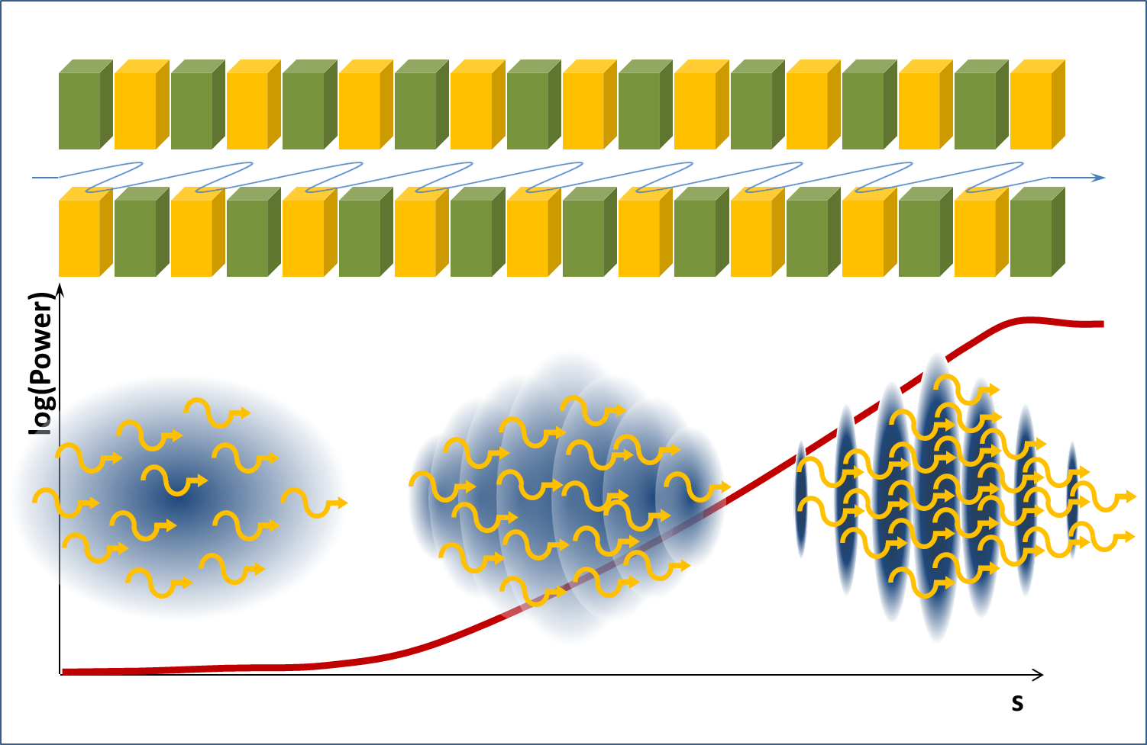
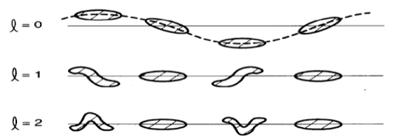
Core elements of accelerator physics
Radio-frequency technology
Charged particle beam non-linear optics
Theory, Simulation, Experiment
Collective effects and beam instabilities
Radiation generation

Slide 6
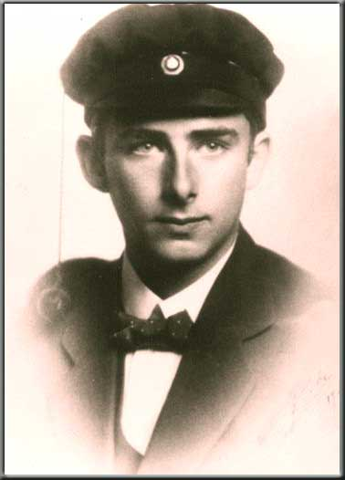
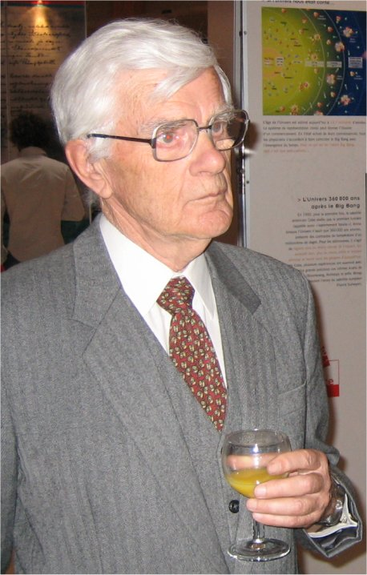
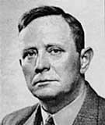
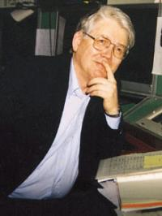
Norwegian accelerator physicists
Norway has a proud tradition of international particle accelerator physics expertise.
Rolf Wideröe
Kjell Johnsen
Oppfinneren radio-frekvensbasert akseleratorer
Odd Dahl
Leder av CERN ISR, og leder av CERN's gruppe for akseleratorforskning
Bjørn Wiik
Leder av CERN PS prosjektet (en viktig del av LHC-komplekset den dag i dag)
Professor og direktør ved Europas nest største akseleratorsenter (DESY i Hamburg)
However, until now we have not had any significant local national competence.

Slide 7

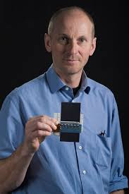
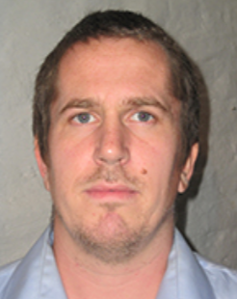
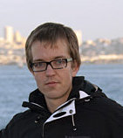
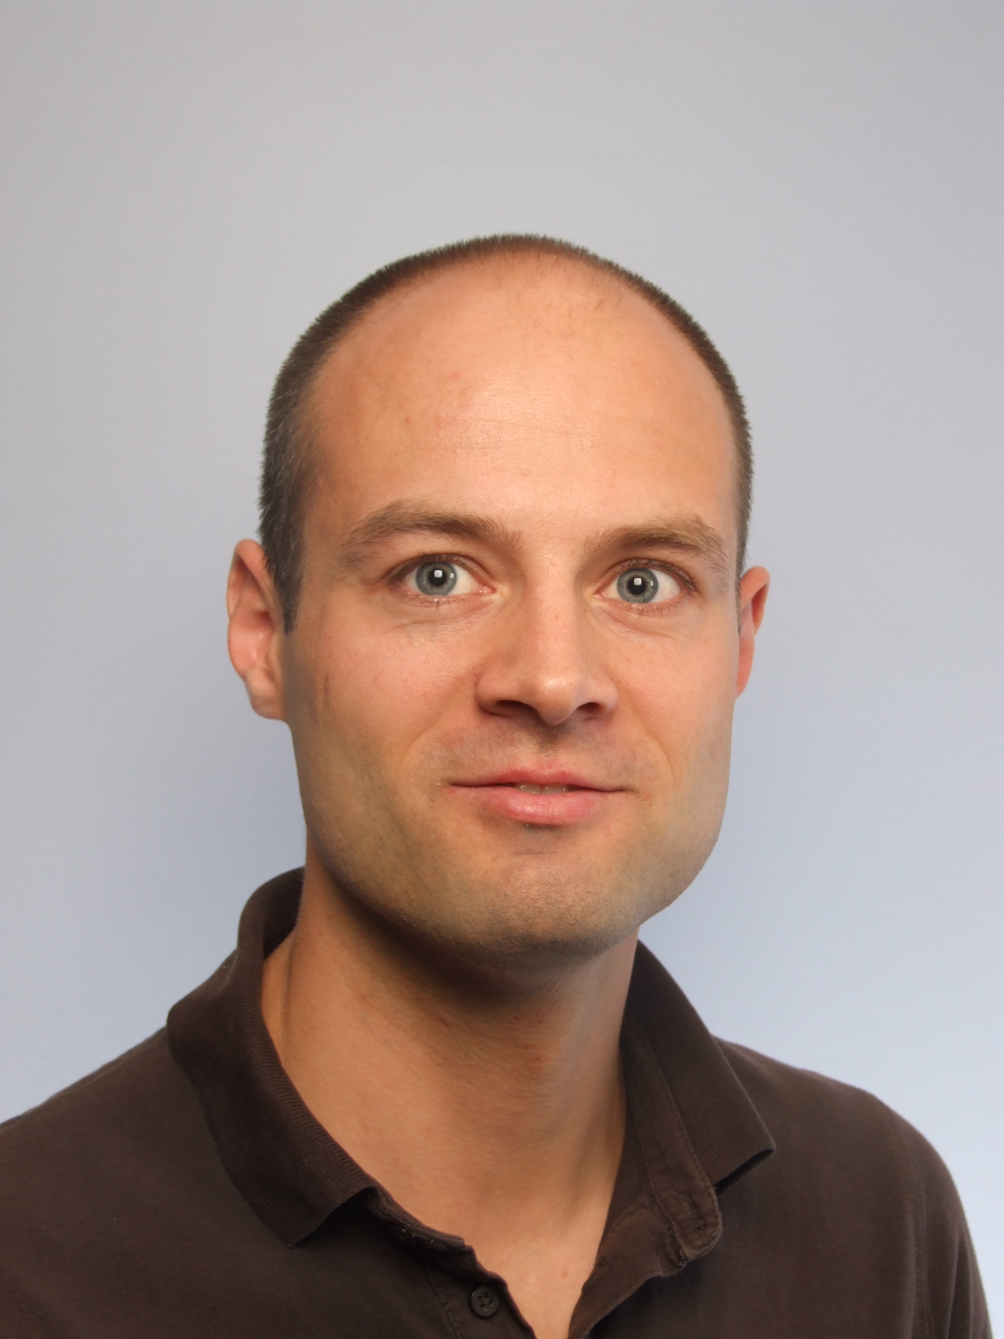





Accelerator science at UiO
2 professors
  Erik Adli (erik.adli@fys.uio.no, particle accelerator project leader)
  Steiner Stapnes (CERN LC study leader)
3 Post.Docs:
  Reidar Lillestol
  Juergen Pfingstner
  Håvard Gjersdal
4 Ph.D. students funded by UiO or CERN Ph.D. student program:
  Riccard Andersson
  Carl Lindstrøm
  Lukas Malina
  Veronica Olsen
1 M.Sc. student
  Rune Sivertsen

Slide 8
Projects overview
Linear colliders for HEP, CLIC
Reidar Lillestøl
Lukas Malina
Plasma wakefield acceleration – FACET@SLAC and AWAKE@CERN
Veronica K.B.Olsen
Rune Sivertsen
Carl A. Lindstrøm
Juergen Pfingstner
Erik Adli
Project leader for particle accelerator based activities.
Medical accelerators
Compact accelerators for particle therapy (based on CLIC technology)
Free electron lasers
Compact FELs (based on CLIC technology). Opportunity for Norway?
ESS Norwegian in-kind contribution
Håvard Gjersdal
Ole Røhne (25%)
Maja Olvegård – Uppsala cooperation
ESS and proton-drivers
Riccard Andersson
Others (Lukas Malina, LHC operations)

Slide 9
2. R&D program at the University of Oslo

Slide 10
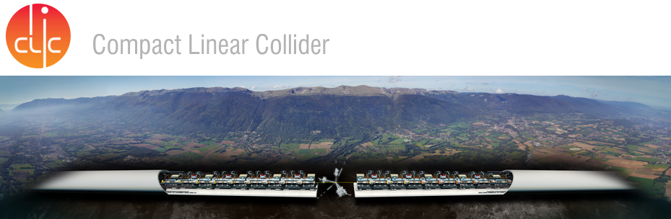
2.1 Future high energy accelerators

Slide 11
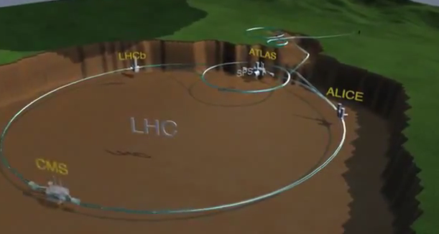
The Large Hadron Collider
youtube: the LHC Accelerator

Slide 12
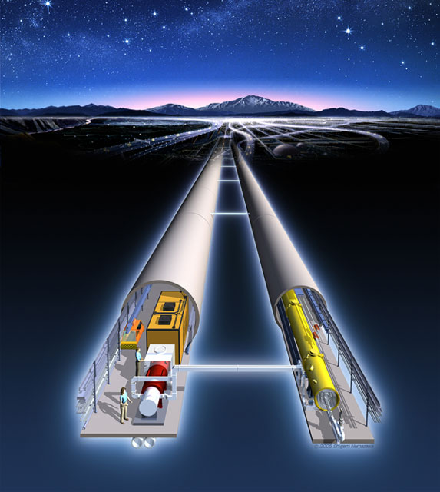
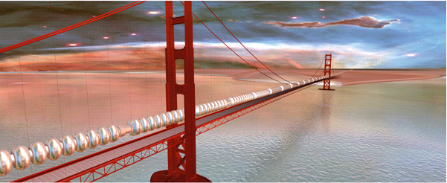
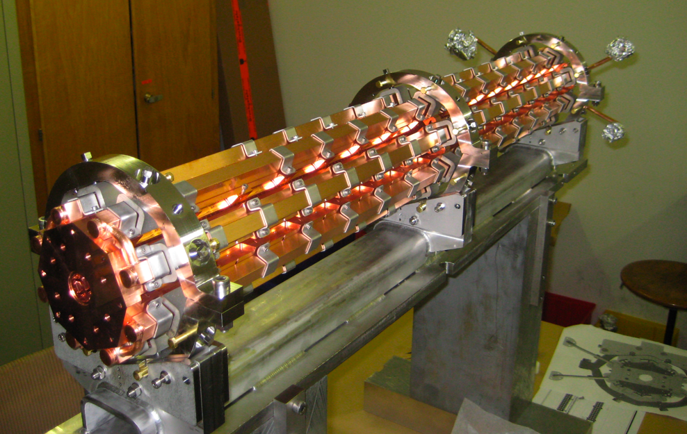
Future colliders for HEP
The next big thing?
Maybe a Linear Collider of several 10 km. Why? And How?

Slide 13
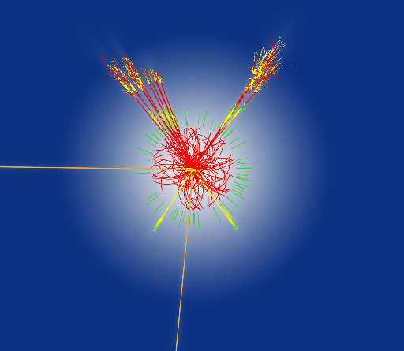
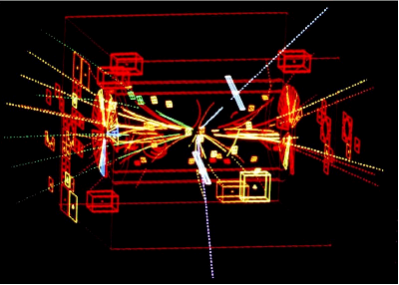
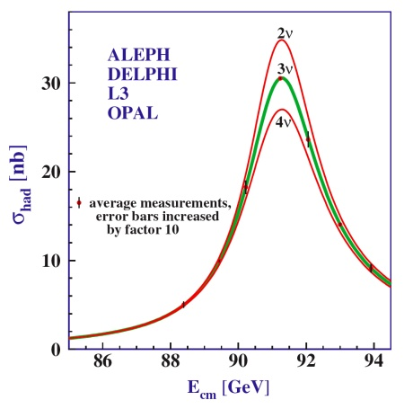
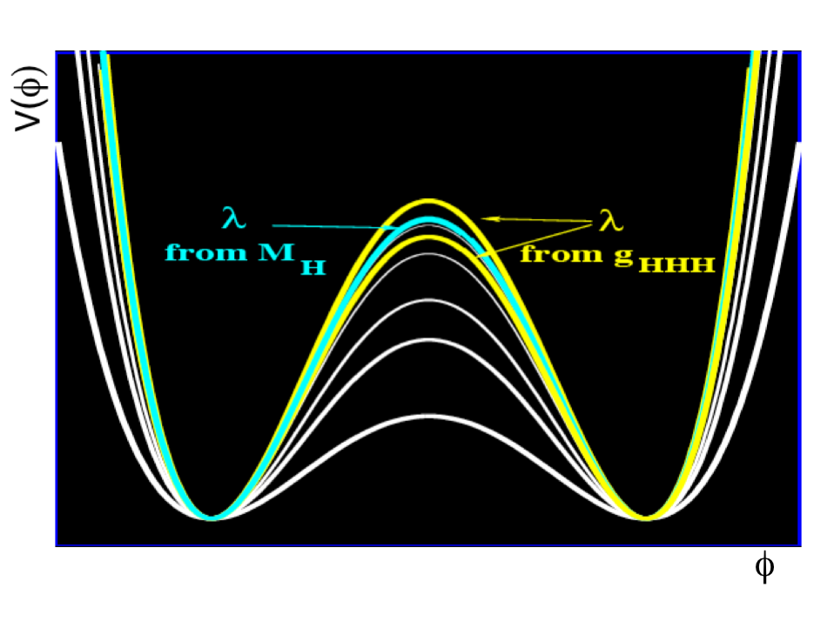
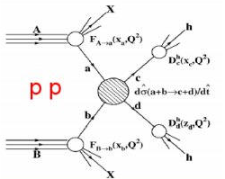

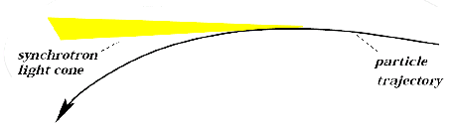
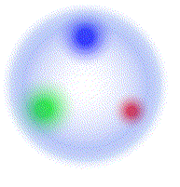

Hadron versus lepton colliders
pp collider, LHC,
√s_{max}=14 TeV,
Higgs discovery
[2008->]
Hadron collider SppS,
√s=540 GeV,
W^{+/-} and Z⁰ discovery
[1983]
Future:
TeV e- e+ collider,
Precision physics,
Model independent measurements
Must be linear!
e- e+ collider, LEP,
√s_{max}=209 GeV,
precision measurements of
Z⁰ decay width
[1989-2000]
Hadron collisions
Lepton collisions
Synchrotron radiation

Slide 14
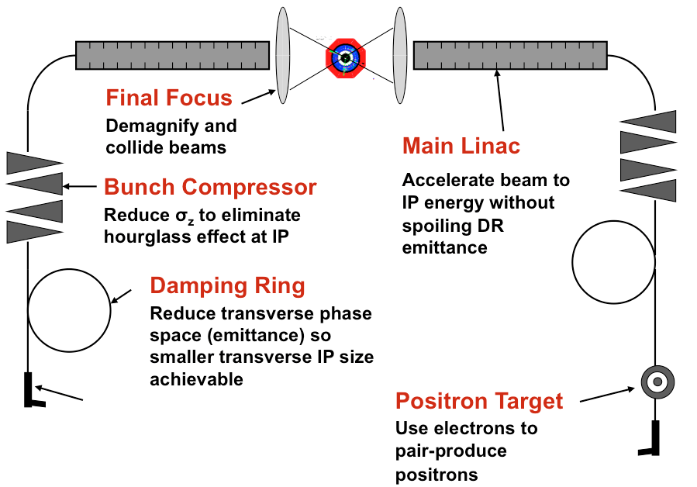
Linear Collider Challenges
Design challenge :
Collide as many particles per second per area, as possible - at as high collision energy as possible – in a cost and energy effective manner.
(Not to scale)
Key requirements :
High accelerating fields (limited to ~100 MV/m)
Good energy efficiency (5-10% from wall-plug to beam)
Excellent beam quality (small emittance, low energy spread)

Slide 15
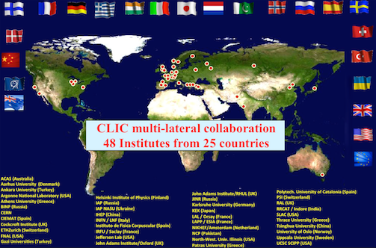
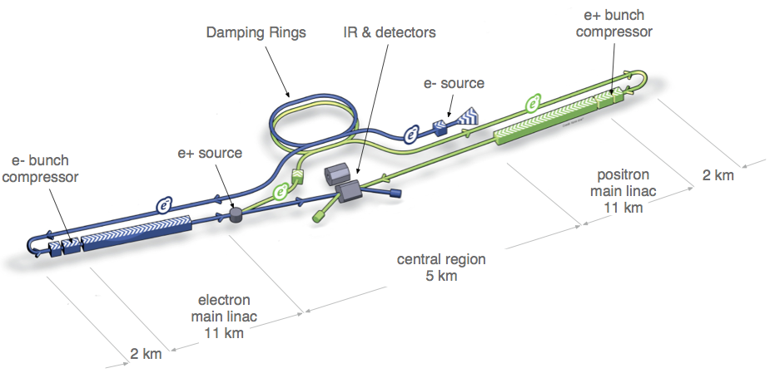
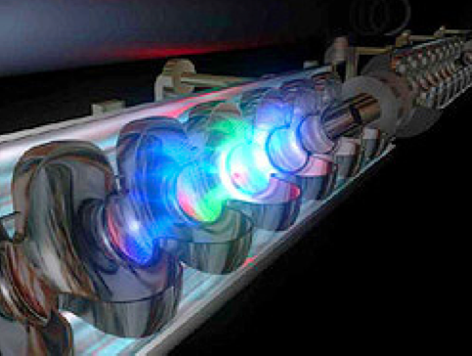
World Wide Linear Collider Collaborations
The Compact Linear Collider, CLIC
Main linac technology: normal conducting 12 Ghz cavities, acc. field = 100 MV/m
Nominal design for E_{CM} = 3 TeV (375 GeV to 3 TeV). 50 km at 3 TeV c.o.m.
The International Linear Collider, ILC
Main linac technology: super conducting 1.3 GHz cavities, acc. field = 31.5 MV/m
Nominal design for E_{CM} = 0.5 TeV (250 GeV to 1 TeV). 30 km at 0.5 TeV c.o.m.

Slide 16
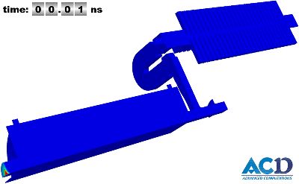
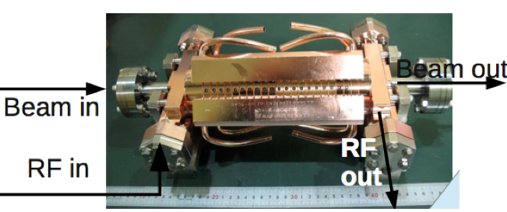
The CLIC Two-Beam scheme
Key concept in CLIC to achieve 100 MV/m in an power efficient manner: two-beam acceleration.
Drive beam - 101 A, 2.4 GeV.
Main beam – 1 A, 9 GeV to 1.5 TeV.
CLIC 100 MV/m accelerating structure. (20 cm long)
Animation courtesy SLAC ACD group
(A. Candel)

Slide 17
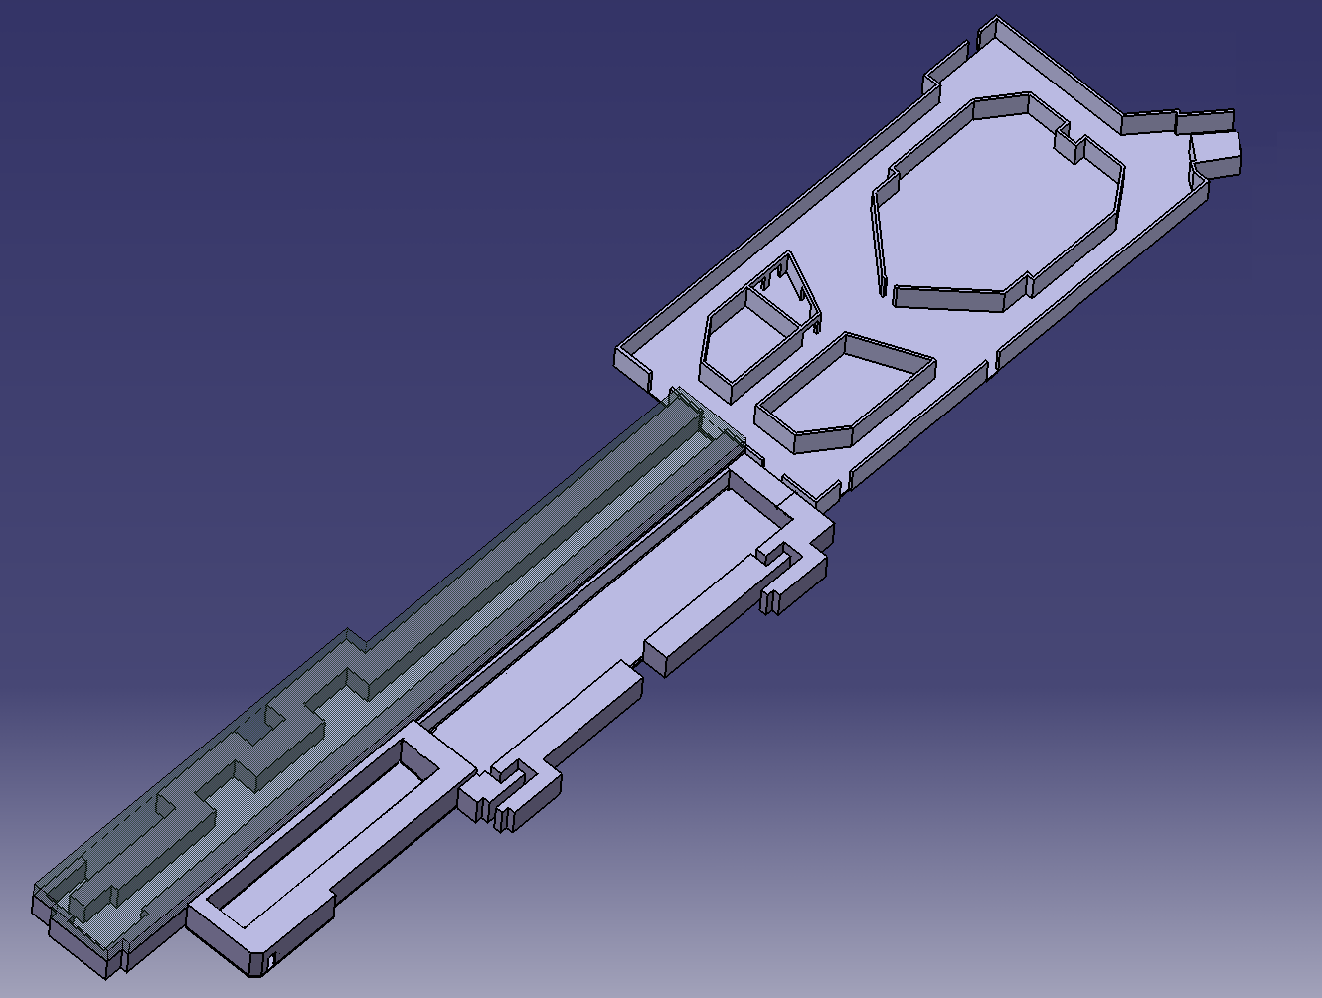
The CLIC Test Facility 3 at CERN
CTF3 – Layout
Total length: 140 m
DELAY
LOOP
4 A – 1.2 μs
150 Mev
COMBINER
RING
DRIVE BEAM
LINAC
28 A – 140 ns
150 Mev
CLEX
CLIC Experimental Area
10 m
Two-Beam Test Stand
CLIC Test Facility 3 : designed to experimentally verify key concept of the two-beam scheme.
Drive Beam generation: acceleration in a fully loaded linac with 95 % efficiency and bunch frequency multiplication by a factor x 2 x 4 (from 1.5 GHz to 12 GHz)
Two-Beam Acceleration experiment – reach nominal CLIC gradient and pulse length
Deceleration experiment – heavy deceleration of intense electron beam (>50 %)

Slide 18
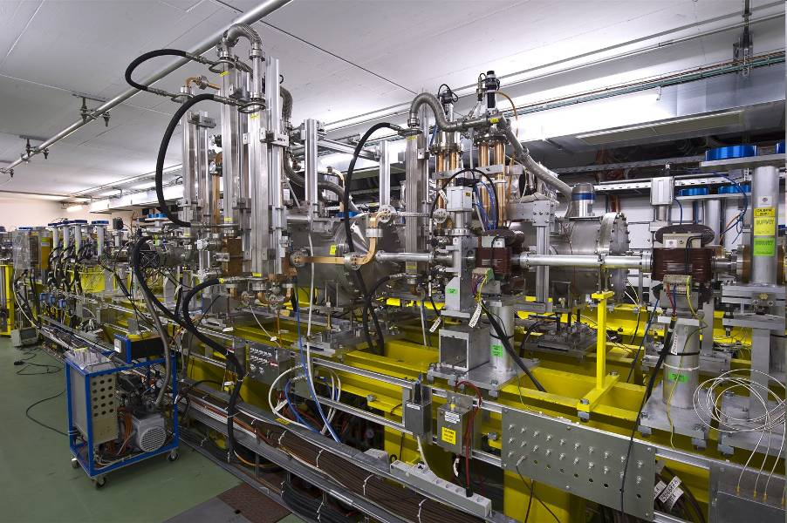
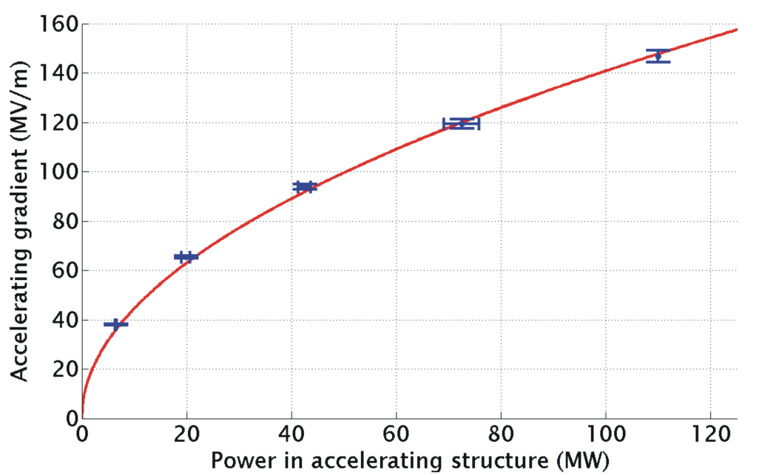
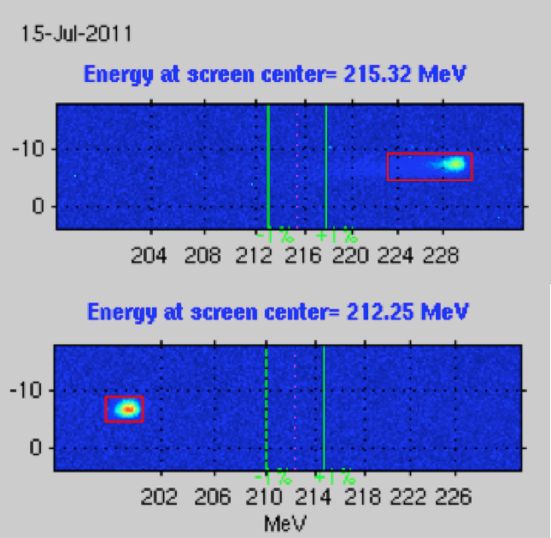
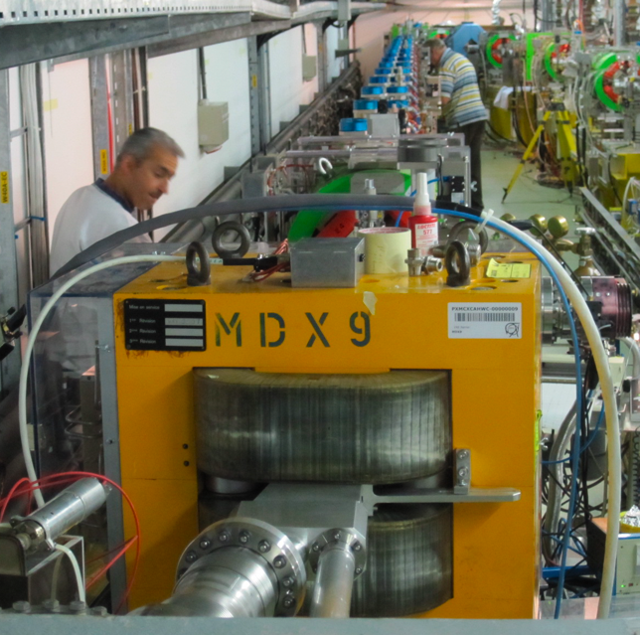
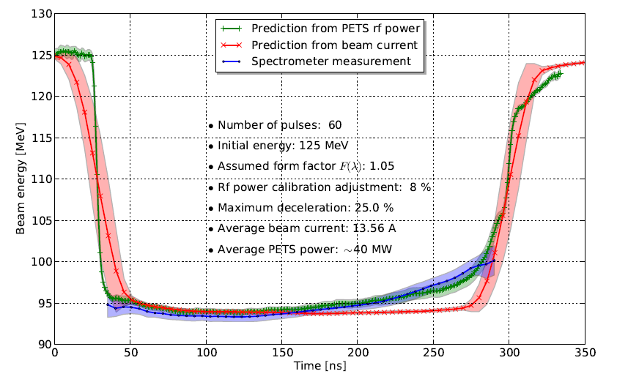
Two-beam acceleration experiments
The Oslo group is heavily involved in the experimental verification of the two-beam acceleration scheme at CERN, in cooperation with CERN and Uppsala University.
These experiments have resulted in two Oslo PhD thesis, and a number of publications.
R. Lillestøl, S. Doebert, E. Adli and M. Olvegaard, Phys. Rev. ST Accel. Beams 17, 031003 (2014)
M. Olvegaard et al. Phys. Rev. ST Accel. Beams 16, 082802 (2013)
M. Olvegaard et al., NIM A683 19-39 (2012)
E. Adli et al. , Phys. Rev. ST Accel. Beams 14, 081001 (2011)
…
Two-beam test stand
Deceleration test beam line
The CLIC two-Beam Acceleration scheme has now been successfully demonstrated. This has resulted the CLIC Conceptual Design report. LHC physics results will decide which machine will follow LHC.

Slide 19
2.2 Wakefield acceleration

Slide 20
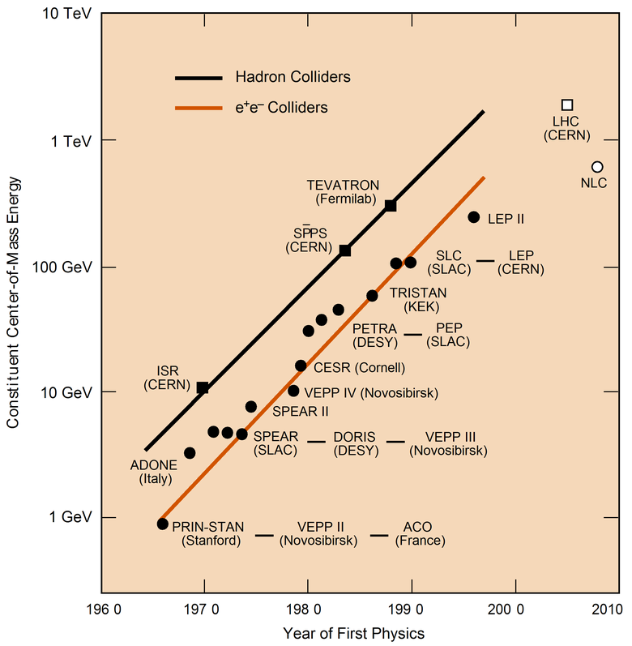

Particle collider Livingstone plot
???
LHC
CLIC ?
IL C ?
Way forward?

Slide 21
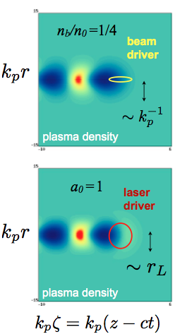
Plasma wakefield acceleration
Drive a wave in plasma by the space charge field of an
  intense charged particle beam (beam-driven)
  radiation pressure of an intense laser beam (laser-driven).
Transfer energy from driver to witness.
  Typical plasma densities: 10¹⁴⁻¹⁸/cm³
  Field strength: 10 – 100 GV/m
  Length scales: λ_{p}~10-1000 um
  No surface material break down
Ideas 1979 T.Tajima and J.M.Dawson (UCLA), Laser Electron Accelerator, Phys. Rev. Lett. 43, 267–270 (1979)

Slide 22
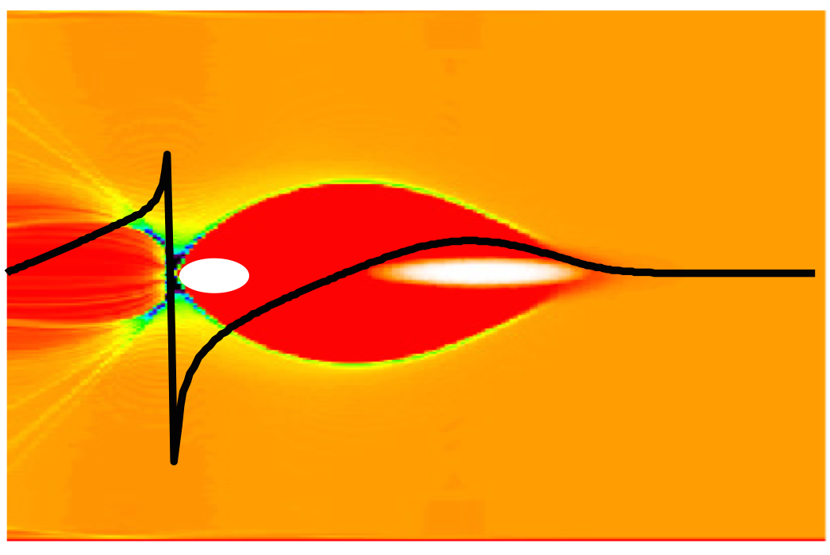

Field and blow-out regime
If the driver beam current is strong enough, the space-charge force of driver blow away all the plasma electrons
Blow-out field scale, “wave breaking” field :
Uniform layer of ions left behind.
Plasma structure length scale: c / ω_{p}
E_{z}
plasma electron
trajectories
z = s -ct
The plasma electrons will form a narrow sheath around the evacuated area, and be pulled back by the ion-channel after the drive beam has passed.
The back of the blown-out region is ideal for plasma acceleration.

Slide 23





Blow-out regime: ideal for accelerating e-
“QuickPIC” simulation example of blow-out regime :
(loaded)
From W. Mori (UCLA)

Slide 24








Ingredients of a plasma experiment
The FACET PWFA experiments at the Stanford Linear Accelerator Center
Talk for another day
2 km
Deflecting cavity
10 TW Ti:Sa laser
Li OVEN
CHERENKOV
YAG
LANEX
Spectrometer y-dipole
e- beam ->
<- W-chicane
Imaging quadrupoles
100 m

Slide 25


June 2013: first experimental demonstration of two-bunch acceleration in a plasma
SLAC experiments started in 2011 and led to ground breaking results.
This has opened opportunities for Oslo students to participate in world class plasma experiments at CERN and at Stanford University/SLAC.
M. Litos et al., Nature, 6 November 2014 (10.1038/nature13882)
E. Adli et al. NIM A (2015), dx.doi.org/10.1016/j.nima.2015.02.003
S. Li et al., Plasma Phys. Control. Fusion 56, 084011 (2014)
N. Vafaei et al., Phys. Rev. Lett. 112, 025001 (2014)
W. An et al., Phys. Rev. ST Accel. Beams 16, 101301 (2013)
…
Acceleration of a witness beam, with high efficiency (>30% wake to beam), high gradient (5 GV/m) and low energy spread (~1%) recently demonstrated at SLAC/FACET, at a plasma of density 5e16/cm³. This is the first experimental demonstration of plasma acceleration of a beam, paving way for a potential revolution in how particle acceleration is done.

Slide 26


The AWAKE experiment at CERN
Surfing the wave, our group has extended its PWFA activities to the new PWFA experiment approved at CERN.
AWAKE: “A Proton Driven Plasma Wakefield Acceleration Experiment at CERN”. Idea: use CERN proton bunches with kJ energies as a PWFA driver. The proton bunch drives self-modulated wake fields with accelerating fields of about 1 GV/m over 10 meters. An e- bunch will sample the wake. First beam: 2016.
The AWAKE experiment is currently under installation in the CERN Gran Sasso tunnel.
The low-density long beam will self-modulated and generate intense wake fields. PIC simulations performed by Veronica Olsen (FI, Oslo)

Slide 27

2.3 European Spallation Source (ESS)

Slide 28



European Spallation Source (ESS)
Spallation:
ESS potential:
5 MW, 2 GeV
Neutrons
Proton beam
Tungsten target
Material science with Neutrons:
ESS: largest accelerator project in Scandinavia up to now, and in foreseeable future.
Norway is committed to contribute In-Kind ≈150MNOK.

Slide 29


Beam power and machine protection
The accelerator will be the world’s most powerful proton driver.
Superconducting part: 310 m of Niobium Cavities in 2.1 K (liquid) He bath.
Beam loss could damage superconducting structures.
Machine protection is essential.
Oslo: currently involved in the development of a novel and robust Machine Protection System:
Proton-driver: same technology as needed in an Accelerator Driven Nuclear Power Plant

Slide 30


Proton Beam Imaging Systems
3) Electronics
The end product
(what we care about) :
1) Photon source
2) Optical system
5) Commissioning GUIs
4) “Auxiliary equipment”
Problem: challenging environment in the target region
High neutron flux set constraints on component choices
Not accessible once put in place. Specs: replaced only after 5 years.

Slide 31


Proton Beam Imaging Systems
Proton Beam Instrumentation Plug
Optics for Target imaging
Optics for Proton Beam Window imaging
Proton Beam WIndow
Rotating 33 sector tungsten target
Beam position monitor (BPM)
Aperturemonitor
Proton Beam Instrumentation Plug
Multi-wire grid
Upstream: position, current, aperture, and loss monitors

Slide 32

Main challenges
1) Photon source: metallic coating, required R&D
2) Optical system for light transport: shielding constraints

Slide 33

2.4 Hadron therapy
CCS Oncologt

Slide 34

Advantages of hadron therapy
From U. Amaldi

Slide 35

Hadron therapy accelerators
Beam transport lines
Synchrotron
Linear accelerator
Beam delivery
25 m
(gantry size)
Heidelberg Ion-Beam Therapy Center (HIT)
H.H. Bjerke, MSc Thesis, “Application of Novel Accelerator Research for Particle Therapy”, 2014

Slide 36

New concepts based on CLIC technology
Decrease size and therefore cost of hadron therapy systems.
CLIC-like structures have so high gradients that everything can be mounted in gantry.
Additional advantage of fast energy changes (fast screening).
From U. Amaldi

Slide 37

2.5 Free-Electron Lasers (FEL)

Slide 38


Sources of X-ray radiation
Accelerated electrons radiate electromagnetic radiation (antenna).
Due to the high electron energy in synchrotrons, this radiation (synchrotron radiation) extents into the X-ray regime.
The extremely high intensity of these X-rays is used for experiments.
World-wide there are about 50 dedicated synchrotrons for X-ray production (light sources).
Soleil in Paris: Anlage und schematischer Aufbau

Slide 39
Free-electron laser (FEL)
Based on a linear accelerator followed by an undulator.
Particles move on sinus trajectory.
Via interaction of particles and produced X-rays, micro-bunches form.
Due to that the particles radiate coherently (laser properties).
10¹⁰ higher X-ray intensity compared to synchrotrons.
Only 2 FELs in hard X-ray regime running at the moment. High current interest.
Undulatorprinzip und Mikrobunch-Entwicklung

Slide 40

Experiments with X-rays
Due to short wavelength of X-rays, very small structures are resolvable.
Pictures of smallest biological objects: cells, proteins.
Synchrotron X-ray source: Averaging over long time period necessary.
FELs: Nearly 1-pulse imaging is possible. This allows to study the dynamics of molecules.

Slide 41

The X-band FEL collaboration
Idea: Use new CLIC-like acceleration to build FELs.
New structures have higher gradient and FELs can (hopefully) be build shorter and cheaper. Hopefully, also smaller countries could effort such FELs.
International collaboration of interested institutes (design report within 3 years).
Example of X-band test facility at CERN
ST Elettra - Sincrotrone Trieste, Italy.
CERN CERN Geneva, Switzerland.
JU Jagiellonian University, Krakow, Poland.
STFC Daresbury Laboratory Cockcroft Institute, Daresbury, UK.
SINAP Shangai Institute of Applied Physics, Shanghai, China.
VDL VDL ETG T&D B.V., Eindhoven, Netherlands.
OSLO University of Oslo, Norway.
IASA National Technical University of Athens, Greece.
UU Uppsala University, Uppsala, Sweden.
ASLS Australian Synchrotron, Clayton, Australia.
UA-IAT Institute of Accelerator Technologies, Ankara, Turkey.
ULANC Lancaster University, Lancaster, UK.

Slide 42
3. Summary
Particle accelerators, a coherent field of physics with many international collaborations.
Particle accelerator studies and particle accelerator research include components from our three pillars: Theory, Computation and Experiment.
Our activities in Oslo, as a Norwegian hub for accelerator expertise, spans a large spectrum of accelerator activities
  Fundamental R&D
  HEP machine design
  Other applications.
If you are interested in participating (summer, master of PhD student) please contact Erik Adli erik.adli@fys.uio.no

Slide 44
Thank you for your attention!

