Slide 1
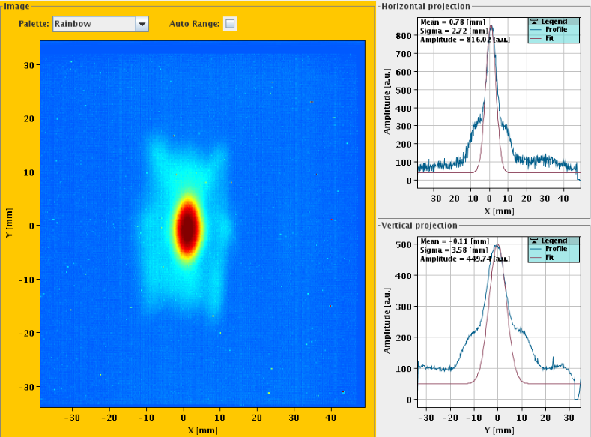
LINAC4 – Instrumentation Status
F.Roncarolo BI-TB 9-Feb-2017
Lots of material (and work!) from
J.C. Alica Santamaria, S.Burger, T.Hoffmann, E.Barrios Diaz, G.Guidobboni, A.Guerrero, M.Bozzolan, L.Soby, S.Bart Pedersen, J.Tan, etc ….
We miss Uli!!!
LINAC4 Bear
… ah no: LINAC4 beam!

Slide 2
LINAC4 Status and Plans
All LINAC RF structures and magnets installed up to the main dump
Transfer line (L4T) equipment installed apart from zone occupied by HST (including de-buncher + some diagnostics)
8-10 mA reached at 160 MeV, main limit in LEBT emittance
Schedule:
HST till end of March
April-May : remove HST, install de-buncher, temporary dump in place
June → LS2: reliability run (with YETS ~overlapped with rest of the complex)

Slide 3
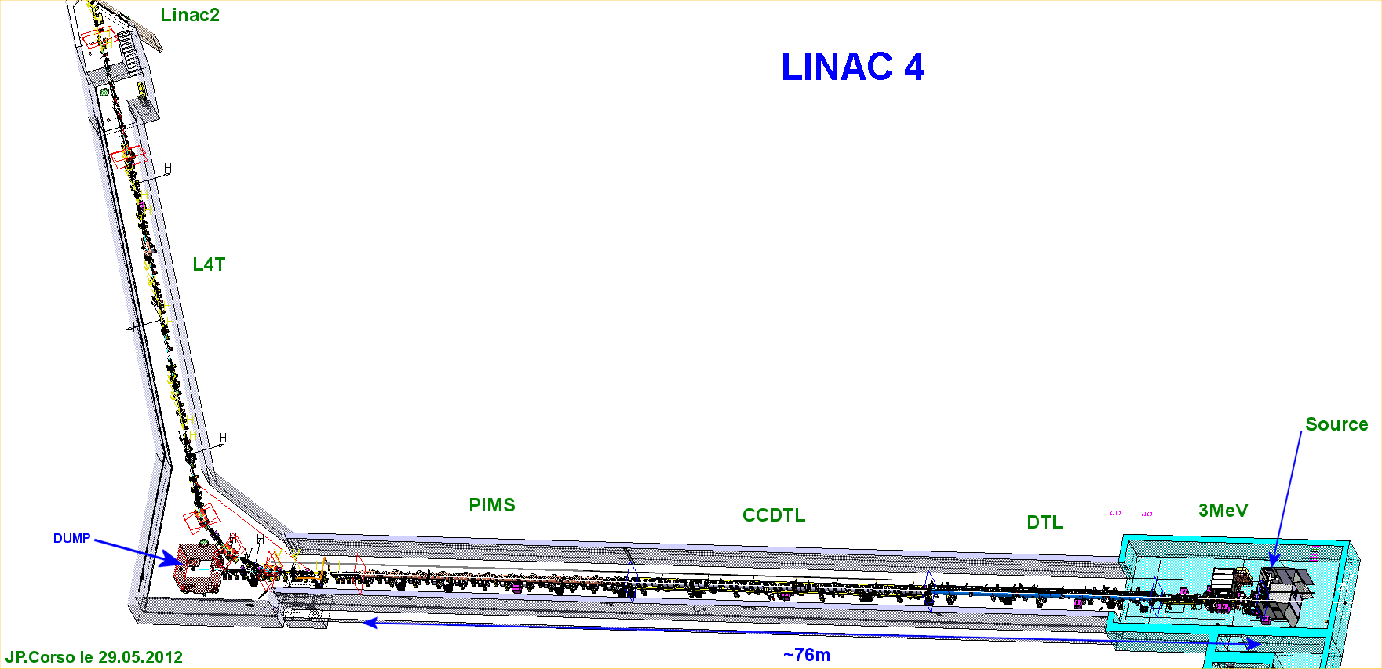
LINAC4 Layout

Slide 4
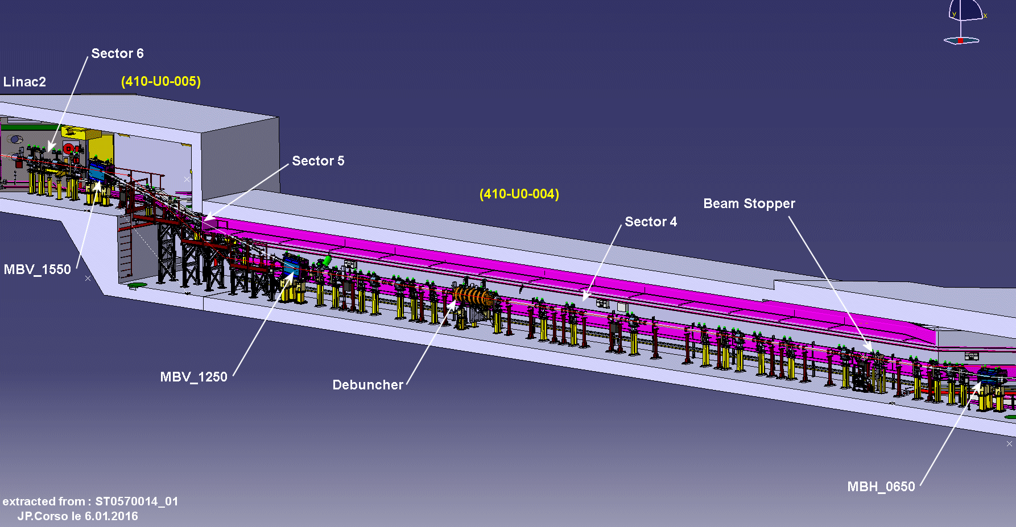
Last part of Transfer Line
Half Sector Test

Slide 5
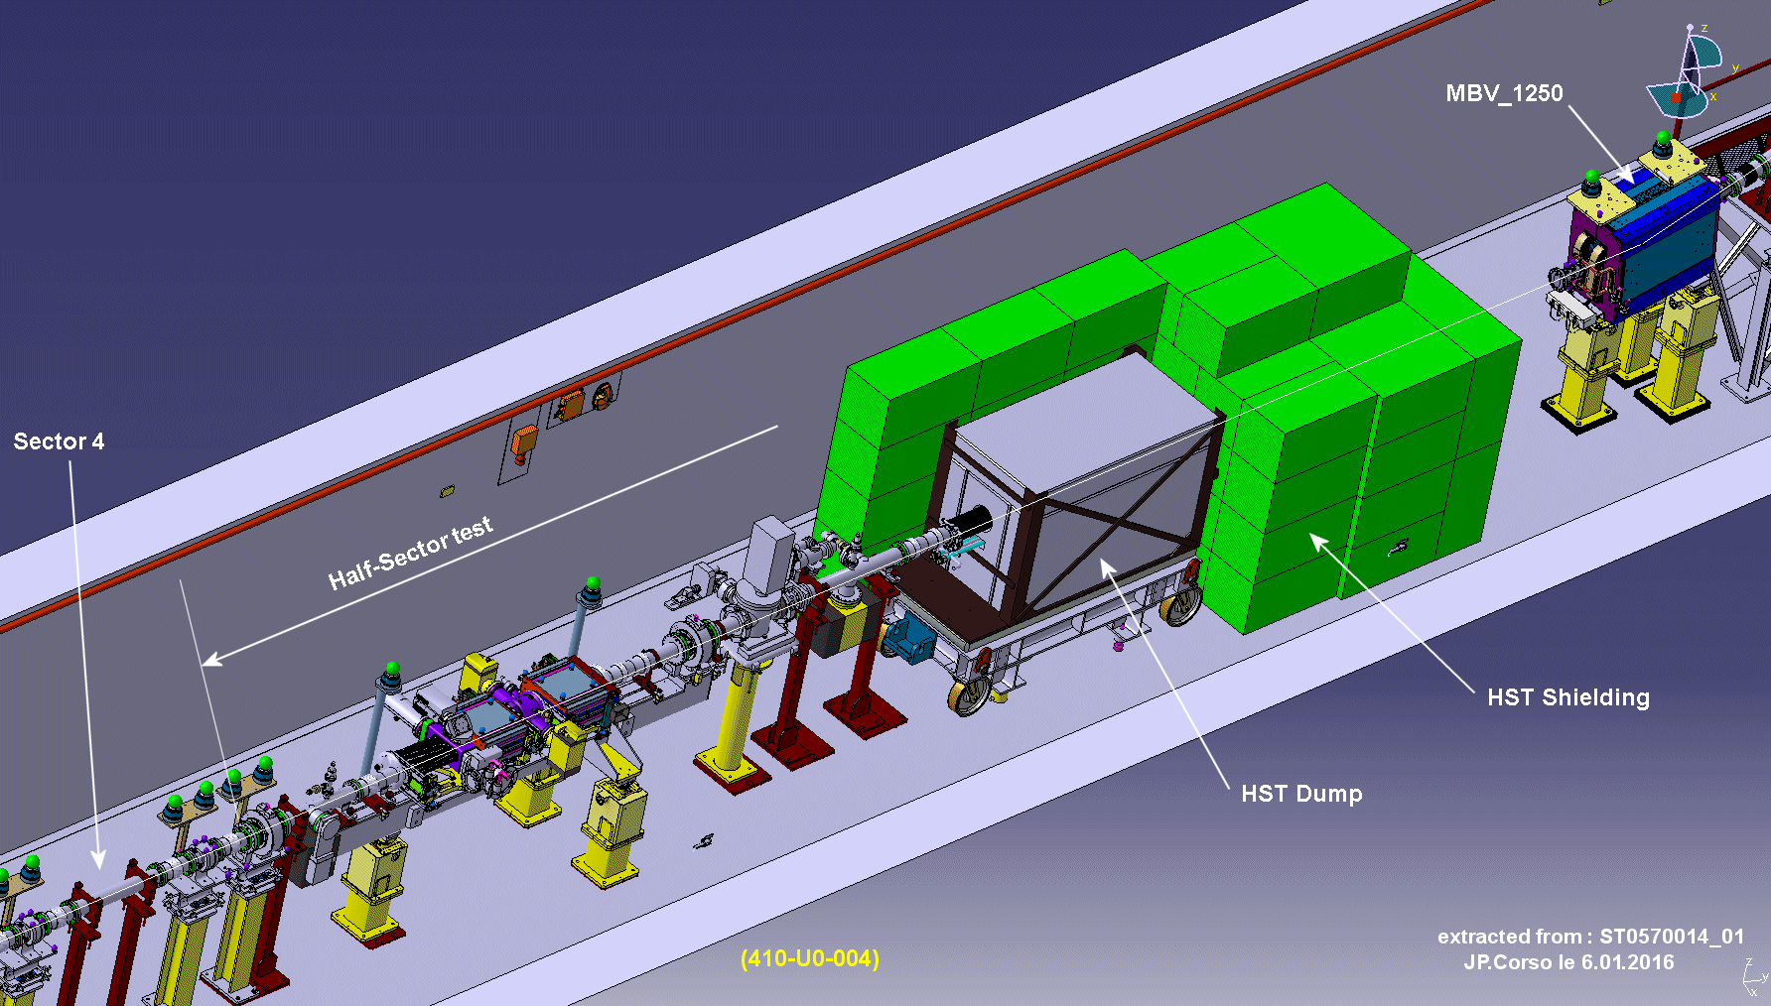
Half Sector Test (HST)

Slide 6
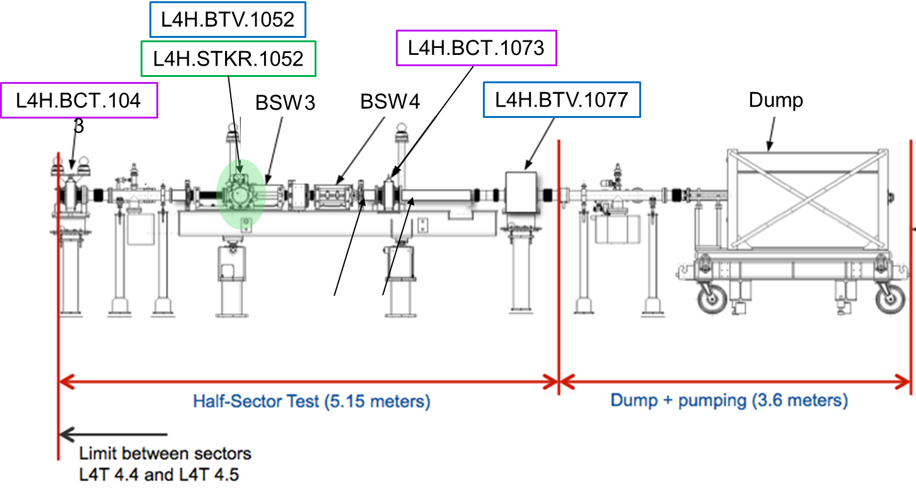
Half Sector Test (HST)

Slide 7
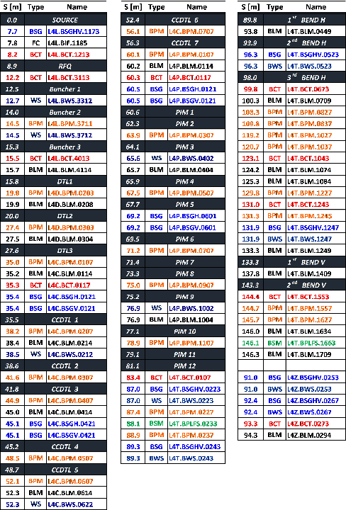
LINAC4 Diagnostics
Now HST
Missing

Slide 8
Instrumentation Installation Status
All installed apart from
2 WS inter-tanks PIMs
2 WS L4T line
Devices to be put at HST location
2 SEM grids + 1 WS
2 BCTs
1 BPM
2nd BSM to be moved to final location (now tested upstream of HST)
Laser Emittance Meters

Slide 9
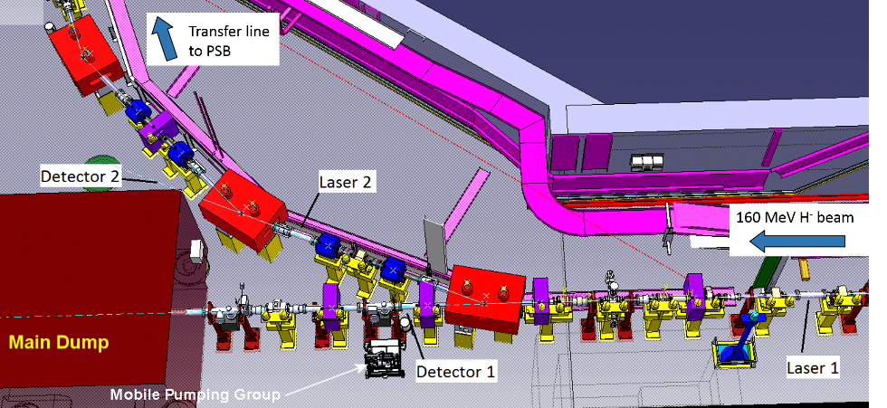
Laser Emittance Meter

Slide 10
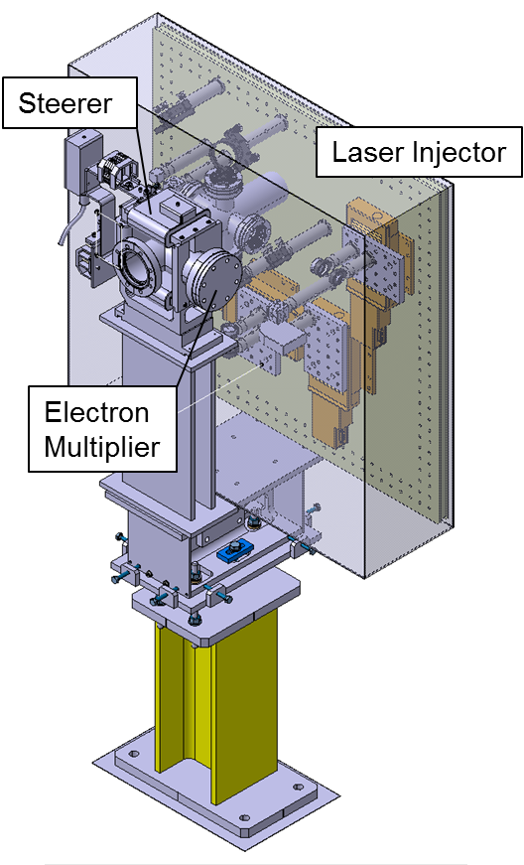
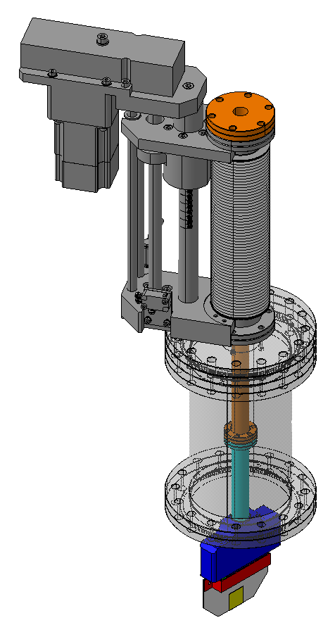
Laser Emittance Meter
2 x (laser + diamond) stations

Slide 11
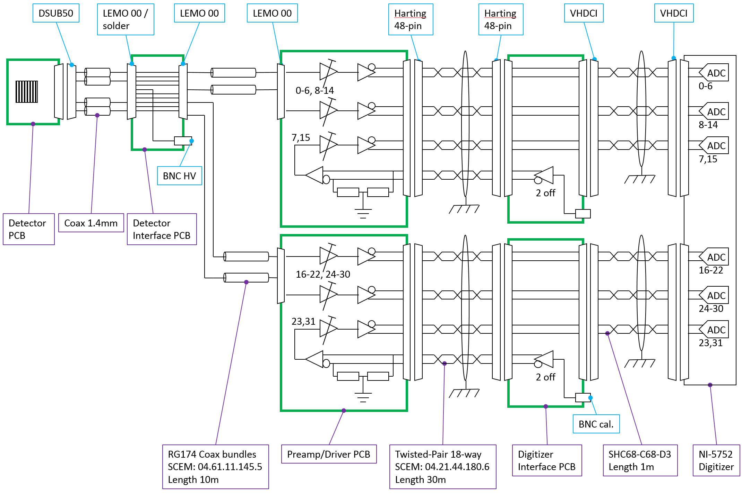
Laser Emittance Meter (diamond read-out)

Slide 12
Laser Emittance Meter (status)
Mechanics
Design and intégration complete
Vacuum chambres & supports in production
Installation scheduled in May
Electronics
Backplanes in production
Pre-amplifiers in test phase
Cables pulled in May
Commissioning ~ June 2017
Laser
Commissioning end of March at RHUL
Diamond Detectors
Being currently assembled

Slide 13
Issues concerning installed device

Slide 14
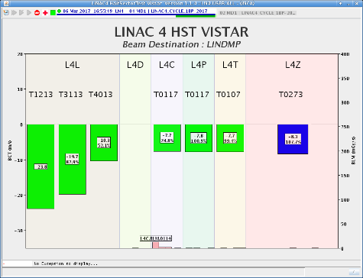
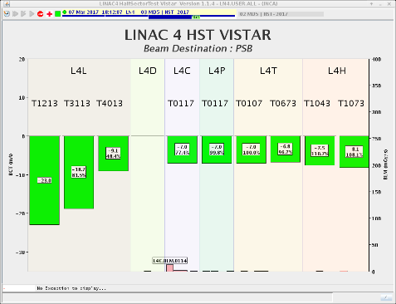
BCT
1 L4Z (dump line) and 2 HST BCTs measure > 100 % transmission of H-
L4Z BCT measures < 90% transmission of protons after stripping (expected > 99%)
107%
110%
106%

Slide 15
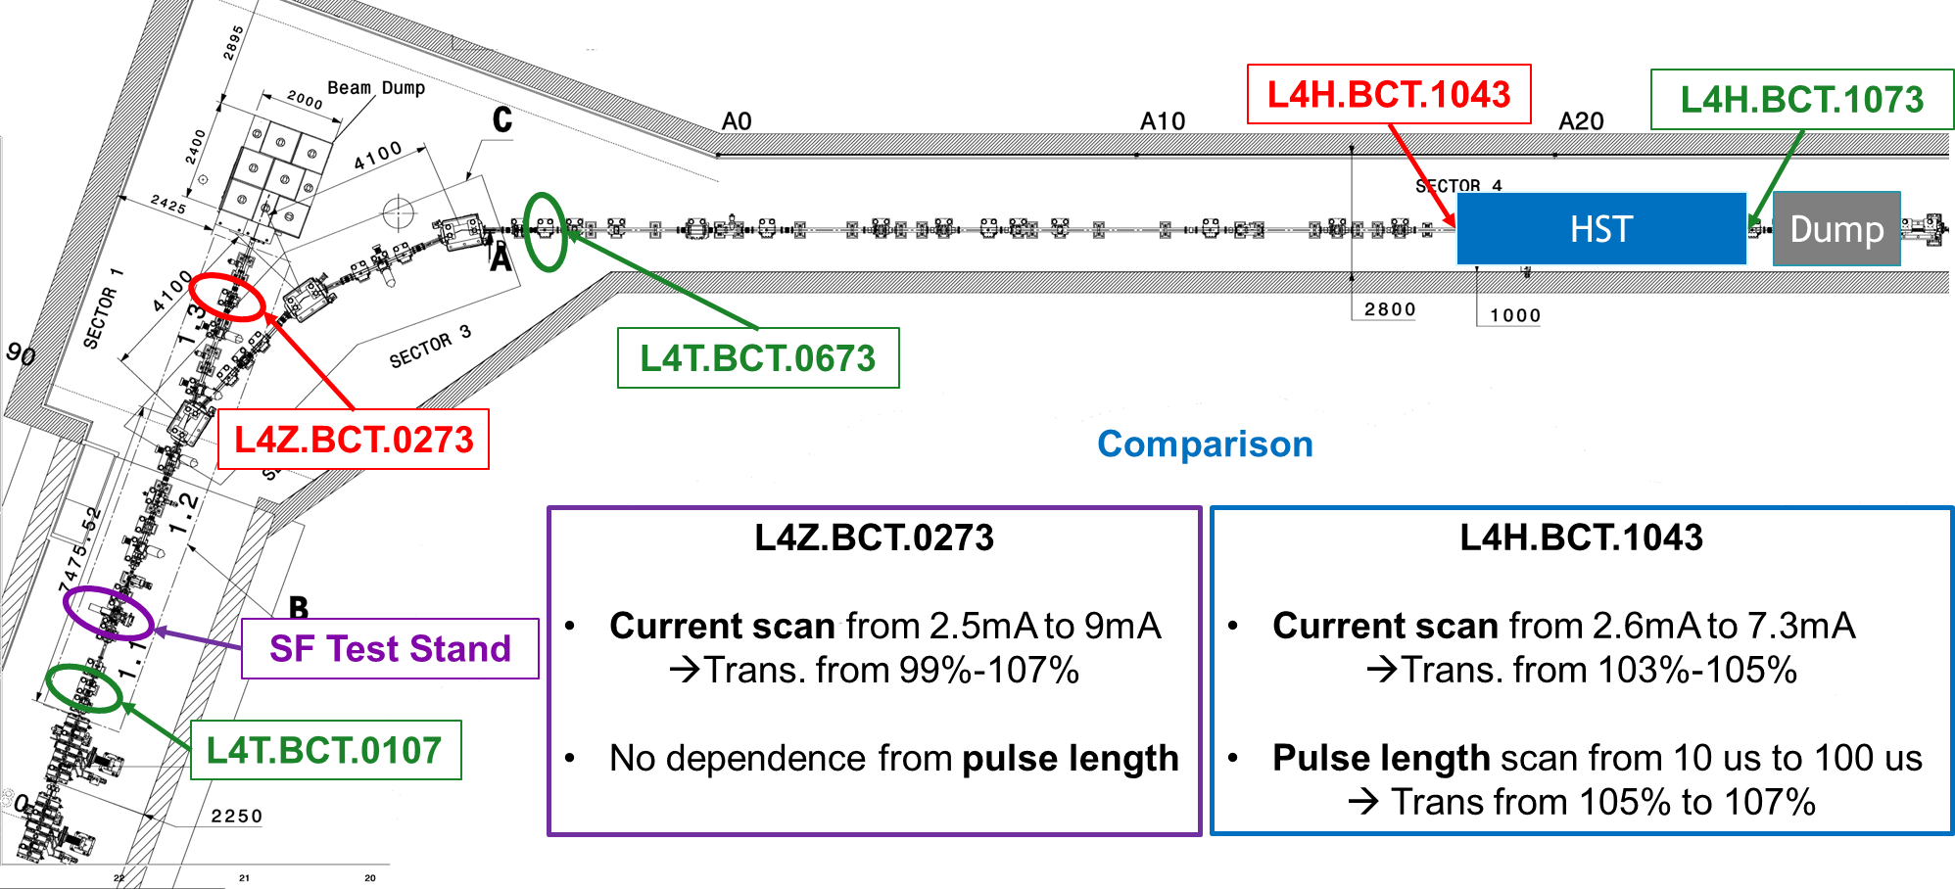
BCT

Slide 16
BCTs
All HW and SW checked / swapped
Problem still not understood
Next:
Check BCT grounding
Try to use BPM intensity signal (close to HST BCT) to measure transmission w.r.t. upstream BCT to see if intensity dependence ~ HST BCT
Re-investigate beam intensity dependence

Slide 17
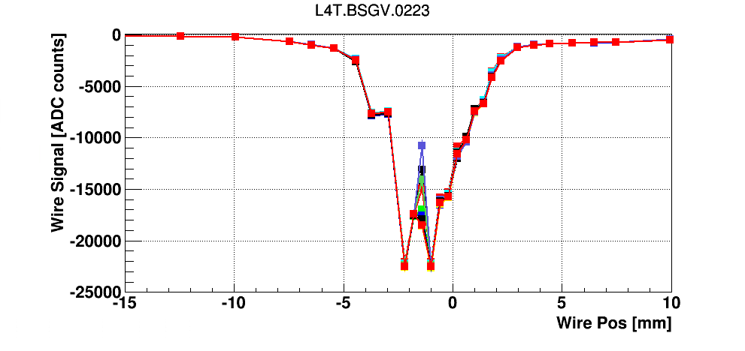
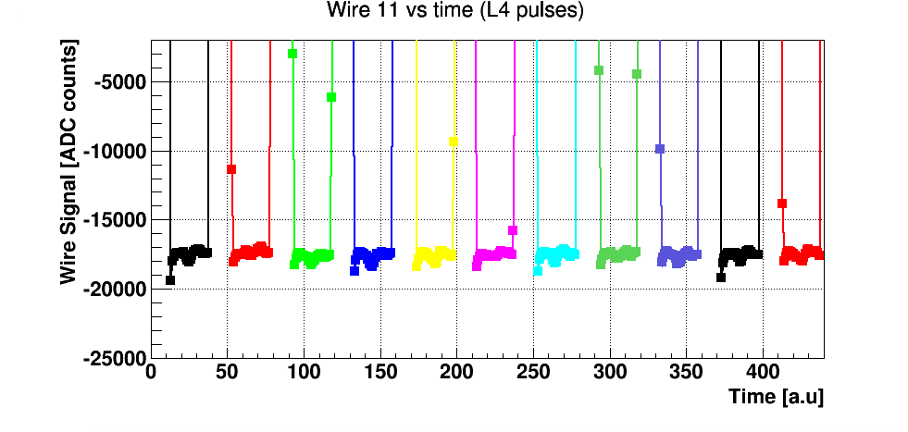
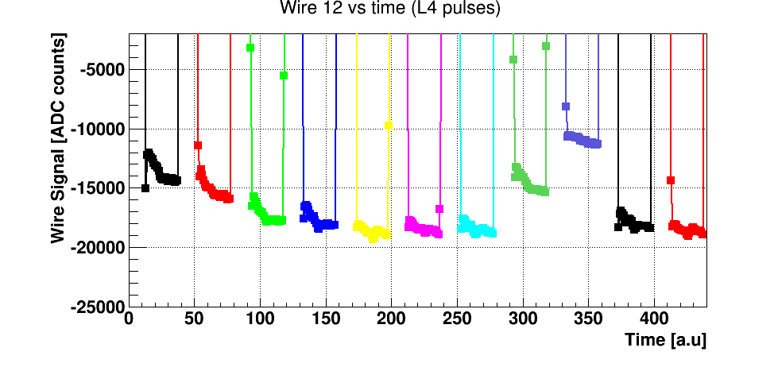
SEM Grids
Case of wires giving very perturbed signals
Problem under investigation
OK
NOT OK

Slide 18
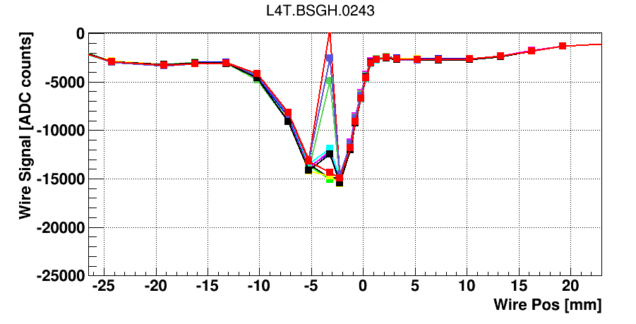
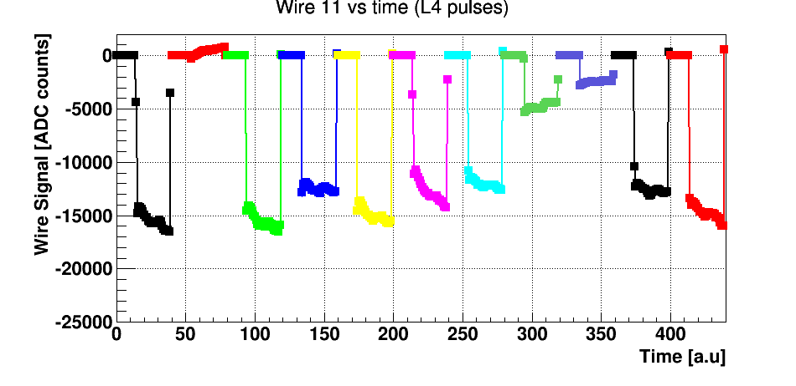
SEM Grids
(OTHER GRID)
Case of wires giving very perturbed signals
Problem under investigation
NOT OK

Slide 19
SEM grids
LEBT SEM grids at source test stand
Removed, several broken wires
Refurbish in the next few weeks
New tank design (equipped with new generation of grid PCBs) in xxx months
Will be then implemented also in tunnel LEBT (YETS?)
Source team very pushy to get priority
Need to review beam intensity-plse length limits to avoid other wire breakage

Slide 20
WS
missing mechanical offsets for L4T scanners
(to have beam position on top of beam size)
New FESA + OP GUI featuring ppm acq. mode fully tested
To be noted:
Both grids and scanners not extensively used in 2017, other hiccups may show up
Need to plan a re-test of all devices before end of march to identify any need for maintenance during April-May

Slide 21
BPM
New SW for trajectory operational
ToF was essential for Linac setup, BI expert mode
SW development on-going
Use of intensity signal for HST under study
BSM
Two monitors validate in BI expert mode, essential to setup LINAC and TL
VME electronics + OP GUI to be made operational during reliability run

Slide 22
BLMs
Installed
Extensively used for HST studies
Diamond BLM at HST suffering large disturbances every LINAC pulse, with no beam
Thresholds to be studied during reliability run

Slide 23
Half Sector Test

Slide 24
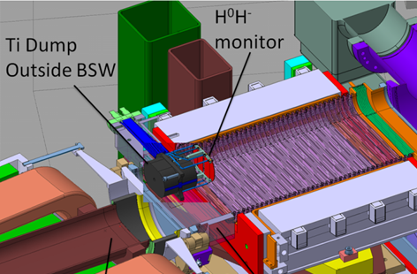
H0-H- beam current monitors

Slide 25
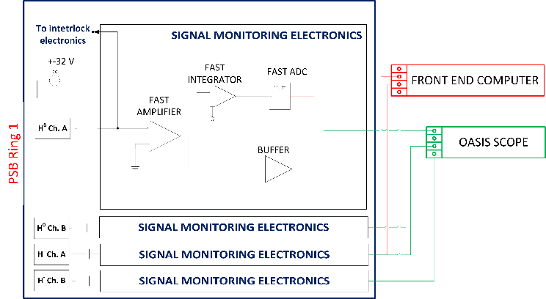
Signal Monitoring Electronics

Slide 26
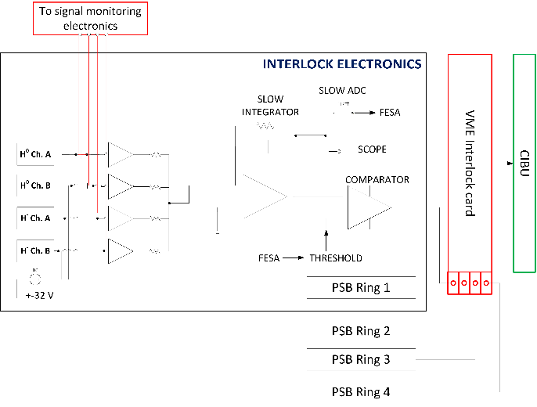
Interlock Electronics

Slide 27
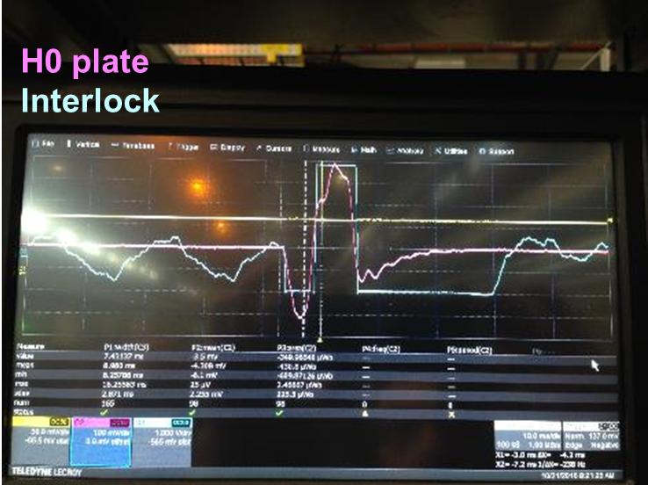
H0-H- B.C.M., Signal disturbances
No beam
Analogue output of signals from VME card
Large disturbances every 1.2 sec
Interlock all the time
10 ms/div

Slide 28
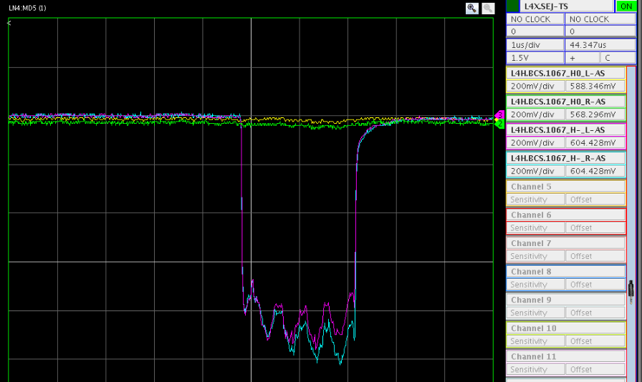
H0-H- BCM - calibration
Disturbances ~stable (change with BSW on-off) can be substracted (ref trace with no beam)
Calibration studies on-going
No stripping foil, send full beam on single plate, compare to BCTs
New VME card
Ready in few days

Slide 29
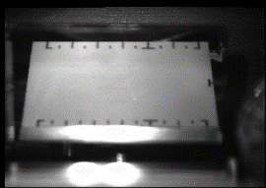
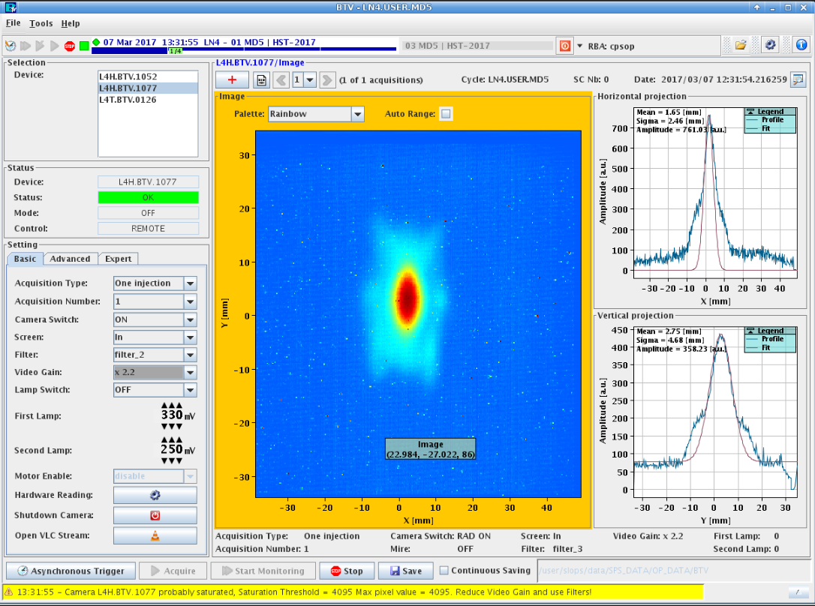
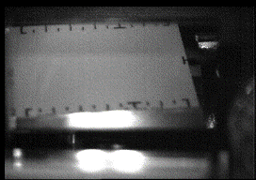
HST - BTV
To observe beam and stripping foil
Operational (and essential)
Minor mechanical (screen slightly tilted at IN position) understood, will be ok for PSB

Slide 30
Summary
Installation in April- May
Missing grids and WS
Laser EM
(ESS BGI radiation tests system)
Issues with xxx SEM grid wires
Issues with LEBT grids
3 BCTs with too high current reading under investigation
BPM ToF to be made operational
H0-H- BCM to be calibrated (hopefully including interlock)

Slide 31
The Plan
Up to March 31st:
HST
Re-assess (with beam if needed) overall instrumentation status)
At the same time: review any need for SW consolidation/upgrade in visage of reliability run
April-May
Installation and maintenance
May->YETS
Reliability run, will also be BI reliability run

Slide 33
