Slide 1
Planned BI renovation of PS East Area
Jocelyn TAN, Philippe CARRIERE, Inaki ORTEGA RUIZ,
Gerard TRANQUILLE
BI-EA
BI Technical board 30 March 2017

Slide 2
Outline
Roadmap of the East Area Renovation project
  Why? What? When?
Implication of BI
Summary

Slide 3
Motivations of the EA renovation programme
Among the oldest exp. areas at CERN: infrastructure & equip date from early 1960’s.
Increasingly popular: 553 users served over the last three years.
Unique low and mid energy facility worldwide.
Beam lines: 63 magnets of 22 different types, many without operational spares!
Several breakdowns of critical elements: access & repair require PS beam stop, or EA physics downtime for months, costly in dose.
Infrastructure issues: asbestos, cables with halogen, unreliable cranes, wooden user barracks, no ventilation in primary zone leading to ozone-induced oxidation of equipment, etc…

Slide 4
What will change ?
Four beam lines: primary beams for T8, secondary beams for T9, T10 & T11
Secondary beam energy up to 15 GeV/c (overlap with NA energy range).
Magnets: 61 laminated for pulsed operation, 15 reliable types, with spares, cables.
Upgrade to NA standards: new absorbers and converters, collimators, VSC, BI.
Consolidate stoppers
Modular power converters: 60 with energy recovery, 0.6 GW.h/year (now 11 !!)
Improved layout: primary zone reduced to target areas + ventilation, shielding, access to element and MTTR, dose to personnel.
Infrastructure: power supply + cables, CV, insulation, roof cladding, user barracks, remove EBCR …
Timeline for decision making process: see appendix

Slide 5
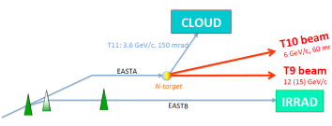
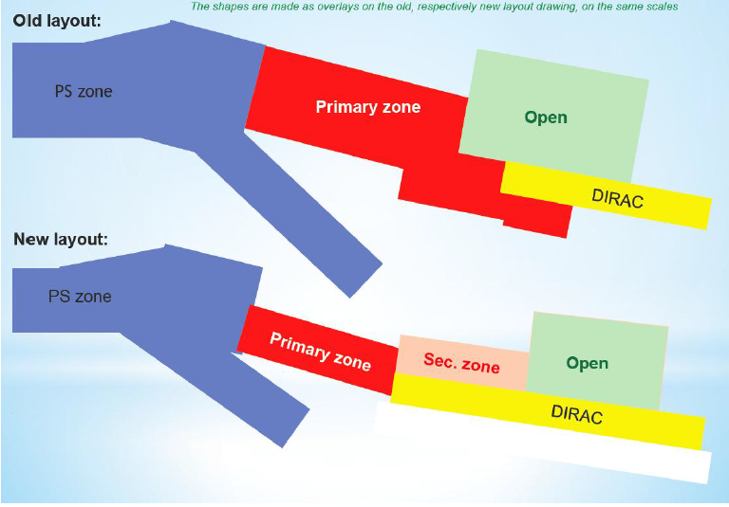
Present and future layout
IRRAD Charm
target
T11
F63
T10
BHZ
IRRAD Charm
F62
target
T09
BHZ PS
BHZ
PS
F61
T08
Courtesy: Lau Gatignon

Slide 6
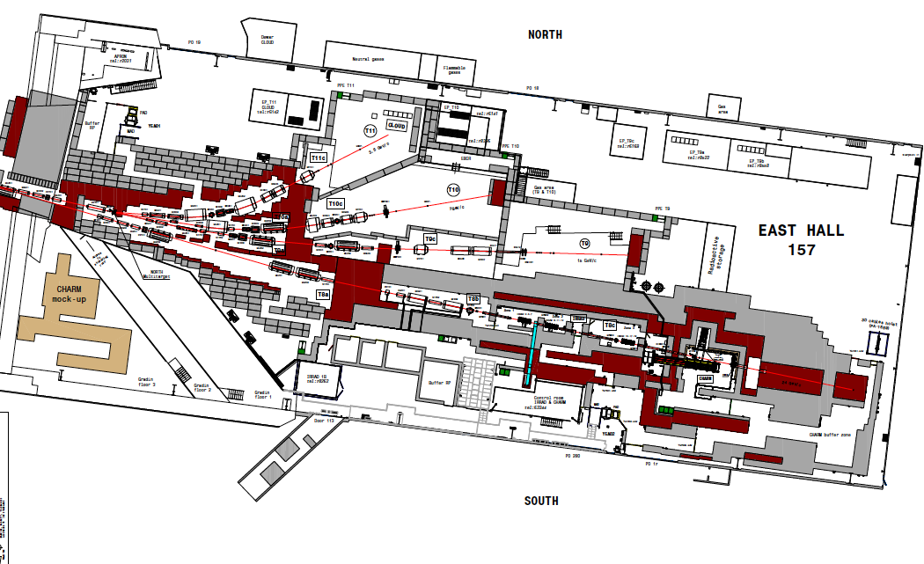
Future layout
3.6 GeV/c
T11
Cloud
6 GeV/c
T10
T9
15 GeV/c
T8
IRRAD
Primary beam
Charm
24 GeV/c

Slide 7
Master schedule
Civil engineering works
Dismantling
Installation
HC
BC
Courtesy: Sebastien Evrard

Slide 8
Impact for BI (1): activity number in PLAN #11259
Upgrade of T9 and T10 lines
  Four Cherenkov counters (1 pair per line) : upgrade aqn chain to NA standards –cost-free for the aqn chain for already in the pipeline.
  Four obsolete sets {XSCI+XDWC} : proposal to replace them by 4 scintillator fiber detectors ⇒ 150kCHF
Cabling: EN-EA has a central budget for cables (tbc)
  move our racks from EBCR (decommissioned) to APRON ⇒ 40kCHF
  Cherenkov ⇒ 30kCHF
  Telescopes ⇒ 10kCHF
  Exp. scaler ⇒ 20kCHF
Total = 100 kCHF

Slide 9
Impact for BI (2): Recommendations and Proposals
BLMs required along the primary lines
  20kCHF for 2020* but unknown quantity and positions
  Recommended from CSR (Dec. 2016)
Two Telescopes
  one per target ⇒ cost-free for aqn chain and monitors
One extra BTV
  to have one per target ⇒ 40kCHF
No upgrade request for T11 line (CLOUD)
  One pair of Scintillator fiber detectors ?
(*)From M. Brugger, Chamonix 2016, slide #40

Slide 10
Summary
BI activities in PLAN are partially set
BI Budget : 210 kCHF identified, but…
  =0.87% of 24MCHF for the EA renovation project
  Cabling cost: confirm that EN-EA will pay for that
  Scintillator fiber detectors in T9 / T10: get green light for their installation
  BLMs: finalize official figures !
Planning
  PS will be closed from Aug. 2020, but EA installation goes on till Oct. 2020
  Should not be an issue for BI
  Procurement can start once budget and WUs are defined

Slide 11
Appendix1: Timeline for decision making process
2012: East Area Day https://indico.cern.ch/event/167761/
2015: LS2 days https://indico.cern.ch/event/436424/
2016: Chamonix http://indico.cern.ch/event/448109/
2016: East Area project meetings https://indico.cern.ch/event/557781/
2016: LS2 days https://indico.cern.ch/event/564604/
IEFCs…

