Slide 1
Beam dynamics simulation with 3D Field map for FCC RF gun
A.Barnyakov, D. Nikiforov, A. Levichev
BINP
A.E.Levichev@inp.nsk.su

Slide 2
Outline
RF Gun overview
FCC RF Gun requirements
Possible FCC Gun Design
Beam dynamic simulation with 3D fields
SUPERKEKB experience
The secondary emission enhanced photoinjector
Conclusion

Slide 3
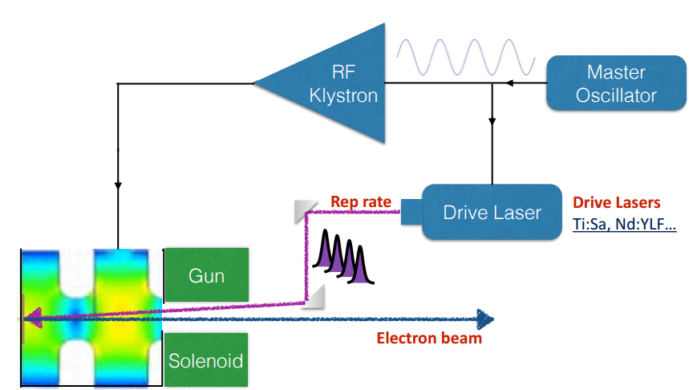
RF Gun Overview
L-band
S-band
X-band
Photocathode material:
Metal: Cu, Mg….
Semi-conductor: CsTe, AsGa…
The ideal cathode should have low intrinsic emittance, high quantum efficiency, long life time, high current density and fast response time

Slide 4
FCC RF Gun requirements
Gun Parameters | Value
Energy (Mev) | 11-12
Charge (nC) | 6.5
Horizontal emittance (um) | 0.35 (or less)
Vertical emittance (um) | 0.5 (or less)
Longitudinal sigma (mm) | 1
Transverse sigma (mm) | 1-2
Energy spread (%) | <1%

Slide 5

Problems
High charge need to be extracted ->needs to find how to increase of the cathode lifetime or find another methods how to obtain such a high charge (like a secondary emission enhanced photoinjector “SEEP” )
The distortion of force lines of the accelerating field near the edges of coupling slots leads to emittance growth. (solution: S-band ->L-band)

Slide 6
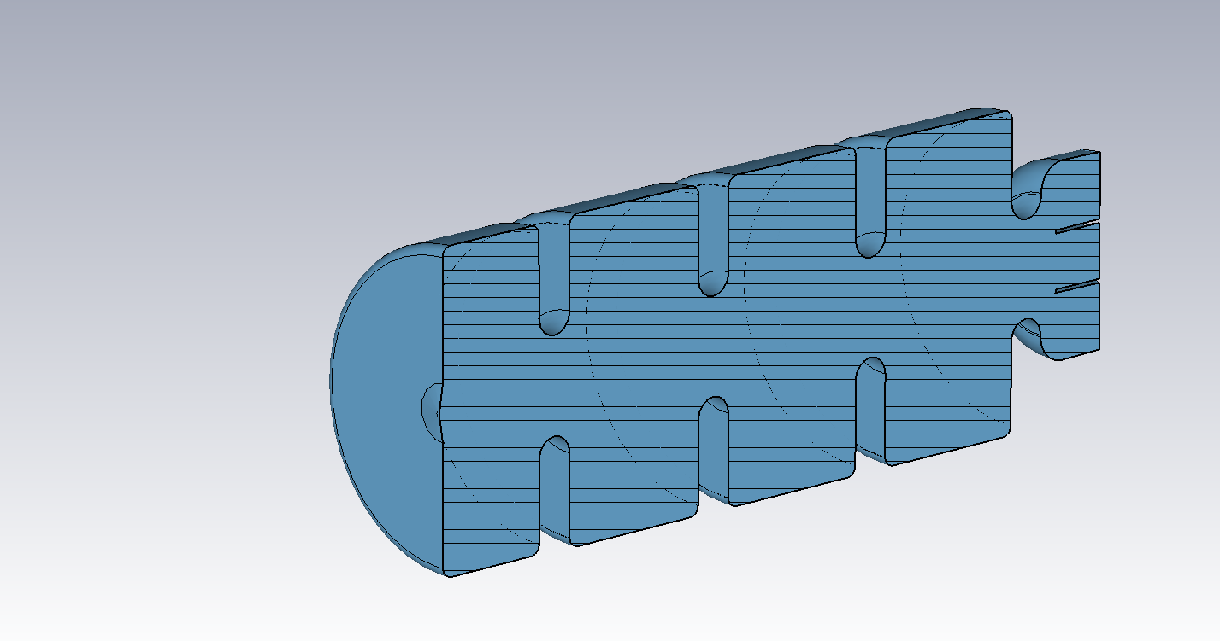
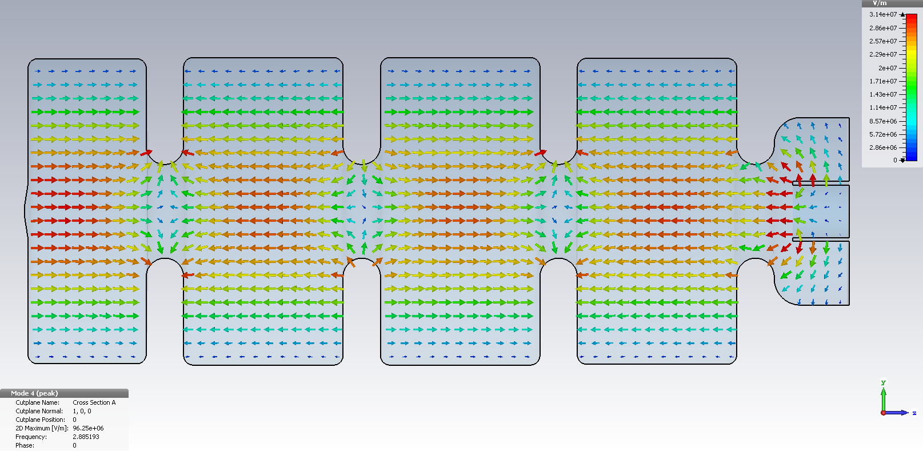
Possible FCC Gun Design
3+1/2 cavity cells with coaxial type feeder for power supplying
The phase shifting of oscillating mode is π

Slide 7
Beam dynamic simulation
Available codes: ASTRA, CST Microwave Studio
ASTRA simulation parameters
Number of electrons | 10^4
Thermal emittance | 0.00
Initial kinetic energy | 0.6 eV
Total charge | 6.5 nC
Cathode spot size | 5 mm
Initial transverse distribution | Flat-top
Laser pulse duration | 7 ps
Laser injection phase | 192⁰
Magnetic field on the cathode | 0 T
Peak accelerating field | 120 MV/m
Focusing solenoid field | 0.69 T

Slide 8
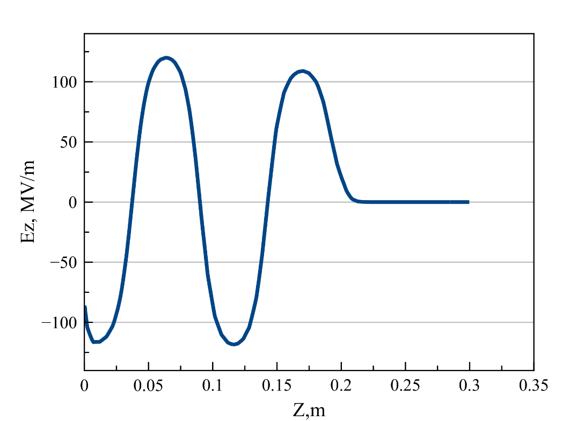
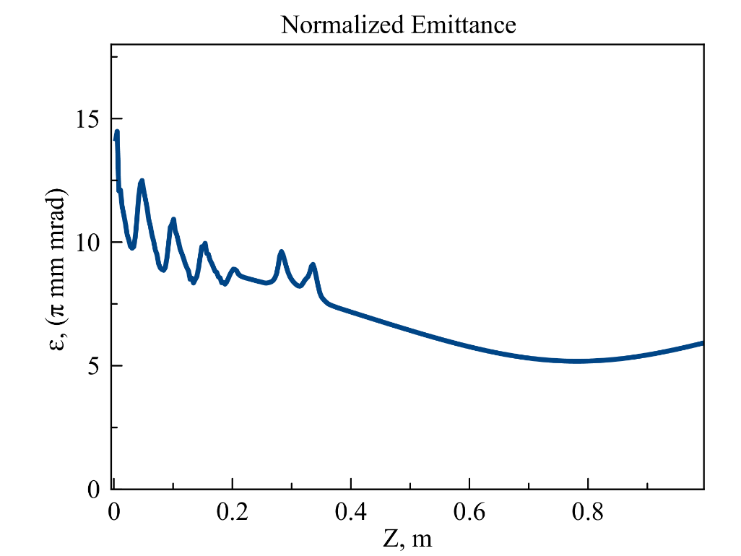
A simplified approach for beam dynamic simulations
Emittance at the gun exit
Electric field on axis
f
In this case we disregard fully the distortion of force lines of the accelerating field near the edge of aperture

Slide 9
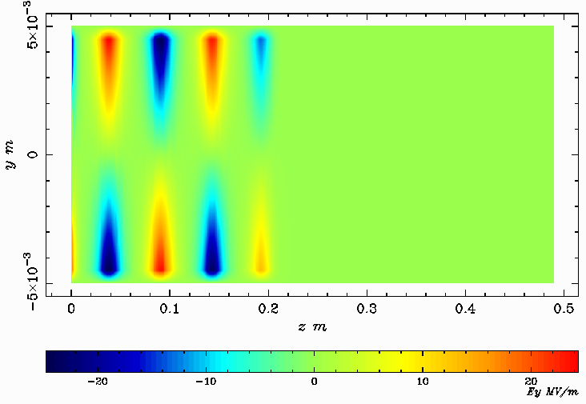
Distribution of the vertical electrical field component near the beam axis

Slide 10
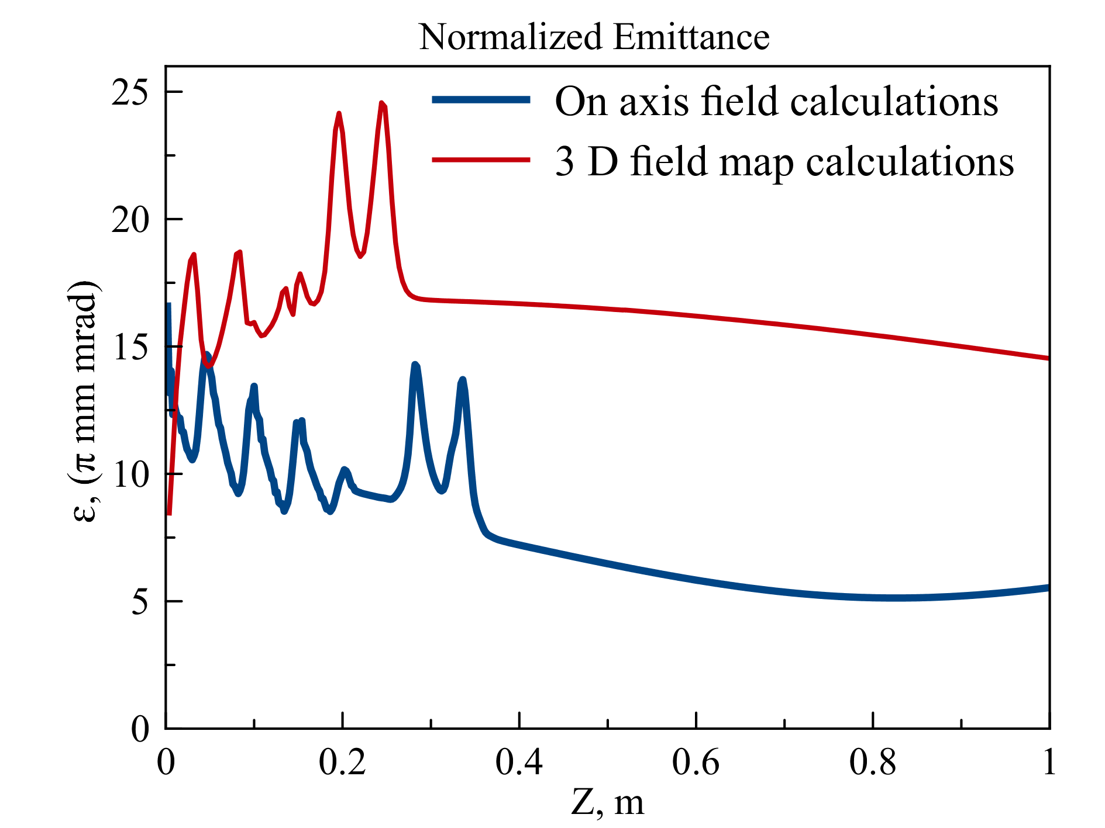
Emittance growth due to edge effects

Slide 11
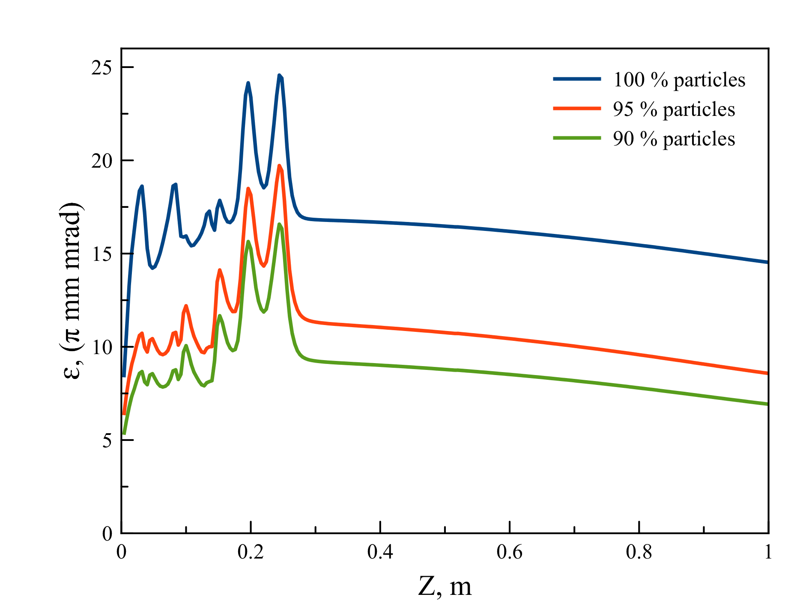
Core emittance

Slide 12
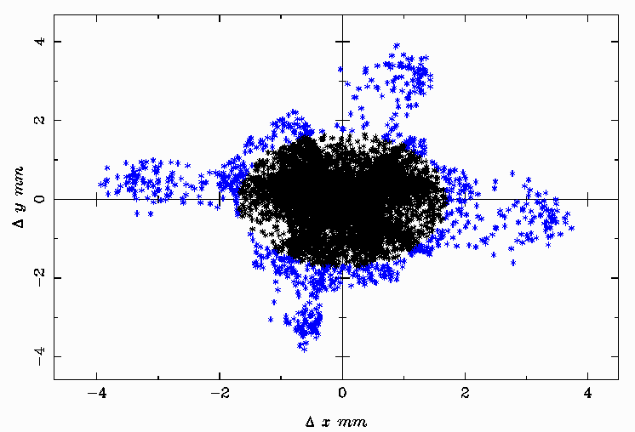
Circular collimator
Collimated beam parameters
Charge | 5.6 nC
Average energy | 13.0 MeV
Energy spread | 1.2%
Normalized transverse emittance | 9.2 π mm mrad (0.34 um)
RMS beam length | 1.1 mm
Beam radius | 2 mm

Slide 13
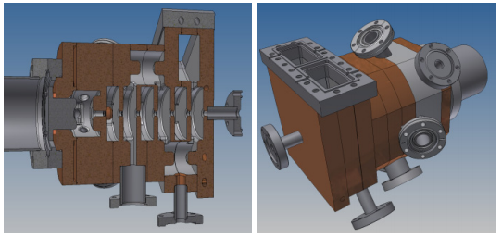
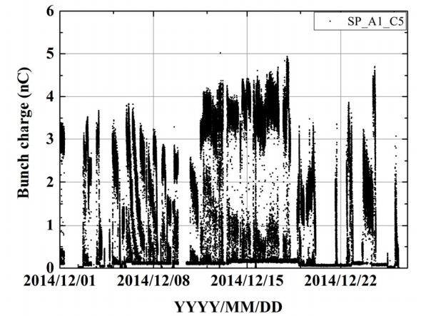
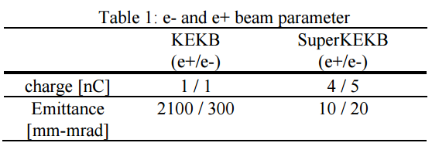
SUPERKEKB experience
Main feature: was confirmed that Ir5Ce is suitable for photo cathode in terms of quantum efficiency and lifetime.
Measured horizontal emittance: 8 mm-mrad for charge 0.6 nC and energy 30 MeV. High charge beam of 5.0 nC beam measurement is required.

Slide 14
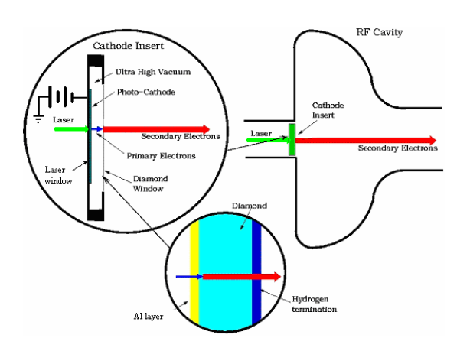
The secondary emission enhanced photoinjector (SEEP)
The laser light passes through the substrate of the primary photocathode and irradiates it, releasing electrons. These electrons are accelerated by the applied field between the primary cathode and diamond, pass through the metal layer into the diamond, to create a shower of secondary electrons. These secondary electrons drift through the diamond in the presence of the RF field in the cavity to emerge from the NEA surface in to the RF cavity to be accelerated further.
Xiangyun Chang, Ilan Ben-Zvi, Andrew Burrill , Peter Johnson, Jorg Kewisch, Triveni Rao, Zvi Segalov, Yongxiang Zhao, BNL, Upton, NY 11973 U.S.A.

Slide 15
The advantages of the SEEP
Significant reduction in the number of primary electrons required to meet the current /charge requirement, resulting in a corresponding reduction in the laser power/energy requirement
Increase in the life time of the primary photocathode due to reduction in current/charge delivered
Isolation of the cathode from the cavity vacuum, increasing the life time of the primary cathode
The Secondary Electron Yield (SEY) can be much larger than 100
Question
Emittance growth due to beam interaction with diamond and metal layer on a diamond window

Slide 16
Conclusion
Conditions for low emittance:
1. Flat top profile of the laser
2. Symmetrical coaxial type feeder for RF power supplying
3. Beam energy
4. Initial transverse beam size and length
Choice of photocathode and laser system:
1. To produce 6.5 nC the cathode material has to be researched
2. Parameters of the laser has to be chosen
3. The cathode life time has to be researched (high power laser will destroy the cathode)
4. Input cathode system, allowing the gun training, has to be developed
A further investigations
1. Development of L-band RF gun and beam dynamic simulation in this gun.
2. Investigation of SEEP methods for FCC gun, investigation of the minimum achievable emittance.

