Slide 1
Particle Physics – Higgs with CMS at LHC
CERN, Geneva 21 april, 2013
by Vladimir Rekovic
Rutgers, USA

Slide 2
Outline
Particle Physics and Standard Model
LHC & CMS, Latest Higgs results
H→γγ analysis update with the full dataset

Slide 3
Particle Physics
Some background and history

Slide 4
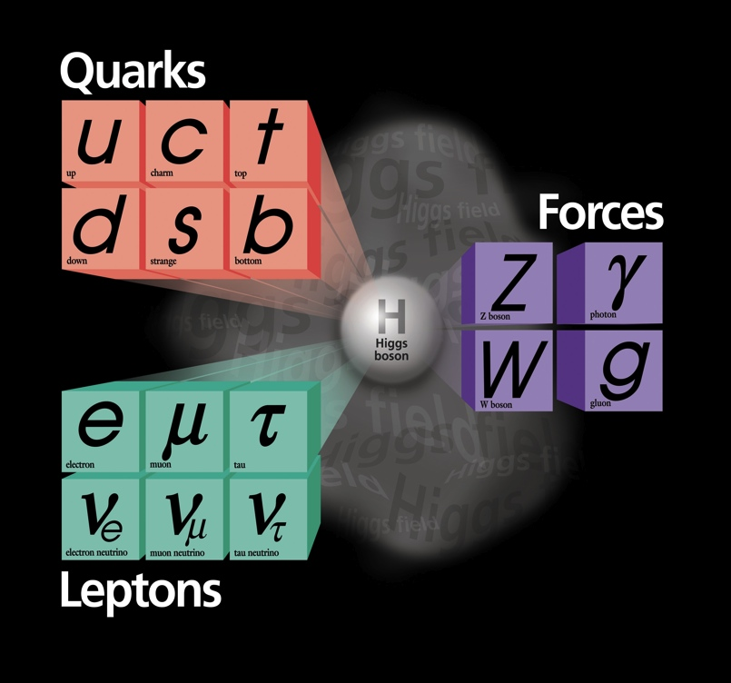
The “Standard Model”
Over the last ~100 years: The combination of Quantum Field Theory and discovery of many particles has led to
The Standard Model of Particle Physics
With a new “Periodic Table” of fundamental elements
One of the greatest achievements of 20th Century Science
Matter particles
Force particles

Slide 5
Quark masses

Slide 6
The Standard Model
These are all we “see” around us in everyday life but the others are crucial to defining what we are.
Higgs was missing, now found
Confirmed by 100’s of precision measurements

Slide 7
What is this Higgs particle?
While developing the modern theory of fundamental forces and interactions, physicists hit a snag
Particles that carry forces had to be massless but the data seemed to say otherwise!
And in fact, why do any particles have mass? What is mass?
Massless particles move at the speed of light
Speed of light: c = 300,000 km/second
E=mc² if a particle of mass m is at rest. So E²=(mc²)²
But if a particle has momentum p then E²=(mc²)²+(pc)²
So, for a massless particle (m=0) you get E=pc
This is the equation for a particle moving at the speed of light
An ingenious idea:
Suppose there is a force field filling the universe that somehow slows particles down to below the speed of light?
This would make them have mass !

Slide 8
Higgs Field Interaction
Massive Particle
Courtesy of Stefan Spanier (UT)

Slide 9
Is it a field or a particle?
All fields have small packets of energy associated with them that we call “quanta”
yes, it’s from quantum mechanics
Field quanta are particles that carry forces
Elementary particles interact by exchange of field quanta
This is not so hard to believe
But it gets weirder…
e⁻
e⁻
γ
Repulsion of 2 electrons by the exchange of a photon.
The photon is the quantum of the electromagnetic field
e⁻
e⁻

Slide 10
Quantum Field Theory
t
Energy and matter are equivalent
(E = mc²)
A particle-antiparticle pair can pop out of empty space (“the vacuum”)
And then vanish back into it
These are Virtual particles.
This has far-reaching consequences
The structure of the universe depends on particles that don’t exist in the usual sense (but did when the Universe was very young and hot)
This is the reason we do what we do
We are searching for the “genetic code” of our universe
We do not see these particles in everyday life
We must recreate the state of the early hot universe to make them
.
.
Vacuum Fluctuation
Involving top quarks
t

Slide 11
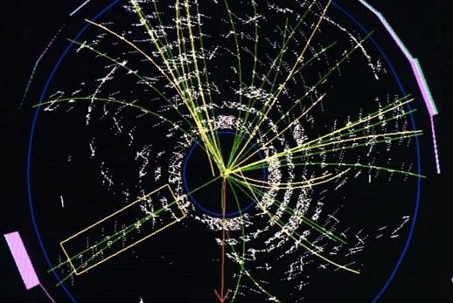
“Real” top quarks were seen for the first time in the 1990’s at Fermilab near Chicago

Slide 12
pp physics at the LHC corresponds
to conditions around here
HI physics at the LHC corresponds
to conditions around here

Slide 13
What makes us so sure about the Higgs?
The Higgs theory has predictable consequences
It predicts very heavy force particles that carry the weak nuclear force known as the W⁺, W⁻ and Zº
The W⁺, W⁻ should both have a mass of 80.4 GeV
Note that the proton has a mass of 1 GeV so these are very heavy fundamental particles!
The Zº should have a mass of 91.1 GeV
We should be able to find them & measure their masses
For instance, the Zº should decay to two muons. We can measure their momenta and reconstruct the Zº mass.
If we do this for many Zº particles, a distribution of the mass values we get should have a very predictable shape.

Slide 14
Zº → μ⁺μ⁻
We predict this distribution to show up when looking at many thousands of Zº → μ⁺μ⁻decay events
Peak at 91.1 GeV
This is what we see
Background events with two muons but not necessarily from simply Zº → μ⁺μ⁻

Slide 15
Fundamental connections
Fundamental particles have deep connections
The mass of the W particle depends a lot on the mass of the top quark and a little on the mass of the Higgs and many other particles
This is because the identity of a particle is not completely separable from what it can become (or decay into)
This “Feynmann diagram” shows a W particle transforming into a top and a bottom quark and back again to a W.
Here we see a W particle transforming itself into a W + Higgs and then back again to a W.

Slide 16
The LHC
Accelerator Complex

Slide 17
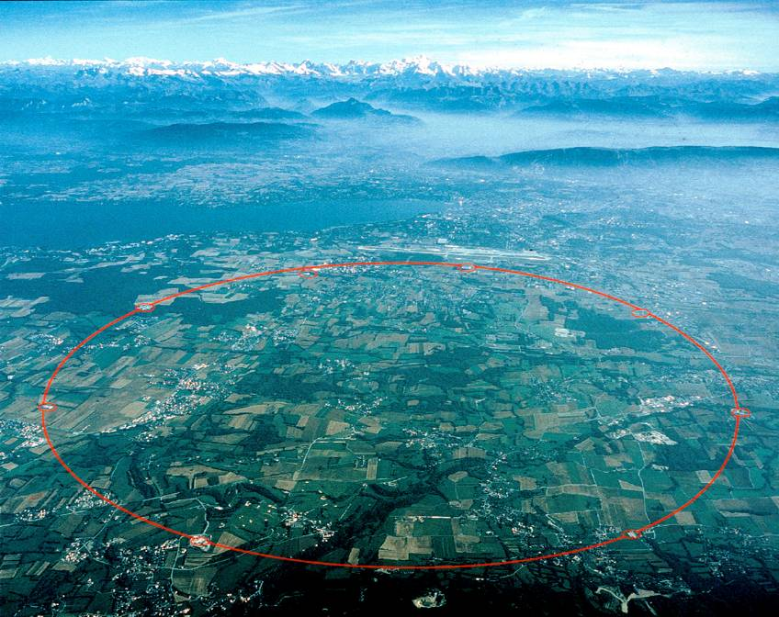
The Large Hadron Collider

Slide 18
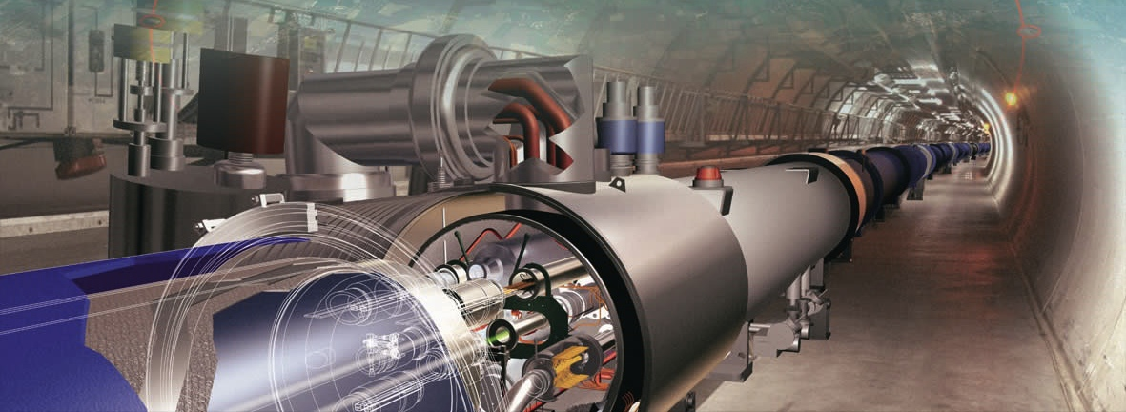
The Large Hadron Collider
LHC : 27 km long
~100m underground

Slide 19

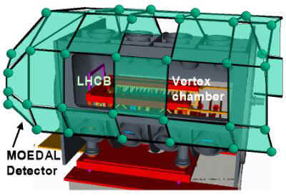
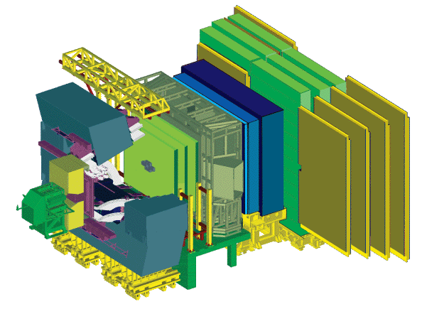
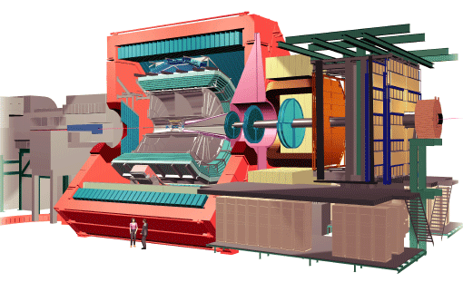

The Large Hadron Collider
LHCb/MOEDAL
pp, B-Physics, CP Violation
Dedicated B Physics
And Heavy Ions
ALICE
Heavy ions, pp

Slide 20
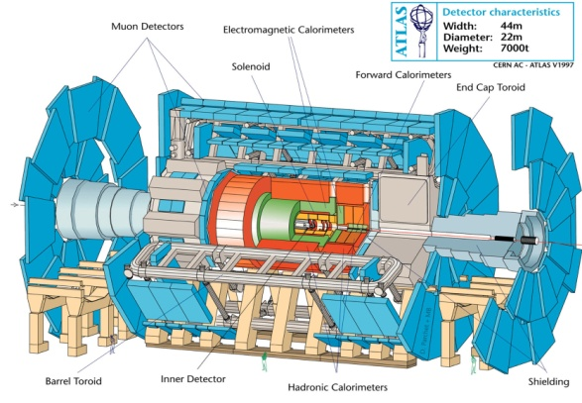
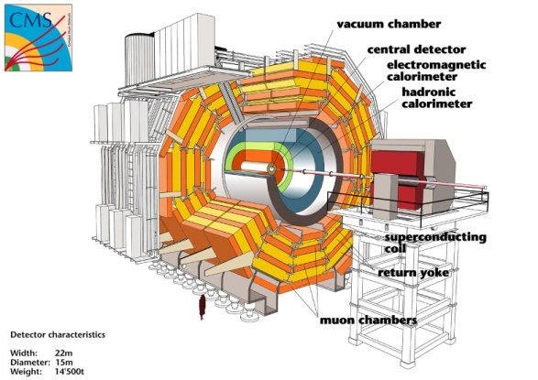
The Large Hadron Collider
SM in 2011
ATLAS
General Purpose, pp, heavy ions
General Purpose: pp, heavy ions
CMS

Slide 21
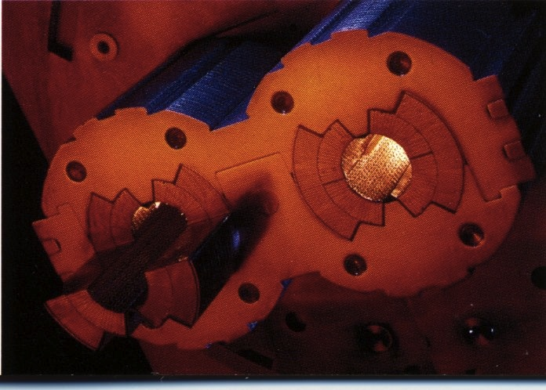
Some LHC facts
Tunnel
Diameter 3m, Length 27 km
2 billion pounds excavated
Beams
Made up of bunches
1.2-1.5x10¹¹ protons/bunch
1404 (2808) maximum bunches in machine for 50 (25) ns separation
50 ns separation = 15 m
At Interaction Point (IP)
Bunch length ~ 6 cm
Beam radius ~23 μm
Bunch collision rates
31.6 MHz (25 ns spacing)
15.8 MHz (50 ns spacing)
Superconducting dipoles
challenge: magnetic field of 8.33 Tesla in total 1232 magnets, each 15 m long operated at 1.9 K
That’s 523 degrees below room temperature
It’s colder than space
It’s emptier than space
Largest cryogenic system in the world

Slide 22
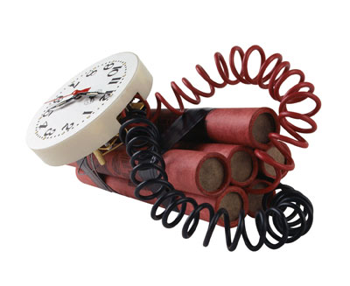
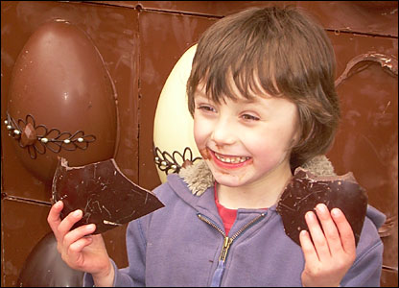

Like Swiss chocolate
Jörg Wenninger
LHC magnets at 14 TeV:
1 dipole magnet E_{stored} = 7 MJ
All magnet E_{stored} = 10.4 GJ
Compared to previous accelerators :
A factor 2 in magnetic field
A factor 7 in beam energy
A factor 200 in stored energy
Enough to melt 12 tons of Copper!
The kinetic energy of an A380 at 700 km/hour
90 kg of TNT
15 kg of chocolate
Energy stored in LHC beams
Kinetic energy of 1 proton bunch:
E₁ = (1.15 x 10¹¹ protons) x 7 TeV = 129 kJ
Kinetic energy of beam = 2808 bunches:
E_{beam} = k x E₁ = 2808 x E₁ = 362 MJ

Slide 23
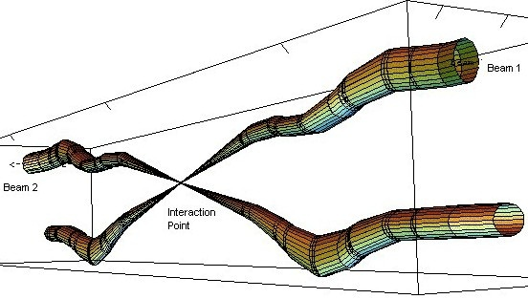
Squeeze & Collide

Slide 24
Hadron collider particulars
A few important facts

Slide 25
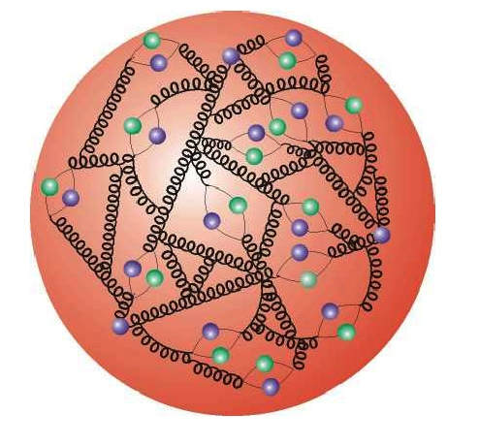
Collide partons (quarks & gluons): qg, qq’, gg
Protons have substructure
Parton distribution Functions (PDF)
Gluons and quarks (which we collectively call partons) carry fractions x of proton momentum: given by parton distribution functions (PDFs)
To produce a mass of
100 GeV: x ≅ 0.007 0.05
5 TeV: x ≅ 0.36 --
LHC Tevatron

Slide 26
The Compact Muon Solenoid
CMS

Slide 27
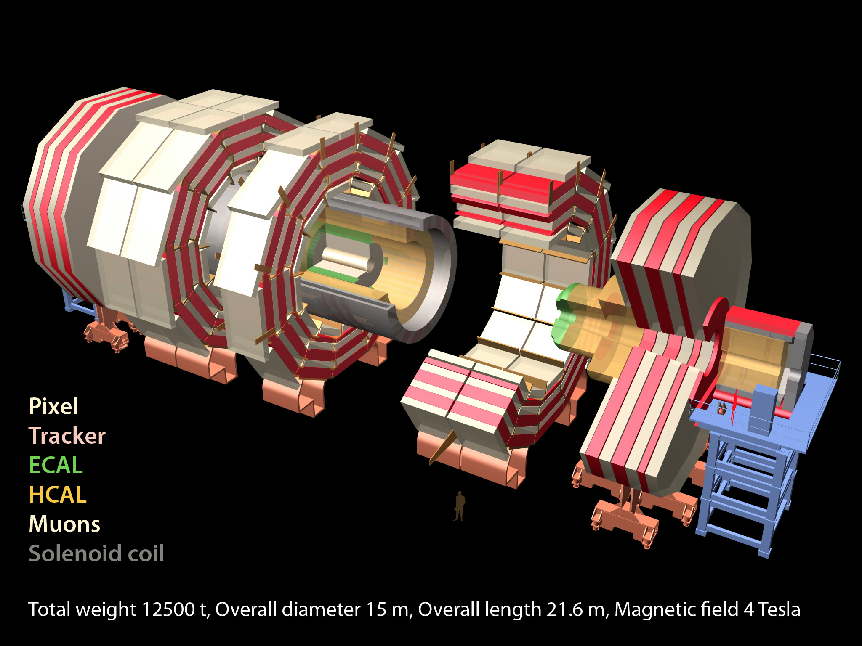
CMS
Total weight 14000 t
Overall diameter 15 m
Overall length 28.7 m
ECAL
76k scintillating
PbWO₄ crystals
MUON ENDCAPS
HCAL
Scintillator/brass
Interleaved ~7k ch
473 Cathode Strip Chambers (CSC)
432 Resistive Plate Chambers (RPC)
3.8T Solenoid
IRON YOKE
Preshower
Si Strips ~16 m²
~137k ch
YE1-3
YBO
Foward Cal
Steel + quartz Fibers ²~k ch
YB1-2
Pixels & Tracker
Pixels (100x150 μm²)
~ 1 m² ~66M ch
Si Strips (80-180 μm)
~200 m² ~9.6M ch
MUON BARREL
250 Drift Tubes (DT) and
480 Resistive Plate Chambers (RPC)

Slide 28
So how do we reconstruct what happened in the collision?

Slide 29
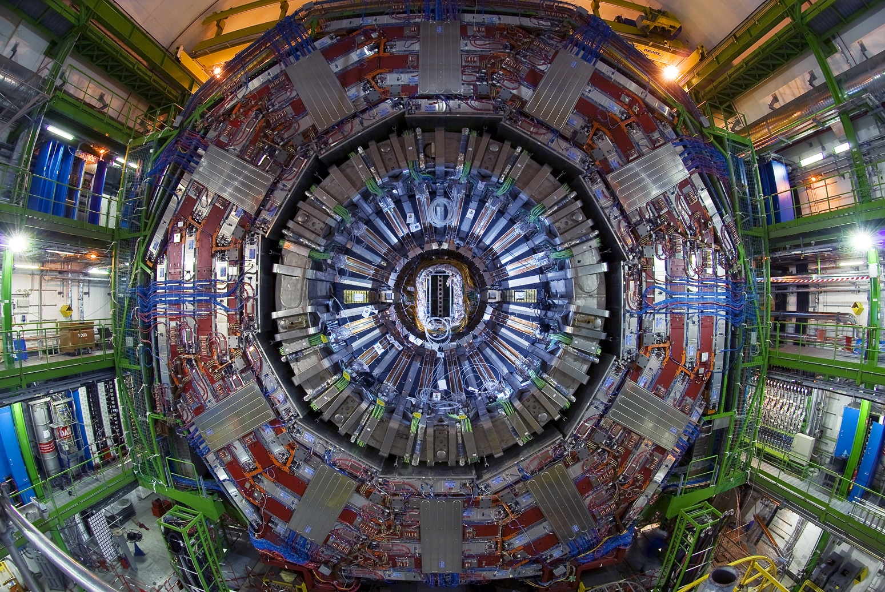
Compact Muon Solenoid (CMS)

Slide 30
Micro-Vertexing with Pixels
9” diameter
Light quark (u,d,s) jet
b,c,τ jet

Slide 31
A tour of CMS during construction

Slide 32
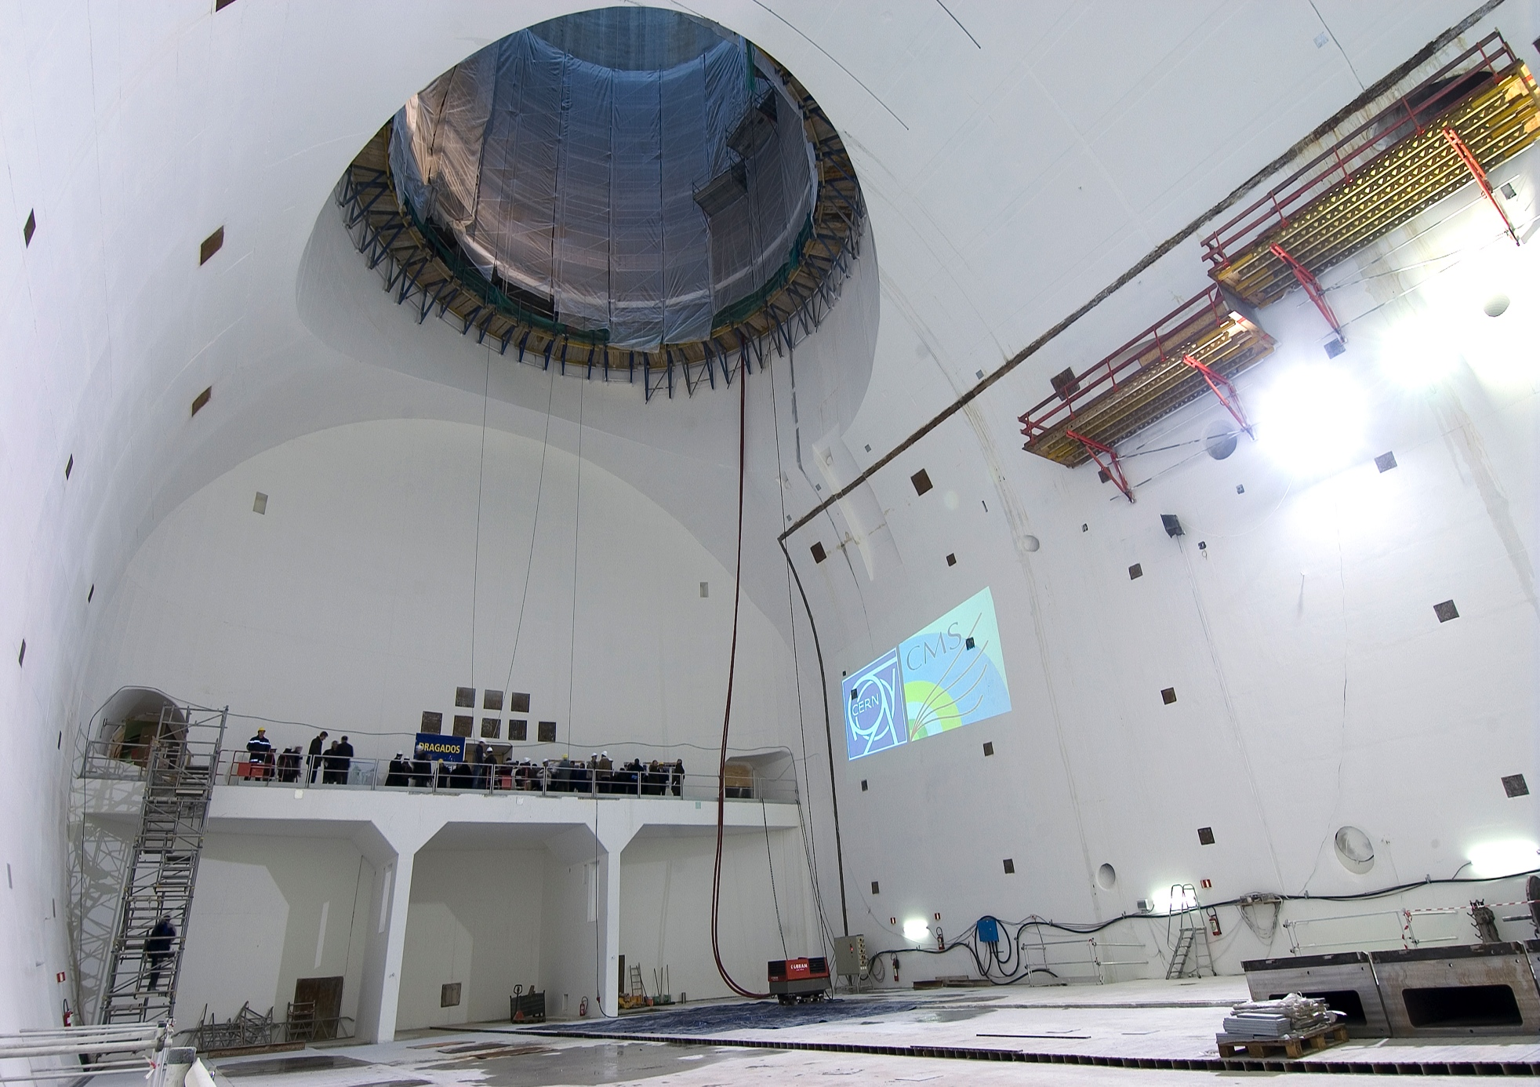
Underground Experiment Cavern
Late 2004

Slide 33
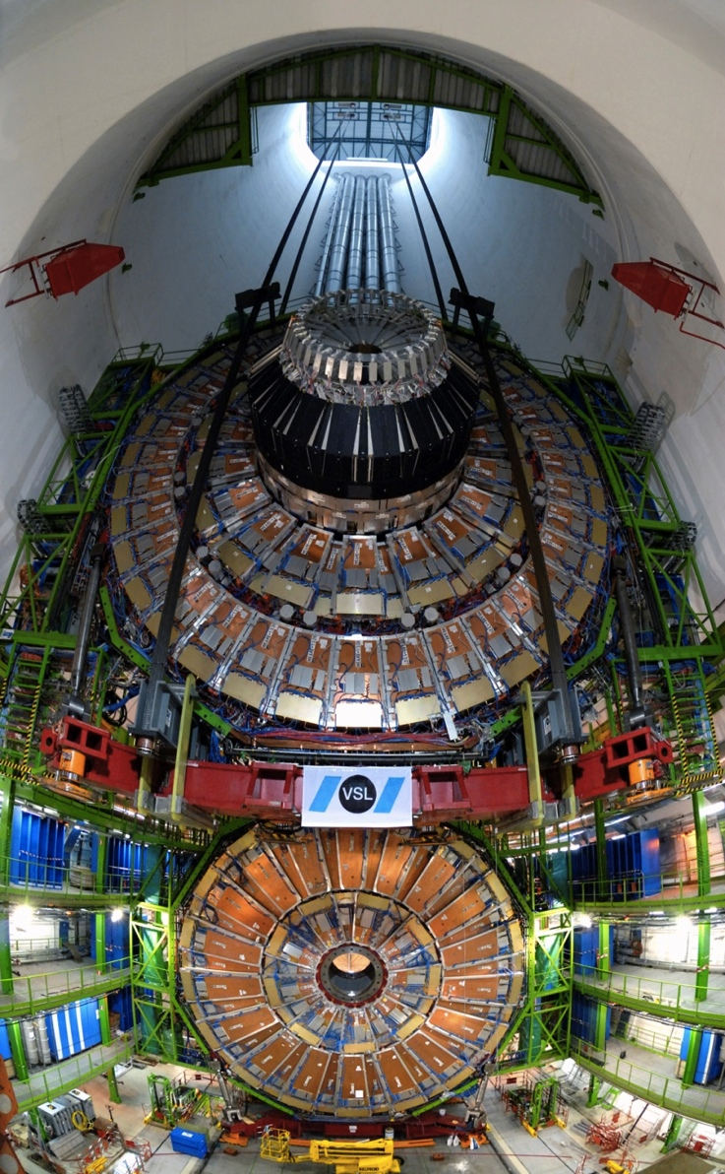
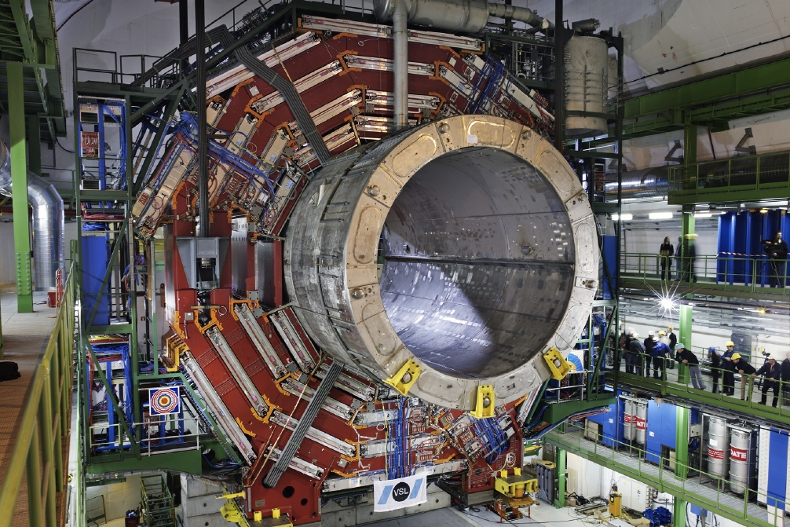
Lowering CMS sections ~30 stories
Lowering YE+1 (Jan’07)

Slide 34
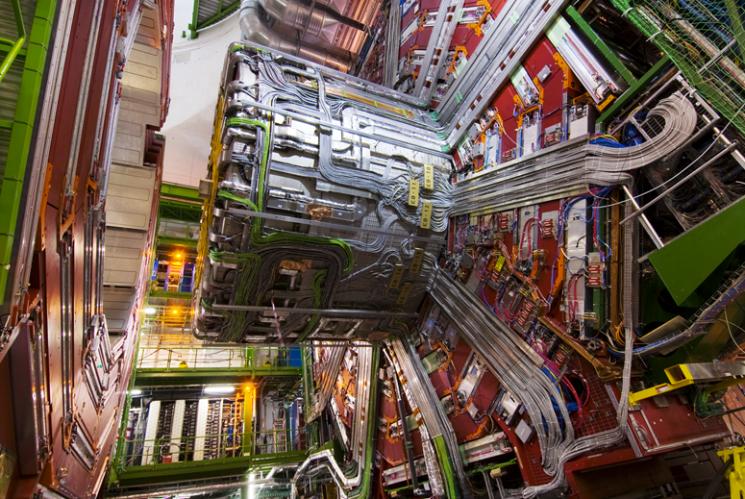
Cables, Pipes and Optical Fibres !
Nov 2007
50,000 man hours

Slide 35
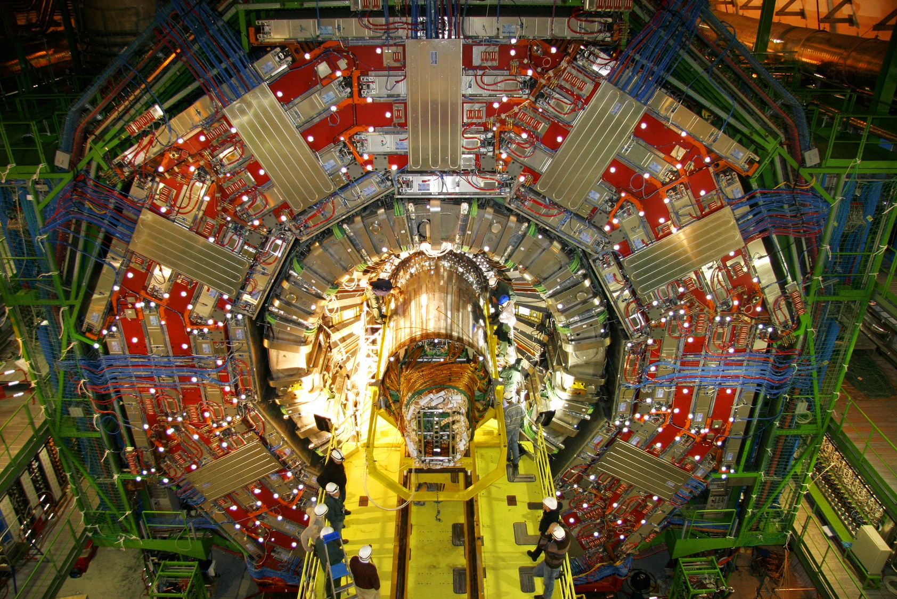
Insertion of Innermost Element
Tracking System 200 m² of Silicon strip detectors
Dec 2007

Slide 36
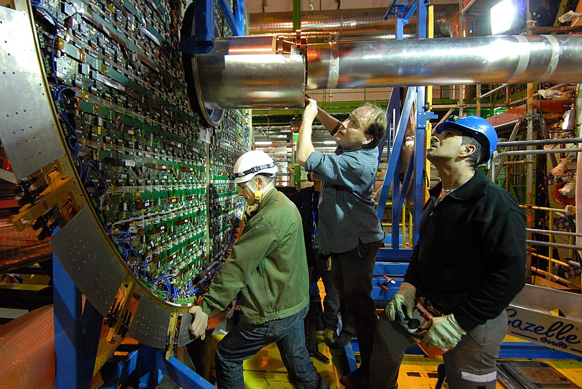
Endcap preShower (ES)

Slide 37
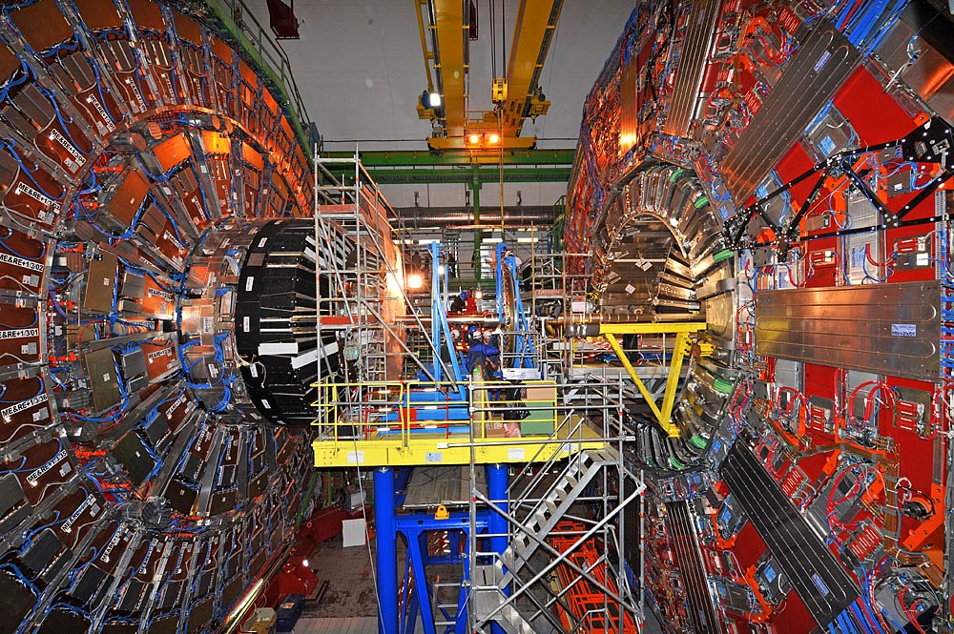
The setting

Slide 38
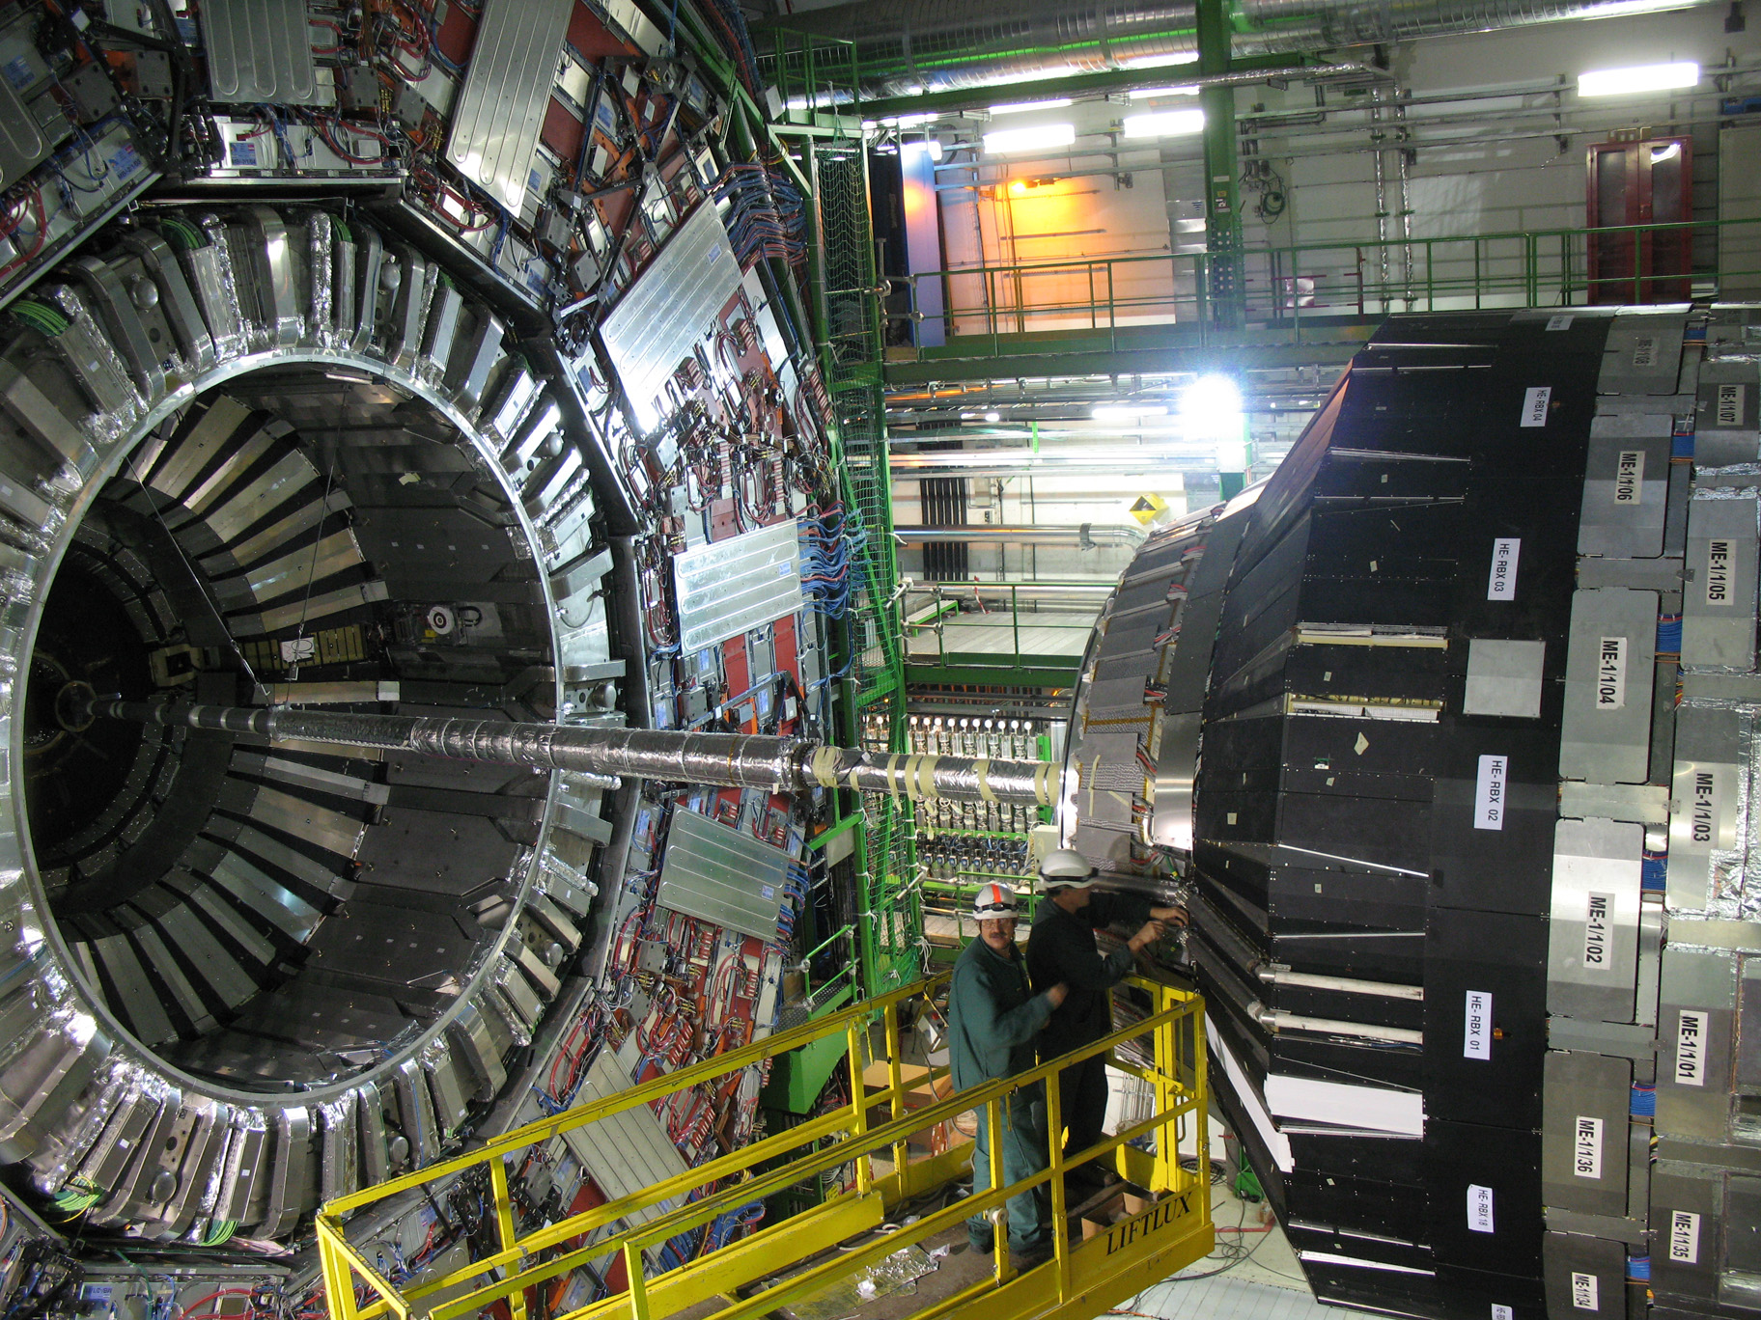
CMS Ready to Close

Slide 39
Quite a camera
CMS is like a camera with 80 Million pixels
But it’s obviously no ordinary camera
It can take up to 40 million pictures per second
The pictures are 3 dimensional
And at 31 million pounds, it’s not very portable
The problem is that we cannot store all the pictures we can take so we have to choose the good ones fast!

Slide 40
Experimental Challenges
Collisions are frequent
Beams cross ~ 16.5 million times per second at present
About 20-30 pairs of protons collide each crossing
Interesting collisions are rare -
less than 1 per 10 billion for some of the most interesting ones
We can record only about 400 events per second.
We must pick the good ones and decide fast!
Decision (‘trigger’) levels
A first analysis is done in a few millionths of a second and temporarily holds 100,000 pictures of the 16,500,000
A final analysis takes ~ 0.1 second and we use ~10000 computers
We still end up with lots of data

Slide 41
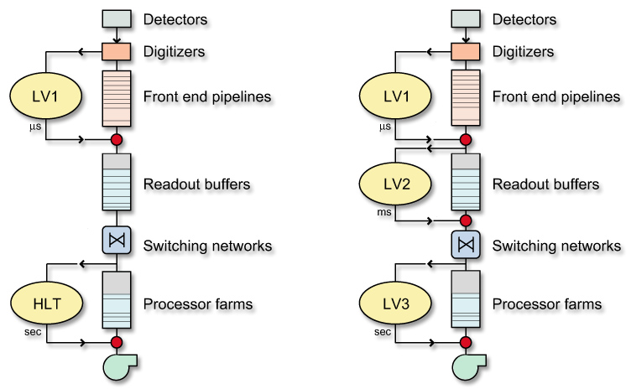
Trigger Architecture
Start from 40 MHz → Decision every 25 ns
Too small even to read raw data
Selection in multiple levels, each taking a decision using only part of the available data
The first level (L1) is only feasible with dedicated, synchronous (clock driven) hardware
40 MHz
100 kHz
CMS choice: All further selection in a single phisical step (HLT)
Build full events and analyze them “as in offline”
Invest in networking (rather than in dedicated L2 hardware)
100 GB/s!!
100 Hz

Slide 42
Level-1 Trigger
Custom programmable processors
To minimise latency
Synchronous decision every 25 ns
delayed by 3.2 μs = 128 BX (Max depth of pipeline memories)
Max output ≡ max DAQ input
Design: 100 kHz; at startup: 50 kHz
Only μ detectors and calorimeters
e/γ, μ, τ jets, jets, E_{T}^{miss}, ΣE_{T}
Selection by the “Global Trigger”
128 simultaneous, programmable algorithms, each allowing:
Thresholds on single and multiple objects of different type
Correlations, topological conditions
Prescaling

Slide 43
HLT
Run on farm of commercial CPUs: a single processor analyzes one event at a time and comes up with a decision
Has access to full granularity information
Freedom to implement sophisticated reconstruction algorithms, complex selection requirements, exclusive triggers…
Constraints:
CPU time (Cost of filter farm)
Reject events ASAP: set up internal “logical” selection steps
L2: muon+ calorimeter only
L3: use full information including tracking
Must be able to measure efficiency from data
Define HLT selection paths from the L1
Keep output rate limited (400 events/sec with 1MB/event)

Slide 44
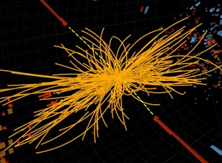
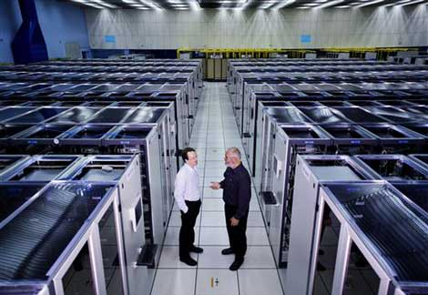
LHC produces 100 million GigaBytes of data per year (equivalent to > 5 million DVDs)
Collision event data

Slide 45
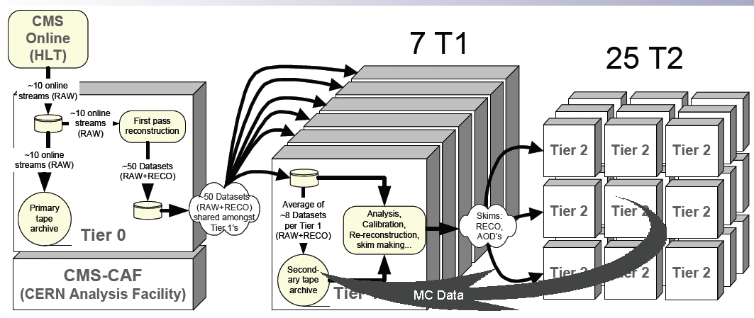
Tier data structure

Slide 46
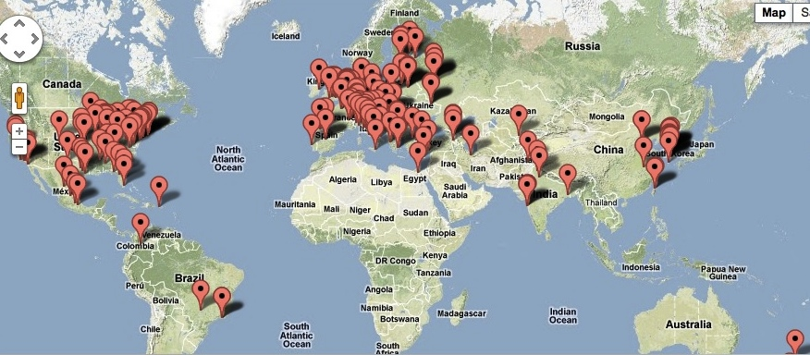
CERN

Slide 47
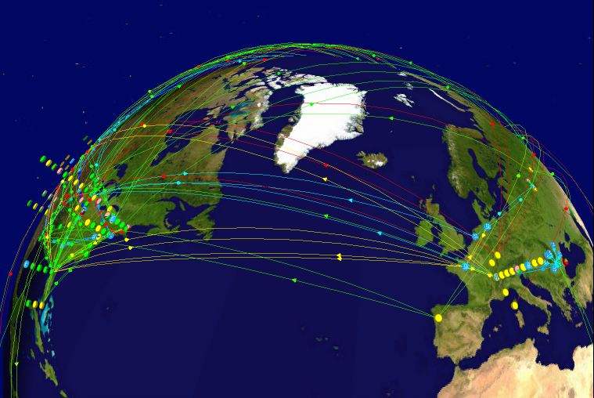
Data distribution
Grid connects >100,000 processors in 34 countries
~100 Petabytes in 2012

Slide 48
Higgs Searches at LHC

Slide 49
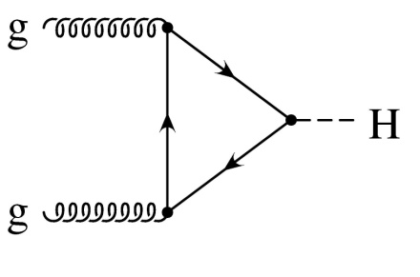
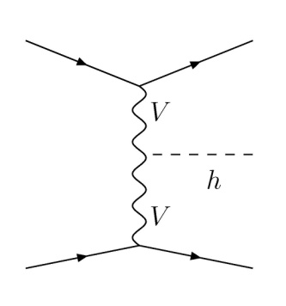
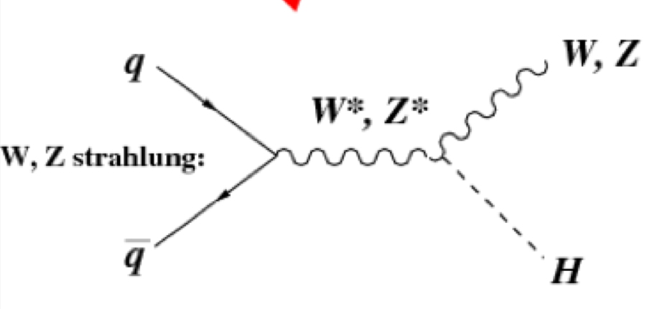
LHC SM Higgs production
t
√s = 14 TeV
H
t
t
Gluon fusion
H
Dawson, Jackson, Reina, Wackeroth
Vector Boson fusion
Two processes
Gluon fusion is dominant for the entire m_{H} range
Vector boson fusion is the next most important
Production rate goes down with higher mass
But backgrounds (“noise”) also go down so it gets easier in many cases
Associated production

Slide 50
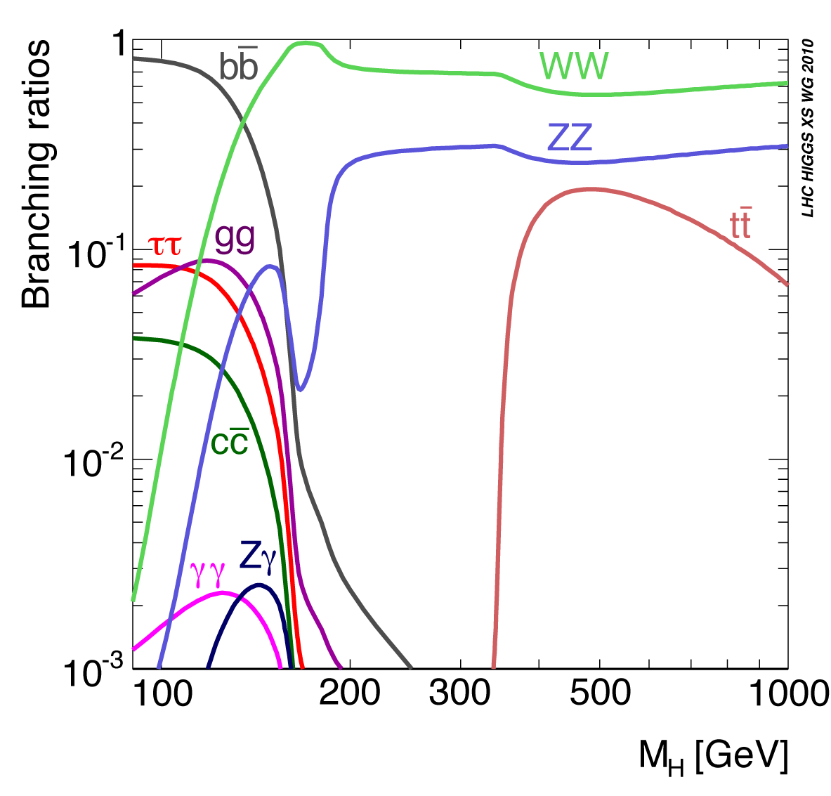
Standard Model Higgs Decays
The SM Higgs is unstable
Decays “instantly” in a number of ways with very well known probabilities (called Branching Fractions or Ratios that sum up to 1).
Branching ratios change with mass as seen here
Some decay modes are more easily seen than others
Firstly if they end with electrons, muons, or photons

Slide 51
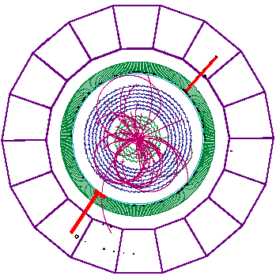
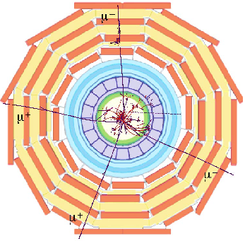
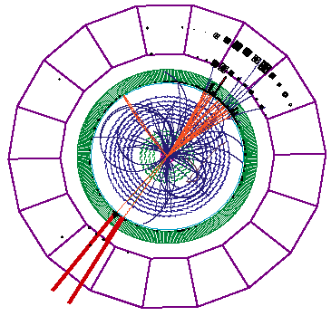
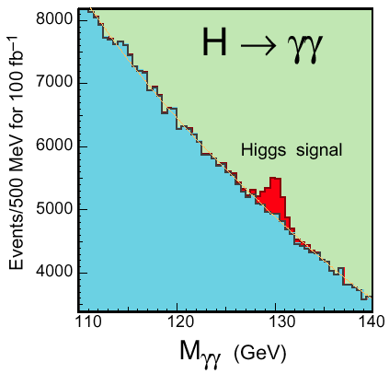
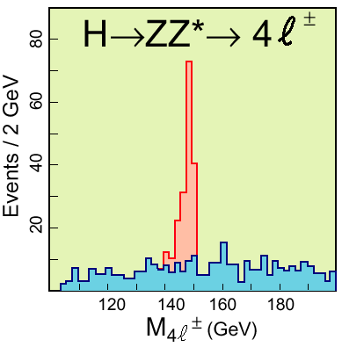
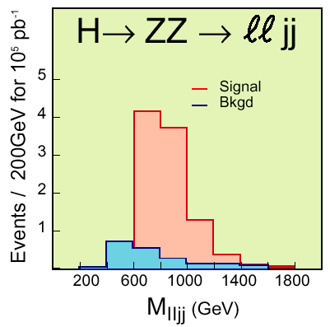
How would we see the Higgs Boson ?
Simulation
NB: These old plots correspond to ~50 times more sensitivity than we have now (20x more data, 2x the energy)!

Slide 52
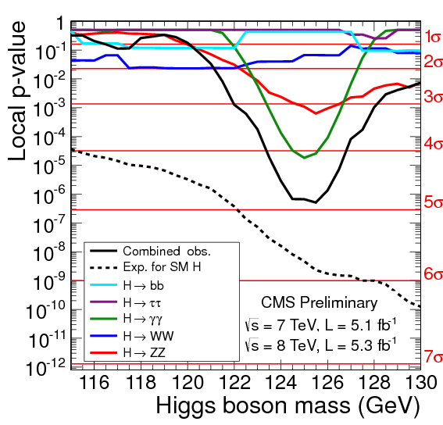
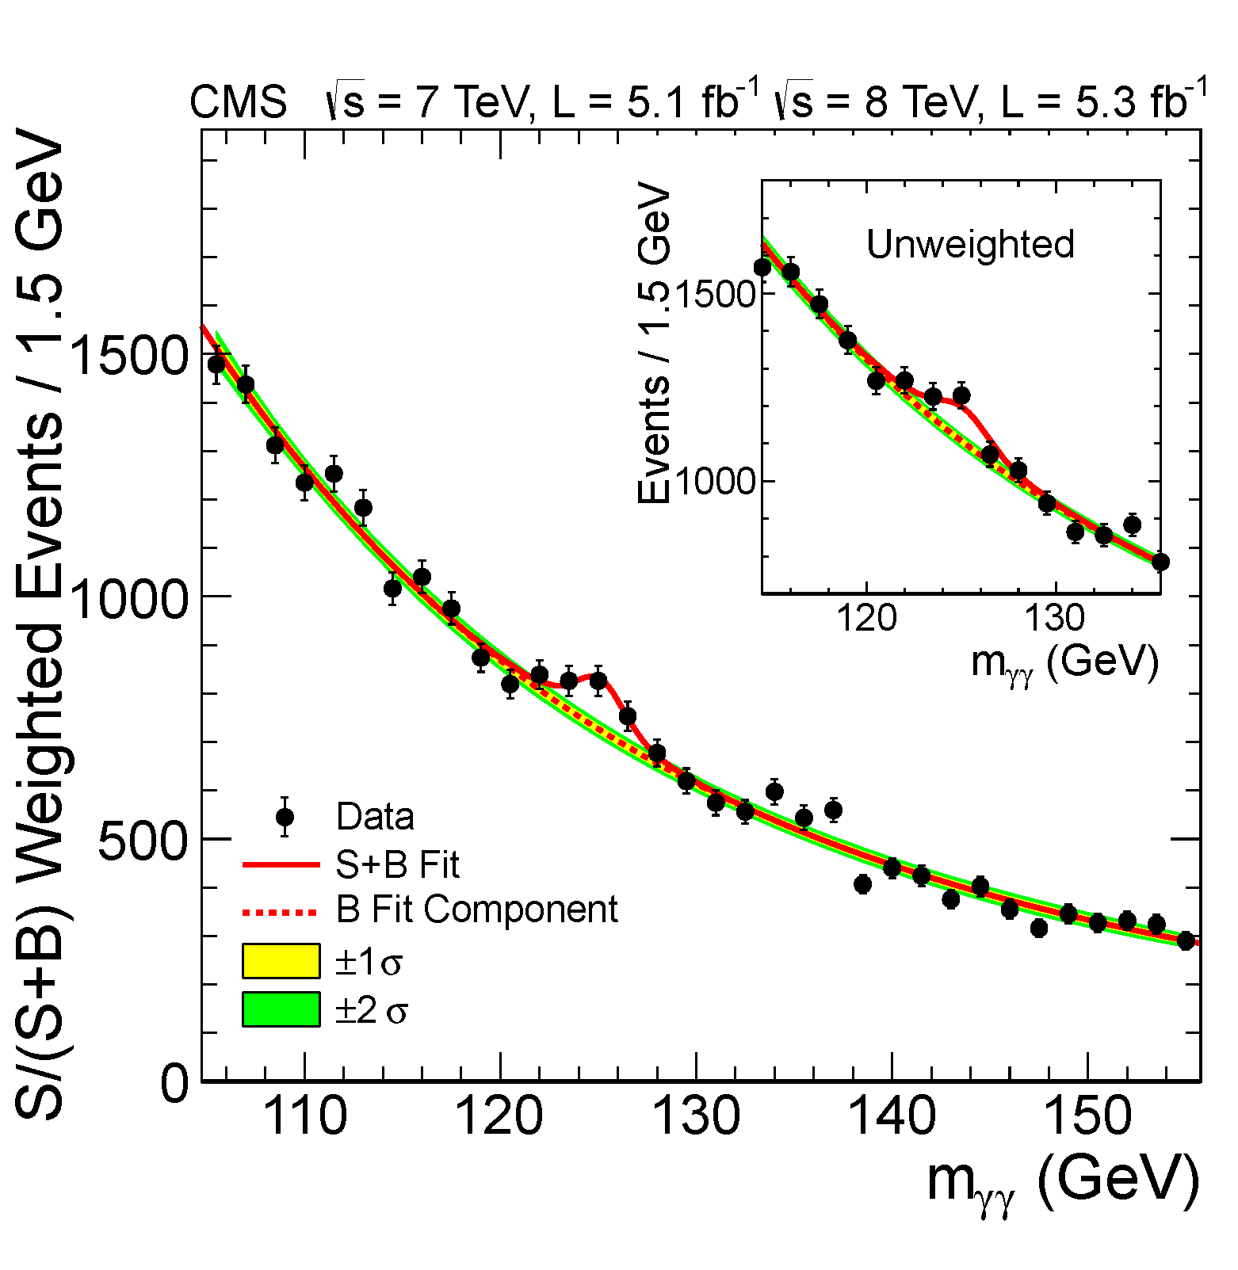
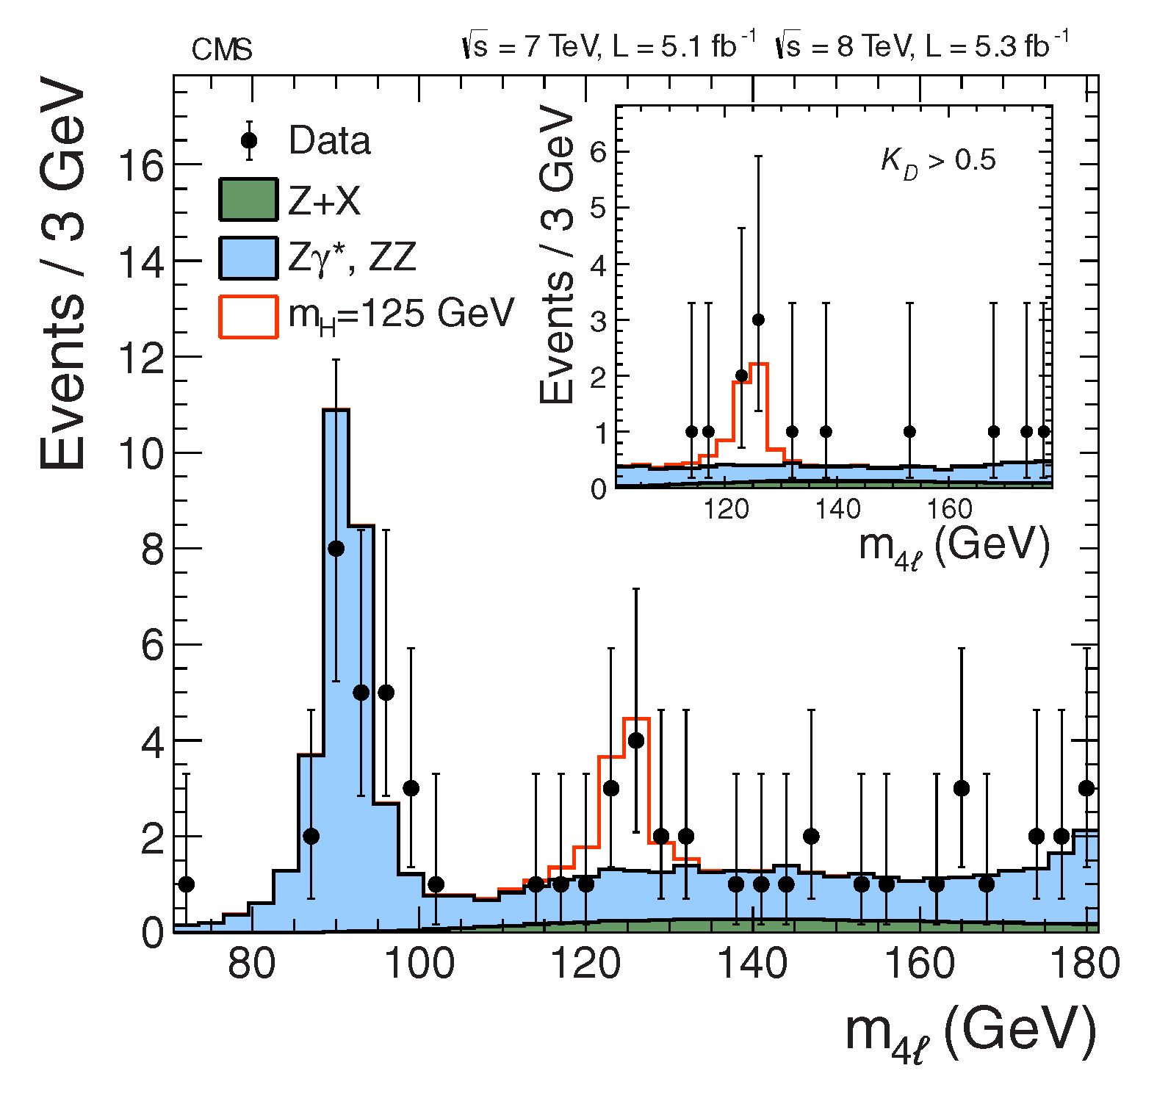
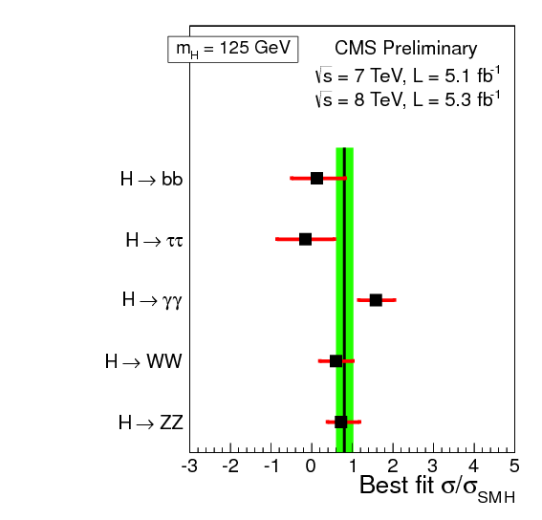
July4th 2012 Higgs-like boson at LHC
An excess of events above the expected SM background is observed at mass 125.3 ± 0.4 (stat) ± 0.5 (syst) GeV.
The evidence is strongest in the two final states with the best mass resolution:
H→γγ
H→ ZZ → 4l
Combined with a local significance of 5.1σ

Slide 53
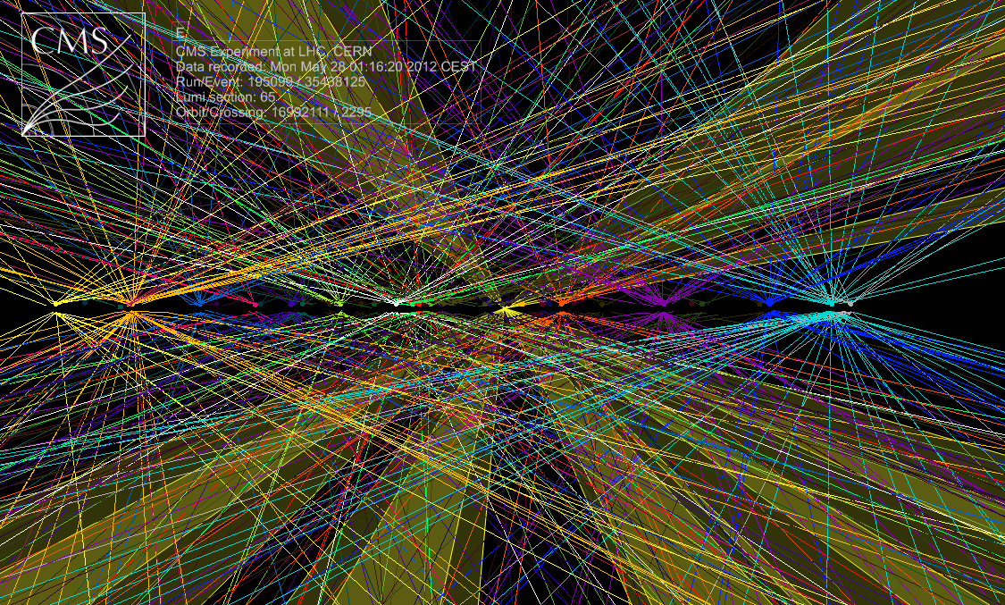
Raw ΣE_{T}~2 TeV
14 jets with E_{T}>40
Estimated PU~50

Slide 54
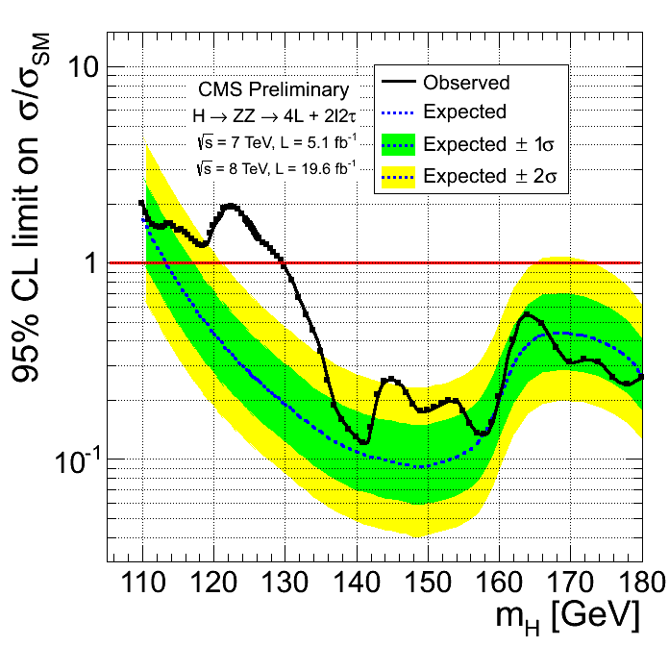
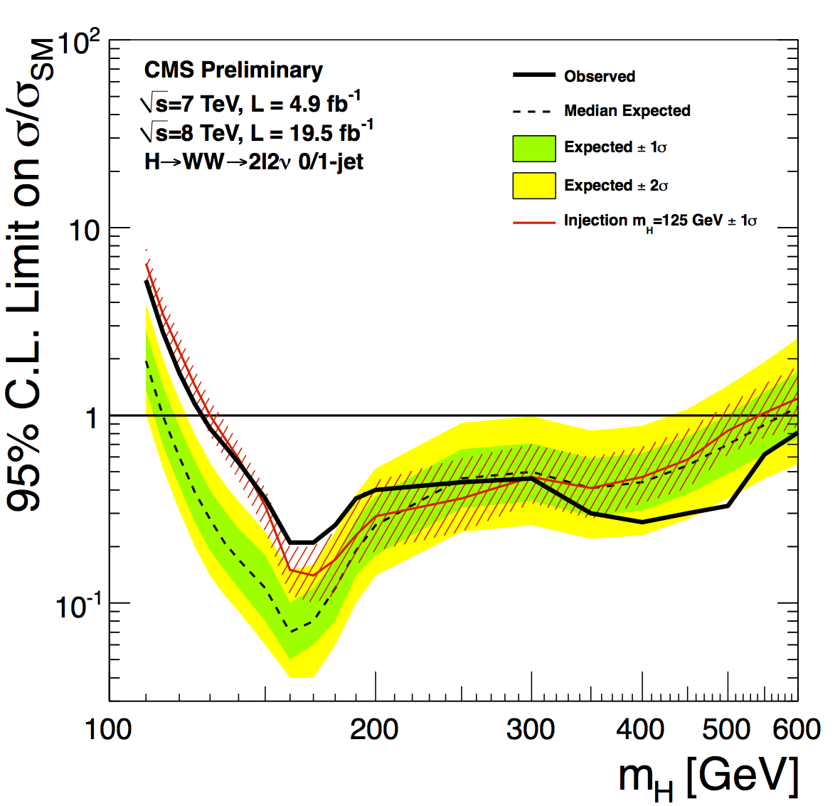
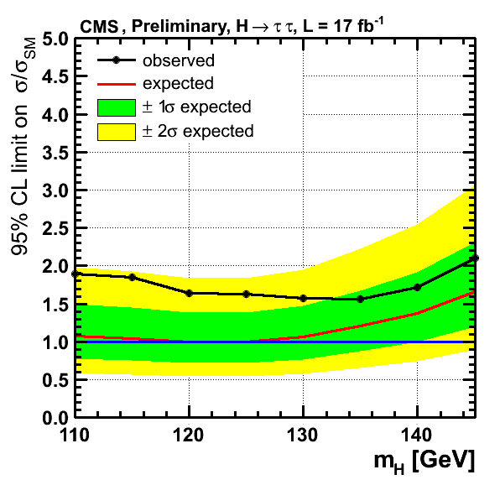
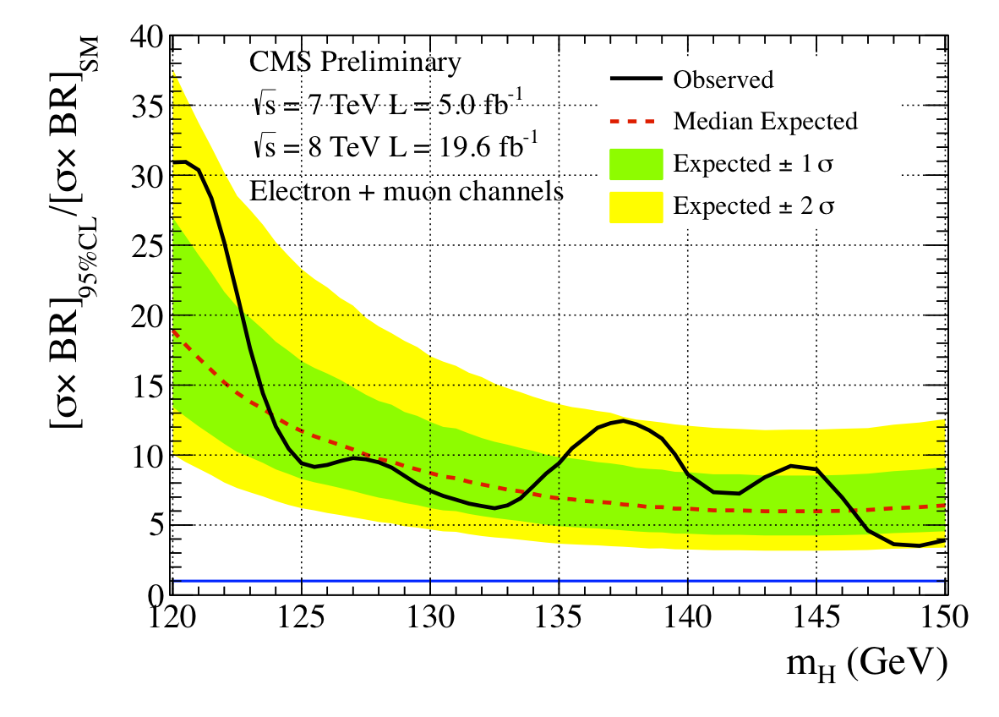
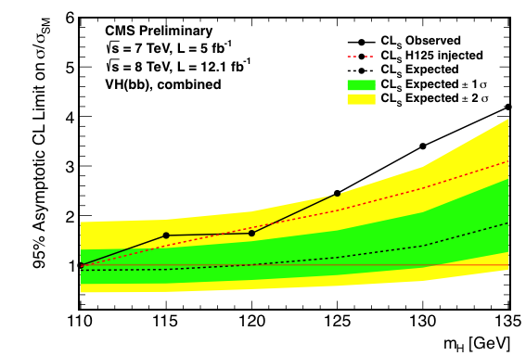
2012/13 was a busy year for Higgs
γγ Moriond 13
ZZ Moriond 13
WW Moriond 13
This talk !
6.7σ
ττ HCP 12
bb HCP 12
Zγ Moriond 13

Slide 55
H ➔γγ

Slide 56

CMS γγ event

Slide 57
Hgγγ history (I)
7 TeV, 2011, 5.3 fb⁻¹
Re-RECO
2.8σ
March 2012

Slide 58
Hgγγ history (II)
7 TeV, 2011, 5.3 fb⁻¹
8 TeV, 2012, 5.1 fb⁻¹
Re-RECO
Run A+B Prompt RECO
4.2σ
July 2012

Slide 59

Hgγγ history (III)
7 TeV, 2011, 5.3 fb⁻¹
8 TeV, 2012, 19.6 fb⁻¹
Re-RECO
Run A+B Re-RECO
Run C Prompt Reco
Run D
Prompt Reco
Today: Preliminary results, Moriond 13
Results with MVA and Cut-in-Categories analysis on 7+8 TeV data. All MC samples re-weighted to the observed pileup distribution in the full 2012 dataset. <NPU>=19.9
Note: MVA algorithm used not retrained for Run D. Dark current noise in data from irradiated APD’s not simulated in MC.
Final results on full 7+8 TeV will be provided later this year w/ final calibrations for Run C+D.

Slide 60
Hgγγ search
Idea: reconstruct di-photon mass and search for a resonance on the smooth background
Need to measure energy of the two photons and their opening angle
Sounds simple. What is the big deal ?!

Slide 61



The challenge
Huge “irreducible” background from QCD di-photon production, plus “reducible” instrumental backgrounds.
Inclusive inv. mass distribution for selected data and MC
Irreducible
Reducible
Natural thing to do is separate events in categories according to resolution to optimize the sensitivity.

Slide 62


Photon shower shape, R9
For some photons, ECAL does a fairly good job at identifying EM clusters on it’s own – and does this local to the supercluster
These photons are self-selecting + a loose H/E
R9 = e3x3/e(supercluster)

Slide 63



Tracker Material
Reasonably well described by simulation
Degrades energy resolution

Slide 64


What Material Does to Photons
Generate back-to-back electrons (photons) and scan event displays
Black: hits in tracker
Green: ECAL outline
Red: E_{T} of ECAL cells

Slide 65

What Material Does to Photons
Generate back-to-back photons and scan event displays
Black: hits in tracker
Green: ECAL outline
Red: E_{T} of ECAL cells

Slide 66


What Material Does to Photons
Generate back-to-back photons and scan event displays
Black: hits in tracker
Green: ECAL outline
Red: E_{T} of ECAL cells
Several bad effects at once:
hard to identify (showers not narrow in azimuth)
energy resolution has tails due to not clustered energy
some energy never reaches ECAL (B = 4 Tesla!)

Slide 67

Photon recovery
Some of the shower can be recovered by making clusters wide in azimuth, but with a cost of picking up energy from UE
→ Q: How to tell which photons have showered and need “recovery”?
→ Q: How to make optimal correction given the detector region and all reconstructed pieces of the photon?
Super-Cluster window

Slide 68
Hgγγ search
Correct energy (MVA)
1.1) Estimate per photon energy resolution (MVA)
2) Identify vertex (MVA)
2.1) Estimate probability that the correct vertex was identified (MVA)
CiC analysis uses 1) and 2) and categorizes events in topology (η-R9).
MVA analysis uses 1) and 2) and
1.1 + 2.1 + event kinematics are used to build event MVA for categorization.

Slide 69

Photon energy corrections
ECAL cluster energies corrected using an MC trained multivariate regression.
Very non-trivial correlations between measured photon properties and the corrections that one needs to apply
Inputs
Impact point in the calorimeter
Whether the photon converted
Radius of conversion
The amount of material that electrons from conversion have to traverse before impacting calorimeter
Energy scale corrections and additional smearings are derived on top of these corrections to resolve the remaining discrepancies between data and MC (next slide)
Analytic fit to the Z invariant mass peak performed using a convolution of a Breit-Wigner with a Crystal Ball
Estimate energy resolution per photon
Train BDT to regress to|(E_{reco}-E_{true)}/E_{true}|
Multi-D minimization
problem

Slide 70



Energy scale (data) and smearings (MC)
Use fit to Z invariant mass peak to:
Determine scale factor to apply to data in order to match the position of the Z peak in MC
Determine amount of additional Gaussian smearing to apply to the MC in order to match the width of the Z peak in data
Both EB |eta|<1
highR9
One EB |eta|>1 lowR9
One EE |eta|<2 highR9

Slide 71

Vertex Identification
Designed MVA to help identify the right vertex, discriminating hard interaction from pileup vertices.
MVA evaluated per-vertex for a given photon pair:
unconverted photons:
Intensity of the vertes Σp_{T}²,
tracks follow direction of Higgs recoil (p_{T} balance)
Track sum should be similar to Higgs recoil (p_{T} asymmetry),
conversions
pull from conversions
Control samples:
Z→ (for unconverted)
+jet (for converted photons)
p_{T}(γγ) is the main discriminant
But can we do better?
Probability to get right vertex
Integrated efficiency 79%

Slide 72


Per-Event Vertex Probability
The probability that the correct vertex has been identified by the vertex ID MVA is evaluated using a further MVA.
Inputs: vertex ID MVA output for first 3 vertices, Nvtx, p_{T}(γγ), dZ between vtx0 and vtx1, vtx2, no. of photons with conversion tracks
Empirically derived linear
relation used to translate
MVA output to probability
of correct vertex

Slide 73
MVA Analysis

Slide 74


Photon Identification MVA
Trained using γ+jet MC to distinguish between prompt and non-prompt photons. Validation with Z→ee and Z→μμγ.
Loose cut applied to the output at -0.2 as part of MVA analysis pre-selection
>99% efficiency for signal
Efficiency scale factors from Z→ee tag and probe
Output used as input to diphoton MVA in MVA analysis
Barrel
Endcaps

Slide 75
MVA analysis: Di-photon Selection
Require two reconstructed photons satisfying:
Photon ID MVA > -0.2
η within the ECAL fiducial region
p_{T}/m_{γγ}>1/3 (lead) and 1/4 (sublead)
If more than one pair passes the selection, the pair with highest Σp_{T} is used.

Slide 76
Diphoton MVA
Encode all relevant information on signal vs background discrimination (aside from m_{γγ} itself) into a single variable
Use input variables which are to 1st order independent of m_{γγ}:
Kinematics: p_{T/}m_{γγ} and η of each photon, and cosΔφ between the 2 photons
Photon ID MVA output for each photon
per-event mass resolution (σ_{M}/M_{γγ})
Constructed from per-photon energy resolutions (from regression), adding beamspot width contribution for wrong vtx hypothesis
Per-event vertex probability
MVA output is used to define
event selection (MVA output>-0.05)
event classification – 4 categories

Slide 77


Diphoton MVA output
Signal MC
Background MC and data
CUT
Blue hashed region:
ID MVA systematic uncertainty
Event selection
Event classification

Slide 78


Diphoton MVA
Low pT <40 GeV
High pT > 40 GeV

Slide 79




Final Classification
Demonstration of what final classifier is sensitive to:
plot mass resolution for each classifier bin. Signal model is sum of Gaussians.

Slide 80

MVA Validation
Validation of the MVA inputs (photonID, energy resolution) done on Z→ee and Z→μμγ
Output of the MVA validated using Z→ee

Slide 81

Di-photon MVA validation
Z→ee lineshape in MVA untagged categories
Untag cat0
Untag cat1
Untag cat2
Untag cat3

Slide 82



MVA: Exclusive Categories
In addition to the four “untagged” event categories defined by the diphoton MVA, five exclusive event categories are defined to enrich the sample in VBF and VH production modes.
Differences w.r.t. cut based analysis highlighted
The categorization proceeds in the following order:
dijet MVA>0.985
1/4m_{γγ}
0.93<dijet MVA<0.985
1/4m_{γγ}

Slide 83

Dijet tag (MVA)
For MVA analysis, two categories defined from the output of a dijet MVA
Pre-selection:
M_{jj} > 250GeV, p_{T}^{j1} > 30GeV, p_{T}^{j2} > 20GeV
BDT classifier to divide into two categories
Input variables include kinematic variables related to the two photons, the two jets and the photon-jet 4-body system
Category boundaries optimized to maximize exclusion power
Validation using Z→ee
 | BDT Boundary | S/B
Tight | 0.985 | 0.50
Loose | 0.930 | 0.16

Slide 84
Lepton and MET tags
Selection same as in published fermiophobic analysis paper:
CMS Collaboration, JHEP 1209 (2012) 11
Diphoton selection same as untagged selection, except
p_{T}(lead γ)/Mγγ > 45/120, p_{T}(sublead γ) > 25GeV, ΔR(lepton,γ) > 1.0
For MET tag use EB photons only
Lepton tag to suppress backgrounds
EWK (W/Z +γ like)
For MET tag, apply topological cuts to enhance S/B and reduce gluon-gluon fusion contamination:
Δφ(γγ,MET) < 2.1, Δφ(jet,MET) < 2.7, p_{T}^{jet}>50GeV

Slide 85

MVA analysis: signal yields
Signal model is sum of Gaussians fitted to MC

Slide 86




MVA analysis: Background model fits (untagged cats)
cat 0
cat 1
cat 2
cat 3

Slide 87




MVA analysis: Background model fits (exclusive cats)
Dijet tight
Dijet loose
Muon tag
Electron tag
MET tag

Slide 88

Statistical Analysis
Having signal and background PDF’s, construct Likelihood ratio:
which can be re-written

Slide 89
Statistical Analysis
Having signal and background PDF’s, construct Likelihood ratio:
which can be re-written
The higher term, the more sensitive the analysis

Slide 90

Statistical Analysis (Confidence Levels)

Slide 91


Results (8TeV)
p-value significance
at 125.0 GeV: 2.07σ

Slide 92


Results (7+8 TeV)
7TeV MVA + 8TeV MVA
p-value significance
at 125 GeV: 3.22σ

Slide 93


Signal Strength (7+8TeV)
7TeV MVA + 8TeV MVA
μ=0.55^{+0.29}_{-0.27}
Best fit μ at 125.0 GeV: 0.78^{+0.28}_{-0.26}

Slide 94


couplings & mass (7+8TeV)
Mass is measured profiling R_{V}, R_{F} and all other nuisances:
M_{H} = 125.4 ± 0.5(stat.) ± 0.6(syst.) GeV
The systematic uncertainty is dominated by the overall photon energy scale uncertainty (0.47%)

Slide 95

weighted mass plot (8TeV)

Slide 96


weighted mass plot (7+8TeV)
7TeV MVA + 8TeV MVA

Slide 97


H→γγ published results (discovery paper)
What CMS showed in July 2012
Maximum significance 4.1σ at 125.0 GeV
Best fit μ at 125.0 GeV: 1.56 ± 0.43

Slide 98
Compatibility among two analyses (MVA vs CiC)
We estimate the correlation between the two analyses using the resampling jackknife technique (Quenouille M (1949), Tukey JW (1958)
The correlation coefficient between the two measurements is found to be r=0.76
Signal strength compatibility only in 2012AB (published) :
New MVA vs published MVA: 1.6σ
Cut-based vs old cut-based (published cross-check): 0.5σ
A large number of tests have been performed. No source of systematic error was found. Differences appear to be of a statistical nature.
 | Signal strength compatibility (including correlation)
MVA vs CiC in full dataset | 1.5 σ
MVA vs CiC only in 2012 dataset | 1.8 σ

Slide 99
Summary and Conclusions
We analyzed the full 2011+2012 datasets
The two analyses measure σ/σ_{SM} of
MVA: 0.8 ± 0.3
CiC: 1.1 ± 0.3
The difference between cut-based and MVA has triggered numerous cross checks but no hints of problems have been identified
The measured mass is: 125.4 ± 0.5(stat.) ± 0.6(syst.) GeV
Higgs production cross-sections times the γγ BR are found consistent with the SM per production process.
Final results on the complete 7 and 8 TeV data will be obtained on re-reco data and are expected in the summer.

Slide 100
Thank you.

Slide 101
Backup

Slide 102


H→ ZZ → 4l
3D analysis - m_{4l}, KD, p_{T}/m_{4l} (VD)
Best fit μ at 125.8 GeV: 0.91^{+0.30}_{-0.24}

Slide 103


H→ ZZ → 4l
M_{H} = 125.8 ± 0.5(stat.) ± 0.2 (syst.) GeV

Slide 104


Vertex from converted photons: gam+jet
Vertex pointing from converted photons is validated with γ+jet

Slide 105


PhotonID MVA
PhotonID MVA is checked with Z→ee and Z→μμγ
Barrel
Endcap

Slide 106

Energy scale vs time
Stability at 0.3% level before application of analysis level corrections with prompt reconstructed data

Slide 107

Pileup Robustness - Energy Scale/Resolution
Data-MC agreement in Z→ee validation maintained across nvtx bins:
nvtx<=13
14<=nvtx<=18
nvtx>=19

Slide 108

Pileup Robustness: Cut-based ID Efficiency
Cut-based Photon ID efficiency decreases with respect to pileup, well described by MC

Slide 109



Jacknife resampling
Can be used to estimate the variance of stat. estimators in a non parametric way.
Achieved evaluating the estimator on subsets of the stat. sample.
Cov. matrix given analyses A and B
Sample selected by analysis A
Sample selected by analysis B
Sample selected by analysis A or B
Estimate the variance of μ_{A}, μ_{B}, and μ_{A}-μ_{B} applying the jackknife resampling to the events selected. For the latter use events selected by either analysis.

Slide 110
The LHC injector complex
Beam 2
LHC
5
Beam 1
4
6
3
7
SPS
TI8
8
2
TI2
1
Energy gain per machine is x10 to x20 because
this is the typical useful range scale of magnets
protons
Booster
LINACS
CPS
Ions
Peak energy [GeV] length/Circumference [m]
Linac 0.12 30
PSB 1.4 157
CPS 26 628 = 4 PSB
SPS 450 6’911 = 11 x PS
LHC 7000 26’657 = 27/7 x SPS
LEIR
Limit stored energy ⇒ 8 power sectors.
~1 GJ/sector
Sector = 2.9 km, 154 dipoles + 50 quads
Notes:
The CERN Proton Injectors:
Linac 2 (1979)
Proton Synchrotron Booster (4 superposed rings !) - PSB (1972)
Proton Synchrotron – PS (1959)
Super Proton Synchrotron – SPS (1976)
The PSB-PS-SPS Complex had to be upgraded in order to provide the beams with the appropriate intensity, pattern (25 ns spacing) and size for the LHC !
Two 3 km long new transfer lines had to be build to transfer the 450 GeV SPS beam to the LHC.
The last item to be commissioned in this chain is the transfer line for the injection into ring 1 (injected in IR2/ALICE). The commissioning will happen in September 2007.
The injectors have a delicate task, because protons ‘remember’ everything you do to them – in particular the harmful things that increase the beam size !
To limit the stored energy within one electrical circuit, the LHC is powered by sectors.
The main dipole circuits are split into 8 sectors to bring down the stored energy to ~1 GJ/sector.
Each main sector (~2.9 km) includes 154 dipole magnets (powered by a single power converter) and ~50 quadrupoles.
→ This also facilitates the commissioning that can be done sector by sector !

Slide 111


Energy scale and resolution vs run rumber
Scale
Resolution
EB
EB
EE
EE

Slide 112

Validation of energy scale and smearing
Validation using electrons reconstructed as photons in Z→ee events
Apply H→γγ analysis pre-selection with electron veto inverted
Both EB
Both high R9
Both EB
At least 1 low R9
At least 1 EE
Both high R9
At least 1 EE
At least 1 low R9

Slide 113



Photon ID MVA: Validation with Z→ee and Z→μμγ
Apply photon ID MVA to electrons reconstructed as photons in Z→ee events (invert electron veto)
Some discrepancy observed – discussed later
Also validate using Z→μμγ:

Slide 114


Diphoton MVA output: Validation with Z→ee
Validation using electrons reconstructed as photons in Z→ee (electron veto inverted, and p_{T} reweighted in MC to match data):
Red hashed region: ID MVA systematic uncertainty
(±0.01 shift in ID MVA output)
All
EB EB
EB EE
EE EE

Slide 115




Diphoton MVA output: Validation with Z→ee
The discrepancy in the diphoton MVA output originates from two of the inputs:
The photon identification MVA
The per-photon energy resolution estimator.
For the ID MVA the data/MC agreement deteriorates in time:
EB
EE
σ_{E}/E
RunAB
RunC
RunD
ID MVA (EB)

Slide 116


The likely cause of the discrepancy
The source of the discrepancy is believed to be the imperfect simulation of the ECAL noise.
The worsening with time can be understood in terms of the noise evolution during the run, due to APD irradiation.
The origin of the photon ID MVA disagreement seems to be linked to the most noise-sensitive cluster shape variables.

Slide 117

Diphoton MVA validation after Corrections
The data and MC distributions from Zee for the ID MVA and σ_{E}/E have been used to derive scaling correction functions which can be applied to the MC in order to make the distributions match the data – validated using Z→μμγ
ID MVA corrections derived separately for R9 >0.94 and for R9 <0.94
σ_{E}/E corrections derived separately for inner (|η|<1.0) and outer barrel, and for inner (|η|<2.0) and outer endcaps
With these corrections applied, data-MC agreement for the diphoton MVA becomes very good. The corrections are applied in the analysis.
All
EB EB
EB EE
EE EE

Slide 118

Effect of the corrections on the analysis
The corrections only affect the analysis through the signal model (background is from data).
To quantify the size of the effect, signal yields have been calculated with and without the corrections applied
The difference in category ε x A is small: <2% on the full 2012 dataset. For run D alone the difference increases to 3%.
Within the systematic uncertainties assigned for the ID MVA and σ_{E}/E

Slide 119

Vertex ID MVA in nvtx bins
nvtx<=13
14<=nvtx<=18
nvtx>=19

Slide 120



Vertex probability MVA in nvtx bins
nvtx<=13
14<=nvtx<=18
nvtx>=19

Slide 121

Cluster Shape Corrections
Shower shape variables suffer from known data-MC discrepancies at the level of the Geant EM-shower simulation
Corrections to shower shape applied to MC :
Linear rescaling, derived using probe electrons from Zee tag and probe, applied event-by-event in MC such that the distribution matches the data
Before
After

Slide 122

Photon pre-selection
Loose pre-selection designed to be tighter than the trigger selection, as well as the EM enrichment filters in γ+jet and QCD MC
Change w.r.t. ICHEP/HCP: drop detector based ECAL isolation cut
Definition changed in the HLT but not offline; observed to be not well described by the simulation due to the increase of ECAL noise with time
Trigger efficiency for photons passing the pre-selection remains >99.5%
Conversion safe electron veto is applied at this stage
Veto if the SC matches a GsfElectron with no missing hits, provided that it does not also match a reconstructed conversion
Inverted for signal model validation using Z→ee
Efficiency measured using Z→μμγ

Slide 123

Photon pre-selection: Efficiency scale factors
Efficiency measured using tag and probe. In a change w.r.t. ICHEP/HCP, the tag and probe sample is selected using the following trigger only in order to reduce a bias towards low pileup:
HLT_Ele32_CaloIdT_CaloIsoT_TrkIdT_TrkIsoT_SC17_Mass50_v*
Residual bias (even after restricting to the above trigger path) is corrected for by reweighting events in the determination of the scale factors
Pre-Selection Scale Factors
 | Data/MC
EB R9>0.9 | 0.997± 0.003
EB R9<0.9 | 0.978 ± 0.006
EE R9>0.9 | 1.006 ± 0.009
EE R9<0.9 | 0.990 ± 0.018

Slide 124
MVA analysis: Event classification
Event classes are defined from the diphoton MVA output as follows:
Events with diphoton MVA output < -0.05 are rejected
Category | Lower boundary | Upper boundary
cat0 | 0.91 | 1
cat1 | 0.79 | 0.91
cat2 | 0.49 | 0.79
cat3 | -0.05 | 0.49

Slide 125


Relation between MVA and cut based event classes
Data
Signal (H→γγ)

Slide 126


Event Overlap - MVA vs CIC
Diphoton MVA distribution in CiC categories for all pre-selected events (unshaded) and events passing the CiC selection (shaded)
Region shaded light blue indicates events not selected by the MVA analysis
cat0
cat1
cat0
cat1
cat2
cat3
cat2
cat3
Data
Signal MC

Slide 127
Event classification for cut based analysis
Events are split into four categories to account for different resolutions and S/B ratios. Analysis performed by fitting m_{γγ} spectrum in each category:
The modelling of the R₉ categorization for photons have been checked using the Z→μμγ control sample. Fraction of high R9 photons is well modelled by MC:
cat0 | Both photons in EB | Both photons R₉>0.94
cat1 | Both photons in EB | At least one photon with R₉<0.94
cat2 | At least one photon in EE | Both photons R₉>0.94
cat3 | At least one photon in EE | At least one photon with R₉<0.94
 | Data 8TeV 19.6fb⁻¹ | MC | Ratio
EB | 0.611±0.009 | 0.619±0.008 | 0.99±0.02
EE | 0.610±0.009 | 0.635±0.013 | 0.96±0.02

Slide 128


8TeV MVA Results from alternative framework

Slide 129

MVA analysis: Selected event sample
Inclusive invariant mass distribution for selected data and MC
Signal Acceptance × Efficiency

Slide 130
Cross-checks

Slide 131
General remarks
The S/B ratio in the Higgs to gamma gamma analysis is relatively low. As a result, changes in observed results induced by changes in the selection are always dominated by statistical fluctuations in the background.
Several of the cross-checks requested by the ARC involve calculating the observed μ for different analysis configurations and/or data subsets. Such results are presented with the caveat that it is difficult to draw conclusions from such tests given the dominance of the background statistical uncertainty.

Slide 132
Previous validation of the analysis
All relevant inputs to both analyses have been validated and/or corrections derived on appropriate control samples (Z→ee, Z→μμγ, high mass di-photons, Z→μμ)
A comprehensive set of validation and corrections were completed prior to unblinding: analyses believed to be correct at that time, but the surprising results understandably triggered additional tests
An extensive list of cross-checks were performed between the unblinding and the pre-approval:
Many details were checked relating to energy scale, resolution, and modelling of the photon and vertex identification
The full list of checks can be found at these links:
https://twiki.cern.ch/twiki/bin/viewauth/CMS/H2GMoriondChecks
https://twiki.cern.ch/twiki/bin/view/CMS/H2GMoriondARCAnswers

Slide 133
Event Overlap - MVA vs CIC
Observed signal strength for 8TeV dataset:
Difference taking into account correlations (jackknife):
σ(δμ) = 0.23 - corresponds to 1.8σ
Expressed as a correlation coefficient, results are 85% correlated
Event Overlap in data: 50% overall, 60% for barrel-barrel events
Event Overlap in signal MC: 81% overall, 86% for barrel-barrel events
Analysis | Observed μ
Mass factorized MVA | 0.54^{+0.31}_{-0.26}
Cut based | 0.96^{+0.37}_{-0.33}

Slide 134
Comparison of signal strength for 7 and 8 TeV datasets
Observed signal strength for MVA analysis for 7 and 8 TeV:
Analysis | Observed μ
8TeV MVA | 0.54^{+0.31}_{-0.26}
7TeV MVA | 1.69^{+0.65}_{-0.59}

Slide 135


Cut-based Stability vs R9 Boundary
R9 boundary used for event categorization in CIC analysis varied and μ re-determined:
Moderate shuffling of events between categories, no large changes expected nor observed
R9 boundary | μ (m_{H}=125.5 GeV)
0.93 | 0.94^{+0.37}_{-0.33}
0.94 (nominal) | 0.96^{+0.37}_{-0.33}
0.95 | 0.89^{+0.37}_{-0.33}
0.93
0.95

Slide 136


Cut-based Barrel vs Endcap Compatibility
Endcap categories compatible with barrel-only within the large statistical uncertainties (and contribute relatively less to the overall )

Slide 137
Pileup Robustness: Cut based ID Efficiency
Cut-based Photon ID efficiency decreases with respect to pileup (isolation quantities intentionally under-corrected to contain fake-rate), but well described by MC
Scale factors are relatively flat vs pileup. It has been checked that there is no significant change to the result from using scale factors in nvtx bins.

Slide 138

Pileup Robustness - Energy Scale/Resolution
Data-MC agreement in Z→ee validation maintained across nvtx bins:
nvtx<=13
14<=nvtx<=18
nvtx>=19

Slide 139


Pileup Robustness - Vertex Efficiency
Vertex ID efficiency vs no. of vertices is well modelled by the MC:
Unconverted photons: validate with Z→μμ
Converted photons: validate with γ+jet

Slide 140

Observed μ vs pileup: Cut based analysis
Nvtx | μ
1-13 | 1.36^{+0.53}_{-0.59}
14-18 | 1.05^{+0.61}_{-0.69}
19+ | 0.51^{+0.61}_{-0.63}
Nominal | 0.96^{+0.33}_{-0.37}
Maximum spread 1.0σ
Consistent with expectation given 3 measurements

Slide 141

Observed μ vs pileup: MVA analysis
Nvtx | μ
1-13 | 0.79^{+0.44}_{-0.42}
14-18 | 0.71^{+0.56}_{-0.49}
19+ | 0.02^{+0.49}_{-0.47}
Nominal | 0.54^{+0.31}_{-0.26}
Maximum spread 1.2σ
Correlated with the MVA result on the previous slide

Slide 142

Robustness vs Ecal Noise: Cut-based ID
Cut-based Photon ID efficiency scale factors measured in run periods:
Most important effect: drop in efficiency of ~4% for barrel low R9 photons in Run2012D, but taken into account by photon ID scale factors

Slide 143
Robustness vs Ecal Noise: Diphoton MVA
As already described, observed time dependent discrepancies in the ID MVA and σ_{E}/E distributions seen in the Z→ee validation are likely to be a result of increasing ECAL noise
Corrections have been derived using Z→ee
Effect on signal ε x A of applying these corrections calculated to be <2% for the 8TeV dataset and 3% for runD alone
Effect of the corrections on the observed mu is:
0.53^{+0.28}_{-0.26} → 0.54^{+0:29}_{-0.27}
Corresponds to a 2% change in observed μ and a 1% degradation in expected sensitivity

Slide 144
Analysis of events common to MVA and CiC
Selecting only common events between the MVA and CIC analyses, compute observed μ using two different categorizations (CIC and MVA categorization):
As these two results use exactly the same events, the
correlation is much higher than some of the other comparisons
jackknife σ(δμ)=0.11
It can be noted that the errors on the observed μ are smaller. The expected sensitivity is also improved
To take into consideration for the next iteration of the analysis
Categorization | Observed μ
MVA categorization | 0.75^{+0.28}_{-0.26}
CiC categorization | 0.75^{+0.32}_{-0.29}

Slide 145
MVA Analysis using CiC categorization
Using events selected by the nominal MVA analysis, compute observed using two different categorizations (CIC and MVA categorization):
Again, smaller differences expected/observed when using identical events
Categorization | Observed μ
MVA categorization | 0.54^{+0.33}_{-0.28}
CiC categorization | 0.50^{+0.34}_{-0.30}

Slide 146


Cut-based Analysis with Σp_{T}² Vertex Selection
Instead of using vertex ID MVA to identify the correct vertex, select the vertex with highest Σp_{T}² and re-calculate the observed μ
Event overlap: 90%, Jackknife σ(δμ) = 0.14, difference is 1.6σ considering correlations
Analysis with Σp_{T}² vertex ID has about 6% lower expected sensitivity
CiC analysis, MVA vertex
CiC analysis, Σp_{T}² vertex
Vertex ID | Observed μ
MVA | 0.96 ± 0.35
Σp_{T}² | 1.19±0.36

Slide 147


Observed μ vs pileup: Cut based analysis using Σp_{T}² Vertex Selection
Compare to (nominal) MVA vertex ID:
Nvtx | μ
All | 0.96^{+0.33}_{-0.37}
1-13 | 1.36^{+0.53}_{-0.59}
14-18 | 1.05^{+0.61}_{-0.69}
19+ | 0.51^{+0.61}_{-0.63}

Slide 148
Summary
Updated results for the H→γγ analysis have been presented for the full 2011+2012 dataset
There is a difference in the signal strengths observed by the cut based and MVA analyses that has a significance of 1.8σ (evaluated by the jackknife technique).
An extensive set of cross-checks and tests have been performed for both analyses. No evidence of problems with either analysis has been identified

Slide 149
Sideband MVA Analysis

Slide 150
Sideband MVA Analysis
Cross-check analysis using alternative background model
All relevant information for extracting the signal is contained in the two variables: diphoton MVA output and m_{γγ}, (plus exclusive categories)
Exploit an alternative complementary approach to modeling the signal and background by fitting the output of an BDT constructed from these two input variables
Less sensitive to the shape of the m_{γγ} distribution
Includes several features which are not naturally incorporated into mass fits:
Sliding window
Exclusion of signal region
Explicit inclusion of a systematic uncertainty for the possible bias in the background mass fit
BDT unchanged since HCP
Results presented are for ID MVA and σ_{E}/E uncorrected (to be updated for final result)

Slide 151

Sideband MVA Analysis
Signal region is defined as a ±2% window around the signal mass hypothesis
Background model is constructed from data in the sidebands of the mass distribution
Normalization from double power law fit to the mass distribution excluding the signal region
Same event selection
as massfit MVA analysis:
Diphoton MVA>-0.05

Slide 152


Sideband MVA Analysis
Event classes are defined by binning the BDT output (bin boundaries optimized to maximize expected significance)
Exclusive categories treated as additional bins
Fit results:

Slide 153



Sideband MVA Results: 8TeV

Slide 154



Sideband MVA Results: 8TeV+7TeV

Slide 155




Cut based analysis: Background Model
Bernstein polynomial fits to data invariant mass distribution
Order chosen by requiring that the bias is smaller than 1/5 of the statistical uncertainty under all truth hypotheses.
Full study made with all 2012 data.
Example: Toy study results for the tight dijet category testing a 4th order Bernstein polynomial against four different truth models:
category | cat0 | cat1 | cat2 | cat3 | DiJet Tight | DiJet Loose | Muon tag | Electron tag | MET tag
Pol order | 5 | 5 | 5 | 5 | 4 | 4 | 3 | 3 | 3

Slide 156


MVA analysis: Signal Strength (8TeV)
Best fit μ at 125.0 GeV: 0.55^{+0.29}_{-0.27}

Slide 157




MVA analysis: Background Model
Bernstein polynomial fits to data invariant mass distribution
Find analytical model to minimize bias against hypothetical truth models.
Example: Toy study results for MVA events category 0 testing a 5th order Bernstein polynomial against four different truth models:

Slide 158

MVA analysis: Systematic Uncertainties

Slide 159

Cut based analysis: Systematic Uncertainties

Slide 160

Outlook

Slide 161


Slide 162
Some LHC facts
Tunnel
Diameter 3m, Length 27 km
1 billion kg excavated
Beams
Made up of bunches
1.2-1.5x10¹¹ protons/bunch
1404 (2808) maximum bunches in machine for 50 (25) ns separation
1 ns = 1 billionth of a second
50 ns separation = 15 m
At Interaction Point (IP)
Bunch length ~ 6 cm
Beam radius ~23 μm
Bunch collision rates
31.6 MHz (25 ns spacing)
15.8 MHz (50 ns spacing)
Superconducting dipoles
challenge: magnetic field of 8.33 Tesla in total 1232 magnets, each 15 m long operated at 1.9 K
Largest cryogenic system in the world

Slide 163

CMS Design Specifications
|η|<2.5 : Tracker
|η|<4.9 : EM Calorimeter
|η|<4.9 : Had Calorimeter
|η|<2.6 : Muon spectrometer
(1TeV muons)

Slide 164


Trigger
General trigger strategy: keep photons passing Iso+CaloId or a cut on shower shape.
Efficiency > 99.5% across all run periods
Efficiency vs p_{T}
Efficiency vs nvtx

Slide 165

Lepton tag – data and bkg MC yields
For 100 < m < 160
Model background from data
Use MC to cross check
In 2011 the yields were smaller so we used bkg MC and Control Sample to derive bkg shape, and normalize it to data.
In 2012 we derive bkg shape from data from fits of power law function, and normalize to data.

Slide 166




MET tag – event selection
Two isolated photons + MET
p_{T}(γ₁)/m_{γγ} > 45/120 GeV p_{T}(γ₂)> 25 GeV
PFMET>70 GeV
EBEB & MET>0
!EBEB & MET>0
!EBEB & MET>70

Slide 167
Cut Based Analysis

Slide 168
Cut based analysis: Event classification
Events are split into four categories to account for different resolutions and S/B ratios. Analysis performed by fitting m_{γγ} spectrum in each category:
cat0 | Both photons in EB | Both photons R₉>0.94
cat1 | Both photons in EB | At least one photon with R₉<0.94
cat2 | At least one photon in EE | Both photons R₉>0.94
cat3 | At least one photon in EE | At least one photon with R₉<0.94

Slide 169



Cut based photon identification
Photon ID for cut based analysis consists of cuts on isolation and shower shape, tuned separately for each of four η,R9 categories:
Data/MC efficiency scale factors determined using Z→ee – up to 3% per photon

Slide 170
Cut based analysis: Exclusive Categories
In addition to the four “untagged” event categories defined by η and R9, five exclusive event categories are defined to enrich the sample in VBF and VH production modes:
The categorization proceeds in the following order:

Slide 171

Dijet Tag (cut based)
For the cut based analysis, dijet categories are defined using a cut based selection
Unchanged since ICHEP
Two categories defined: high and low M_{jj}

Slide 172


Cut based analysis: Signal Model
Constructed from MC in each category, applying resolution smearing, shower shape rescaling and efficiency scale factors
Sum of Gaussians fitted separately to each process per category, then combined for each category
Signal model for
untagged cat 1
Mass resolution and S/B depend on the category

Slide 173




Cut based analysis: Background model fits (untagged cats)
cat 0
cat 1
cat 2
cat 3

Slide 174





Cut based analysis: Background model fits (exclusive cats)
Dijet tight
Dijet loose
Muon tag
Electron tag
MET tag

Slide 175


Cut based analysis: Results (8TeV)
p-value significance
at 125.0 GeV: 3.06σ

Slide 176
Cut based analysis: Results (7+8 TeV)
p-value significance
at 124.5 GeV: 3.9σ expected 3.5σ

Slide 177


Cut based analysis: Signal Strength (8TeV)
Best fit μ at 125.0 GeV: 0.95⁺³⁴₋₃₂

Slide 178


Cut based analysis: Signal Strength (7+8TeV)
Best fit μ at 125.0 GeV: 1.14^{+0.31}_{-0.29}

