Slide 1
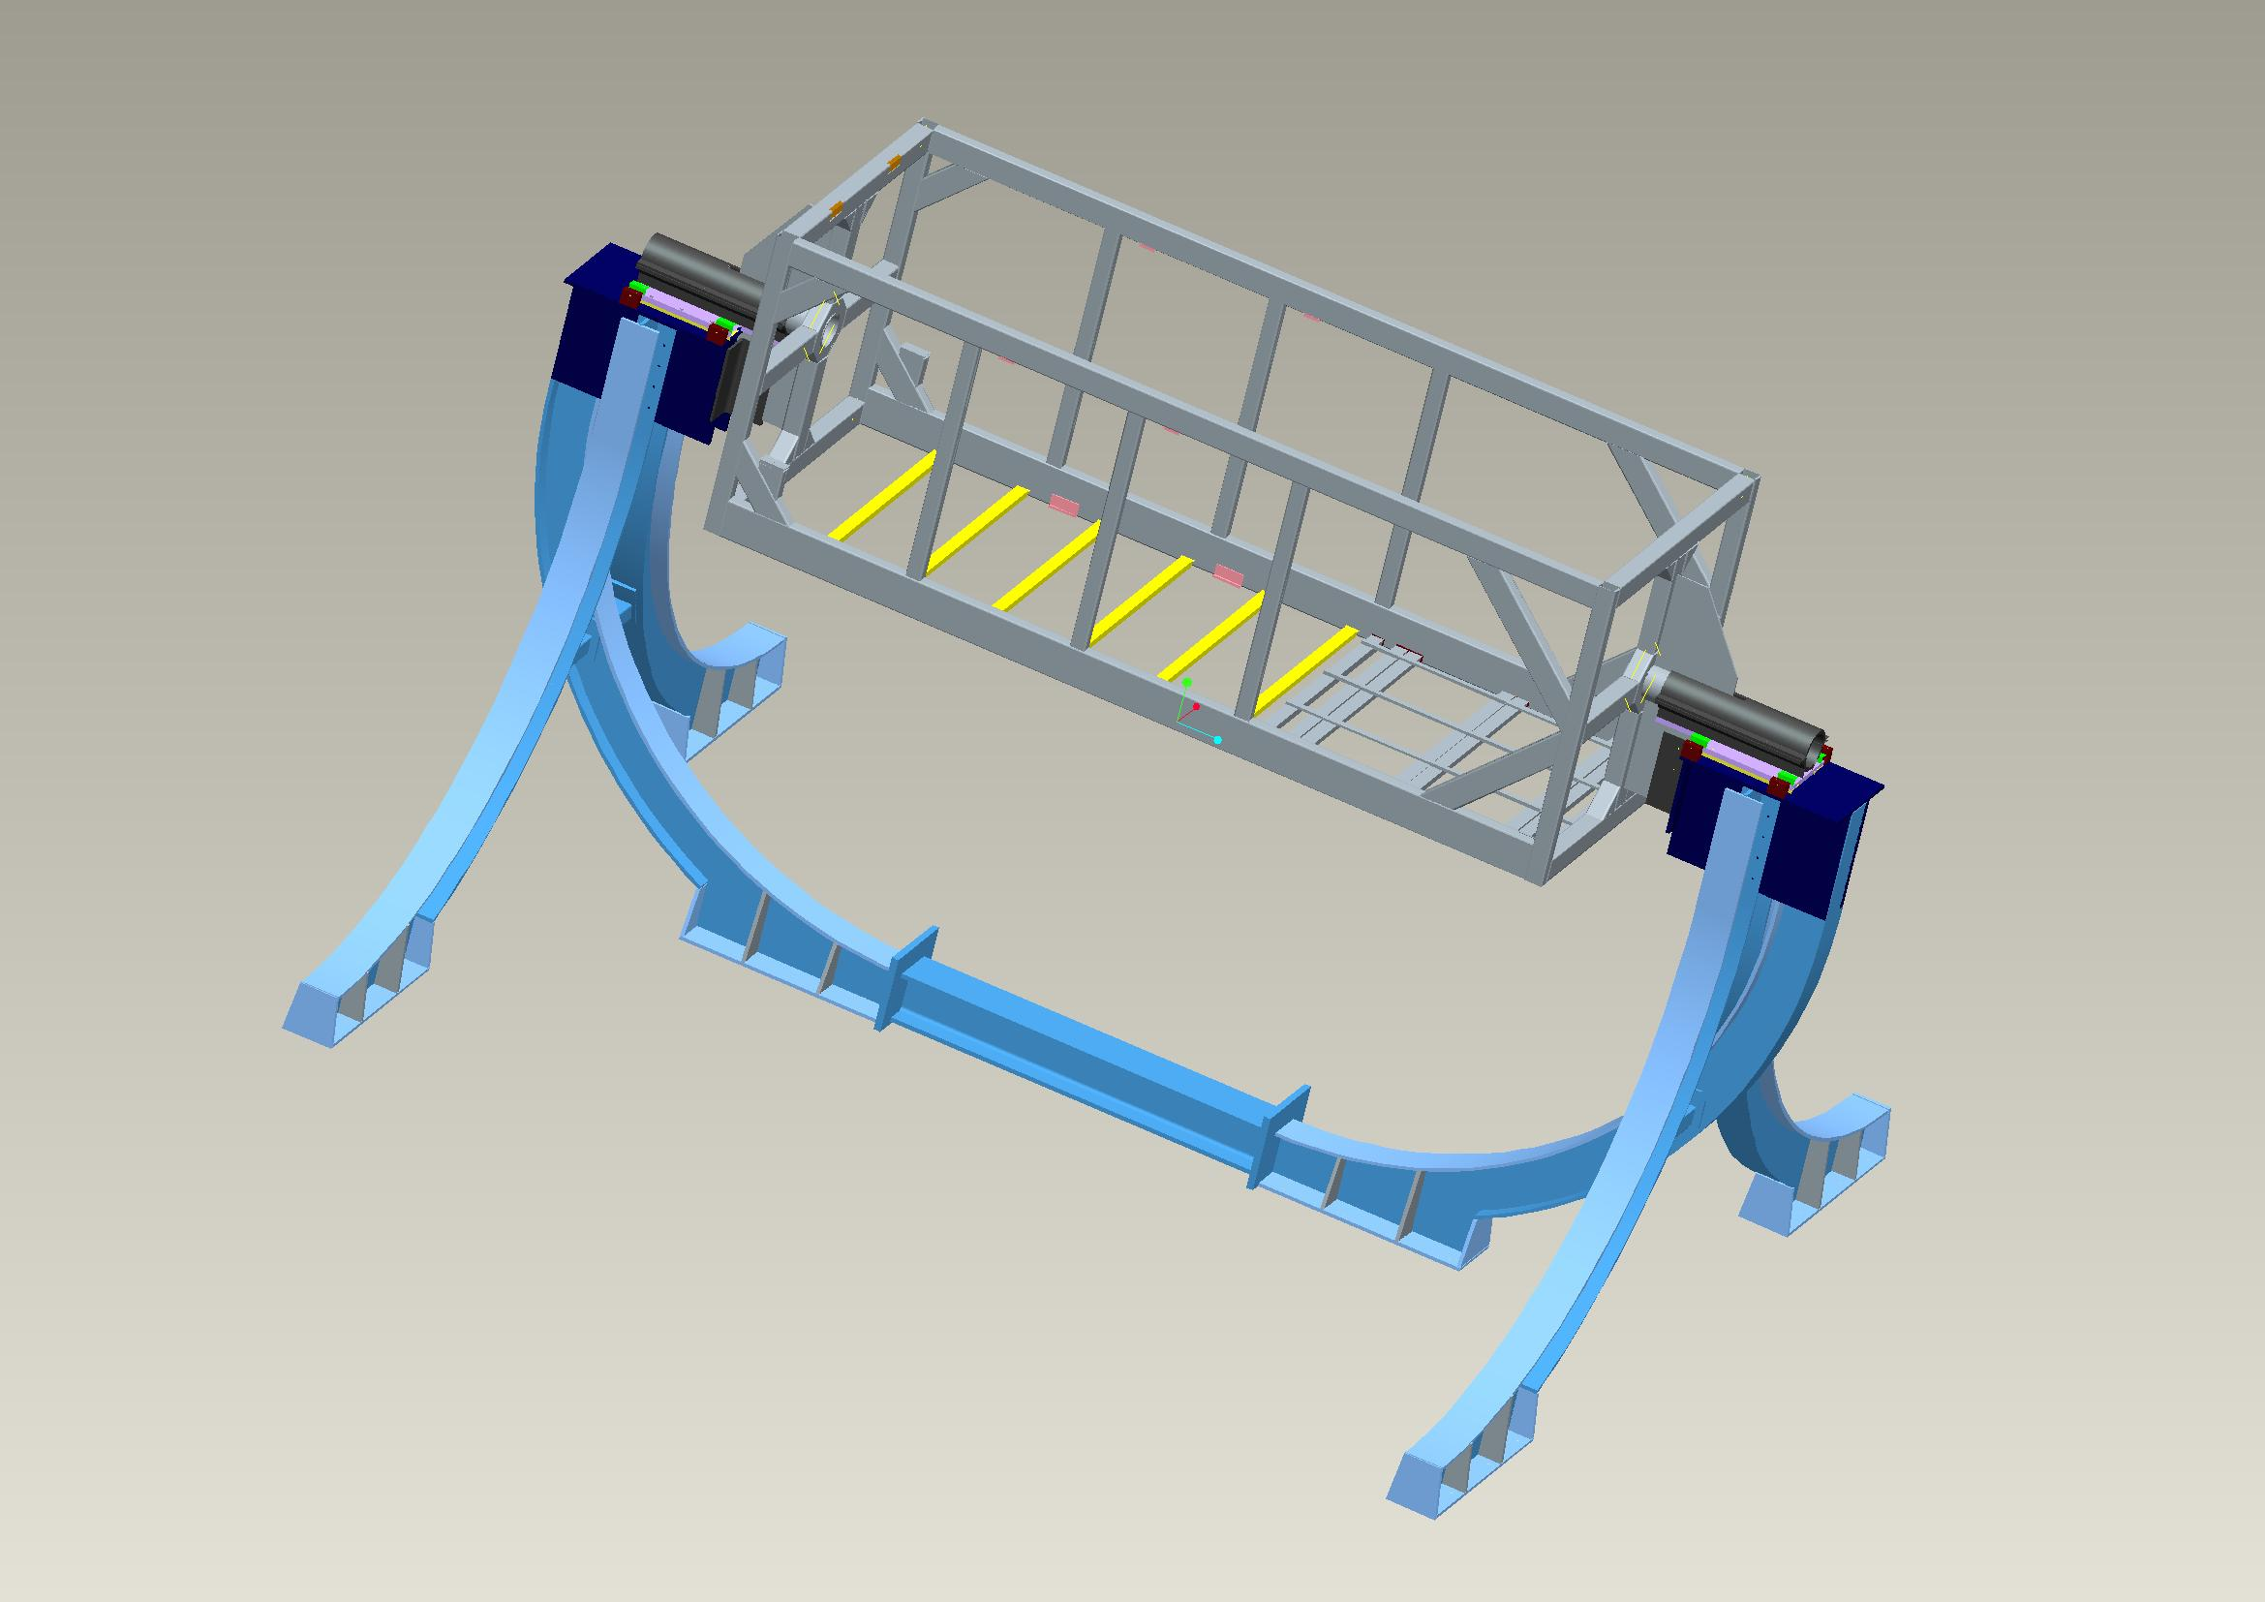
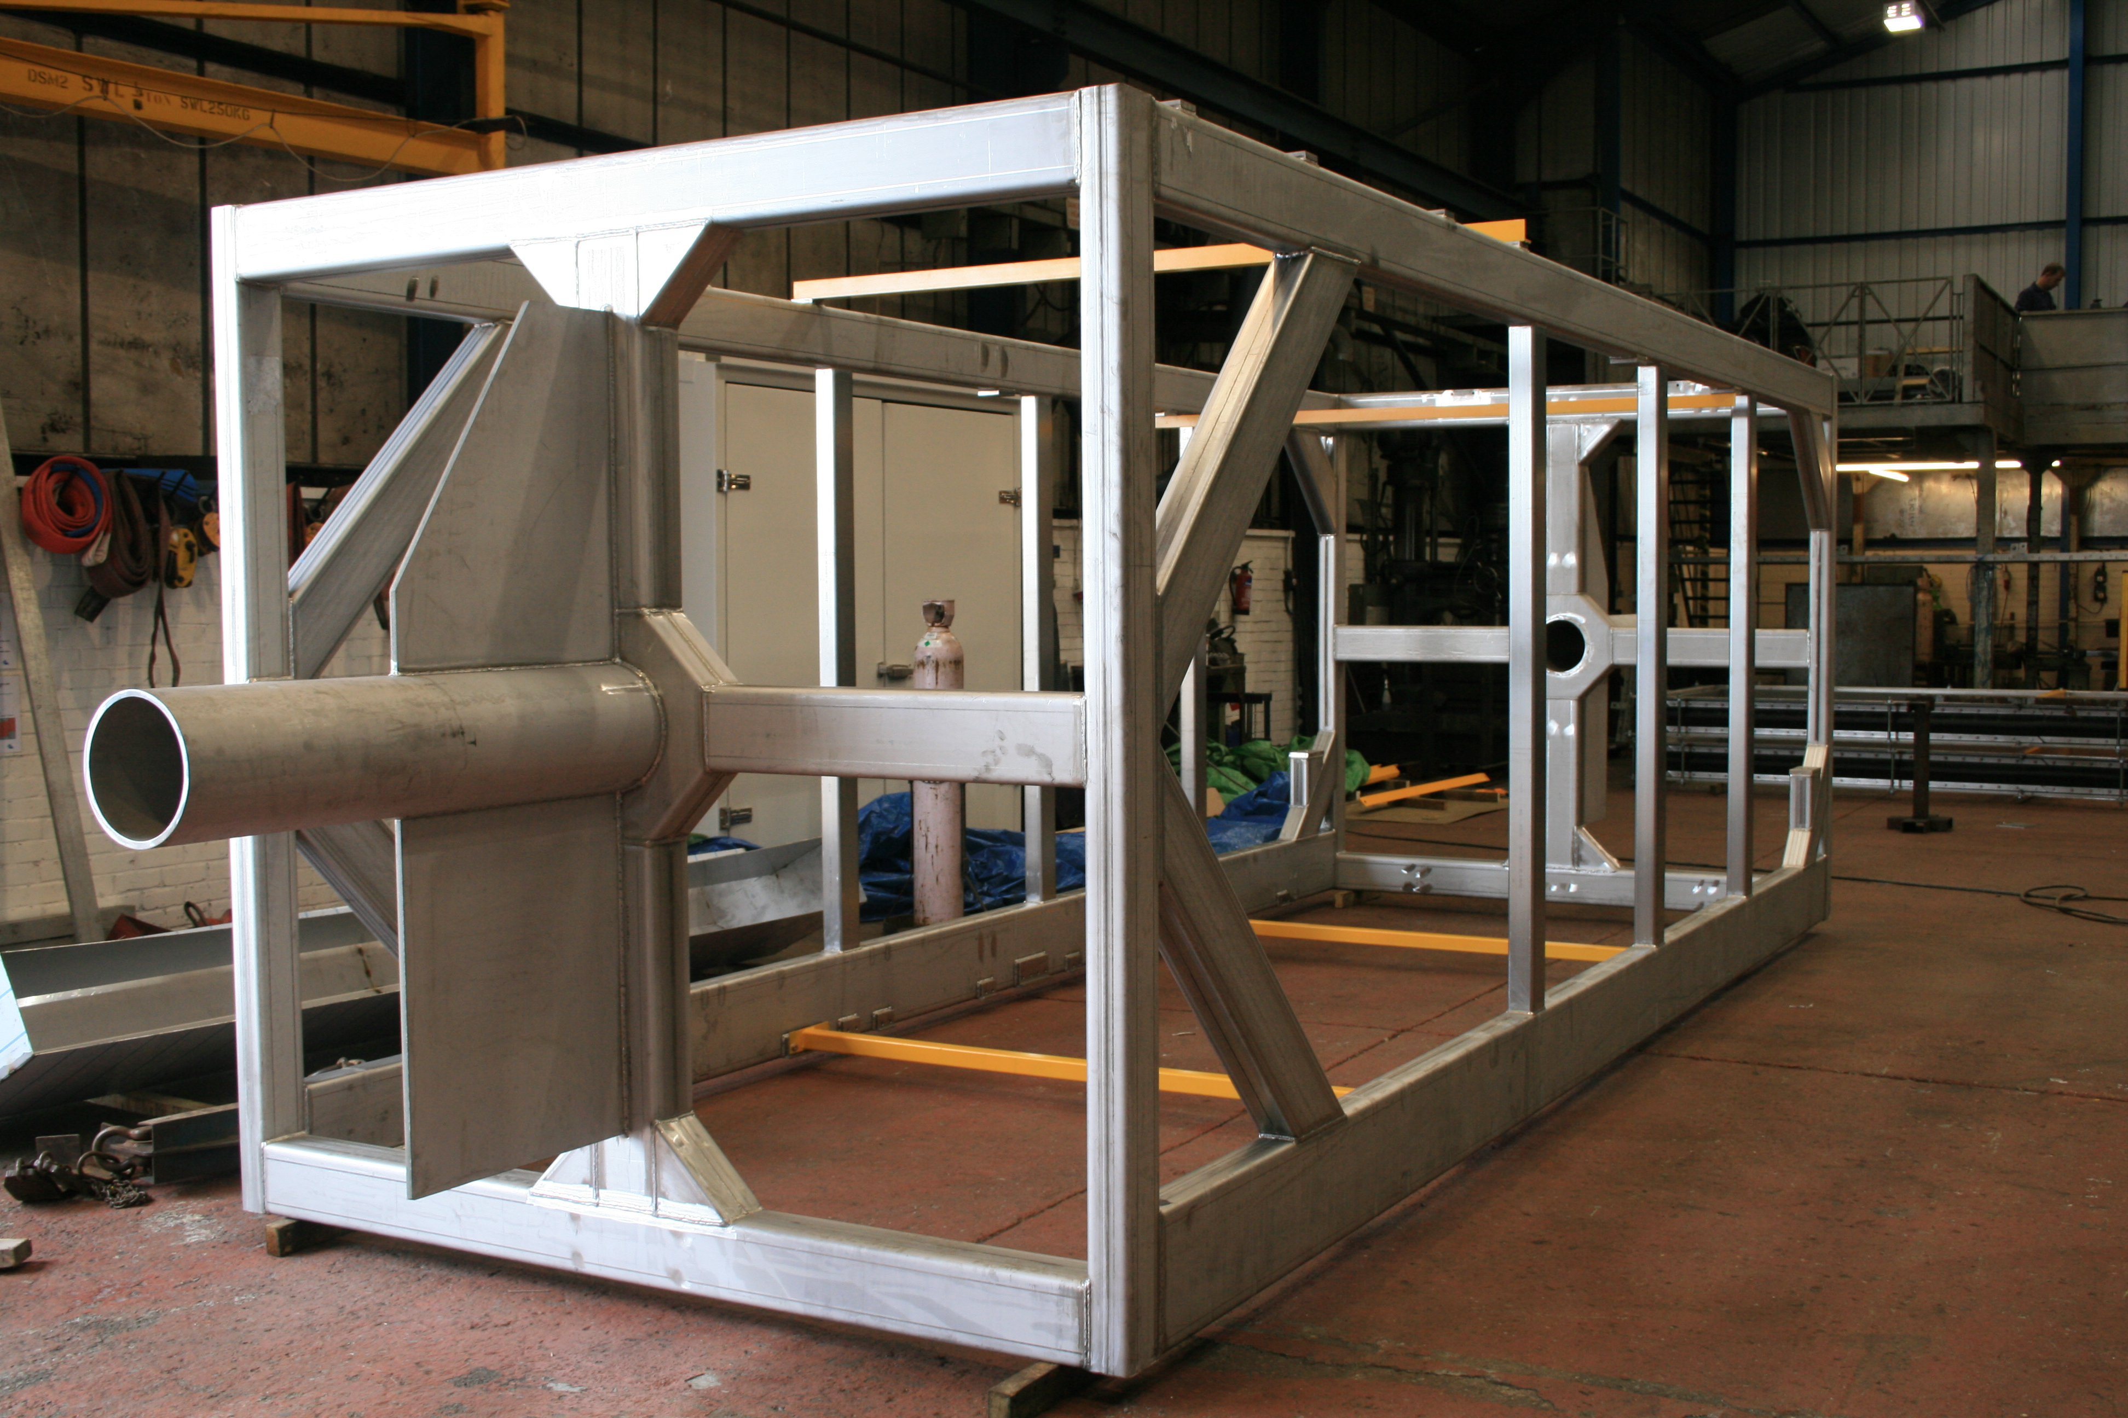
The ND280
Basket Structure
Peter Sutcliffe
University of Liverpool
20th March 2017

Slide 2
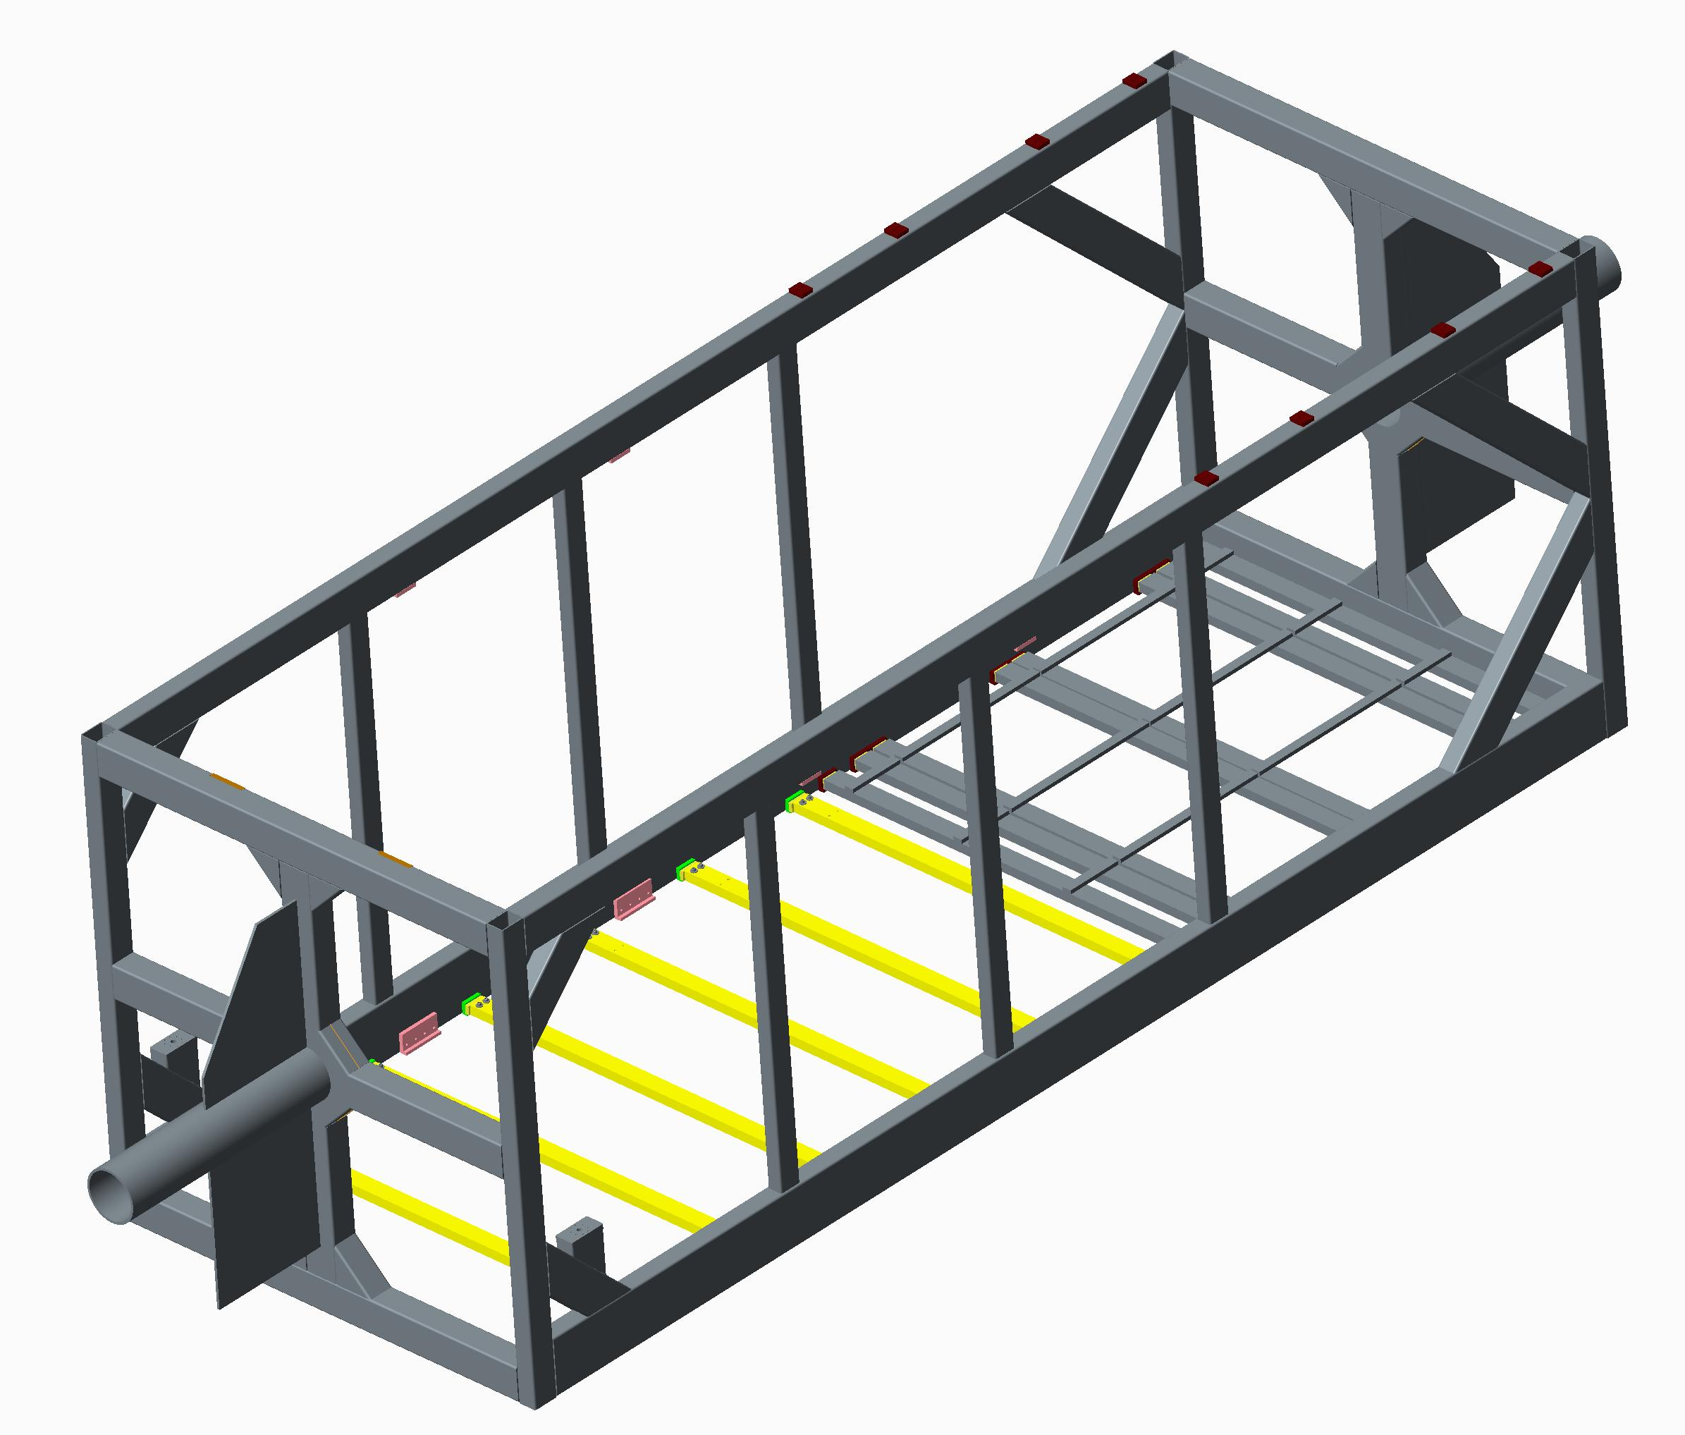
Stainless Steel basket Dimensions
2320mm
Internal
Design comprised of mainly 300 x 100 x 6 and 200 x 100 x 6 Stainless RHS.
6650mm
Internal

Slide 3
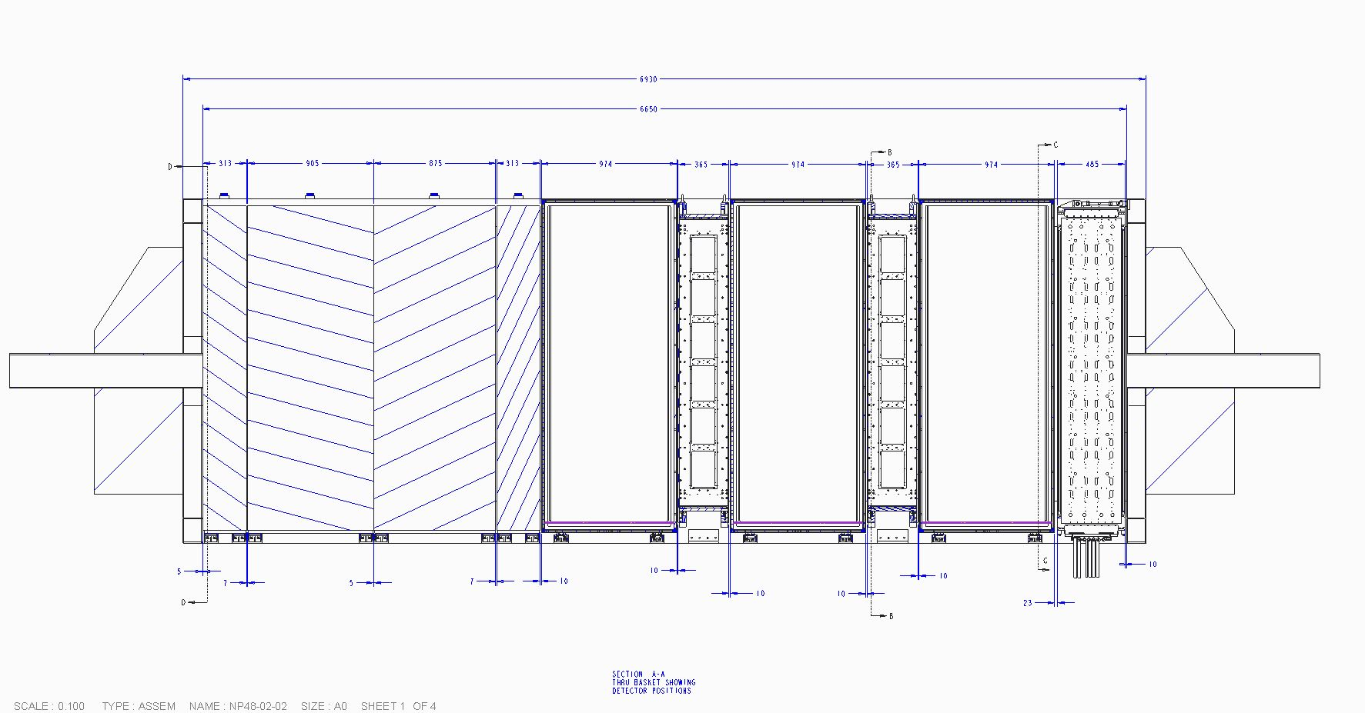
Detector Layout
Total mass of detectors for analysis
29,000Kg
Detector | Mass (kg) | No. Off
ECAL | 6000 | 1
TPC | 1000 | 3
FGD | 1500 | 2
POD ECAL | 3000 | 2
POD TARGET | 11000 | 1
POD
ECAL
POD
TARGET
POD
ECAL
TPC
FGD
TPC
FGD
TPC
D/Stream
ECAL

Slide 4
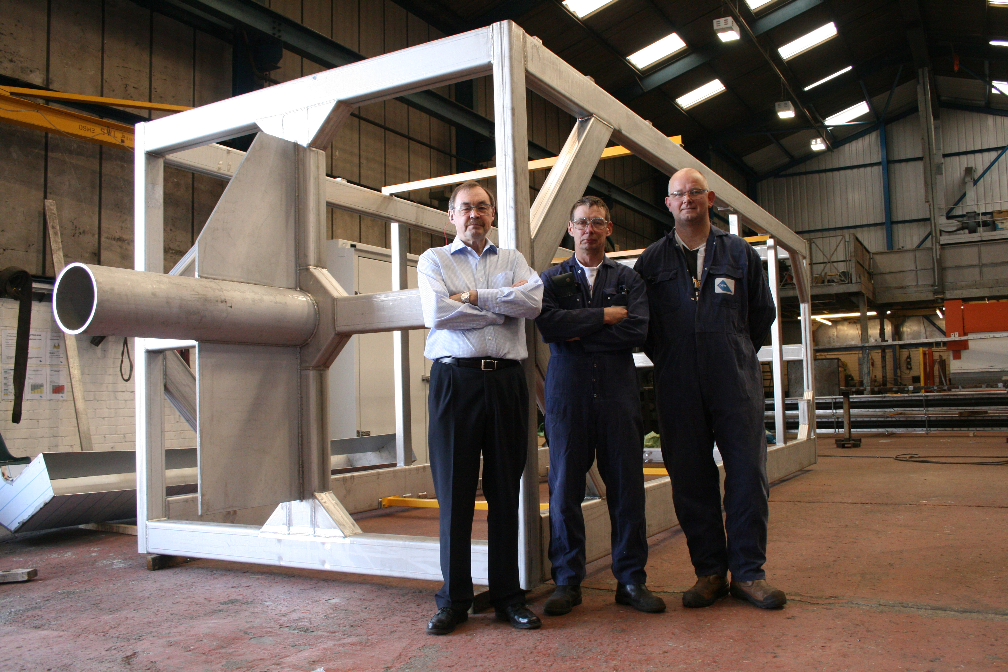
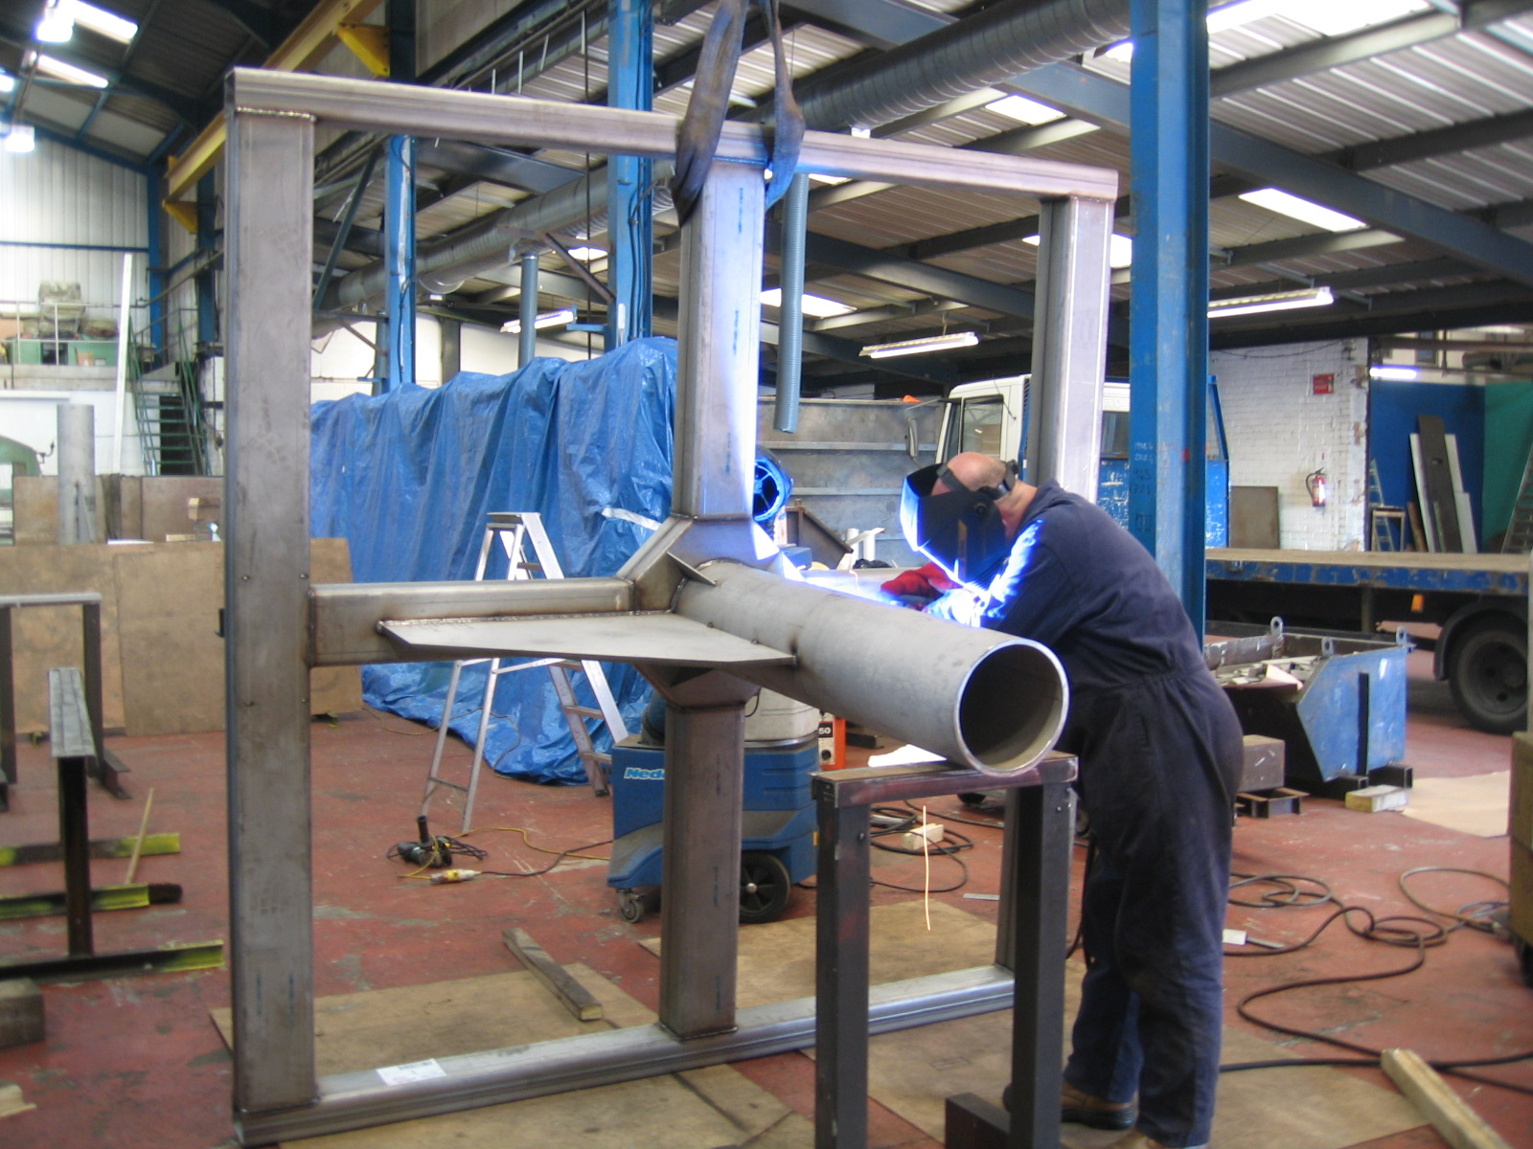
Stainless Steel basket
Manufactured at Durham Sheet Metal, South Shields’ Near Newcastle

Slide 5
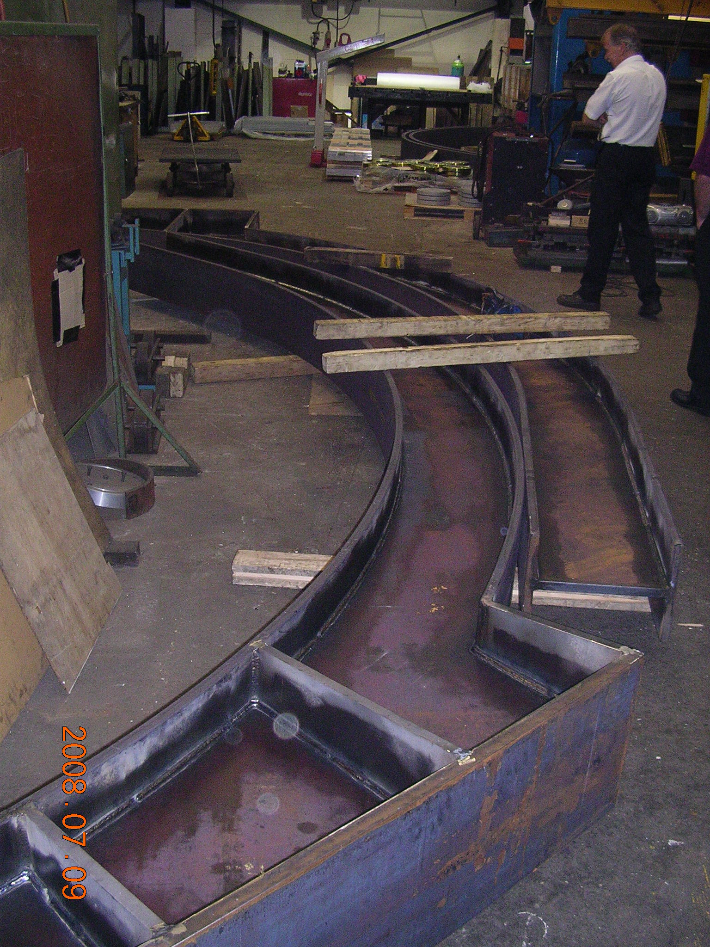
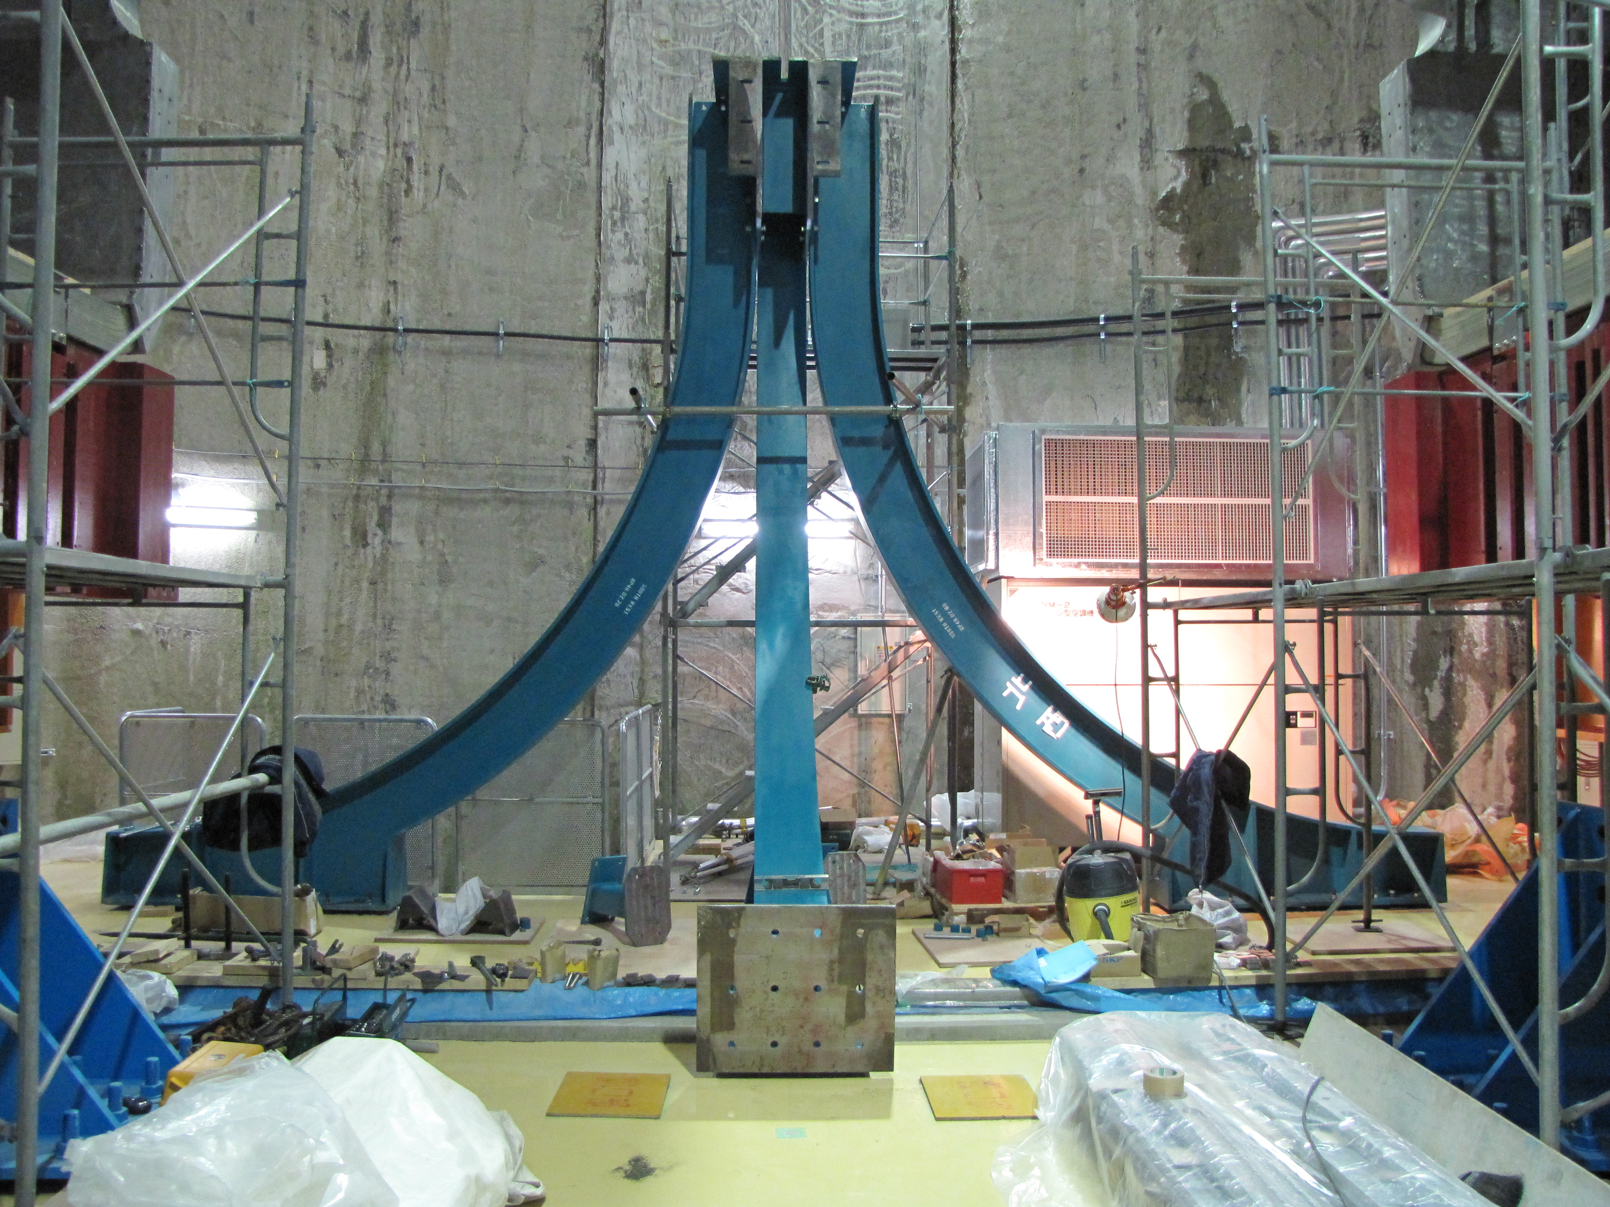
Basket Stand
Basket stand is manufactured from Carbon steel and was made at Priory Engineering on the south coast

Slide 6
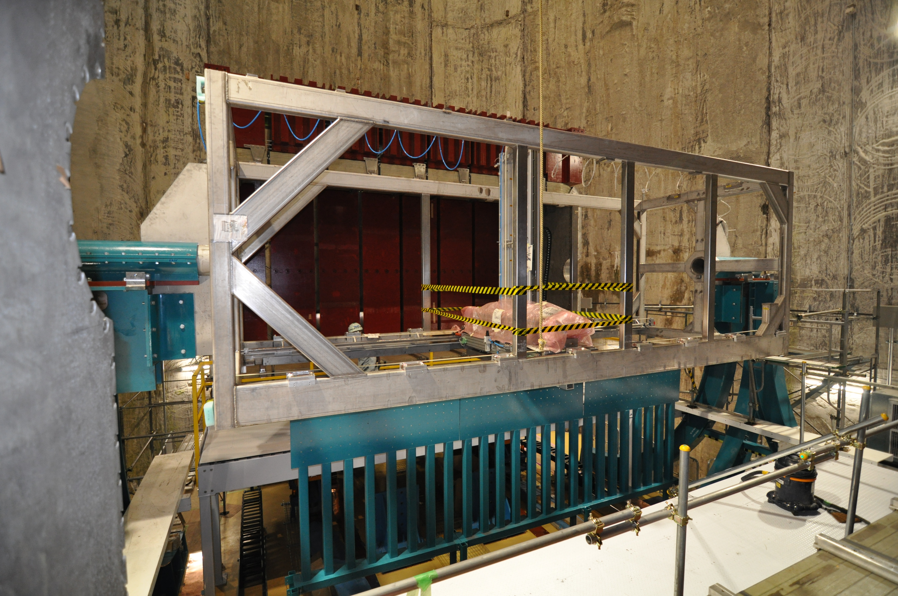
Services Rack

Slide 7
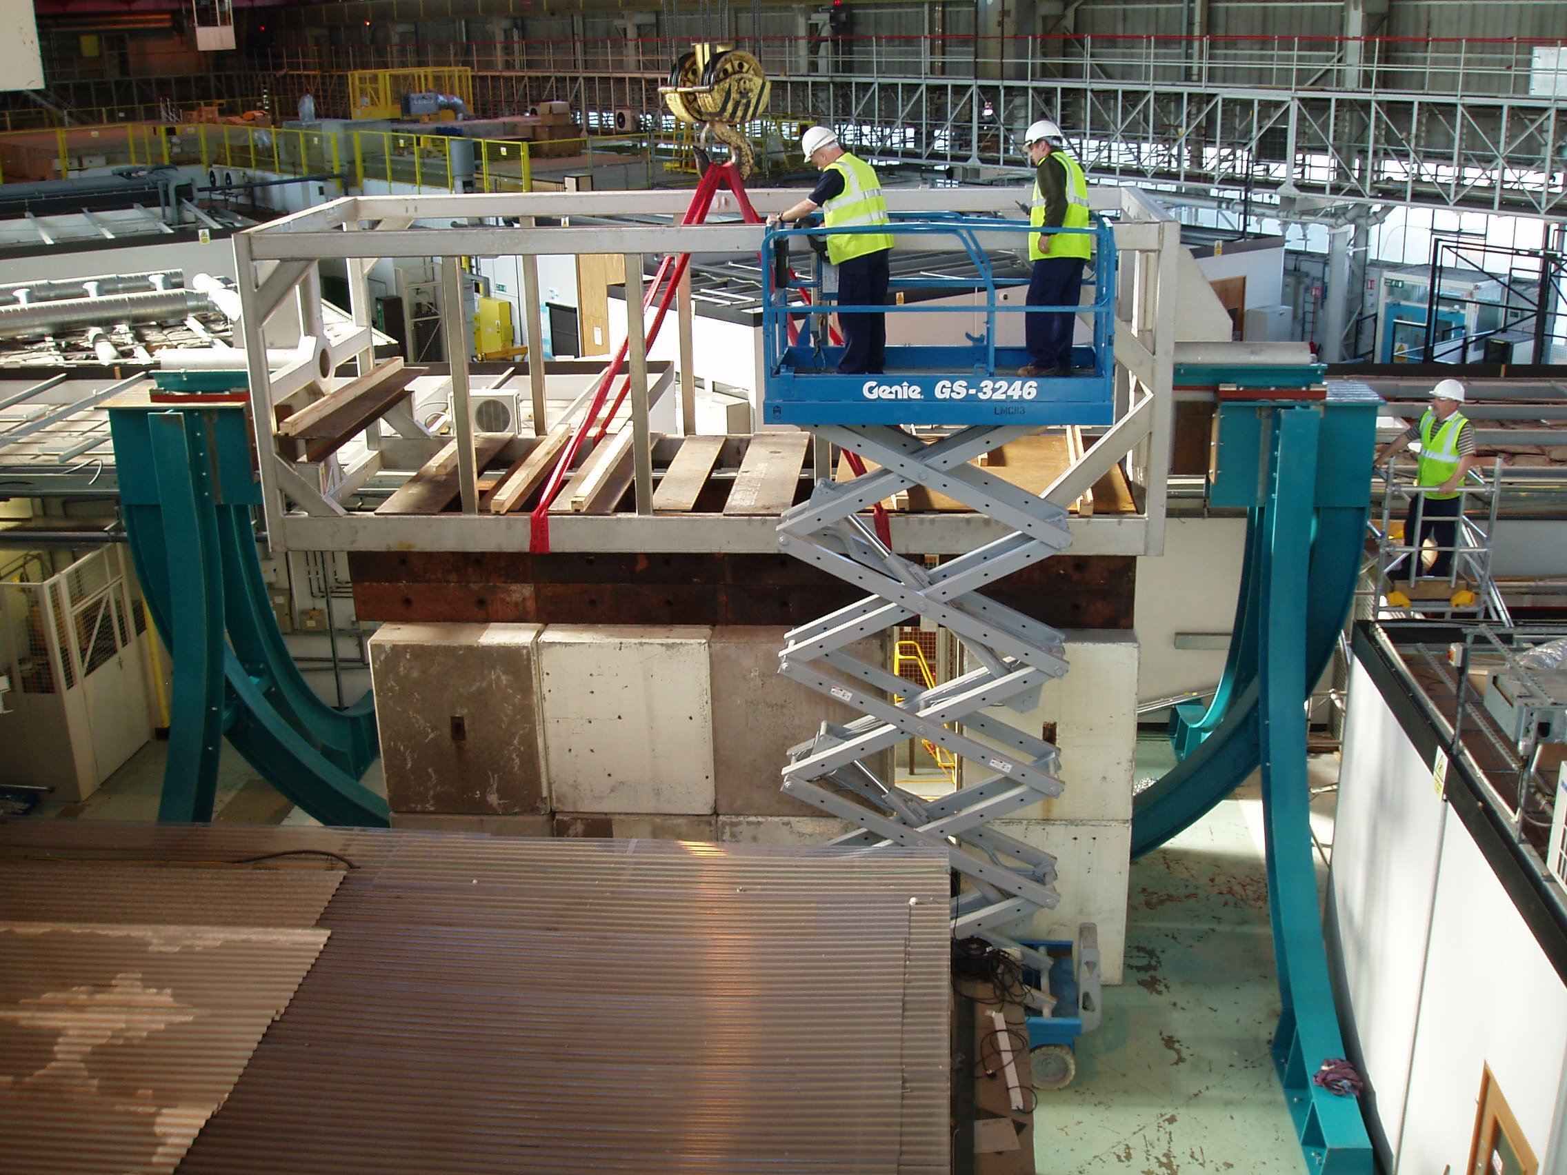
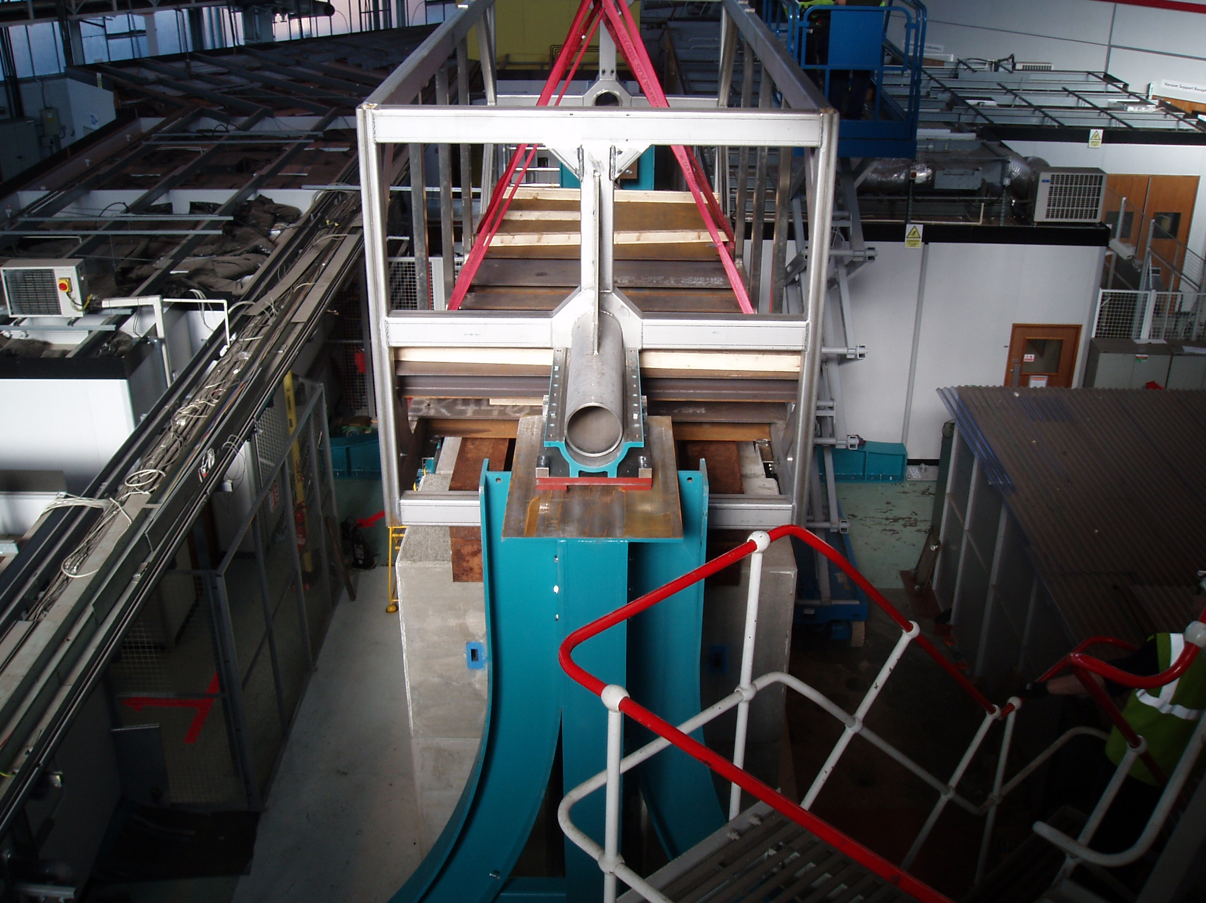
Full assembly at Daresbury Lab

Slide 8
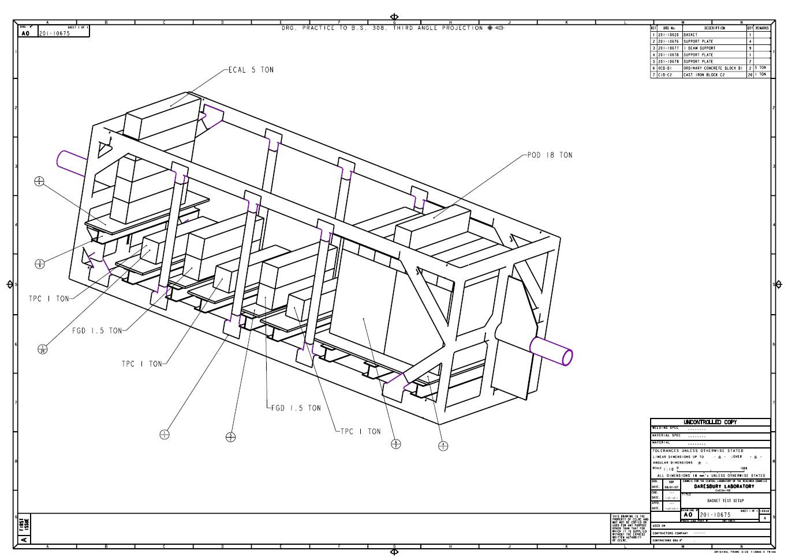
Load testing at Daresbury Lab
Loaded up with concrete blocks in the correct detector positions to 29 tonnes

Slide 9
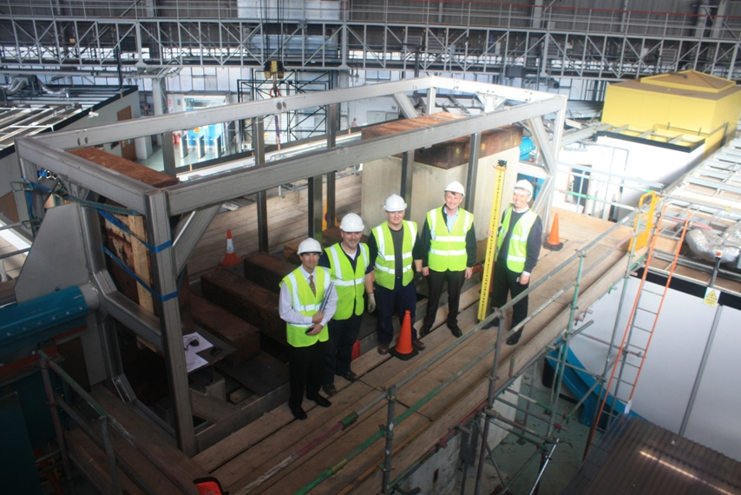
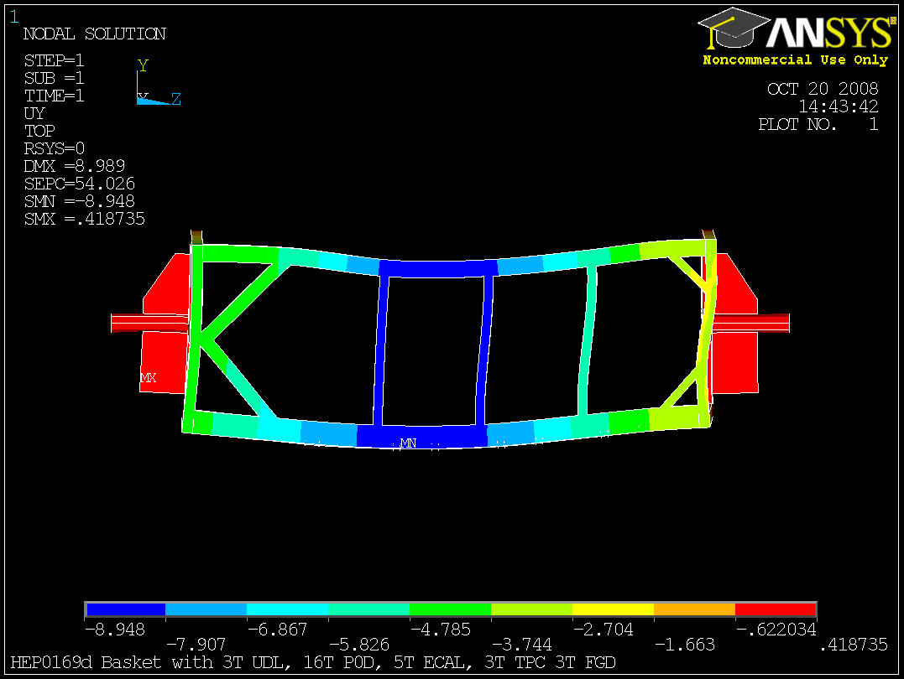
Testing at Daresbury
Loaded up to 30 tonnes
Total deflection 12mm
ANSYS analysis shows 9mm

Slide 10
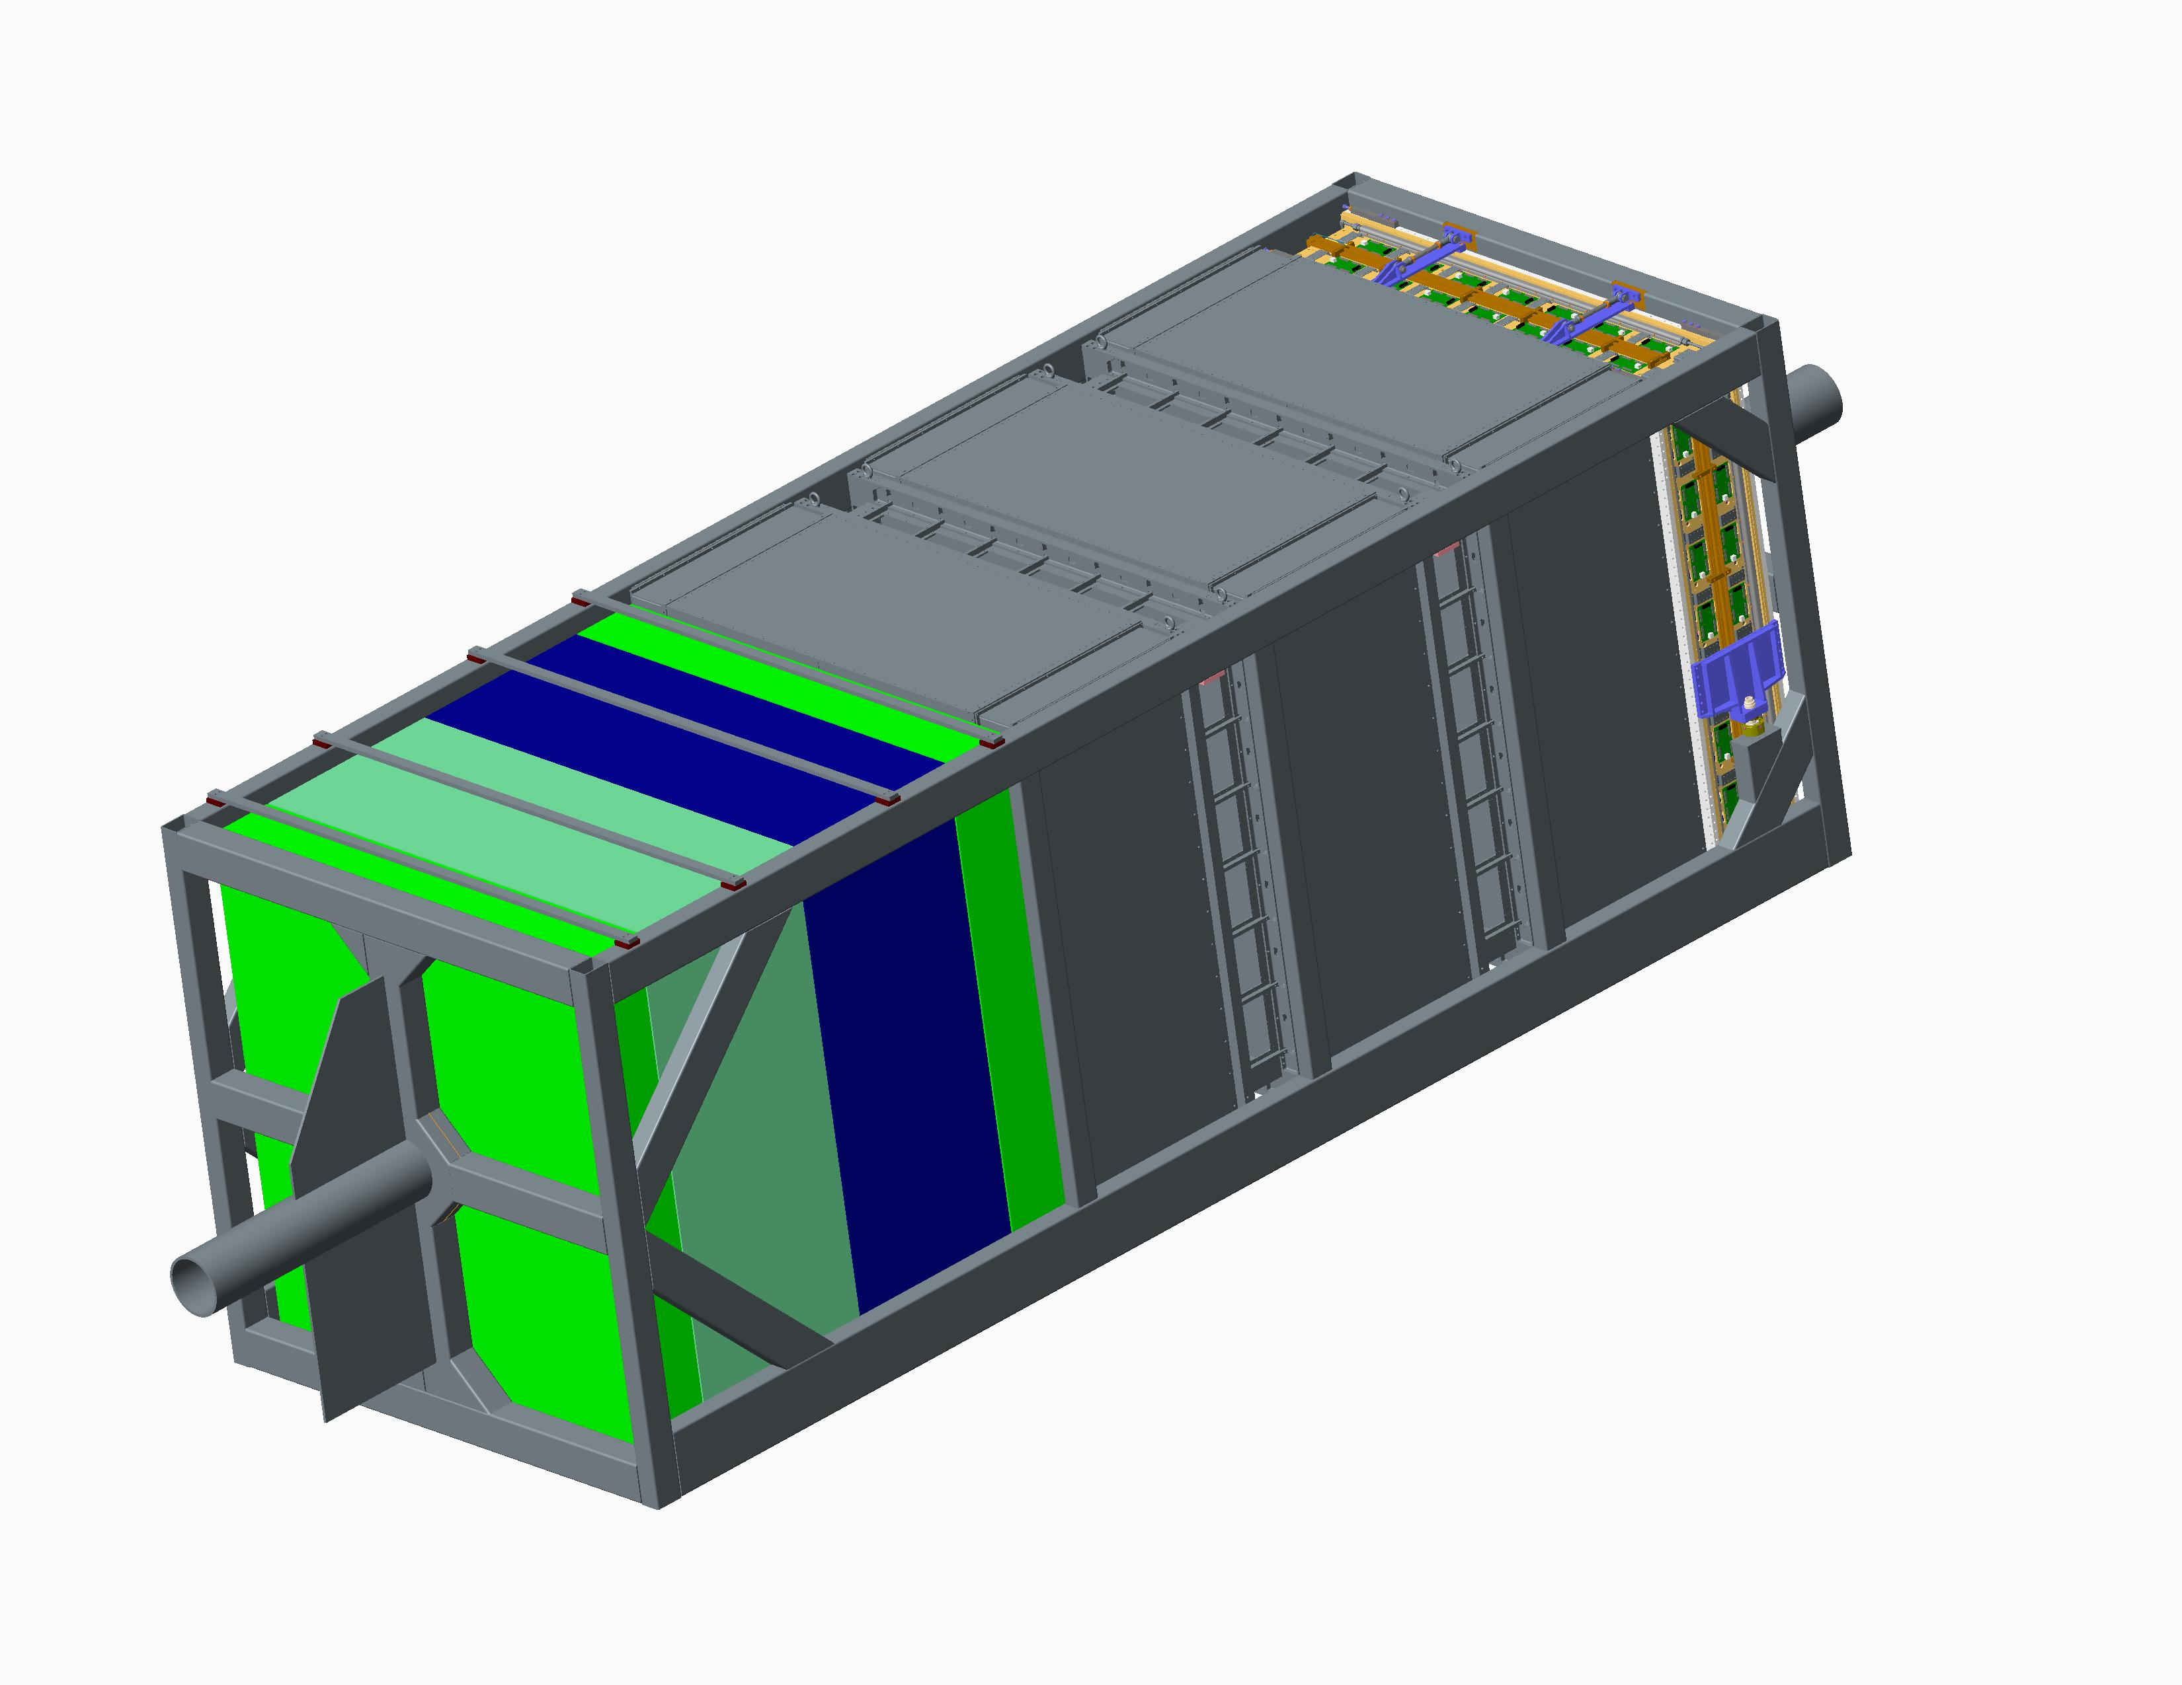
Detector attachment to Basket

Slide 11
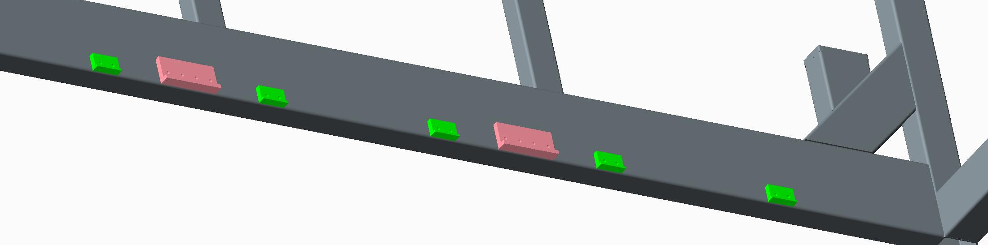
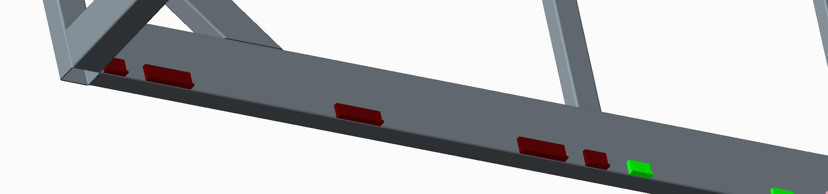
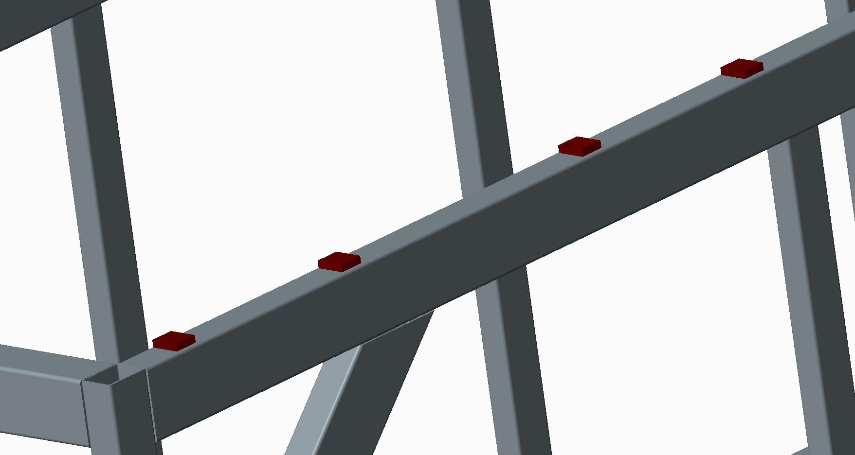
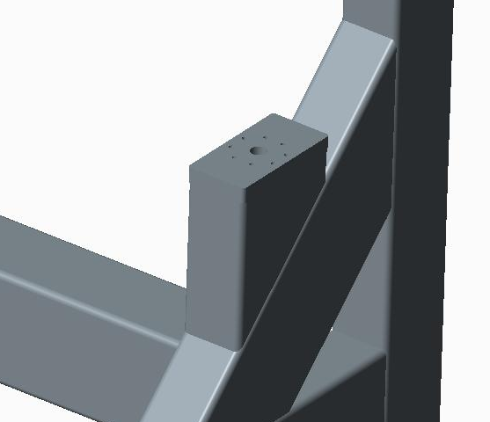
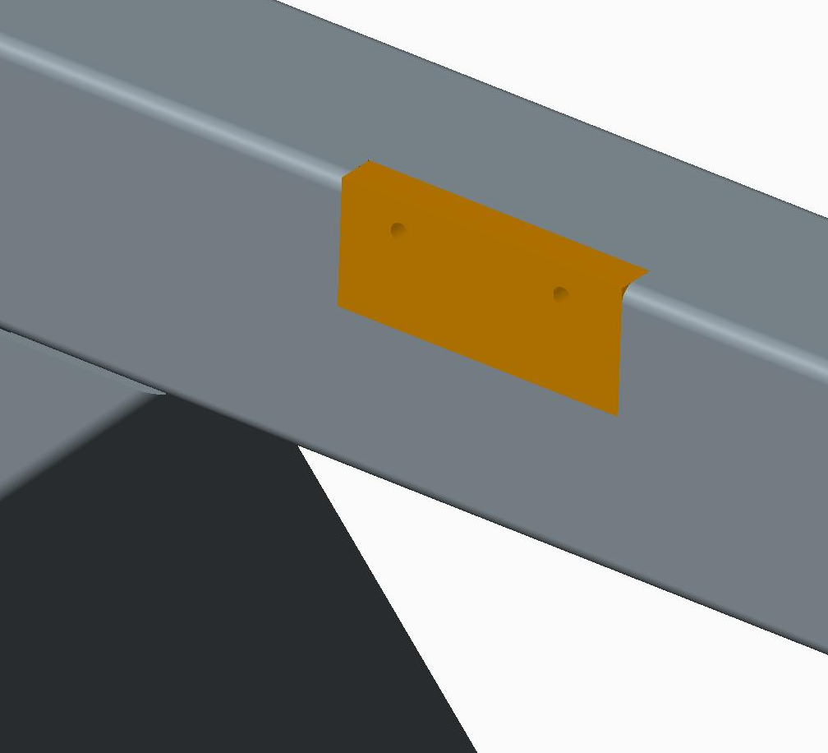
Basket machined bosses
Basket has several machined bosses which were positioned to attached all the original detectors.

Slide 12
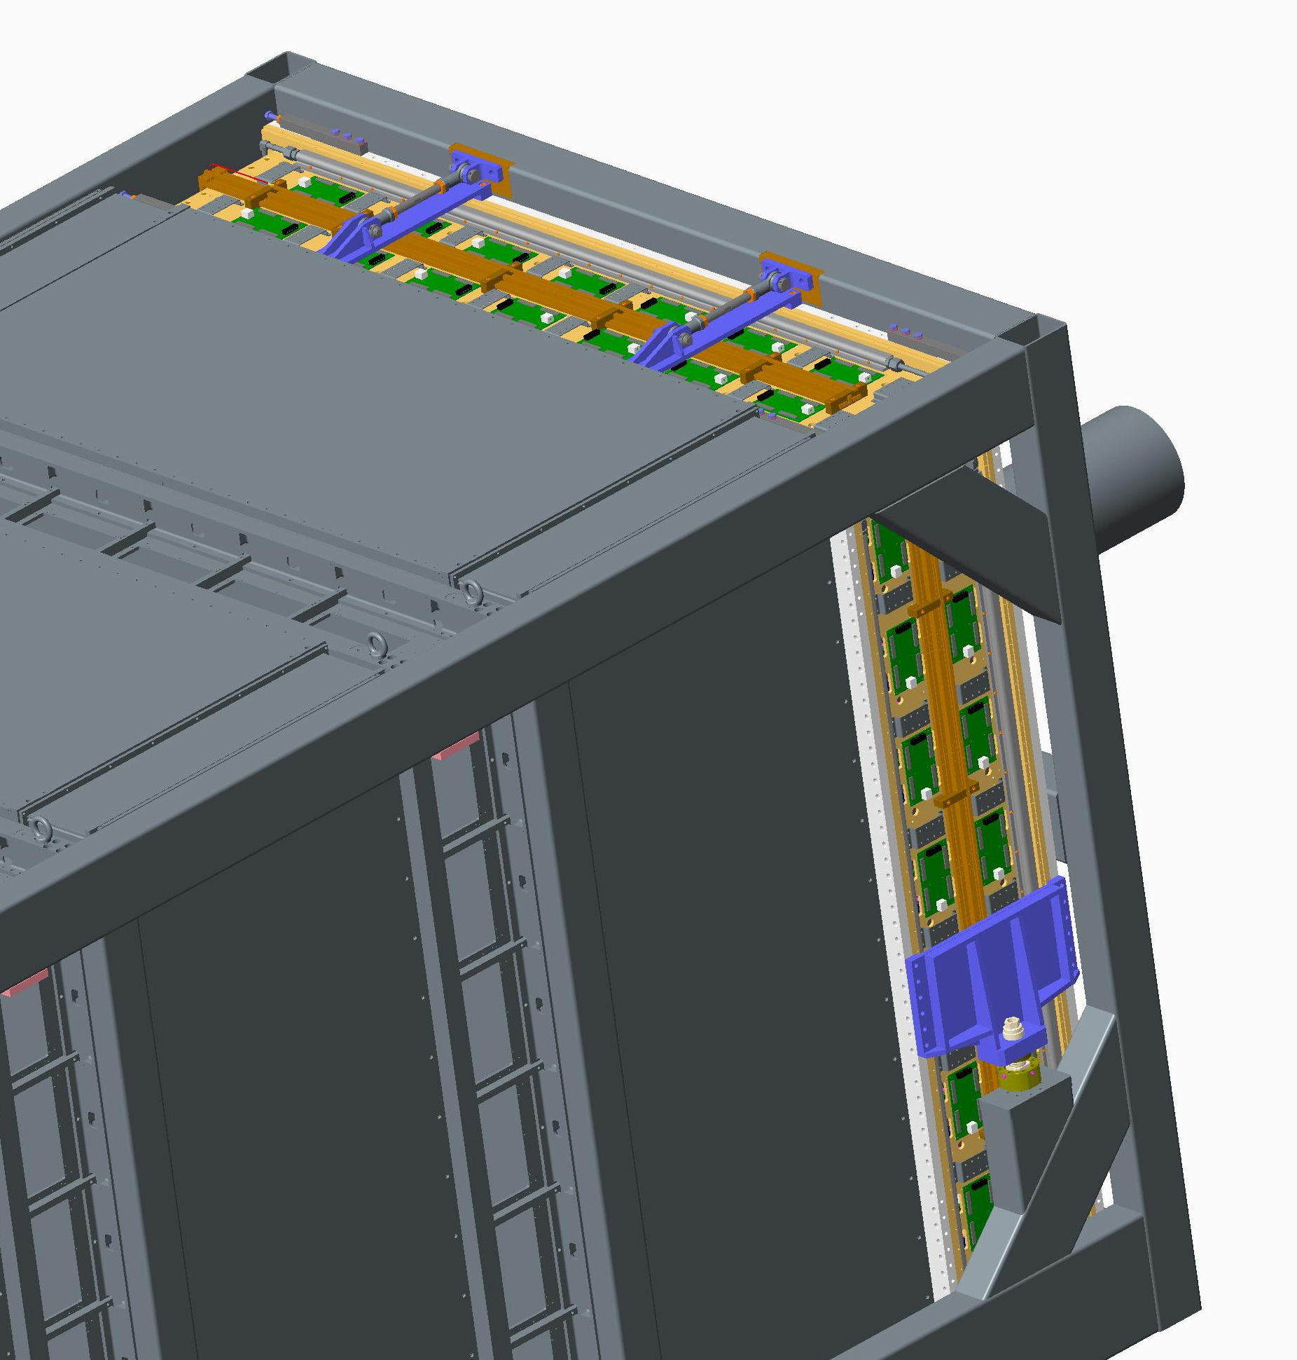
Downstream ECAL
Main vertical support is on the machined pillar
2 machined location bosses to attach tie bars

Slide 13
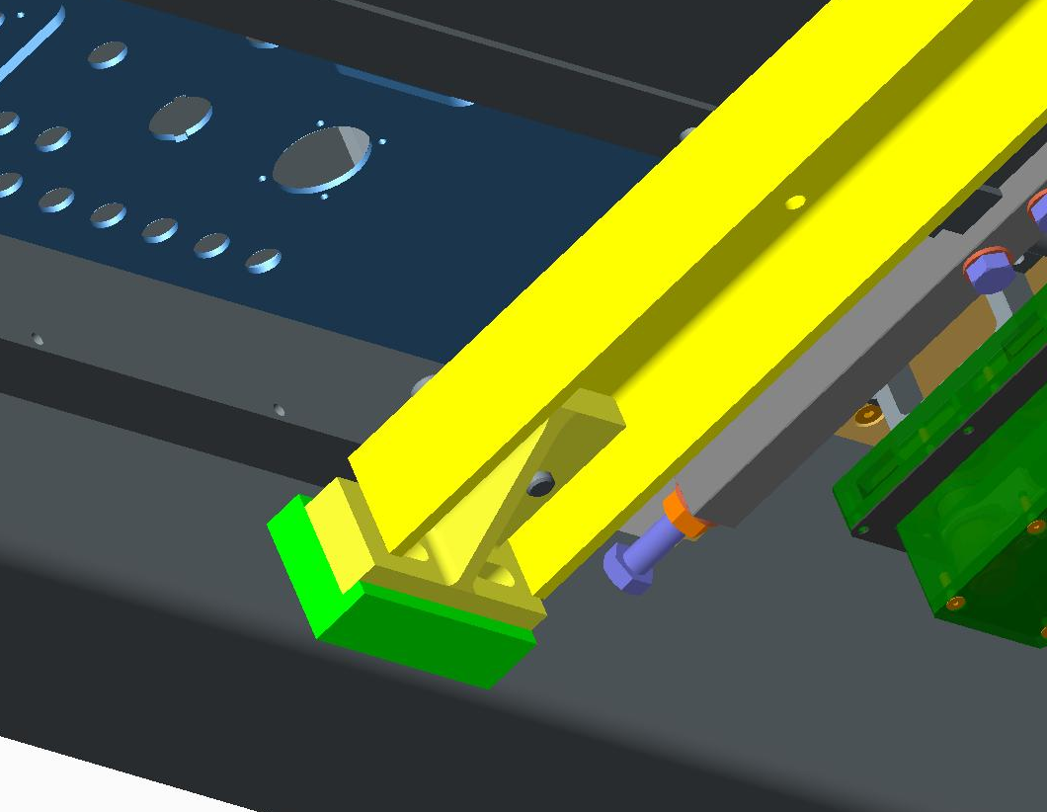
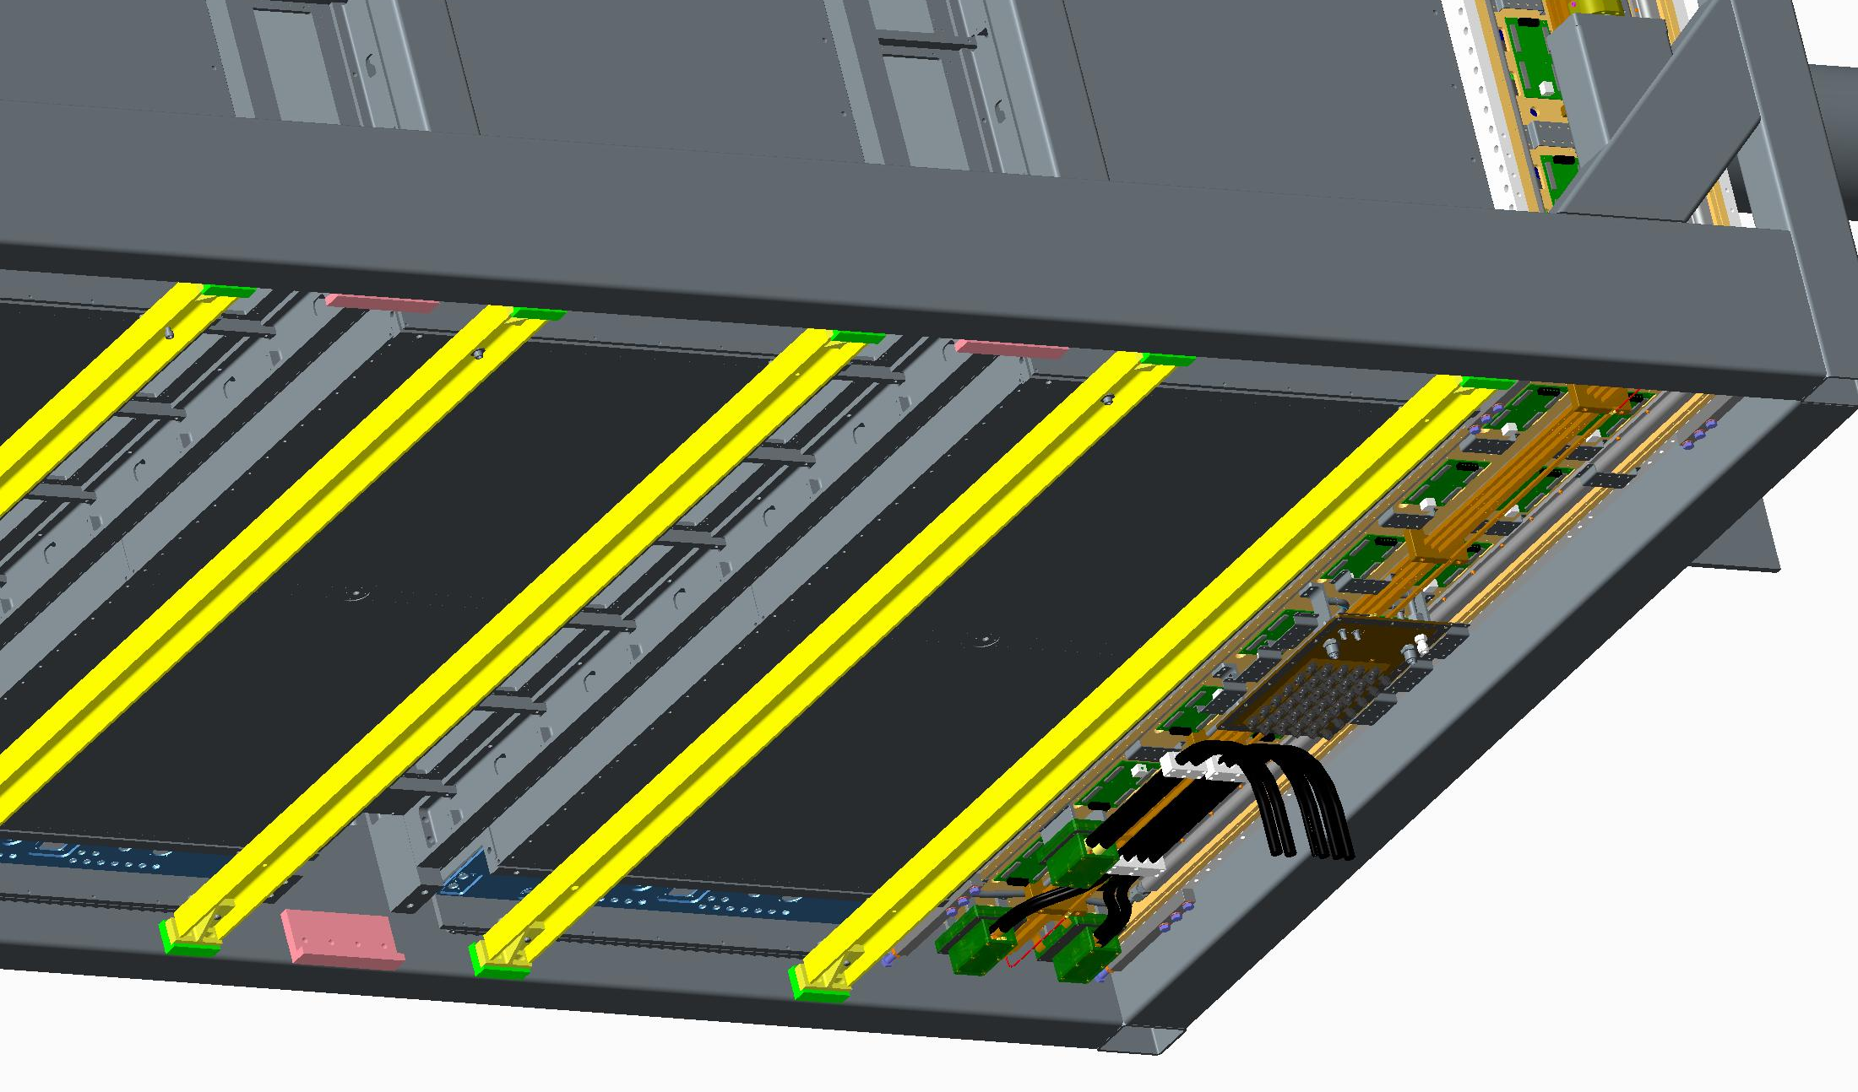
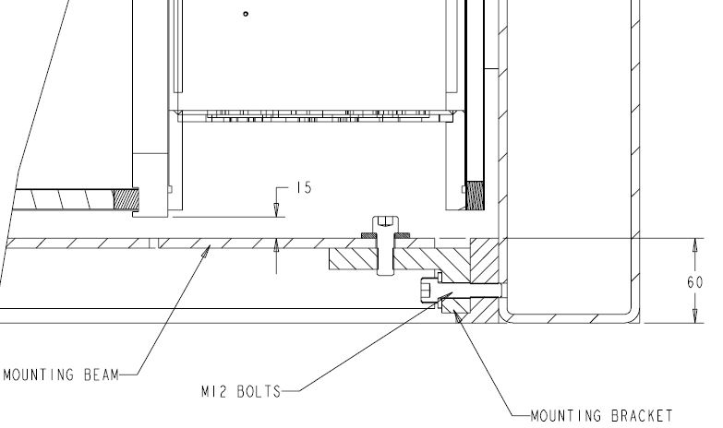
TPC
TPC is attached to two rails supported on two angle brackets and fastened to machined bosses on the basket

Slide 14
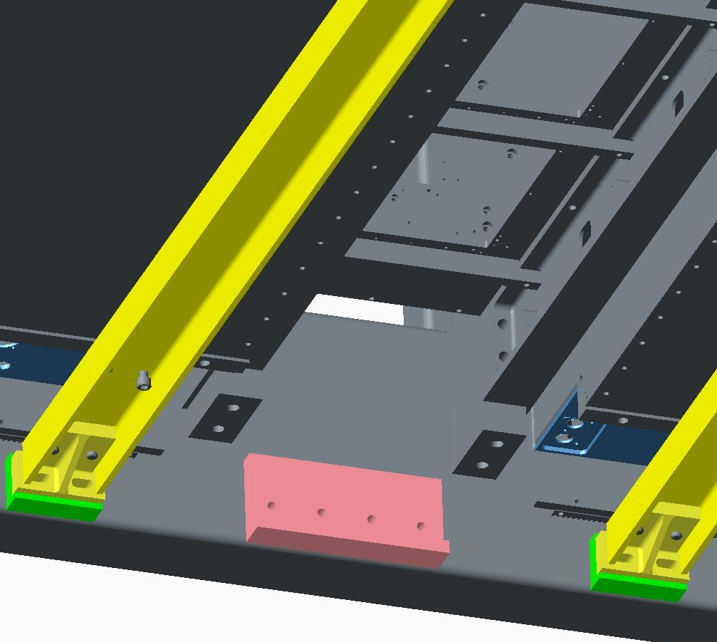
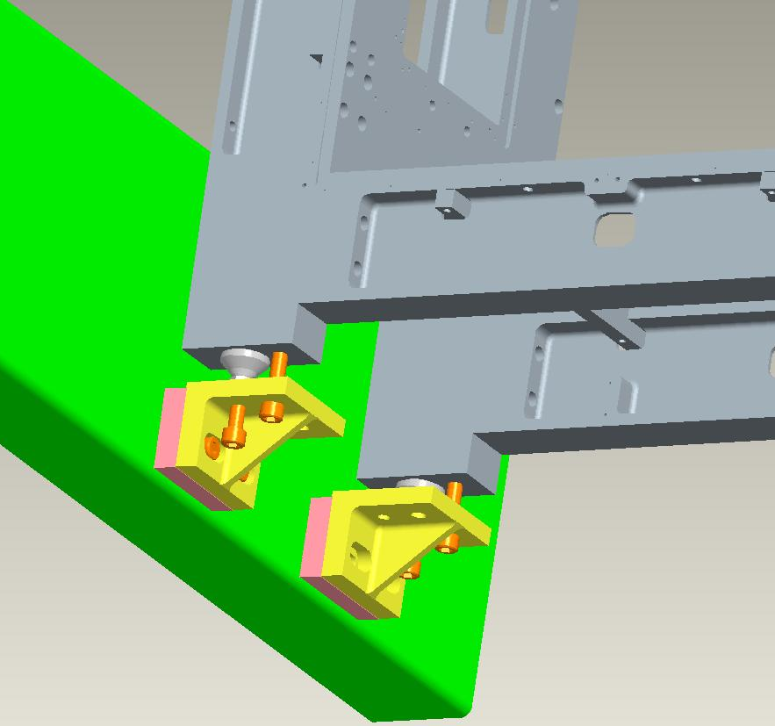
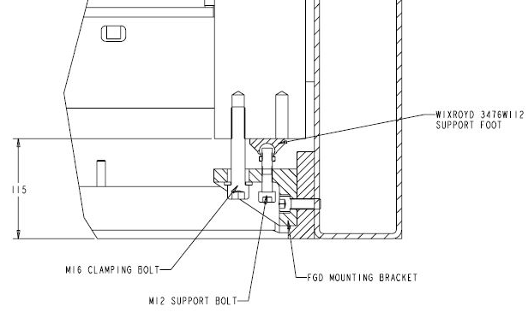
FGD
Attached to two right angle brackets fixed to machined bosses on the basket.
Unsure of final attachment...
‘Final’ basket design
Original design

Slide 15
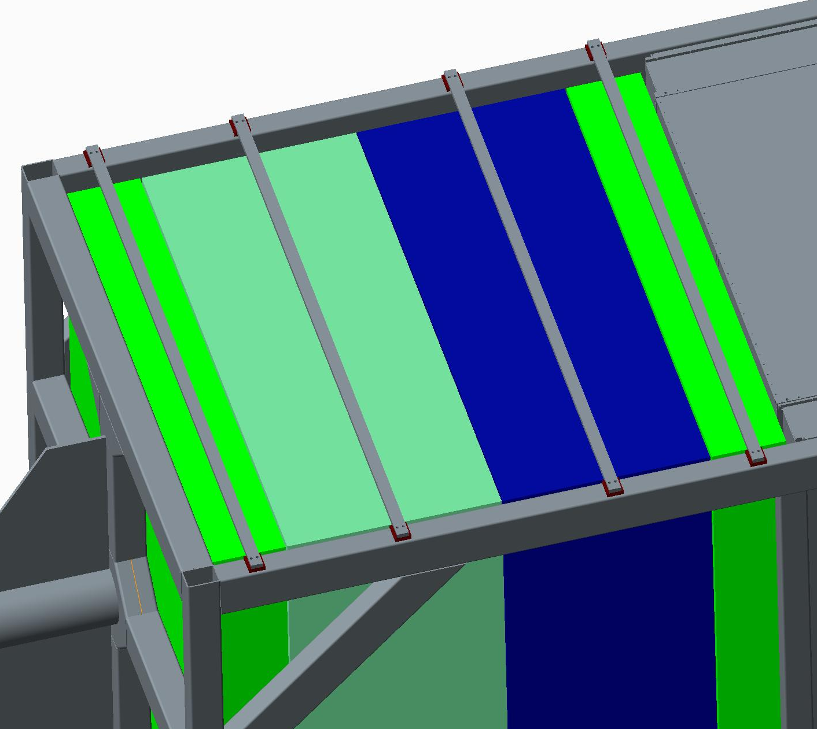
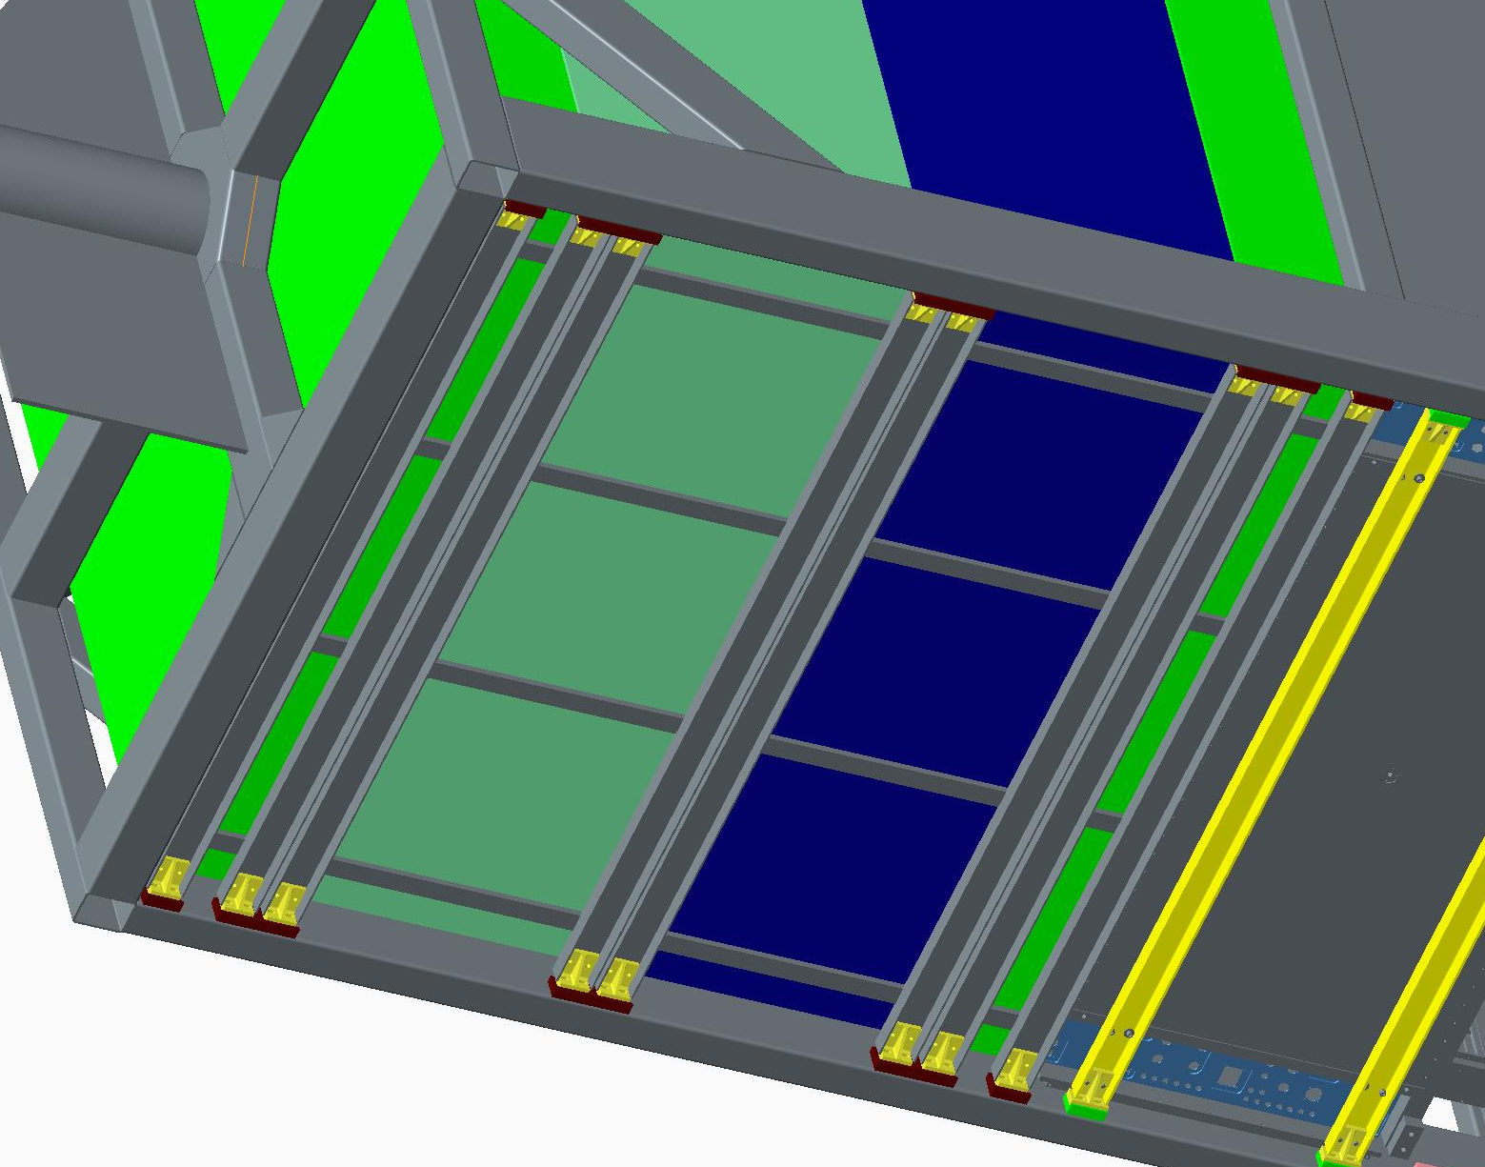
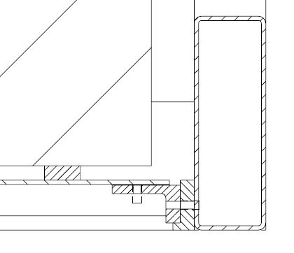
P0D detectors
P0D fixed using cross member lower bars and upper bars.
Bars fixed using angle brackets attached to machined bosses on the basket

Slide 16
STEP files and Drawings
Attached are 2 drawings and step files
  NP48-01-03 Basket
  NP48-01-26 Basket and support bars
Thanks for Listening

