Slide 1


Overview of CERN Test Beam Facilities relevant for TPC tests
J. Bernhard, N. Charitonidis, M. Brugger, A. Fabich, L. Gatignon,
E. Gschwendtner, B. Rae and H. Wilkens
2nd Workshop on Neutrino Near Detectors based on gas TPCs
20-21 March 2017, CERN

Slide 2
Presentation Outline
  CERN Accelerator Complex overview
  The East Area test beams
    General description and performance
    Fluxes and beam composition
    Optics example
    Some pictures
  The EHN1 beams
    The VLE extensions for the neutrino platform
    Large magnets
  Beam requests
  Summary

Slide 3
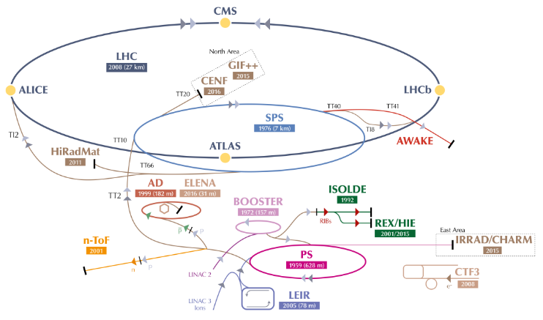

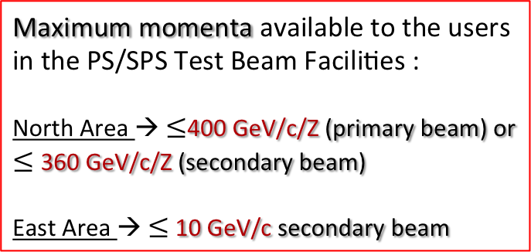
CERN Accelerator Complex
SPS : protons/ions @ 400 GeV/c/Z
PS: protons /ions @ 24 GeV/c/Z
Maximum momenta available to the users in the PS/SPS Test Beam Facilities :
North Area → 400 GeV/c/Z (primary beam) or 360 GeV/c/Z (secondary beam)
East Area → 10 GeV/c secondary beam
Reference : OPEN-PHO-ACCEL-2016-013

Slide 4
East Area
Test Beams
Secondary beams:
  T9: 1 GeV/c – 10 GeV/c
  T10: 1 GeV/c – 6 GeV/c
Particle types and intensity
  electrons, hadrons, muons
  Max. 10⁶ particles per spill,
  typically 10³ - 10⁴ used
Spill structure from PS
  400 ms spill length
  Typically 1 spill every 18s (15bp), more on request
New Aida telescope AZALEA in T10
Quick access, short routes from control room to experimental area
T11
T10
T9
CHARM
IRRAD

Slide 5
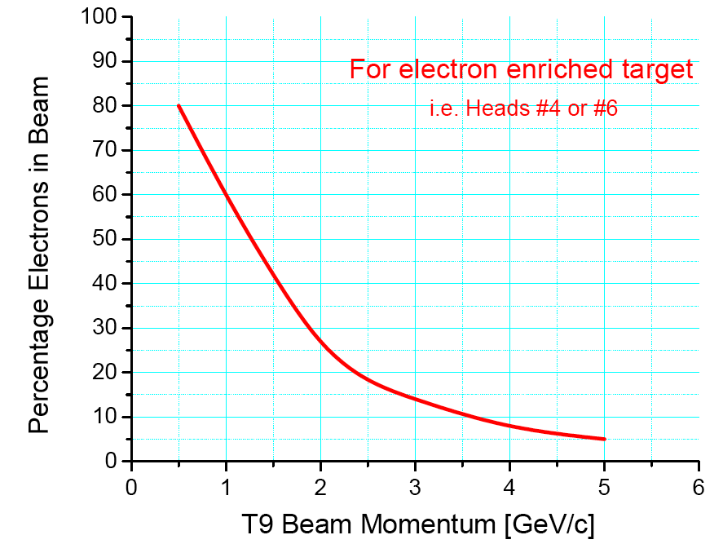
East Area Test Beams
The T9 and T10 beam lines are mixed beams.
Their maximum flux is 10⁶ per EASTA cycle.
Both beams are served from a common target,
together also with the T11 beam for CLOUD.
The flat top is 0.4 seconds.
The number of EASTA cycles is defined by the
physics coordinator, depending on the overall
schedule, but is normally 2 per super-cycle.
When CLOUD runs up to 3.
Each beam line is equipped with 1 (T10) or 2 (T9)
threshold Cerenkov counters, a scintillator and
a Delay wire chamber.
Parameter | T9 | T10
Maximum momentum (GeV/c) | 10 | 6
Production angle (mrad) | 0 | 61.6
Beam length to ref. focus (m) | 55.8 | 34.9
Beam height above floor (m) | 2.50 | 2.505
Ang.acceptance Horiz (mrad) Vertic (mrad) | ±4.8 ±5.8 | ±5.4 ±13.9
Acc. Solid angle (μsterad) | 87 | 224
Theor. momentum resol. (%) | 0.24 | 0.24
Max. momentum band (%) | ±10 | ±8
Magnification at ref. focus | 1.0, 1.2 | 0.8, 0.6
Protons on North target | ~2.5 10¹¹
Max. flux (depending on p, Q) | 10⁶ | 10⁶
For e⁻-enriched targets,
i.e. heads 1 or 2
The only ‘big’ magnet is MNP17 with 30 cm high gap.

Slide 6
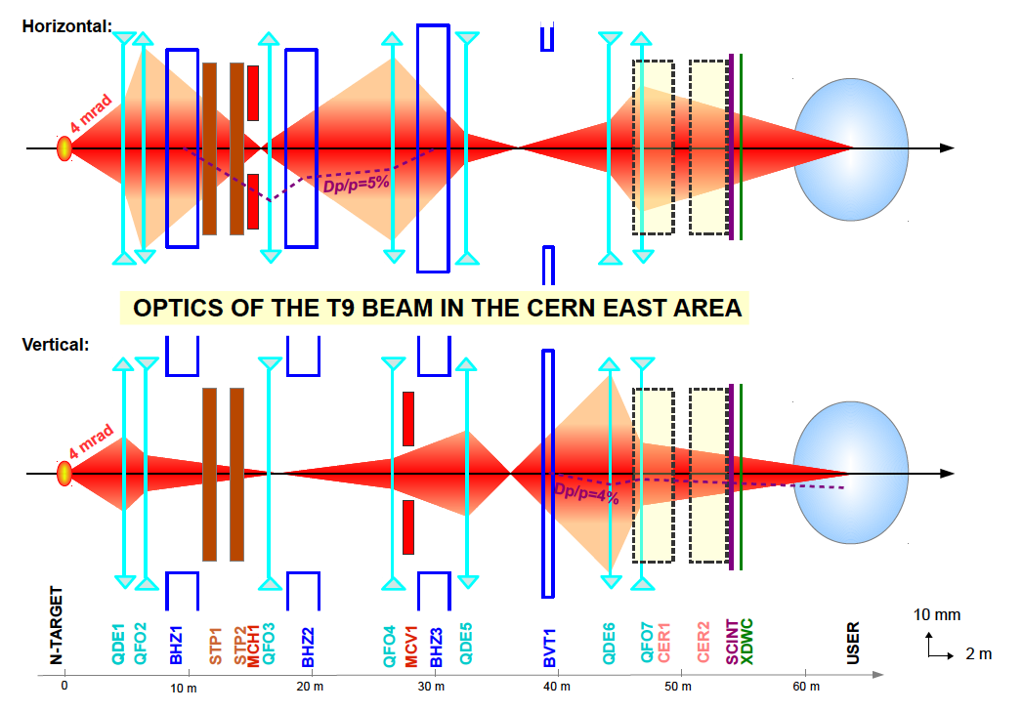

Slide 7
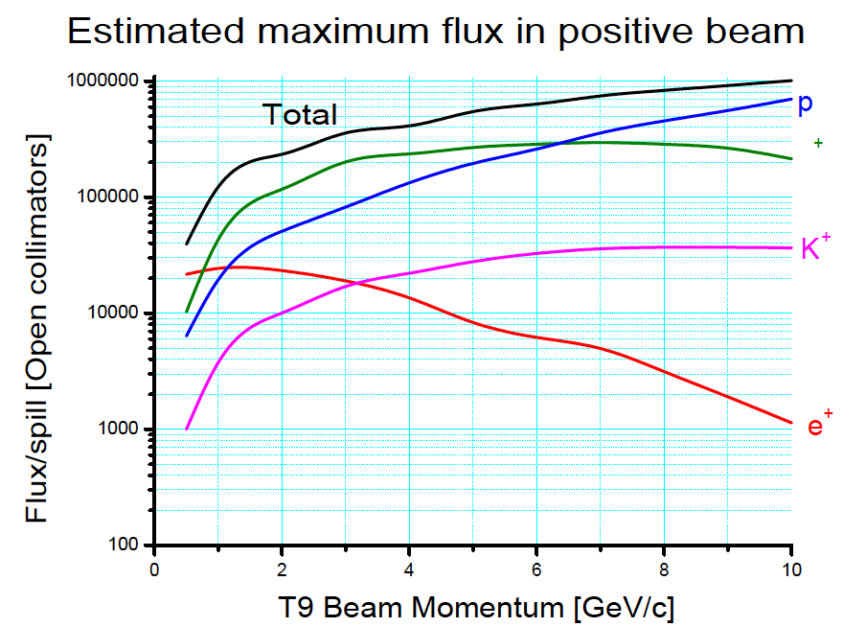
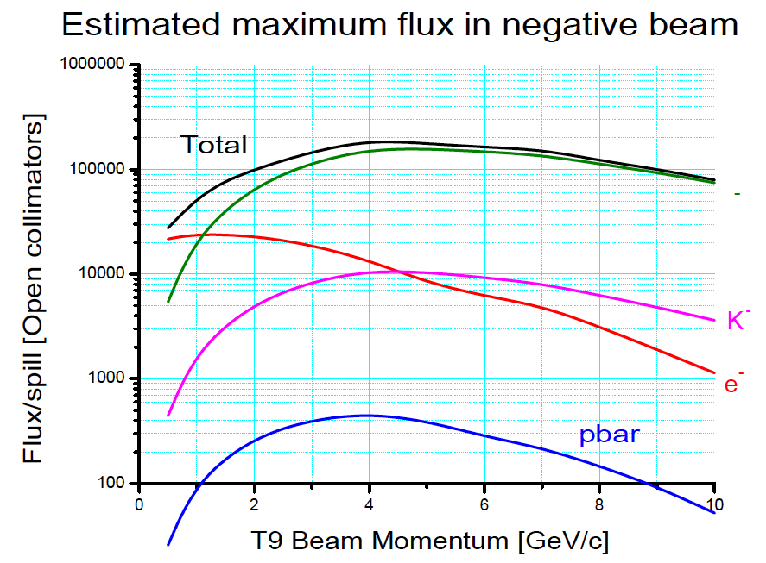
T9 estimated MAXIMUM Beam rates
π
π
For wide open collimators, i.e. Δp/p ≈ ±7.5% (but very big beam).
Typically very good conditions for 10x lower rates

Slide 8
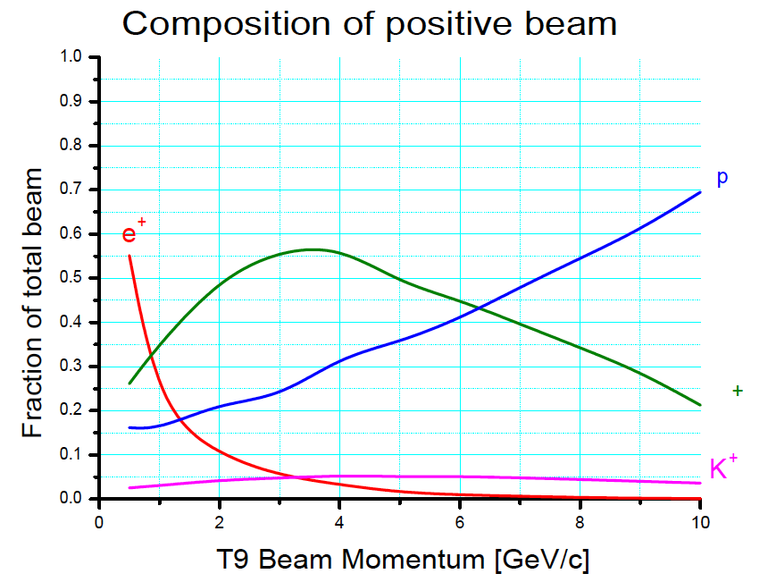
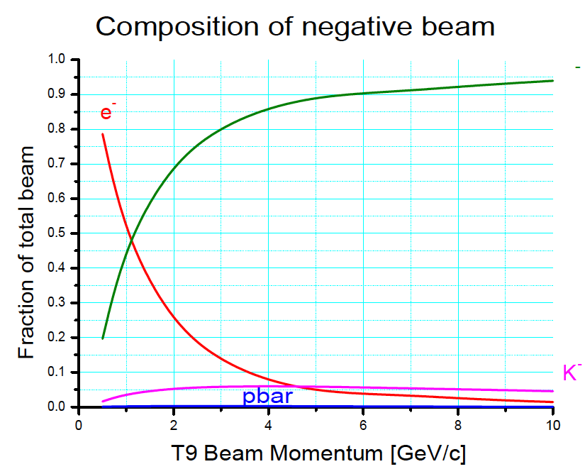
Beam Composition
π
π
With electron enriched target (otherwise e± strongly reduced, by about factor 8)

Slide 9
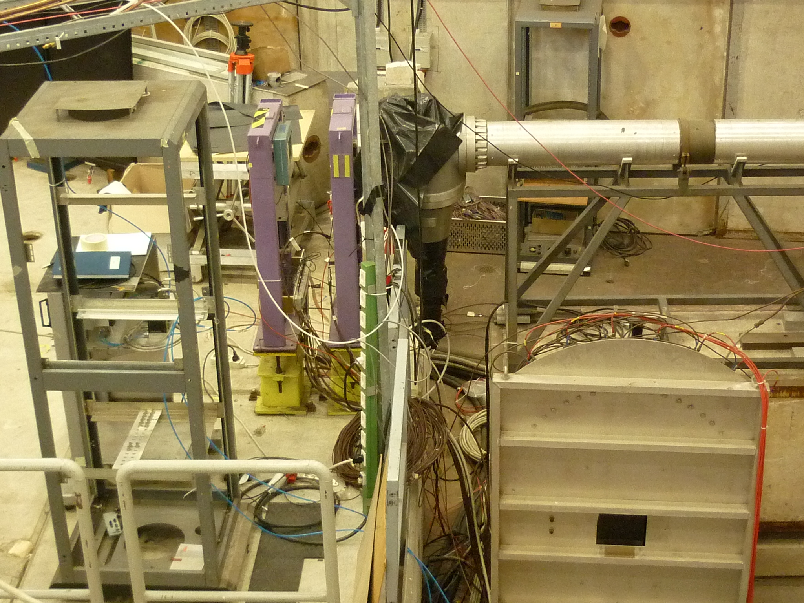
Beam instrumentation

Slide 10
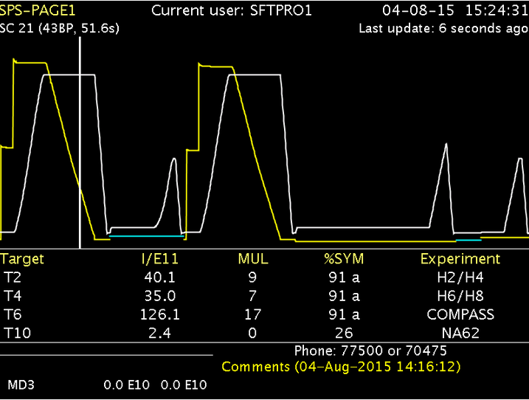
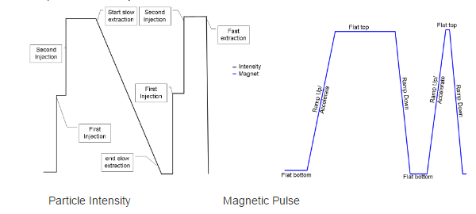
North Area Secondary Beam Lines
The 400 GeV/c primary beam is slowly extracted onto 3 ‘primary’ targets
North Area
Test Beam Facilities
NA62
COMPASS
SPS beam @ 400 GeV/c
Spill duration approx. 5 seconds
Usually : 2 cycles / SPS supercycle for NA
Spill length / repetition frequency dependent on the physics program of all the facilities served by SPS and LHC
  → Variability to be expected.

Slide 11
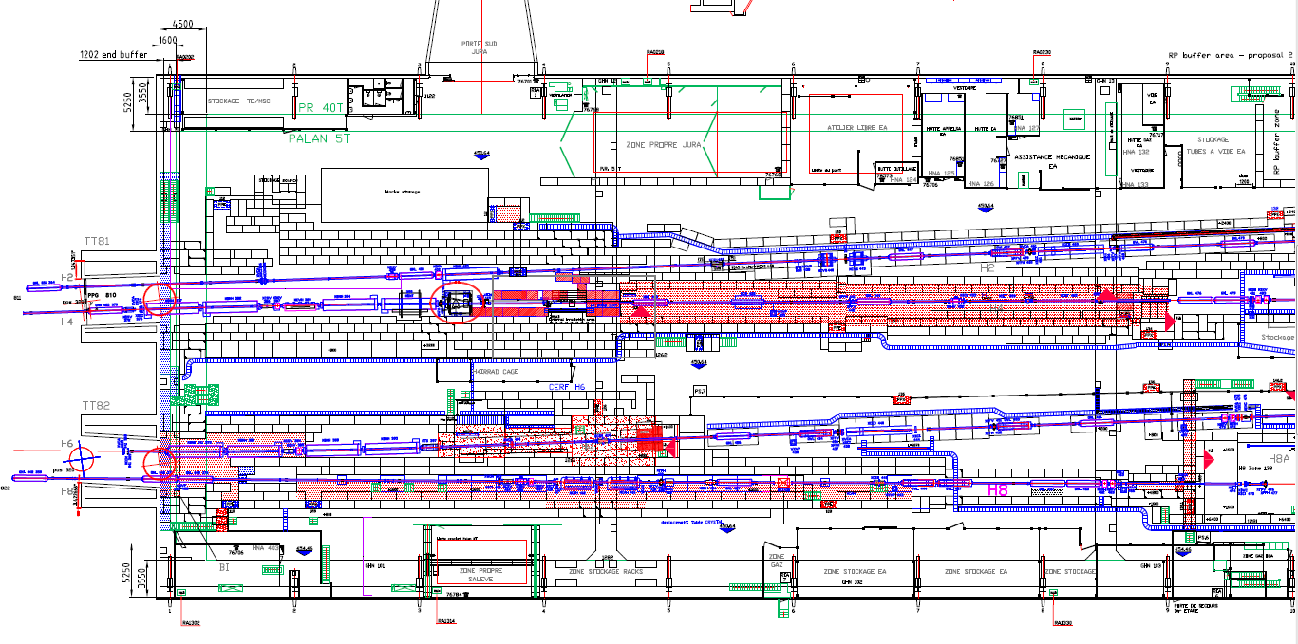
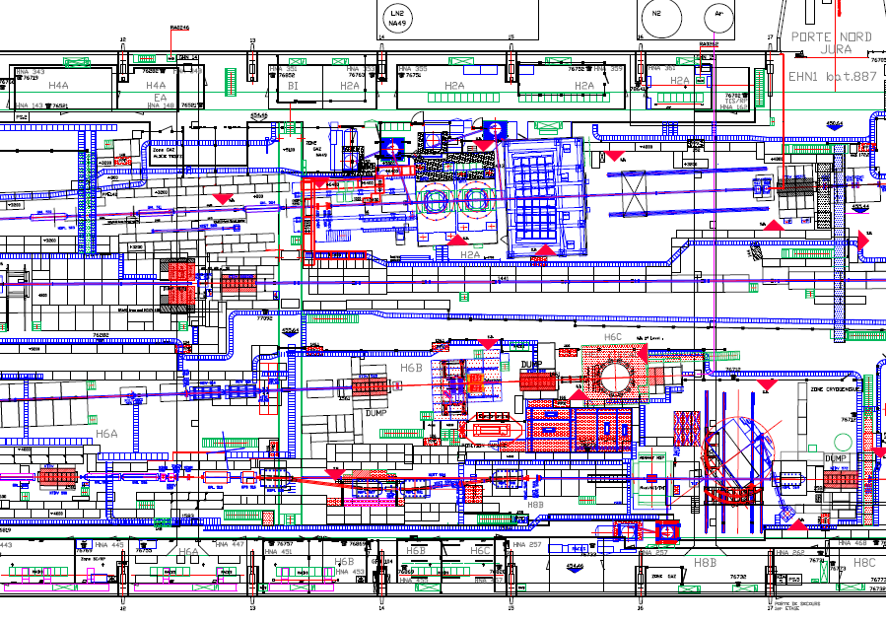
Schematic of the beam lines & experimental areas in EHN1
Top view of b. 887 @ CERN, Prevessin
Experimental Zones H2 & H4
Experimental Zones H6 & H8
Towards the targets (~300m)
Approx. 150 m
Approx. 100 m

Slide 12
North Area Beam Lines General Characteristics
Primary mode Secondary mode
Parameters | Target T2 |  | Target T4
Beam Line | H2 | H4 | H6 | H8
Maximum Momentum [GeV/c] | 400 / 350 | 400 /330 | - / 205 | 400 / 350
Maximum Acceptance [uSr] | 1.5 | 1.5 | 2 | 2.5
Maximum Δp/p [%] | ± 2.0% | ± 1.4 % | ±1.5% | ±1.5%
Maximum Intensity / spill * (Hadrons / Electrons) | 10⁷/10⁵ | 10⁷/10⁶ | 10^{7 **}/10⁵ | 10^{7 **}/10⁵
Available Particle Types | Primary protons/ions*** OR pure electrons OR mixed hadrons (pions, protons,kaons)
Other / Special requests | sba-physicists@cern.ch & sps.coordinator@cern.ch
* Imposed by Radio Protection, and not available to every zone
** In some zones can be elevated up to 10⁸ subject to certain restrictions
*** Not available in H6
Nota Bene : The particle momenta in H2/H4 and in H6/H8 are coupled.

Slide 13
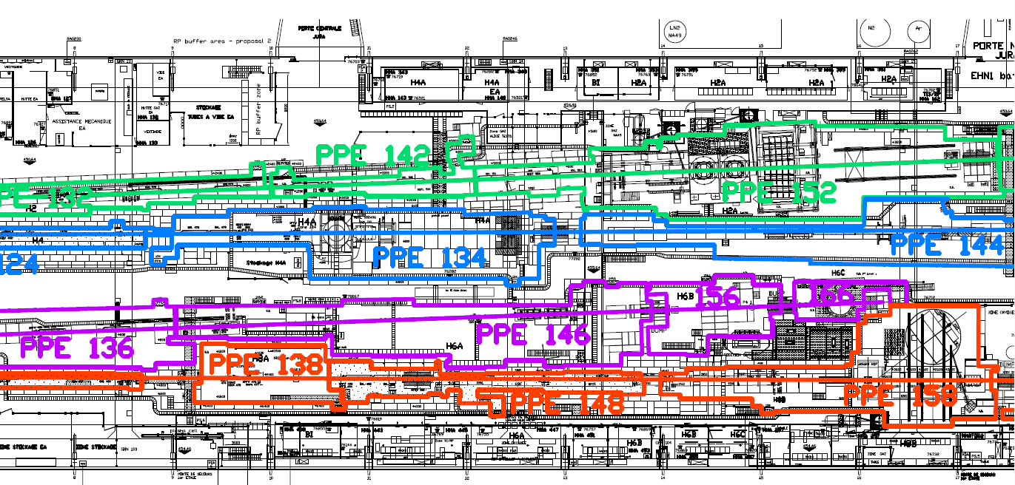
Experimental Zones
Nota Bene : The different beam lines/zones offer different beam possibilities and have different space/infrastructure constraints. Send your beam request and discuss questions & possibilities in advance with the SPS coordinator and the responsible liaison physicists.
H2
  PPE152 (NA61), PPE172
H4
  PPE134, PPE164 (CMS)
H6
  PPE126(CERF), PPE146, PPE156
H8
  PPE128 (UA9), PPE138, PPE158, PPE168
Many “parasitic” users can share the beam zone, under certain circumstances.

Slide 14
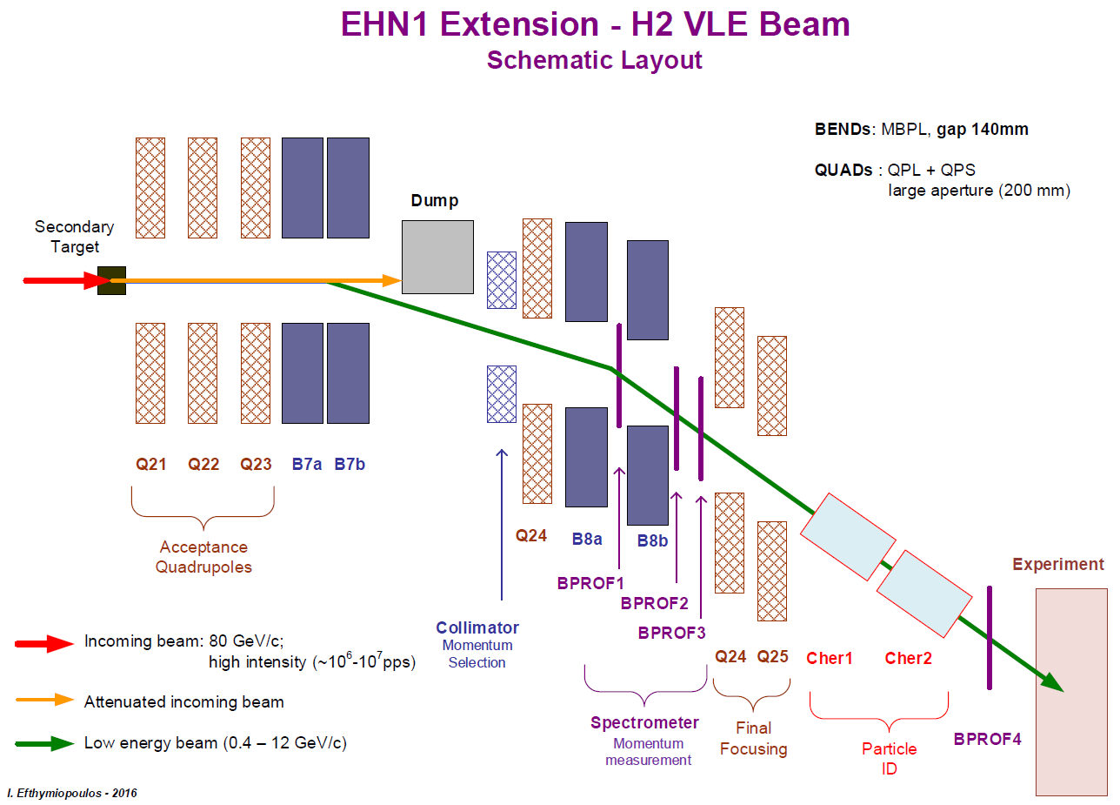
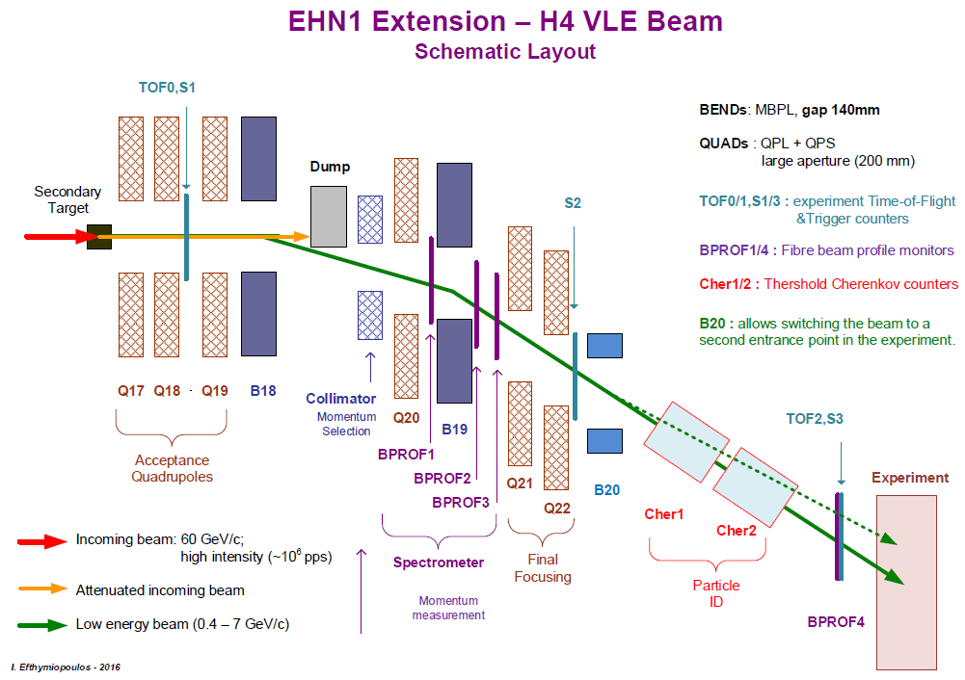
H2 & H4 VLE (NP) Beam design characteristics

Slide 15
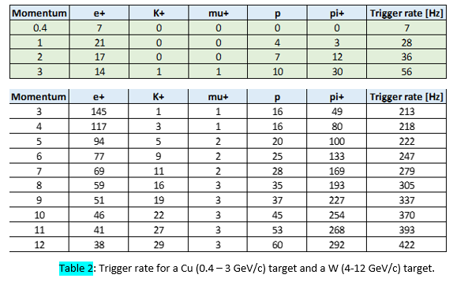
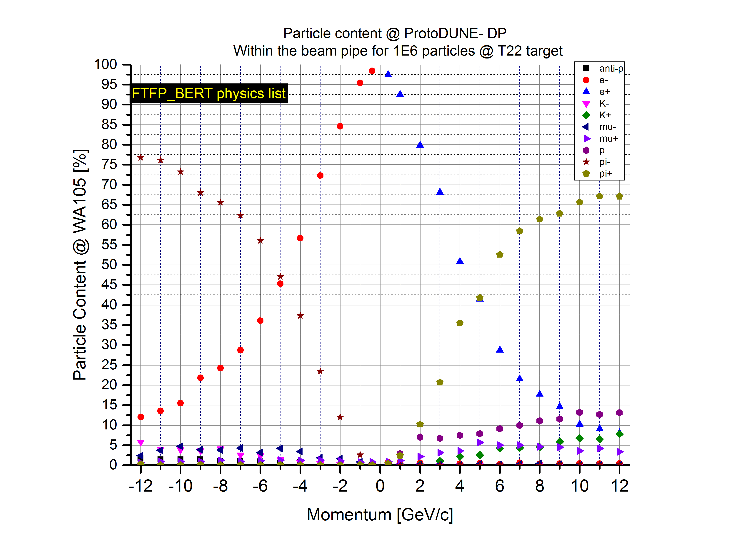
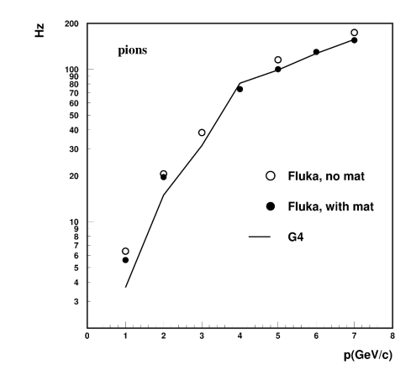
Beam Composition
Assuming ~10⁶ particles / spill on the secondary target
NP-02 rate
References : CERN-ACC-NOTE-2016-0052, CERN-ACC-NOTE-2016-0059
NP-04 rate

Slide 16
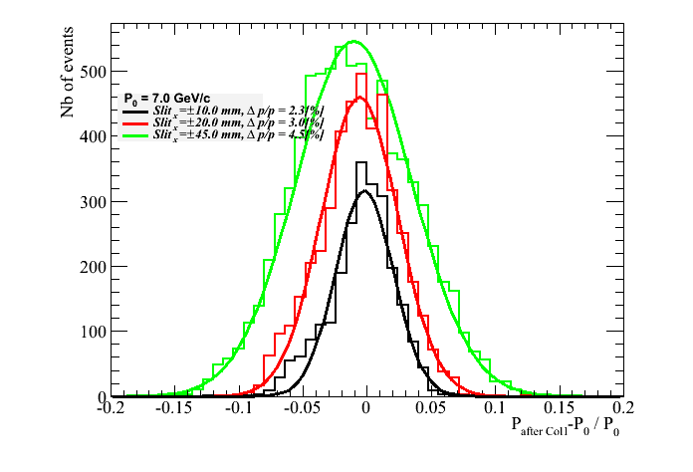
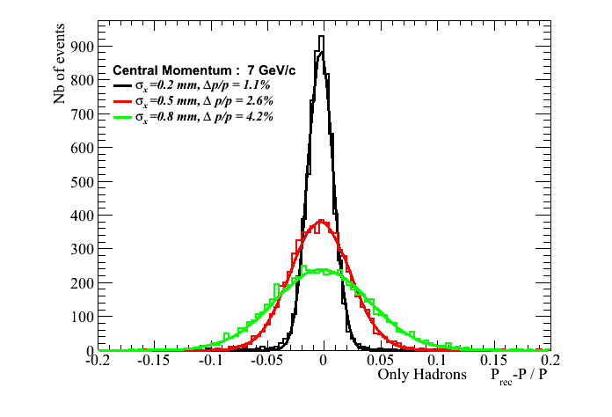
Momentum Resolution
Beam lines equipped with a momentum selection station which can offer a Δp/p down to 2.3%
Further improve of the resolution with a spectrometer (using 3 profile monitors) around a bending magnet
References : CERN-ACC-NOTE-2016-0052, CERN-ACC-NOTE-2016-0059

Slide 17
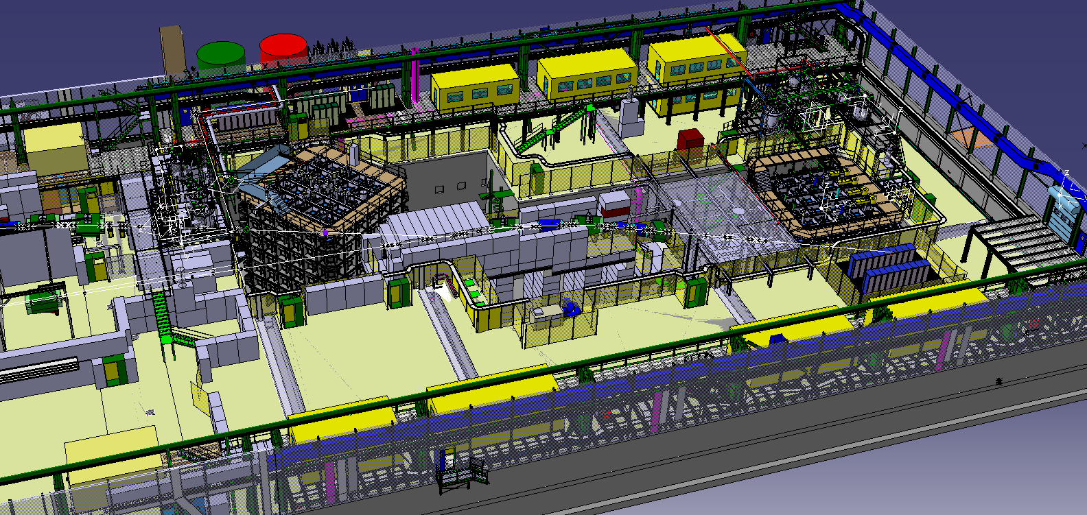
EHN1 Extension – General View
NP-02
NP-04

Slide 18
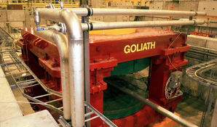
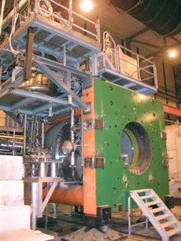
Large Magnets available for tests with beam
Goliath
EHN1, H4 beam line
Large classical dipole
100 x100 x100cm
1.5 T field
Morpurgo
EHN1, H8 beam line
superconducting dipole
1.6m diameter, 4m length
1.5T field
CMS M1 magnet
EHN1, H2 beam line
superconducting dipole
82 cm gap, 1.4m diameter
3 T field
MNP22: A stand alone magnet test facility available to the users.
Info: https://sba.web.cern.ch/sba/Documentations/MNP22/mnp22_controlbackup.htm

Slide 19
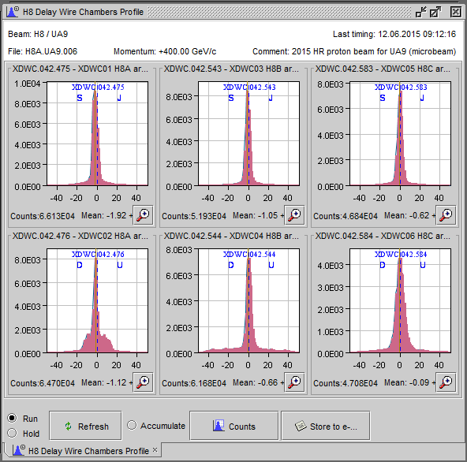
Instrumentation (available to users)
Depending on the beam line and the zone :
  Beam profile & intensity monitors (scintillators & analog/delay multi wire chambers), installed in several positions along the beam line
  FISC scanners (precise slower profile monitors – can be used for angular measurements)
  Cherenkov gas counters (used for particle species tagging)
  (a few) EM calorimeters
Most of the signals available in the counting rooms !

Slide 20
Schedule and planning
The beam time request has to be sent to the SPS coordinator @ ~ November for the next year.
  Short (<1 week @ SPS or < 2 weeks @ PS) requests can be approved by the SPS coordinator only.
  Longer requests require recommendation by CERN physics committees (SPSC, INTC)
The scheduling is based on priorities of different experiments and is discussed with the committees’ chairs. The draft schedule is presented at CERN’s research board for approval.

Slide 21
Summary
CERN offers a great variety of test-beam experimental areas
Area | East Area |  | EHN1-ext (NP) |  | EHN1 – North Area
Beam line | T9 | T10 | H2VLE | H4VLE | H2 | H4 | H6 | H8
p_{min} (GeV/c) | 0.5 | 10 | 0.4 | 0.4 | 10 | 10 | 10 | 10
p_{max} (GeV/c) | 0.5 | 6 | 12 | 7 | 400 | 400 | 205 | 400
Particles | Mixed. h or e-enr. Tgt Some μ |  | Mixed. h or e-enr. Tgt |  | e,π ,μ Quite pure beams
Contact in advance sps.coordinator@cern.ch and sba-physicists@cern.ch in order to optimally exploit your beam time and the facilities.
  Visit often https://sps-schedule.web.cern.ch/sps-schedule/ for the updated version of the schedule and other useful information

