Slide 1
Introduction
Machine Availability and Reliability Panel
(MARP)
R. Schmidt

Slide 2
Agenda
Rüdiger: Introduction
Ben: Availability Working Group and Accelerator Fault Tracker – Status & Plans 2017
Jan: Follow-up meeting of the Availability Workshop meetings
Johannes: Collaborations and Training
Event in INDICO will be created, summary of the meeting will be written

Slide 3
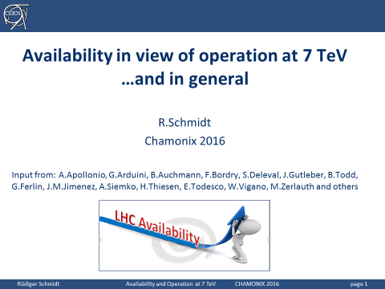
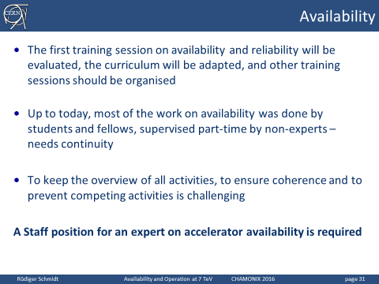
From Chamonix 2016

Slide 4
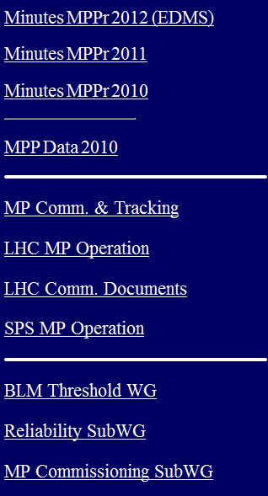
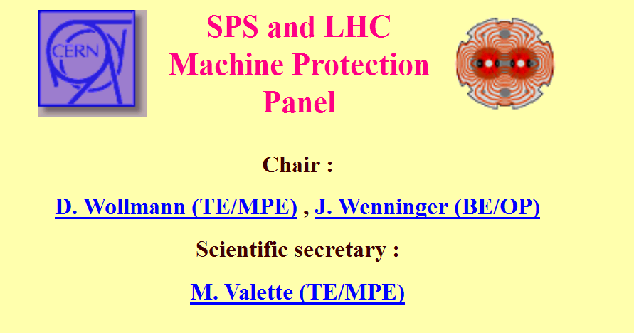
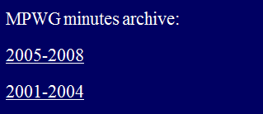
Machine Protection Panel
+Linac4

Slide 5
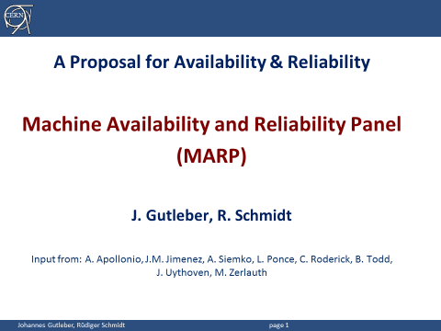
Presentation to ATSMB 28/11/2016
Input from: A.Apollonio, J.M.Jimenez, A.Siemko, L.Ponce, C.Roderick, B.Todd, J.Uythoven, M.Zerlauth

Slide 6
Overview
What is required?
What is currently being done?
Who are the (main) actors?
Proposal for an organised approach

Slide 7
What is required?
“Cost effective operation”: Maximum integrated performance in given time (e.g. integrated luminosity)
Reliability: Machine Protection Systems need to be designed with high reliability in mind – this must be demonstrated
  LHC machine protection systems (LBDS, Interlocks, BLM system, magnet protection system – extensive studies on their reliability since >15 years)
  Other CERN accelerators: in particular beam dumping systems
Availability: Accelerators need to operate with acceptable availability (requires reliable subsystems and efficient operation, minimising turnaround time and minimising dead time is of key importance)
  LHC as flagship operating machine
  Pre-accelerators (circular and linear, including Linac4)
  Challenge for future accelerators

Slide 8
Some Key Topics and Questions
How can we keep the LHC availability observed this year ?
Can we operate safely the accelerators (machine protection) ?
Can the “cost-effectiveness” of operation be improved?
Is reliability of HL-LHC technical designs/realization adequate to achieve the nominal Integrated Luminosity (availability) ?
Is Linac4 going to be as reliable as Linac2 ?
Can post-LHC accelerator infrastructures be realized with adequate availability?
How to balance maintenance and repair costs with high availability?
How to propagate high-level availability requirements to technical systems?

Slide 9
Current activities / teams
Accelerator Fault Tracking (mainly BE-OP, TE-EPC and TE-MPE) and Accelerator Fault Tracker tool (BE/CO)
Studies on availability in project work-packages (e.g. WP 7 for HL-LHC, WP for FCC and work package for CLIC)
FCC Reliability, Availability, Maintainability studies
  Model LHC accelerator complex + injectors + tech. infrastructures
  Integration of continuous monitoring of the accelerator operation to derive good quality information for Monte-Carlo simulation
  Sector wide training and Book of Knowledge creation
Availability studies related to the LINAC4 availability run

Slide 10
Some examples of current and future work…
Extend the ‘Accelerator Fault Tracking’ from LHC to injectors
Model and simulate the LHC + Injector chain operation with high confidence to quantify expected performance for different accelerators under different operation scenarios
Training + creation of durable network across CERN teams
Coherent guidelines and methods (“Book of Knowledge”)
Common services and infrastructures (hardware, test stands, software, analytics, …)
Implementation of the outcome of studies - ensuring continuity
Studies
  For future machines
  For efficiency improvement of operation
Collaborations
  What collaborations exist?
  How to efficiently work together?

Slide 11
Current Activities at CERN (resources approximate)
Many activities on availability are across machines / projects
RAMS training (2/year, 4 years, Uni-STUTT, T-Uni-T, Ramentor)
FCC (model, simulation, analytics) – 3 FTE
CLIC / Linac4 (modelling, simulation) – 1.5 FTE
Machine and magnet protection (electronics, SW, HW) – 2.5 FTE (HL-LHC)
Accelerator Fault Tracking – 2 FTE (in several groups)
Power converters – 1.2 FTE
Beam Instrumentation – 1.2 FTE
Beam Transfer – 1 FTE (until recently)
Technical infrastructure (EN) – 1.2 FTE
Operation – “task force” activity on AFT for injectors
Mostly fellows, PhD students and Technical students

Slide 12
Partners for today and for the future
FCC collaborations (engaged resources)
University Stuttgart (KE 3046/ATS)
Technical University Tampere (EDMS 1390679 & KE 3331)
Ramentor (Finnish company, KE 3357/ATS)
TU Delft (KN2914/BE)
Heidelberg Ion Therapy facility (ARIES H2020 Grant Agreement)
University of Vienna (data integration)
Linac4 collaborations (engaged resources)
Myrte (H2020 Grant Agreement 662186)
Existing contacts
University Stuttgart
Empresarios Agrupados (Spanish company)
ESS Lund
TU Munich (Robotics and Embedded Systems/CPS)
ZHAW Zürich

Slide 13
Machine Availability & Reliability Panel
Goals:
  Develop and maintain a consistent and coherent approach to reliability and availability activities across department and group boundaries and across different systems
  Core team analyses, develops and proposes strategies that can be implemented in dedicated teams according to priority and needs
Scope:
  Existing accelerators and infrastructures, projects and studies at CERN
Working mode:
  Provide forums for information exchange
  Consensus based conclusions
  Creation of limited-duration activity groups
  Meets regularly with agenda + minutes (about monthly?)
  Reports to appropriate committees / projects

Slide 14
Proposal for Composition of Core Members
Andrea Apollonio
Oliver Brüning
Johannes Gutleber
Laurette Ponce
Rudiger Schmidt (during the initial phase)
Luigi Serio
Ben Todd
Jan Uythoven
....up to the core team to further detail work and composition
  to ensure continuity, membership reviewed on yearly basis to adapt to scope and evolving environment

Slide 15
Proposed Next Step
ATSMB endorsed the proposed approach
Interim chair and organiser (secretary) to be nominated
Interim chair calls for a constituting panel meeting(s)
Panel repeats scope, tasks, composition in minutes

