Slide 1
Follow-up Meetings of the Availability Workshop & …
First MARP Meeting 09/02/2017
Jan Uythoven
Andrea Apollonio

Slide 2
Follow-up Meetings of the Availability Workshop
History, what is in place
What it is presently about
Future, what we would like to do

Slide 3
Recent History
Many activities in the field of dependability
  In many groups, often detached
  Since many years (>15 years), see slides Rudiger
Workshop on Availability Modelling Tools and Synergies for Collaboration – 7th July 2016
  https://indico.cern.ch/event/537567/
  1 Day workshop organised by Odei Rey Orozco (TE-MPE)
  Including outside collaborators (Stuttgart, ESS, Ramentor, EAI Spain), in total about 25 people
Follow-up meetings of the workshop
  First meeting follow-up meeting 25th August 2016
  …..
  Follow-up meeting VIII, 10th February 2016
    All documented in Indico under https://indico.cern.ch/category/3224/

Slide 4
Present Format & Topics
Organisation
  Chair: Andrea & Jan
  Scientific secretary: Odei
Topics
  Direct follow-up of workshop
    Standardising on tools for dependability calculations
      Collaboration with ESS on AvailSim 3
    Focus on Linac4 availability
      Preparation of Linac4 Reliability Run & modelling
    Database of models, failure rates
  Miscellaneous topics
    Presentations by students and fellows in the field of dependability of their current topic, discussion on approach and methods
    Standardisation of Risk definition (alternative to SIL)
    ….

Slide 5
Future Mandate and Topics
Ask for a Mandate by the MARP to continue with the ‘Follow-up meetings’ but with a more appropriate name
Focus points
  Standardisation
    Software tools, input format, reference data bases
    Approach for dependable electronics design
      Involvement of Ben Todd, William Vigano
    Risk assessment and categories
    Exploitation of AFT data
    …
  Interface to other projects, future machines, etc.
  Continue with Linac4:
    Dependability modelling, Reliability Run and related collaborations
  Miscellaneous presentations in the field of dependability with the aim of learning and going to a common approach. Feedback and help to the different groups across CERN

Slide 6
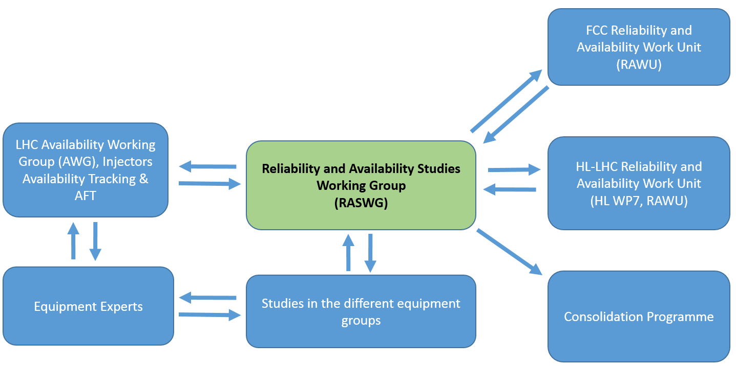
Similar to what was once proposed as RASWG

