Slide 1
AFS survey and usage in BE/ABP
ABP-CWG meeting

Slide 2
Main points from survey (70 responses, ~½ group)
Daily use of AFS across the group
  Connection through lxplus (90%)
  Use as home directory (90%)
Main uses of AFS (in order of percentage, all above 50%)
  Working directory: edit/process files, compile programs, run scripts
  Run applications from shared AFS locations
  Share files through workspaces and public directories
  Use workspaces to do team work
  Copy files and applications to my computer
  Submit jobs to LSF
Dramatic impact expected if AFS phased out without proper replacement. From few weeks to few months work expected to re-adapt all working environments + loss of functionalities

Slide 3
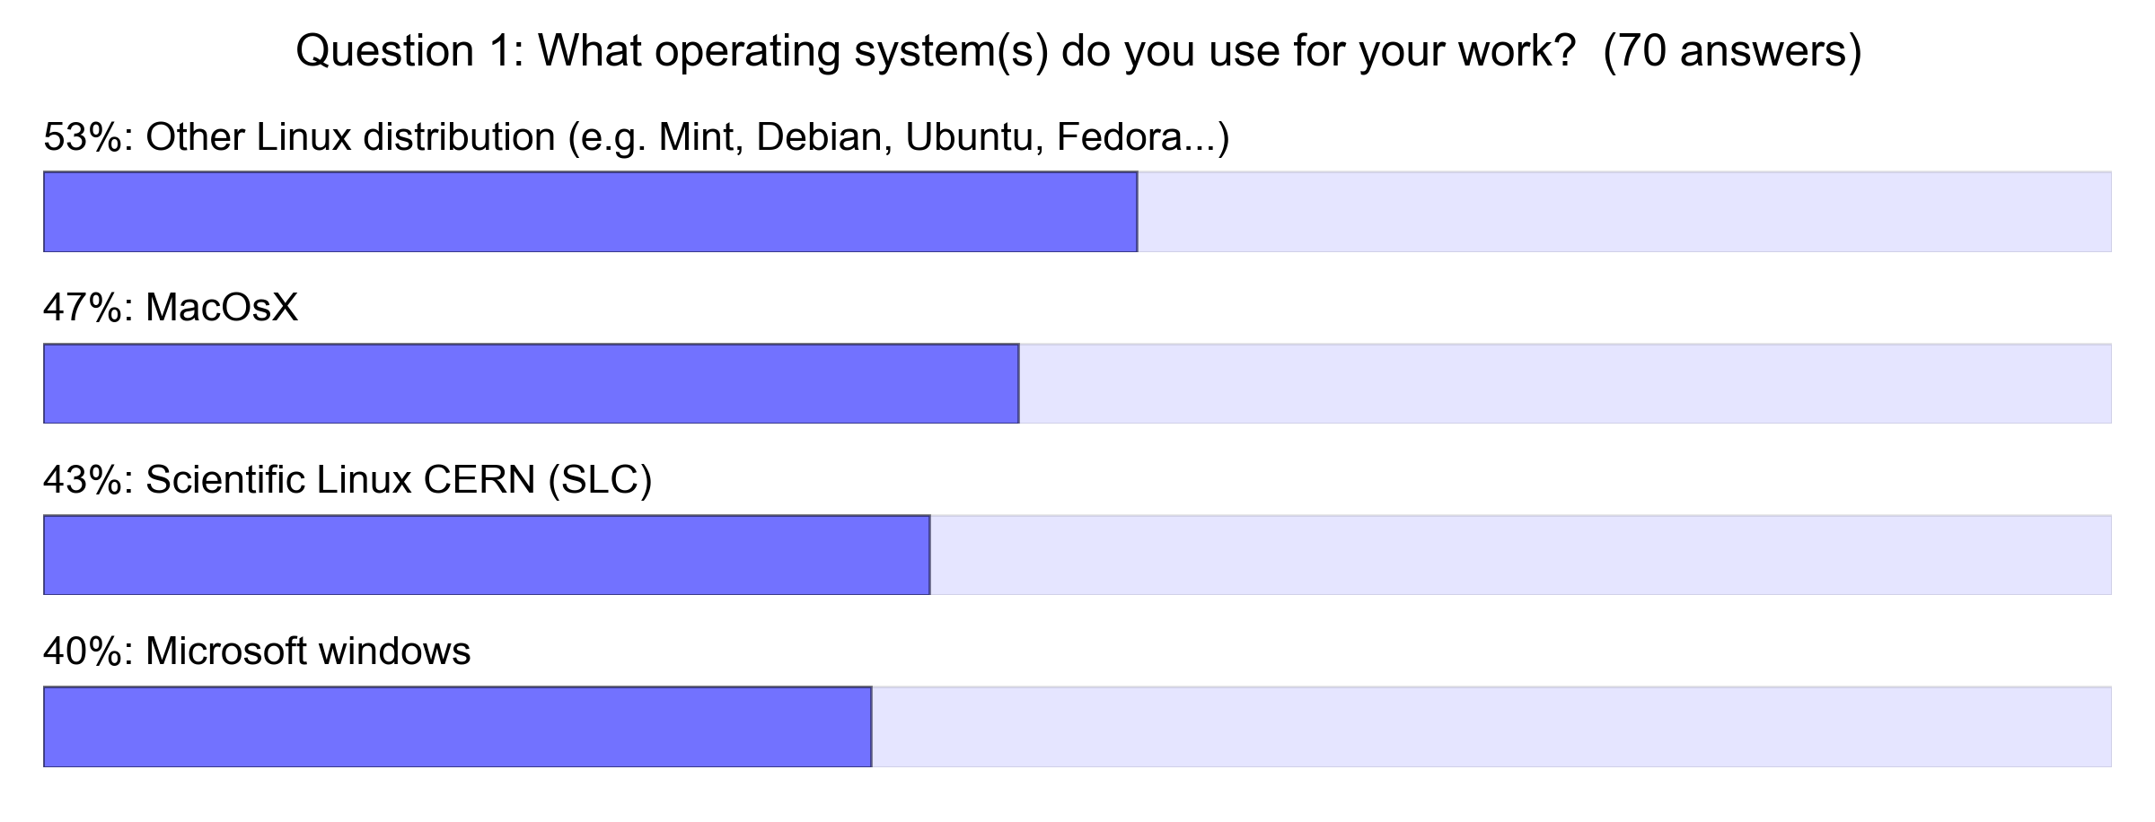
In detail

Slide 4
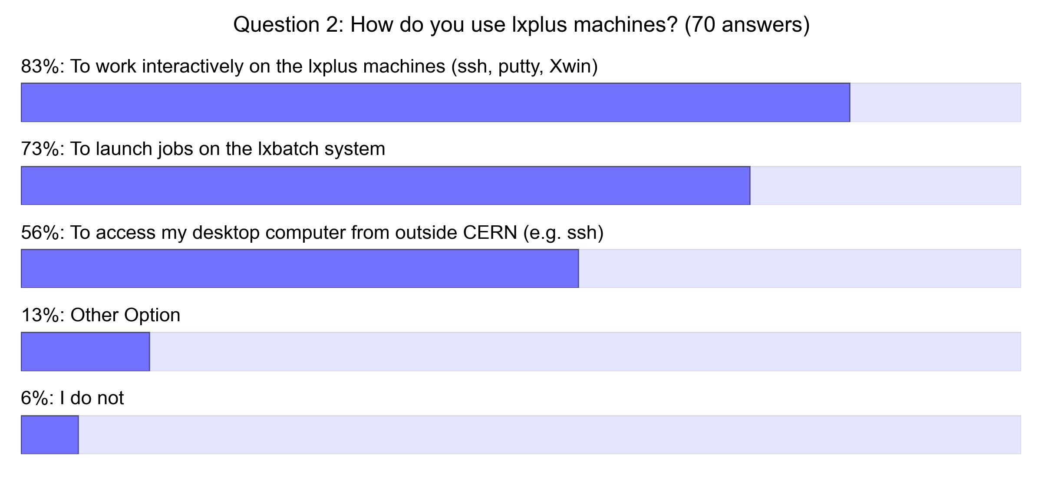
In detail

Slide 5
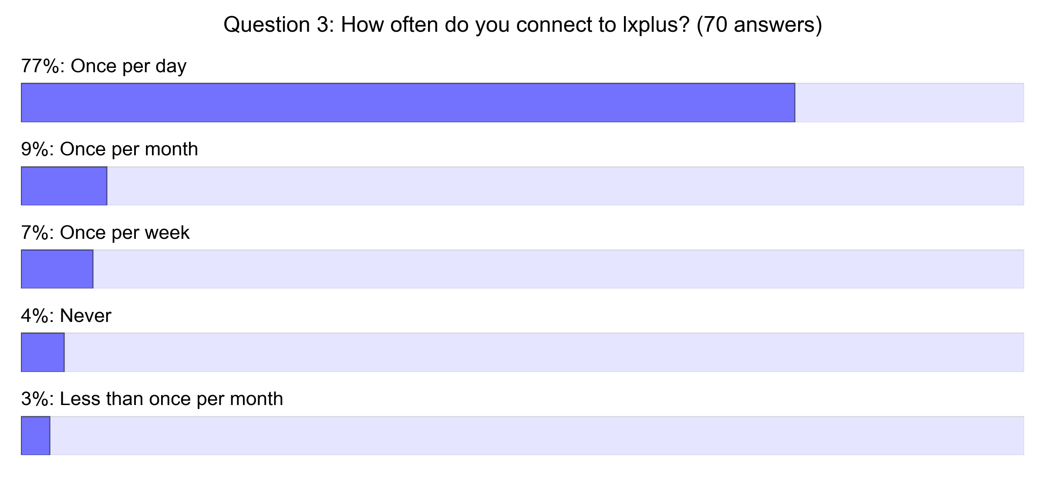
In detail

Slide 6
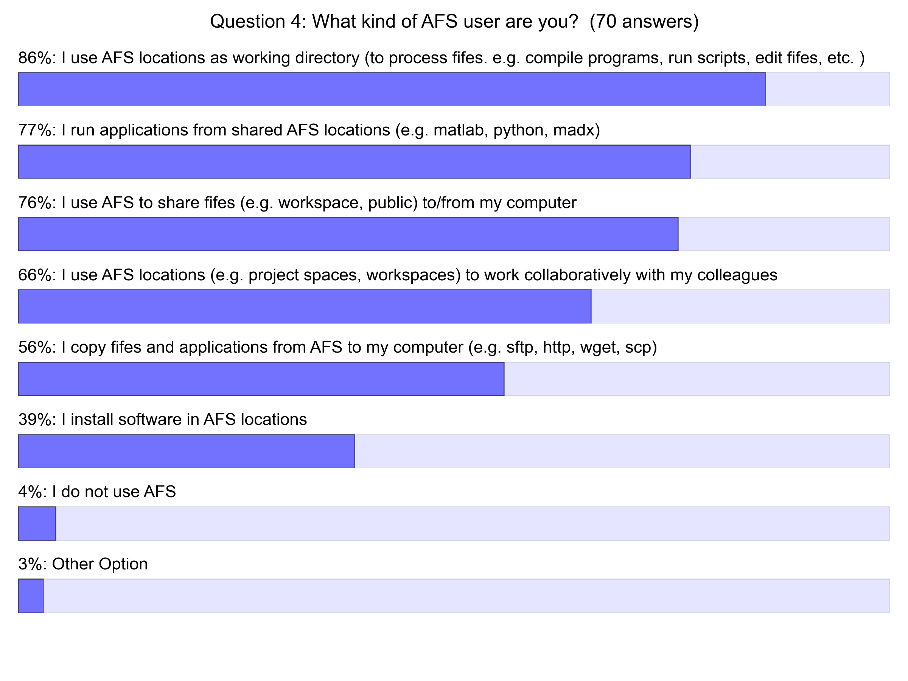
In detail

Slide 7
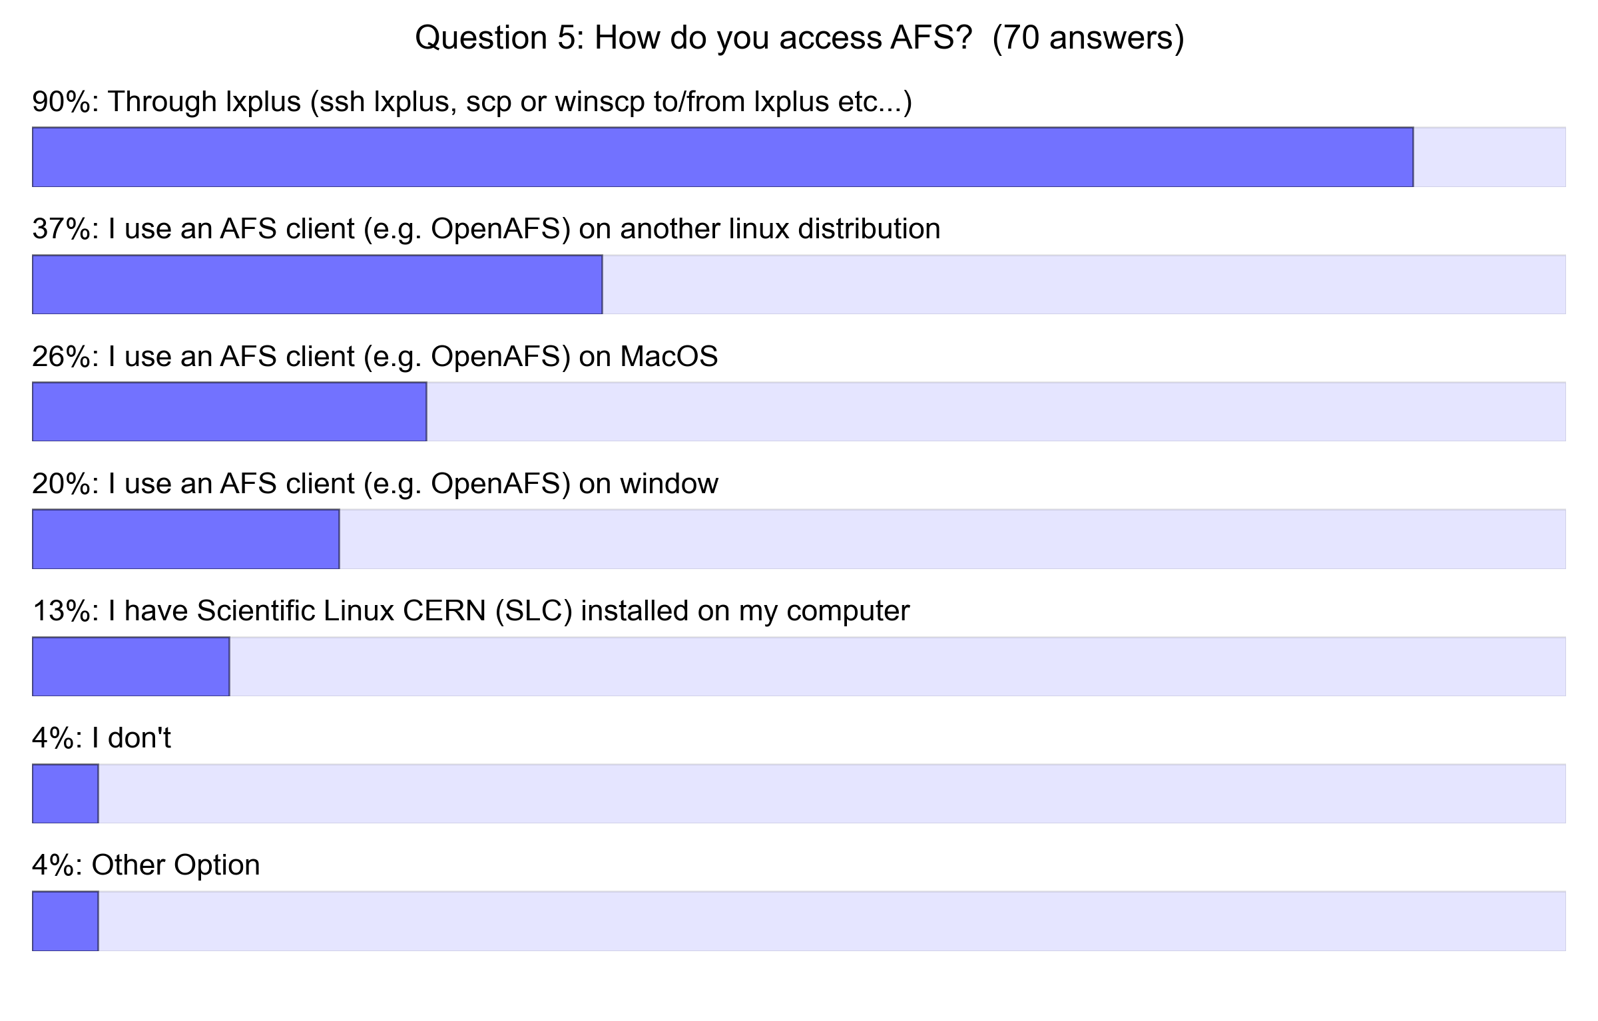
In detail

Slide 8
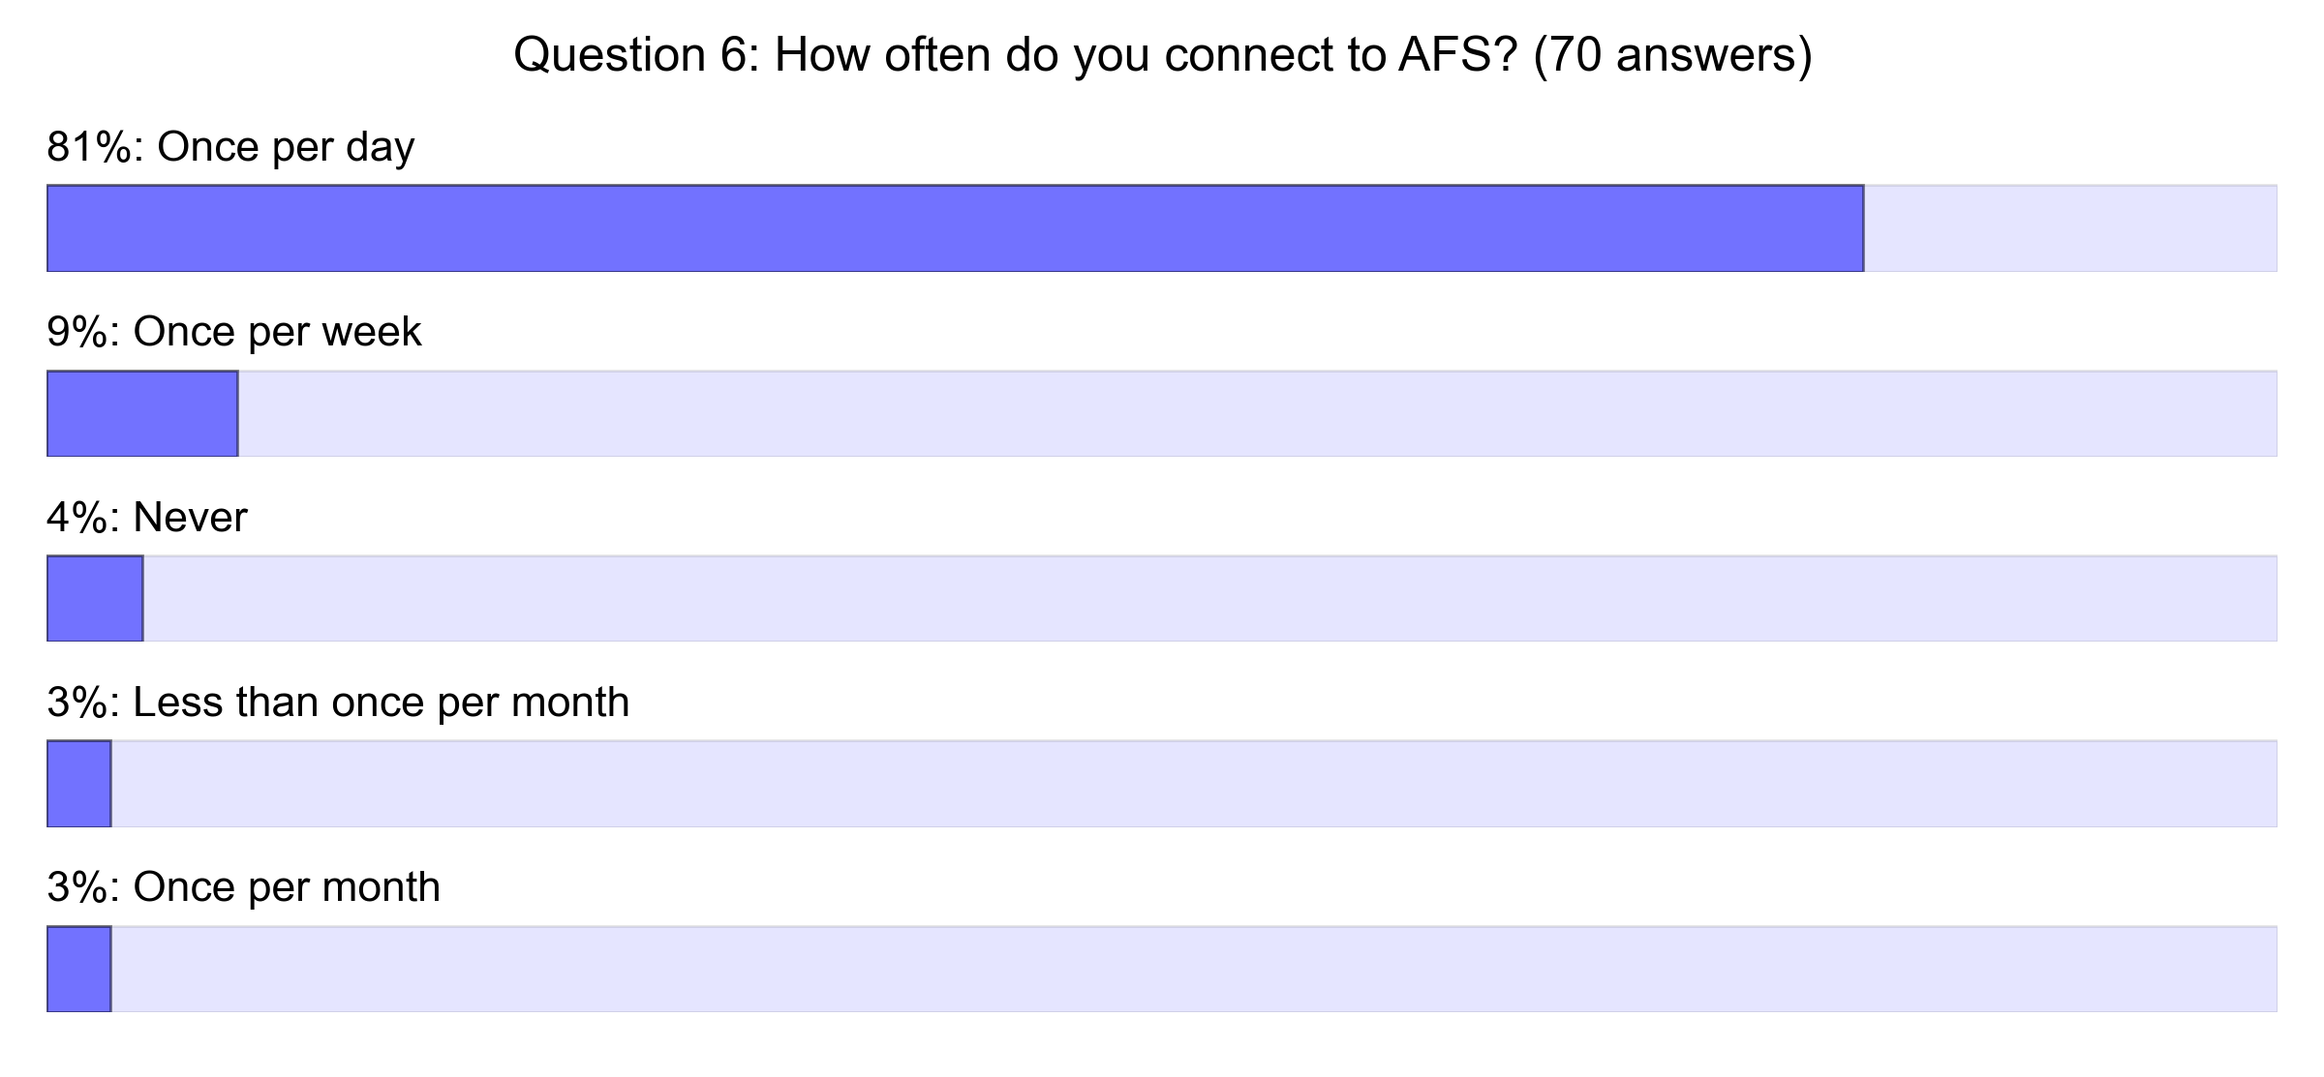
In detail

Slide 9
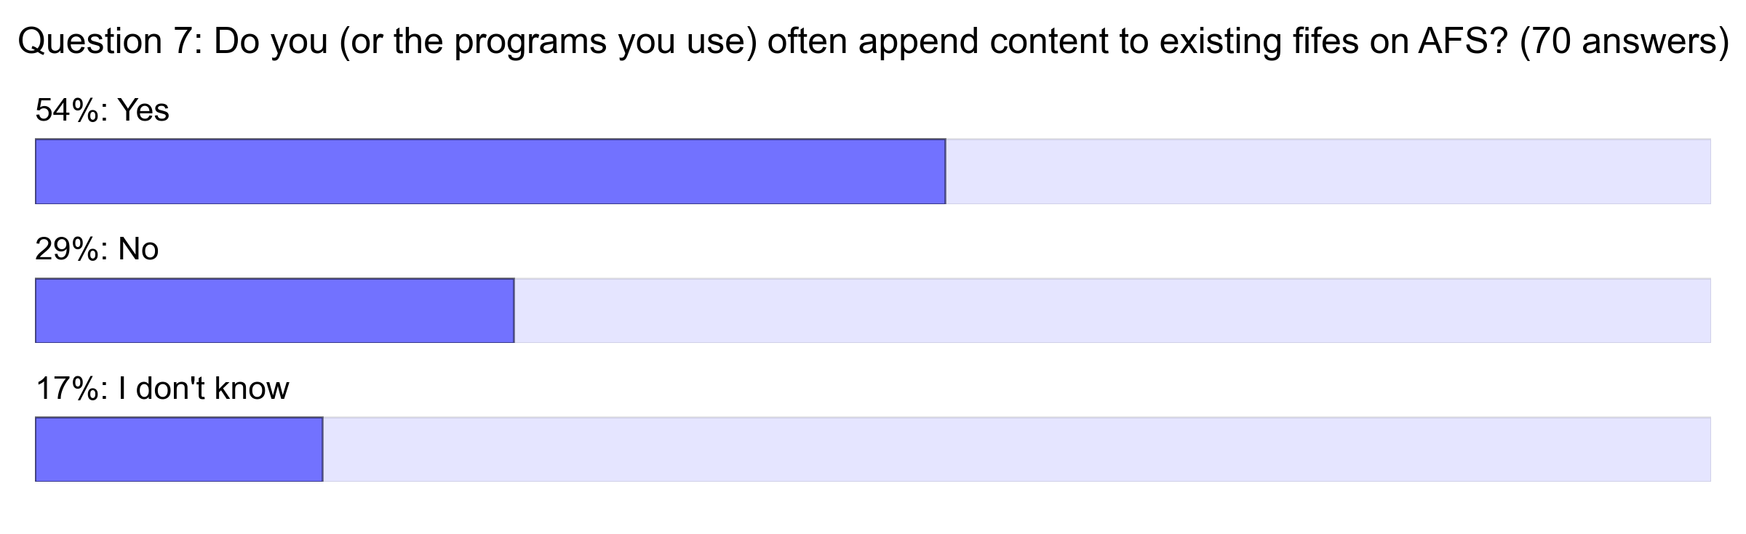
In detail

Slide 10
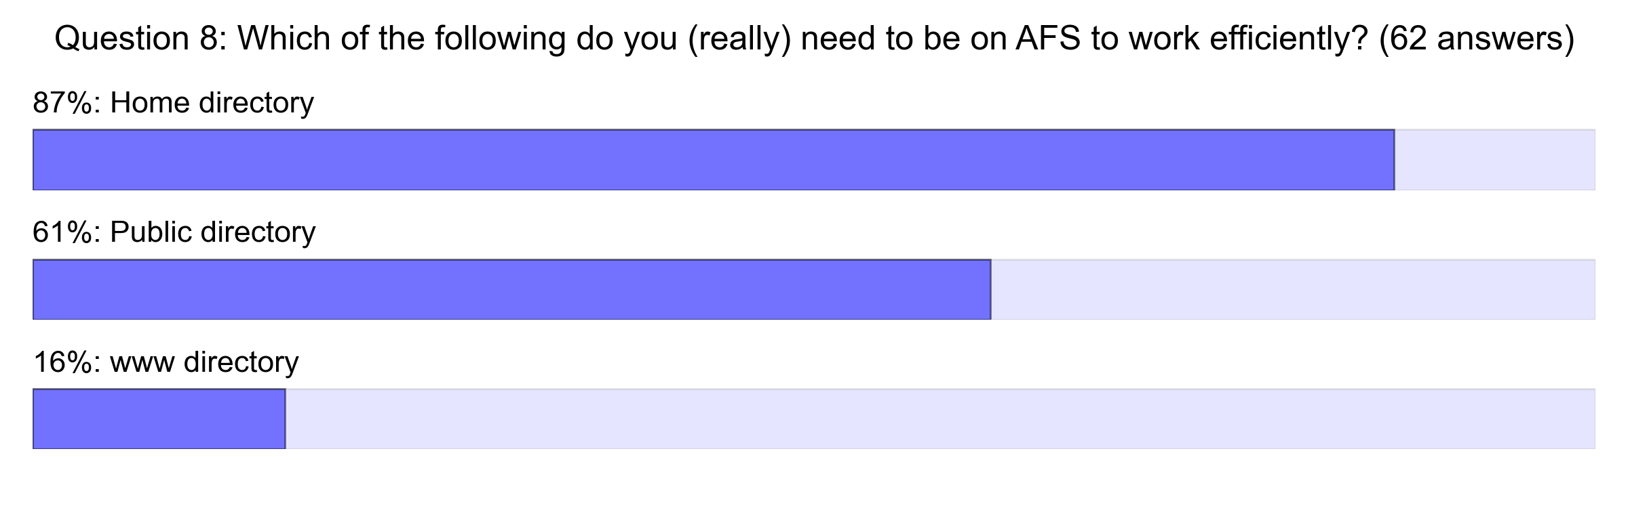
In detail

Slide 11
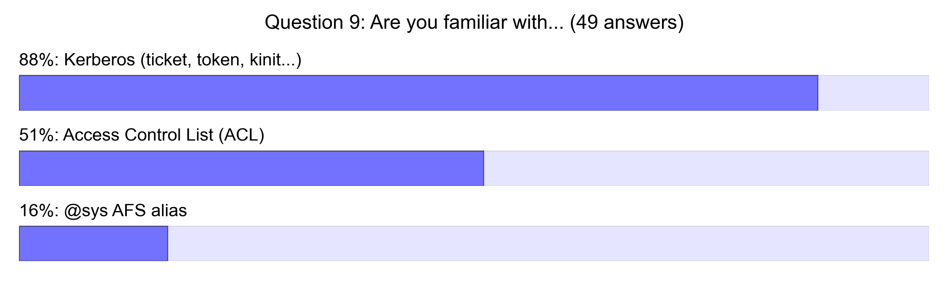
In detail

